Slide 1
UserForm

Slide 2
USERFROM BASICS
UserForm is useful if you need to get some information from users
A dialog box can be created to handle such situation from the users
This dialog box is created on a userform in the VBE and it is displayed by using a VBA macro
The official name for a dialog box in VBA is a userform
But userform is really an object that contains what is commonly known as dialog box
When designing a userform, yu are creating what developers call the Graphical User Interface (GUI)

Slide 3
USERFROM BASICS
Designing a useform can also be referred to as an object oriented interface
The main key to creating a userform is to take some time to think or research about how the form should look like and how you want the users to interact with the elements on the form
What is essential is to understand how you will guide your users through the steps they need to take on the form by carefully considering the arrangements and wordings of the controls
Remember, like most things, the more you practise it, the easier it gets

Slide 4
CREATING USERFORMS
Determine how the dialog box will be used and at what point it will be displayed in your VBA macro
Activate the VBE and insert a new userform objet
Add controls to the iuserform
Use the properties window to modify the properties for the controls or for the userform itself
Write event-handler procedures for the controls( macro codes that executes when the user clicks a button in the dialog box). This code is stored in the userform window
Write a procedure that will display the dialog box to the user. This code is stored in the VBA module

Slide 6
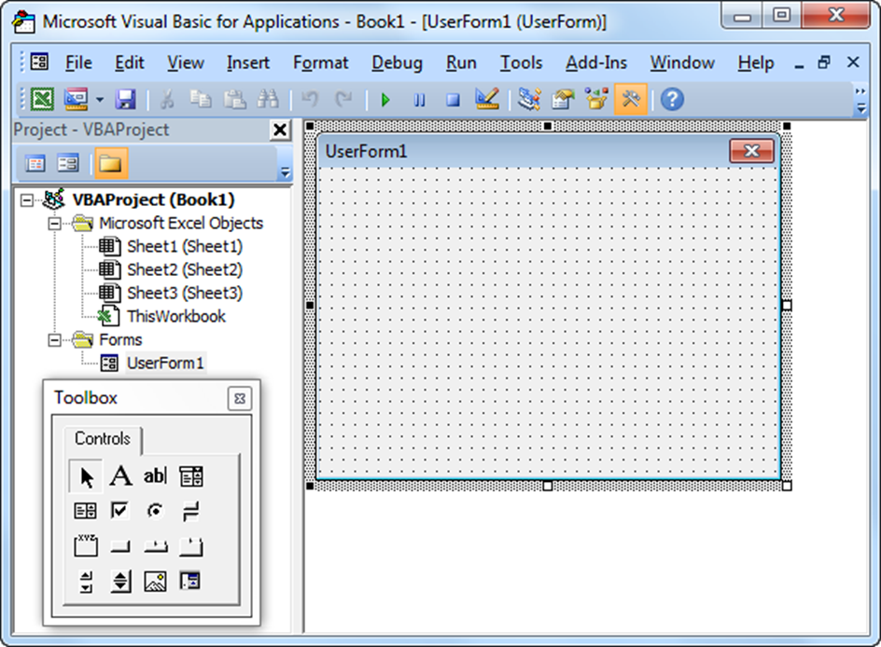
To create this Userform, execute the following steps.
Open the Developer-Visual Basic-Insert-UserForm
2. Your screen should be set up as below.

Slide 7
Userform with Multiple Pages
we will look at how to create a Userform that contains multiple pages.
The Multipage Control contains two pages.
At page 1, the user can fill in his/her personal information.
At page 2, the user can indicate which programme he/she want to register for and the session he/she wish to commence the programme
This will require the following controls
Multipage control, labels, text boxes (first at the top, the second below the first), frame, option buttons (first at the left, the second at the right), list box, Image control and command button.
Each of this control can be created: Multipage control by clicking on Multipage from the Toolbox.
When you arrive at the Gender frame, remember to draw this frame first before you place the two option buttons in it.

Slide 8
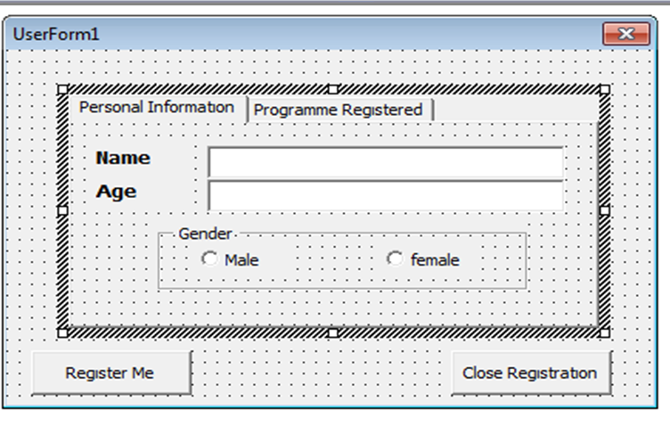

Slide 9
Remember to take note of the name tag and the caption you assign to each of the control.
These tags are needed in the Excel VBA code.
Captions are those that appear on your screen.
It is good practice to change the names of the controls, but it is not necessary here because we only have a few controls in this example.
To change the caption of the Userform, Multipage tabs, labels, frame, option buttons and command button, click View, Properties Window and click on each control.

Slide 10
Create the second Userform1
Again take note of the names and caption tags
The UserForm is to serve as the Student Registration Portal to contain two pages namely: Personal Information and Programme Registered
Personal Information should consist of
Name
Age
Gender- Male or Female
Programme Registered should consist of
Programme Enrolled
Programme Session
Now create an Excel as shown below

Slide 11
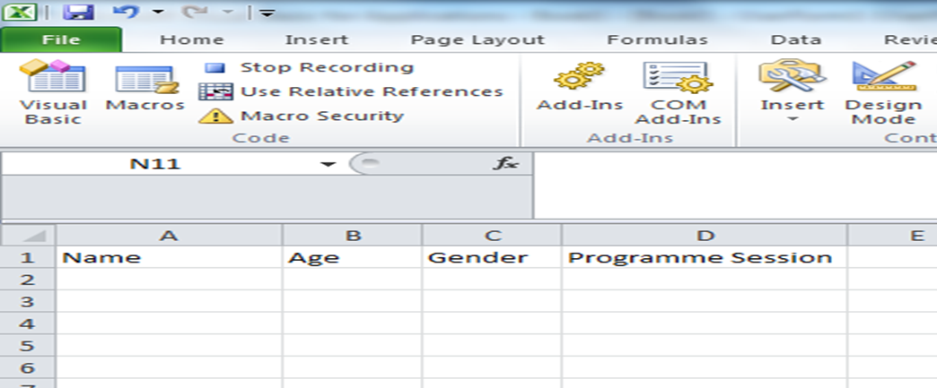

Slide 12
We can now write Excel macro code to allocate our entry into the Excel file
This will be written for Command button1 so that when it is clicked, after filling the required pages, the data will be transferred into the Excel file.
To Command button1, write the following codes to Register Me
Private Sub CommandButton1_Click()
Dim emptyRow As Long
Sheet1.Activate
emptyRow = WorksheetFunction.CountA(Range("A:A")) + 1
Cells(emptyRow, 1).Value = TextBox1.Value
Cells(emptyRow, 1).Columns.AutoFit
Cells(emptyRow, 2).Value = TextBox2.Value
If OptionButton1.Value = True Then
Cells(emptyRow, 3).Value = "Male"
Else
Cells(emptyRow, 3).Value = "Female"
End If
Cells(emptyRow, 4).Value = ListBox1.Value
End Sub

Slide 13
The next thing now is to assign the list for the Listbox1, combobox1, we can also preset the invoice and shipped to the actual date that the entries are made, and we can set the first items to be filled first.
To this end, we have to initialize the UserForm to be able to perform this by writing the following codes
Private Sub UserForm_Initialize()
With ListBox1
.AddItem "Fall Semester"
.AddItem "Spring Semester"
.AddItem "Summer School"
.AddItem "Orientation"
End With
ComboBox1.List = Array("Industrial Engineering", "Economics", "Computer Engineering", "Mechanical Engineering", "Civil Engineering", "Mathematics")
End Sub
To Exit from the records, we shall have to write macro code for the Commanbutton2: Close Registration
Private Sub CommandButton2_Click()
Unload Me
End Sub

Slide 14
Create the second Userform2
Again take note of the names and caption tags
The UserForm is to take invoice particulars to contain three pages namely: Customers details, Product details and shipment details.
Customer Details should consist of
Invoice No
Invoice Date
Customer Name
Customer Address
Mobile
Product Details should consist of
Invoice No
Invoice Date
Product Description
Quantity Ordered
Unit Price
Total Amount

Slide 15
Shipment Details should consist of
Invoice No
Invoice Date
Transportation Mode (Air, Land, Rail, Road)
Date Shipped
Destination
Command button 1: Lodge Customer Order Records
Command button2: Exit Records
Your Userform2 with Caption: INVOICE PARTICULARS should look like this

Slide 16
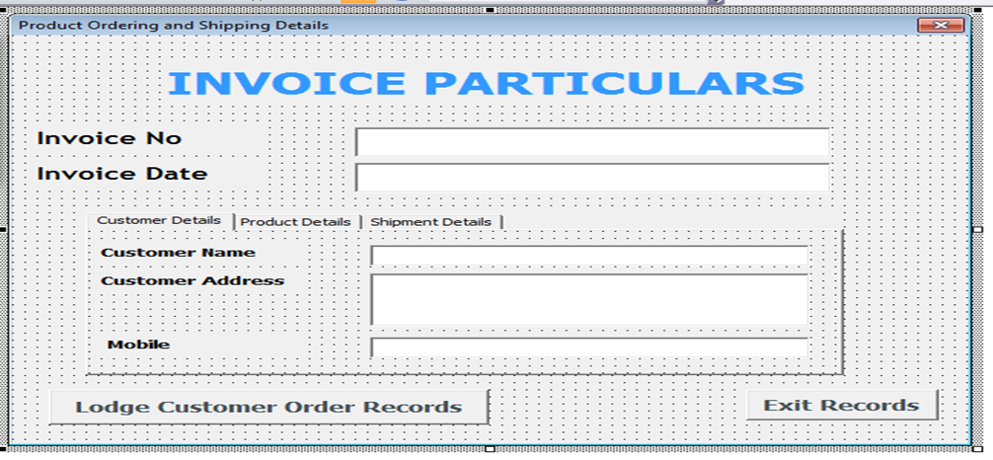

Slide 17
We can now write Excel macro code to allocate our entry into the Excel file
This will be written for Command button1 so that when it is clicked, after filling the required pages, the data will be transferred into the Excel file.
To Command button1, write the following codes to customer details
Private Sub CommandButton1_Click()
Dim LastRowCustomerDetails As Long, LastRowProductDetails As Long, LastRowShipmentDetails As Long
LastRowCustomerDetails = Sheets("CustomerDetails").Range("A" & Rows.Count).End(xlUp).Row
Sheets("CustomerDetails").Cells(LastRowCustomerDetails + 1, "A").Value = TextBox1.Text
Sheets("CustomerDetails").Cells(LastRowCustomerDetails + 1, "B").Value = TextBox2.Text
Sheets("CustomerDetails").Cells(LastRowCustomerDetails + 1, "C").Value = TextBox3.Text
Sheets("CustomerDetails").Cells(LastRowCustomerDetails + 1, "D").Value = TextBox4.Text
Sheets("CustomerDetails").Cells(LastRowCustomerDetails + 1, "E").Value = TextBox5.Text
End Sub

Slide 18
Product and Shipment details can be written is a similar form to transfer the entries made on them to the Excel file as;
LastRowProductDetails = Sheets("ProductDetails").Range("A" & Rows.Count).End(xlUp).Row
Sheets("ProductDetails").Cells(LastRowProductDetails + 1, "A").Value = TextBox1.Text
Sheets("ProductDetails").Cells(LastRowProductDetails + 1, "B").Value = TextBox2.Text
Sheets("ProductDetails").Cells(LastRowProductDetails + 1, "C").Value = TextBox6.Text
Sheets("ProductDetails").Cells(LastRowProductDetails + 1, "D").Value = TextBox7.Text
Sheets("ProductDetails").Cells(LastRowProductDetails + 1, "E").Value = TextBox8.Text
Sheets("ProductDetails").Cells(LastRowProductDetails + 1, "F").Value = TextBox9.Text
Sheets("ProductDetails").Cells(LastRowProductDetails + 1, "F").Value = Val(TextBox7.Text) * Val(TextBox8.Text)
LastRowShipmentDetails = Sheets("ShipmentDetails").Range("A" &Rows.Count).End(xlUp).Row
Sheets("ShipmentDetails").Cells(LastRowShipmentDetails + 1, "A").Value = TextBox1.Text
Sheets("ShipmentDetails").Cells(LastRowShipmentDetails + 1, "B").Value = TextBox2.Text
Sheets("ShipmentDetails").Cells(LastRowShipmentDetails + 1, "C").Value = ComboBox1.Text
Sheets("ShipmentDetails").Cells(LastRowShipmentDetails + 1, "D").Value = TextBox11.Text
Sheets("ShipmentDetails").Cells(LastRowShipmentDetails + 1, "E").Value = TextBox12.Text
End Sub

Slide 19
The next thing now is to assign the list for the combobox, we can also preset the invoice and shipped to the actual date that the entries are made, and we can set the first items to be filled first.
To this end, we have to initialize the UserForm to be able to perform this by writing the following codes
Private Sub UserForm_Initialize()
TextBox1.SetFocus
TextBox2.Text = Date
TextBox11.Text = Date
ComboBox1.List = Array("By Land", "By Rail", "By Sea", "By Air")
End Sub

Slide 20
The next thing now is to assign the list for the combobox, we can also preset the invoice and shipped datesTry to run Command button1 with these codes
You should have all your entries in the Excel file created, inside their respective pages
To Exit from the records, we shall have to write macro code for the Commanbutton2: Exit Records
Private Sub CommandButton2_Click()
Unload Me
End Sub

Slide 21
Multiple UserForms can be created within the same Excel file to serve different purposes
Instead of creating multiple Excel files, we can create multiple UserForms to take different Information from the users.
We can just be switching between userforms within the same Excel file.
For example we can create a switch macro codes for switching between our UserForm1 and Userform2 using the codes below;
Private Sub CommandButton2_Click()
Unload Me
UserForm1.Hide
UserForm2.Show
End Sub
Try and demonstrate this to see how it is possible to switch between UserForms in a single Excel file.

Slide 22
Thanks for listening remember , lab final is on the 25th of may there will not make-up lab exams

