Slide 1
Mect 361 sensors
Gizem Aytac

Slide 2
WHY WE NEED SENSORS ?

Slide 3
Transducer
A device which converts one form of energy to another
When input is a physical quantity and output electrical → Sensor
When input is electrical and output a physical quantity → Actuator
Sensors
Actuators
Electrical Input
Physical parameter
Electrical Output
Physical Output

Slide 4
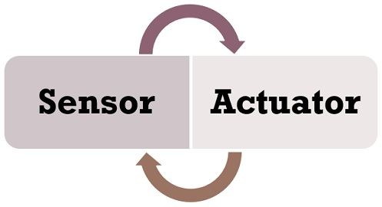
Sensors and Actuators are essential elements of the embedded systems. These are used in several real-life applications such as flight control system in an aircraft, process control systems in nuclear reactors, power plants that require to be operated on an automated control.
Sensors and Actuators mainly differ by the purpose both provide, the sensor is used to monitor the changes in the environment by using measurands while the actuator is used when along with monitoring the control is also applied such as to control the physical change.

Slide 5
Actuators
An actuator is a device that alters the physical quantity as it can cause a mechanical component to move after getting some input from the sensor. In other words, it receives control input (generally in the form of the electrical signal) and generates a change in the physical system through producing force, heat, motion, etc.
An actuator can be interpreted with the example of the stepper motor, where an electrical pulse drives the motor. Each time a pulse given in the input accordingly motor rotates in a predefined amount. A stepper motor is suitable for the applications where the position of the object has to be controlled precisely, for example, robotic arm.

Slide 6
Sensors
A sensor is an electronic instrument that is able to measure the physical quantity and generate a considerate output. These output of the sensors are usually in the form of electrical signals
A sensor acquires a physical quantity and converts it into a signal suitable for processing (e.g. optical, electrical, mechanical)
Common sensors convert measurement of physical phenomena into an electrical signal

Slide 7
Commonly Detectable Phenomena
Biological
Chemical
Electric
Electromagnetic
Heat/Temperature
Magnetic
Mechanical motion (displacement, velocity, acceleration, etc.)
Optical
Radioactivity

Slide 8
Common Conversion Methods
Physical
thermo-electric, thermo-elastic, thermo-magnetic, thermo-optic
photo-electric, photo-elastic, photo-magnetic,
electro-elastic, electro-magnetic
magneto-electric
Chemical
chemical transport, physical transformation, electro-chemical
Biological
biological transformation, physical transformation

Slide 9
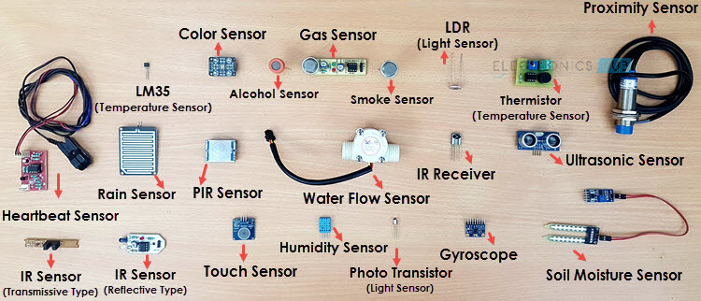
The following is a list of different types of sensors that are commonly used in various applications. All these sensors are used for measuring one of the physical properties like Temperature, Resistance, Capacitance, Conduction, Heat Transfer etc.
Temperature Sensor
Accelerometer
IR Sensor (Infrared Sensor)
Pressure Sensor
Light Sensor
Smoke, Gas
Touch Sensor
Colour Sensor
Humidity Sensor
Tilt Sensor
Flow and Level Sensor

Slide 10
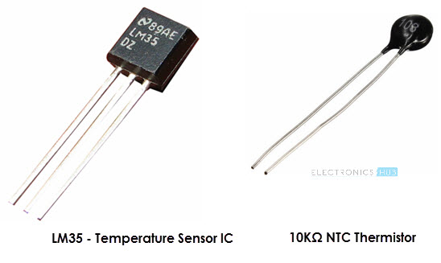
Temperature Sensor
Temperature sensor is a device, to measure the temperature through an electrical signal it requires a thermocouple, RTD (Resistance Temperature Detectors) or thermistor. The thermocouple is prepared by two dissimilar metals which generate the electrical voltage indirectly proportional to change the temperature. The measurement of the temperature sensor is about the hotness or coolness of an object. The working base of the sensors is the voltage that read across the diode. If the voltage increases, then the temperature rises and there is a voltage drop between the transistor terminals of base & emitter, they are recorded by the sensors. If the difference in voltage is amplified, the analogue signal is generated by the device and it is directly proportional to the temperature.

Slide 11
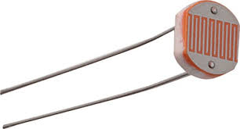
Light Detector using LDR
A Light Detector or a Light Sensor is a device or circuit that detects the intensity of the light incident on it. All these devices are called as Photoelectric Devices as they convert light energy to electric energy. Different types of light detectors are LDRs (or Light Dependent Resistors), Photo Diodes, Photo Transistors, etc.

Slide 12
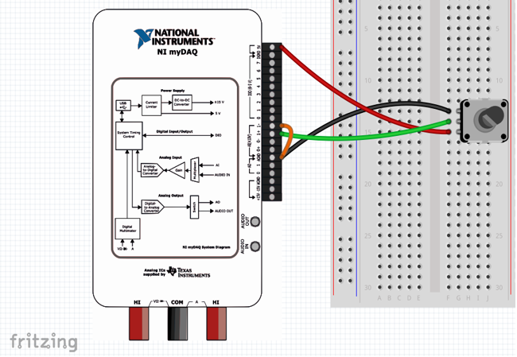
Rotational Position Sensors
A typical use of a potentiometer is for dimming a light. You may want to have control over how bright a light is, either for energy-saving purposes or personal preferences. A potentiometer provides a great solution for this by giving the user control over the variable resistance provided to the light.
Notes:
Two common electrical components used to measure rotational position are the rotary encoder and the potentiometer. Although they function differently, they are both useful in determining the rotational position of an object.

Slide 13
Potentiometer
The potentiometer is very popular in light and audio control applications, specifically with dimming lights and sound manipulation.
The potentiometer uses a wiper and resistive strip to change the amount of resistance in the material. As the knob turns, the wiper is moved to create more or less resistance. The change in resistance results in a change in voltage output from the potentiometer. If we are given a 10 kΩ potentiometer, the max resistance will be 10 kΩ and the minimum is 0 Ω, creating a variable resistor.

Slide 14
The relationship between voltage and angle in most potentiometers is either logarithmic or linear and all potentiometers have a minimum and maximum position. According to information you will find a relation in between voltage and angle and by using this relation can define voltage of the circuit.

Slide 15
The potentiometer uses a wiper and resistive strip to change the amount of resistance in the material. As the knob turns, the wiper is moved to create more or less resistance. The change in resistance results in a change in voltage output from the potentiometer. If we are given a 10 kΩ potentiometer, the max resistance will be 10 kΩ and the minimum is 0 Ω, creating a variable resistor. This concept is shown in the image below

Slide 16
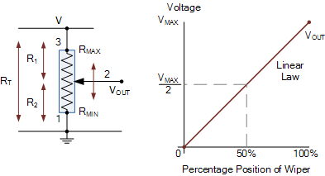

Slide 17
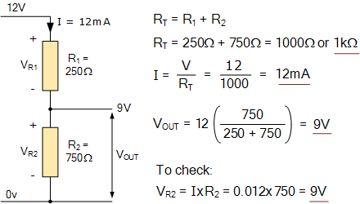
A 250 ohm resistor is connected in series with a second 750 ohm resistor so that the 250 ohm resistor is connected to a 12 volt supply and the 750 ohm resistor is connected to ground (0V). Calculate the total series resistance, the current flowing through the series connection and the voltage drop across the 750 ohm resistor.

Slide 18
In this simple example of a voltage divider, it was found that the voltage developed at R2 is 9 volts. However, by changing the value of one of the two resistors, the voltage can theoretically be between 0V and 12V. This idea of ​​a series connection with two resistors, where you can change the value of one of the two resistors to get a different voltage output, is the basic concept behind the operation of the potentiometer.
The difference to the potentiometer is that to achieve different voltages at the output, the total resistance, the R _{T} value of the resistance track of the potentiometer does not change, but only the ratio of the two resistances that are formed on both sides of the grinder during its movement.
The movable wipers of the potentiometer thus provide an output that varies between the voltage at one end of the track and that at the other end, usually between maximum and zero, as shown.

Slide 19
https://youtu.be/Ox05Bks2Q3s
https://youtu.be/sjAZGUcjrP8

Slide 20
Thank you for your attention

