Slide 2
Objectives
Detailed Object-Oriented Requirements Definitions
System Processes—A Use Case/Scenario View
Identifying Inputs and Outputs—The System Sequence Diagram
Identifying Object Behavior—The Statechart Diagram
Integrating Object-Oriented Models

Slide 3
Overview
Refine requirements to threshold of implementation
Apply OOA to use cases and models
Translate process descriptions into working algorithms
Observe that analysis-design boundary is fluid

Slide 4
Detailed Object-Oriented Requirements Definitions
System requirements captured with OO models
“Divide and conquer” strategy toward complexity
Two subsets of OO modeling approach
Use case driven extending four specific models
Use case diagrams, use case descriptions, activity diagrams, system sequence diagrams
Object driven extending statechart diagram

Slide 5
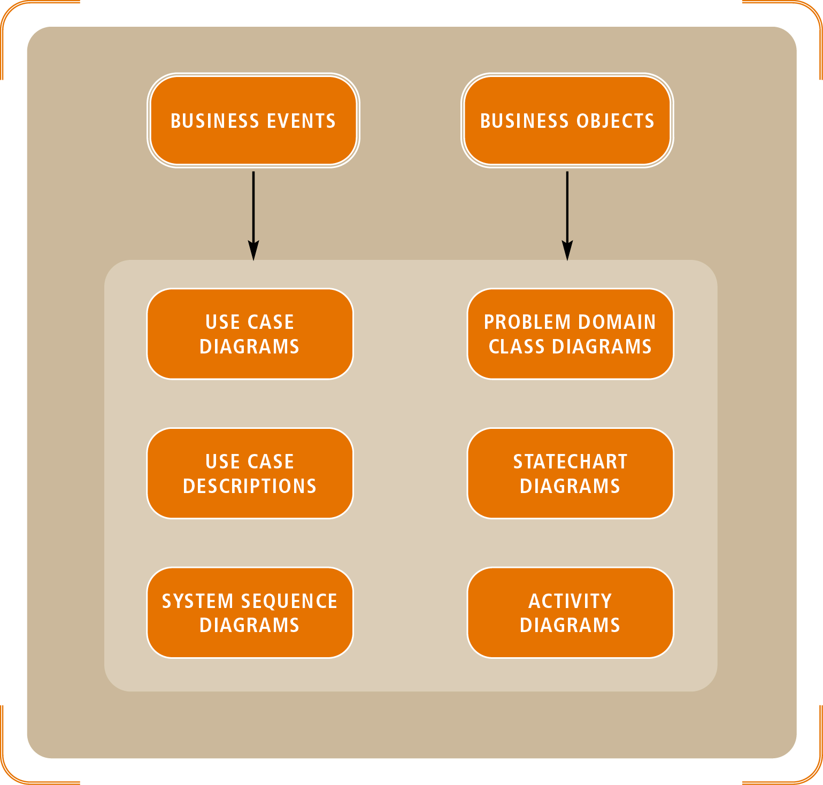
Figure 6-1
Requirements Diagrams With UML Models

Slide 6
Detailed Object-Oriented Requirements Definitions (continued)
Use case diagram: table of contents for business events
System sequence diagrams (SSDs)
Define and order sequence of inputs and outputs
Information flows referred to as messages
Class diagrams
Identify real-world “things”
Determine the structure of the programming classes
Statechart diagram describes collection of object states

Slide 7
System Processes—A Use Case/Scenario View
Define use cases into two tiers:
Overview level derived from:
Event table and use case diagrams
Detailed level derived from combination of:
Use case description
Activity diagram
Sequence diagram

Slide 8
Use Cases and Actors
Source
Person or thing initiating the business event
Must be external to the system
Actor
Person or thing that touches the system
Lies outside of automation boundary
Identifying actors at the right level of detail
Assume actors (even non-human types) have hands
Use case is a goal that the actor wants to achieve

Slide 9
The Use Case Diagram
Notation for use case diagrams
Simple stick figure represents an actor
Actor’s hands indicate direct system access
Use case itself symbolized by an oval
Connecting lines match actors to use cases
Actors may also be other system interfaces
May be represented with stick figure or rectangle

Slide 10
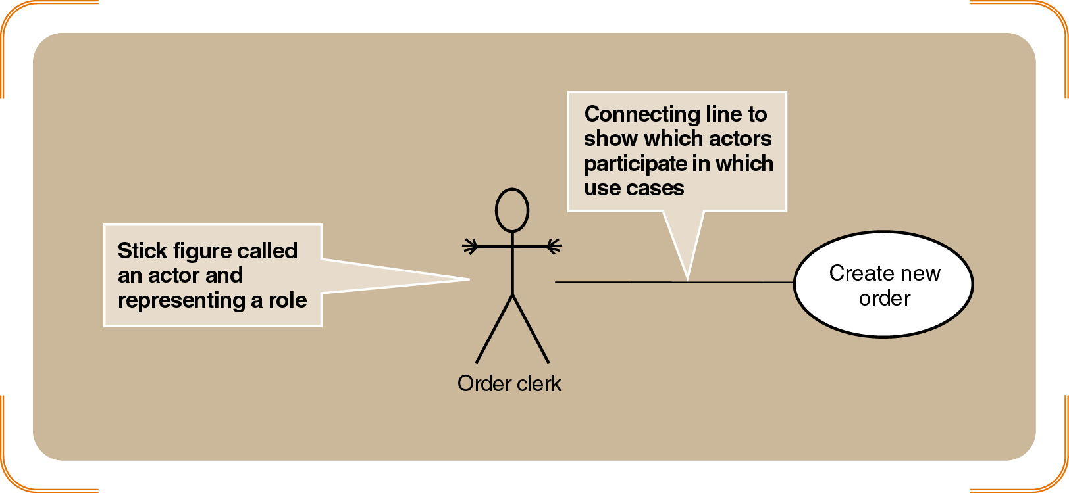
Figure 6-2
A Simple Use Case with an Actor

Slide 11
Automation Boundary and Organization
Expand use case diagrams with other actors and use cases
Relationship line: allows each actor to interact with each use case
Automation boundary
Line drawn around the entire set of use cases
Defines interface between actors and computer system

Slide 12
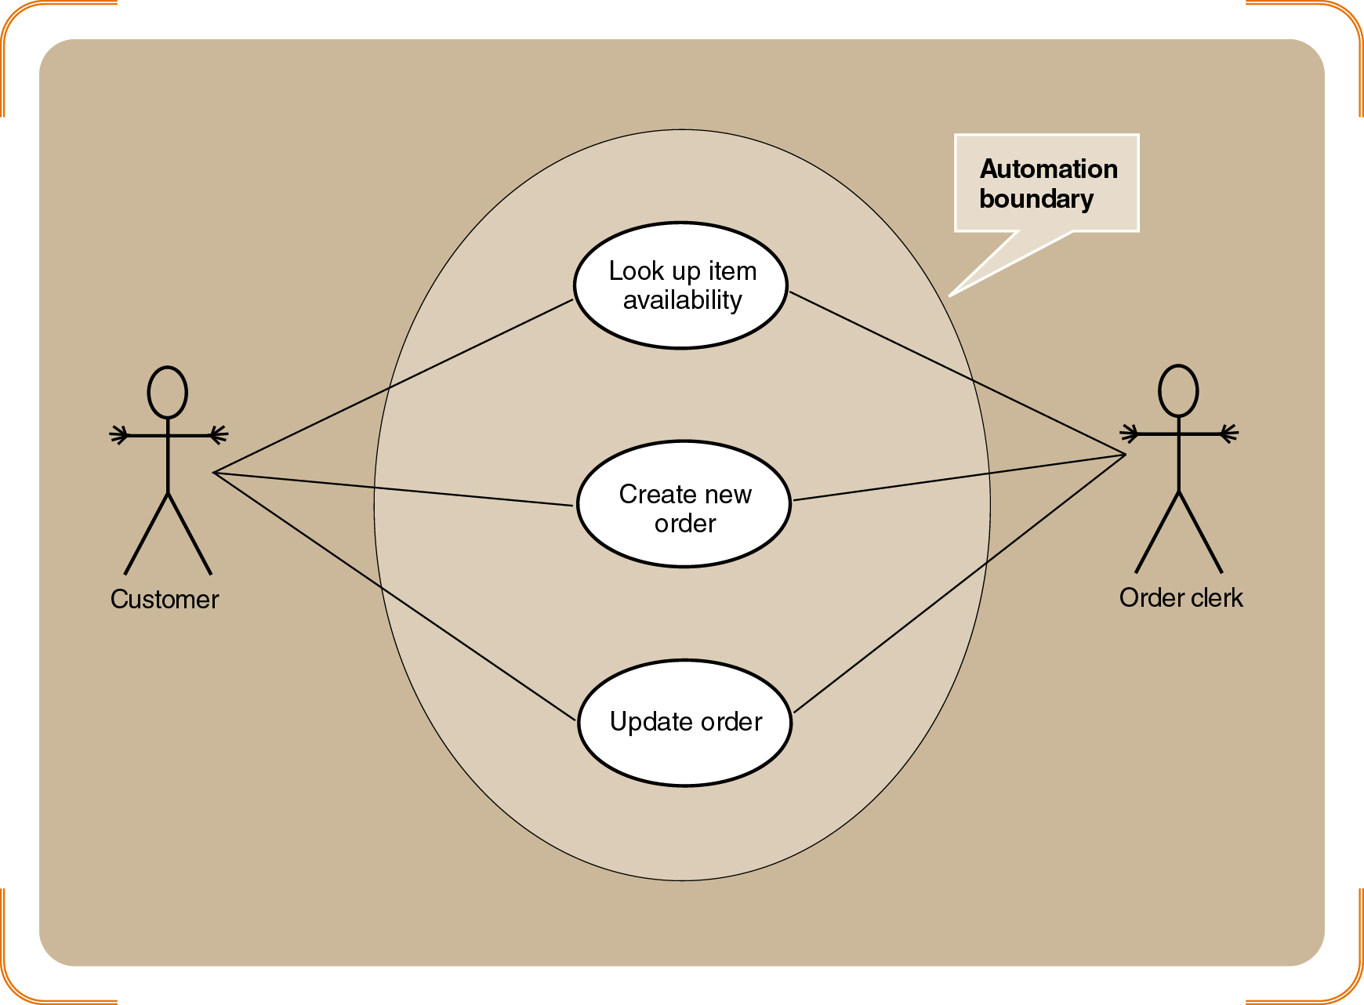
Figure 6-3
A Use Case Diagram of the Order-Entry Subsystem for RMO, Showing a System Boundary

Slide 13
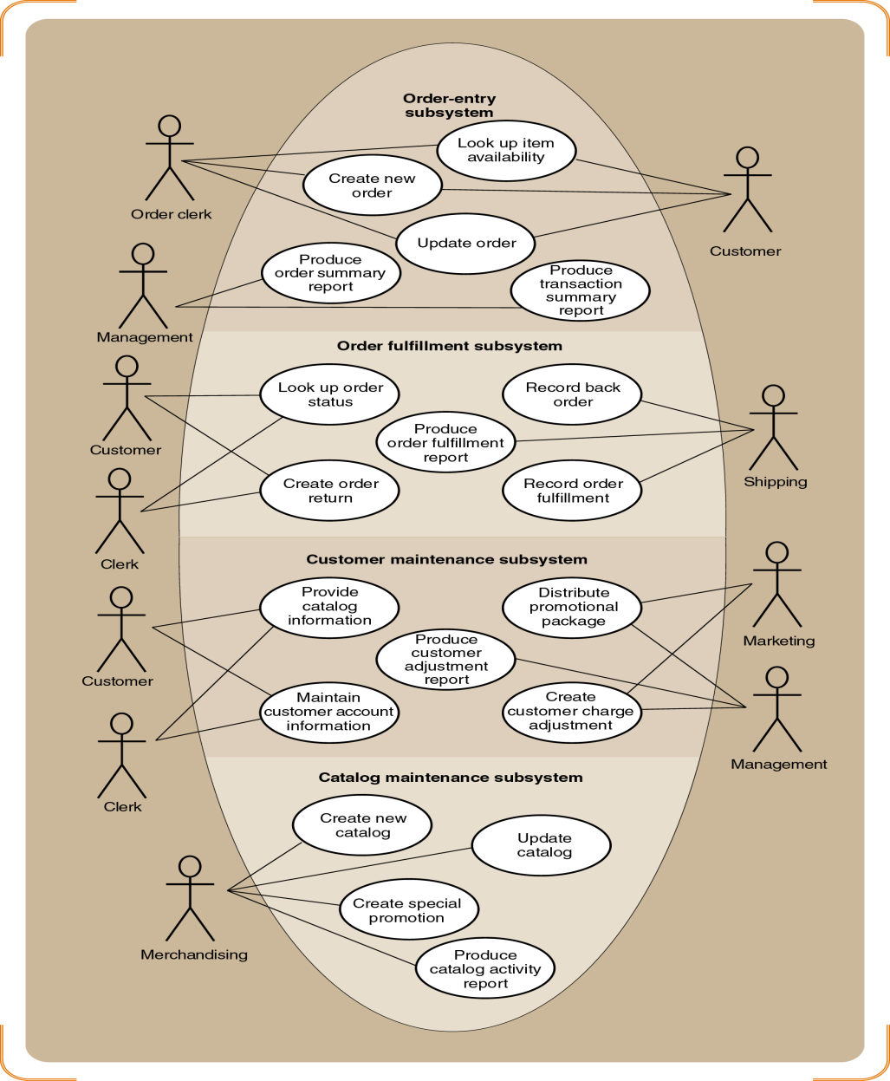
Figure 6-4
A Use Case Diagram of the Customer Support System (by Subsystem)

Slide 14
« Includes » Relationships
«includes» or «uses» relationship
Use case calling services of common subroutine
Common subroutine itself becomes additional use case
Examples: “Validate customer account” and “Look Up Item Availability”
Notation
Relationship denoted by connecting line with arrow
Direction of the arrow indicates major/minor cases

Slide 15
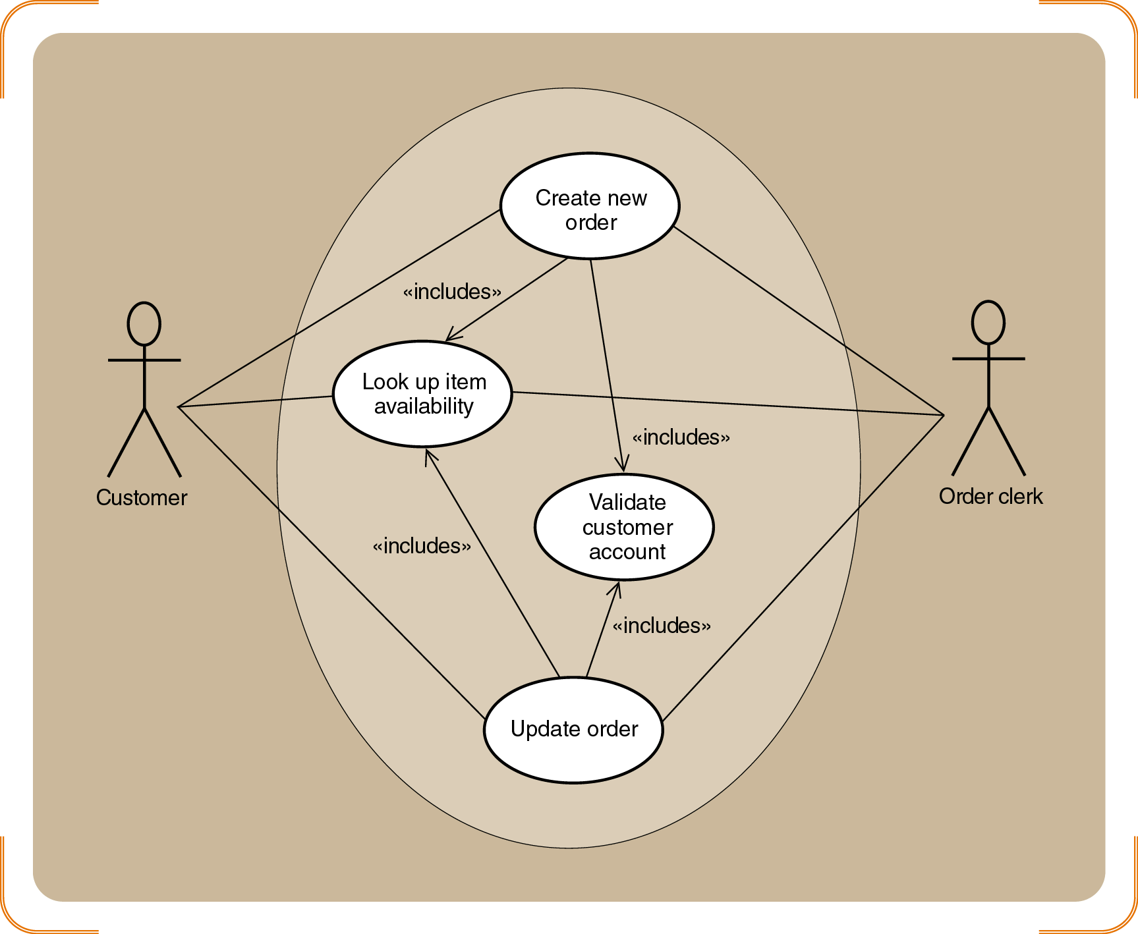
Figure 6-6
An Example of the Order-entry Subsystem With «Includes» Use Cases

Slide 16
Developing a Use Case Diagram
Two ways to identify additional use cases
Divide one large use case into two
Define another use case based on a common subroutine
Distinguish between temporal and state events
Iterative process translates business events to use cases
[1] Identify the actors and roles for each use case
[2] Extract system response to business events
Data of system stabilizes after completion of the goal

Slide 17
Use Case Detailed Descriptions
Use cases have internal complexity
Sequence of steps to execute business process
Several variations may exist within single use case
Valid variation known as scenario
Example: “Create new order” varies from phone to Internet order
Work with variety of diagrams and descriptions for each use case

Slide 18
Use Case Detailed Descriptions (continued)
Use case descriptions written at (3) levels of detail
Brief description
Summary statement conjoined to activity diagram
Intermediate description
Expands brief description with internal flow of activities
Fully Developed Description
Expands intermediate description for richer view

Slide 19
Figure 6-7
Brief Description of Create New Order Use Case

Slide 20
Figure 6-8
Intermediate Description of Telephone Order Scenario for Create New Order Use Case

Slide 21
Use Case Detailed Descriptions (continued)
Fully developed use case description
Superset of intermediate and brief descriptions
Consists of eleven compartments
User, actor, stakeholder, EBP, and conditions identified
Activity Diagram Description
Document the workflows of business processes
Document flow of activities for use case scenarios
Form basis of system sequence diagrams (SSDs)

Slide 22
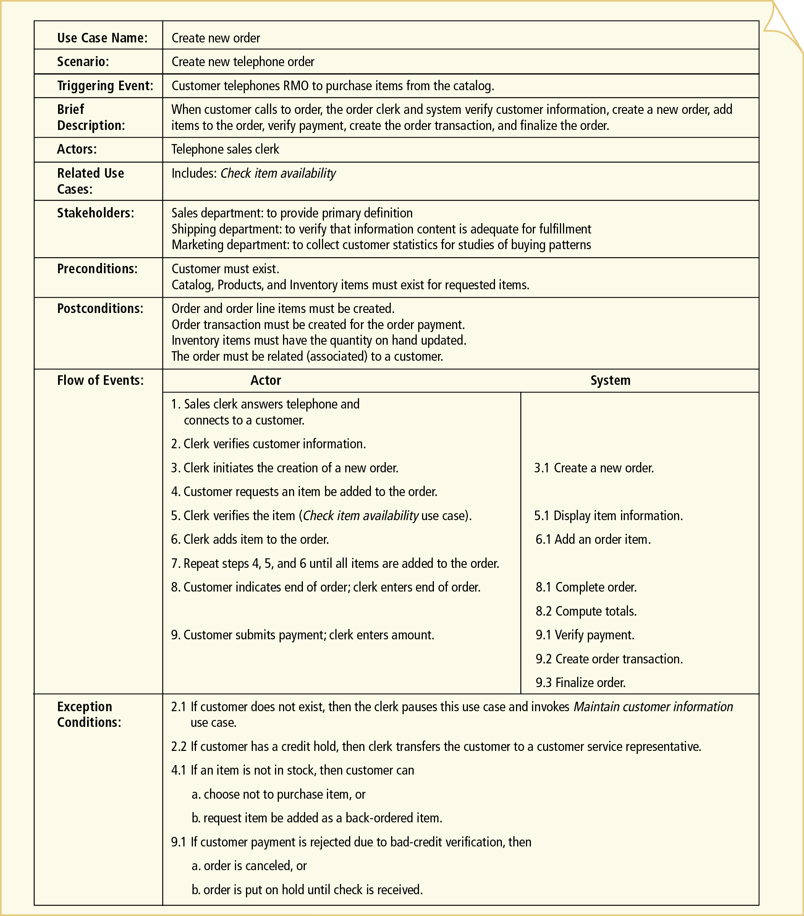
Figure 6-10
Fully Developed Description of Telephone Order Scenario for Create New Order Use Case

Slide 23
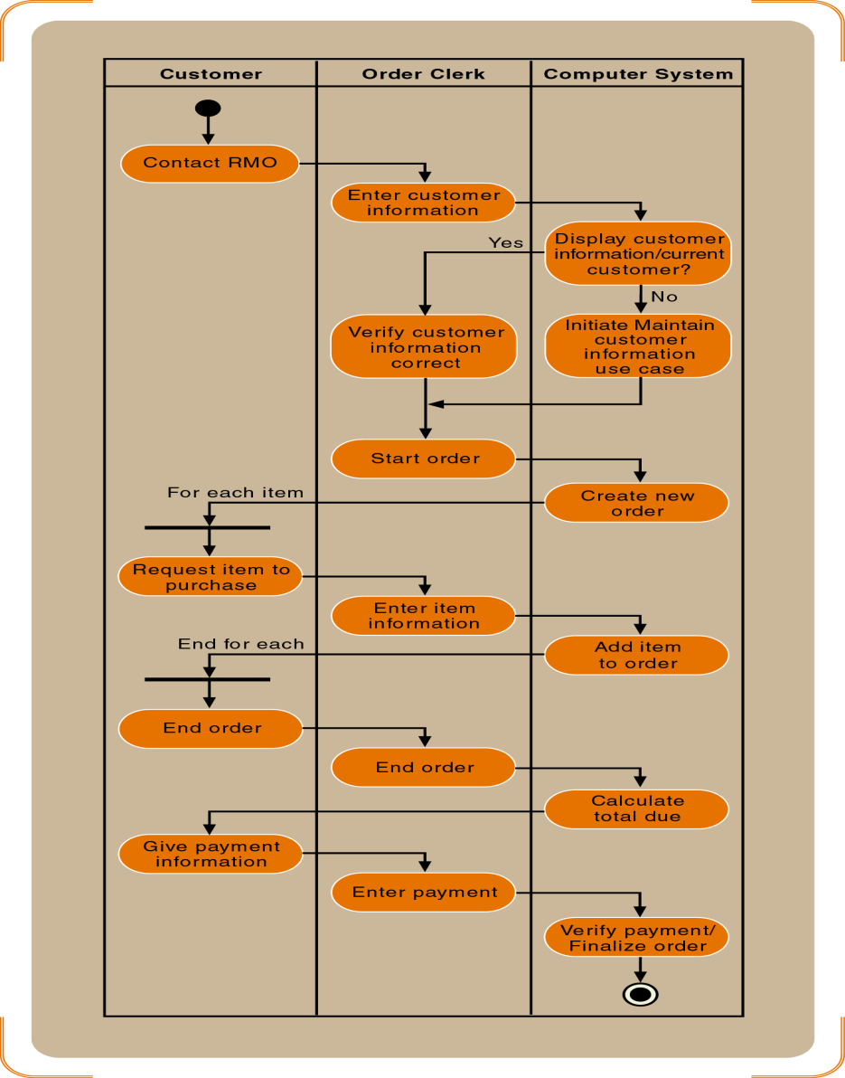
Figure 6-12
Activity Diagram of the Telephone Order Scenario

Slide 24
Identifying Inputs and Outputs—the System Sequence Diagram
System sequence diagram (SSD)
Describes flow of information
Identifies interaction between actors and system
Message oriented

Slide 25
SSD Notation
Actor “interacts” with the system via input/output
SSDs use object notation
Box (rectangle) refers to individual object
Name of the object underlined
Messages sent/received by objects, not classes
Lifeline
Extension of object or actor for duration of the SSD
Indicates sequence of the messages sent/received

Slide 26
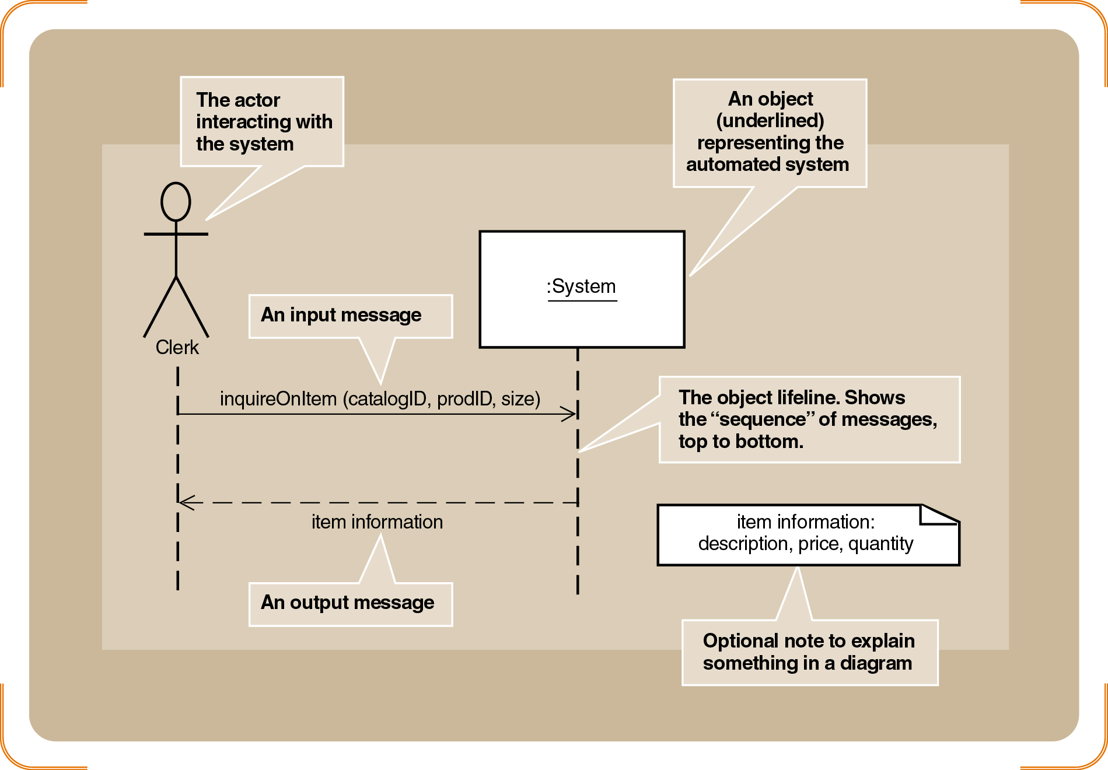
Figure 6-14
Sample System Sequence Diagram

Slide 27
SSD Notation (continued)
Message syntax can take several forms
Depends on send/return direction
Message semantics: actions (like commands) invoked on destination object
Complete message notation:*[true/false condition] return-value := message-name (parameter-list)

Slide 28
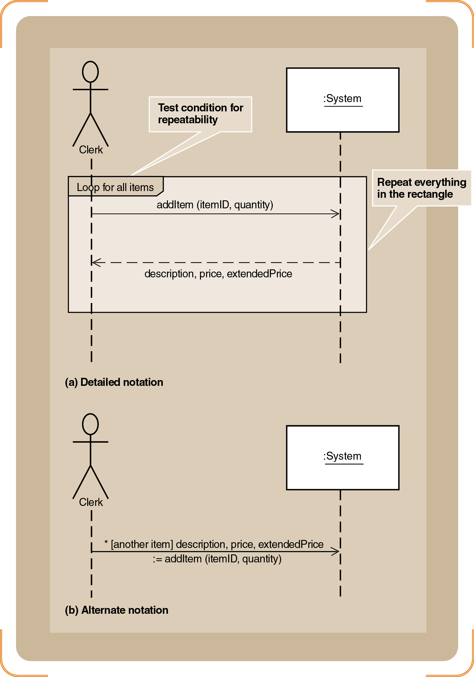
Figure 6-15
Repeating Message (A) Detailed Notation (B) Alternate Notation

Slide 29
Developing a System Sequence Diagram
Begin with detailed description of use case
Fully developed form
Activity diagrams
(4) step process for turning activity diagram into SSD
[1] Identify the input messages
[2] Describe messages from external actor to system
[3] Identify/apply special conditions to input messages
[4] Identify and add the output return messages

Slide 30
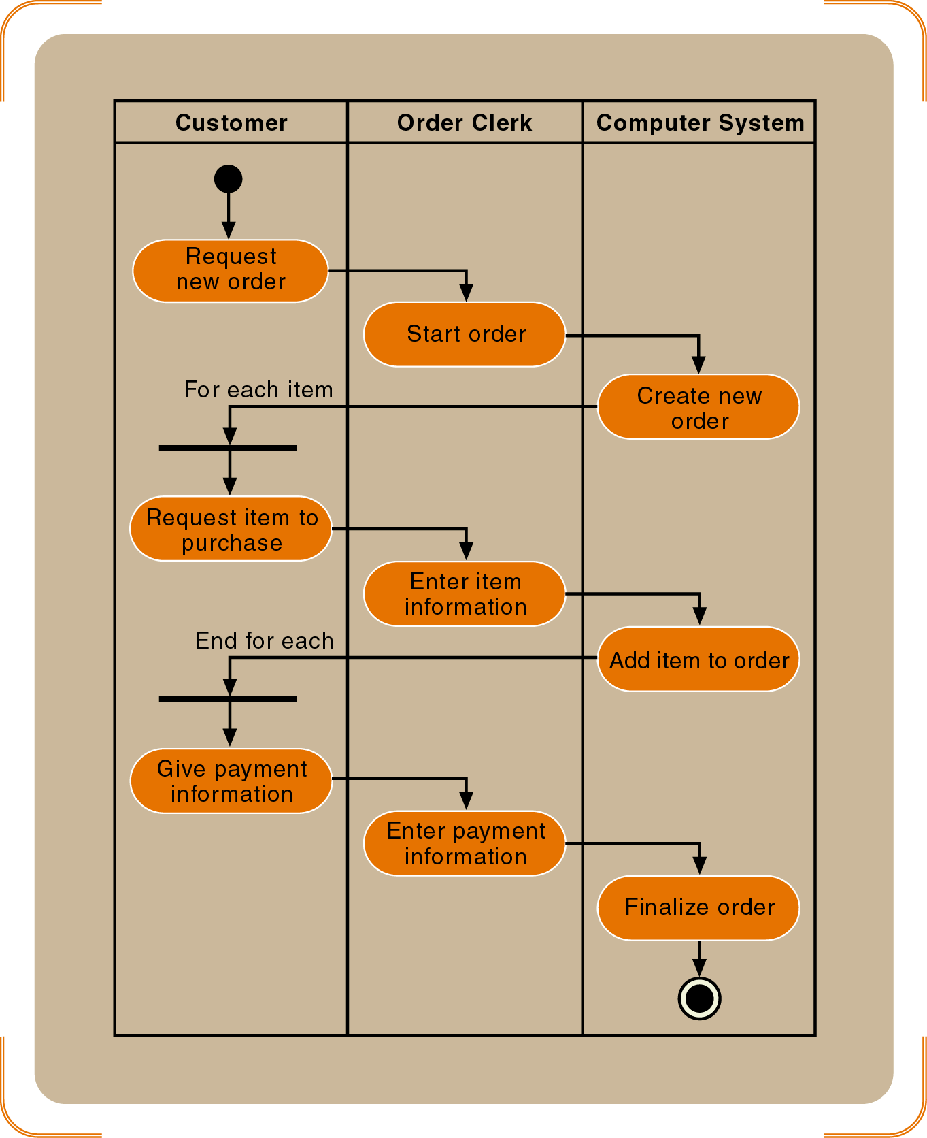
Figure 6-16
A Simplified Diagram of the Telephone Order Scenario

Slide 31
Developing a System Sequence Diagram (continued)
Names of messages reflect services performed
Important principle for identifying data parameters
Base the list on the class diagram
Attributes from the classes listed as parameters
Iteratively define input/output parameters around workflows
Objective: discovery and understanding

Slide 32
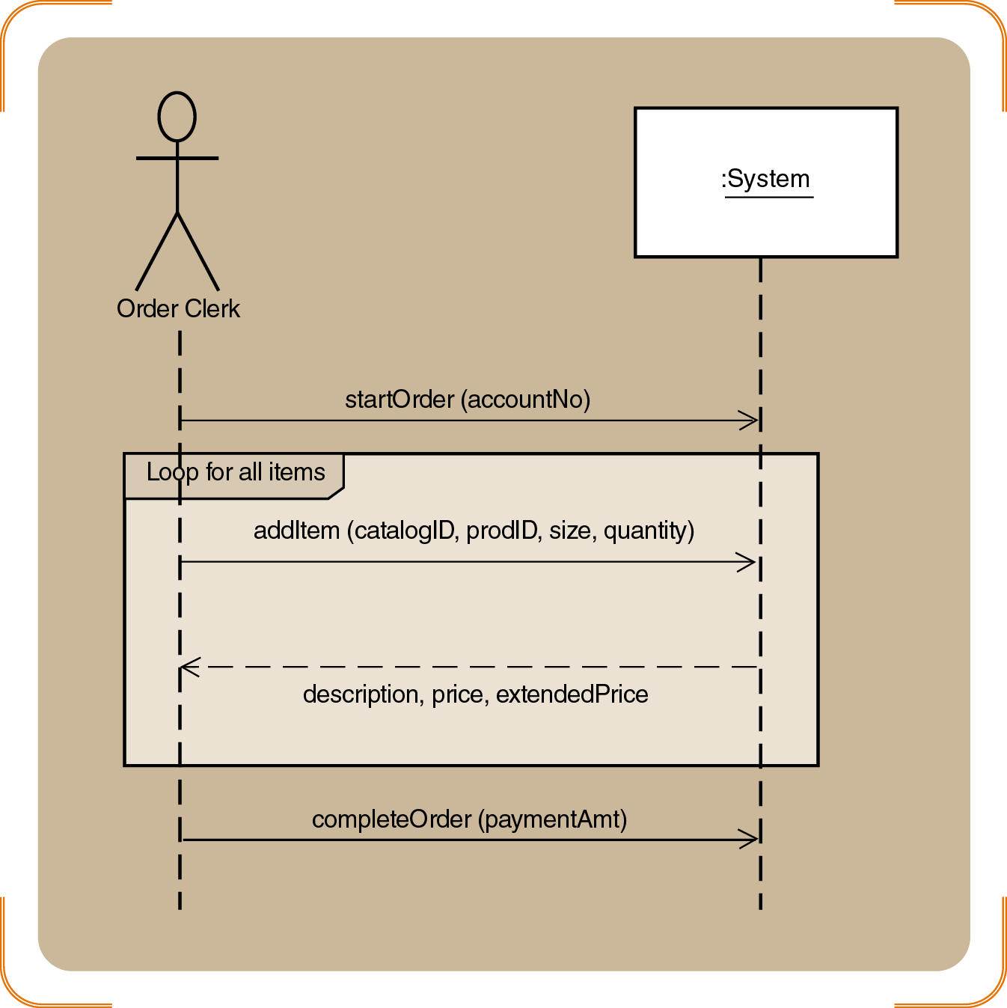
Figure 6-17
An SSD of the Simplified Telephone Order Scenario for the Create New Order Use Case

Slide 33
Identifying the Object Behavior⎯the Statechart Diagram
A state in a statechart similar to status condition
Spans many business events
Developed for complex problem domain classes
Statechart diagram
Composed of ovals representing status of object
Arrows represent transitions

Slide 34
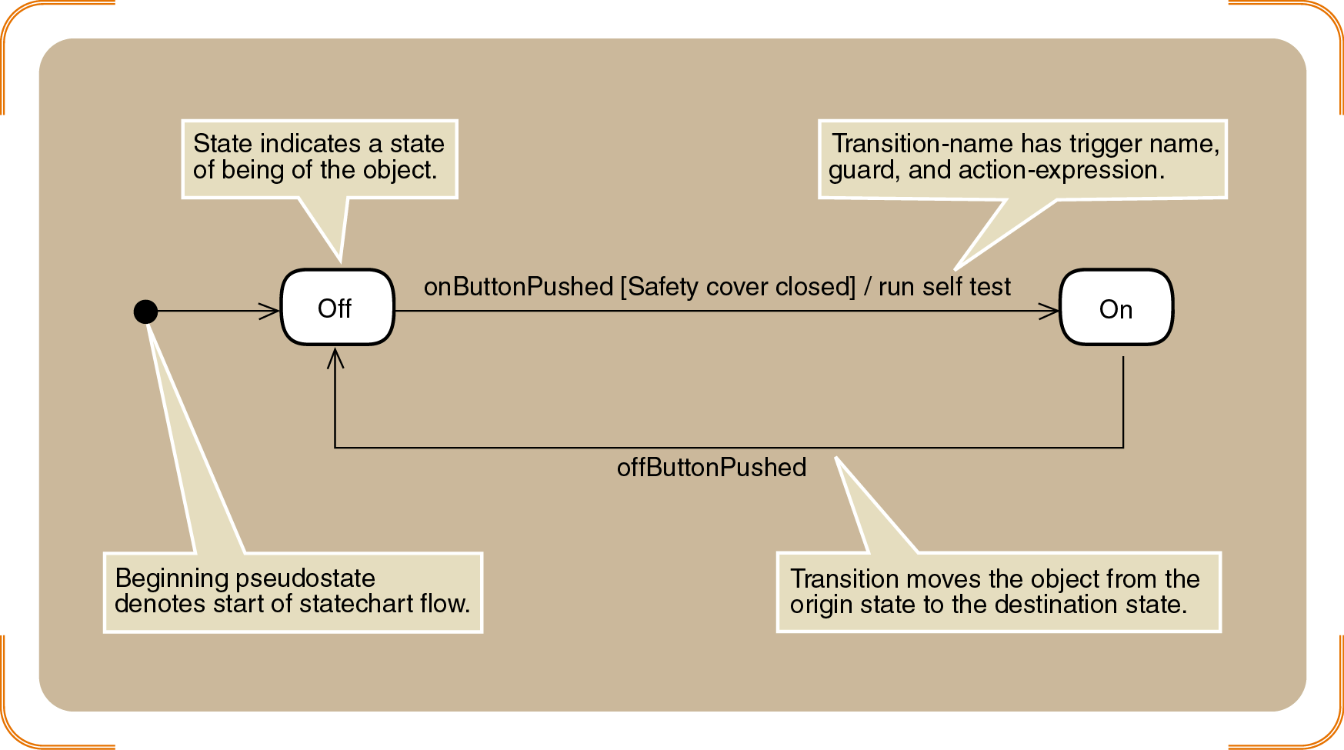
Figure 6-19
Simple Statechart for a Printer

Slide 35
Identifying the Object Behavior⎯the Statechart Diagram (continued)
Guidelines to help identify states
Check naming convention for status conditions
Simple states reflect simple conditions such as “On”
Complex states labeled with gerunds or verb phrases
Example: “Being shipped”
Active states usually not labeled with nouns
Describe only states of being of the object itself
Status conditions reported to management/customers
Example: “Shipped”

Slide 36
Nested States And Concurrency
Concurrency: condition of being in more than one state at a time
Two modes of representation
Use synchronization bars and concurrent paths
Nest low-level states inside higher-level states
Higher-level states also called composite states
Complex structure of sets of states and transitions
Represent a higher level of abstraction

Slide 37
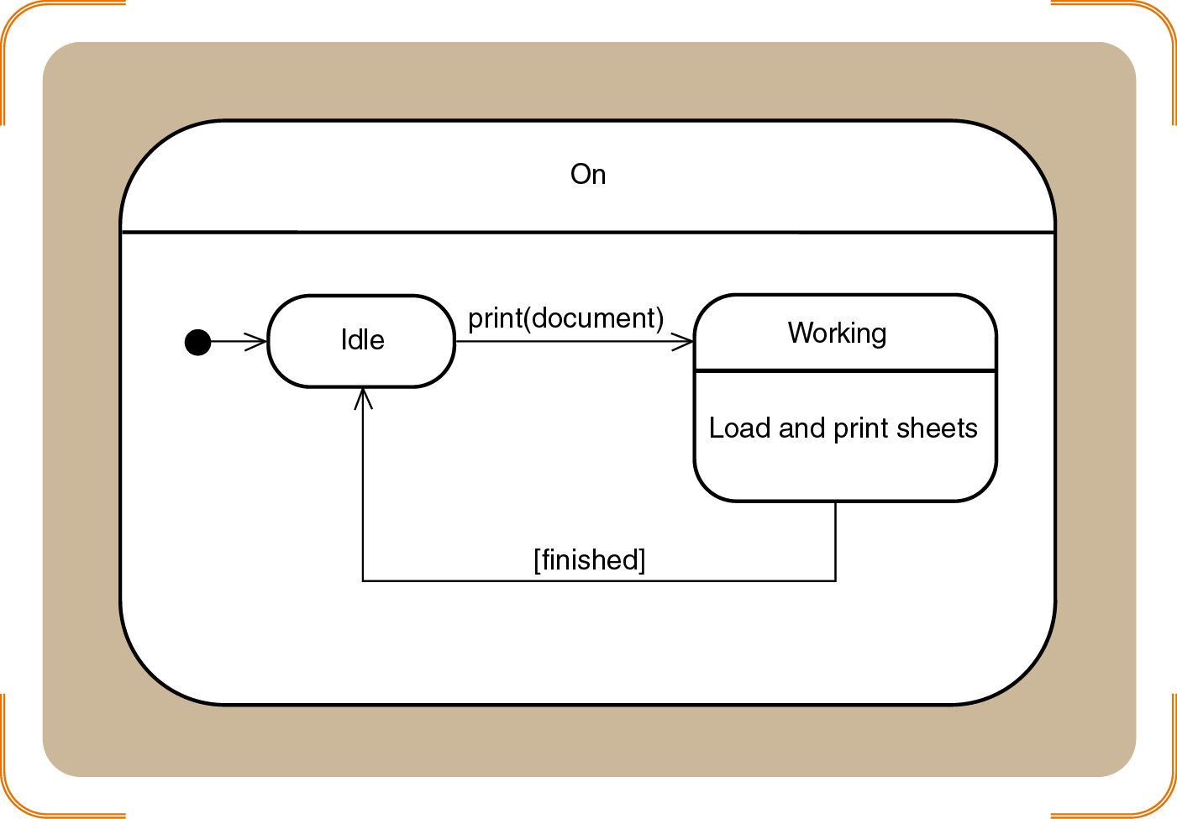
Figure 6-20
Sample Composite States for the Printer Object

Slide 38
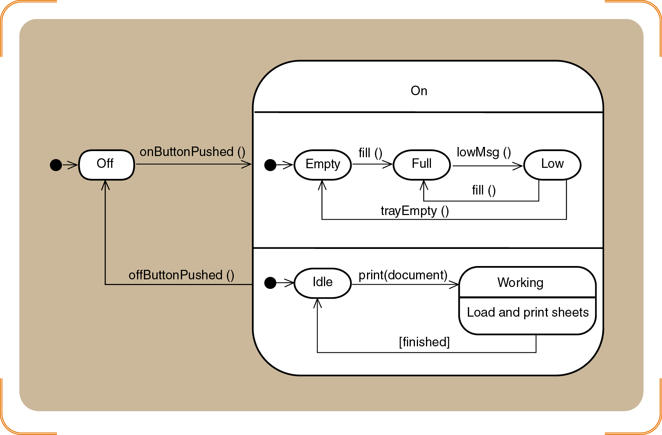
Figure 6-21
Concurrent Paths for the Printer in the On State

Slide 39
Rules for Developing Statecharts
[1] Select the classes that will require statecharts
[2] List all the status conditions for each group
[3] Specify transitions that cause object to leave the identified state
[4] Sequence state-transition combinations in correct order

Slide 40
Rules for Developing Statecharts (continued)
[5] Identify concurrent paths.
[6] Look for additional transitions
[7] Expand each transition as appropriate
[8] Review and test each statechart

Slide 41
Developing RMO Statecharts
Review the domain class diagram
Select classes with status conditions that need to be tracked
Candidates: Order, OrderItem, InventoryItem, Shipment, Customer
Choose Order and OrderItem
Simplicity
Location in the class hierarchy

Slide 42
Developing The Order Item State Chart
Identify possible status conditions of interest
“Ready to be shipped”
“On back order”
“Shipped”
Continue developing statechart according to eight rules

Slide 43
Figure 6-22
States and Exit Transitions for Orderitem

Slide 44
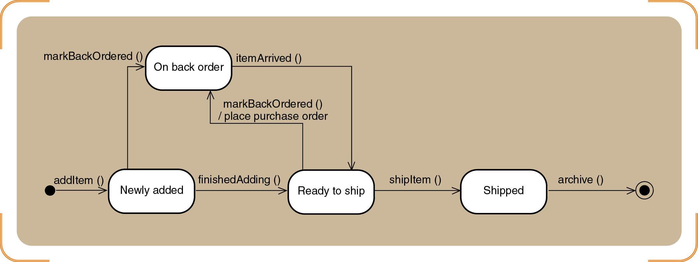
Figure 6-24
Final Statechart for Orderitem

Slide 45
Developing the Order State Chart
States mirror the life cycle of an order
Application of rules leads to greater complexity
Concurrent states
New transitions
Benefits of developing a statechart for an object
Captures and clarifies business rules
Gain true understanding of system requirements

Slide 46
Figure 6-25
States and Exit Transitions for Order

Slide 47
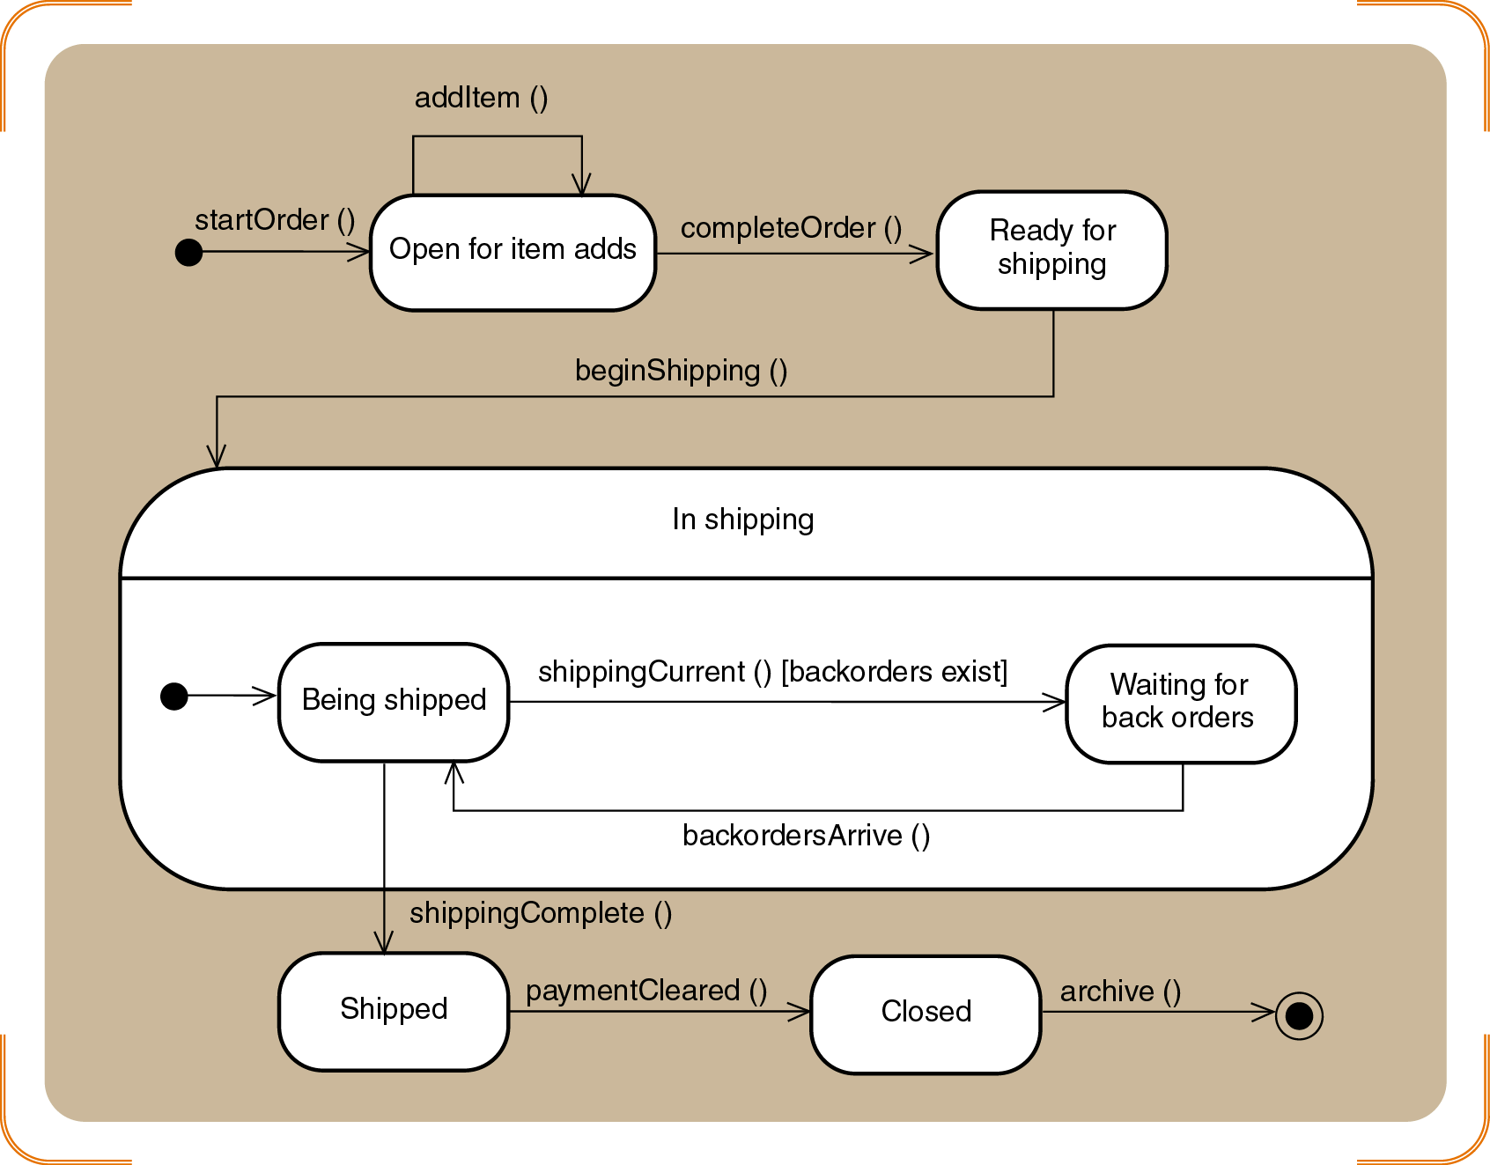
Figure 6-27
Second-cut Statechart for Order

Slide 48
Integrating Object-Oriented Models
Primary (or source) models
Use case diagram
Problem domain class diagram
CRUD analysis validates model completeness
Construction of one model depends on another
Models capturing processes of new system
Use case diagram and models to lower left
Models capturing information about classes
Class diagrams and dependencies

Slide 49
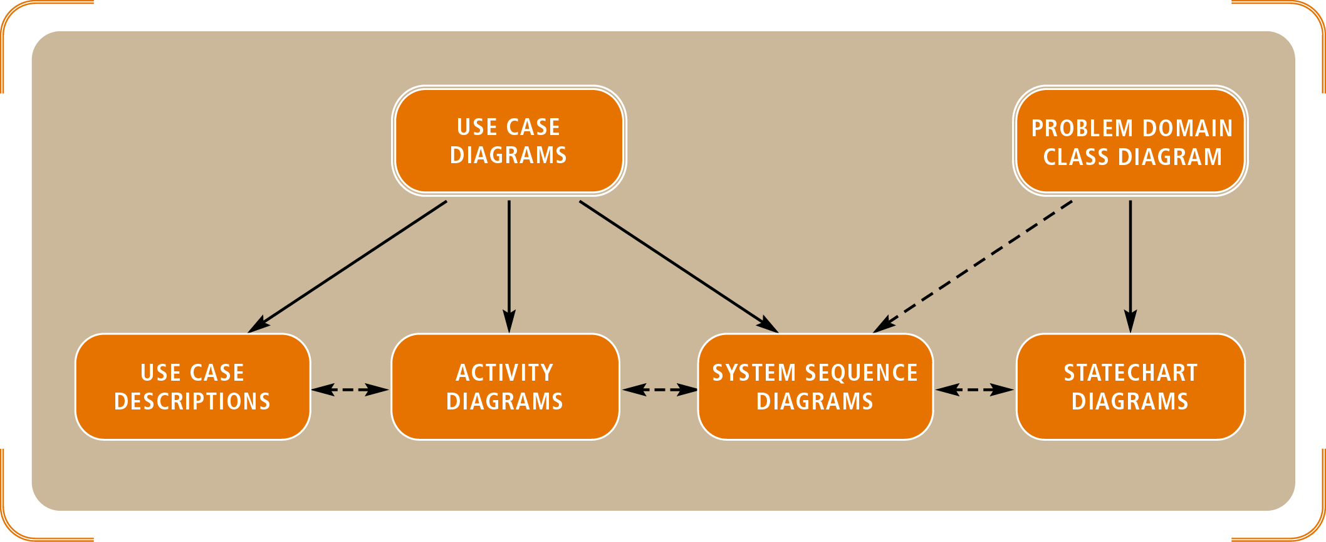
Figure 6-28
Relationships among OO Requirements Models

Slide 50
Summary
OOA family of models documents users’ needs and defines system requirements
Use case detailed models (descriptive or activity)
Sequence diagrams (SSDs)
Domain model class diagrams
Statechart diagrams

Slide 51
Summary (continued)
Use case: single system function responding to an event
Actors: human users or system interfaces that initiate system response
System function decomposed into workflows
SSDs, domain models, statecharts emulate routines and object interaction
Software engineering terms signal transition into design phase

