Slide 1
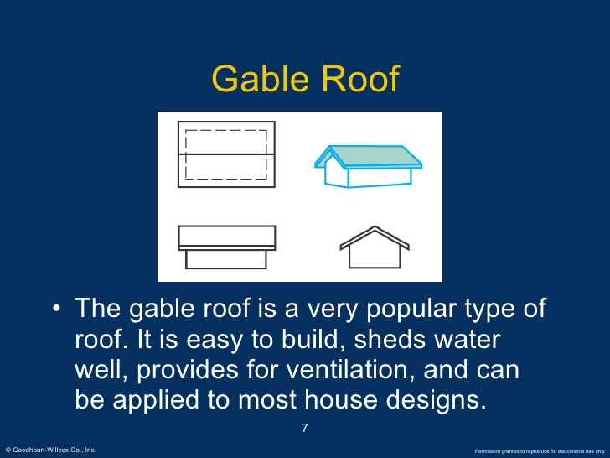

Slide 2
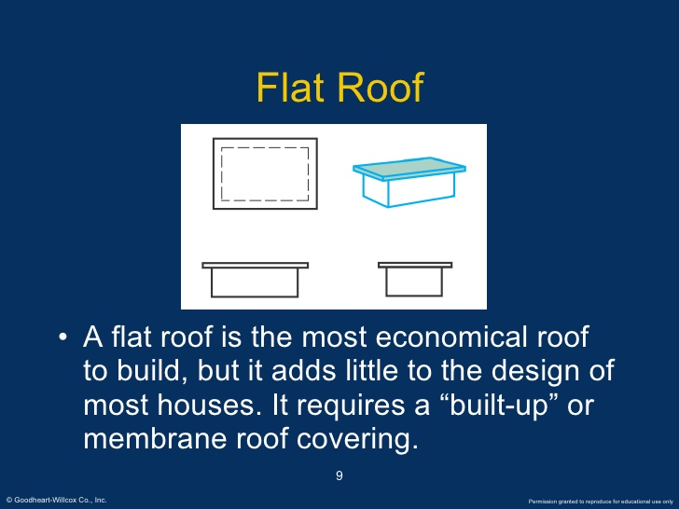

Slide 3
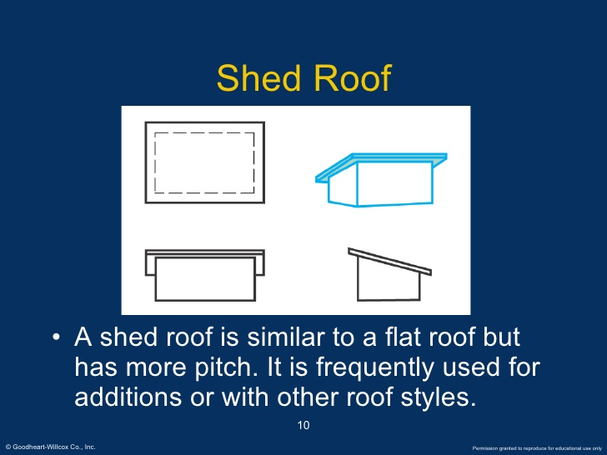

Slide 4
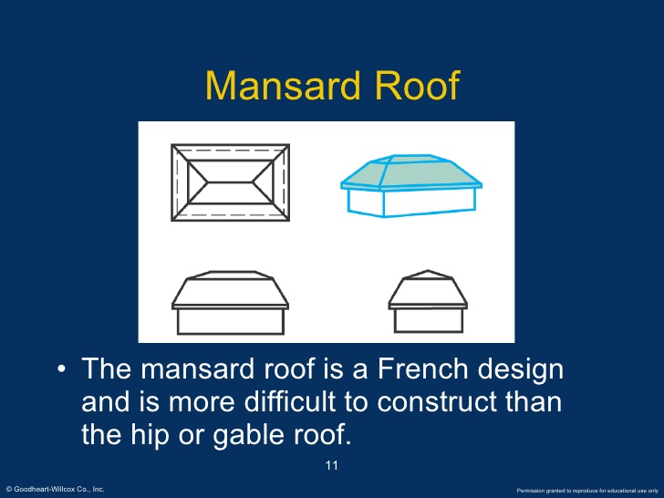

Slide 5
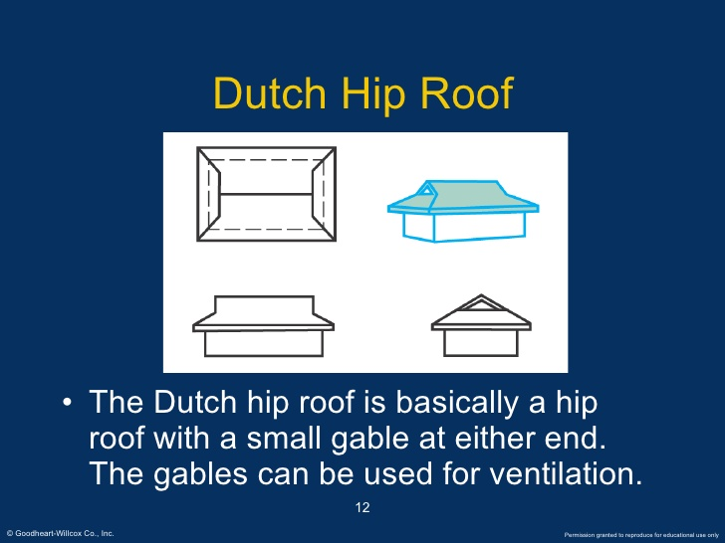

Slide 6
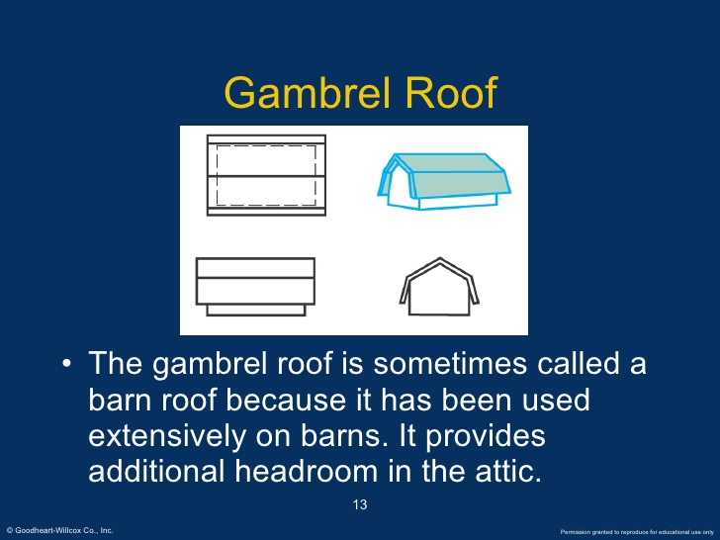

Slide 7
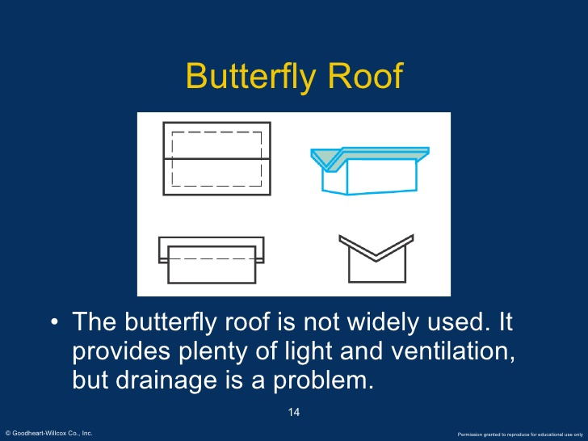

Slide 8
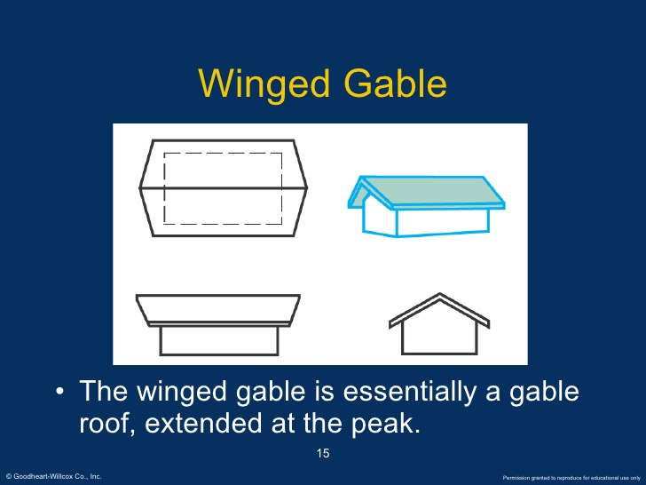

Slide 9
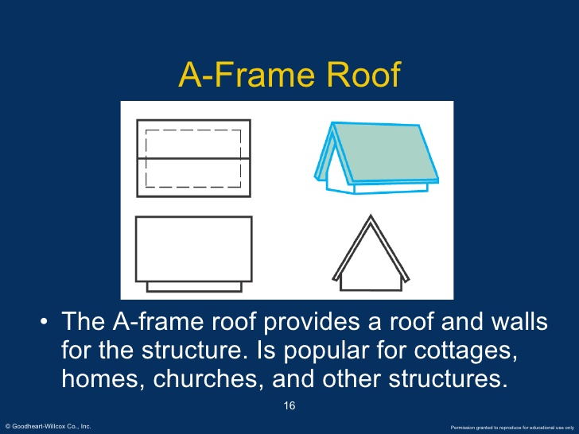

Slide 10
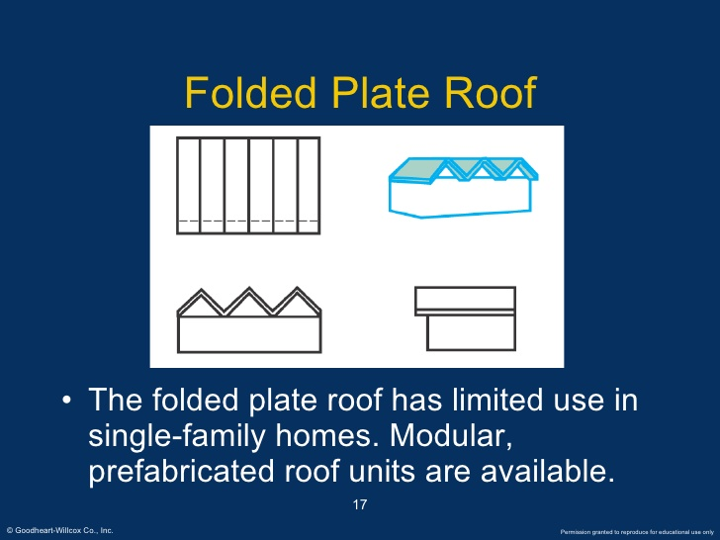

Slide 11
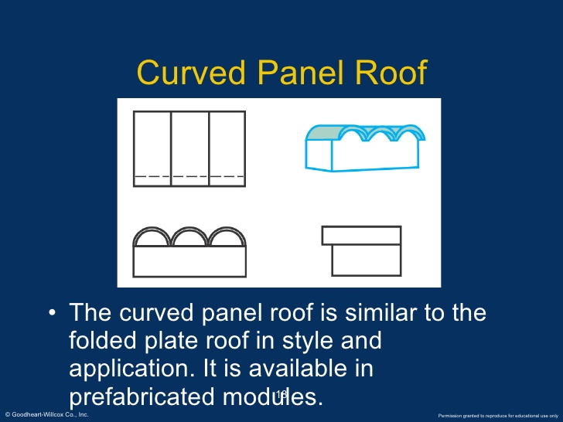

Slide 12
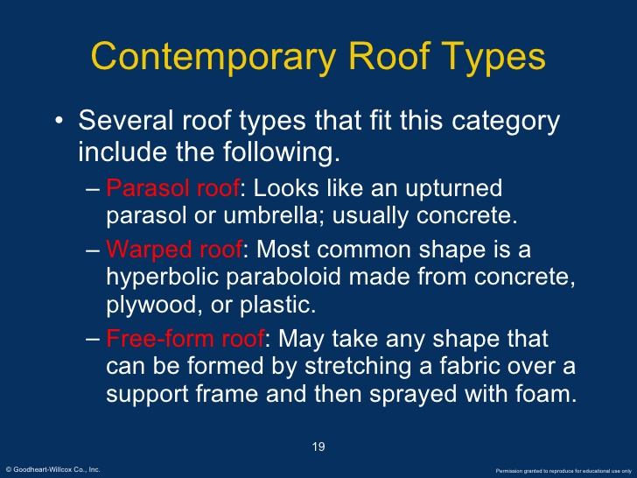

Slide 13
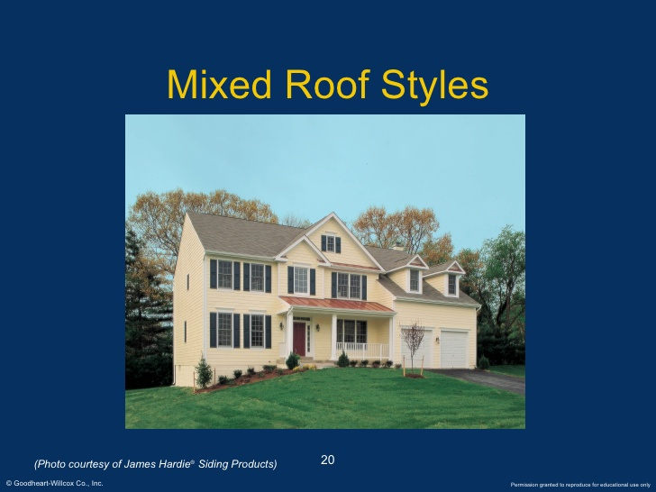

Slide 14
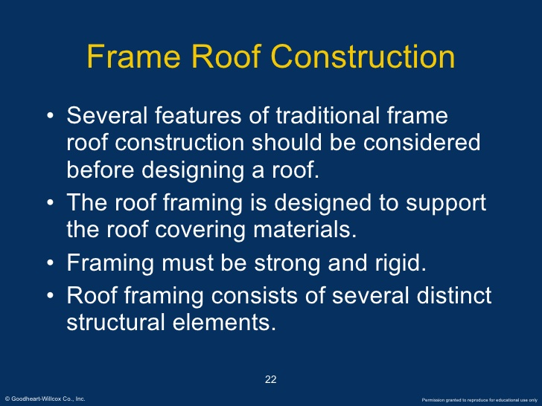

Slide 15
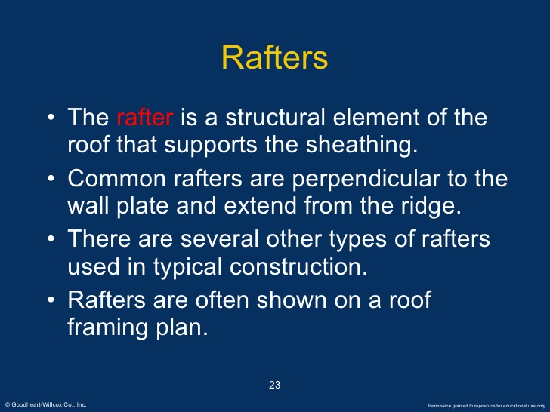

Slide 16
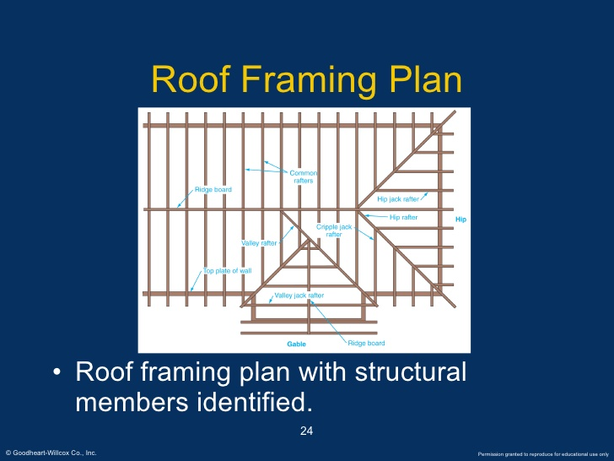

Slide 17
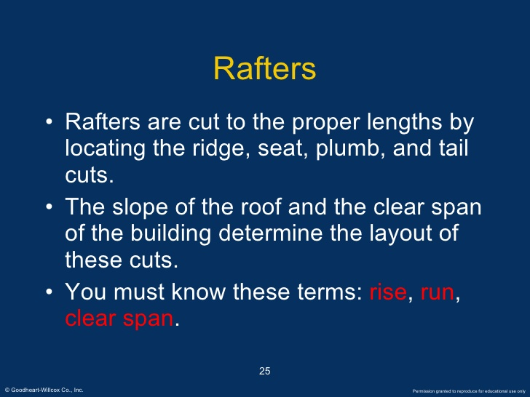

Slide 18
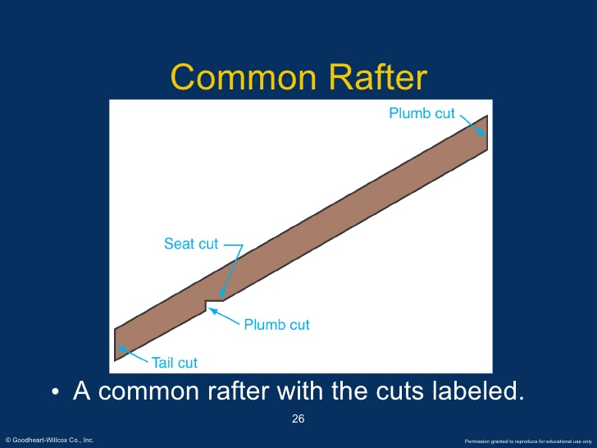

Slide 19
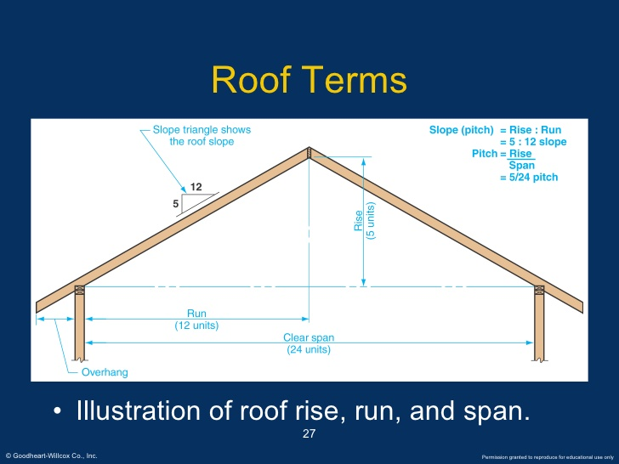

Slide 20
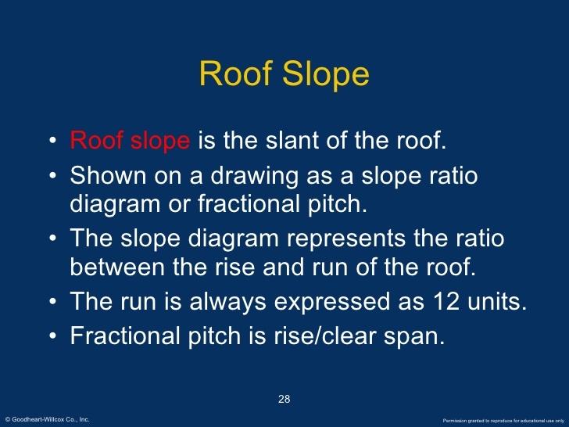

Slide 21
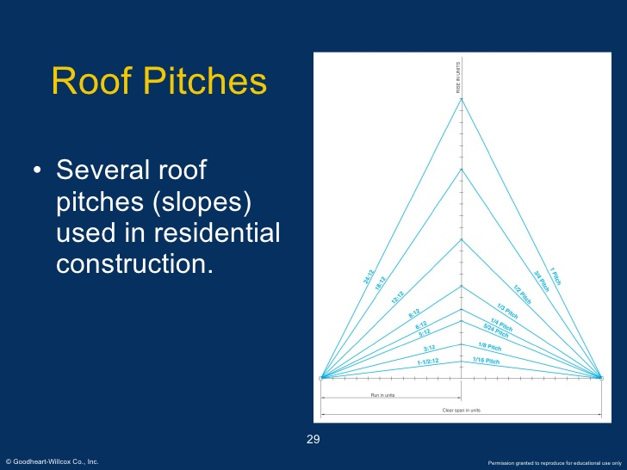

Slide 22
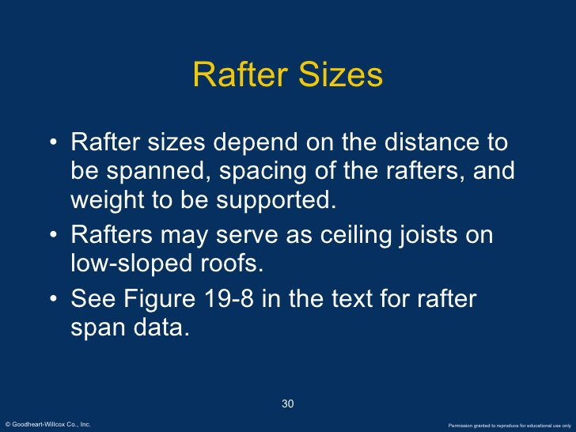

Slide 23
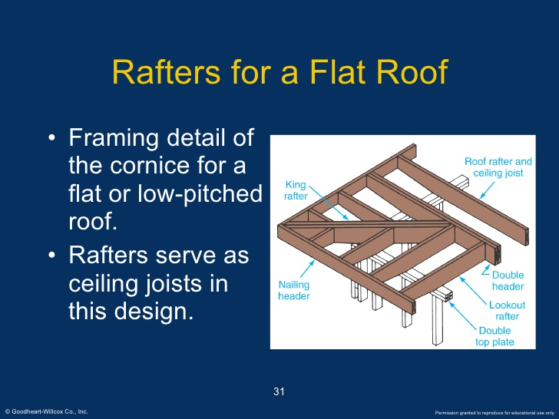

Slide 24
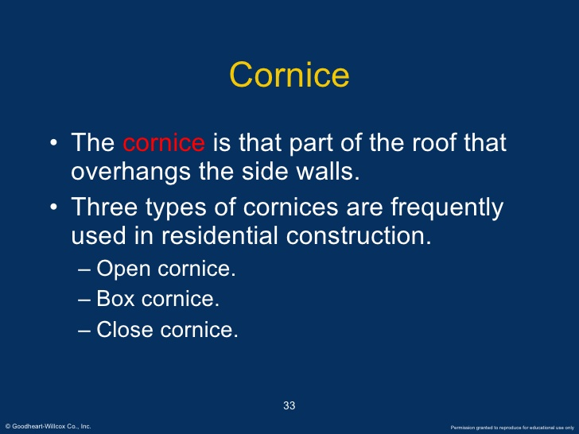

Slide 25
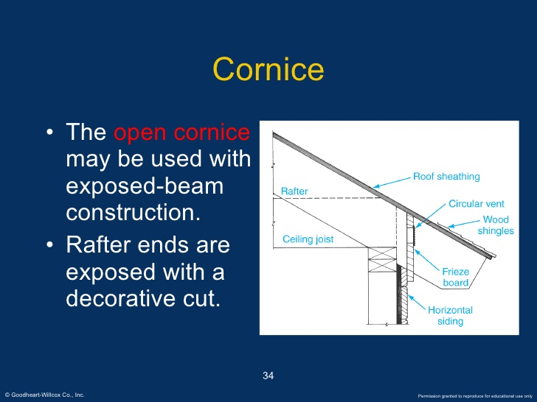

Slide 26
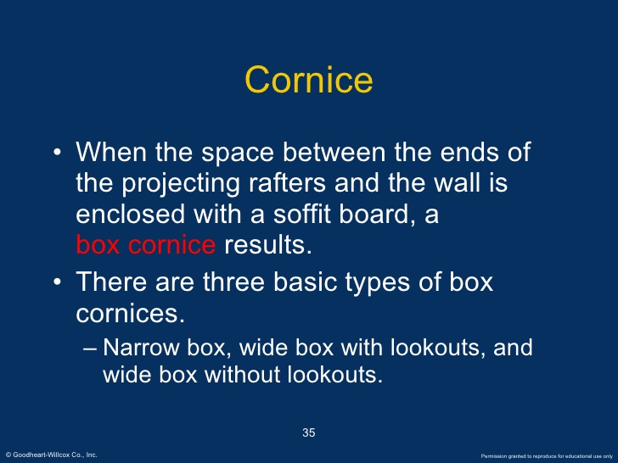

Slide 27
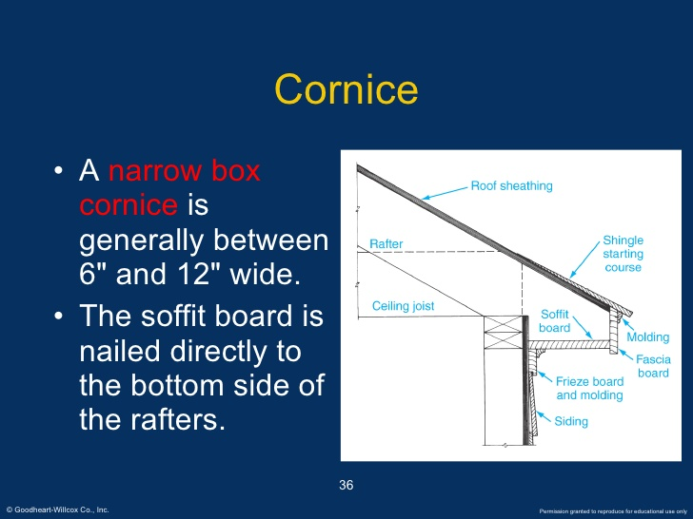

Slide 28
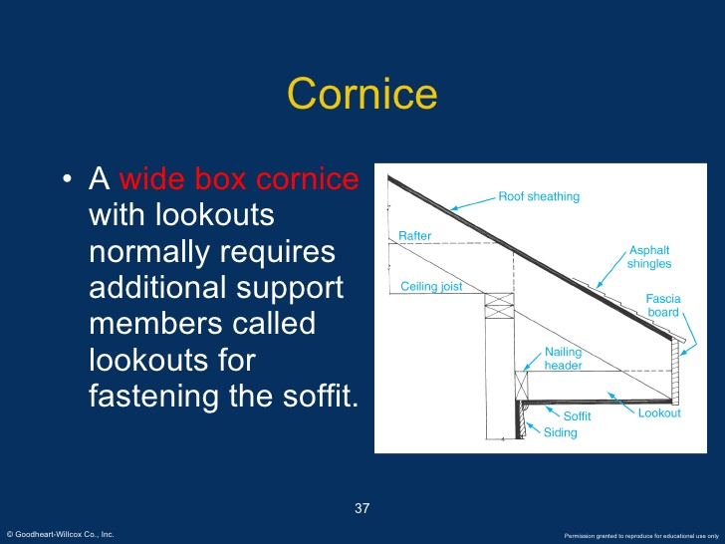

Slide 29
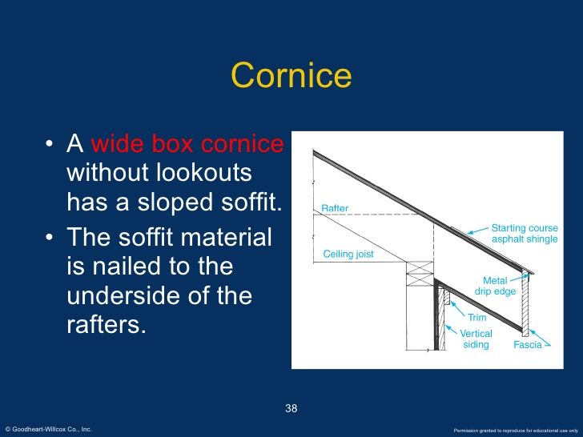

Slide 30
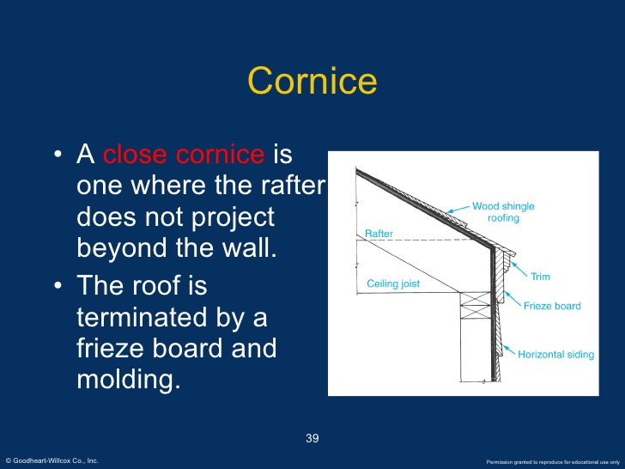

Slide 31
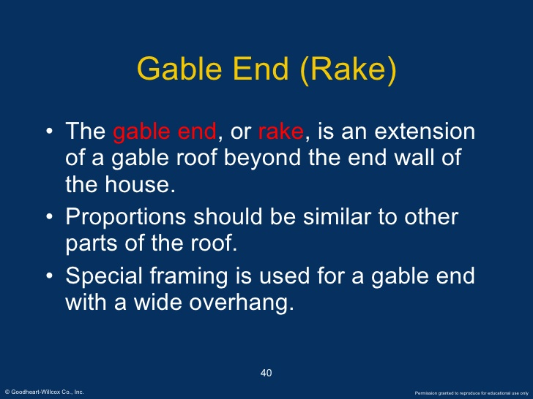

Slide 32
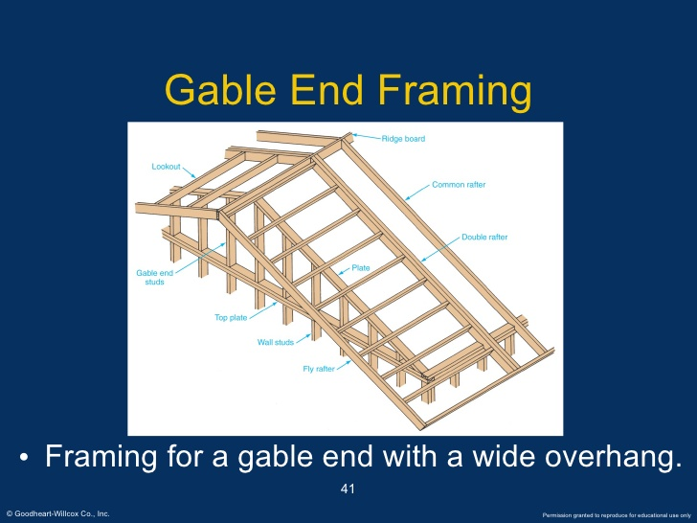

Slide 33
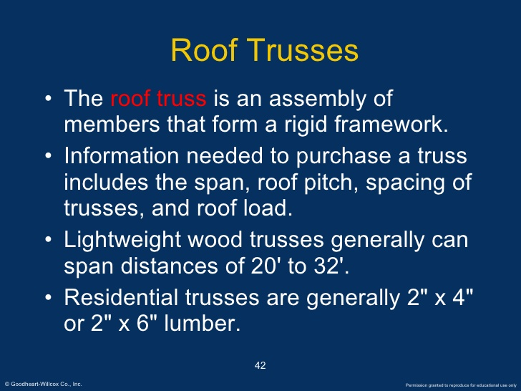

Slide 34
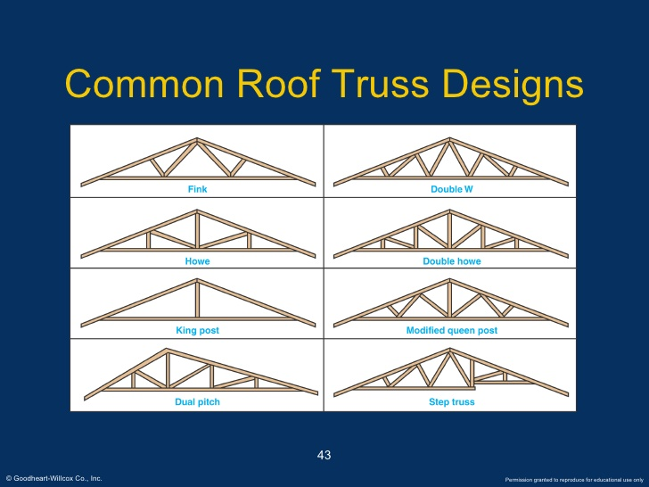

Slide 35
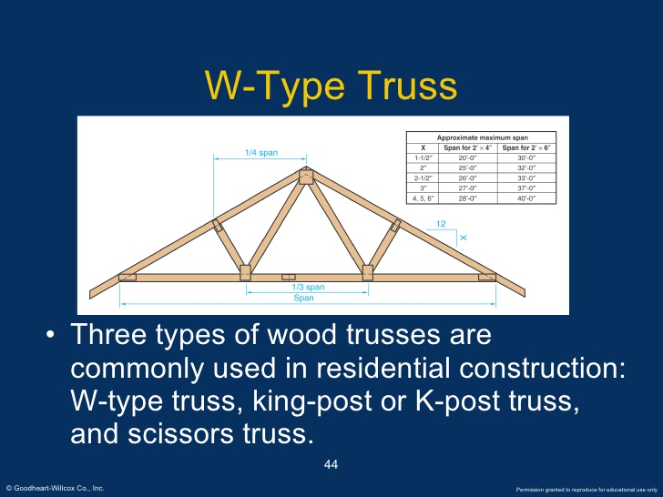

Slide 36
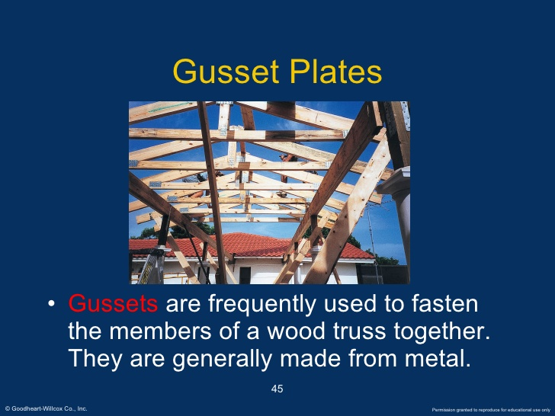

Slide 37
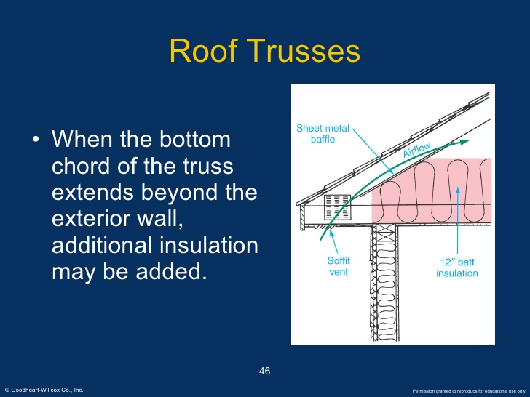

Slide 38
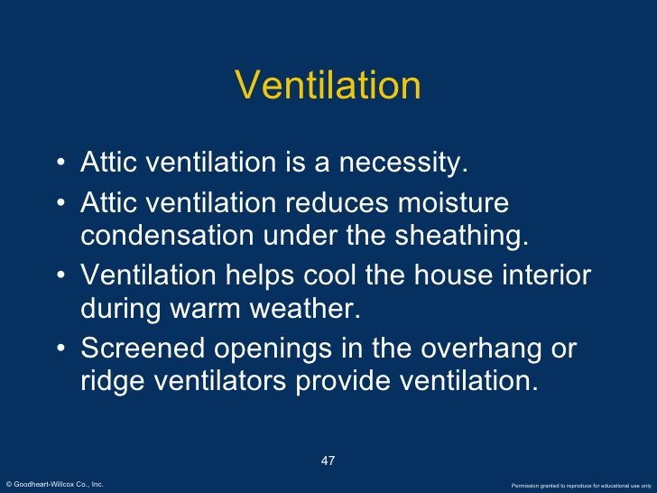

Slide 39
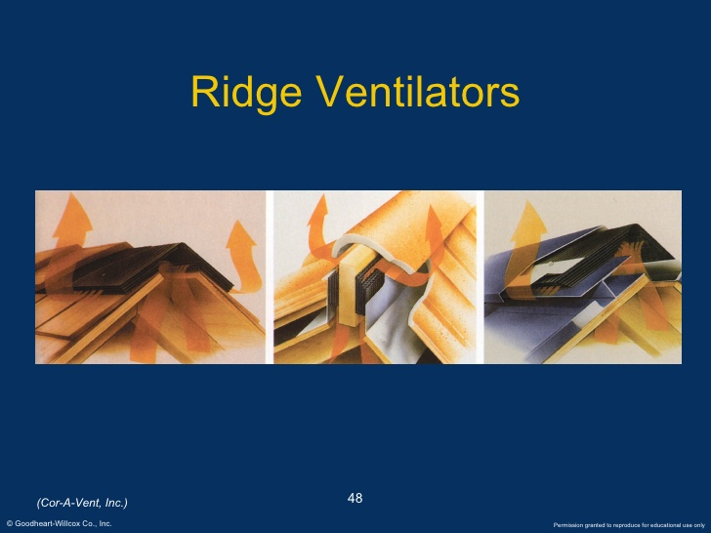

Slide 40
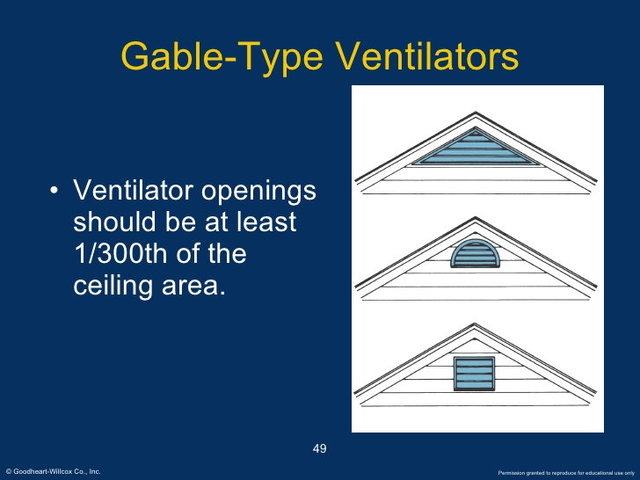

Slide 41
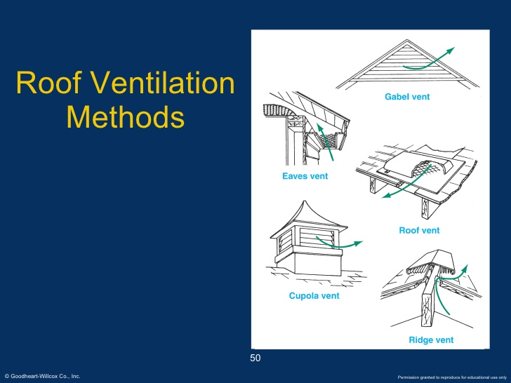

Slide 42
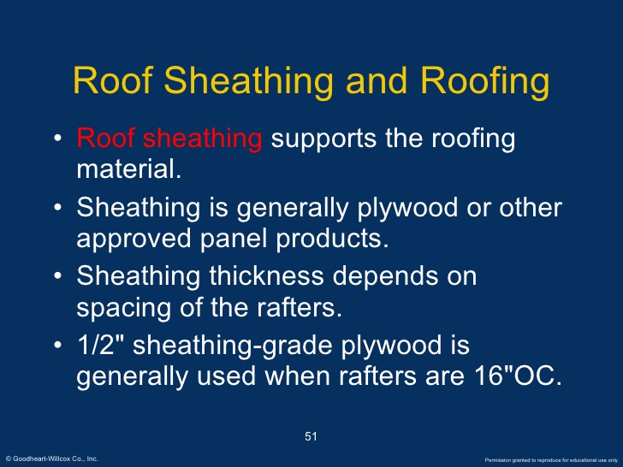

Slide 43
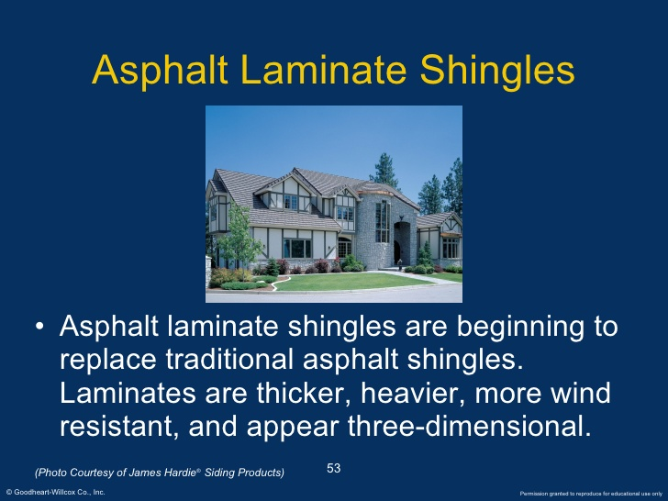

Slide 44
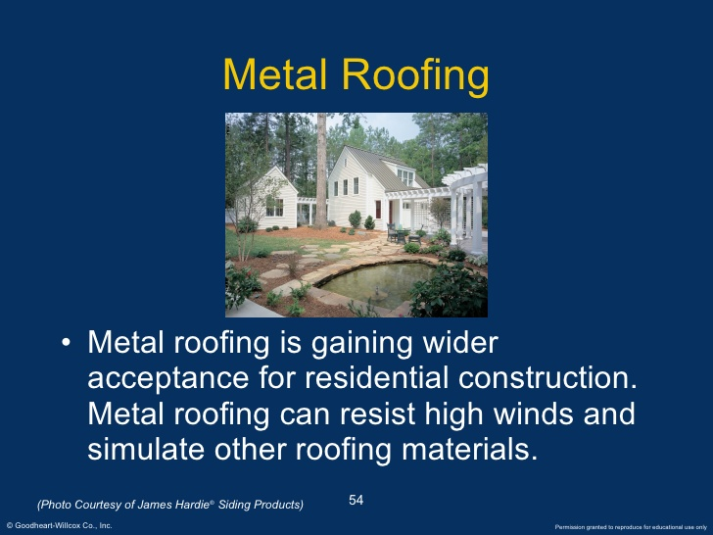

Slide 45
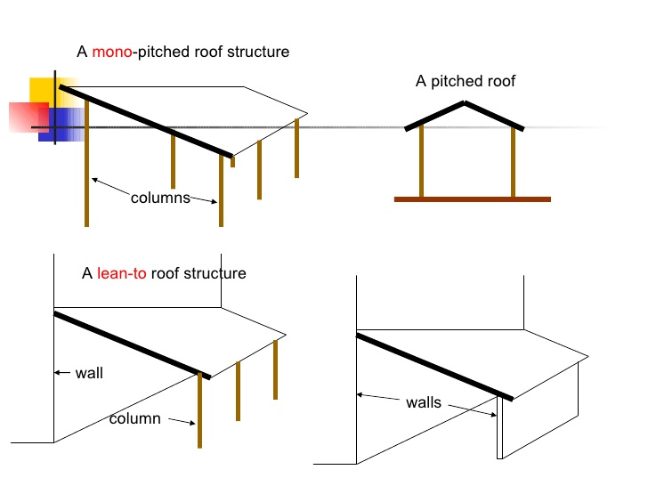

Slide 46
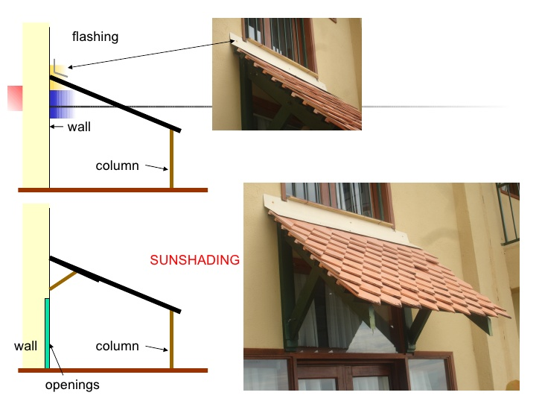

Slide 47
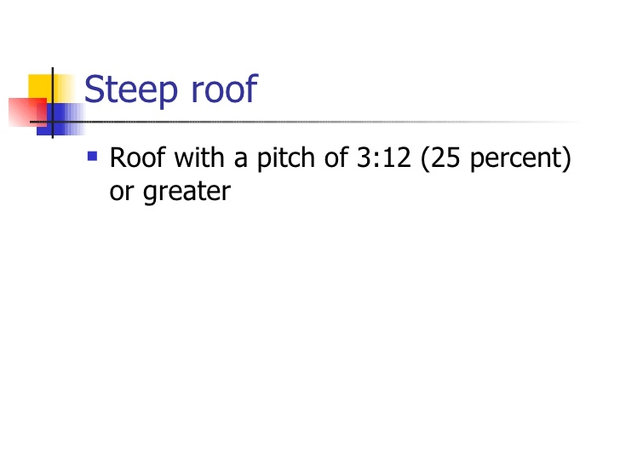

Slide 48
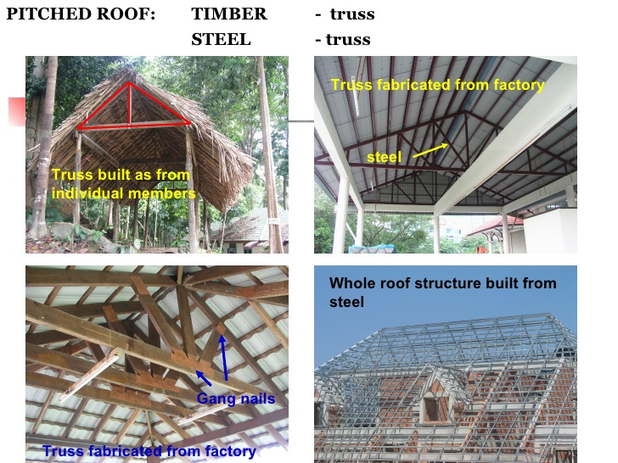

Slide 49
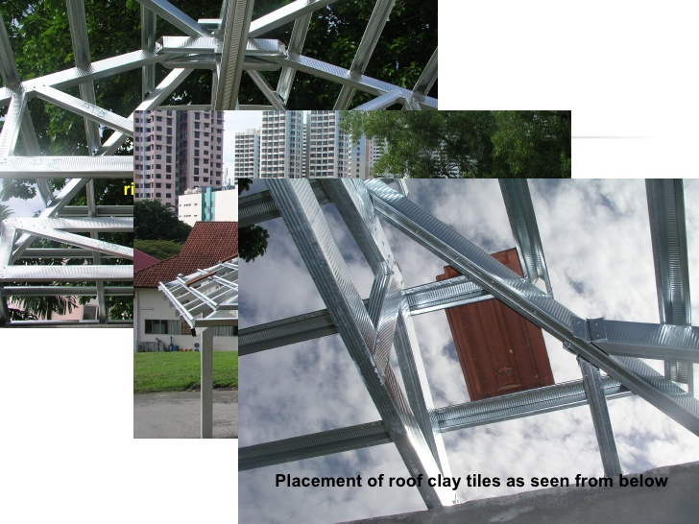

Slide 50
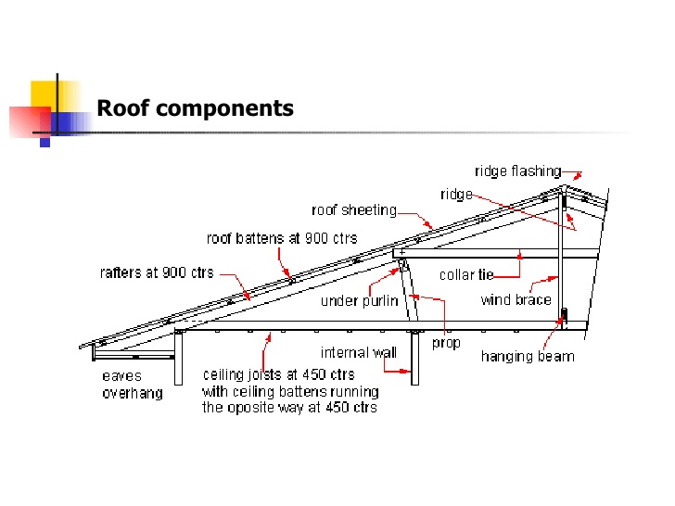

Slide 51


Slide 52


Slide 53


Slide 54


Slide 55


Slide 56


Slide 57


Slide 58


Slide 59


Slide 60


Slide 61


Slide 62


Slide 63


Slide 64


Slide 65


Slide 66


Slide 67


Slide 68


Slide 69


Slide 70


Slide 71


Slide 72


Slide 73


Slide 74


Slide 75


Slide 76


Slide 77


Slide 78


Slide 79


Slide 80


Slide 81


Slide 82


Slide 83


Slide 84


Slide 85


Slide 86


Slide 87


Slide 88


Slide 89


Slide 90


Slide 91


Slide 92


Slide 93


Slide 94


Slide 95


Slide 96


Slide 97
Trusses
2
•Fabricated from various steel sections available, jointed together by welding or by bolting usually via gusset plates.
•Plane trusses and space trusses.
•Bridge trusses and roof trusses.
•Members supporting heavy loads
•Members having longer span.
•Saving in weight.

Slide 98

Roof truss

Slide 99

Supporting truss

Slide 100

Bracing truss

Slide 101

Space truss - Truss System

Slide 102

Singapore Esplanade theatre

Slide 103


Slide 104
Roof Truss
▪Roof rafters spanning more than 20 m can be designed
▪Usual span-to-depth ratio of steep roof trusses is 7.5 to 12
▪Panel width should be constant
▪Even number of panels avoids cross-braces
▪Diagonal web members should be in tension under worst-case loading
▪Inclination angle of the diagonals should be between 35° and 50°
▪If at all possible, the purlins and verticals should closely coincide

Slide 105

Usual range of depths of roof trusses

Slide 106

Approximate mass for roof trusses

Slide 107

Approximate mass for roof trusses

Slide 108

(a)centre of gravity lines intersect at the node;
(b)eccentric connection can be a practical way of detailing but additional bending stresses are induced

Slide 109

(a) to (f ): commonly used in welded construction (though (a), (c), (d) and (e) may be bolted) (g) to (k): common sections used for chord and web/diagonal members

Slide 110

(a) Gussetless construction using Tee-chords; (b) gussets are required where diagonals carry large forces; (c) Tee-diagonals and chords, gussetless; (d) and (e) node detail for heavy trusswork, and (f ) riveted/bolted nodes

Slide 111

(a) portal-type Pratt truss (b) Fink truss with large eaves overhang (c) alternative chord cross-sections

Slide 112

(a) sandwich plate splice; (b) sandwich plate splice at chord reduction; (c) jacket splice; (d) welded butt splice; (e) welded butt splice with reducer, and; (f ) flange splice

Slide 113

(a) Direct contact overlap connection without eccentricity; (b) direct contact overlap connection with eccentricity; (c) direct contact gap connection with/without eccentricity (with chord face reinforcing plate shown—without reinforcing plate is very common); (d) T-joint with chord face reinforcing plate (for very heavy loads—otherwise no reinforcing plate is also popular); (e) connection detail at support (note vertical stub portion with flange splice for lifting onto support); (f ) concentric reducer where chord section is stepped down (alternatively, if the overall section is not stepped down then the wall thickness is reduced—the latter applies for RHS/SHS); (g) slotted-gusset connections; (h) flattened end connections, and; (i) slit tube connections.

Slide 114


Slide 115


Slide 116


Slide 117


Slide 118


Slide 119


Slide 120


Slide 121


