Slide 1
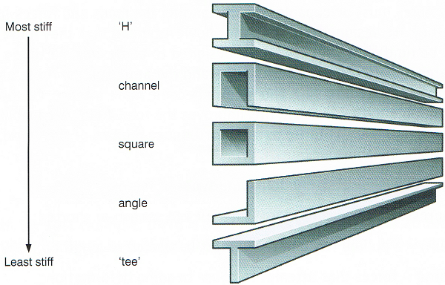
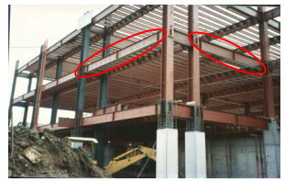
TYPES OF BEAM STRUCTURES AND THEIR USES

Slide 2
introduction
A beam is a structural element that is capable of withstanding load primarily by resisting bending. The bending force induced into the material of the beam as a result of the external loads, own weight, span and external reactions to these loads is called a bending moment.
Beams are traditionally descriptions of building or civil engineering structural elements, but smaller structures such as truck or automobile frames, machine frames, and other mechanical or structural systems contain beam structures that are designed and analyzed in a similar fashion
DEFINITION
A squared-off log or a large, oblong piece of timber, metal, or stone used especially as a horizontal support in construction
Notes:
A squared-off log or a large, oblong piece of timber, metal, or stone used especially as a horizontal support in construction

Slide 3
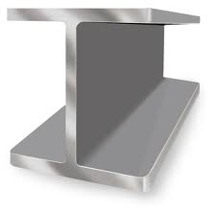
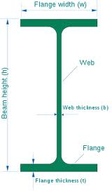
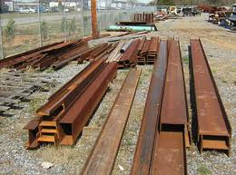
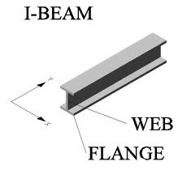
TYPES OF BEAM
Steel Beams
The best known type of construction beam is the I-beam, so named because of its shape when viewed from the side, reminiscent of the capital letter "I." I-beams are usually used in commercial construction, in everything from skyscrapers to stadiums, but can also be used in residential construction.

Slide 4
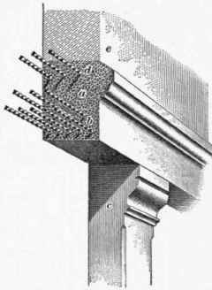
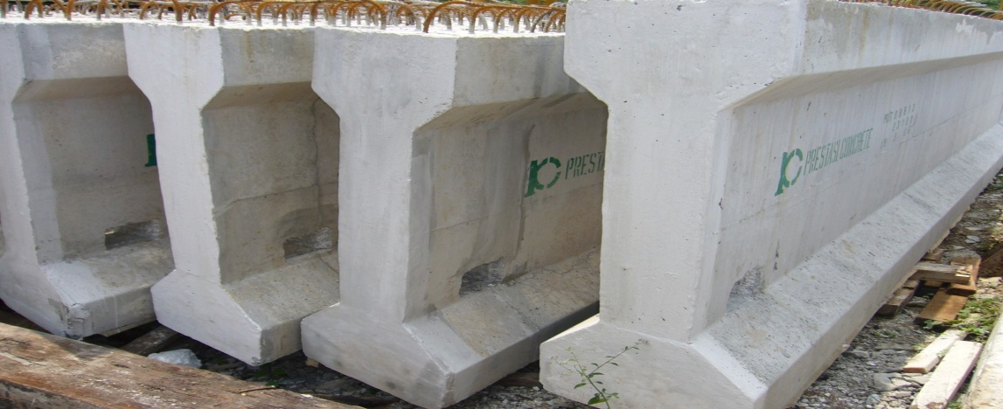
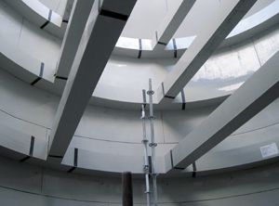
Rein-Forced concrete beams
A structural member of reinforced concrete placed horizontally to carry loads over openings.The methods of production are:CAST,PRECAST or a combination of the two.

Slide 5
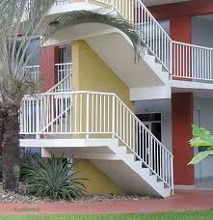
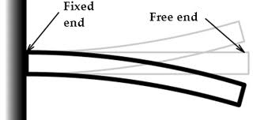
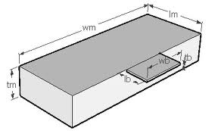
Cantilever Beams
Cantilever beams are used in bay windows, bridges and balconies. They manage to redistribute the weight from whatever structure they are holding up to the main structural beams in the house or building to which they are connected.

Slide 6
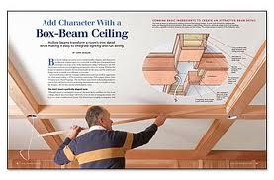
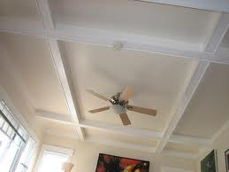
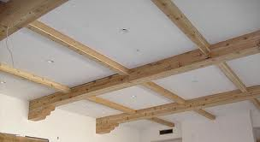
Box Beams
Box beams are made by taking a piece of plywood and nailing and/or gluing it to pieces of 50mm-by-100mm or 50mm-by-150mm lumber, in essence created a long box-like structure

Slide 7
FUNCTION:
To help support the building. also to build up the building bigger or taller depending on the size of the beam. They provide support for floors and ceilings, and come in a variety of forms
USES:
1. I-beams are usually used in commercial construction, in everything from skyscrapers to stadiums, but can also be used in residential construction.
2.redistribute the weight from whatever structure they are holding up to the main structural beams in the house or building to which they are connected.
3.In residential architecture, cantilever design is often used for creating balconies and other extensions above ground level

Slide 8
4.Used as major support trusses in building, to ensure that a structure will be physically sound.
MATERIALS
● STEEL
●TIMBER
●REINFORCE-CONCRETE
●PRECAST CONCRETE

Slide 9
ADVANTAGES
● Advantage of box beams is that they are less expensive than beams constructed solely of metal.
● In box beam offers better resistance to torsion
●Beams(concrete,steel,etc) can withstand very heavy loads.
●Because the weight of the structure is supported by posts that are spaced relatively far apart, post and beam construction allows for large expanses of glass. Consequently, post and beam houses often feature large windows. Furthermore, post and beam houses usually feature high vaulted ceilings, creating a large, room living space.

Slide 10
disadvantages
●Termites and similar kinds of wood-eating insects can quickly and severely damage a wood house.
●Uncontrolled moisture in basements and crawl-spaces will promote wet rot and dry rot, two related fungal decays.
●Steel construction costs more.
●You will need a deputy inspector at the job site whenever on-site welding takes place. You will need to book him in advance, and the site may effectively shut down until he becomes available.
●Lifting precast concrete members into place usually requires large cranes; these also add to the cost of construction
●Concrete is naturally very strong againt compression but not so strong in tension.

Slide 11
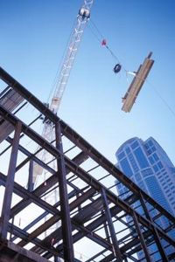
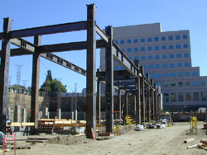
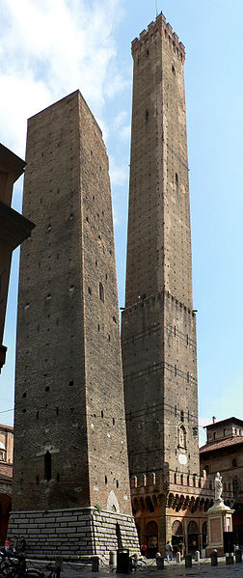
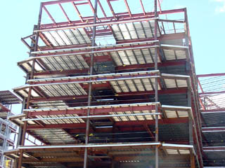
Case study
Ronald reagan ucla medical center
The two towers of Bologna
In the 12th century. reached 97.2m
In height

Slide 12
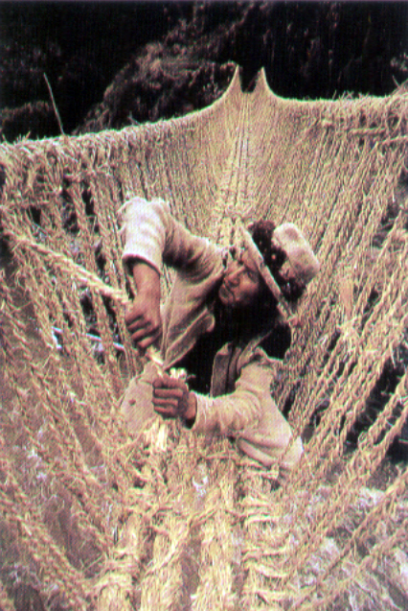
THE ORIGINA OF
TENSILE ARCHITECTURE
Amongst the very first man-made artefacts were the simple shelters used by hunter gathers more than a hundred thousand years ago. Like their other tools, these shelters were made from the by-products of their hunting activities. The remains of these simple shelters, skin-clad building with bone or timber frames, and more sophisticated buildings grouped into organised settlement , have been found at archaeological sites all over the word. More recent vernacular architecture of nomadic peoples also makes use of tensile structures.

Slide 13
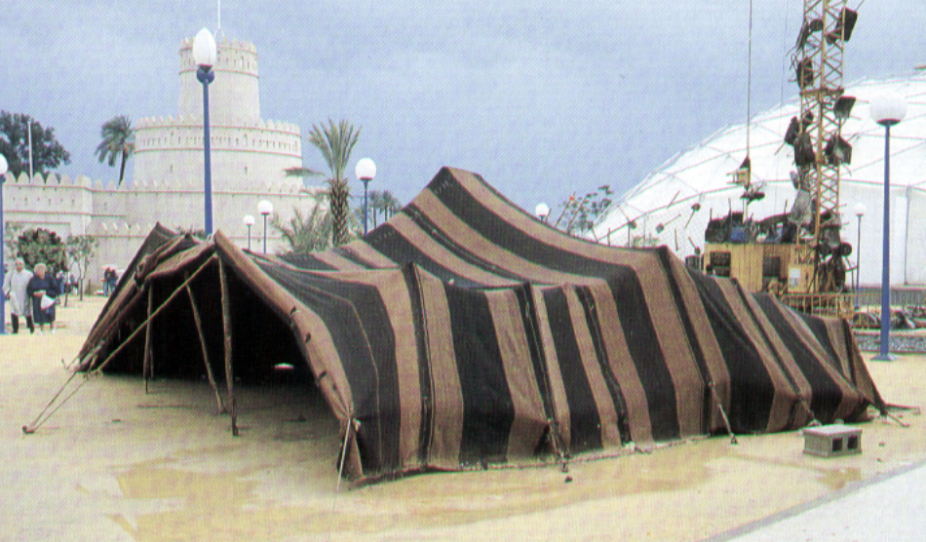
The North American teepee utilised bison skins as a covering for a conical framed structure, in fact a single cell of space frame. Though simple in form these buildings were sophisticated in their environmental modification and development characteristics, providing easily portable buildings suitable to a number of function and able to accommodate relatively wide extremes in weather conditions. In harsh climate are many types of tent , North Africa and parts of Asia with complex detailed differences in form and construction that related to social , cultural and economic practices.
More than five thousands years ago Mediterranean mariners had devised a method for harnessing the wind to propel their boats. The sailing ship utilises all the structural principles of tensile architecture pneumatic form in the sails tensile elements in the rigging and compressive support in the masts. The requirement for a strong, light weight structure in heavier-than-air flying machines also resulted in the exploitation of tensile systems.

Slide 14
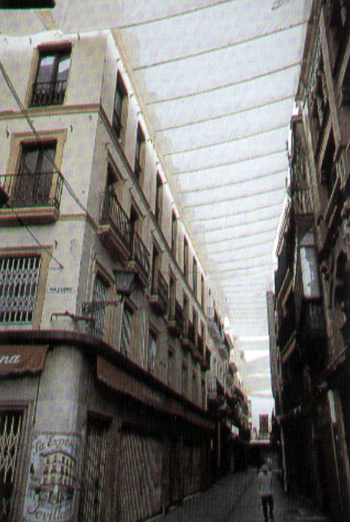
THE FIRST MANIFESTATION
OF TENSILE ARCHITECTURE
The Roman velarium was a fabric covering
suspended from masts over auditorium
such as the Colosseum in Rome.
Office of the English Monarch, in 1520
“Toldos” The narrow Streets of the Spanish
city Seville
All these structures undoubtedly used skills
and materials acquired from shipbuilding
in their construction:
Rope and canvas, and structural
techniques developed for raising
large, though relatively lightweight, objects
quickly and efficiently.
Early tents used a simple umbrella shape
like Henry VIII’s banqueting house.

Slide 15
WHY USE OF TENT STRUCTURE?
Fabric structures have been used in many permanent buildings for almost 30 years. Some of these applications are significant for their size or importance. Their form is a critical aspect of their efficiency.
The reasons for selecting a fabric structure often include their speed of erection, use of daylight, reflection of heat from the sun, dispersal of interior sound, the beauty of the interior space, and the excitement of the exterior sculpture.

Slide 16
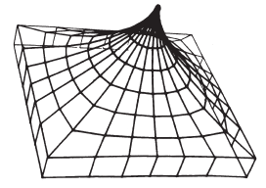
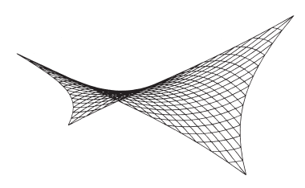
SIMPLE FORM OF TENT
Point-supported structures
Fig. 2. A minimum of four supports is required to generate a tensile structure surface. Using an orthogonal grid this four-point-structure is
the basic form. Cables are along the edges only.
Fig. 1. The alternate principal form, using polar coordinates, is the radial tent. In this form the ring lines represent the fabric which rests in radial cables. The edges could be catenaries.

Slide 17
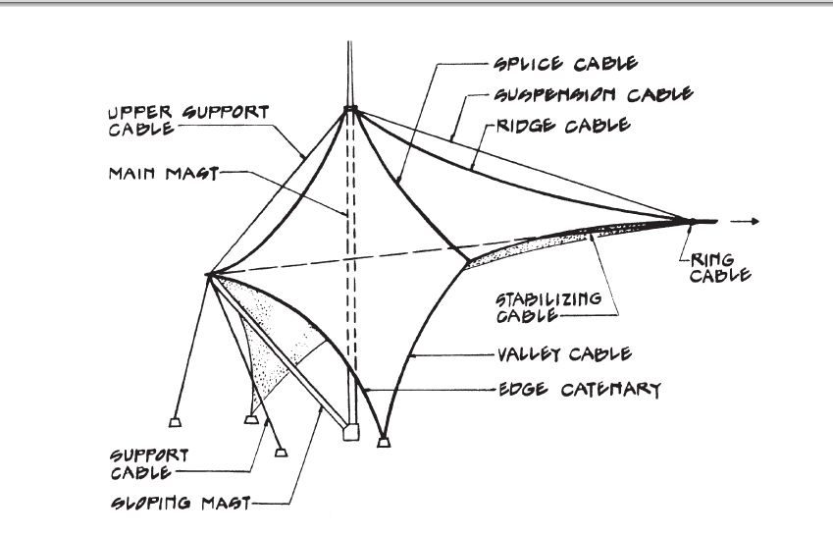
Fig. 3. This diagram of one of the 24 units of the Riyadh Stadium roof shows all the components. Structurally the fabric surface functions are repeated by cables to allow erection, replacement, and redundancy.

Slide 18

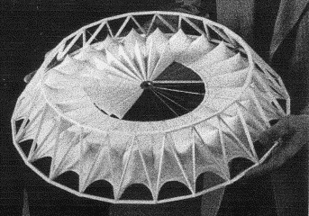
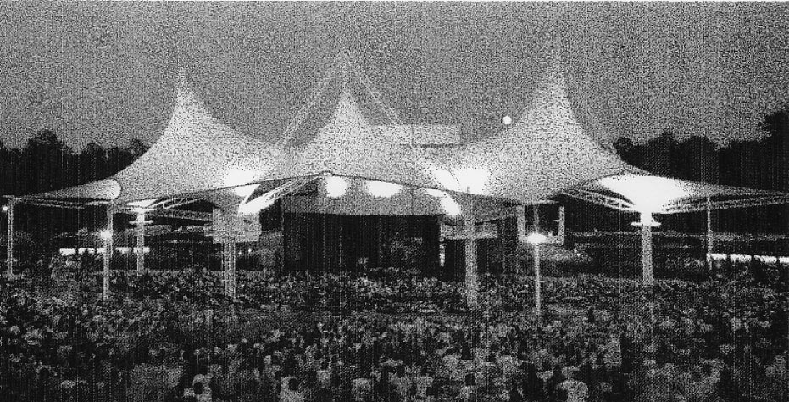
A-frame supported structures
Fig. 4. The Mitchell Performing Arts Centre near Houston, Texas. Three tent units are supported by A-frames. Trussed struts under the roof balance the horizontal forces. The 2600 m2 covers 3000 seats.

Slide 19
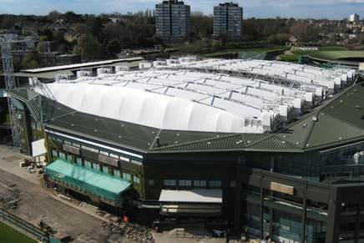
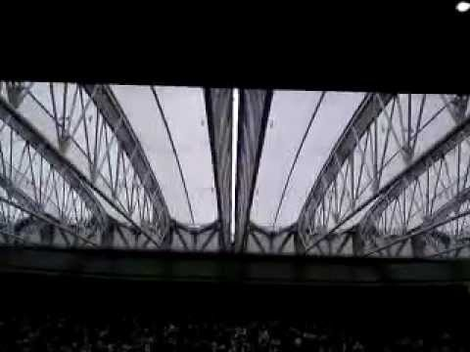
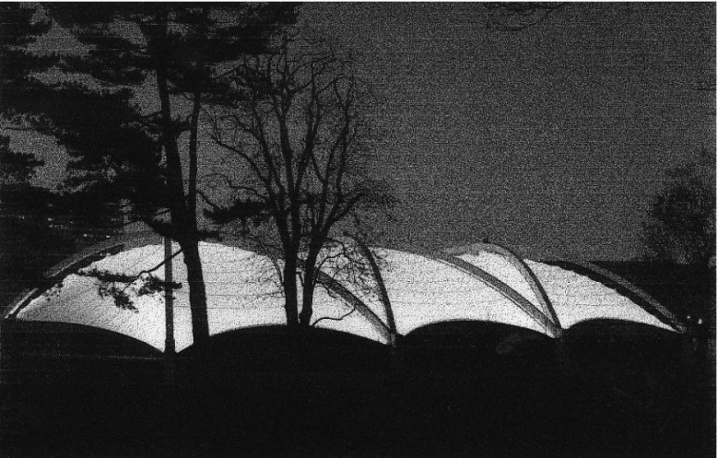
Arch-supported structures
Fig. 5. The Wimbledon Indoor Tennis Facility. The PVC-coated polyester fabric membrane hangs from precast concrete cross arches. Opaque fabric infill panels close the space between fabric roof and rigid side walls.

Slide 20
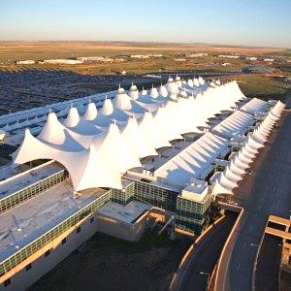
Completed in 1994, is an important public building space enclosed by a fabric structure. demonstrates the use of fabric tensile architecture on a large scale. Extreme light weight, daylight, energy savings, internal sound absorption, and speed of construction are among its positive features. Beyond that, it is a beautiful space to be in and a dramatic building to look at.
The terminal building
of the new Denver
International Airport

Slide 21
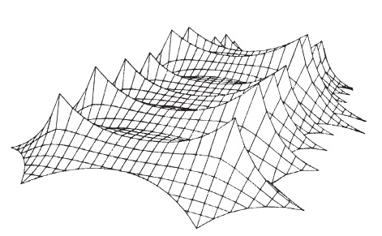
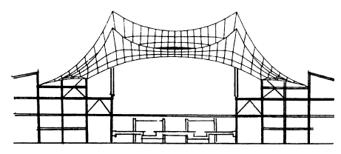
Fig. 6. The section through the Denver terminal shows ridge cables carrying downward loads and valley cables resisting upward loads.
Note the high and low modules of the fabric roof. Diagonals in the support framing assist in closing the path of horizontal forces.
Fig. 7. The membrane shape of the Denver roof (half model shown) is generated with the form-finding program developed by Horst Berger Partners. A given set of supports and a specific pattern of surface stresses yields one unique shape.

Slide 22
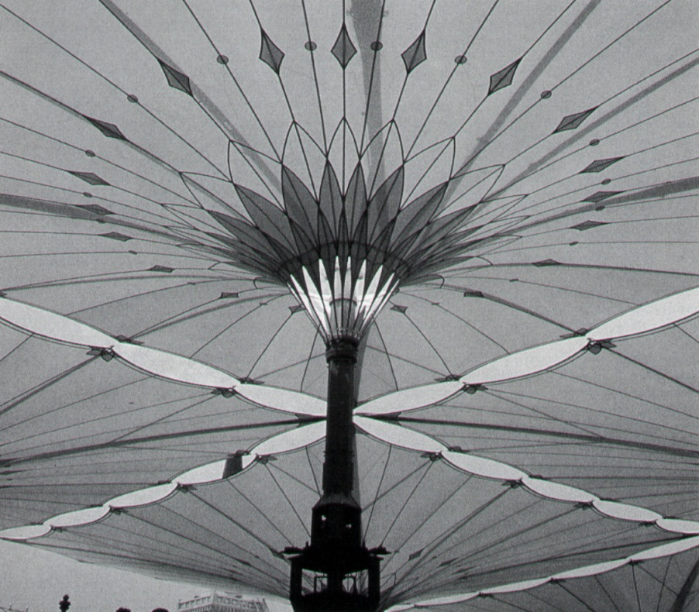
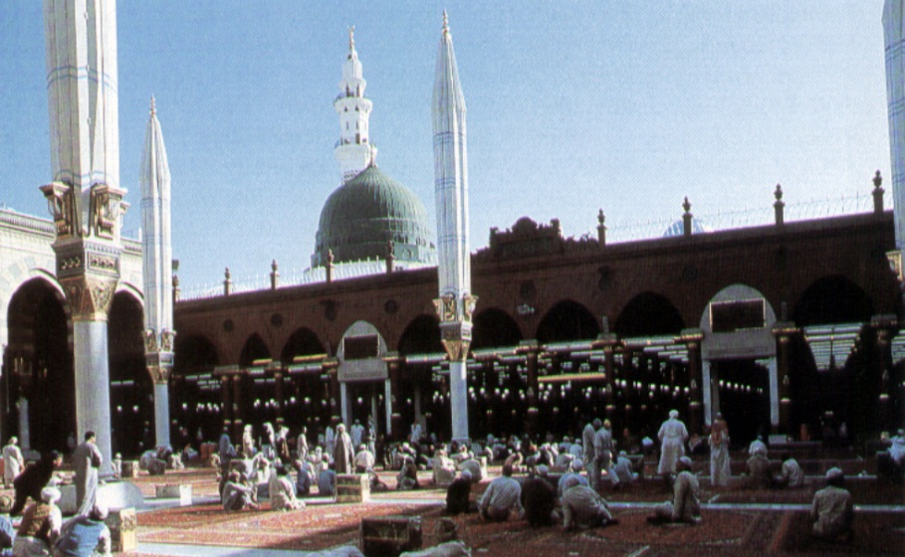
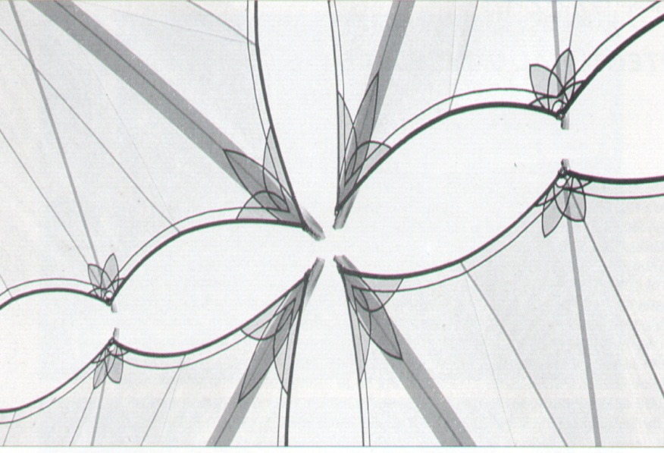
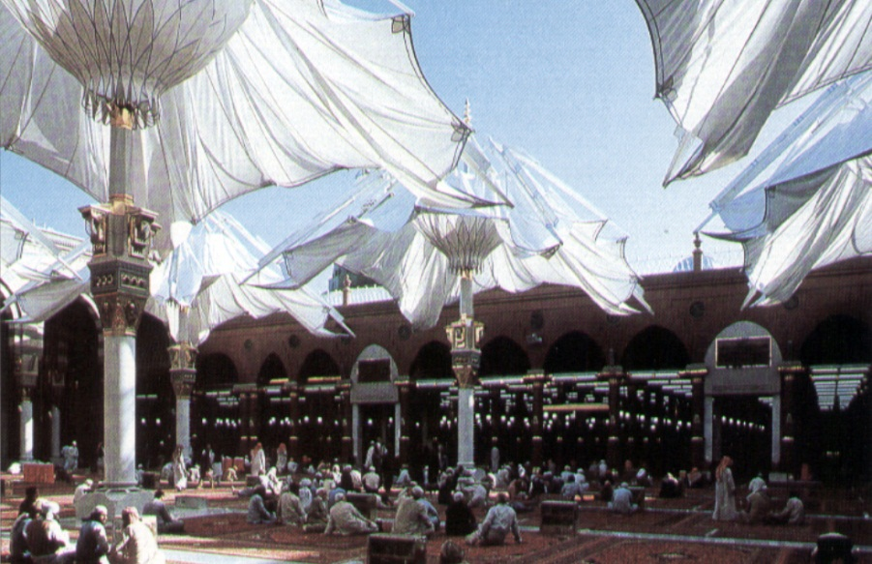
Bodo Rash
Architectural Umbrellas

Slide 23
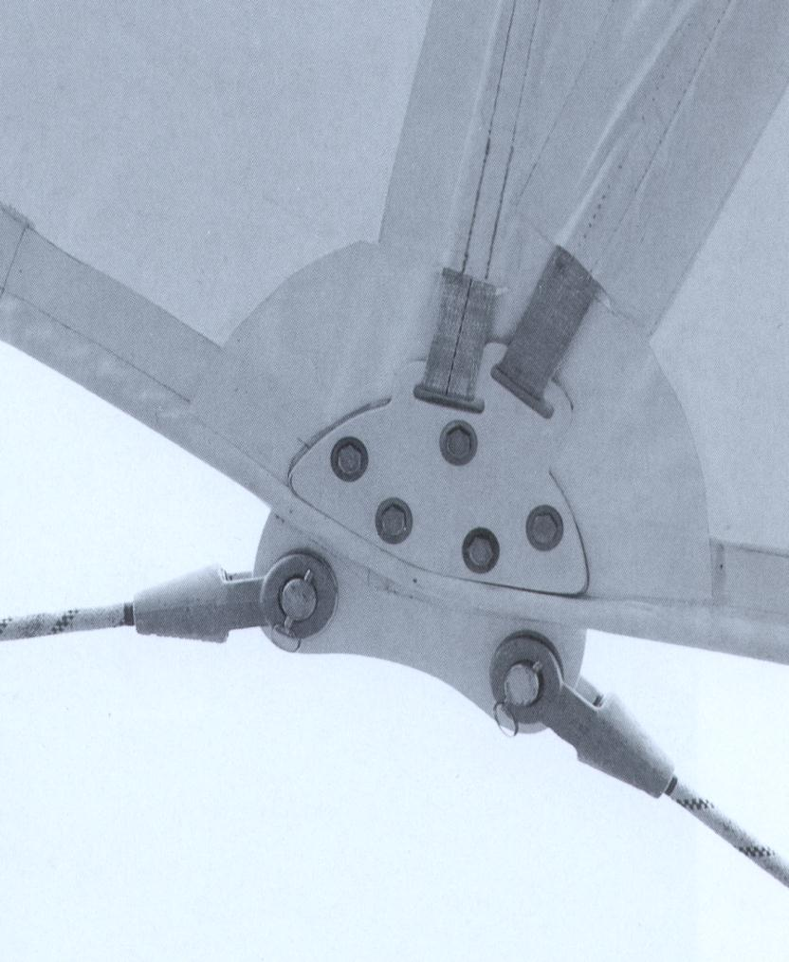
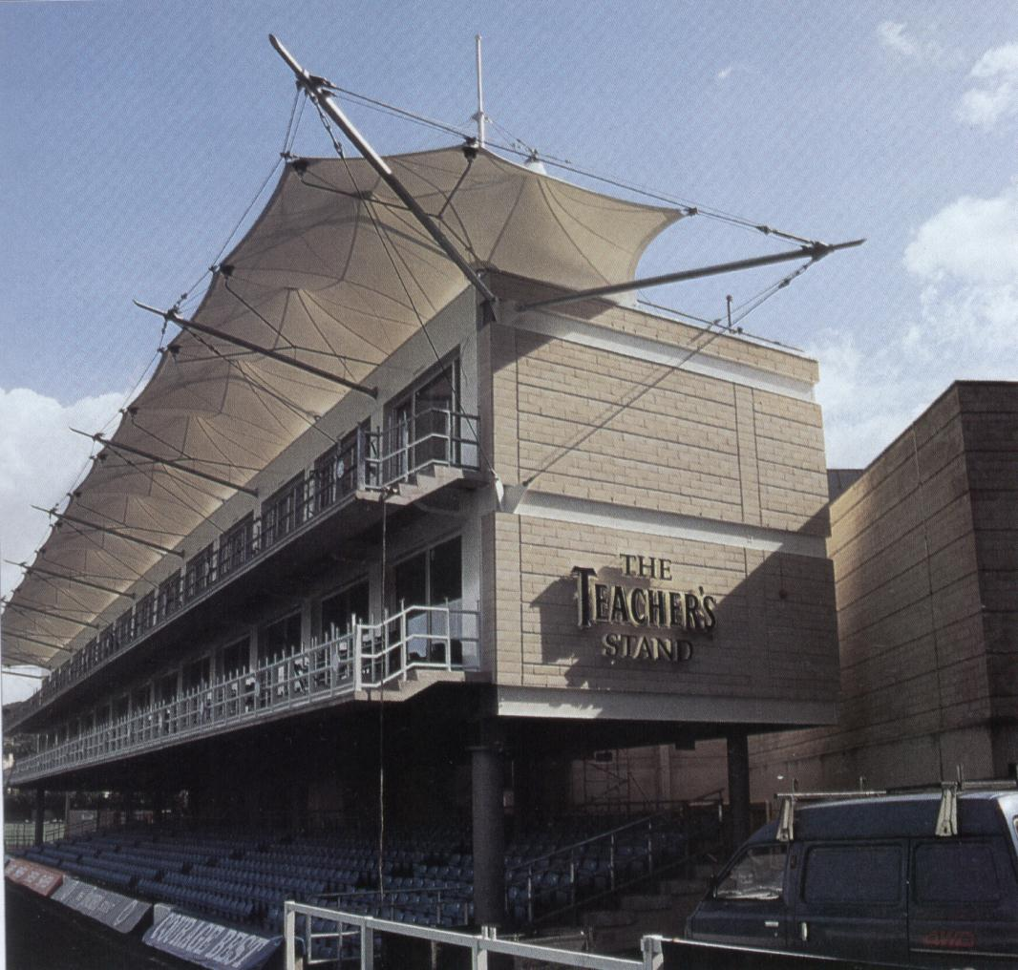
Teachers 'Stand, Bath Rugby Football Club

Slide 24
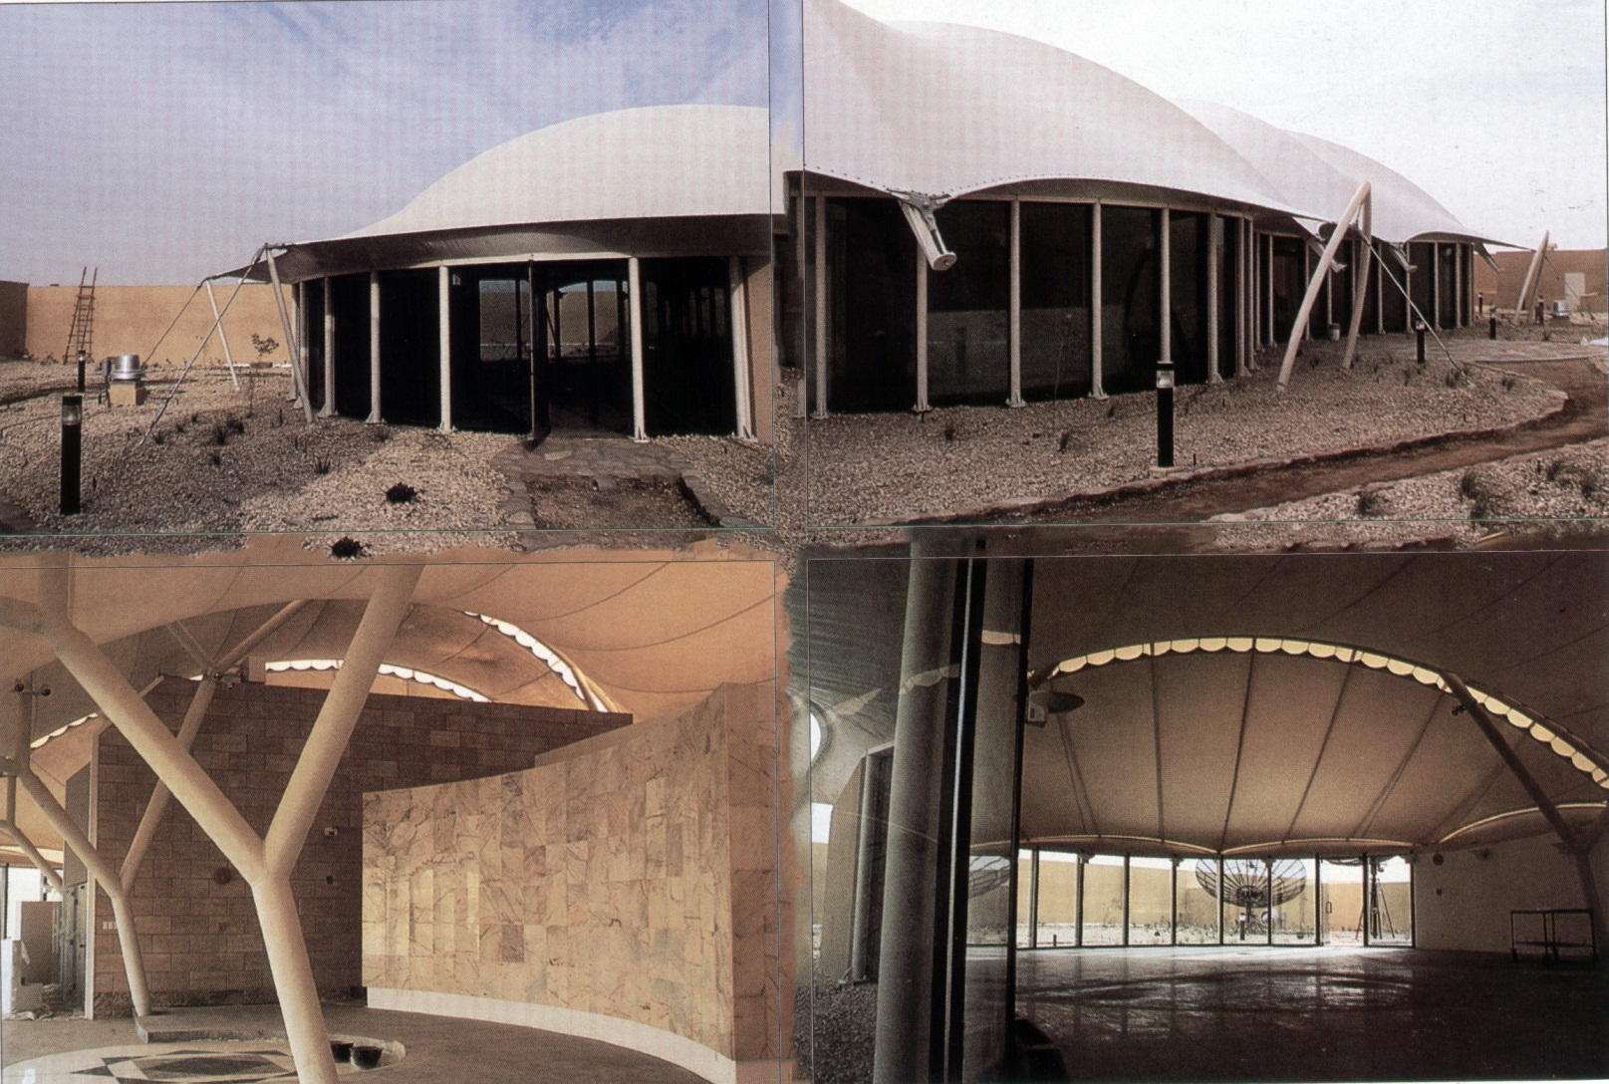
Rooftop recreation centre
Riyadh, Saudi Arabia

Slide 25
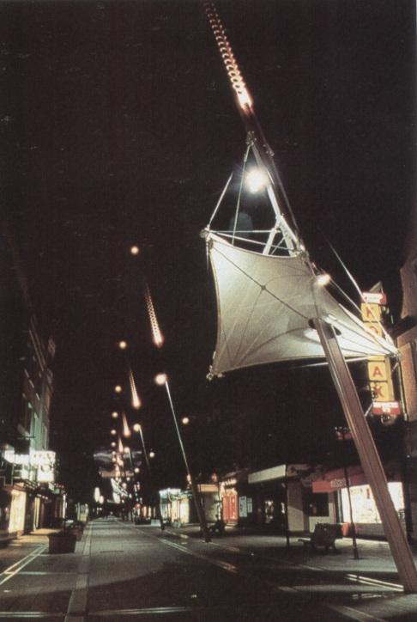
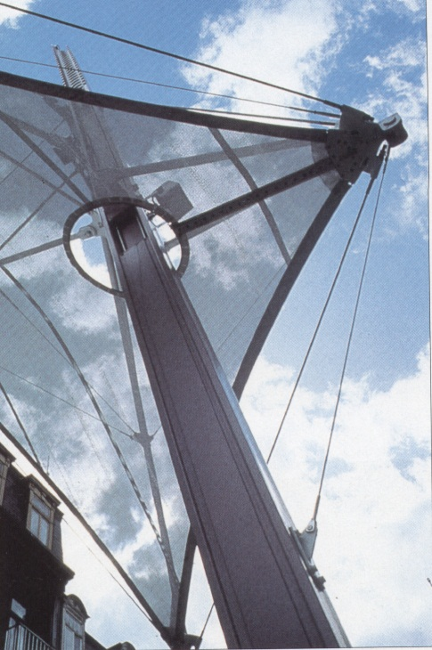
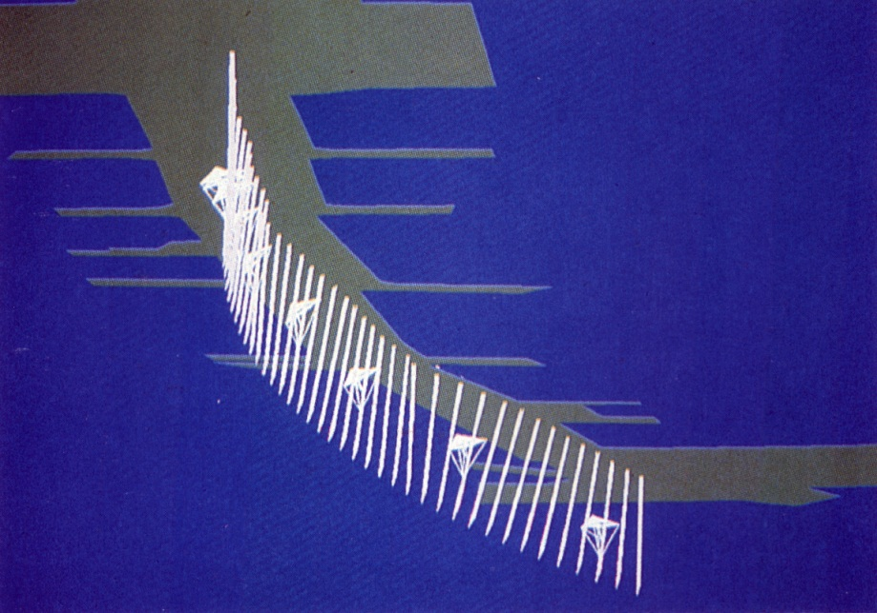
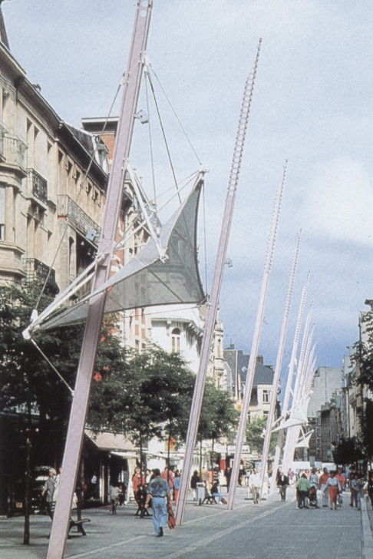
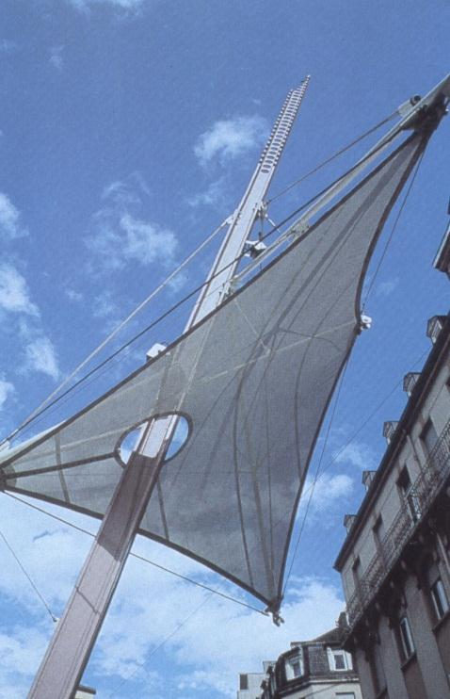
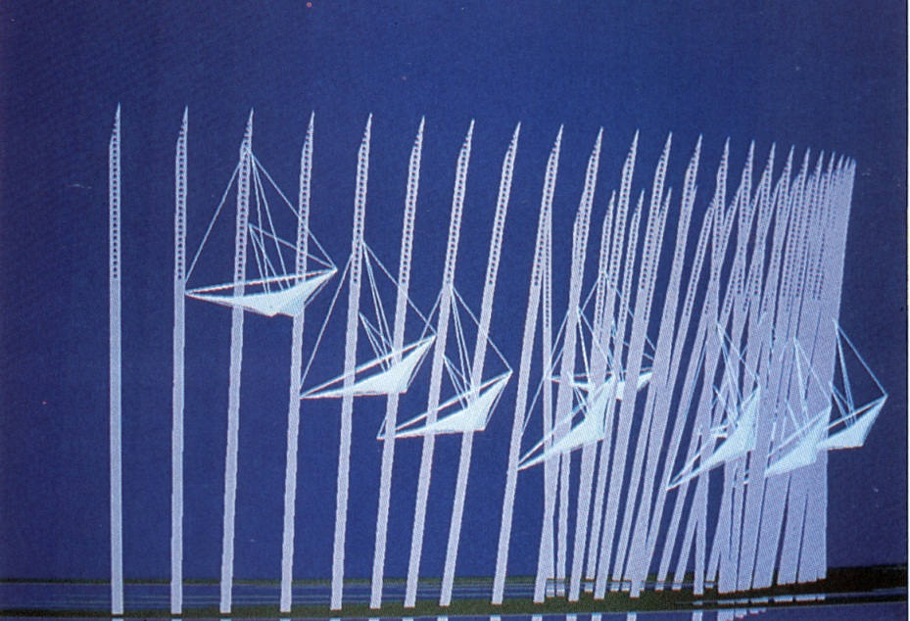
Light Masts
Esch,Luxemburg

Slide 26
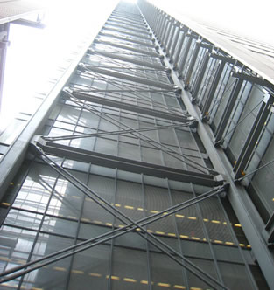
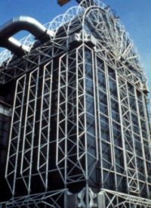
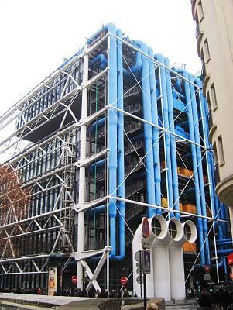
What is Exposed Structure ?
An exposed structure facade indicates that a building's structural framework is not covered.
A facade in which the structural framework is left uncovered or merely painted.
The aesthetic appeal of exposed structures, in which the structure becomes the architecture, can result in very expressive buildings that pose challenges to designers.

Slide 27
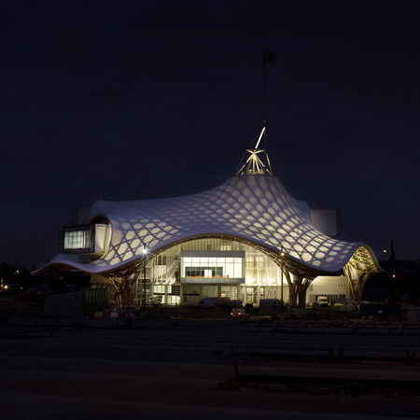
Centre Pompidou
in
France
2010

Slide 28

The Centre Pompidou-Metz was completed in May of 2010, designed by the offices of Shigeru Ban Architects Europe and Jean de Gastines Architects.
A museum of contemporary art in Metz, Architects programmed for three large exhibition and gallery spaces, auditorium, theatre and a central forum.

Slide 29


The specific focus of both the investigation and the model was the primary timber Glulam roof canopy and the central steel truss spire. Both act interdependently as gravity and lateral superstructure, and meet the foundation piles both directly and
indirectly through a concrete slab.

Slide 30


The roof canopy structure is laterally braced both by a hexagonal 77-meter truss spire and at four unique conditions at which the hexagonally gridded canopy, essentially acting as a timber space-frame system, deforms to become piers that meet four pile caps in the foundation.

Slide 31


Slide 32



Steel-to-Timber Connection
Inserting Connection plates

Slide 33



Connection Detail and Structural Diagram
Doweled Pin Connection

Slide 34



The moisture-resistant membrane of fiberglass and Teflon is stretched over the lattice structure and secured along the edge of the canopy, at the spire, and within each pier. The combination of the hexagon lattice framework made from laminated timber, and clean white tensile membrane is beautiful. Interior lights are transmitted through the membrane roof at night, emphasizing the laminated timber silhouette.
Tensile Membrane:

Slide 35

Seagram Building in
New York
1958

Slide 36

The Seagram Building in New York City is often cited as a pinnacle of corporate. Formally, Mies van der Rohe designed the Seagram Building as a glass box surrounded by vertical steel members.
Structural system of the building is steel grid frame and the façade system is bronze curtain wall.

Slide 37


vertical I-profile elements seems to hold up the building Even at the corners, where Mies pulls back the skin to allow the columns to peek out, the columns seen in the façade are not the actual columns holding the structure up.

Slide 38


The metal bronze skin that is seen in the facade is nonstructural but is used to express the idea of the structural frame that is underneath.
I-Beam in the façade

Slide 39



Slide 40

Zahner Factory Expansion in Kansas City
2011

Slide 41


In this building with an undulating skin of aluminum fins, Crawford Architects may have created one of the coolest façades .
Architect ended up creating a curtain wall of glass and aluminum pins which is nicknamed the Cloud Wall.

Slide 42


By encircling the building with undulating vertical-steel columns, Jones created a horizontal rippling effect to emulate sand in the wind.

Slide 43


In this case the skin is left absent both exposing and expressing the structural skeleton beneath. Placement of the fins is every 24 inches glass panel system in-between producing a structural curtain wall set on a cast-in-place concrete base.

Slide 44


The glass panel system provides transparency between the shop’s activities and the surrounding neighborhood.

Slide 45

Centre Georges Pompidou in Paris
1971-1977

Slide 46

The aim was to construct a cultural center in Paris that would attract visitors and be a monumental aspect of the city.

Slide 47


The most obvious concept was exposing all of the infrastructure of the building. The skeleton itself absorbs the building from its exterior, showing all of the different mechanical and structure systems not only so that they could be understood but also to maximize the interior space without interruptions.

Slide 48


The structural system provided for a braced
and exposed steel superstructure with
reinforced concrete floors. External services
give scale and detail to the façades, while
celebration of movement and access is provided by lifts and escalators.
The result
is a highly expressive.

Slide 49


The different systems on the exterior of the building are painted different colors to show their different roles. The structure and largest ventilation components were painted white, stairs and elevator structures (silver gray), ventilation (blue), plumbing and fire control piping (green), the electrical elements are (yellow and orange), and the elevator motor rooms and shafts, or the elements that allow for movement throughout the building, are painted red.

Slide 50


Slide 51

Miroiterie Flon
Lausanne, Switzerland
2007

Slide 52


The building with its unique designed triangular cushion facade is intended to host high level commercial shops. The facade is build up from a 4-layer cushion with three air chambers and two different internal pressures.

Slide 53


Membrane-cable tensile structure (for facades):
The outer layer is made from PTFE-coated glass fabric, the three inner layers from ETFE due to light requirements. The triangular cushions will be illuminated from the inside during night time.
Another application is creating tensile structures and fabric architecture in tensioned membranes such as PTFE, PVC, and ETFE .

Slide 54

RELEVANCE OF SHELL STRUCTURES
Notes:
By
Ihemadu Chukwubueze
125465

Slide 55

INTRODUCTION
DEFINITION
Shell structures are light weight constructions using shell elements. These elements are typically curved and are assembled to large structures. Typical applications are fuselages of aeroplanes, boat hulls and roof structures in some buildings.
In other words they are structures that keep their shape and support loads, even without a frame, or solid mass material inside. These structures use a thin, carefully shaped, outer layer of material, to provide their strength and rigidity. The shape of a shell structure spreads forces throughout the whole structure, which means every part of the structure supports only a small part of the load, giving it its strength.
A thin shell is defined as a shell with a thickness which is small compared to its other dimensions and in which deformations are not large compared to thickness. A primary difference between a shell structure and a plate structure is that, in the unstressed state, the shell structure has curvature as opposed to plates structures which are flat.
Notes:
INTRODUCTION

Slide 56
INTRODUCTION
ADVANTAGES:
Attraction of elegant simplicity of curved shell forms that utilize the natural strength and stiffness of shell form with great economy in the use of material.
Continuity and Curvature- The essential ingredients of a shell structure
DISADVANTAGES:
More expensive than a part framed structure, cost of labour , the construction of centering of shell is very high.
While rigidity and strength are in many cases desirable attributes of shell structures, there are some important difficulties that can occur precisely on account of unavoidable rigidity.
Materials:
Most suited: Reinforced concrete, highly plastic with small section, reinforcement bars to follow curvature of shells.
Notes:
INTRODUCTION

Slide 57
TYPES OF SHELL STRUCTURES
Folded plate
Barrel vaults
Short shells
Domes
Intersection shells
Warped surfaces
Shell arches
Notes:
INTRODUCTION

Slide 58

FOLDED PLATES
The distinguishing feature of the folded plate is the ease in forming plane surfaces. Therefore, they are more adaptable to smaller areas than curved surfaces which require multiple use of forms for maximum economy. A folded plate may be formed for about the same cost as a horizontal slab and has much less steel and concrete for the same spans. Folded plates are not adapted to as wide bay spacing as barrel vaults. For widths of plate over say, 3.6 meters, the thickness of the folded plate must be thicker than for a barrel vault. Some advantages may be gained by increasing the thickness of the slab just at the valleys so it will act as a hunched beam and as an I section plate girder.
Notes:
INTRODUCTION

Slide 59

FOLDED PLATES
The folded plates are the typical two-element construction. North light is achieved in this roof structure by truss elements cast in the plates. The edge plates are small because they are supported by columns.
Folded plate for gymnasium

Slide 60
BARREL VAULTS
Barrel vaults are perhaps the most useful of the shell structures because they can span up to 45 meters with a minimum of material. They are very efficient structures because they use the arch form to reduce stresses and thicknesses in the transverse direction. Barrel vaults are essentially deep concrete beams with very thin web members and may be designed as such by the ordinary methods of reinforced concrete. The curve of the cross section of the barrel is usually a circle. However, any other form maybe used, such as the ellipse, a parabola, or a funicular curve which fits the thrust line of the applied load. Each curve has its particular structural and aesthetic qualities. A number of terms have been developed to describe cylindrical shells. If the span is large in comparison to the width, the form is called a long shell. If the length is short, it is called a short shell. An arbitrary ratio for long shells is a span/radius ratio of 5. A short shell has a span/radius ration less than 1 and shells between these limits are called intermediate shells.
Notes:
INTRODUCTION

Slide 61

BARREL VAULTS
This structure has a clear span of 12 meters with large windows for north light on work surfaces. The upturned shell at the entrance is supported at the middle by columns so it does not have to span the entire 12 meters, and can be made smaller. The projections of the shell beyond the walls do not have any roofing to show that the thickness of the shell is small.
Barrel shell for small office

Slide 62

SHORT SHELLS
The elements of a short shell are the barrel, which is relatively short compared to radius, the element at the base of the cylinder to pick up the arch loads, and the arches or rigid frame to pick up the entire ensemble. In this case it is a rigid frame arch. The size of the arch could have been reduced by horizontal ties at the springing. There may be multiple spans.
The short shell carries loads in two ways: (1) As an arch carrying load to the lower elements. and (2) As a curved beam to the arches. The thickness of the shell can be quite thin due to these properties.

Slide 63

SHORT SHELLS
Candela built hundreds of thousands of square feet of this basic design of a short shell, mostly for open air markets. Note that the ties to take the thrusts form the arches are above the shell and exposed, thus making a tie free open space. Our architects might not like this kind of solution but Candela had complete control of all phases of design and construction. Some examples had skylights between adjacent arches, so that there was natural light for the interior.
Open air market

Slide 64

DOMES
A dome is a space structure covering a more or less square or circular area. The best known example is the dome of revolution, and it is one of the earliest of the shell structures. Excellent examples are still in existence that were built in Roman times. They are formed by a surface generated by a curve of any form revolving about a vertical line. This surface has double curvature and the resulting structure is much stiffer and stronger than a single curved surface, such as a cylindrical shell. The simples dome of revolution is a portion of a sphere. However, other curves are also satisfactory, such as the ellipse, the parabola, other conic sections, or random curves.

Slide 65

DOMES
These translation domes are each about 12 meters square. and there are four elements in one direction and nine in the other. There are no interior ties at the springing of the domes and thrusts are carried by diagonal braces at the exterior. Movable forms were used and units were four elements wide. Each element was formed by four bowstring trusses which could be reused for a typical bowstring industrial building.
Barrel shell for small office

Slide 66

INTERSECTION SHELLS
The previous shells have all been basic types: the folded plate, the cylindrical barrel shell, the dome of revolution, and the folded plate domes. The next category is made up by combining portions of the previous types arranged to form more stable combinations than the individual elements alone. The most appropriate name is "intersection shell" because the surfaces that produce the shell appear to meet at an intersection. Any of the basic types may be used in this manner but the barrel shell is the most familiar and useful.
The structural efficiency of the intersection shell depends on the angle of the intersection of the surfaces. If the angle is small (called here for descriptive purposes, sharp), then a natural rib is formed by the adjacent elements of the basic shells which is much stiffer than the adjacent shells on each side. An intersection for which the angle is very large is called here a shallow intersection. An intersection of 90 degrees is the optimum value because it gives a stiff rib. On large structures with shallow intersections, massive ribs may be necessary which are very evident and detract from the light appearance.

Slide 67

INTERSECTION SHELLS
A good example is this structure by Engineer Felix Candela, this structures features repeating arches that resembles a giant clam shell, all the arches intersect at a point.
Félix Candela. Restaurant Los Manantiales, 1958, Xochimilco

Slide 68

WARPED SURFACES
Warped surfaces have a great advantage for shell structures because they may be formed from straight form boards even though they are surfaces of double curvature. There are two types which are most useful: the conoid, which, as its name suggests, is a portion of a cone, and the hyperbolic paraboloid, a name for a particular mathematical surface. This type of shell structure can be built to what appears to be the ultimate in lightness of construction, minimum reinforcing and ease of moving forms. Stresses in the hyperbolic paraboloid shell are almost entirely membrane (direct tension and compression), and all forces are delivered as shear parallel to the stiffening ribs. The shell thickness in structures built by Candela in Mexico, is on and one-half inches except for slight extra thickness at the intersection of the surfaces. This dimension is based on a cover of one centimetre on each side of two layers of bars and not an any structural requirement for strength. In this country, using No. 3 bars, (3/8 inch diameter), and a cover of ¾ inches, a minimum thickness of 2 ¼ inches is required.

Slide 69

WARPED SURFACES
This roof in this construction picture is supported on steel tripod elements. In plan, the structure is not square but has eight sides, so the length of the top rib is roughly the same length as the sloping side ribs. This is to avoid the box like roof of a square roof plan. The structural ribs, however, are on square plan. The roof thickness is 75 mm, except for the ribs.
Hyperbolic paraboloid roof for entertainment center

Slide 70

SHELL ARCHES
Shell arches are somewhat in the same category as short shells in that the shell action is subservient to the arch action. All the thicknesses can be made quite small if an arch is used because the stresses will be principally compression. The curve of the arch has to be generally a funicular form, that is, it should fit the thrust line of the applied loads. Shells are not very efficient structures if the bending moments are high, as in the folded plate rigid frame

Slide 71

SHELL ARCHES
This is an example of shell arches, it can be considered as a barrel arch.
Precious Shell Museum in Dalian, China
Notes:
This is an example of shell arches, it can be considered as a barrel arch.

Slide 72

RELEVANCE OF SHELL STRUCTURES
The importance of shell structures worldwide has been evident and need not much introduction. Their efficient load carrying capabilities have rendered their use widespread in a variety of engineering applications.
The continuous development of new structural materials leads to ever increasingly complex structural designs that require careful analysis.
Attraction of elegant simplicity of curved shell forms that utilize the natural
strength and stiffness of shell form with great economy in the use of material.
Continuity and Curvature- The essential ingredients of a shell structure.

Slide 73
RELEVANCE OF SHELL STRUCTURES
INTERESTING POSSIBILITIES FOR SHELL STRUCTURES
There are several types of shell structures that offer advantages in terms of utility and cost and perhaps in aesthetics.
LONG SPAN DOMES
Constructions of spherical domes by using inflated membranes as forms has proven to be a viable solution to many problems. The largest shells constructed are now less than 300 feet in diameter. Some uses, such as sports facilities demand greater spans, perhaps as much as 1000 feet. The design and construction of such a shell is a challenge, and using inflatable forms and a uniform depth may not be possible. For very large spans, a grid constructed with pans is necessary so that the dome will be stiff enough and still weigh less than a uniform depth.
The construction of this structure will require the greatest ingenuity. One method will be to construct the dome by a form on a track that moves around the inside of the dome, placing concrete at a short horizontal and vertical section, and then moving around to place the next section. After each circle is completed, then the rig would be raised, and the ring above placed. The grid could be formed by using semirigid insulation thus ensuring acoustical treatment

Slide 74
RELEVANCE OF SHELL STRUCTURES
INTERESTING POSSIBILITIES FOR SHELL STRUCTURES
VAULTS
A vault may be defined as a single barrel shell, supported on its side by walls or columns. The virtue of the vault is that half of the load on the shell is carried by the walls, and the other half is carried to the ends and at that point the usual arch and tie are required. The thickness of a shell can be much less that for a normal arch of the same span because the shell carries loads as a space structure.
This structural system can be used, for example, for sports facilities with widths up to 300 feet and lengths to 500 feet. These spans will require a ribbed structure created by pans or insulating blocks of foam set on the forms. Again ingenuity will be required for maximum economy.

Slide 75

RELEVANCE OF SHELL STRUCTURES
INTERESTING POSSIBILITIES FOR SHELL STRUCTURES
FOLDED PLATE
The usual folded plate structure, has been constructed with two or three element folded plates, with slopes of slightly less than 45 degrees, and tied at the ends by frames and horizontal ties. A much more interesting system is to use plates with much less slope and use vertical columns for end support rather than the usual ties. The spans of the slab elements can be of relatively long, (25 to 30 feet), if the slabs are haunched. The optimum distance valley to valley would then be, say, 50 ft., and the span of the folded plates, 50 ft. with a height of 5 ft. The slope of the slabs is the a ratio of 1 to 5. The concrete would be much easier to place than The usual steep slope, thus leading to better economy. In my opinion the shape would be more esthetically interesting, leading to a de-emphasis of the repetitious nature of some folded plate structures.

Slide 76

RELEVANCE OF SHELL STRUCTURES
INTERESTING POSSIBILITIES FOR SHELL STRUCTURES
FUNICULAR SHELLS
A dome of any size or shape can be designed for any plan by using the differential equation of a bubble. Finite differences are used to solve the equations. The photo shows a stick model of a tear drop shaped dome. The construction of this model was possible because the dimensions were generated by the program.

Slide 77
RELEVANCE OF SHELL STRUCTURES
INTERESTING POSSIBILITIES FOR SHELL STRUCTURES
SHELL ARCHES
A shell arch has a longitudinal cross section of a barrel shell or a folded plate, but is a circular arch or other shape in profile. This arch is suitable for extremely long spans, say to 1000 feet, and is one of the most efficient structural systems possible. To put it another way, there will be less concrete in the roof than in the floor system, and the reinforcing will be minimum.
The most interesting aspect of the design is the selection of the forming system. The usual method would be to use a curved form moving on a track that would form two or three units, and then decenter, move to the next set of shells, recenter and cast the next unit. The decentering of such a large structure for would be a real chore and would require expensive manual or hydraulic jacks. My idea is to form the final curves with air inflated bags, then the bags could be deflated to move to the next placement, and the massive forms would not need to be decentered. This type of structure deserves further study.

Slide 78

Symbolism and Utzon's Sydney opera house
Symbolism is the greatest tool that an architect has at his disposal to influences the minds and souls of the public. Whether it is abstract or literal, it will always cause an emotive response from the users either consciously or subconsciously.

Slide 79

Global Importance
The Sydney opera house is globally important because of all the performances they have.

Slide 80

The History of the Sydney Opera House
The Sydney Opera house was opened in 1973.
The creator was a Danish architect named Jorn Utzon.
The opera House was originally supposed to house two theatres, one seating more people, and one small seating less people.

Slide 81





Vaulted Roof
Ove Arup and Partners explored a range of constructions starting with Utzon’s suggestion for a single skin reinforced concrete shell with stiffening ribs. The engineer also investigated many types of construction before settling on the final precast ribbed vault with insitu solution.

Slide 82


Additive Architecture - Elements
“The exteriors of the building stand as an expression for something basic in the concept - the idea of dividing the various parts up into equal components, which can be produced industrially and afterwards put together to form a structure of the desired form.
Referring to spherical geometry: “Now the shells could be sub-divided into ribs, which again could be divided into smaller elements, which could be cast within formwork representing the largest rib-entity.”

Slide 83




Vaulted Roof
The vaulted roof shells with their glistening white tiled skin set amidst the grand waterscape setting of Sydney Harbour are an exceptional architectural element. Utzon originally conceived them as ‘single layer, rib-reinforced parabolic shells’ but they had to be refit need during the design, engineering and construction
process. The eventual design solution turned the shells into ‘arched vaults’ (Weston 2002: 130–132).

Slide 84



Structural Expression
The Architecture with the ribs is much more expressive than if the shells had been cast in situ, with the resulting flat constructed surfaces.
“The top surface of the shells is covered with a weatherproof membrane, a series of precast panels matching the rib segments and covered with white glazed tiles.”

Slide 85



Structural expression
By sub-dividing of the tile surface into glossy tile lids, with matte tiles at the edges. I achieved my aim, to have the structure expressing the architecture and vice-versa. You find a similar situation in Gothic cathedrals.”

Slide 86



Outside and inside
“Each rehearsal room is treated in the same way as the hall, that is, we have the structure withholding the outside elements and inside we have a complete box to retain the sounds produced internally.”
“The walls will show the concrete as it
was constructed, contrasting with the moulded plywood panels which form the components of the furniture and fixings.”

Slide 87

San Josemaría Escrivá Church
Alvaro Obregon, Mexico

Slide 88


San Josemaría Escrivá Church
The Church and Santa Fe training Center, dedicated to Josémaria Escrivá Balaguer, is located on the west side of Mexico City in an urban context of recently completed projects. The completion of this project results in an urban space that is recovered, literally conformed by trash creating a representation of social and cultural values that have become a city landmark.

Slide 89
The structure of the temple, it was solved by steel columns with two non orthogonal directions, formed by four plates forming a box which has a similar behavior in all directions which benefits in earthquake load and wind load The basement structure was solved with retaining walls of reinforced concrete.

Slide 90


The entire design comes from the shape of the main building, (the church) formed by two curved walls that never reach . The origin of these “endless” walls, is the traditional symbol the fish from the first Christians –an ellipse- on the floor plan and develop to the top to become parallel -but still with out reaching- and take the shape of a cross bar, and while this two walls are shaping them selves to end perfectly parallel with each other, their development force them to twist from the floor plan shape of the fish, to the ceiling shape of the cross bar, revealing a third symbol: The infinite. All this leaving an interior height of 17mts.

Slide 91


Cover System
The cover system for the exterior design with zinc, a material which has the benefit of its lightness, durability and flexibility also helps sound insulation for the interior design acoustics so that the absorption is concentrated in the rear and a line in the highest part to avoid echoes of reflections. The sides of the altar was left reflecting to project sound towards the audience, the speakers were placed on the different sound sources for both the eye and ear to the speaker to lead us, connecting the visual with the source.

Slide 92





ARCH AND KEYSTONE :
An arch is a very strong and useful structure. A true arch is a curved structure. It can span large openings. It can be built into a wall or from its own base. It is made from wedge shaped pieces that lean against each other. The middle piece, or keystone, holds all the pieces in place; it is usually larger than the other wedge shapes.
Triangular arch
Round arch
Segmental arch
Lancet arch
Three-centered arch

Slide 93

The keystone is the last piece to be put into the structure. A curved support or scaffold, which is in place during the construction of the arch, is removed once the keystone is in place; the sturdy arch then stands on its own.
A masonry arch
1. Keystone
2. Voussoir
3. Extrados
4. Impost
5. Intrados
6. Rise
7. Clear span
8. Abutment

Slide 94



The Arc de Triomphe, Paris
Arch of Constantine ,Rome, Italy
Arches in the nave of the church in
monastery of Alco Baca, Portugal

Slide 95
DOME :
A dome is a three-dimensional form on a circle base. It is usually a half sphere. It can also form other shapes than a sphere. A dome is made up of a series of equal arches that span the circle. These are called ribs. All of the ribs meet at the center of the circle. The top of the dome gets stronger with more weight on the dome. All of the ribs press against each other making the structure stronger. The bottom ring is the base that keeps everything in line so the dome does not collapse.

Slide 96

A very large dome is found on the Cathedral of Saint Peter and Paul (the Roman Catholic Basilica) on the Benjamin Franklin Parkway in Philadelphia, PA.

Slide 97

Inside the building, you can see how the ribs meet in the center of the dome.

Slide 98

The Great Glass House (Carmarthenshire , UK)

Slide 99



This building as a model of sustainable development is a glasshouse for the twenty-first century opened to public since May 2000 , designed by the world renowned architect Lord Norman Foster.
. The Great glasshouse is the largest single-span glasshouse in the world minimized the used materials and maximized the natural light enters within as well .
This building is constructed by 24 arches with recyclable aluminum.

Slide 100



Span measuring is ,110m long by 60m wide.
The internal landscape covers 3500m2, while the glass dome covers 4500m2
The dome is the shape of an elliptical torus
and consists of 785 panes of glass , most of
which are 4m x 1.5m.

Slide 101




Each glass plane consist of two 9mm thick sheets of glass with a laminated film in between making a glass sandwich 19.5mm thick in total.

Slide 102



The building's concrete substructure is banked to the north to provide protection from cold northerly winds and is hidden by a covering of turf so that the three entrances on the northern side appear to be cut discreetly into the hillside.

Slide 103


sustainable strategy:
• The glass dome is tilted by 7 degrees on its axis and is orientated to face south this helps capture the maximum amount of sunlight in a day.

Slide 104



sustainable strategy:
• 147 computer controlled vents regulate a fully controllable and natural airflow.
• Heat is provided from a biomass furnace which in conjunction with the climate control.
this building is heated by burning the timber trimming in a biomass boiler; the Co2 which releases from combustion is as much as the plants absorb for growing thus this system is much cleaner than fossil fuel as being used for usual buildings.

Slide 105



• prevents the glasshouse temperature falling below 9 degrees Celsius.
• High mounted fans, blow air around the glasshouse interior this simulates the windy conditions of the Mediterranean regions and strengthen the plants.
sustainable strategy:

Slide 106


sustainable strategy:
• The north part of the building by a blanket of lawn has been protected against the northerly wind .

Slide 107


sustainable strategy:
• Another important issue in this building is collecting the rainwater. This building with an elliptical plan by the aid of the roof collects the rainwater for usage as grey water for irrigating the plants and grass and toilet flushing .
• Collect fresh water from a borehole 90m under the Boardwalk.
Also, plants prefer rainwater to tap water.

Slide 108
In this building which curve construction with aluminum as force conveyor and glass as cover material, wholly can be recycled; it means whether during construction, for extra materials, or during usage, if any changing would be needed, or after the building lifetime, there is not waste material for harming the environment.

Slide 109

Singapore Sports Hub / Arup

Slide 110


Construction has commenced on the world’s largest dome roof at Singapore’s National Stadium. Once completed in 2014, the Arup-designed structure will provide shelter to the 55,000 seat stadium and surrounding ticketed community spaces in the heart of the 35ha sports precinct. Singapore’s National Stadium will be the only stadium in the world, custom-built to host football, rugby, cricket and athletic events in one venue.

Slide 111


The simple geometric form of the ultra-thin, retractable dome spans 310m and is designed to use only a fraction of the energy required for an equivalent fully enclosed stadium.

Slide 112

In order to maximize energy efficiency in the tropical climate of Singapore, Arup prioritize the following passive design solutions: shading to seating, insulation to roof cladding and giant louvers that reduced solar heat gain. Furthermore, they equipped the naturally ventilated stadium bowl with localized cooling to ensure spectator comfort. The additional energy required to switch on the bowl cooling for a stadium event will be offset by energy harnessed throughout the year from a large photo voltaic array, allowing the operation of the bowl cooling to have a zero carbon impact on the environment.

Slide 113

The tropical climate in Singapore poses a challenge in the design of the National Stadium. People will only enjoy the stadium experience if the environmental conditions are right. In this building they wanted to keep the rain and heat out, but they also wanted it to be an open and dynamic space. After extensive research into comfort expectations and energy in use, they realized that a naturally ventilated stadium with localized cooling gave them the best solution for the local climate in Singapore.

Slide 114

By incorporating a moving roof, the stadium will be further protected from the harsh climatic conditions, allowing events to be hosted during the hottest parts of the day.”

Slide 115


The 20,000m2 moving roof is supported by the fixed roof dome structure with a clear span of 310m. It will be clad in a multi-layer ETFE pillow and incorporate a matrix of LED lights, making it one of the largest addressable LED screens in the world.

Slide 116
To optimize information exchange through the entire building process, Arup used advanced parametric modeling software, as well as in-house software developed specifically for the project. The result is a super efficient shell dome structure, with a total steel weight of 8,057 metric tons. At a structural weight per square meter of just over 100kg/m2, this would be considered efficient even for a roof that was half this span.

Slide 117

Building Integrated Photovoltaics

Slide 118

PV
• Technology to heat water.
• Copper based technology.
• Black body absorption.
• Cost effective solution.
• Water heating panels are
‘SOLAR COLLECTOR’

Slide 119


The BIPV Module:
    Fixing of Standard Solar Module on Building Roof
SPV Module consists of a top glass (low Fe, high transmissivity)
with a set of crystalline blue silicon cells laminated
onto them
The module can have a 2nd layer of backing that can be either transparent or opaque or even developed.
Modules need to have a provision for carrying the electric cables either through hollow frame or other suitably designed means.
BIPV

Slide 120
PV
• Technology to heat water.
• Copper based technology.
• Black body absorption.
• Cost effective solution.
• Water heating panels are
‘SOLAR COLLECTOR’

Slide 121

Color and Texture
PV

Slide 122



Integrating Modules on Facades
BIPV or Building Integrated Photo Voltaic, as the name suggests deals
with integrating the Solar Photo Voltaic panels into building design.
The can be used to replace proposed glazing areas without affecting
the contemporary aesthetics of steel & glass or fixed on South façade
as building cladding
BIPV

Slide 123

Integrating Modules on Facades
Opaque solar modules can be aesthetically integrated onto South facades of building similar to Aluminum claddings over s structural grid.
The modules can be designed to have visible grid in required finish (color) or modules can be flushed with one another to create a uniform façade.
Ideally it is recommended that the facade is designed to have a slight tilt to ensure optimum output from
BIPV

Slide 124



Integrating Transparent Modules into Building Design:
BIPV

Slide 125
Integrating Transparent Modules into Building Design:
Transparent BIPV panels can be thought of similar
to structural glazing. They can be designed as single,
double or triple glazing with a variety of structural framing.
The glazing panels be designed in a variety of sizes & cell
spacing (for varying the light passing thro) design options
are limited only by imagination of the architect.
BIPV

Slide 126




Integrating Transparent Modules into Building Design:
BIPV

Slide 127
National Air and Space Museum
Location: Dulles Center, Washington, DC
PV Product: Various BIPV systems
Size: To be determined for BIPV curtain wall, facades, and canopy
Projected System Electrical Output: 15.12 kWh for the canopy system
Gross PV Surface Area: 223 m2 for the canopy system
PV Weight: 5 lb/ft2 for the canopy system
PV Cell Type: Polycrystalline cells, amorphous silicon film for various systems
PV Efficiency: Systems will range from 5% to 12%
PV Module Manufacturer: Energy Photovoltaics, Inc., for the canopy system
BIPV

Slide 128


National Air and Space Museum
The BIPV installations at the entryway will
demonstrate different BIPV systems and
technologies, such as thin films
and polycrystalline solar cells.
BIPV

Slide 129

National Air and Space Museum
Plan view of BIPV installation at entry areas
BIPV

Slide 130

National Air and Space Museum
The south-facing facades of the entry hall will be glazed with
polycrystalline glass laminates
BIPV

Slide 131
National Air and Space Museum
The west-facing facades of the entry hall will be glazed with
polycrystalline glass laminates
BIPV

Slide 132

National Air and Space Museum
Thin-film BIPV glass laminates will function as the canopy.
BIPV

Slide 133
National Air and Space Museum
Five BIPV subsystems could be demon- strated at the new NASM facility, including the south wall and skylight of the entry "fuselage," the roof of the restoration hangar and space shuttle hangar, the facade of the observation tower, and awning canopies.
The entry fuselage figure clerestory windows will be a highly visible way of demonstrating PV to visi- tors approaching the center. Once in the entryway, visitors would also see the patterns of shadow and light the fritted glass creates on the floor, thus focusing visitors attention on the PV. Labels, exhibit material, and museum tour staff could further highlight the PV arrays and call attention to the energy savings being realized. PV would also be used to power some exhibit material exclusively. The related exhibit materials could highlight the many connections between PV and the field of space exploration and utiliza- tion, as well as today’s construction and building industry.
BIPV

Slide 134

National Air and Space Museum
Curtain wall details indicate
how mullion channels will
act as electrical conduits.
BIPV

Slide 135

National Air and Space Museum
The canopy plan and
perspective demonstrate
how shading and power
output are combined in one
architectural expression.
BIPV

Slide 136

National Air and Space Museum
PV Glass Panel: Wiring Schematic
BIPV

Slide 137
National Air and Space Museum
9-Panel Series: Wiring Schematic
BIPV

Slide 138




Case Study: TVA Building
BIPV

Slide 139




Ijsselstein Row Houses, Netherland
BIPV

Slide 140
Ijsselstein Row Houses, Netherland
BIPV
  PV Module Mounting and Attachment Details
Standard PV modules are set into a wood framing system, which can be either site- built or prefabricated.
The opaque units are set as typical single glazing, using minimum-profile glazing stops and caulk. The translucent panels are incorporated into double-glazed window units.
The horizontal members of the wood frame have an absolute minimum exposed depth to prevent shadowing.
The vertical members, which are not as likely to inter- fere with solar exposure, have a raised profile.

Slide 141

Denver Federal Courthouse
BIPV

Slide 142



Denver Federal Courthouse, USA
BIPV

Slide 143


Denver Federal Courthouse, USA
BIPV

Slide 144
Denver Federal Courthouse, USA
  PV Module Mounting and Attachment Details
The glazing-integrated PV modules will be shipped to the site individually with terminals for
making electrical connec- tions. Because the skylight installer will mount the modules into
the mullions and make the electrical connections, the elec- trical connections must be
very simple.
Electrical terminals are located on the panel edges so they are concealed by the mullion system.
Traditional modules have a junction box mounted on the back.
Special plug-and-socket connectors will enable easy one-wire connections to be made between
adjacent modules. The mullions will be constructed so that indi- vidual modules may be
removed for repairs.
BIPV

Slide 145


Photovoltaic Manufacturing Facility
  PV Product:
  Glass laminates as curtain wall spandrel, skylight, and awning
Views looking north (top) and south show how BIPV is integrated into both the façade
and the canopy that runs the length of the building
BIPV

Slide 146

Photovoltaic Manufacturing Facility
  PV Product:
  Glass laminates as curtain wall spandrel, skylight, and awning
BIPV

Slide 147
Photovoltaic Manufacturing Facility
  PV Module Mounting and Attachment Details
● Standard PV modules are 31 in. x 61 in. but can be produced in custom sizes as required
to fit the framing requirements of the curtain wall. One unique feature is that the modules
are glass-to glass laminated products. The modules are installed with an insulated inner
liner, which forms a plenum for ventilation.
● Heat radiated into the curtain wall plenum is vented to the outside by natural convection
through holes drilled in the horizontal mullions.
● In some cases, the hollow vertical mullions are used as ducts to direct the warm air upward.
●The skylight panels are standard modules that transmit approximately 5% of the sunlight
through the laser scribe lines.
●The PV modules are supplemented by clear glazing units to increase light trans- mission.
● Another unique feature of this BIPV system is that the skylight is vented to remove
heat gain from the modules.
●The awning panels are bolted through the steel tube awning structure to aluminum
channels epoxied to the encapsulating glass. This is the attachment used in typical field mounted. arrays
BIPV

Slide 148

Photovoltaic Manufacturing Facility
  PV Product:
  Glass laminates as curtain wall spandrel, skylight, and awning
BIPV

Slide 149



Solar Structure
BIPV

Slide 150

Solar Shading Systems
  PV modules could be readily substituted for the external blinds in metal, timber
  or plastic materials now used, but would probably be too fragile to retract
  unless mounted in a protective frame.
BIPV

Slide 151
Rain Screen Systems
  ● Rainscreen over-cladding adopts a two-stage approach to weather resistance
  whereby the rain and wind barriers are separated by an air-space cavity.
  ●The outer leaf acting as rainscreen provides the major barrier to rain penetration,
  while the inner leaf of the wall, which forms the air barrier, is kept relatively dry.
  ●The inner structural leaf or backing wall can be built of any material, for example
  concrete or brickwork, a cast-concrete wall or a metal-stud wall.
  ● A layer of insulation is provided on the outside of the backing wall, ﬁnished oﬀ with
  a vapour barrier on the warm side (on the inside in a typical central-Europe climate)
  and possibly a breather-type waterprooﬁng membrane on the cold side of the
  insulation (on the outside in a typical central-Europe climate).
BIPV

Slide 152

Rain Screen Systems
  General scheme of a rainscreen
  clad- ding system in front of an opaque wall
BIPV

Slide 153

Rain Screen Systems
  Vertical section through a
  typical horizontal joint detail
  in a drained and back-ventilated
  metal rainscreen
BIPV

Slide 154

Rain Screen Systems
  Principal of Construction
BIPV

Slide 155

Integration of PV Modules
BIPV

Slide 156

International Solar Cities Congress (ISCC) &
Exhibition, Daeju, South Korea, Nov. 2004
BIPV

Slide 157


International Solar Cities Congress & Exhibition, Daeju, South Korea, Nov. 2004
BIPV

Slide 158


ISCC, South Korea, 2004
BIPV

Slide 159


EXCO, DAEJU,
BIPV

Slide 160


ISCC, South Korea, 2004
BIPV

Slide 161


ISCC, South Korea, 2004
BIPV

Slide 162


EXCO, DAEJU,
BIPV

Slide 163

ISCC, South Korea, 2004
BIPV

Slide 164


EXCO, DAEJU,
BIPV

Slide 165



Arch
Examples of some integrations;
The New German Parliament in Reichstag, Berlin by Norman Foster
Noran Foster created a dome structure for using steel arches. It is an integration of dome and arch structure together.

Slide 166




Arch
American Air Museum by Norman Foster
Norman Foster created a shelter roof for this project by using steel arches. So it provides huge place without column.

Slide 167



Arch
Bilbao - Fosterito, Metro Station by Norman Foster
These pictures just from the entrance of the metro station but we can realise the usage of arches very clearly and combination of steel arches and glass. So it is sustainable entrance and metro station.

Slide 168



Arch
Durban Stadium For World Cup 2010 by GMP Architecture

Slide 169





Arch
In this stadium in the middle there is large arch which use as a load bearing element for tent roof. There is a example of combine cable, arch and tent structure together.

Slide 170




Arch
Baroque Architecture, London
Chinese Architecture
Tac Mahal, Indian Architecture
Persian Architecture

Slide 171



Arch
Arch
Examples of arch from different periods;
Integrated Arch in Different Structures
Coliseum, Roman Architecture
Deniz Özgün Ertugay 125388
Gothic Architecture
Islamic Architecture

Slide 172


Atrium, House of the Silver Wedding, Pompeii
Classical Style Architecture
Atrium consisting of a colonnade of the Corinthian order
Barrel Ceilings (Barrel Vault)
Open ceiling and "courtyard“ area is an example of a peristyle

Slide 173


The Old St. Peter's Church
Location: Rome
Material/Technique:
Porphyry, copper-sealed tomb, apse covered with gold foil, basilica-like plan and elevation
Period: Early Christian

Slide 174
Introduction
Courtyard buildings extend back to ancient civilizations based in warmer climates, such as the Greeks and Romans, and Arab culture, where the central court performed important social and space conditioning functions.
The roofed court first appeared in the 19th century as a result of advances in iron and glazing manufacturing technology. Barry’s design for the Reform Club in 1837 and Paxton’s Crystal Palace of 1850-51 are early examples of atrium architecture.
Reform Club

Slide 175
Introduction
Nowadays, the term atrium is typically associated with commercial or public buildings. A large open space of several stories high and having a glazed roof or large windows which are situated within a large multi-level shopping malls, luxurious hotels and prestigious offices.
An atrium is the social center of a building where people gather for social activities and also is a significant element of passive building systems when well designed to provide user requirements.

Slide 176
Typical features of atrium space types
Accessible
Include accessible elevators and ramps in addition to stairways.
Aesthetics
Specify appropriate finishes for open stairways, pedestrian bridges, and other transitional spaces that match finishes in adjacent spaces.
Include glazing system materials or detailing that emits natural light, but prevents glare and light reflection.
Functional / Operational
Design appropriate spaces for the unique requirements of plant species, including attention to lighting, temperature, and air flow. Specify plants with comfort levels similar to occupant comfort levels.

Slide 177
Typical features of atrium space types
Productive
Specify HVAC equipment that will ensure a comfortable and reliable temperature.
Secure / Safe
Provide for smoke control/Fire protection engineering requirements.
In high-risk buildings, such as government or public assembly areas, incorporate blast-resistive design in atria structural system and glazing.
Sustainable
Atria can be used as light courts. Utilize daylighting to reduce energy use through skylights and window walls.

Slide 178
Atrium designed at various shapes
Typical atrium configurations can be totally surrounded by building elements or partially enclosed. They maybe top lit, side lit or a combination of both. The first consideration of atrium design is an acknowledgement of the necessity of fire and smoke management.

Slide 179

Atrium designed at various shapes
In orbit roof(Dome Shape)
Circular shape atrium is provided beyond the main entrance
Huge space is provided below atrium
Gathering more natural light

Slide 180



Example

Slide 181


Inorbit Mall(Malad)
Escalators are provided on both side with hydraulic lift at centre.
Huge shape space is provided below atrium for promotions, children`s activity, etc.
Services like toilets, telephones, cyber are placed close to the atrium
Interior of Inorbit Mall, Malad

Slide 182


Atrium designed at various shapes
2. Rectangular shape
It is provided over food court
Tampered glass and steel strips are used
Height of the atrium is around 5-6 m

Slide 183



Example

Slide 184


Infinity mall 2(Malad)
It is one of the best and finest mall in Mumbai.
It is located in Malad West
It is one of the largest atrium through out the Mumbai suburbs.
Four atriums were constructed at infinity out of which 3 atriums were rectangular in shape

Slide 185


Atrium designed at various shapes
3. Pyramid shape
- It is provided beyond the entrance
- Open space area are used for events and promotional activities
- Escalators are provided below the atrium
- Materials used are stainless steel and laminated glass

Slide 186



Example

Slide 187


The Louvre pyramids revisited
The main pyramid epitomises the end of the structural frame era
The inverted pyramid represents one of the supremacy of structural glass
The main pyramid has a square base of 35.4m and a height of 21.6m, while the inverted one has a square base of 15.5m and a height of just 7m
The reason for the two structures to have been designed different is wind load.

Slide 188


The Louvre pyramids revisited
Inox materials (term conventionally used for stainless steel) are ferro-chromium alloys where there is a minimum chrome content of 10.5% and a maximum carbon content of 1.2%.
Resistance to corrosion is due to the chrome which, in the presence of an oxidising medium, forms an invisible but protective complex layer on the surface of the steel, rendering the steel passive. This resistance to corrosion evidently increases with a higher chrome content but reacts to the effects of the alloying elements added to the steel.

Slide 189



The Louvre pyramids revisited
It is the resistance or strength of the protective coating which determines the stainless qualities of the steel. The fundamental property of stainless steel is the presence of the “passive film” or “passive layer” which acts as an actual barrier between the alloy and the surrounding medium. Also, if this passive layer were to be accidentally destroyed (scarring), it has the ability to spontaneously re-form in many areas.
Detail of the Louvre Pyramid stainless steel structure

Slide 190


The Louvre pyramids revisited
The complexity of connecting elements next to the bottom of the pyramid. Notice the air fans pointing towards the inner face of glass, intended to reduce the risk of condensation.
Left: a Mero space frame with integrated framing. Right: the top detail of the main Louvre pyramid

Slide 191



Structure of The Louvre pyramids revisited
Detail of the side glass brackets. Each glass unit is drilled at the corners. The bracket is a mirror piece to avoid swinging and provide additional stiffening.
Inverted pyramid: section and structural diagram

Slide 192



Fundamentals of designing atrium
Geometry
Inhabited by office workers, residents, or other uses, these spaces are impacted greatly by the shape of the atrium space. There are several simple and several complex basic configurations of atrium space. They are:
Simple Types
1. Single sided
2. Two sided
3. Three sided
Shape No.1
Shape No.2
Shape No.3

Slide 193


Fundamentals of designing atrium
Simple Types
4. Four sided:
Atrium abuts four sides of the occupied portion of the structure.
5. Linear:
Atrium sandwiched between two occupied portions of structure.
Shape No.4
Shape No.5

Slide 194


Fundamentals of designing atrium
(Complex Types)
Shape No.1
Complex Types:
Bridging: Atrium connects several occupied portions of structure.
2. Podium: Atrium sits at the bottom or below an occupied portion of structure.
Shape No.2

Slide 195


Fundamentals of designing atrium
(Complex Types)
Shape No.3
3. Multiple Lateral: Atrium spaces scattered throughout plan on single or multiple stories.
4. Multiple Vertical: Atrium spaces scattered throughout height of tower structure
Shape No.4

Slide 196
Structure points
Using exterior glazing systems in atrium with a high performance curtain wall system
Exterior glazing systems constructed expressly for the purpose of spanning large distances while controlling water and air infiltration without the aid of water shedding overhangs or other protection.

Slide 197


Structure points
The use of movement joints to resolve a variety of differential movement between the skin and the frame, different skin elements as well as different building elements.
Plan Details at Expansion Joint tracking through different materials.
The movement joint configuration for the atrium

Slide 198

Structure points
Deflection joints can occur at every floor level or every other floor level depending on vertical spans and loads being carried. Attention must also be paid to geographic location, wind loading on components and cladding which will vary.
Plan Details showing tracking of expansion joint through different skin materials.

Slide 199

Atrium Roof Structure
Atrium roof forms come in a variety of shapes and sizes. The form chosen will depend upon the size (span), usage, materials, objectives and many more factors.
a. trussed; b. girder; c. northlight; d. monitor; e. portal frame; f. shell; g. barrel; h. saddle; i. grid dome; j. polygonal dome; k. geodesic dome; l. slab; m. space frame; n. flat grid; o. lattice; p. suspended; q. membrane (Stroud Foster & Harington, 1990).

Slide 200
Advantage
After 1970’s, the atrium performs impressive spaces revives the indoor space by:
Admitting natural light
Maximizes the benefit from direct solar gain
Maintains solutions to the problems of natural ventilation
Increases interaction and socialization of the people

Slide 201
Advantage
Providing circulation and communication between stories
Comfortable buffer zones between indoor and outdoor environment
It acts as a filter of undesirable effects of outdoor environment factors such as rain, snow or wind etc.
Atrium is also reported to increase the marketing values of many buildings, beside their psychological and physiological effects on increasing the moral of people and exposure to daylight

Slide 202
Disadvantages
Some disadvantages cause high energy consumption like:
Excessive solar heat gain in summer
Heat loss from largely glazing surfaces
Air stratification affect thermal comfort and performance of atrium

Slide 203
Case 1: Plaza of the Americas, Dallas, Texas
It is an example of the bridging atrium, a complex form which utilizes the atrium to connect several buildings.
25 story office towers, a 12 story hotel and a 12 story parking garage. There are retail shops at the two lowest levels
Natural light is admitted to the atrium space through full height glazing at the side walls between the buildings
Daylight is transmitted to the adjacent buildings through floor to ceiling clear glass
The Atrium is oriented with its long axis north-south.

Slide 204

Case 1: Plaza of the Americas, Dallas, Texas
The smoke control is achieved through smoke vents at the bottom and top of the atrium exterior walls.
The exterior skin is a glazed curtain wall system supported by steel wide flange beams spanning between the building structures which the atrium connects.
The roof system consists of deep long span steel trusses covered with exposed metal deck, insulation and roofing.
Each building also has an individual entrance accessible without entering the atrium.
Landscaping within the atrium is limited with small planting areas. Additionally there are large palm trees in individual planters.

Slide 205

Case Study Of
The Turning Torso
By Santiago Calatrava

Slide 206



TURNING TORSO (Santiago Calatrava)
The 190 meter tall concrete and steel tower turns 90 degrees from bottom to top. Designed for a prominent urban site on the occasion of the European Housing Expo 2001, Calatrava's residential tower for Malmö, at the city's West Harbor, is based in form on his sculpture Turning Torso.

Slide 207


A VIEW SHOWING THE CORE AT THE APEX AND BOTTOM
OF THE STRUCTURE

Slide 208

VIEW THROUGH POINT OF ANCHORAGE

Slide 209
A SIDE VIEW OF THE STRUCTURE

Slide 210

BASIC PRINCIPLE
A VIEW SHOWING THE CORE SYSTEM

Slide 211

Norddeutsche Landesbank / North German State Bank - Hannover

Slide 212

Norddeutsche Landesbank / North German State Bank - Hannover

Slide 213



DEFINITION
ITS A MEMBRANE SRUCTURE THAT IS STABILIZED BY THE PRESSURE OF COMPRESSED AIR.
Simply put it is a temporary and semi-permanent structure or a portable inflatable structure
This makes pneumatic membrane structures without doubt the lightest construction material and can withstand extreme sizes.
Pneumatic structures
Pneumatic structures
Pneumatic structures

Slide 214


To maintain structural integrity, the structure must be pressurized such that the internal pressure equals or exceeds any external pressure being applied to the structure (i.e. wind pressure). The structure does not have to be airtight to retain structural integrity—as long as the pressurization system that supplies internal pressure replaces any air leakage, the structure will remain stable. Air-supported structures are secured by heavy weights on the ground, ground locks, attached to a foundation, or a combination of these. Tensile loads are distributed evenly and tension cables to anchor a fabric membrane to the foundation.
DIAGRAM SHOWING THE PRICINPLE OF PNUEMATIC STRUCTURE

Slide 215






FOLLOWING THE DEFINITION OF PNUEMATIC STRUCTURES AS “a membrane structure that is stabilized by the pressure of compressed air”,
WE CAN THEREFORE SAY, PNEUMATIC STRUCTURES HAVE ALWAYS EXISTED AMOUNG MAN’S ANCIENT CONSTRUCTIONS. E.G. WINE, PARACHUTES, SAFETY BELTS, CAMPING TENTS, FISH BAGS, TYRES ETC.
WINE SKIN
PARACHUTES
Pneumatic structures
SAFETY BELTS
CAMPING TENTS
FISH BAGS
TYRES

Slide 216





FLEXIBITY OF FORM
THE AIR PRESSURE WITHIN THE MEMBRANE AND THE NATURE OF THE MEMBRANE ITSELF, MAKES IT POSSIBLE TO TAKE ANY FORM AND SIZE YOU WANT.
“TEA HOUSE” FAMBOROUGH
Bochum, Germany
4.500 sqm Ferrari PES/PVC Typ 5
Satellite protection cover
Total height: 38 m, Diameter: 35 m
BOUNCING CASTLE
Guthrie-Pavillion Kuala-Lumpur
6.500 qm PTFE-Glasfiberlaminated-Mesh
Shade Canopy fixed on hanger cables, Cussion pressure: 1,5KN/qm
Fabric Shade Canopy, Inflatable Structure
Residential building

Slide 217


AESTHETICS
FINMECCANICA PAVILION
Famborough
United kingdom
2006
THE MAGNIFICIENT FORMS AND COLOURS GIVES THE STRUCTURE A 21ST CENTUARY OUTLOOK
National Aquatics Center (Water Cube)
Olympic Park, Chaoyang District, China
Completed: 2008 in 6 months
Architect: PTW
Pneumatic structures

Slide 218


FLEXIBILITY OF USAGE
UNLIKE THE REGULAR BLOCK OR BRICK WALL, PNEUMATIC STRUCTURES CAN EASILY BE DISMOUNTED AND CHANGED FROM FORM/SIZE TO ANOTHER OR ONE USEABLE SPACE TO ANOTHER E.G NATIONAL TENNIS CENTER LONDON.
COVER OVER THE TENNIS COURT
FOLDED OPEN

Slide 219



MULTI-FUNCTIONAL USE
THE STRUCTURE COULD BE USED FOR VARIOUS PURPOSES
HANGERS
Pneumatic structures
CONNECTED TO EXISTING BUIDINGS
Pneumatic structures
Pneumatic structures
Pneumatic structures
TOLL GATES

Slide 220



Pneumatic structures
MULTI-FUNCTIONAL USE
THE STRUCTURE COULD BE USED FOR VARIOUS PURPOSES
Event Center @ Canada
Pneumatic structures
Bochum, Germany
4.500 sqm Ferrari PES/PVC Typ 5
Satelite protection cover
Total hight: 38 m, Diameter: 35 m
Pneumatic structures
Pneumatic structures
Pneumatic structures
Day-Care-Center Kleinostheim, United States

Slide 221
ADVANTAGES
More economical to design and manufacture.
Easier to build, even in urban environments.
A cheaper, more sustainable alternative and with the demand for modern buildings, membrane architecture provides increased versatility for eye-catching designs.
Lightweight (c.1% of the weight of glass) thereby significantly reducing building material requirements
Pneumatic structures

Slide 222
Easy to clean and therefore low maintenance
allows 95% transmission of all light frequencies
Highly resistant to tearing, weathering and corrosion
Able to absorb shock loading
Environmentally friendly (sustainable)
Easily moved from one place to another.
ADVANTAGES
Pneumatic structures

Slide 223


TOKYO DOME
STRUCTURAL TYPE: | AIR-SUPPORTED MEMBRANE STRUCTURE
FUNCTION / USAGE: | STADIUM/ARENA
BUILT: | 1985-1988
STATUS: | in use
 | HEIGHT | 56.19 m
 | MEMBRANE COVERED AREA | 28. 592 m²
 | SITE AREA | 111 372m²
 | BUILDING AREA | 46 755.5 m²
 | TOTAL FLOOR AREA | 116 463 m²
The first all weather type multiple-purpose dome institution in Japan.
Pneumatic structure.

Slide 224

TOKYO DOME
FLOOR PLAN

Slide 225

SECTION

Slide 226
DETAIL

Slide 227


TOKYO DOME
AERIAL VIEW
INTERIOR (STADIUM)

Slide 228


TOKYO DOME
APPROAH ELEVATION
INTERIOR

Slide 229
NATIONAL TENNIS CENTER
Project: | NATIONAL TENNIS CENTRE
Location: | ROEHAMPTON LONDON
Structural Type: | AIR-SUPPORTED MEMBRANE STRUCTURE
Function / usage: | TENNIS CENTER
Built: | 2010
Status: | IN USE
Architect: | GEORGE STOWELL
Span: | 42 Meters
COVER OVER THE TENNIS COURT
FOLDED OPEN

Slide 230


NATIONAL TENNIS CENTER
GS-CA has designed a weather-resistant canopy to shelter the clay tennis courts of the National Tennis Center. Developed by an international team led by George Stowell, the long span structure utilizes a low pressure air inflation system to provide a lightweight aesthetic and spacious playing atmosphere.
More images and more about the canopy after the break
The canopy is designed as a prototype for future uses and is an experiment examining “seasonal demount ability”. Constructed from composite pneumatic fabric beams that span 42 meters, internal steel braces the tensile fabric covering.
As the canopy can be dismounted at the end of each season, the design provides large savings when compared with the costs of maintaining existing pneumatic structures, and uses 75% fewer materials than similar large span metal structures.
APPROAH ELEVATION
SIDE ELEVATION

Slide 231

M E D U S A
Location: | GERMANY
Structural Type: | AIR-SUPPORTED MEMBRANE STRUCTURE
Function / usage: | MIXED-USE
Built: | 2010
Status: | IN USE
Architect: | MARCO CANEVACCI
Span: | 26 METERS
FOLDED OPEN

Slide 232


M E D U S A
The pneumatic structure MEDUSA has been designed to provide the main venue for the five day festival 'flippat', organized by the 'City of Malmö for young people. The MEDUSA is a mobile sculpture, that engages with the subjects of privacy and publicity, as well as with the mutation, utilization and function of urban space. Throughout the course of 'flippat', the MEDUSA is placed in Gustav Adolfs Torg, downtown Malmö. As a stranger it occupies and disturbs habitual relationships and connections. Generally this kind of installation has the possibility to adapt itself to the different environments and context, even including features of the landscape (i.e. a tree, a column etc.) inside its middle-core the MEDUSA structure is blending with its surroundings.

Slide 233

Classification Of Structures
Schodek(2005) classified building structural systems under the following typologies:
Fig 1
Daniel. L. schodek

Slide 234

Fig 2
Daniel. L. schodek

Slide 235

Fig 3
Daniel. L. schodek

Slide 236

Fig 4
Daniel. L. schodek

Slide 237

Fig 5
Daniel. L. schodek

Slide 238

Fig 6
Daniel. L. schodek

Slide 239

Fig 7
Daniel. L. schodek

Slide 240

Building Definition(Regular or freeform)
In Seismic studies, the International building code (IBC), structures are designated as structurally regular or irregular.
According to the IBC, a regular structure has no significant discontinuities in plan, vertical configuration, or lateral force resisting systems. An irregular structure, on the other hand, has significant discontinuities.
This is a very important classification when considering the structural integrity as seen in the diagram.

Slide 241

Other forms of irregularities according to the International building codes are as shown in the diagram
Schodeks(2004) classifies structural system typology into planar or curvilinear properties based on geometry.(fig 2) It will be obvious to classify cube, rectangular forms or buildings with angular edges and planar surfaces as regular forms and other spherical buildings and those with curved edges as irregular.
This is however, an easier classification to work with because, the structural systems of the buildings classified as irregular such as the one in the figure above, have similar structural systems as the structurally regular ones and are still constrained in form by planar edges and angles.

Slide 242



For the purpose of this study, this kind of buildings are considered as regular form buildings
Empire State building, New York
FLATIRON BUILDING, new York
United nations Organization Building

Slide 243


Case studies by Daniel Schodek (Regular building Form)
The exeter academy library considered a regular form building has regular grid pattern, a one way span system, (beams) .

Slide 244


The Minneapolis federal Reserve bank, structural steel system in a regular grid pattern, one way level system with a cable floor structural system

Slide 245

Irregular Buildings (Freeform Buildings)
According to Veltkamp(2007), In the 1990s, building structures were mostly constituted of planar elements, often in an orthogonal arrangement at regular intervals. This construction pattern made use of simple structural frameworks that obeyed regular forms but with software design tools freeform architectural design was given a boost .
For this study, here are some examples of free form buildings
The Gherkin

Slide 246



Irregular Buildings Form
Buildings refer to buildings that have parametric, undefined geometry.
BMW Group building in Munich
Vodafone building in porto
The Performing Arts Centre, Abu Dhabi

Slide 247

Document title: Radial and parallel steel structures Mezz concert hall
Project: Mezz concert hall, Breda (the Netherlands)
Architect: Erick van Egeraat Associated Architects
Steel manufacturer: Smulders Staalwerken
Structural engineer: Pieters Bouwtechniek, preliminary design with Arup Year: 1992
Parent features: Geometry > Surface > Planar

Slide 248


Slide 249


Slide 250


Case studies by Daniel Schodek (Irregular building Form)
Radial grid system.
Munich Olympic stadium, steel cables radial pattern, two way funicular system.

Slide 251


Irregular form structure, Tensile membrane, two way funicular spanning system
Irregular form structure, in Switzerland shell structure, Surface active (material)

Slide 252
Irregular form structure, Tensile membrane, two way funicular spanning system
Irregular form structure, in Switzerland shell structure, Surface active (material)

Slide 253




History
A tent is a shelter consisting of sheets of fabric or other material draped over, attached to a frame of poles or attached to a supporting rope. While smaller tents may be free-standing or attached to the ground, large tents are usually anchored using guy ropes tied to stakes or tent pegs.
Tents were used at least as far back as the early Iron Age; they are mentioned in the bible, for example in the Genesis 4:20 where Jabal is described as 'the first to live in tents and raise sheep and goats'. (CEV)
The Roman Army used leather tents, copies of which have been used successfully by modern reenactors.
Various styles developed over time, some derived from traditional nomadic tents, such as the yurt. Most military tents throughout history were of a simple ridge design

Slide 254

Cable Structure?
Form of long-span structure that is subject to tension and uses suspension cables for support. Highly efficient, cable structures include the suspension bridge, the cable-stayed roof, and the bicycle-wheel roof.
The graceful curve of the huge main cables of a suspension bridge is almost a catenary, the shape assumed by any string or cable suspended freely between two points. The cable-stayed roof is supported from above by steel cables radiating downward from masts that rise above roof level.
The bicycle-wheel roof involves two layers of tension cables radiating from an inner tension ring and an outer compression ring, which in turn is supported by columns.

Slide 255



applications
Tensile structures are used as:
Stadia and other sporting facilities
Malls, concert halls
bridges
Shades, restaurants, cafes, commercial buildings
Airport roofs bus stations, train stations terminals, car parks, etc and other permanent structures

Slide 256

applications

Slide 257

Examples of tensile structures

Slide 258

Advantages of tensile structure
Natural light through the whole surface
Freedom of shape and creation
Tensile structure large free span
Longevity
tensile structure recycling
Tensile structure forms

Slide 259

component

Slide 260

component

Slide 261


Slide 262

hardware

Slide 263


Slide 264


Case Study 1
The millennium Dome is a fabric clad tensioned cable structure which acts as a giant umbrella providing a protected environment for exhibition pavilions and a central show areas.
The dome has a diameter of 320 m and a central height of 48m.
It encloses an area of 80,000 square meters (20 acres) and has a capacity of 40,000 people.
Millennium Dome Greenwich

Slide 265

Structural system

Slide 266


Slide 267


Slide 268

Case Study 2
1. Introduction
The impressive bowl is covered by an unconventional roof consisting of a steel arch which is stabilized by the cable structure and the membrane cover. Light and yet dominating the arch spans the pitch.
Moses Mabhida Stadium, Durban, South Africa

Slide 269

Munich Olympic Stadium case study 3

Slide 270

Munich Olympic Stadium
Otto and Behnisch conceptualized a sweeping tensile structure that would flow continuously over the site imitating the draping and rhythmic protrusions of the Swiss Alps. The result is a suspended cloud-like structure that appears to be floating over the site branching in between the natatorium, gymnasium, and the main stadium.
The canopies membrane is suspended from a multitude of vertical masts that allow for the dramatic draping curves of the surface to flow dynamically across the site changing form, scale, and sectional characteristics

Slide 271



Munich Olympic Stadium

Slide 272



Slide 273


Slide 274


Case study 4
The Gymnastic Arena for the Korean Olympics

Slide 275


Structural system

Slide 276

Fig 3: Roof isometric of Jeddah Haj Terminal

Slide 277

Introduction
(( A tensile structure is a construction of elements carrying only tension and no compression or bending ))
Most tensile structures are supported by some form of compression or bending elements, such as masts, compression rings or beams.
Tensile membrane structures are most often used as roofs as they can economically and attractively span large distances.

Slide 278

- Water management: geometry and form of membrane plays an important role due to avoid ponding. Water deflectors should be added along membrane edges as well. Rainwater also can be collected and removed through columns.
1. It helps to reduce using non-renewable energy by applying flexible photovoltaic cells to the fabric which it is possible to save energy and distribute energy for suitable period of time.

Slide 279

2. In most cases, structures have possibility of reloading and reusing.
3. 100% recycling of steel
4. Energy can be saved through the natural light transmission.
5. Since tensile fabric structure follows lightweight structure's rules, with minimum mass design materials would be conserved.
6. As a non-direct option, there is lower fuel consumption for shipment in comparison to heavy structures.
7. Light color of fabric cause to reflecting heat and radiation of sun and reducing A/C demand.
A fine example in this relevant is that exterior fabric shading on facades are seasonally adjustable and they can act as passive solar energy elements. As a matter of fact, they reduce heat before reaching to the glazing. (AIA, 2012, slide: 15-40)

Slide 280

Multi-storey car park - Cardiff, UK
Cardiff bay is one of the Europe's largest waterfront developments; hence, a multistory car park with 1238 space was built during 1990s as part of this development which it required being a landmark in this area. Firstly, architects tries to transform rectangular box like of car park by a series of six 120m long tensile fabrics in a parallel way. To be more specific, waving-like fabrics integrated into front façade to make the car park remarkable. The tensile fabrics also install to the building with a lighting systems.

Slide 281


Besides, silver mesh of PVC was selected as materials of membrane for a number of reasons that were necessary to the function of façade. Furthermore, filtered light and fresh air enter through mesh fabric eliminating the sense of darkness and exhaust filled space. Therefore, wave design certainly improved the airflow leading to reduce amount of electricity power for ventilate space as an important issue in car parks.

Slide 282

Project 1:THE MILK MARKET, LIMERICK Ireland
Client: The Trustees, Limerick Milk Market
Year of Completion: 2010
Architect/Designer: Healy and Partners
Main Contractor/Customer: LM Keating Limited
As part of the revitalization, architects expect the space covered with a tensile fabric canopy, creating a modern central point. The light fabric structure was intended to provide weather protection which has a lot of rainfall making it an all round usable space.

Slide 283

the tensile roof is formed by a single fabric cone spanning over 39m and with a surface area of 1331 square meters . The canopy is entirely independently supported by a central mast of almost 24m high which supports a head ring via 12 mast cables. In addition there are four corner posts of varying height were installed at each corner to support a boundary system of cables.

Slide 284

Material
Generally , materials for fabric structure are
PTFE-coated fiberglass
ETFE film (single layer /cushion form)
PVC-coated polyester
Advantages:
Control weather conditions and temperature fluctuation
Access to a lighter structure
Requires less tension to eliminate the non-elastic stretch
Category:
Exterior
Fabric type:
PVC
Design style :
Cone
Function :
weather protection, sculptural/decorative roof

Slide 285

Introduction :
Any knowledge by learning from the previous are progressing over the time, thus learning from earlier experiences in architecture, whether in building scale or urban scale can be useful .
Dome structures made of various
materials have a long architectural
lineage extending into prehistory.
These days with the development of society, it’s necessary more required to provide large open spaces for public activities such as concert hall, stadium, museum, library and etc. In some of development countries by use of glass structure they solved this problem and provide large open spaces.

Slide 286


Literature review:
Dome history
A dome is a structure of architecture that looks like the hollow upper half of a sphere. From prehistory to modern times dome dwellings constructed by using local materials. The earliest dome dwellings made of Mammoth tusks and bones.
The construction of the first technically advanced true domes began in the Roman Architectural Revolution, when they were frequently used by the Romans to shape large interior spaces of temples and public buildings, such as the Pantheon.

Slide 287


The ancient Persians invented the technique of making transition from a square shaped room to a circular dome. The first large-scale domes construction, in Persia Sassanid Empire in Palace of Ardashir.

Slide 288

An original tradition of using multiple domes was developed in the church architecture in Russia, which had adopted Orthodox Christianity from Byzantium.

Slide 289



During the Renaissance period, domes in Western Europe became popular again, during the early 18th century, in Baroque period they reaching in popularity. Most of the domes in the Muslim world ,Constructed during the 16th – 18th centuries.
The Sultan Ahmed Mosque the Shah Mosque and the Badshahi Mosque are primary examples of this style of architecture.

Slide 290





We can divide domes period to:
1-Early history and primitive domes
2-Roman and Byzantine domes
3-Chinese domes
4-Arabic and Western-European domes
5-Persian domes

Slide 291





6-Russian domes
7-Italian Renaissance and Ottoman domes
8-South-Asian and Mughal domes
9-Early modern period domes
10-Modern period domes

Slide 292


Dome stricture:
A dome structure is an arch which has been rotated around its central vertical axis. So domes, like arches, have a huge amount of structural strength when properly built and can span large open spaces without interior supports.

Slide 293
Domes divided into two kinds: simple compound
Simple Dome : the pendentives are part of the same sphere as the dome itself.
compound dome: the pendentives are part of the surface of a larger sphere below that of the dome itself and form a circular base for either the dome or a drum section.

Slide 294




General types :
Onion dome
Oval dome
Parabolic dome
Polygonal dome

Slide 295



Sail dome
saucer dome
Umbrella dome

Slide 296

Glass Structure:
The story of glazing material and the concept of their usage onto the building envelope goes so far deeply into the history. Human tried to figure out a boundary around his living area, but no one could live without light, view and air circulation. The development of glazing materials and the ways of their construction systems have been changed from the prehistoric era up to Roman ages, Middle Ages till the recent decades.

Slide 297


The main reason to use glass was to bring light into the architectural space. By the development of glazing production technology and the desire to receive more light into architectural spaces lead producers to design and find ways to apply glazing by bigger sizes in different styles.

Slide 298


Slide 299


Slide 300


Slide 301


Slide 302


Slide 303

Content
Abstract
Introduction
  1.1. An history development of atrium building
  The Study
  Literature Review
  Structural aspect of Atrium Building
  4.1. Atrium Classification
  4.1.1. Type of Atrium by Construction
  4.1.2. Type of Atrium by Use
  4.2. Atrium Shapes and Height
  4.3. Atrium Roof Profile and Structure
  General Aspects of Atrium
  5.1. Energy Conservation Aspects
  5.2. Architectural Aspects
  5.3. Environmental Aspects
  5.4. Economic Aspects
  5.5. Design Criteria
  Case Studies
  Finding and Discussion
  Conclusion
  References

Slide 304

Introduction
In the 1970s, The atrium, which is a significant architectural form, has continued to be very popular in public buildings particularly in commercial and official buildings
It brought the industrial revolution with great advances in iron and glass manufacturing techniques.
Generally, it concludes a grand entrance space, a focal courtyard or a sheltered semi-public area.
To achieve optimum benefits, it is necessary to have a good understanding of the atrium roof form and structure, its orientation, the glazed area within the space which would influence the energy consumption.

Slide 305



  An history development of atrium building
The traditional atrium form has been traced back to 3000 BC in the archaeological remains of a courtyard house in Ur, Mesopotamia (Bednar, 1986) shown in right photo. The structure which was used in that building was bearing masonry, earthen blocks
Historically, Atria were used extensively by the ancient Romans in their domestic architecture. All rooms opened onto this space and it was essentially the heart of the house
Section of House of Faun, Pompeii, showing two type of atria, Tuscan and Tetrastyle atrium.
Plan and section of House of Ur.Mesopotamia

Slide 306

  An history development of atrium building
In modern architecture, an atrium (plural: atria or atriums) is a large glazed open space, which connects openings in floors; it is wholly or partially enclosed at the top by a floor or roof (D. Bastings 1988).
The reasons for including a sunspace or an atrium in a building design are the following:
To create a dramatic entry or central space
To facilitate circulation and provide more perimeter space
To increase amenities for the users of the building
Atrium of Kurayoshi Park Square in Kurayoshi, Japan

Slide 307
Example

Slide 308
Inorbit Mall(Malad)
Escalators are provided on both side with hydraulic lift at centre.
Huge shape space is provided below atrium for promotions, children`s activity, etc.
Services like toilets, telephones, cyber are placed close to the atrium
Interior of Inorbit Mall, Malad

Slide 309
Atrium designed at various shapes
2. Rectangular shape
It is provided over food court
Tampered glass and steel strips are used
Height of the atrium is around 5-6 m

Slide 310
Example

Slide 311
Infinity mall 2(Malad)
It is one of the best and finest mall in Mumbai.
It is located in Malad West
It is one of the largest atrium through out the Mumbai suburbs.
Four atriums were constructed at infinity out of which 3 atriums were rectangular in shape

Slide 312
Atrium designed at various shapes
3. Pyramid shape
- It is provided beyond the entrance
- Open space area are used for events and promotional activities
- Escalators are provided below the atrium
- Materials used are stainless steel and laminated glass

Slide 313
Example

Slide 314
The Louvre pyramids revisited
The main pyramid epitomises the end of the structural frame era
The inverted pyramid represents one of the supremacy of structural glass
The main pyramid has a square base of 35.4m and a height of 21.6m, while the inverted one has a square base of 15.5m and a height of just 7m
The reason for the two structures to have been designed different is wind load.

Slide 315
The Louvre pyramids revisited
Inox materials (term conventionally used for stainless steel) are ferro-chromium alloys where there is a minimum chrome content of 10.5% and a maximum carbon content of 1.2%.
Resistance to corrosion is due to the chrome which, in the presence of an oxidising medium, forms an invisible but protective complex layer on the surface of the steel, rendering the steel passive. This resistance to corrosion evidently increases with a higher chrome content but reacts to the effects of the alloying elements added to the steel.

Slide 316
The Louvre pyramids revisited
It is the resistance or strength of the protective coating which determines the stainless qualities of the steel. The fundamental property of stainless steel is the presence of the “passive film” or “passive layer” which acts as an actual barrier between the alloy and the surrounding medium. Also, if this passive layer were to be accidentally destroyed (scarring), it has the ability to spontaneously re-form in many areas.
Detail of the Louvre Pyramid stainless steel structure

Slide 317
The Louvre pyramids revisited
The complexity of connecting elements next to the bottom of the pyramid. Notice the air fans pointing towards the inner face of glass, intended to reduce the risk of condensation.
Left: a Mero space frame with integrated framing. Right: the top detail of the main Louvre pyramid

Slide 318
Structure of The Louvre pyramids revisited
Detail of the side glass brackets. Each glass unit is drilled at the corners. The bracket is a mirror piece to avoid swinging and provide additional stiffening.
Inverted pyramid: section and structural diagram

Slide 319
Fundamentals of designing atrium
Geometry
Inhabited by office workers, residents, or other uses, these spaces are impacted greatly by the shape of the atrium space. There are several simple and several complex basic configurations of atrium space. They are:
Simple Types
1. Single sided
2. Two sided
3. Three sided
Shape No.1
Shape No.2
Shape No.3

Slide 320
Fundamentals of designing atrium
Simple Types
4. Four sided:
Atrium abuts four sides of the occupied portion of the structure.
5. Linear:
Atrium sandwiched between two occupied portions of structure.
Shape No.4
Shape No.5

Slide 321
Fundamentals of designing atrium
(Complex Types)
Shape No.1
Complex Types:
Bridging: Atrium connects several occupied portions of structure.
2. Podium: Atrium sits at the bottom or below an occupied portion of structure.
Shape No.2

Slide 322
Fundamentals of designing atrium
(Complex Types)
Shape No.3
3. Multiple Lateral: Atrium spaces scattered throughout plan on single or multiple stories.
4. Multiple Vertical: Atrium spaces scattered throughout height of tower structure
Shape No.4

Slide 323
Structure points
Using exterior glazing systems in atrium with a high performance curtain wall system
Exterior glazing systems constructed expressly for the purpose of spanning large distances while controlling water and air infiltration without the aid of water shedding overhangs or other protection.

Slide 324
Structure points
The use of movement joints to resolve a variety of differential movement between the skin and the frame, different skin elements as well as different building elements.
Plan Details at Expansion Joint tracking through different materials.
The movement joint configuration for the atrium

Slide 325
Structure points
Deflection joints can occur at every floor level or every other floor level depending on vertical spans and loads being carried. Attention must also be paid to geographic location, wind loading on components and cladding which will vary.
Plan Details showing tracking of expansion joint through different skin materials.

Slide 326
Atrium Roof Structure
Atrium roof forms come in a variety of shapes and sizes. The form chosen will depend upon the size (span), usage, materials, objectives and many more factors.
a. trussed; b. girder; c. northlight; d. monitor; e. portal frame; f. shell; g. barrel; h. saddle; i. grid dome; j. polygonal dome; k. geodesic dome; l. slab; m. space frame; n. flat grid; o. lattice; p. suspended; q. membrane (Stroud Foster & Harington, 1990).

Slide 327
Advantage
After 1970’s, the atrium performs impressive spaces revives the indoor space by:
Admitting natural light
Maximizes the benefit from direct solar gain
Maintains solutions to the problems of natural ventilation
Increases interaction and socialization of the people

Slide 328
Advantage
Providing circulation and communication between stories
Comfortable buffer zones between indoor and outdoor environment
It acts as a filter of undesirable effects of outdoor environment factors such as rain, snow or wind etc.
Atrium is also reported to increase the marketing values of many buildings, beside their psychological and physiological effects on increasing the moral of people and exposure to daylight

Slide 329
Disadvantages
Some disadvantages cause high energy consumption like:
Excessive solar heat gain in summer
Heat loss from largely glazing surfaces
Air stratification affect thermal comfort and performance of atrium

Slide 330
Case 1: Plaza of the Americas, Dallas, Texas
It is an example of the bridging atrium, a complex form which utilizes the atrium to connect several buildings.
25 story office towers, a 12 story hotel and a 12 story parking garage. There are retail shops at the two lowest levels
Natural light is admitted to the atrium space through full height glazing at the side walls between the buildings
Daylight is transmitted to the adjacent buildings through floor to ceiling clear glass
The Atrium is oriented with its long axis north-south.

Slide 331
Case 1: Plaza of the Americas, Dallas, Texas
The smoke control is achieved through smoke vents at the bottom and top of the atrium exterior walls.
The exterior skin is a glazed curtain wall system supported by steel wide flange beams spanning between the building structures which the atrium connects.
The roof system consists of deep long span steel trusses covered with exposed metal deck, insulation and roofing.
Each building also has an individual entrance accessible without entering the atrium.
Landscaping within the atrium is limited with small planting areas. Additionally there are large palm trees in individual planters.

Slide 332

Case 2: EDS Corporate Headquarters, Plano, Texas
It is located in north of Dallas, Texas
The buildings are designed as clusters of office space connected with skylit multi-story atria.
This is an example of a multiple lateral atrium design.
Smoke control and containment were achieved through separate mechanical systems.
The largest of the multiple atria is located in the center of the campus and is flanked by two large catenary trusses providing support for the floors of the space adjacent to the atrium.
These atria provide daylight, accessible common spaces for all company departments to use and a large gathering space for full company gatherings.

Slide 333
Case 3: Methodist Willowbrook Hospital, Houston, Texas
Methodist Willowbrook Hospital is a four story Hospital with a linear atrium dividing the building between the hospital function and the Medical Office Building function.
The atrium has a fully mechanical smoke evacuation system.
There is very little vertical exterior skin for the atrium. It is located only at the two short ends above entry and consists of glazed aluminum curtain wall.
The majority of the natural light is admitted by the sky light at the roof plane.
The atrium houses waiting areas for some Ground Level departments as well as a dining area for the Hospital cafeteria and a piano for entertaining patients, employees and guests during the day and at special functions in the atrium.

Slide 334

Burj Al Arab
As of 2007, Dubai's Burj Al Arab, has the tallest atrium. The Burj Al Arab was built to impress and to iconize the urban development in the city of Dubai.

Slide 335


Burj Al Arab
It was built to resemble the sail of a dhow, a type of Arabian vessel. Two "wings" spread in a V to form a vast "mast", while the space between them is enclosed in a massive atrium.

