Slide 1
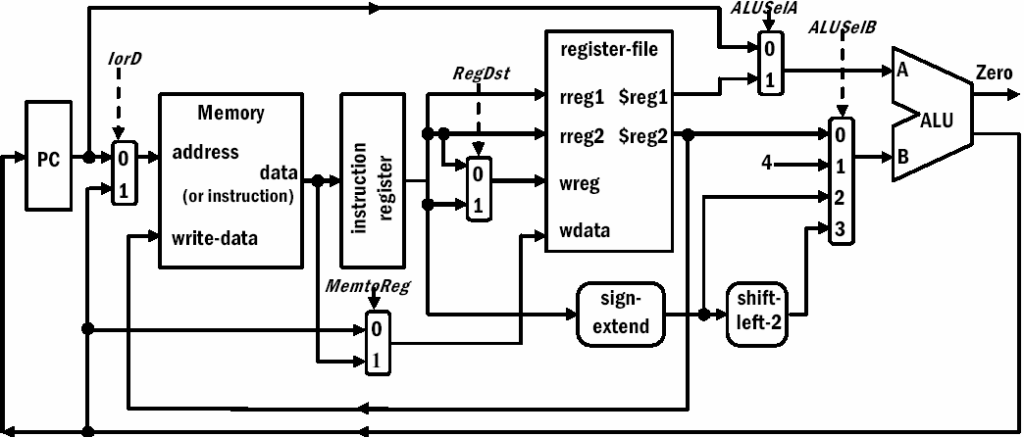
Step: 1 Instruction Fetch
Figure 1. Development of the multiclock cycle
IR = Mem[PC]; PC = PC + 4;
PC 0
0
M
u x 1
M
u x
Address
Memory
MemData
Write data
Instruction [25– 21]
Instruction [20– 16]
Read register 1
Read
A
1
Read
Zero
Instruction
[15– 0]
Instruction
0
register 2 ^{data 1} Registers
Write
ALU _{ALU}
result
ALUOut
M
register
Write data
Read
B
0
Instruction u
data 2
[15– 11] x
1
4
₁ M
register
₂ u
Instruction
[15– 0]
0
M
u
3
x
Memory data register
x 1
16
32
Sign extend
Shift left2
Step 2 Instruction Decode and Register Fetch A = Reg[IR[25-21]]; ($rs)
B = Reg[IR[20-16]]; ($rt) (imm)
ALUOut = PC + (sign-extend(IR[15-0]) << 2); (Target)
PC
0
M
u x
1
Address
Instruction [25– 21]
Instruction [20– 16]
Read register 1
0
M
u x 1
Memory
MemData
Read
Read
A
Zero ALU _{ALU}
result
Instruction
[15– 0]
Instruction
0
register 2 ^{data 1} Registers
Write
ALUOut
M
register
Write data
Read
B
0
1 M
Write data
Instruction ^{u}
data 2
[15– 11]
x
4
register
1
u
2
Instruction
[15– 0]
0
M
u
3
x
Memory data register
x 1
16
32
Sign extend
Shift left 2
Control Lines: Not dependent on instruction type, Instruction is still being decoded at this step, ALU used to calculate branch destination just in case we decode a branch instruction
23

Slide 2
Step 3 R-Type Execution ALUOut = A op B;
PC 0
0
M
u x 1
M
u x
Address
Memory
MemData
Write data
Instruction [25– 21]
Instruction [20– 16]
Read register 1
Read
A
1
Read
Zero
Instruction
[15– 0]
Instruction
0
register 2 ^{data 1} Registers
Write
ALU _{ALU}
result
ALUOut
Instruction u
M
register
Write data
Read data 2
B
0
₁ M
[15– 11] x
4
₂ u
register
1
0
M
u
x
Instruction
[15– 0]
3
Memory data register
x 1
16
32
Sign extend
Shift left 2
Step 4 R-Type Write Back
Reg[IR[15-11]] = ALUOut; ($rd€ ALUOut)
This is the last step for R-Type
PC 0
0
M
u x 1
M
u x
Address
Memory
MemData
Write data
Instruction [25– 21]
Instruction [20– 16]
Read register 1
Read
A
1
Read
register 2 ^{data 1}
Zero
0
Registers Write
ALU _{ALU}
ALUOut
Instruction
[15– 0]
Instruction register
M
register
Write data
Read data 2
B
0
₁ M
result
Instruction ^{u}
[15– 11]
x 1
4
u
2
Instruction
[15– 0]
0
M
u
3
x
Memory data register
x 1
16
32
Sign extend
Shift left 2
Step 3: Branch Execution
if (A == B) PC = ALUOut (target)
This is the last step for Branch
PC 0
0
M
u x 1
M
u x
Address
Memory
MemData
Write data
Instruction [25– 21]
Instruction [20– 16]
Read register 1
Read
A
1
Read
register 2 ^{data 1}
Zero
Instruction
[15– 0]
Instruction
0
Registers Write
ALU _{ALU}
result
ALUOut
M
register
Write data
Read
B
0
₁ M
Instruction u
data 2
[15– 11] x
4
u
2
register
1
0
M
u
x
Instruction
[15– 0]
3
Memory data register
x 1
16
32
Sign extend
Shift left 2
24

Slide 3
Step 3: Memory Execution
ALUOut = A + sign-extend(IR[15-0]);
PC 0
0
M
u x 1
M
u x
Address
Memory
MemData
Write data
Instruction [25– 21]
Instruction [20– 16]
Read register 1
Read
A
1
Read
Zero
Instruction
[15– 0]
Instruction
0
register 2 ^{data 1} Registers
Write
ALU _{ALU}
result
ALUOut
M
register
Write data
Read
B
0
₁ M
Instruction u
data 2
[15– 11] x
4
u
2
register
1
0
M
u
x
Instruction
[15– 0]
3
Memory data register
x 1
16
32
Sign extend
Shift left 2
Step 4: Load Memory
MDR = Memory[ALUOut];
PC 0
0
M
u x 1
M
u x
Address
Memory
MemData
Write data
Instruction [25– 21]
Instruction [20– 16]
Read register 1
Read
A
1
Read
register 2 ^{data 1}
Zero
0
Registers Write
ALU _{ALU}
ALUOut
Instruction
[15– 0]
Instruction register
M
register
Write data
Read
B
0
1 M
result
Instruction u
data 2
[15– 11]
x 1
4
u
2
Instruction
[15– 0]
0
3
x
M
u
Memory data register
x 1
16
32
Sign extend
Shift left 2
Step 4: Store Write Back
Memory[ALUout] = B;
This is the last step for Store
PC 0
0
M
u x 1
M
u x
Address
Memory
MemData
Write data
Instruction [25– 21]
Instruction [20– 16]
Read register 1
Read
A
1
Read
Zero
0
register 2 ^{data 1} Registers
Write
ALU _{ALU}
ALUOut
Instruction
[15– 0]
Instruction register
M
register
Write data
Read data 2
B
0
₁ M
result
Instruction u
[15– 11] x
1
4
u
2
Instruction
0
3
x
[15– 0]
M
u
Memory data register
x 1
16
32
Sign
Shift left 2
extend
25

Slide 4
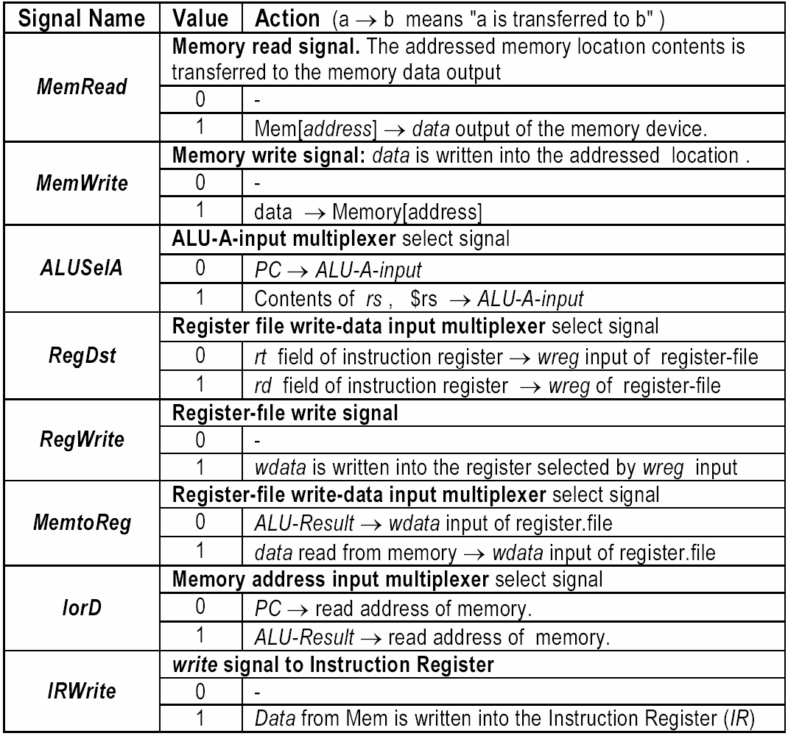
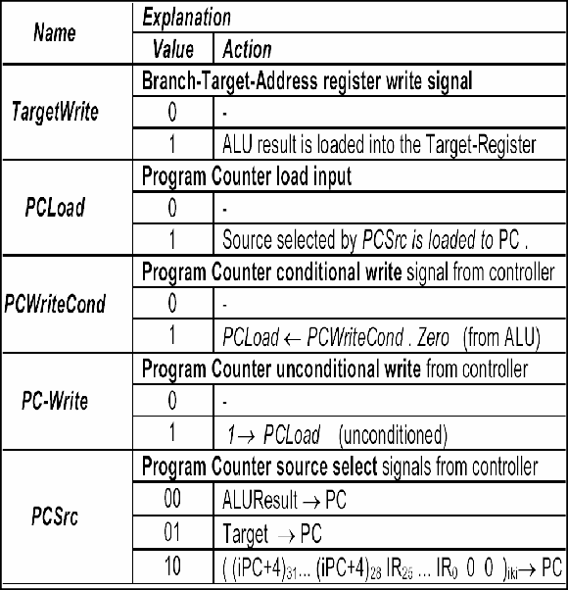
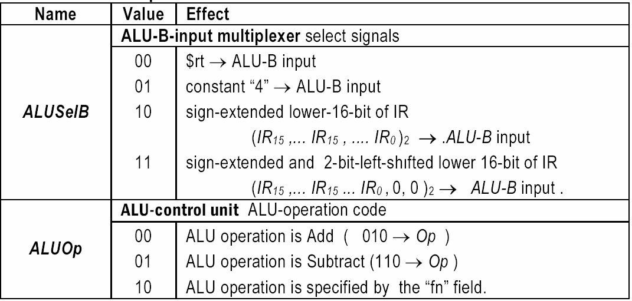
Step 5: Load Write Back
Reg[IR[20-16]] = MDR;
This is the last step for Load
PC 0
0
M
u x 1
M
u x
Address
Memory
MemData
Write data
Instruction [25– 21]
Instruction [20– 16]
Read register 1
Read
A
1
Read
Zero
0
register 2 ^{data 1} Registers
Write
ALU _{ALU}
ALUOut
Instruction
[15– 0]
Instruction register
M
register
Write data
Read data 2
B
0
₁ M
result
Instruction u
[15– 11]
x 1
4
u
2
Instruction
[15– 0]
0
3
x
M
u
Memory data register
x 1
16
32
Sign extend
Shift left 2

Slide 5
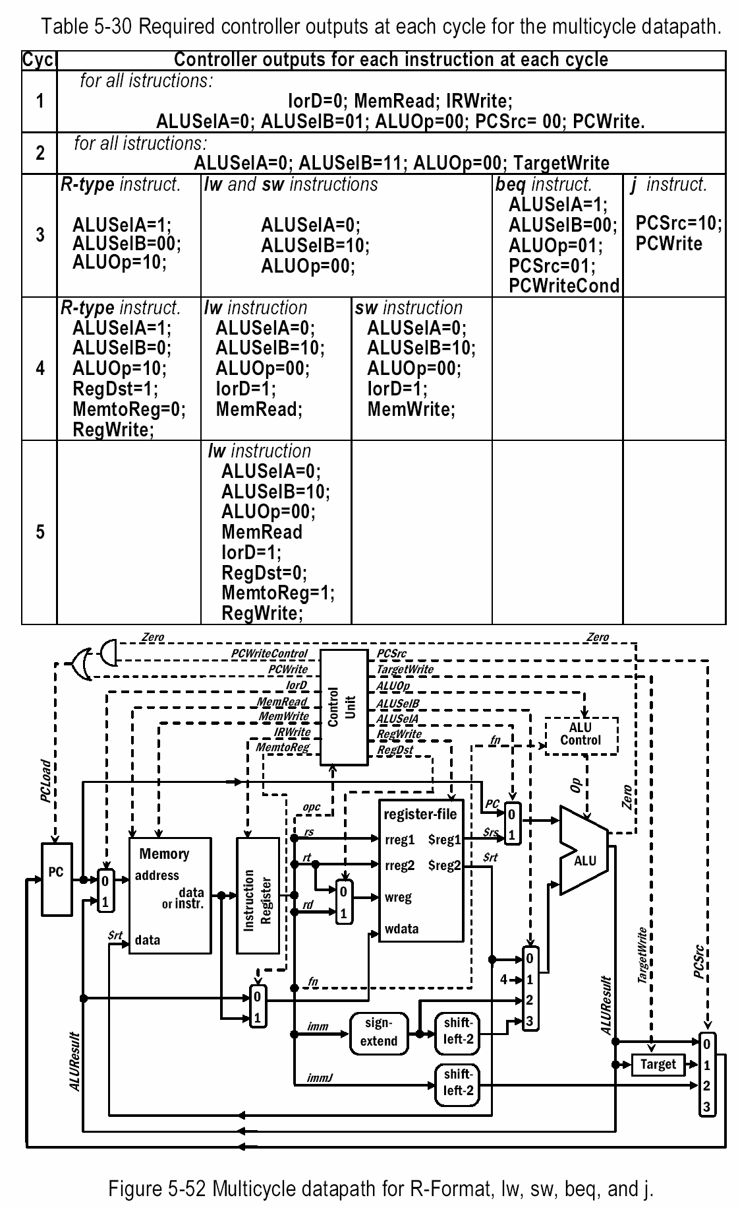
1;
00;
1;
1;
1;
27

