Slide 1
Network Design Principles
Computer Networks 2 [ITEC310]

Slide 2
Outline
Network Definition
Network Design
Building a Good Network
Network Requirements
Fundamental Network Design Goals
Network Design Layers
References

Slide 3
Network
A network is a set of devices connected by communication links.
The devices are often referred to as nodes.
A node could be a printer, router, switch, or any device capable of receiving and/or sending data generated by other nodes on the network.

Slide 4


Slide 5
Network Design
Network design refers to the planning of the implementation of a specific network.
It entails the understanding, evaluation, and scoping of the network to be implemented.
This is usually done before the implementation of a network infrastructure.
Network design is usually performed by network designers, engineers, IT administrators, and the like.

Slide 6
Network Design Cont’d
Network design includes the following:
Logical map of the network to be designed.
Cabling structure.
Quantity, type, and location of network devices (router, switches, servers, etc.).
IP addressing structure.
Network security architecture and overall network security processes.

Slide 7
Building a Good Network
A good network requires a careful in-depth consideration before it can be designed. Some of such considerations include:
Verification of business technical goals and requirements. Some examples are security improvement, performance, availability, and scalability of network.
Determine the features and functions required to meet needs identified in Step 1.
Perform a network-readiness assessment.
Network assessment gives a detailed analysis of a network traffic and how it is been used.
Network-readiness assessment provides a detailed analysis of an existing network’s capabilities and a guide to readiness as you prepare to adopt new solutions or upgrade your current network.

Slide 8
Building a Good Network Cont’d.
Network Readiness Assessment is important because as networks are been developed, they are expanded. Also, tools and equipment are upgraded, and new applications are incorporated.
4. Create a solution and site acceptance test plan.
The site acceptance plan refers to the evaluation of the location where the network will be implemented.
5. Create a project plan.

Slide 9
Network Requirements
Some of the prerequisites of a good network include:
Near 100% uptime
Three aspects of network failure must be addressed to reach near 100% uptime.
Link failure
Equipment failure
Overload conditions

Slide 10
Network Requirements Cont’d
Performance: The performance of a network can be measured by the transit time and response time.
Transit time is the amount of time required for a message to travel from one device to another.
Response time refers to the elapsed time between an inquiry and a response.
The performance of the network depends on factors such as the number of users, type of transmission medium (twisted pair, coaxial or fiber optics cable), software efficiency, and the connected hardware capability.

Slide 11
Network Requirements Cont’d.
Reliability: The reliability of a network is measured by the following:
Frequency of failure
Recovery time
Security: The network security issues include:
Authorization
Authentication
Implementing policies and procedures for recovery from breaches and data losses.
Modification: It should be easy to modify the network to adopt growth and general business changes.
Troubleshoot: Analysis of possible network failure should be feasible.

Slide 12
Fundamental Design Goals
Scalability
Ability to grow for new user groups and remote sites or even new applications.
Availability
To be reliable for working 24/7, redundant, and easy to fix.
Security
Must be designed in the network, not after it’s completed.
Manageability
A too complex or difficult to maintain network cannot function effectively and efficiently.

Slide 13
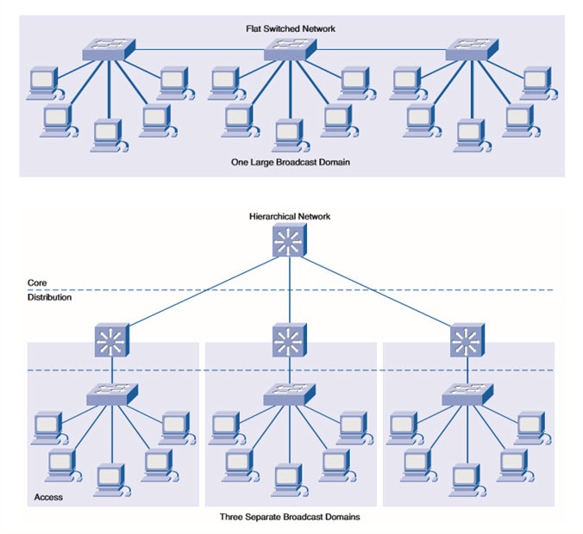
Network Design Architecture

Slide 14
Flat-switched Network Architecture
The typical architecture for a small LAN is workstations, printers, and servers attached to one or more hubs or to a small switch in a flat topology.
Flat-switch network design approach aims to reduce cost, maintenance and administration.
Such networks are designed to reduce the number of routers and switches on a computer network by connecting the devices to a single switch instead of separate switches.

Slide 15
Flat-switched Network Architecture cont’d

Slide 16
Hierarchical Network Architecture
Hierarchical network design involves dividing a network into independent layers.
This model provides a framework that network designers and architects can use to help ensure that the network is flexible, easy to implement, and troubleshoot.
Each of the independent layers performs specific network functions.
Hierarchical models apply to LAN and WAN design.
A typical Hierarchical design network includes the following three layers:
Core layer
Distribution layer
Access layer

Slide 17
Hierarchical Network Architecture

Slide 18
Core Layer
The core (or backbone) layer provides high-speed transport to satisfy the connectivity and transport needs of the distribution layer devices.
It is the network’s backbone.
May connect multiple buildings.
Provides fast transport between distribution switches within a network.
Connect to Server Farm
A server farm or server cluster is a collection of computer servers – usually maintained by an organization to supply server functionality far beyond the capability of a single machine.

Slide 19
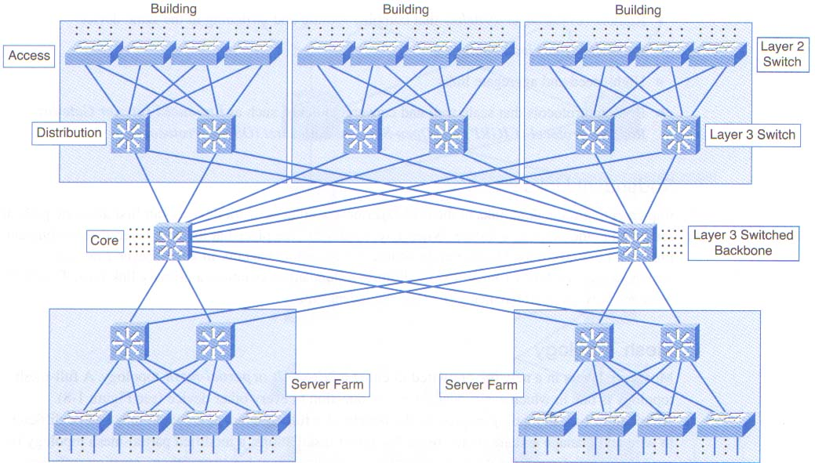
Core Layer cont’d

Slide 20
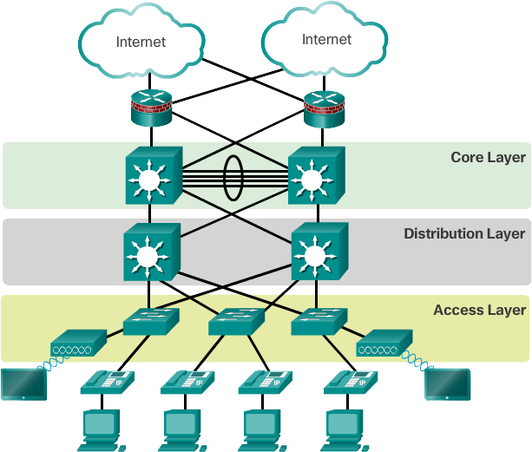
Hierarchical Network Design Layers

Slide 21
Distribution Layer
Provides policy-based connectivity and controls the boundary between the access and core layers.
Filtering and managing traffic flows.
Enforcing access control policies.
Summarizing routes before advertising the routes to the core.
Isolating the core from access level failures and disruptions.
Provides routing between access layer VLANs.

Slide 22
Access Layer
Provides local and remote workgroup or user access to the network.
Provides Layer 2 switching
Layer 2 switching which is also known as Data Link Layer switching uses devices’ MAC addresses to decide where to forward frames.
Provides wired or wireless access.
PoE(Power-over-Ethernet) for IP Cameras, IP Phones, and Access Points

Slide 23
References
Behrouz A. Forouzan. Data Communications and Networking, 4th Edition Mc Graw-Hill
ITEC309 Computer Networks 1. Chapter 1 introduction lecture notes
https://www.techopedia.com/definition/30186/network-design
https://www.yorktel.com/microsoft-solutions/modern-workplace/microsoft-network-readiness-assessment/
https://www.oreilly.com/library/view/lan-switching-first-step/1587201003/1587201003_ch10lev1sec3.html
https://en.wikipedia.org/wiki/Flat_network
https://study-ccna.com/layer-2-switching/
https://www.ques10.com/p/50374/network-hierarchy-1/
https://ccnacompletecourse.blogspot.com/2019/11/hierarchical-network-design.html

