Slide 1
ITEC 420
Validation & Rich Controls

Slide 2
Validation
Why we need Validation ?
Users might ignore an important field.
Users might try to type short string of nonsense to circumvent a required field (like e-mail).
Users might make an honest mistake, such as entering a typing error, entering a non-numeric character in numeric field.
Malicious users might try to exploit a weakness in your code by entering carefully structured wrong values (like sql injection).

Slide 3
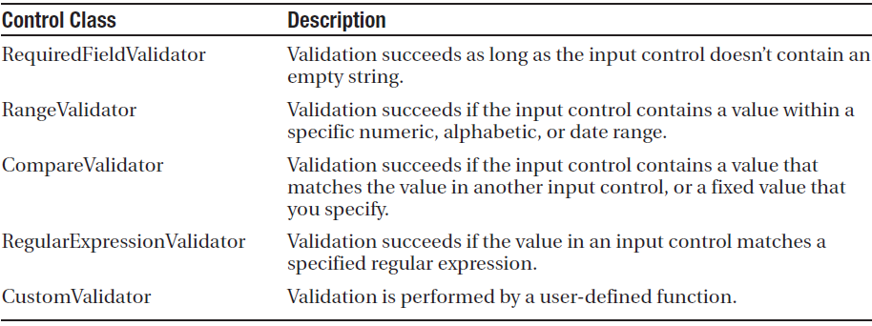
Validator Controls
Asp.NET provides five validator controls. Four of these are tagetted at specific types of validation, while the fifth allows you to apply custom validation routines.
Each validation control can be bound to a single input control. In addition, you can apply more than one validation control to the same input control to provide multiple types of validation.

Slide 4
Validation Controls Behaviour
RangeValidator, Compare Validator and RegularExpressionValidator, validations will automatically succeed if the input control is empty due to the lack of value to validate.
If that is not the behaviour you want, you should also add a Required field validator and link to the same input control.

Slide 5
Server Side Validation & Client Side Validation
When a user clicks a button to submit submit the page depending on the buttons CausesValidation property, which can be set to True or False.
If True (default one):
ASP.NET will automatically validate the page when user clicks the button.
It does this by performing the validation for each control on the page.
If any control fails to validate, ASP.NET will return the page with some error information,depending on your settings.
Click event-code may or may not be executed. - You have to specifically check in the event handler whether the page is valid (p.s. Page.IsValid)
In most modern browsers ASP.NET automatically adds JavaScript code for client-side validation.
In this case as guessed without informing the server validation takes place on client side.
Even if the page validates successfully on client-side, ASP.NET revalidates it when it is received at the server. (Due to the possibility of hacking javascript)
ASP.NET remains secure via double validation.

Slide 6
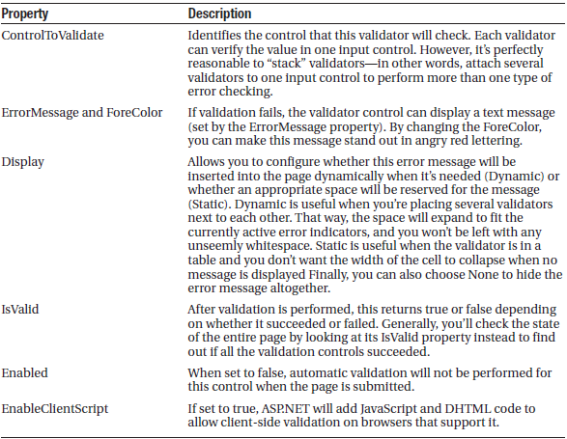
Validation Controls
Found in System.Web.UI.WebControls namespace.
Key properties could be listed as

Slide 7
Validation Controls
Each validator has some specific properties which must be taken into account inoerder to validate an input. Below table lists these properties.

Slide 8
Sample Validation
Create a form with two textboxes, one button, a label control (to prove button is clicked) and a RangeValidator.
Set RangeValidator so that an integer from 1 to 10 will be valid.
Button has CausesValidation property set to true by default.
ASP.NET handles lost focus event, when the textbox looses focus if validation fails error message will be displayed in most browsers.
Problem is that: click-event will be executed, even the page is invalid. To fix such problem use on buttons click (In this sample)==>
if (!RangeValidator.IsValid) return; // if we have a single validator
Otherwise
İf (!Page.IsValid) return;

Slide 9
Sample Validation
Place the codes below to their appropriate addresses
A number (1 to 10):
<asp:TextBox id="txtValidated" runat="server" />
<asp:RangeValidator id="RangeValidator" runat="server"
ErrorMessage="This Number Is Not In The Range" ControlToValidate="txtValidated" MaximumValue="10" MinimumValue="1" Type="Integer" />
<br /><br />
Not validated:
<asp:TextBox id="txtNotValidated" runat="server" /><br /><br />
<asp:Button id="cmdOK" runat="server" Text="OK" OnClick="cmdOK_Click" />
<br /><br />
<asp:Label id="lblMessage" runat="server" EnableViewState="False" />
Finally, here is the code that responds to the button click:
protected void cmdOK_Click(Object sender, EventArgs e)
{
if (!Page.IsValid) return;
lblMessage.Text = "cmdOK_Click event handler executed.";
}

Slide 10
Another Sample Validation
Sometimes you have a carefully designed and created web page so you are looking for another space to display validation messages. In such cases the following method may help (validation summary control):
From the previous sample set the Display property of the Range Validator control to none.
Add a validation summary to a suitable location.
In any case, the validation summary will display even if you did not update the display property, this control is able to collect and display all error messages in case of an invalid input.
If you set the text property of Range Validator control to * and error message to an detailed message and if you set display property to static or dynamic and have a validation summary. Then validation summary will display the error message while range validator displaying the *.
Also
HeaderText property of Validation control could be used to display a specialized title.
DisplayMode property of Validation control could be arranged to displays error as bulletlist,List and Single paragraph.
Using Showsummary property as false and setting Showmessagebox to true will force the error messages to be displayed in a dialog box.

Slide 11
Manual Validation
You can create manual validation in one of three ways
Use your own code to verify the values. (not using validation controls)
Disable the EnableClientScript property for each validation control. This allows an ivalid page to be submitted.
Set buttons CausesValidation to false. Then you have to validate the page manually using Page.Validate() method. Then examine the IsValid property or properties, and decide what to do.
This sample uses the 2nd technique:
protected void cmdOK_Click(Object sender, EventArgs e)
{
string errorMessage = "<b>Mistakes found:</b><br />";
// Search through the validation controls.
foreach (BaseValidator ctrl in this.Validators)
{
if (!ctrl.IsValid)
{
errorMessage += ctrl.ErrorMessage + "<br />";
// Find the corresponding input control, and change // the generic Control variable into a TextBox
// variable.
// This allows access to the Text property.
TextBox ctrlInput =
(TextBox)this.FindControl(ctrl.ControlToValidate);
errorMessage += " * Problem is with this input: ";
errorMessage += ctrlInput.Text + "<br />";
}
}
lblMessage.Text = errorMessage;
}

Slide 12
Custom Validation Sample
protected void vldCode_ServerValidate(Object source, ServerValidateEventArgs args)
{
try
{
// Check whether the first three digits are divisible by seven.
int val = Int32.Parse(args.Value.Substring(0, 3));
if (val % 7 == 0)
{
args.IsValid = true;
}
else
{
args.IsValid = false;
}
}
catch
{
// An error occurred in the conversion.
// The value is not valid.
args.IsValid = false;
}
}
protected void cmdSubmit_Click(Object sender, EventArgs e)
{
if (Page.IsValid)
{
lblMessage.Text = "This is a valid form.";
}
}

Slide 13
Validation Groups
In more complex pages, you might have several distinct groups of controls, possibly in separate panels. In these situations, you may want to perform validation separately. For example, you might create a form that includes a box with login controls and a box underneath it with the controls for registering a new user. Each box includes its own submit button, and depending on which button is clicked, you want to perform the validation just for that section of the page.
This scenario is possible thanks to a feature called validation groups. To create a validation group, you need to put the input controls, the validators, and the CausesValidation button controls into the same logical group. You do this by setting the ValidationGroup property of every control with the same descriptive string (such as “LoginGroup” or “NewUserGroup”). Every control that provides a CausesValidation property also includes the ValidationGroup property.

