Slide 1
CMPE 410 / CMSE 318
LR Parsing Extended Session

Slide 2
Shift-Reduce Algorithms
REDUCE is the action of replacing the handle on the top of the parse stack with its corresponding LHS
SHIFT is the action of moving the next token to the top of the parse stack
R1. E -> E + T
R2. E -> T
R3. T -> T * F
R4. T -> F
R5. F -> ( E )
R6. F -> id
Input to be parsed: id + id * id $

Slide 3
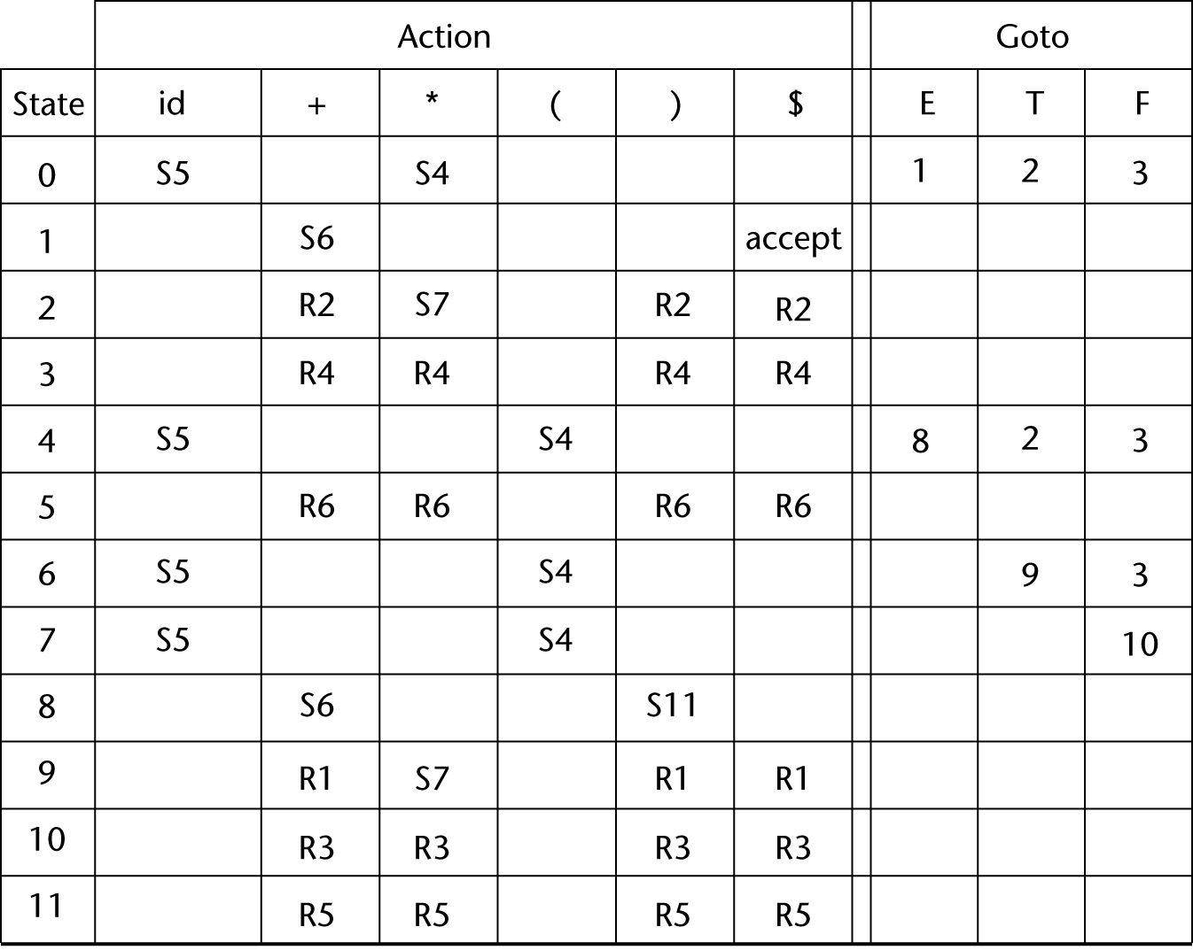
Stack | Input | Action
0 | id+id*id$ | Shift 5
0id5 | +id*id$ | Reduce 6 (Goto [0,F])
0F3 | +id*id$ | Reduce 4 (Goto[0,T])
0T2 | +id*id$ | Reduce 2 (Goto[0,E])
0E1 | +id*id$ | Shift 6
0E1+6 | id*id$ | Shift 5
0E1+6id5 | *id$ | Reduce 6 (Goto[6,F])
0E1+6F3 | *id$ | Reduce 4 (Goto[6,T])
0E1+6T9 | *id$ | Shift 7
0E1+6T9*7 | id$ | Shift 5
0E1+6T9*7id5 | $ | Reduce 6 (Goto[7,F])
0E1+6T9*7F10 | $ | Reduce 3 (Goto[6,T)
0E1+6T9 | $ | Reduce 1(Goto[0,E])
0E1 | $ | Accept

Slide 4
Stack | Input | Action | R RULES
0 | id+id*id$ | Shift 5 | R1. E -> E + T R2. E -> T R3. T -> T * F R4. T -> F R5. F -> ( E ) R6. F -> id
0id5 | +id*id$ | Reduce 6 (Goto[0,F])
0F3 | +id*id$ | Reduce 4 (Goto[0,T])
0T2 | +id*id$ | Reduce 2 (Goto[0,E])
0E1 | +id*id$ | Shift 6
0E1+6 | id*id$ | Shift 5
0E1+6id5 | *id$ | Reduce 6 (Goto[6,F])
0E1+6F3 | *id$ | Reduce 4 (Goto[6,T])
0E1+6T9 | *id$ | Shift 7
0E1+6T9*7 | id$ | Shift 5
0E1+6T9*7id5 | $ | Reduce 6 (Goto[7,F])
0E1+6T9*7F10 | $ | Reduce 3 (Goto[6,T)
0E1+6T9 | $ | Reduce 1 (Goto[0,E])
0E1 | $ | Accept

