Slide 1
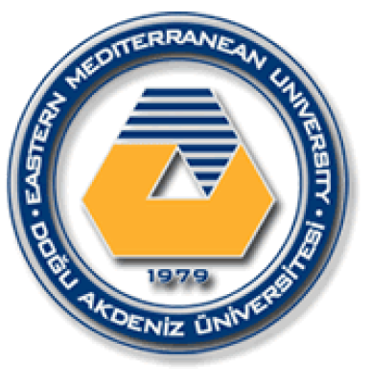
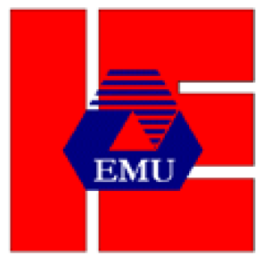
EASTERN MEDITERRANEAN UNIVERSITY DEPARTMENT OF INDUSTRIAL ENGINEERING
INFORMATION SYSTEMS AND TECHNOLOGY
IENG 372 / MANE 372
Spring 2021-2022
Introduction
Lecturer : Ms. Khaoula Chnina

Slide 2
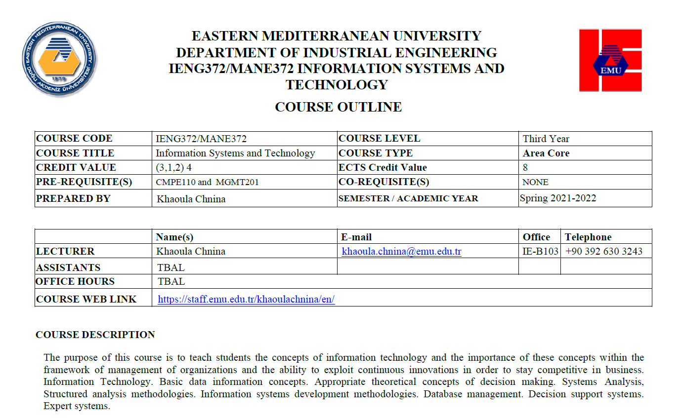

Slide 3
Grades
Assessment Category | Type | Percentage
Exams | Final exam 30% | 30%
 | Midterm exam 20% | 20%
 | Quizzes 15% | 15%
Project | Progress Reports | 5%
 | Final Report | 10%
 | Project Presentation | 10%
LAB | Lab Exam | 8%
 | Lab Attendance | 2%
BONUS | Attendance & Participation | 5%

Slide 4
Course Planning
Report Guidelines
Report Template

Slide 5
Information
The act of making enquiries about something or someone.
Information is data that has been processed, interpreted, organized, structured or presented so as to make them meaningful or useful to the person who receives it.
Data : Raw Facts such as measurements or statistics
Informatics studies the representation, processing, and communication of information in natural and engineered systems.

Slide 6
System
A system is a collection of interacting or interdependent elements or components that are organized for serving a common purpose, such as a group of devices or artificial objects or an organization forming a network especially for distributing something or accomplishing a certain mission.

Slide 7
Technology
Technology is the sum of techniques, skills, methods, and processes used in the production of goods or services or in the accomplishment of objectives, such as scientific investigation. Technology can be the knowledge of techniques, processes, and the like, or it can be embedded in machines to allow for operation without detailed knowledge of their workings.
It is science or knowledge put into practical use to solve problems or invent useful tools.

Slide 8
Information System
Information system is an integration of a set of coordinated network of components that act together for retrieving, filtering, creating, distribution, storage and processing of data in order to provide information and contribute to knowledge. It is a resource for decision making.
Information systems are composed by four components: task, people, structure (or roles), and technology.
Humans have been manipulating information since the development of writing in about 3000 BC. In pre-computer information systems, the data used to be stored in human-readable form, such as ledger books, guidebooks and card catalogs.
A computer information system is a system composed of people and computers that processes or interprets information.

Slide 9
Career pathways
The average salary of an Information Systems Manager is $82,450 yearly
Chief Information Officer (CIO): the executive who is in charge of the IS function.
Management Information Systems : decision-making, coordination, control, analysis, and visualization of information in an organization.
Project Management : initiating, planning, executing, controlling, and closing the work of a team to achieve specific goals
Enterprise Architecture : conducting enterprise analysis, design, planning, and implementation
business analysts ; systems analysts
IS Strategy ; IS Development; IS Organization ; IS Consulting
IS Security ; IS Auditor

Slide 10
Information Technology
Information technology is a subset of information systems. It deals with the technology part of any information system, and as such deals with hardware, servers, operating systems and software, databases etc.
IS
IT

Slide 11
Career pathways
The average salary of an IT Specialist is $55,000 a year
1- Technical Support : install and update software, maintain hardware)
2- Network Engineer : link the devices with each other
3- System Administrator : Control users
4- Web Designer : Expose products..
5- Web Developer
6- Software Developer : switch from using papers to using computers
7- Programmer : Management of accounting operations such as depots, sales and purchases
8- Database Administrator : backup and repair software
9- Mobiles Developer : Create and manage mobile applications ( android…)
10- IT security

Slide 12
Information Systems and Technology
>> Business success relies on the the ability of the organization to gather, organize, and interpret information.
>> Analyze, Design and Manage the information systems to deal with information.
>> Use Information Technology to improve the efficiency of information systems
By the mean of Information systems analysis and design
What Is Information Systems Analysis and Design???

Slide 13
methodology
The study of methods used in a field . It is A collection of methods, practices, procedures and rules
approach
the theoretical framework you are going to use in a project. Once you have decided how you are going to approach the task, you can decide the methods you are going to use.
Method
the way in which something is done. Method is always organized, structured and systematic.
A process
a series of related tasks events to produce a result.
A procedure
a prescribed way of undertaking a process or part of a process.

Slide 14
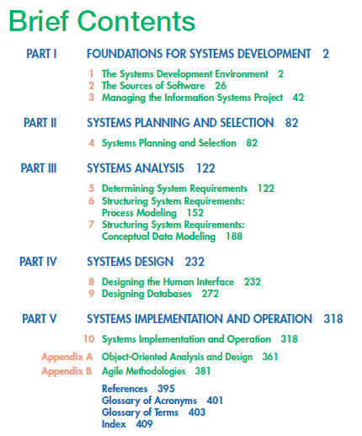
END INTRO

