Slide 1
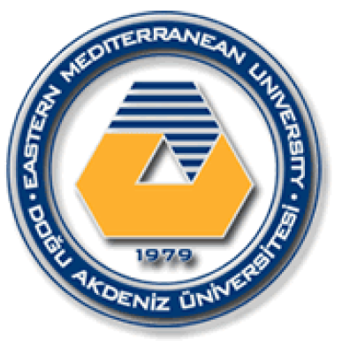
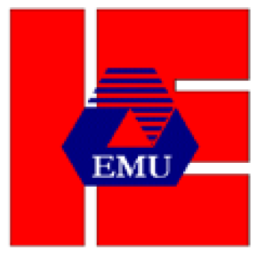
EASTERN MEDITERRANEAN UNIVERSITY DEPARTMENT OF INDUSTRIAL ENGINEERING
INFORMATION SYSTEMS AND TECHNOLOGY
IENG 372 / MANE 372
Spring 2021-2022
Lecturer : Ms. Khaoula Chnina

Slide 2
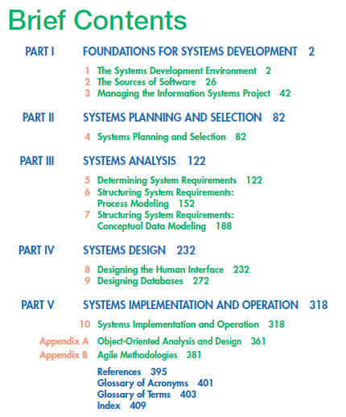

Slide 3
Modeling a System’s Process
Process Modeling
Deliverables and Outcomes
Chapter 6
Definitions and Symbols
Developing DFDs: An Example
Data-Flow Diagramming Mechanics
Data-Flow Diagramming Rules
Decomposition of DFDs
Structuring System Requirements: Process Modeling
Balancing DFDs
Guidelines for Drawing DFDs
Using Data-Flow Diagramming in the Analysis Process
Using DFDs as Analysis Tools
Using DFDs in Business Process Reengineering
Logic Modeling
Modeling Logic with Decision Tables
Pine Valley Furniture WebStore: Process Modeling
Process Modeling for Pine Valley Furniture’s WebStore

Slide 4
Learning Objectives
Explain process modeling
Discuss data-flow diagramming
mechanics, definitions, and rules
Examine decision tables used to represent process logic
Discuss the use of data-flow diagrams
as analysis tools
Decompose data-flow diagrams into lower level diagrams.
Discuss balancing data-flow diagrams

Slide 5
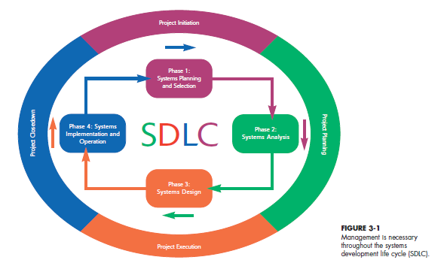
Project Management Process
Project Management Process |  | Stage 1 | Stage 2 |  | Stage 3 |  | Stage 4
SDLC |  | Phase 1 |  | Phase 2 | Phase 3 | Phase 4
0,9
0,9

Slide 6
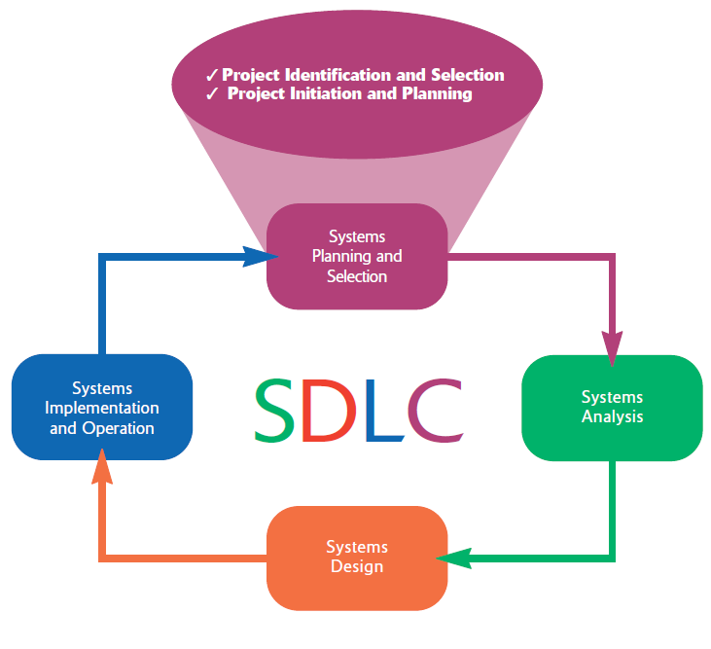
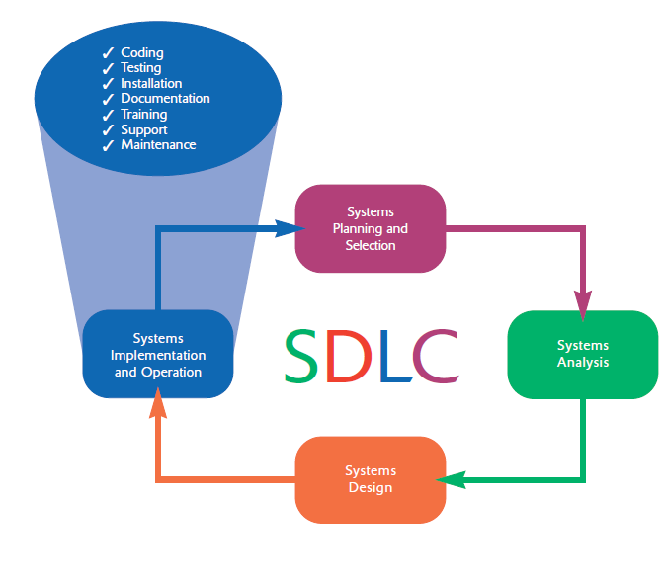
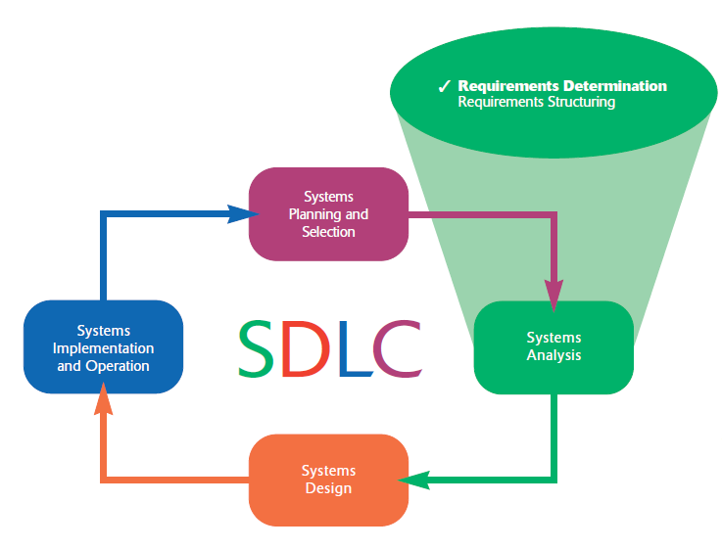
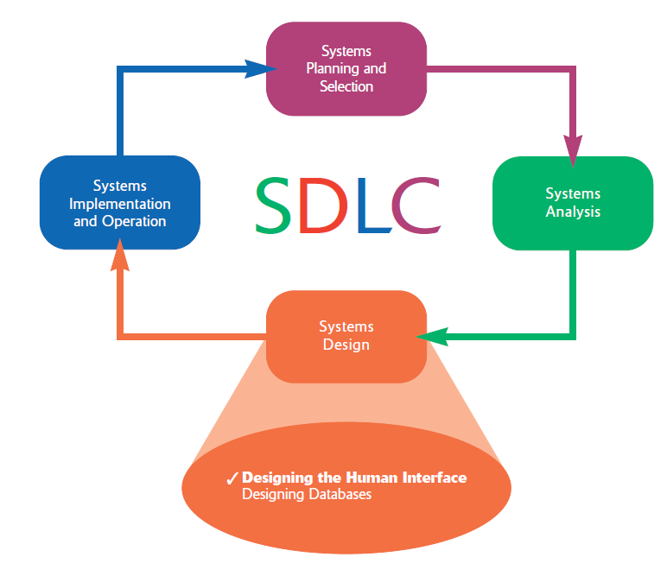
.

Slide 7
Stage 1 : Initiating the Project
Phase 1: Systems planning and selection
Two primary activities.
Identification of the need for a new or enhanced system.
Information needs of the organization are examined, analyzed arranged , and projects to meet these needs are identified (Investigation and determination of scope).
The organization’s information system needs may result from:
- Requests to deal with problems in current procedures
- The desire to perform additional tasks
- The realization that information technology could be used to capitalize on an existing opportunity
A feasibility study is conducted before the second phase of the SDLC to determine
the economic and organizational impact of the system.
activities are performed to assess the size, scope, and complexity of the project and to establish procedures to support later project activities:
The project initiation team
Relationship with the customer
The project initiation plan
Management procedures
Establish the project management environment
Develop the project charter

Slide 8
Stage 2: Planning the Project
Phase 2 : Systems Analysis
Study of current procedures and information systems and suggestion of alternative replacement systems.
Analysis has several subphases :
Determining the requirements of the system: what the users want from a proposed system. This subphase involves a careful study of any current systems, manual and computerized, that might be replaced or enhanced as part of this project.
Study and Structure of the requirements according to their interrelationships, eliminating any redundancies. And generate alternative initial designs to match the requirements.
Compare the alternatives to determine which best meets the requirements within the cost, labor, and technical levels the organization is willing to commit to the development process.
Description and recommendation of best alternative solution
focuses on defining clear, discrete activities and the work needed to complete each activity within a single project.
Describe project scope, alternatives and feasibility
Divide the project into manageable tasks
Estimate resources and create a resource plan
Develop a preliminary schedule
Develop a communication plan
Determine project standards and procedures
Identify and assess risk Identify sources of risk
Create a preliminary budget
Develop a project scope statement
Set a baseline project plan

Slide 9
Stage 3: Executing the Project
Phase 3: Systems Design
Logical design (Theory):
The system could be implemented on any hardware and systems software.
concentrates on the business aspects of the system and how it will impact the functional units within the organization.
Physical design (Practice):
Turn the logical design into physical, or technical, specifications.
Convert diagrams into a structured systems design that can be converted to instructions written in a programming language.
Decision of the programming languages, database systems and file structures
Decision of hardware platform, operating system, and network environment the system will run under.
The plans created in the prior phases (project initiation and planning) are put into action.
Executing the baseline project plan
Monitoring project progress against the baseline project plan
Managing changes to the baseline project plan.
Maintaining the project workbook.
Communicating the project status

Slide 10
Stage 4: Closing Down the Project
Phase 4: Systems Implementation and Operation
It is a two-step process:
Systems implementation:
Coding, testing, and installation.
Application software is installed, or loaded, on existing or new hardware.
Documentation, training programs, and ongoing user assistance
Operation:
Programmers correct the errors and make the changes that users ask for and modify the system to reflect changing business conditions.
System obsolescence, begin designing the system’s replacement, thereby completing the loop and starting the life cycle over again.
Project closedown Is The final phase of the project management process, which focuses on bringing a project to an end.
Closing down the project
Conducting postproject reviews
Closing the customer contract

Slide 11
1- Process Modeling
Process modeling
Graphically representing the processes that capture, manipulate, store, and distribute data between a system and its environment and among components within a system.
Data-flow diagrams (DFDs) :
Data-flow diagramming is one of several structured analysis techniques used to increase software development productivity and quality.
A tool analysts use to structure information.
A DFD is a graphical tool that allow to model how data flow through an information system, the relationships among the data flows, and how data come to be stored at specific locations.
Show the processes that change or transform data.
The IS can be physical or logical, manual or computer based.
Data-flow diagrams are a common form of process models, they concentrate on the movement of data between processes.
A graphic that illustrates the movement of data between external entities and the processes and data stores within a system.

Slide 12
Modeling a System’s Process
The analysis team begins the process of structuring requirements with an abundance of information gathered during requirements determination.
They organize the information into a meaningful representation of the existing IS and of the requirements desired in a replacement system.
They model the processing elements of an IS and transformation of data in the system.
They model the structure of data within the system (Ch7).
Analysts use both process and data models to establish the specification of an information system. With a supporting tool, such as a CASE tool, process and data models can also provide the basis for the automatic generation of an information system.

Slide 13
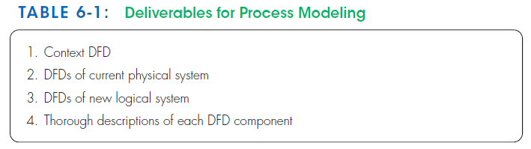
Deliverables and Outcomes
In structured analysis, the primary deliverables from studying and documenting a system’s process are :
Context data-flow diagram : shows the scope of the system, indicating which elements are inside and outside the system.
Data-flow diagrams of the current system : specify which people and technologies are used in which processes to move and transform data, accepting inputs and producing outputs. They allow analysts to understand the current system and to determine how to convert the current system into its replacement.
Data-flow diagrams of the new logical system :They are technology-independent, and show the dataflow, structure, and functional requirements of the new system.
The project dictionary and CASE repository : entries for all of the objects in all diagrams.

Slide 14
The said DFDs are coherent and interrelated.
Requirements determination and structuring are often parallel steps, DFDs evolve from the more general to the more detailed as current and replacement systems are better understood.
Some organizations have developed their own type of diagrams to model processes.
Some methodologies, such as rapid application development (RAD), do not model processes separately . RAD builds processes (the work or actions that transform data so that they can be stored or distributed) the prototypes created as the core of its development life cycle.
Next Chapters : how the new system will deliver these new requirements in specific manual and automated functions.

Slide 15
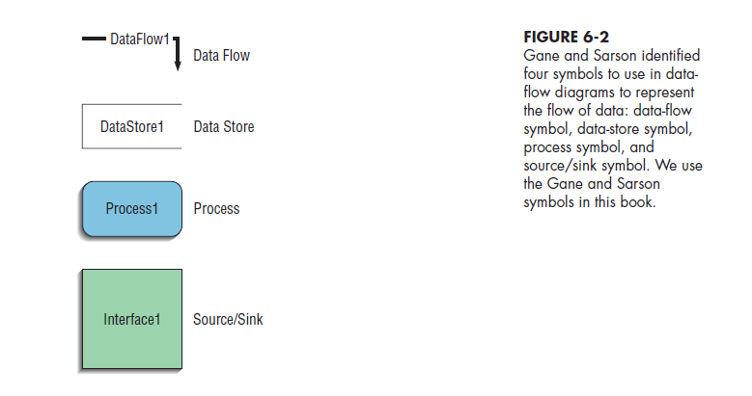
2- Data-Flow Diagramming Mechanics
Data-flow diagrams are versatile (Flexible) diagramming tools.
Data-flow diagrams can represent both physical and logical information systems.
The four symbols used in DFDs represent data flows, data stores, processes, and sources/sinks (or external entities).
The set of four symbols we use in this book was developed by Gane and Sarson (1979)

Slide 16
Definitions and Symbols
Data flow : data that are in motion and moving as a unit from one place in a system to another.
It could represent data on a customer order form or a payroll check.
It could represent the results of a query to a database, the contents of a printed report, or data on a data-entry computer display form.
It can be composed of many individual pieces of data that are generated at the same time and that flow together to common destination
It is drawn as an arrow.
The arrow is labeled with a meaningful name for the data in motion; for example, customer order, sales receipt, or paycheck.
The name represents the aggregation of all the individual elements of data moving as part of one packet, that is, all the data moving together at the same time.

Slide 17
Data store : data at rest.
It may represent one of many different physical locations for data, including a file folder, one or more computer-based file(s), or a notebook.
A data store might contain data about customers, students, customer orders, or supplier invoices.
Drawn as a rectangle with the right vertical line missing
Label includes name of the store as well as the number (e.g., D1 or D2) and a meaningful label, such as student file, transcripts, or roster of classes.
Process : the work or actions performed on data so that they are transformed, stored, or distributed.
When modeling the data processing of a system, it doesn’t matter whether a process is performed manually or by a computer.
Drawn as a rectangle with rounded corners
Number of process as well as name are recorded inside the rectangle, which indicates what the process does. For example, the process may generate paychecks, calculate overtime pay, or compute grade-point average.

Slide 18
source/sink : the origin and/or destination of the data, define the system’s boundaries.
Source/sinks are sometimes referred to as external entities because they are outside the system.
Data must originate outside a system from one or more sources, and the system must produce information to one or more sinks.
A source/sink might consist of :
Another organization or organizational unit (e.g., a supplier or an academic department)
A person inside or outside the business unit (e.g., a customer or a loan officer)
Another information system
Many of their characteristics are of no interest to us such :
Interactions that occur between sources and sinks
What a source or sink does with information or how it operates (i.e., a source or sink is a “black box”)
How to control or redesign a source or sink
How to provide sources and sinks direct access to stored data
Drawn as a square or a rectangle symbol
Its name states what the external agent is, such as customer, teller, Environmental Protection Agency (EPA) office, or inventory control system.

Slide 19
Context diagram
A data-flow diagram of the scope of an organizational system that shows the system boundaries, external entities that interact with the system, and the major information flows between the entities and the system. It contains NO data stores ,It has only one process labeled “0.”
Level-0 diagram
A data-flow diagram that represents a system’s major processes, data flows, and data stores at a high level of detail ( no details).
Each process has a number that ends in .0 (corresponding to the level number of the DFD).
Level-n diagram
A DFD that is the result of n nested decompositions of a series of subprocesses from a process on a level-0 diagram (More details).

Slide 20
When a system’s data flow across office or departmental boundaries, you can be confused about whether a person or activity is a source/sink or a process within a system.
In such a case, some processing occurs in one office, and the processed data are moved to another office, where additional processing occurs.
Error :
Identify the second office as a source/sink to emphasize that the data have been moved from one physical location to another.
Correction:
If the processing of data in the other office is part of your system, then you should represent the second office as one or more processes on your DFD.
If the work done in the second office might be redesigned to become part of the system you are analyzing, then that work should be represented as one or more processes on your DFD.
If the processing that occurs in the other office takes place outside the system you are working on, then it should be a source/sink on your DFD.

Slide 21
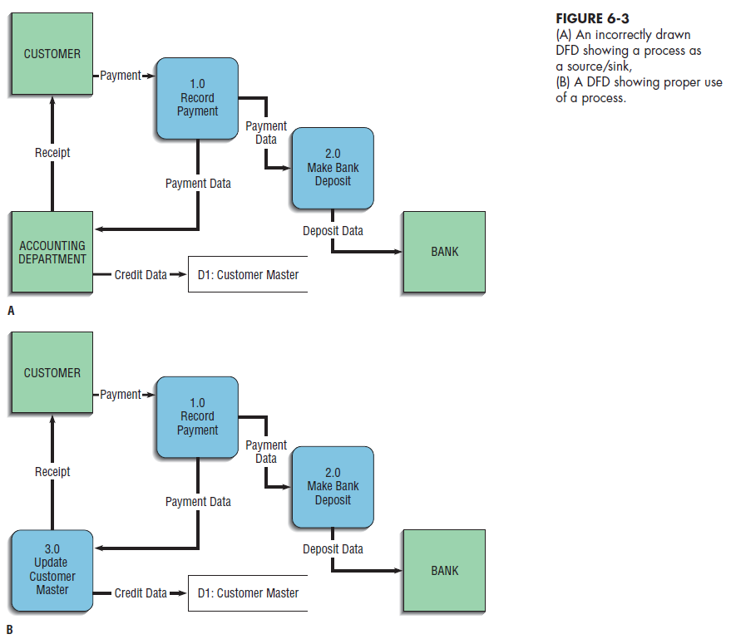
9
9
9
X
9
9

Slide 22
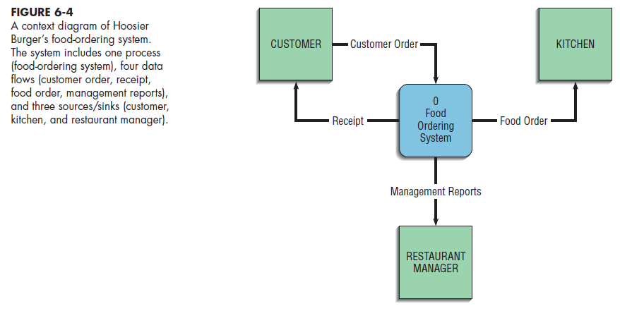
Developing DFDs: An Example
Consider Hoosier Burger, a fictional fast food restaurant in Bloomington, Indiana.
It is a favorite of students at nearby Indiana University.
Hoosier Burger uses an automated food-ordering system.
1- Context diagram :
A DFD that Represents the boundary or scope of this system, and the system’s relationship to its environment
The single process, labeled “0,” represents the entire system; The sources/sinks represent its environmental boundaries.

Slide 23
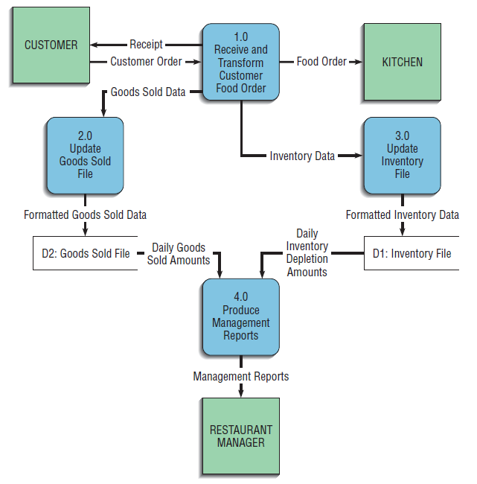
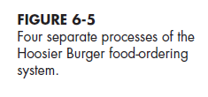
2- Level 0 Diagram :
which processes are represented by the single process ?
The main processes in the DFD represent the major functions of the system, and these major functions correspond to such actions as the following:
1. Capturing data from different sources (Process 1.0)
2. Maintaining data stores (Processes 2.0 and 3.0)
3. Producing and distributing data to different sinks (Process 4.0)
4. High-level descriptions of data transformation operations (Process 1.0)
The system begins with an order from a customer,
In the first process, labeled “1.0,” the customer order is processed.
The results are four streams or flows of data: (1) The food order is transmitted to the kitchen, (2) the customer order is transformed into a list of goods sold, (3) the customer order is transformed into inventory data, and (4) the process generates a receipt for the customer.

Slide 24
First, the data labeled Goods Sold go to Process 2.0. The output for this process is labeled Formatted Goods Sold Data updates a data store labeled Goods Sold File.
If the customer order were for two cheeseburgers, one order of fries, and a large soft drink, each of these categories of goods sold in the data store would be incremented appropriately.
The Daily Goods Sold Amounts are then used as input to Process 4.0, Produce Management Reports.
The Inventory Data, serves as input for Process 3.0, Update Inventory File. This process updates the Inventory File data store, based on the inventory that would have been used to create the customer order.
For example, an order of two cheeseburgers would mean that Hoosier Burger now has two fewer hamburger patties, two fewer burger buns, and four fewer slices of American cheese.
The Daily Inventory Depletion Amounts are then used as input to Process 4.0.
The data flow leaving Process 4.0, Management Reports, goes to the sink Restaurant Manager.
We know from this diagram that Process 1.0 produces this data flow and that Process 3.0 receives it. However, we do not know the timing of when this data flow is produced, how frequently it is produced, or what volume of data is sent.
Thus, this DFD hides many physical characteristics of the system it describes.

Slide 25
We know that this data flow is needed by Process 3.0 and that Process 1.0 provides this needed data.
whenever Process 1.0 produces the Inventory Data data flow , Process 3.0 must be ready to accept it. Thus, Processes 1.0 and 3.0 are coupled to each other.
The output from Process 2.0, Formatted Goods Sold Data, is placed in a data store, and when Process 4.0 needs such data, it reads Daily Goods Sold Amounts from this data store. In this case, Processes 2.0 and 4.0 are decoupled by placing a buffer, a data store (Goods Sold File), between them. Each of these processes can work at its own pace, and Process 4.0 does not have to be vigilant by being able to accept input at any time.
Further, the Goods Sold File becomes a data resource that other processes could potentially draw upon for data.

Slide 26
Data-Flow Diagramming Rules
Two DFD guidelines apply most of the time:
1- The inputs to a process are different from the outputs of that process:
The reason is that processes, to have a purpose, typically transform inputs into outputs, rather than simply passing the data through without some manipulation. The same input may go in and out of a process, but the process also produces other new data flows that are the result of manipulating the inputs.
2- Objects on a DFD have unique names:
Keep the diagram uncluttered.
You can repeat data stores and sources/sinks.
When two arrows have the same data-flow name, you must be careful that these flows are exactly the same.
It is a mistake to reuse the same data-flow name when two packets of data are almost the same but not identical. Because a data-flow name represents a specific set of data, another data flow that has even one more or one less piece of data must be given a different, unique name.

Slide 27
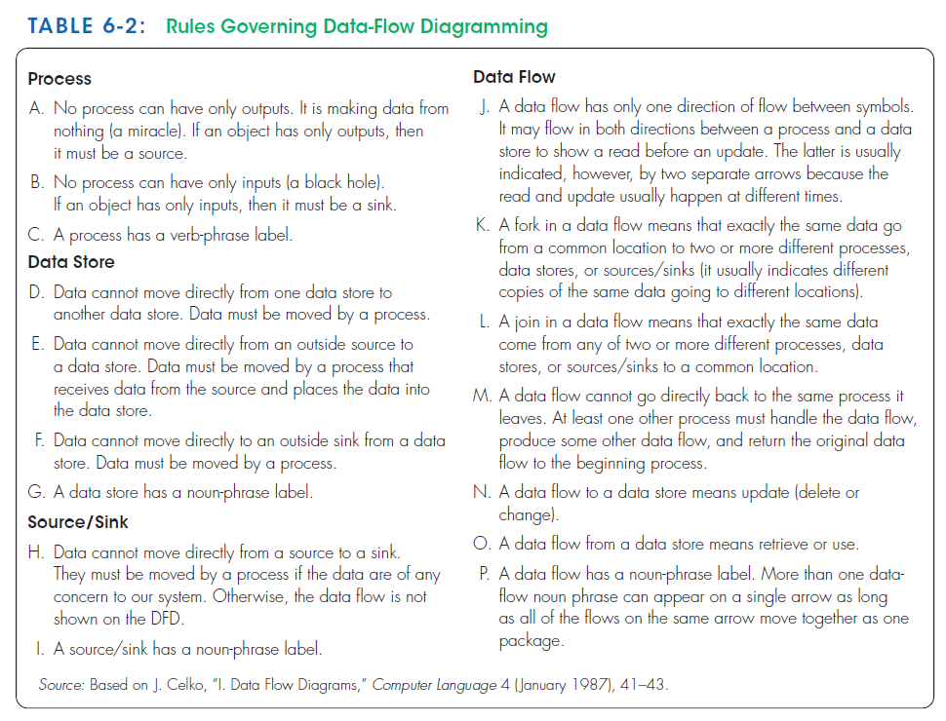
Naming conventions (rules C, G, I, and P)
How to interpret data flows in and out of data stores (rules N and O )

Slide 28
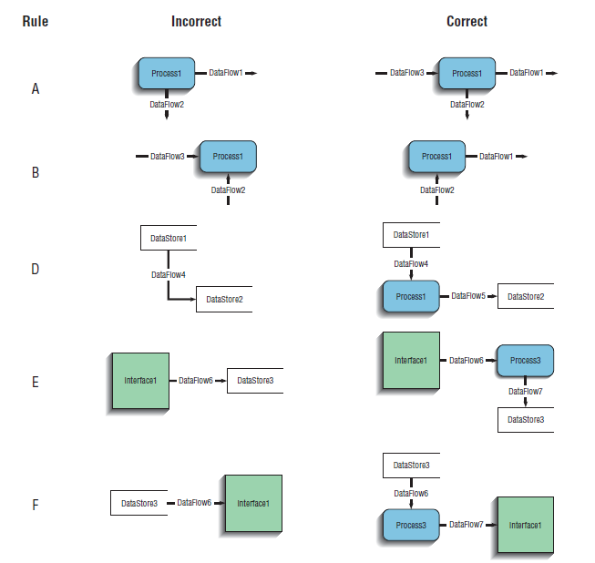
A process should use inputs and produce outputs, and has verb-phrase name.
A Data is moved from/to a source or a file by process, and has noun-phrase name.

Slide 29
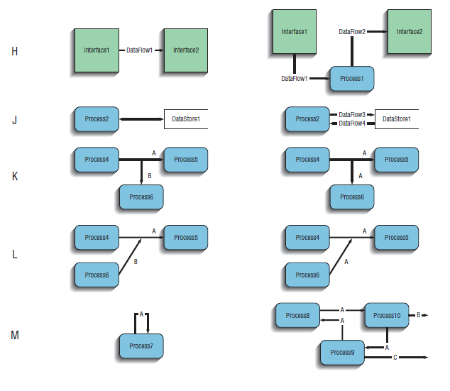
A Data is moved from/to a source by process, and source has noun-phrase name.
Data flow has one direction,
A fork and Join in data are a different copies of the same data,
A data flow cannot be an input and output of a process unless it moves through another process,
A data flow to a store is an update,
A data flow From a store is retrieved,
Data flow has a noun-phrase name,
Many data flows can move together on a single arrow,

Slide 30
Decomposition of DFDs
Functional decomposition :
The act of going from a single system to many component processes.
It is a repetitive procedure of breaking the description of a system down into finer and finer detail.
This process creates a set of hierarchically related charts in which one process on a given chart is explained in greater detail on another chart.
Each of those processes (or subsystems) is also a candidate for decomposition.
Each process may consist of several subprocesses.
Each subprocess may also be broken down into smaller units.
Decomposition continues until no subprocess can logically be broken down any further.
The lowest level of DFDs is called a primitive DFD

Slide 31
0
Food Ordering System
1.0
Receive and Transform Customer Food Order
3.0
Update
İnventory File
4.0
Produce Management
Reports
2.0
Update
Goods Sold File
1.1
Receive
a customer
order
1.5
Generate Inventory Decrements
1.3
Transform
Order to Kitchen Format
1.2
Generate Customer
Receipt
4.1
Access Goods Sold and Inventory Data
4.2
Aggregate Goods Sold and Inventory Data
4.3
Prepare Management Reports
1.4
Generate
Goods Sold Increments
4.3.1
Format Management Reports
4.3.2
Print Management Reports
Context DFD
Context DFD
Level-0 DFD
Level-0 DFD
Level-1 DFD
Level-2 DFD

Slide 32
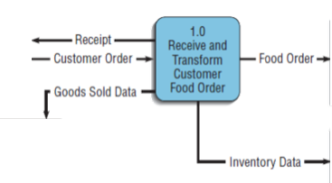
Level- 1 DFDs : Decomposition of level-0 DFD for Hoosier Burger’s food-ordering system
The first process in level-0 DFD (Figure 6-5 ) , called Receive and Transform Customer Food Order, transforms a customer’s verbal food order into four different outputs:
(1) The food order
(2) goods sold
(3) inventory data
(4) receipt for the customer.
At least these five logically separate functions occur in Process 1.0:
(1) Receive a customer order,
(2) transform the entered order into a printed receipt for the customer,
(3) transform the order into a form meaningful for the kitchen’s system,
(4) transform the order into goods sold data
(5) transform the order into inventory data
We can represent the decomposition of Process 1.0 as another DFD, as shown in Figure 6-7 ( level-1 DFD)

Slide 33
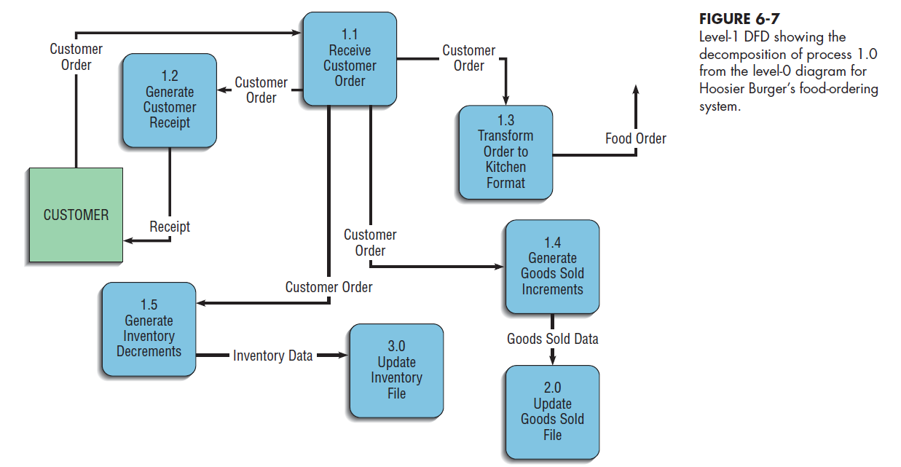
Note that each of the five processes in level-1 DFD are labeled as subprocesses of Process 1.0: Process 1.1, Process 1.2, and so on.
No sources or sinks are represented.
The context and level-0 diagrams show the sources and sinks.
The decomposition of Processes 2.0, 3.0, or 4.0 in a similar manner, the DFDs would also be called level-1 diagrams.
In general, a level-n diagram is a DFD that is generated from n nested decompositions from a level-0 diagram.

Slide 34
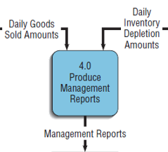
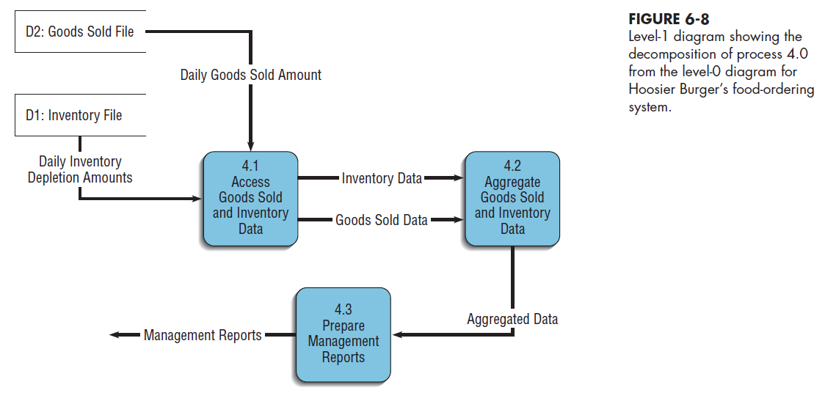
Processes 2.0 and 3.0 perform similar functions in that they both use data input to update data stores. Because updating a data store is a singular logical function, neither of these processes needs to be decomposed further.
Process 4.0, Produce Management Reports, can be decomposed into at least three subprocesses:
(1) Access Goods Sold and Inventory Data,
(2) Aggregate Goods Sold and Inventory Data
(3) Prepare Management Reports.
The decomposition of Process 4.0 is shown in the level-1 diagram of Figure 6-8.
Each level-1, -2, or -n DFD represents one process on a level-(n-1) DFD;
Each DFD should be on a separate page.
No DFD should have more than seven processes in it (too crowded and difficult to understand)

Slide 35
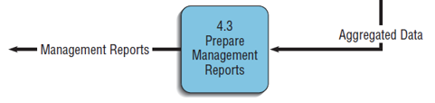
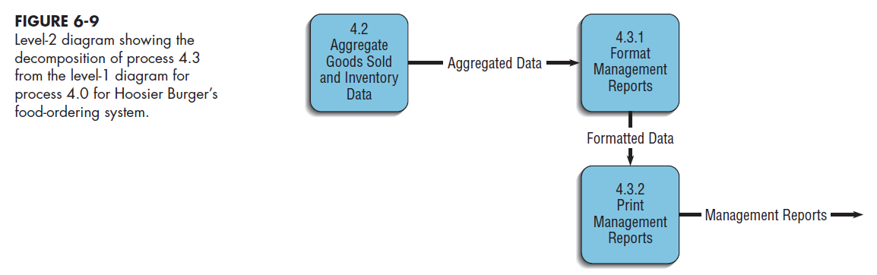
Level- 2 DFDs : Decomposition of level-1 DFDs for Hoosier Burger’s food-ordering system
we examine each of the subprocesses identified in the two level-1 diagrams, one for Process 1.0 and one for Process 4.0.
For example, if we decided to further decompose Process 4.3 in Figure 6-8, we would create a diagram that looks something like Figure 6-9 (level-2 DFD).

Slide 36
Context DFD
Level-0 DFD

Slide 37
Level-1 DFDs
Level-0 DFD

Slide 38
Level-1 DFD
Level-2 DFD

Slide 39
Balancing DFDs
When you decompose a DFD , You must conserve inputs and outputs to a process at the next level of decomposition.
In other words, Process 1.0, which appears in a level-0 diagram, must have the same inputs and outputs when decomposed into a level-1 diagram. This conservation of inputs and outputs is called balancing.
Example: Hoosier Burger’s food-ordering system
Context Diagram and Level-0 DFD
In the context diagram (Figure 6-4), there is one input to the system, the customer order
Three outputs: Customer receipt, Food order, Management reports
In the level-0 diagram (Figure 6-5). We have the same inputs and outputs
No new inputs or outputs have been introduced
We can say that the context diagram and level-0 DFD are balanced
Level-0 DFD and Level-1 DFD
Now look at Figure 6-7, where Process 1.0 from the level-0 DFD has been decomposed. Process 1.0 has one input and four outputs.
The single input and multiple outputs all appear on the level-1 diagram in Figure 6-7.
No new inputs or outputs have been added.
Compare Process 4.0 in Figure 6-5 to its decomposition in Figure 6-8. You see the same conservation of inputs and outputs.

Slide 40
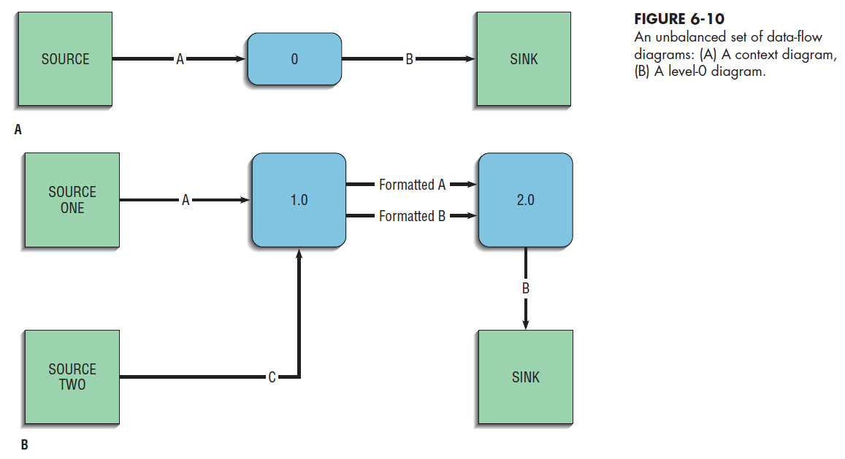
An Unbalanced Example
Figure 6-10A :
the context diagram contains one input to the system, A, and one output, B.
Figure 6-10B :
the level-0 diagram contains an additional input C.
Flows A and C come from different sources.
These two DFDs are not balanced.
X
.
.
X
X

Slide 41
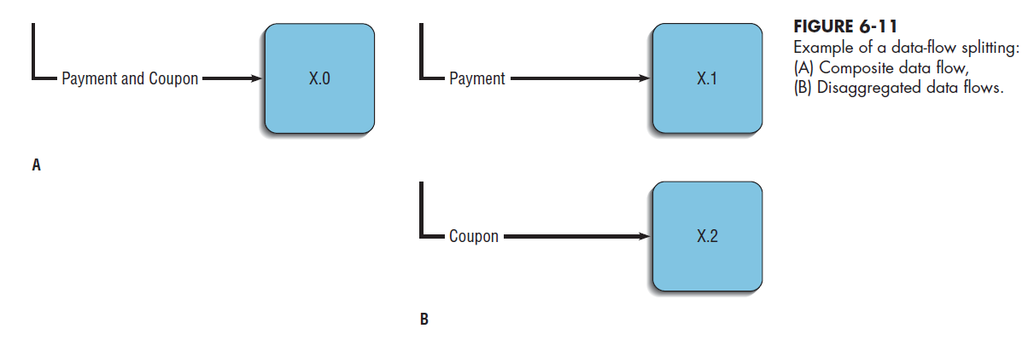
What happened in this example?
Perhaps when drawing the level-0 DFD, the analyst realized that the system also needed C in order to compute B. A and C were both drawn in the level-0 DFD, but the analyst forgot to update the context diagram.
In making corrections, the analyst should also include SOURCE ONE and SOURCE TWO on the context diagram.
We can split a data flow into separate data flows on a lower level diagram. :
A data flow consisting of several sub flows on a level-n diagram can be split apart on a level-n+1 diagram for a process that accepts this composite data flow as input.
For example, consider the partial DFDs from Hoosier Burger illustrated in Figure 6-11.
In Figure 6-11A, we see that the payment and coupon always flow together and are input to the process at the same time.
In Figure 6-11B, the process is decomposed (sometimes called exploded or nested) into two subprocesses, and each subprocess receives one of the components of the composite data flow from the higher-level DFD.
These diagrams are still balanced because exactly the same data are included in each diagram.

Slide 42
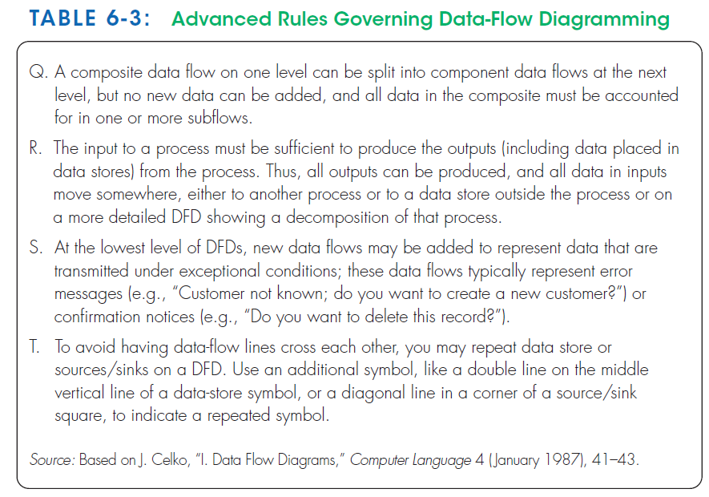
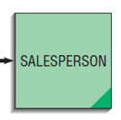
The principle of balancing and the goal of keeping a DFD as simple as possible lead to four additional, advanced, rules for drawing DFDs, summarized in Table 6-3.
Rule Q covers the situation illustrated in Figure 6-11(split).
Rule R covers a conservation principle about process inputs and outputs.
Rule S addresses one exception to balancing.
Rule T tells you how you can minimize clutter on a DFD.

Slide 43
Chapter 6 - Part 2

Slide 44
3- Using Data-Flow Diagramming in the Analysis Process
In addition to drawing DFDs that are mechanically correct, you must be concerned about whether the DFDs are complete and consistent across levels.
You also need to consider how you can use them as a tool for analysis.
Guidelines for Drawing DFDs
Guidelines for drawing DFDs that extend beyond the simple mechanics of drawing diagrams and making sure that the rules listed in Tables 6-2 and 6-3 are followed.
These additional guidelines include:
1. Completeness
2. Consistency
3. Timing considerations
4. The iterative nature of drawing DFDs
5. Drawing primitive DFDs

Slide 45
1- Completeness
The concept of DFD completeness refers to whether your DFDs include all of the components necessary for the system you are modeling.
If your DFD contains data flows that do not lead anywhere, or data stores, processes, or external entities that are not connected to anything else, your DFD is not complete.
Most CASE tools have built-in facilities to help find incompleteness in your DFDs.
When you draw many DFDs for a system, it is not uncommon to make errors; either CASE-tool analysis functions or walkthroughs with other analysts can help you identify such problems.
Each of the components must be fully described in the project dictionary.
A data-flow repository entry includes:
The label or name for the data flow as entered on DFDs
A short description defining the data flow
A list of other repository objects grouped into categories by type of object
The composition or list of data elements contained in the data flow
Notes supplementing the limited space for the description that go beyond defining the data flow to explaining the context and nature of this repository object
A list of locations (the names of the DFDs) on which this data flow appears and the names of the sources and destinations for the data flow on each of these DFDs

Slide 46
2 - Consistency
The concept of DFD consistency refers to whether the depiction of the system shown at one level of a DFD is compatible with the depictions of the system shown at other levels.
A gross violation of consistency would be a level-1 diagram with no level-0 diagram.
Another example of inconsistency would be a data flow that appears on a higher-level DFD but not on lower levels (a violation of balancing).
another example is a data flow attached to one object on a lower-level diagram but attached to another object at a higher level. For example, a data flow named Payment, which serves as input to Process 1 on a level-0 DFD, appears as input to Process 2.1 on a level-1 diagram for Process 2.
You can use the analysis facilities of CASE tools to detect such inconsistencies across nested (or decomposed) data-flow diagrams.
For example, to avoid making DFD consistency errors when you draw a DFD using a CASE tool, most tools will automatically place the inflows and outflows of a process on the DFD you create when you inform the tool to decompose that process.
In manipulating the lower-level diagram, you could accidentally delete or change a data flow, which would cause the diagrams to be out of balance; thus, a consistency check facility with a CASE tool is quite helpful.

Slide 47
3 - Timing
A given DFD provides no indication of whether a data flow occurs constantly in real time, once per week, or once per year. No indication of when a system would run is given either.
For example, many large transaction-based systems may run several large, computing-intensive jobs in batch mode at night, when demands on the computer system are lighter. A DFD has no way of indicating such overnight batch processing.
When you draw DFDs, then, draw them as if the system you are modeling has never started and will never stop.
4 - Iterative Development
The first DFD you draw will rarely perfectly capture the system you are modeling.
You should count on drawing the same diagram over and over again, in an iterative fashion.
With each attempt, you will come closer to a good approximation of the system or aspect of the system you are modeling.
Iterative DFD development recognizes that requirements determination and requirements structuring are interacting, not sequential, subphases of the analysis phase of the SDLC.
One rule of thumb is that it should take you about three revisions for each DFD you draw.
CASE tools make revising drawings easier

Slide 48
5 - Primitive DFDs
Lowest logical level of decomposition
Decision has to be made when to stop decomposition
Rules for when to stop decomposing are:
When you have reduced each process to a single decision or calculation or to a single database operation, such as retrieve, update, create, delete, or read
When each data store represents data about a single entity, such as a customer, employee, product, or order
When the system user does not care to see any more detail, or when you and other analysts have documented sufficient detail to do subsequent systems development tasks
When every data flow does not need to be split further to show that different data are handled in various ways
When you believe that you have shown each business form or transaction, computer online display, and report as a single data flow (e.g., often means that each system display and report title corresponds to the name of an individual data flow)
When you believe a separate process is shown for each choice on all lowest-level menu options

Slide 49
By the time you stop decomposing DFDs, a DFD can become quite detailed.
Seemingly simple actions, such as generating an invoice, may pull information from several entities and may also return different results depending on the specific situation.
For example, the final form of an invoice may be based on the type of customer (which would determine such things as discount rate), where the customer lives (which would determine such things as sales tax), and how the goods are shipped (which would determine such things as the shipping and handling charges).
At the lowest-level DFD, called a primitive DFD, all of these conditions would have to be met.
Given the amount of detail required in a primitive DFD, perhaps you can see why many experts believe analysts should not spend their time diagramming the current physical information system completely: much of the detail will be discarded when the current logical DFD is created.

Slide 50
Using DFDs as Analysis Tools
DFDs can be used for a process called gap analysis.
Gap analysis
The process of discovering discrepancies between two or more sets of data-flow diagrams or discrepancies within a single DFD.
Discrepancies : an illogical or surprising lack of compatibility or similarity between two or more facts.
DFDs allow to identify redundancies and inefficiencies.
Comparing a set of DFDs that models the current logical system to DFDs that model the new logical system can better determine which processes systems developers need to add or revise while building the new system.
Processes for which inputs, outputs, and internal steps have not changed can possibly be reused in the construction of the new system.
The logical DFDs for the new system can also serve as the basis for developing alternative design strategies for the new physical system. As we saw with the Hoosier Burger example, a process on a new logical DFD can be implemented in several different physical ways.

Slide 51
Redundancies:
Examine the details of individual DFDs for such problems as redundant data flows, data that are captured but not used by the system, and data that are updated identically in more than one location.
Redundant data flows may have been labeled with different names
Many CASE tools can generate a report listing all the processes that accept a given data element as input.
From the label of these processes, you can determine whether the data are captured redundantly or if more than one process is maintaining the same data stores.
In such cases, the DFDs may accurately mirror the activities occurring in the organization.
As the business processes being modeled took many years to develop, with participants in one part of the organization sometimes adapting procedures in isolation from other participants, redundancies and overlapping responsibilities may well have resulted.

Slide 52
Inefficiencies:
Some inefficiencies relate to violations of DFD drawing rules.
Consider rule R from Table 6-3: The inputs to a process must be sufficient to produce the outputs from the process. A violation of rule R could occur because obsolete data are captured but never used within a system.
Other inefficiencies are due to excessive processing steps.
Consider the correct DFD in rule M of Figure 6-6: Although this flow is mechanically correct, such a loop may indicate potential delays in processing data or unnecessary approval operations.

Slide 53
Using DFDs in Business Process Reengineering
Data-flow diagrams make a useful tool for modeling processes in business process reengineering (BPR).
Example : IBM Credit Corporation
IBM Credit Corporation is a firm that successfully reengineered its primary business process.
IBM Credit Corporation provides financing for customers making large purchases of IBM computer equipment.
Its job is to analyze deals proposed by salespeople and write the final contracts governing those deals.
IBM Credit Corporation typically took six business days to process each financing deal.

Slide 54
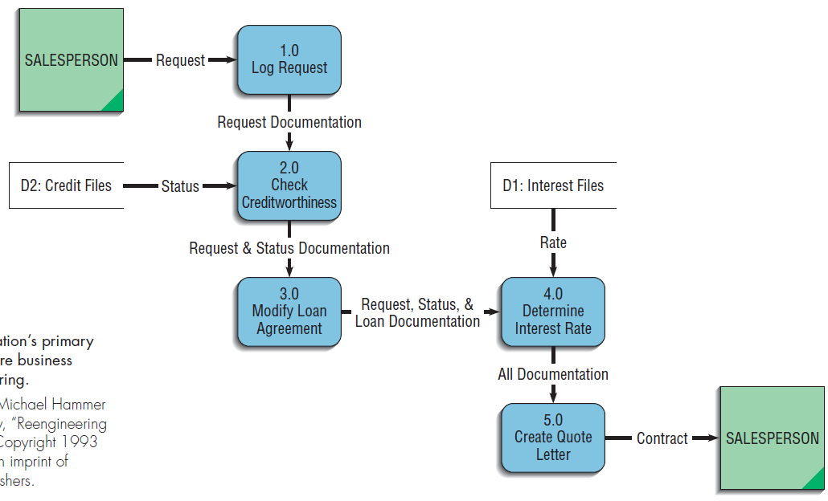
Step 1: the salesperson call was taken by one of six people sitting around a conference table. They logged it and wrote the details on a piece of paper.
A clerk then carried the paper to a second person, who enters the data into a computer system and checks the client’s creditworthiness.
Step 2 : This person wrote the details on a piece of paper and carried the paper, along with the original documentation, to a loan officer.
Step 3 : the loan officer modified the standard IBM loan agreement for the customer (another computer).
Step 4: Details of the modified loan agreement, along with the other documentation, were then sent on to the next station in the process, where a different clerk determined the appropriate interest rate for the loan.
Step 5: the interest rate from step 4 and all of the paper generated up to this point were then used to create the quote letter.
Once complete, the quote letter was sent via overnight mail back to the salesperson.
The credit approval process steps

Slide 55
Some IBM managers decided to see if they could improve the overall process at IBM Credit Corporation.
They took a call from a salesperson and walked him through the system.
They found that the actual work being done on a contract took only ninety minutes.
For much of the rest of the six days it took to process the deal, the various bits of documentation were sitting in someone’s in-basket, waiting to be processed.
IBM Credit Corporation management decided to reengineer its entire process.
The five sets of task specialists were replaced with generalists.
Now each call from the field comes to a single clerk, who does all the work necessary to process the contract.
Instead of having different people check for creditworthiness, modify the basic loan agreement, and determine the appropriate interest rate, now one person does it all.
IBM Credit Corporation still has specialists for the few cases that are significantly different from what the firm routinely encounters.
The process uses a single supporting computer system.

Slide 56
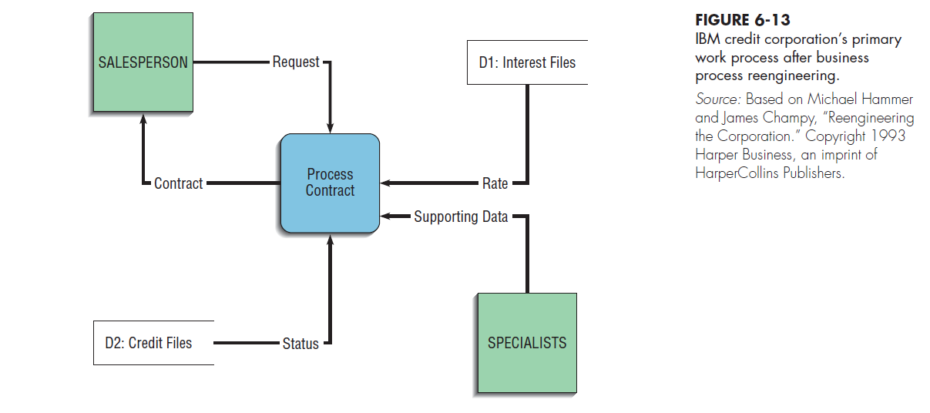
The most striking differences between the DFDs in Figures 6-12 and 6-13 :
the number of process boxes in each one,
the lack of documentation flow in Figure 6-13.
The resulting process is much simpler and cuts down dramatically on any chance of documentation getting lost between steps.
BPR allowed IBM Credit Corporation to handle a hundred times more work in the same amount of time and with fewer people!

Slide 57
4 - Logic Modeling
Although data-flow diagrams are good for identifying processes, they do not show the logic inside the processes.
Even the processes on the primitive-level data-flow diagrams do not show the most fundamental processing steps.
Logic modeling involves representing the internal structure and functionality of the processes represented on data-flow diagrams.
Processes must be clearly described before they can be translated into a programming language.
Users, analysts, and programmers use logic diagrams throughout analysis to incrementally specify a shared understanding of requirements.
Logic diagrams do not take into account specific programming languages or development environments.
Such diagrams may be discussed during JAD sessions or project review meetings.
System prototypes generated from such diagrams may be reviewed, and requested changes to a prototype will be implemented by changing logic diagrams and generating a new prototype from a CASE tool or other code generator.
Sometimes the logic of a process can become quite complex, people become confused in trying to interpret more than three nested IF statements for example .

Slide 58
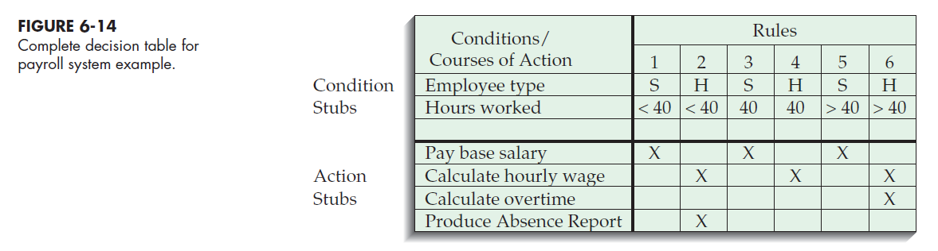
Modeling Logic with Decision Tables
Decision table
A common method for modeling system logic
Decision tables allow you to represent in a tabular format a set of conditions and the actions that follow from them. When several conditions and several possible actions can occur, decision tables help you keep track of the possibilities in a clear and concise manner.
It is a diagram of process logic where the logic is reasonably complicated. All of the possible choices and the conditions the choices depend on are represented in tabular form
A matrix representation of the logic of a decision, which specifies the possible conditions for the decision and the resulting actions.
The three parts to the table include the condition stubs, the action stubs, and the rules.

Slide 59
Condition stubs
That part of a decision table that lists the conditions relevant to the decision.
The condition stubs contain the various conditions that apply in the situation the table is modeling.
Indifferent Condition : Condition whose value does not affect which action is taken for two or more rules
In Figure 6-14, two condition stubs correspond to employee type and hours worked. Employee type has two values: “S,” which stands for salaried, and “H,” which stands for hourly.
Hours worked has three values: less than 40, exactly 40, and more than 40.
Action stubs
That part of a decision table that lists the actions that result for a given set of conditions.
contain all the possible courses of action that result from combining values of the condition stubs.
4 possible courses of action are indicated in this table: pay base salary, calculate hourly wage, calculate overtime, and produce Absence Report.
You can see that not all actions are triggered by all combinations of conditions.
Instead, specific combinations trigger specific actions.
Rules
That part of a decision table that specifies which actions are to be followed for a given set of conditions.
It links conditions to actions

Slide 60
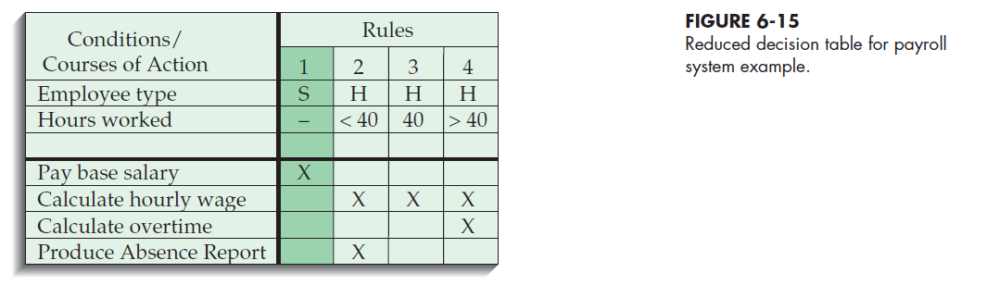
Employee type is “S,” or salaried, and hours worked are less than 40. When both of these conditions occur, the payroll system is to pay the base salary.
In the next column, the values are “H” and “<40,” meaning an hourly worker who worked fewer than 40 hours. In such a situation, the payroll system calculates the hourly wage and makes an entry in the Absence Report.
Rule 3 addresses the situation when a salaried employee works exactly 40 hours. The system pays the base salary, as was the case for rule 1.
For an hourly worker who has worked exactly 40 hours, rule 4 calculates the hourly wage.
Rule 5 pays the base salary for salaried employees who work more than 40 hours. Rule 5 has the same action as rules 1 and 3 and governs behavior with regard to salaried employees.
Rule 6 calculates hourly pay and overtime for an hourly worker who has worked more than 40 hours.
Rules 1&3&5 Are condensed:
The number of hours worked does not affect the outcome for rules 1, 3, or 5. For these rules, hours worked is an indifferent condition, in that its value does not affect the action taken.
we can reduce the number of rules by condensing rules 1, 3, and 5 into one rule
The indifferent condition is represented with a dash.

Slide 61
Standard Procedures for Creating Decision Tables :
1. Name the conditions and the values each condition can assume. Determine all of the conditions that are relevant to your problem, and then determine all of the values each condition can take. For some conditions, the values will be simply “yes” or “no” (called a limited entry). For others, such as the conditions in Figures 6-14 and 6-15, the conditions may have more values (called an extended entry).
2. Name all possible actions that can occur. The purpose of creating decision tables is to determine the proper course of action given a particular set of conditions.
3. List all possible rules. Every possible combination of conditions must be represented. It may turn out that some of the resulting rules are redundant or make no sense, but these determinations should be made only after you have listed every rule so that no possibility is overlooked.
To determine the number of rules, multiply the number of values for each condition by the number of values for every other condition (2*3=6) .
Notice how we alternated the values of hours worked in Figure 6-14. We repeated “<40” for both values of type of employee, “S” and “H.” Then we repeated “40,” and then “>40.”
4. Define the actions for each rule. If an action doesn’t make sense, you may create an impossible” row in the action stubs in the table to keep track of impossible actions. If you can’t tell what the system ought to do in that situation, place question marks in the action stub spaces for that particular rule.
5. Simplify the decision table. Remove any rules with impossible actions. Consult users on the rules where system actions aren’t clear, and either decide on an action or remove the rule. Look for patterns in the rules, especially for indifferent conditions.

Slide 62
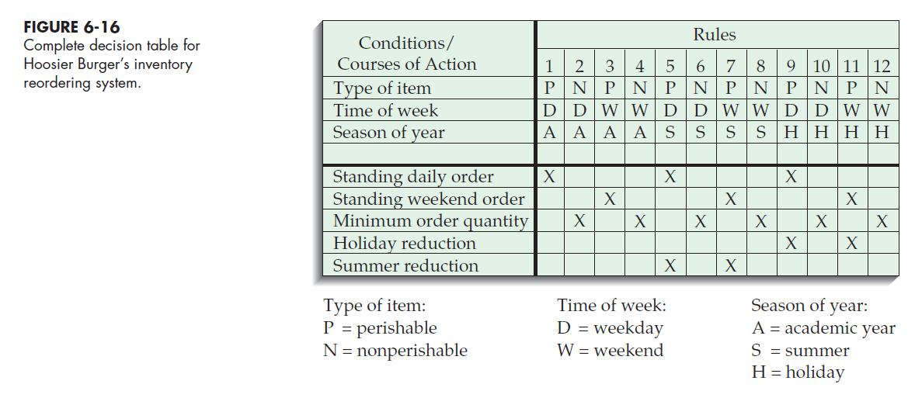
Example : Hoosier Burger
1- the Mellankamps realize that how they reorder depends on whether the item is perishable.
If an item is perishable, such as meat, vegetables, or bread, the Mellankamps have a standing order with a local supplier stating that a prespecified amount of food is delivered each weekday for that day’s use and each Saturday for weekend use.
If the item is not perishable, such as straws, cups, and napkins, an order is placed when the stock on hand reaches a certain predetermined minimum reorder quantity.
2- The Mellankamps also realize the importance of the seasonality of their work.
Their standing orders with all their suppliers are reduced by specific amounts during the summer and holiday breaks.

Slide 63
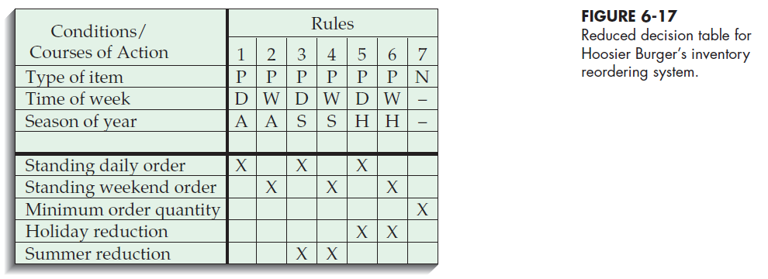
The action for nonperishable items is the same, regardless of the day of the week or the time of year.
For nonperishable goods, both time-related conditions are indifferent.

Slide 64
You can also use decision tables to specify additional decision-related information. For example, if the actions that should be taken for a specific rule are more complicated than one or two lines of text can convey, or if some conditions need to be checked only when other conditions are met (nested conditions), you may want to use separate, linked decision tables.
In your original decision table, you can specify an action in the action stub that says “Perform Table B.” Table B could contain an action stub that returns to the original table, and the return would be the action for one or more rules in Table B.
Another way to convey more information in a decision table is to use numbers that indicate sequence rather than Xs where rules and action stubs intersect. For example, for rules 3 and 4 in Figure 6-17, it would be important for the Mellankamps to account for the summer reduction to modify the existing standing order for supplies. “Summer reduction” would be marked with a “1” for rules 3 and 4, whereas “standing daily order” would be marked with a “2” for rule 3, and “standing weekend order” would be marked with a “2” for rule 4.

Slide 65
5 - Pine Valley Furniture WebStore: Process Modeling

Slide 66
Reminder : Previous Steps

Slide 67
Pine Valley Furniture WebStore
Previous Step : Initiation and planning ( Chapter 4)
The board wants to incorporate all three target markets into its long-term EC plan :
Corporate furniture buying
Home-office furniture purchasing
Student furniture purchasing
Initially focus on the corporate furniture buying system
building block for moving into the customer-based markets.
The new EC system should integrate with two currently existing systems, Purchasing Fulfillment and Customer Tracking.
Initiating and Planning PVF’s E-Commerce System
1- Agreement about the proposed system project name “WebStore”.
2- Identifying potential benefits, costs, and feasibility concerns.
WebStore Project Walkthrough
1- An initial list of benefits and costs
2- several feasibility concerns
3- An initial project schedule.
4- presentation of the initial project plans in a walkthrough to PVF’s board of directors and senior management.
5- Approval was given to move the WebStore project on to the analysis phase.

Slide 68
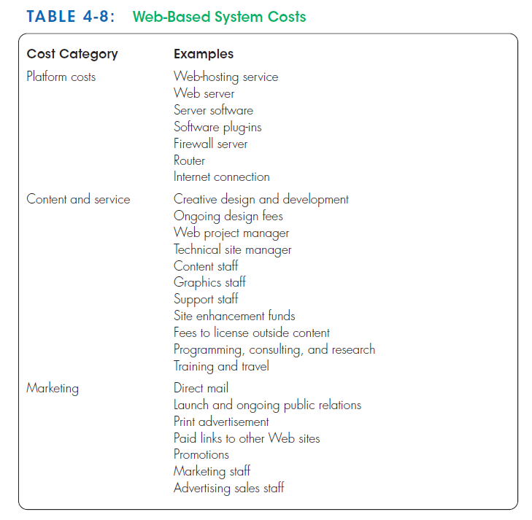
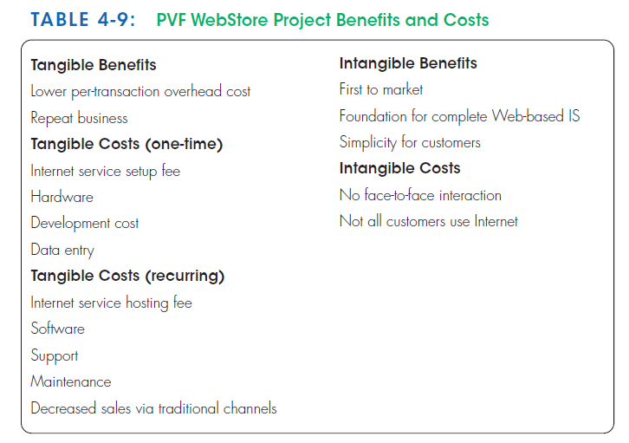
Previous Step : Initiation and planning ( Chapter 4)

Slide 69
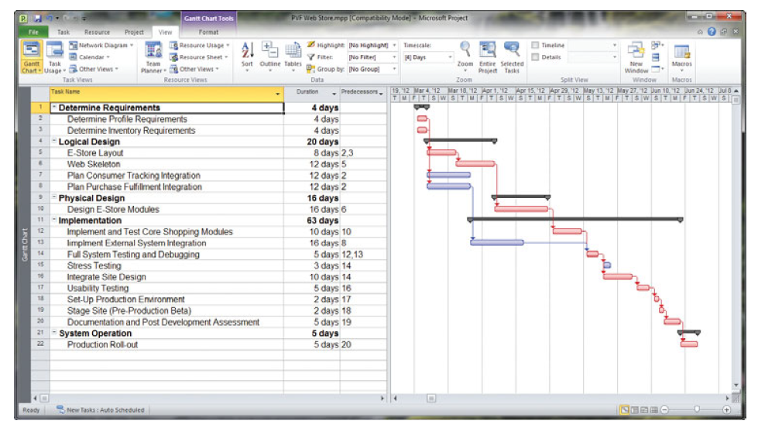
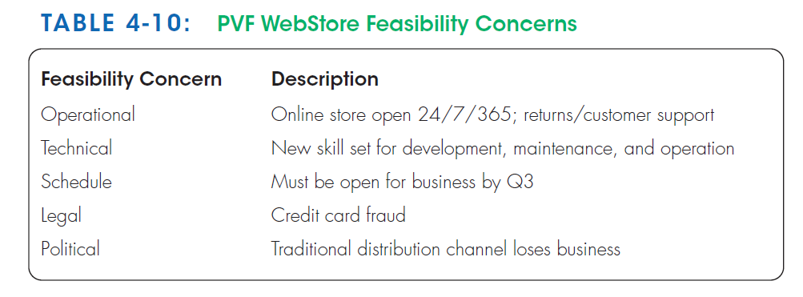
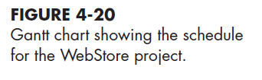
Previous Step : Initiation and planning ( Chapter 4)

Slide 70
Collection of the system requirements
Hold a three-day JAD session.
Participants:
Representatives from sales and marketing, operations, and information systems.
An experienced JAD facilitator who to conducts the session.
Outputs of JAD:
An ambitious and detailed agenda for the session.
Their goal was to collect requirements on the following items:
System layout and navigation characteristics
WebStore and site management system capabilities
Customer and inventory information
System prototype evolution
Previous Step :
System Requirement collection
( Chapter 5)

Slide 71
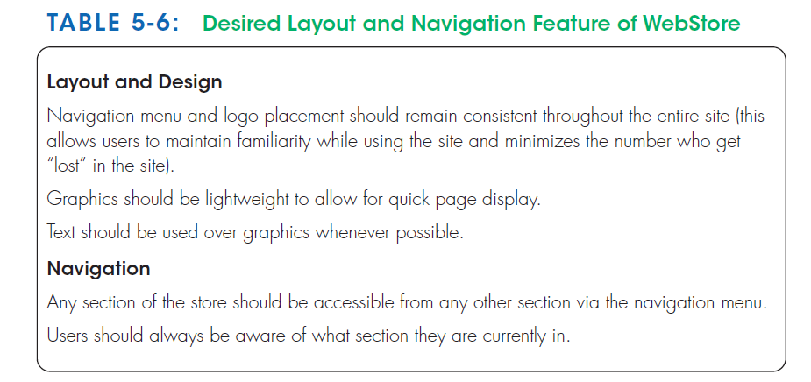
System Layout and Navigation Characteristics
As part of the process of preparing for the JAD session, all participants were asked to visit several established retail Web sites, including www.amazon.com, www.landsend.com, www.sony.com, and www.pier1.com.
At the JAD session, participants were asked to identify characteristics of these sites that they found appealing and those they found cumbersome (heavy) ; this allowed participants to identify and discuss those features that they wanted the WebStore to possess.
Previous Step :
System Requirement collection
( Chapter 5)

Slide 72
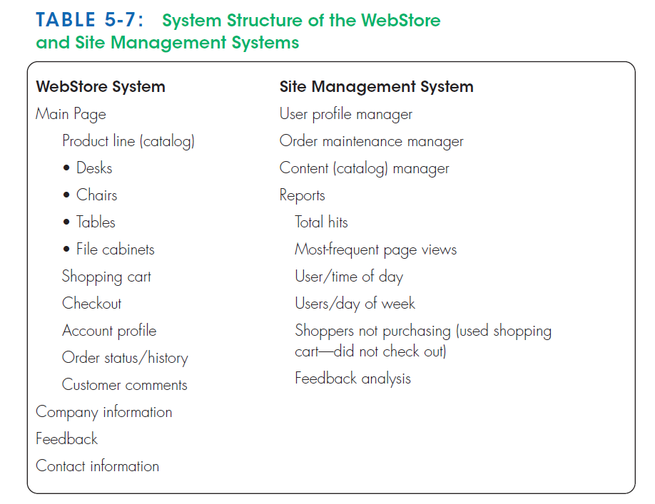
WebStore and Site Management System Capabilities
Systems analysts from IS department developed a draft skeleton of the WebStore based on the types of screens and capabilities of popular retail Web sites ( shopping cart)
Members of the sales and marketing department described several reports that would be necessary to manage customer accounts and sales transactions effectively. And they wants to be able to conduct detailed analyses of site visitors, sales tracking, and so on.
Members of the operations department expressed a need to update the product catalog easily.
These collective requests and activities were organized into a system design structure called the Site Management system.
The structures of both the WebStore and Site Management systems will be given to IS department as the baseline for further analysis and design activities.
Previous Step :
System Requirement collection
( Chapter 5)

Slide 73
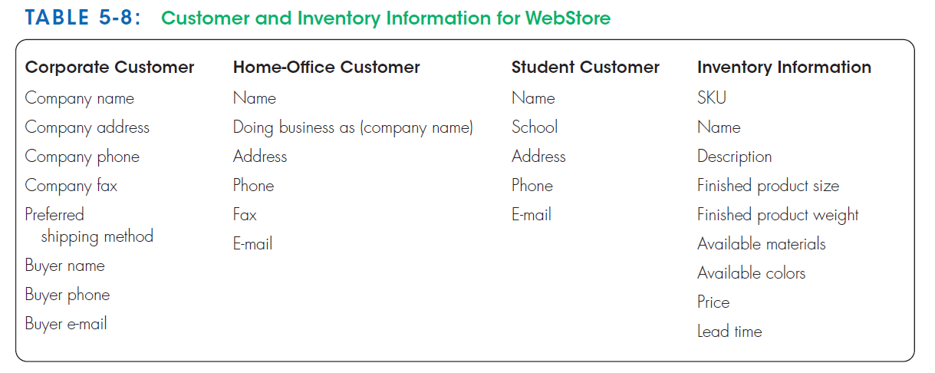
Customer and Inventory Information
The WebStore will be designed to support the furniture purchases of three distinct types of customers:
Corporate customers
Home-office customers
Student customers
To track the sales to these different types of customers effectively, the system must capture and store distinct information.
Orders reflect the range of product information that must be specified to execute a sales transaction.
Product and sales data must also be captured and stored.
Previous Step :
System Requirement collection
( Chapter 5)

Slide 74
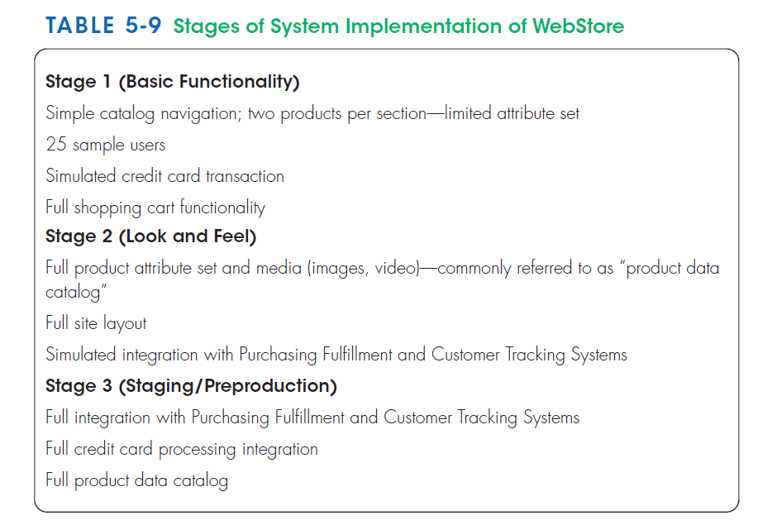
System Prototype Evolution
The JAD participants discussed, along with extensive input from the IS staff, how the system implementation should evolve.
After completing analysis and design activities, they agreed that the system implementation should progress in three main stages so that requirement changes could be more easily identified and implemented.
At the conclusion of the JAD session, They could begin to turn these lists of requirements into formal analysis and design specifications.
To show how information flows through the WebStore, They will produce data-flow diagrams (Ch6).
To show a conceptual model of the data used within the WebStore, they will generate an entity-relationship diagram (Ch7).
Both of these analysis documents will become the foundation for detailed system design and implementation.
Previous Step :
System Requirement collection
( Chapter 5)

Slide 75
Process Modeling for Pine Valley Furniture’s WebStore
After completing the JAD session, senior systems analyst went to work on translating the WebStore system structure into a data-flow diagram.
His first step was to identify the level-0—major system—processes.
To begin, he carefully examined the outcomes of the JAD session that focused on defining the system structure of the WebStore. From this analysis, he identified six high level processes that would become the foundation of the level-0 DFD.
Next, He determined that it would be most efficient if the WebStore system exchanged information with existing PVF systems rather than capturing and storing redundant information. (the Purchasing Fulfillment System—a system for tracking orders (discussed in Chapter 3)—and the Customer Tracking System (discussed in Chapter 4).
These two existing systems will be “sources” (providers) and “sinks” (receivers) of information for the WebStore system.
When a customer opens an account, his or her information will be passed from the WebStore system to the Customer Tracking System.
When an order is placed (or when a customer requests status information on a prior order), information will be stored in and retrieved from the Purchasing Fulfillment System.
The system would need to access two additional data sources.
First, in order to produce an online product catalog, the system would need to access the inventory database.
Second, to store the items a customer wants to purchase in the WebStore’s shopping cart, a temporary database would need to be created.

Slide 76
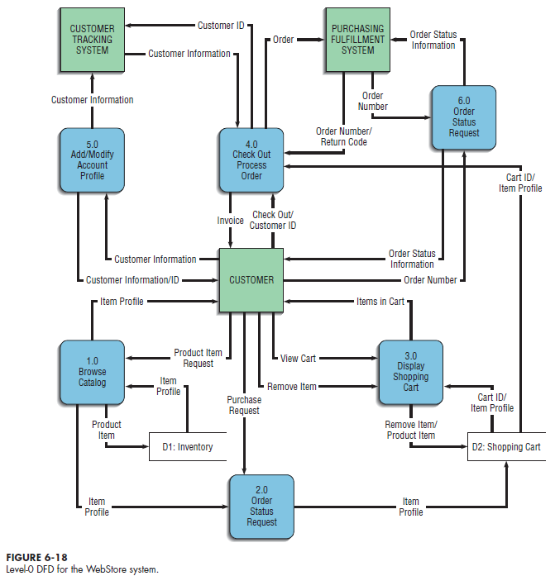
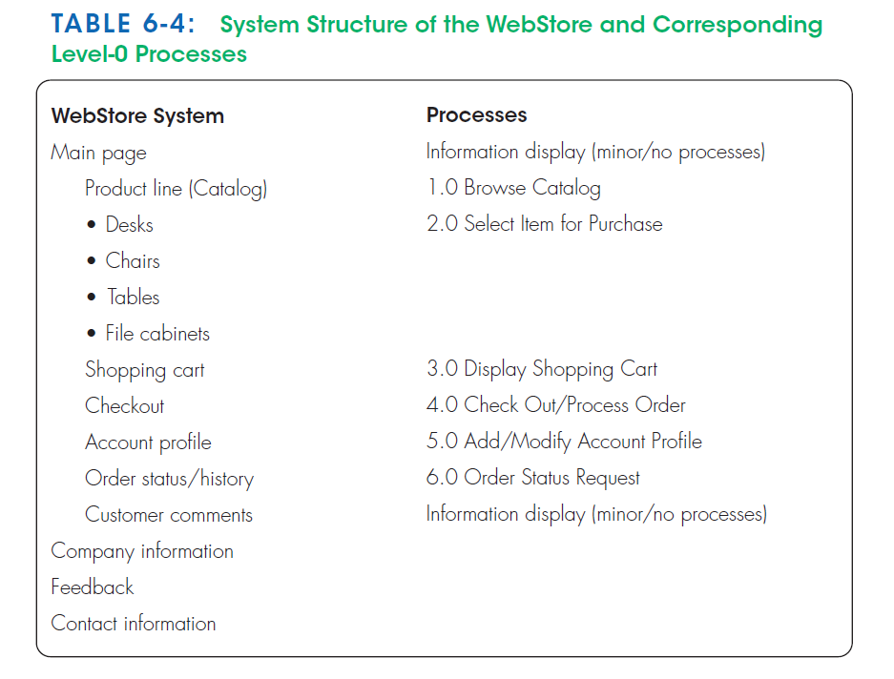

Slide 77
summary
Data-flow Diagrams (DFD)
Symbols
Rules for creating
Decomposition
Balancing
DFDs for Analysis
DFDs for Business Process Reengineering (BPR)
Logic Modeling
Decision Tables
Process Modeling for the Internet

Slide 78
Thank you for your attention
Any Questions
???

