Slide 2
What is pollution ?
When Harmful Substances Contaminate the Environment it is Called Pollution.
Pollution refers to the very bad condition of environment in terms of quantity and quality .

Slide 3
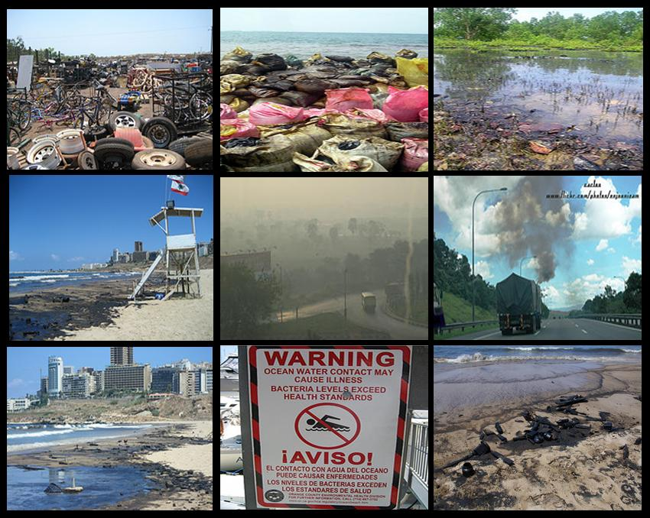
Types of pollution
Air Pollution
Water pollution
Noise Pollution
Soil Pollution
Personal Pollution
Radioactive Pollution

Slide 4
Industrial Pollution
Industrial pollution is pollution which can be directly linked with industry, in contrast to other pollution sources. This form of pollution is one of the leading causes of pollution worldwide
According to the Environmental Protective Agency (EPA), it has been estimated that up to 50% of the nation's pollution is caused by industry.

Slide 5
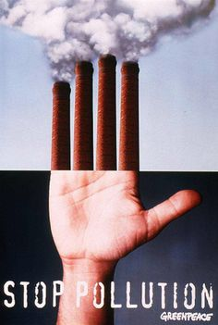
Why people are nowadays more concerned about industrial pollution more than before?
In the past the number of factories were limited and worked only a certain number of hours a day, the levels of pollution did not grow significantly. But when these factories became full scale industries and manufacturing units, the issue of industrial pollution started to take on more importance in endangering people and the environment.

Slide 6
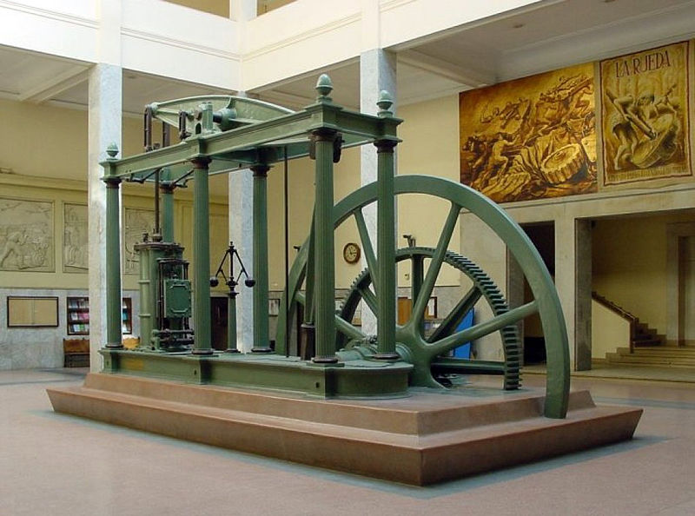
Industrial Revolution (1820 and 1840)
A Watt steam engine. James Watt transformed the steam engine from a reciprocating motion that was used for pumping to a rotating motion suited to industrial applications. Watt and others significantly improved the efficiency of the steam engine.
The Industrial Revolution marks a major turning point in history; almost every aspect of daily life was influenced in some way. In particular, average income and population began to exhibit unprecedented sustained growth. Some economists say that the major impact of the Industrial Revolution was that the standard of living for the general population began to increase consistently for the first time in history, although others have said that it did not begin to meaningfully improve until the late 19th and 20th centuries

Slide 7
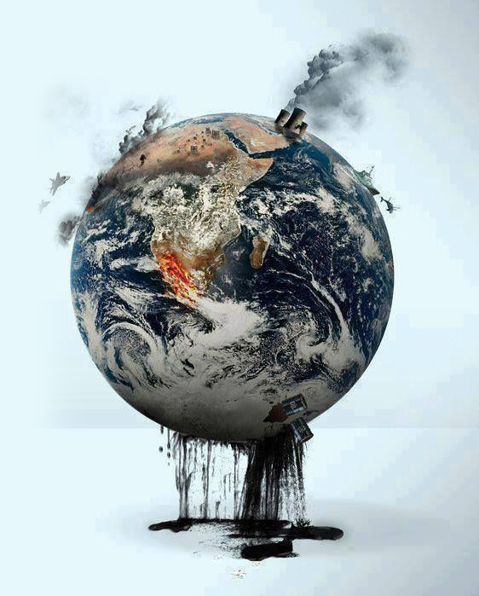
Industrial Pollution Types
1- Air Pollution
2- Water Pollution
3- Soil Pollution

Slide 8
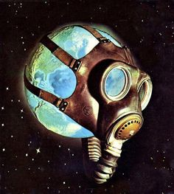
Air Pollution
Air pollution occurs when different toxic gases like carbon Di oxide, nitrogen Di oxide etc. get emitted from different industries and mix with atmosphere and cause environmental hazard.

Slide 9
The top countries with the highest oxide gases emissions
1- China
2- USA
3- Russia
4- India
5- Germany
Those countries are producing a large amount of toxic gases and release it into the atmosphere which causes many catastrophic impacts.

Slide 10
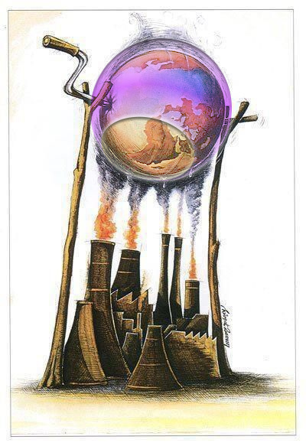
Air Pollution Impacts:
OZONE HOLE
This layer is present in the atmosphere, and it prevents too many harmful ultra violet rays from reaching earth. Ultra violet rays have the capability to destroy plants and animals and can cause skin cancer to human beings.
The main cause of the ozone hole was found to be gases that contained Cholorofluorocarbons (CFCs)

Slide 11
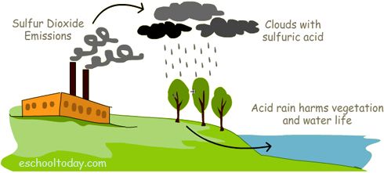
Acid Rain
Air pollutants can trigger a chemical reactions that create acidic compounds which can cause harm to humans, animals and plants
when sulfuric acid combines with the water droplets that make up clouds, the water droplets become acidic, forming acid rain. When acid rain falls over an area, it can kill trees and harm animals, fish, and other wildlife.

Slide 12
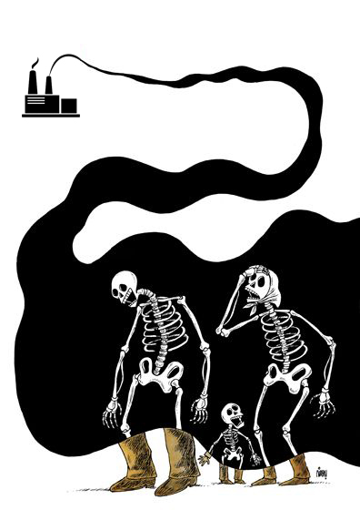
Air pollution kills people
There are many diseases that may be caused by air pollution. Such as Asthma and Lung Cancer. Also increases the risk of heart disease and stroke.
According to a new study by Harvard University
Air pollution kills 3.3 million people every year

Slide 13
Global Warming
Global warming is primarily a problem of too much carbon dioxide (CO2) in the atmosphere - which acts as a blanket, trapping heat and warming the planet
A warming world also has the potential to change rainfall and snow patterns, reduce lake ice cover, melt glaciers, increase sea levels, and change plant and animal behavior.

Slide 14
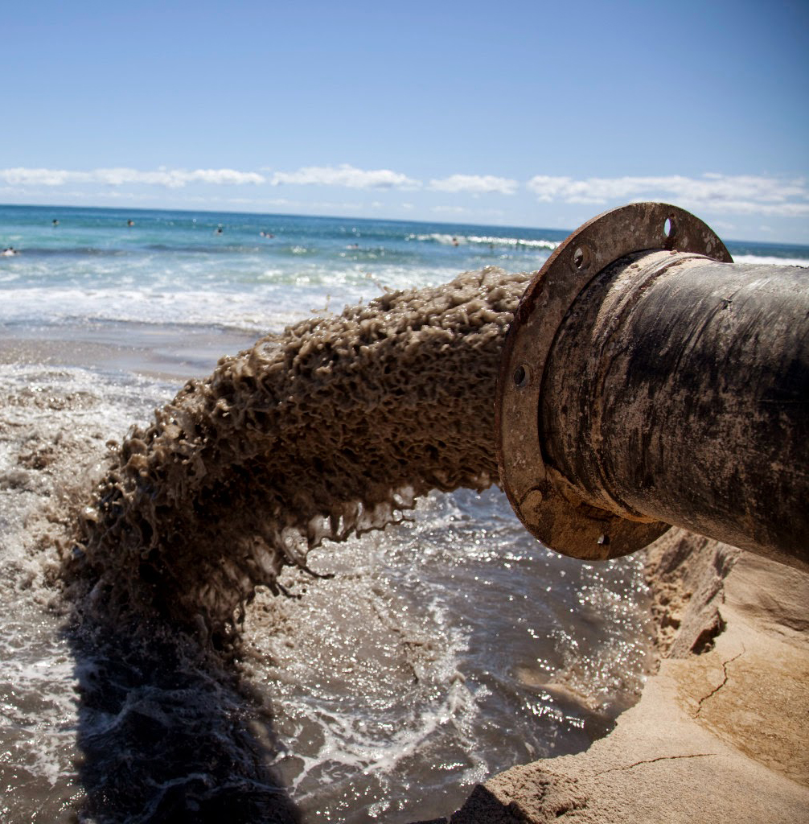
Water Pollution
occur when pollutants (chemicals or substances that make water contaminated) are discharged directly or indirectly into water without enough treatment to get rid of harmful compounds.
Industries cause huge water pollution with their activities.

Slide 15
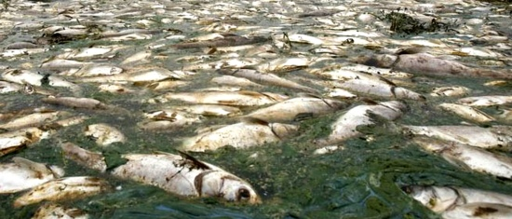
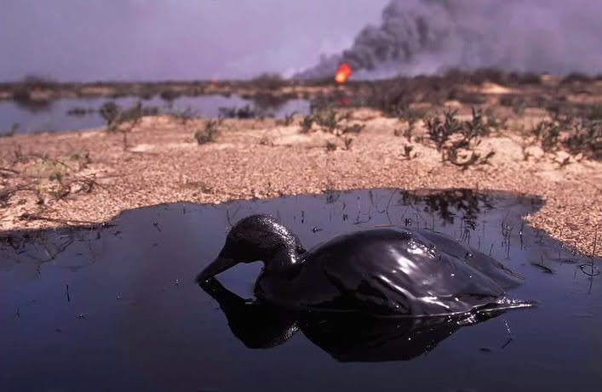
Many industrial facilities use freshwater to carry away waste from the plant and into rivers, lakes and oceans.
negative impacts on wild animals and the environment as a whole.

Slide 16
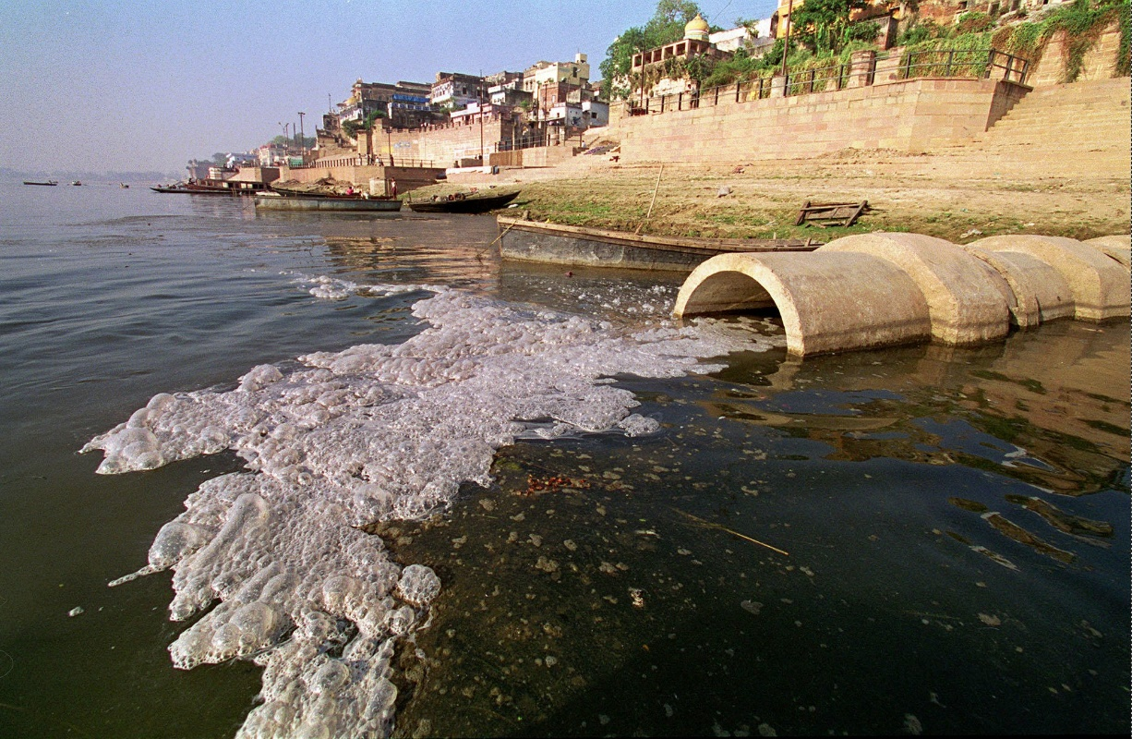
Water is essential to human life and There are many diseases caused by water pollution.
1- Cholera
2- Diarrhea
3- Hepatitis
4- Typhoid Fever
5- Malaria

Slide 17
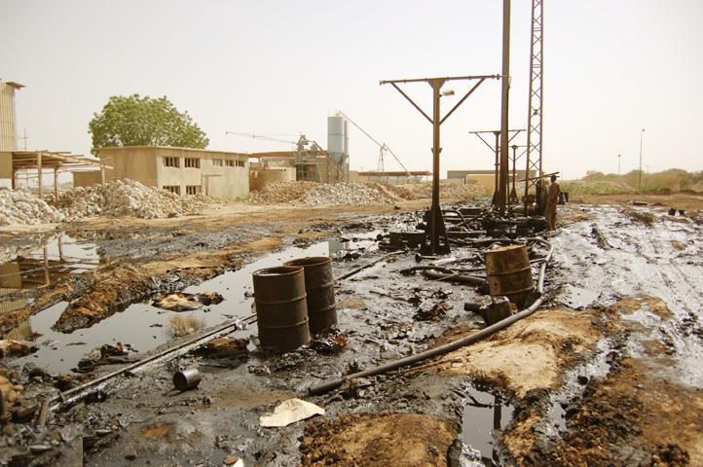
Soil Pollution
Large quantity of solid wastes like unused and rejected chemicals, unwanted industrial wastes generated (plastic or wooden solids) are dumped over on the surface of soil by almost all industries with difference in degree.
The industrial waste lingers in the soil surface for a long time and makes it unsuitable for use

Slide 18
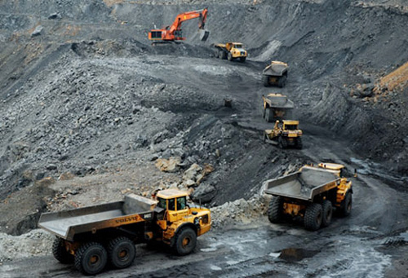
Industrial activity has been the biggest contributor to the problem in the last century, especially since the amount of mining and manufacturing has increased.

Slide 19
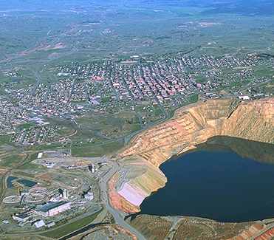
Berkeley Pit Lake
the lake is known as the ‘most deadly lake in the United States’. It was a copper mine, groundwater pumped into it and now it hold 40 billion gallons of acid water and toxic chemicals

Slide 20
Soil Pollution Impacts:
Many common soil pollutants are carcinogenic (cancer-cause)
It Can lead to water pollution if toxic chemicals leach into groundwater
It causes changes in Soil Structure

Slide 22
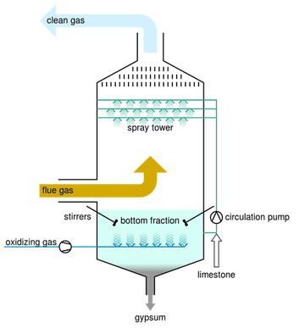
Solutions
Air pollution solution:
The industries should implement Scrubber systems are a diverse group of air pollution control devices that can be used to remove some particulates and/or gases from industrial exhaust streams or chimneys.

Slide 23
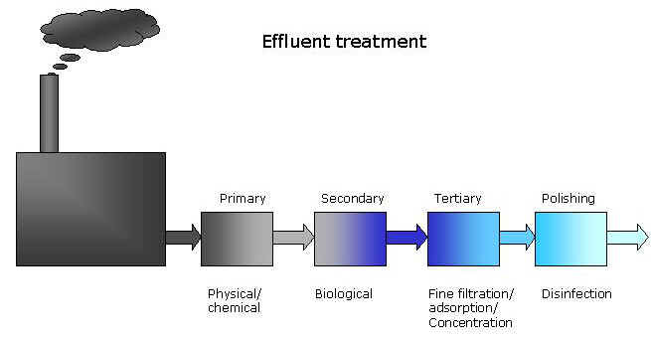
Water pollution solution:
An effective solution to industrial water pollution is to ensure that pollution from industrial wastewater does not reach waterways unless it is treated by an Effluent treatment plant.

Slide 24
POLLUTION If you don’t kill it , it will kill you
Be a part of solution not part of Pollution

Slide 25
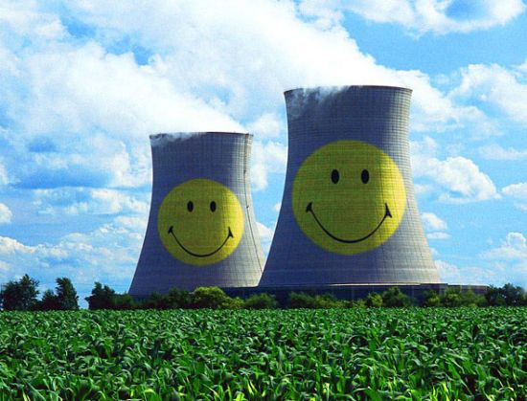
Thank you so much for your listening.
Any Question?

