Slide 1
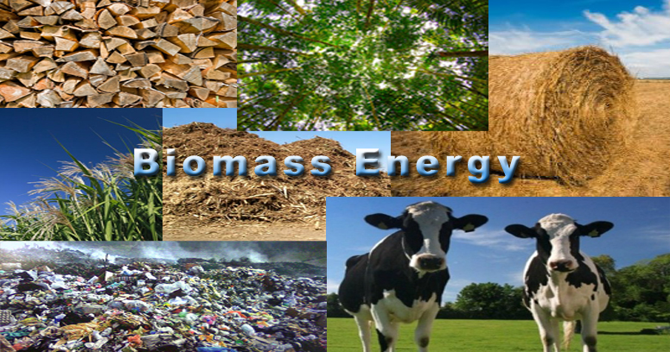

Slide 2
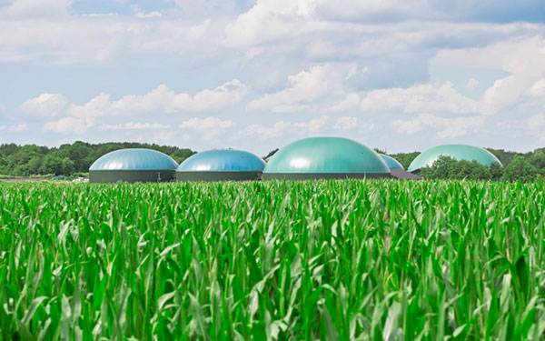
Renewable energy is generally defined as energy that is collected from resources which are naturally replenished on a human timescale, such as sunlight, wind, rain, tides, waves.

Slide 3
Types of renewable
Solar Energy
Wind Energy
Bioenergy
Geothermal Energy
Hydro Energy
Ocean Energy

Slide 5
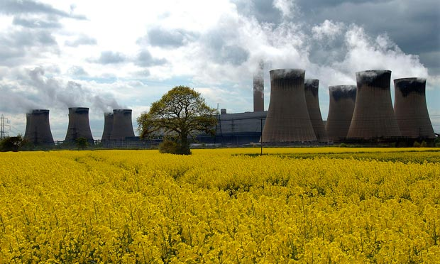
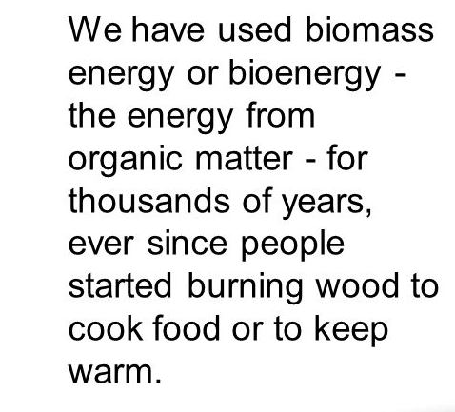
HISTORY OF BIOMASS
HI
History of Biomass

Slide 7
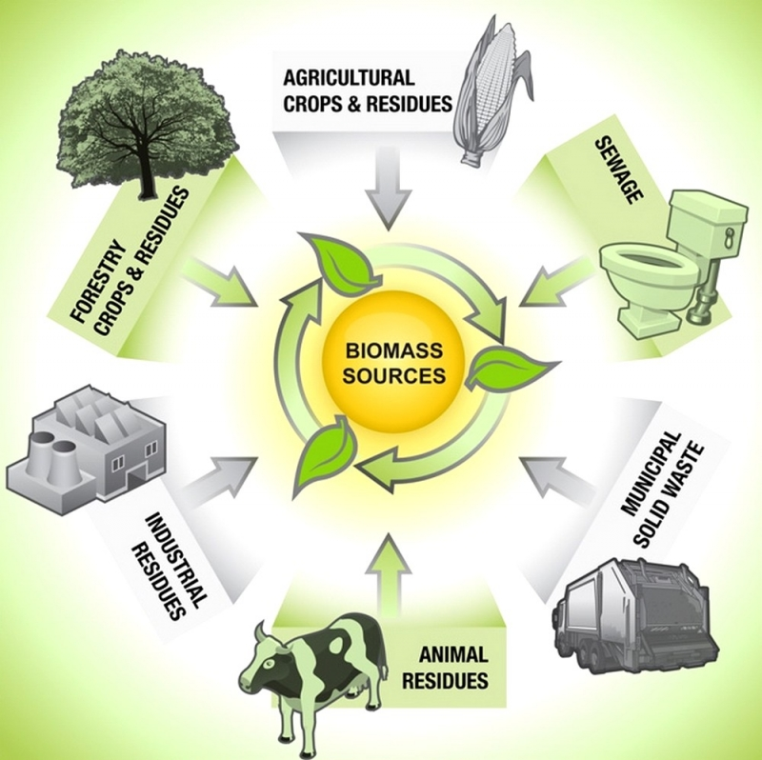
Definition of biomass
Fuel developed from organic materials, a sustainable source of energy used to create electricity or other forms of power
Biomass includes all of the earth’s living matters, which are plants and animals…etc.
It’s internationally considered as a renewable source of energy

Slide 8
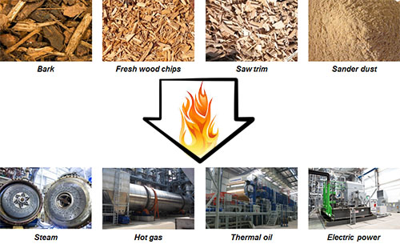
It is based on carbon and composed of a mixture of organic molecules such as hydrogen, atoms of oxygen, nitrogen, and some quantities of other atoms.
As an energy source, biomass can either be used directly via combustion to produce heat

Slide 10
Some usage of biomass :
Ethanol
Ethanol made from plant can be blended with or directly substitute for gasoline.
Biodiesel Biodiesel is made from vegetable oil or animal fat instead of petroleum, can be blended with or directly substitute for diesel
Gaseous fuel
Animal wastes broken down by bacteria through an anaerobic process produces methane

Slide 11
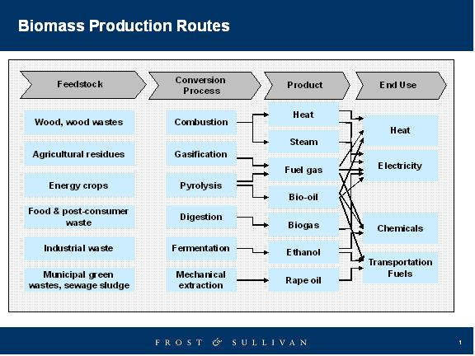
Biomass energy
conversion
technologies:
Combustion
Pyrolysis
Anaerobic Digestion-biogas
Gasification
Fermentation

Slide 12
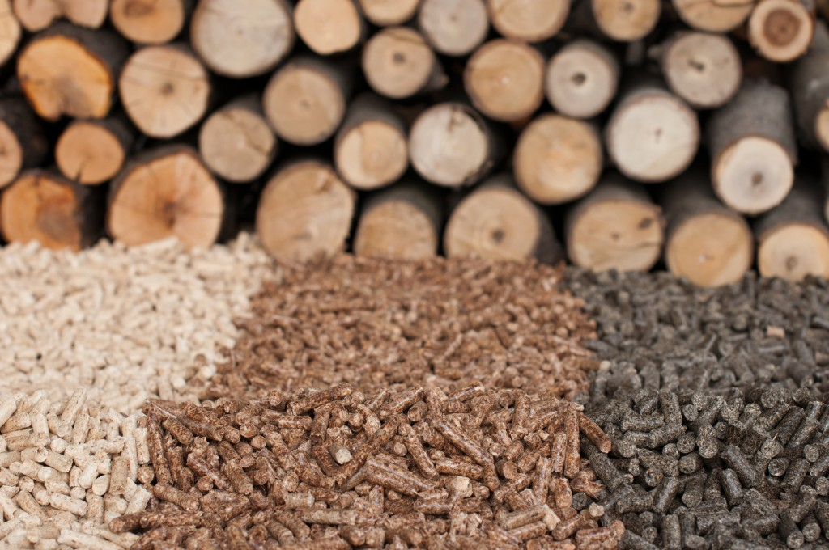
Advantages of utilizing biomass :
1. No Harmful Emissions-Biomass energy creates no harmful carbon dioxide emissions
2.Clean Energy
3.Abundant and Renewable-these products potentially never run out
4. Reduce Dependency on Fossil
5.Reduce Landfills -can take waste that is harmful to the environment and turn it into something useful. For instance, garbage as landfill can, at least partially, be burned to create useable biomass energy.
6. Can be Used to Create Different Products -different forms of organic matter can be used to create different products-

Slide 13
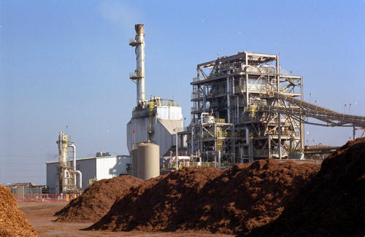
Disadvantages of Biomass Energy
1. Expensive
2. Inefficient as Compared to Fossil Fuels
3. Harmful to Environment
4. Consume More Fuel
5. Require More Land

Slide 14
Environmental impact
The environmental repercussions of using biomass as a source of fuel vary according to the type of conversion technology. The combustion of biomass produces significantly fewer nitrogen oxides and sulphur dioxide than the burning of fossil fuels.
Unlike fossil fuel combustion, the use of biomass fuels in a well managed, sustainable production programme will not contribute to carbon dioxide levels that cause global warming.

Slide 15
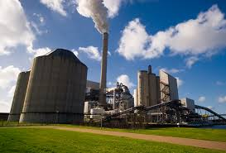
Application of biomass
At home
Industrial business Wood and agricultural residues are burned as a fuel for cogeneration of steam and electricity in the industrial sector
Power plant Biomass materials can also be used directly in the manufacturing of a variety of products.

Slide 16
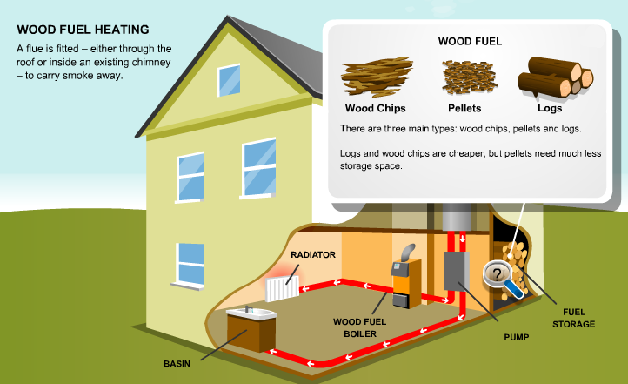
At home
Wood-fuelled heating systems, also called biomass systems, burn wood pellets, chips or logs to provide warmth in a single room or to power central heating and hot water boilers.

Slide 17
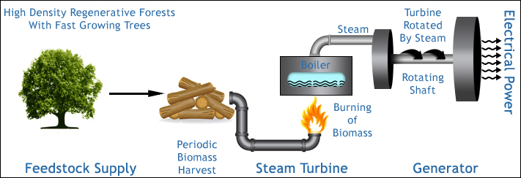
Industrial Process Heat and Steam
Combined heat and power systems utilizing biomass are used in industry to and process heat
It is a simple process to harness the energy created by biomass. The waste wood and other sources are gathered in large quantities, It is then transported to a biomass plant. Then it is fed into furnaces where it is burned. The heat created is used to boil water and the steam is what is used to rotate the turbines and generators.

Slide 18
Expensive: Firstly, its expensive.
Inefficient as Compared to Fossil Fuels: Secondly, and connected to the first, is the relative inefficiency of biomass energy. Ethanol, as a biodiesel is terribly inefficient when compared to gasoline, and it often has to be mixed with some gasoline to make it work properly anyway. On top of that, ethanol is harmful to combustion engines over long term use.
3. Harmful to Environment: Thirdly, using animal and human waste to power engines may save on carbon dioxide emissions, but it increases methane gases, which are also harmful to the Earth’s— ozone layer. So really, we are no better off environmentally for using one or the other. And speaking of using waste products, there is the smell to consider. While it is not physically harmful, it is definitely unpleasant, and it can attract unwanted pests (rats, flies) and spread bacteria and infection.
4. Consume More Fuel: Finally, using trees and tree products to power machines is inefficient as well. Not only does it take a lot more fuel to do the same job as using conventional fuels, but it also creates environmental problems of its own. To amass enough lumber to power a nation full of vehicles or even a power plant, companies would have to clear considerable forest area. This results in major topological changes and destroys the homes of countless animals and plants.
5. Require More Land: Combustion of biomass products require some land where they can easily be burnt. Since, it produces gases like methane in atmosphere; therefore it can be produced in those areas which are quite far from residential homes.

Slide 19
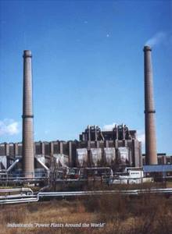
Pecs
One of the biggest biomass station in the world.
Location: Hungary
Configuration: 2 X 35, 2 X 65 MW
Fuel: wood, natural gas
Quick facts: This CHP plant was originally coal-fired.
In 2004, one of the 65-MW units was converted by Kvaerner to burn wood and the two 35-MW units were converted to gas.

Slide 20
Conclusion
Biomass is a potential alternative energy source to fossil fuels but it is not very viable.

