Slide 1
ENVIRONMENT POLLUTION AND CONTROL
Görkem Magemizoğlu
Kaan ŞEN

Slide 2
Environmental Pollution
Environmental Pollution can be defined as any undesirable change in physical, chemical, or biological characteristics of any component of the environment i.e. air, water, soil which can cause harmful effects on various forms of life or property.
Pollution: The term pollution can be defined as influence of any substance causing nuisance, harmful effects, and uneasiness to the organisms
Pollutant:- Any substance causing Nuisance or harmful effects or uneasiness to the organisms, then that particular substance may be called as the pollutant.

Slide 3
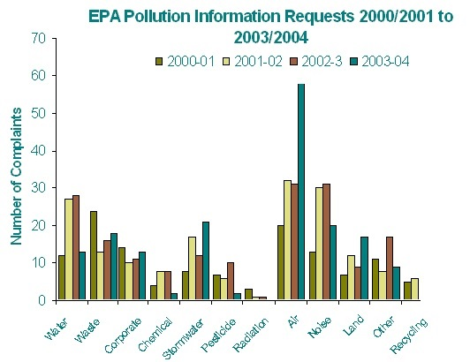

Slide 4
Types of Pollution
WATER POLLUTION
AIR POLLUTION
LAND POLLUTION
NOISE POLLUTION

Slide 5
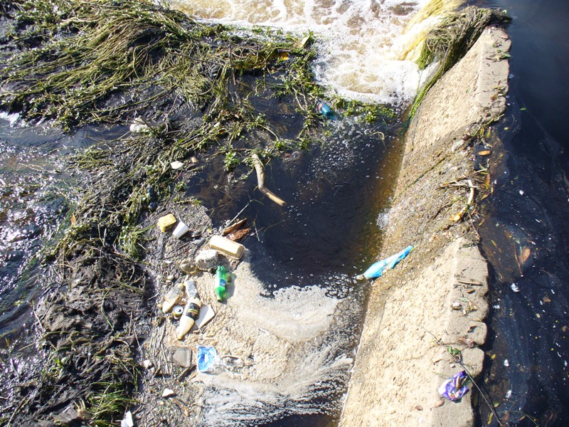
WATER POLLUTION

Slide 6
Water Pollution can be defined as alteration in physical, chemical, or biological characteristics of water through natural or human activities and making it unsuitable for its designated use.
Fresh Water present on the earth surface is put to many uses. It is used for drinking, domestic and municipal uses, agricultural, irrigation, industries, navigation, recreation. The used water is called waste water.

Slide 7
Sources of Water Pollution
The sources of water pollution can be classified as
Municipal Waste Water
Industrial Waste
Inorganic Pollutants
Organic Pollutants
Agricultural Wastes
Marine Pollution
Thermal pollution

Slide 8
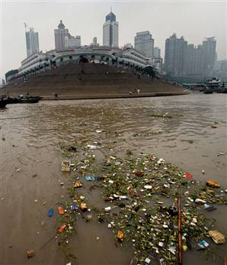
Municipal Waste Water

Slide 9
Industrial Waste
The major source of water pollution is the waste water discharged from industries. They discharge several organic and inorganic pollutants. That prove highly toxic to living beings.

Slide 10
Industrial Waste

Slide 11
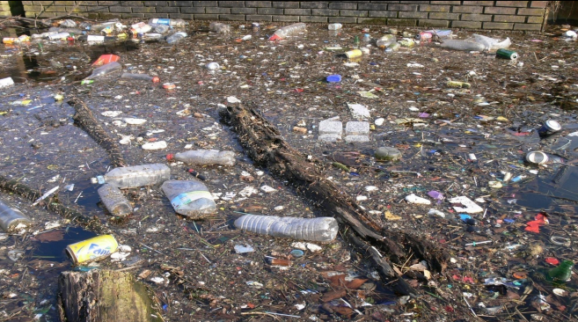
Inorganic Pollutants
They include fine particles of different metals, chlorides, sulphates, oxides of iron, cadmium, acids and alkalies.

Slide 12
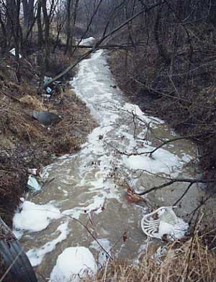
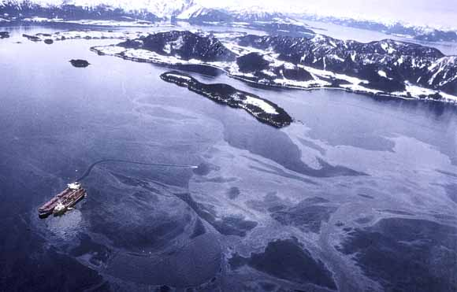
Organic Pollutants
They Include oils, fats, phenols, organic acids grease and several other organic compounds

Slide 13
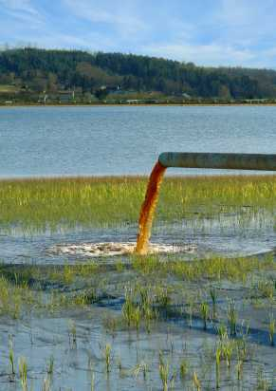
Agricultural Wastes
Chemical fertilizers and pesticides have become essential for present day high yielding crops.
Consequently , they have become a potential source of water pollution. These fertilizers contain major plants nutrients mainly nitrogen, phosphorous, and potassium.

Slide 14
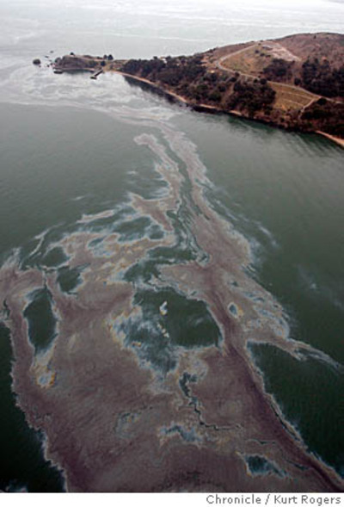
Marine Pollution
Ocean are the final sink of all natural and manmade pollutants. Rivers discharge their pollutants into the sea. The other sources include, discharge of oils, grease, detergents and radioactive wastes from ships.

Slide 15
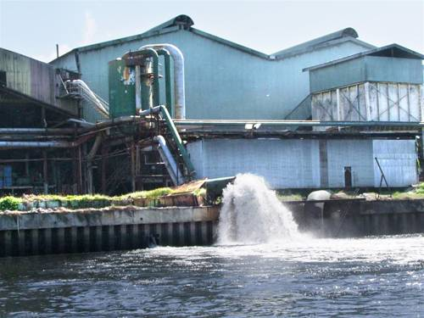
Thermal Pollution
The main source of thermal pollution are the thermal and nuclear power plants. The power generating plants use water as coolants and release hot water into the original source. Sudden rise in temperature kills fish and other aquatic animals.

Slide 16
Air Pollution

Slide 17
Air pollution is the introduction of chemicals, particulate matter, or biological materials that cause harm or discomfort to humans or other living organisms, or cause damage to the natural environment or built environment, into the atmosphere.
A substance in the air that can cause harm to humans and the environment is known as an air pollutant.

Slide 18
Causes of Air Pollution
Carbon dioxide-this happens because of Deforestation and fossil fuel burning.
Sulfur dioxide –Due to the burning of sulfur containing compounds of fossil fuels.
Sulfur oxides- in the atmosphere is responsible for acid rain.

Slide 19
Consequences of Air Pollution
CO2 (Carbon dioxide) is a good transmitter of sunlight which produces the so called greenhouse effect that prevents a drastic cooling of the Earth during the night.
CO2 in atmosphere --> GLOBAL WARMING

Slide 20
Land Pollution

Slide 21
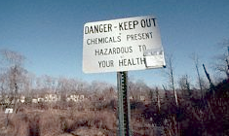
Land pollution is the demolition of Earth's land surfaces often caused by human activities and their misuse of land resources. Appears when the waste is properly disposed.
Urbanization and industrialization are major causes of land pollution.

Slide 22
Causes of Land Pollution
Four Main causes of land pollution:
Construction
Agriculture
Domestic waste
Industrial Waste

Slide 23
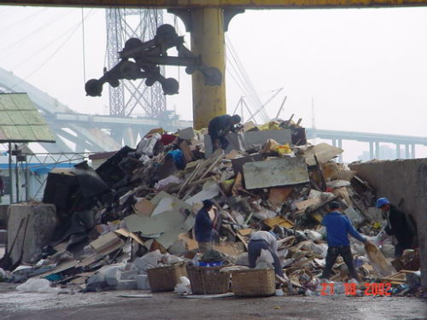
Construction
Buildings take up resources and land, the trees are chopped down and used to make buildings.
Takes away the places for animals and other organisms to live.

Slide 24
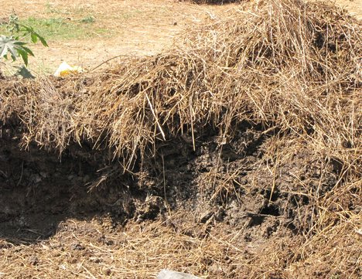
Agriculture
As there are more and more people inhabiting the earth, food is in higher demand and so forests are chopped down and turned into farmland
In addition, herbicides, pesticides, artificial fertilizers are washed into the soil and pollute it.

Slide 25
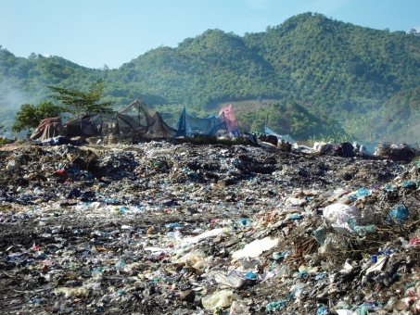
Domestic Waste
Tons of domestic waste is dumped every day. Some waste
from homes, offices and industries can be recycled or
burnt in incinerators .
There is still a lot of garbage, such as refrigerators and
washing machines that are dumped in landfills simply
because they cannot be reused in anyway, not recycled .

Slide 26
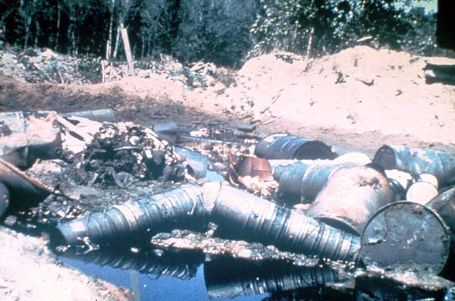
Industrial Waste
Plastics factories, chemical plants, oil refineries, nuclear waste disposal activity, large animal farms, coal-fired power plants, metals production factories and other heavy industry all contribute to land pollution.

Slide 27
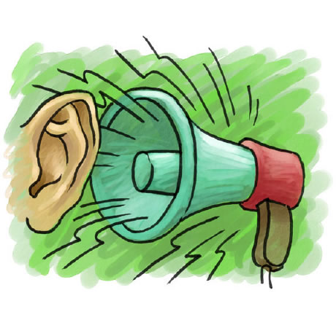
NOISE POLLUTION

Slide 28
Noise pollution is excessive, displeasing human, animal, or machine-created environmental noise that disrupts the activity or balance of human or animal life.
World Health Organization stated that “Noise must be recognized as a major threat to human well-being”

Slide 29
Sources of Noise Pollution
Transportation systems (Traffic) are the main source of noise
pollution in urban areas.
Construction of buildings, highways, and streets cause a lot
of noise, due to the usage of air compressors, bulldozers,
loaders, dump trucks, and pavement breakers.
Industrial noise also adds to the already unfavorable
state of noise pollution.
Loud speakers, generators, air conditioners, fans and many household appliances add to the existing noise pollution.

Slide 30
Effects of NOISE POLLUTION
According to the US EPA, there are direct links between
noise and health. Also, noise pollution affects badly the
lives of millions of people.
High blood pressure, stress related illness, sleep disruption, hearing loss, and productivity loss are problems related to noise pollution.
It can also cause memory loss, severe depression, and panic
attacks.

Slide 31
Solutions for Noise Pollution
Planting bushes and trees in and around sound
generating sources is an effective solution for noise pollution.
Social awareness programs should be taken up to educate the public about the causes and effects of noise pollution.

Slide 32
Similar to automobiles, lubrication of the machinery and servicing should be done to minimize noise generation.
Regulations should be imposed to restrict the usage
of play loudspeakers in crowded areas and public
places.
Factories and industries should be located far from
the residential areas.

Slide 33
WAYS TO STOP POLLUTION
We believe that it is the responsible thing to do to increase recycling.
It is just like doing laundry and separating blacks and colors.
The residents of the country should also try and do their part and put in at least one day of litter picking up.

Slide 34
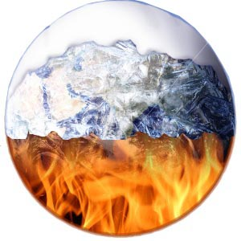
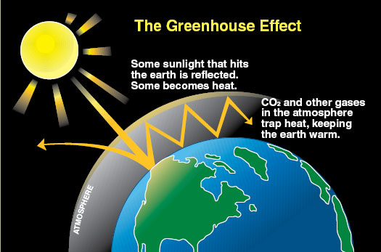
GLOBAL WARMING AND THE GREENHOUSE EFFECT
Global Warming
Greenhouse Effect

Slide 35
difference between Global Warming and the Greenhouse Effect
Global warming refers to a rise in the
temperature of the surface of the earth.
The Greenhouse Effect is a process by which
thermal radiation from a planetary surface is
absorbed by atmospheric greenhouse gases,
and is re-radiated in all directions.

Slide 36
Some Proof of Global Warming
Portage Glacier Alaska then..
Portage Glacier Alaska now..
Notes:
Portage Glacier Alaska then….

Slide 37
Colorado River, As of
June 2002
Colorado River, As of
December 2003

Slide 38
ANY QUESTIONS??

Slide 39
THANK YOU
for
LISTENING

