Slide 1
Software Architecture
Notes:
Is the notion of software architecture really important?

Slide 2
Software Architecture
Software architecture refers to the high level structures of a software system, the discipline of creating such structures, and the documentation of these structures. These structures are needed to reason about the software system.
An architectural pattern is a general, reusable solution to a commonly occurring problem in software architecture within a given context. Architectural patterns are similar to software design pattern but have a broader scope.
Wikipedia

Slide 3
Architectural Patterns
The fundamental problem to be solved with a large system is how to break it into chunks manageable for human programmers to understand, implement, and maintain.
Large-scale patterns for this purpose are called architectural patterns.

Slide 4
Architecture Patterns
Layered pattern
Client-server pattern
Master-slave pattern
Pipe-filter pattern
Broker pattern
Peer-to-peer pattern
Event-bus pattern
Model-view-controller pattern
Blackboard pattern
Interpreter pattern

Slide 5
1. Layered pattern
This pattern is also known as n-tier architecture pattern.
It can be used to structure programs that can be decomposed into groups of subtasks, each of which is at a particular level of abstraction.
Each layer provides services to the next higher layer.
Usage
General desktop applications.
E commerce web applications.

Slide 6
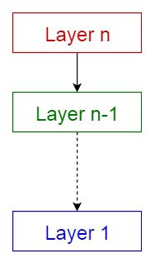
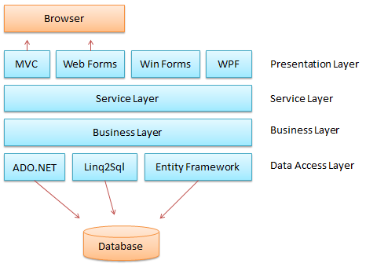
Common layers of a general information system
Presentation layer (also known as UI layer)
Application layer (also known as service layer)
Business logic layer (also known as domain layer)
Data access layer (also known as persistence layer)

Slide 7
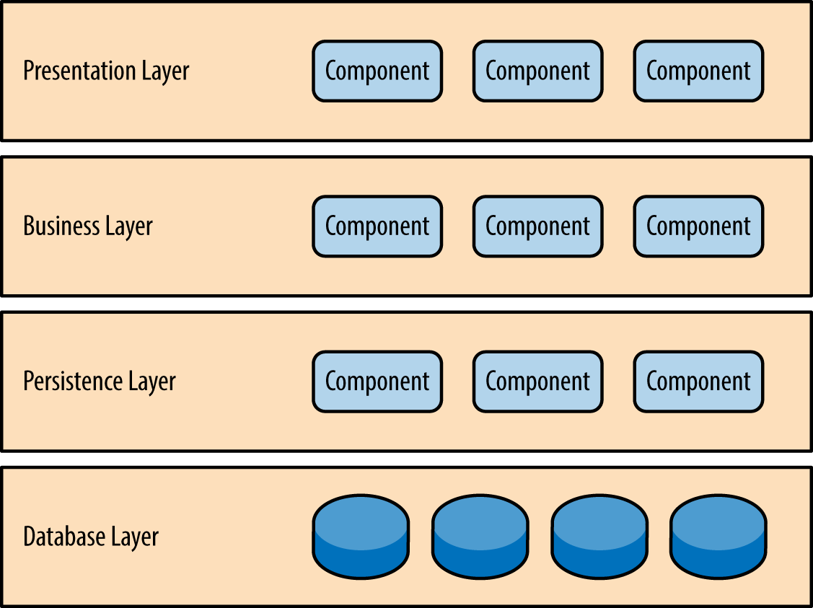
Layered pattern
  Different levels of abstraction
  Requests go down, notifictions go back up
  Possible to define stable interaces between layers
  May add or change layers over time

Slide 8
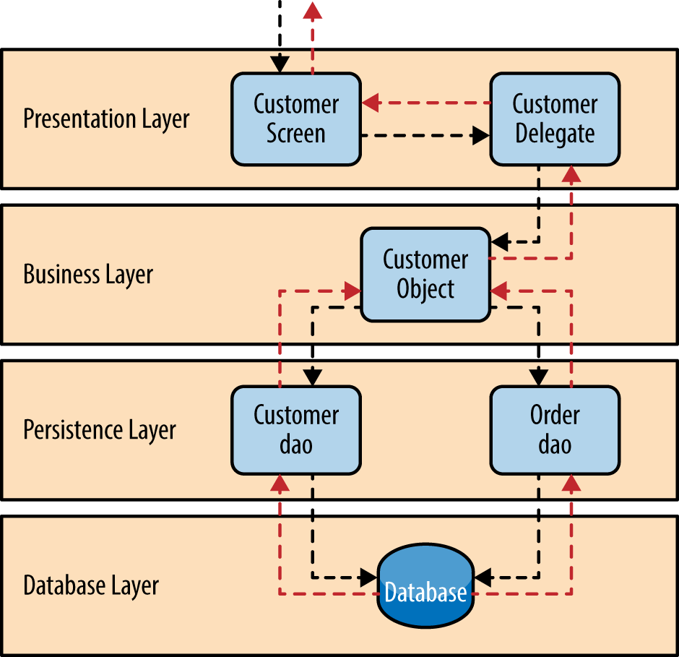
Solution
Layered pattern
Start with the lowest later
Build layers on top
Use same level of abstraction within each layer
Componenets cannot spread over two layers
Keey lower layers lean
Specify interfaces for each layer
Handle errors at the lowest level possible

Slide 9
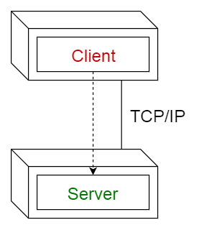
2. Client-server pattern
This pattern consists of two parties;
  a server and
  multiple clients.
The server component will provide services to multiple client components.
Clients request services from the server and the server provides relevant services to those clients.
The server continues to listen to client requests.
Usage
Online applications such as email, document sharing and banking.

Slide 10
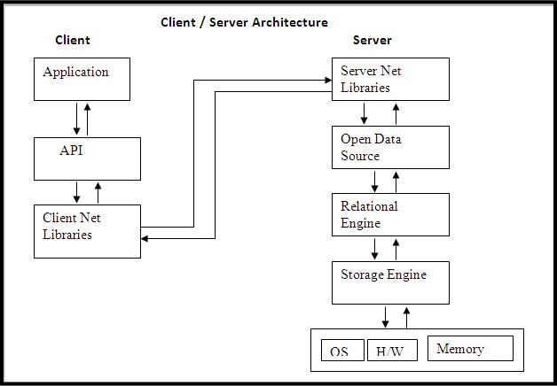

Slide 11
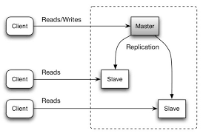
3. Master-slave pattern
This pattern consists of two parties;
  master and
  slaves.
The master component distributes the work among identical slave components, and computes a final result from the results which the slaves return.
Usage
In database replication, the master database is regarded as the authoritative source, and the slave databases are synchronized to it.
Peripherals connected to a bus in a computer system (master and slave drives).

Slide 12
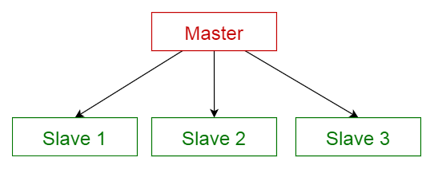

Slide 13
4. Pipe-filter pattern
This pattern can be used to structure systems which produce and process a stream of data.
Each processing step is enclosed within a filter component.
Data to be processed is passed through pipes.
These pipes can be used for buffering or for synchronization purposes.
Usage
Compilers. The consecutive filters perform lexical analysis, parsing, semantic analysis, and code generation.
Workflows in bioinformatics.

Slide 14
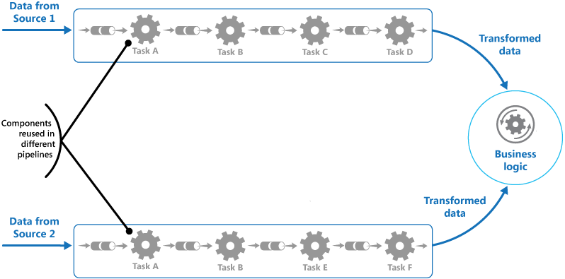
Pipes eliminate need for intermediate files
Can replace filters easily
Can achive different effects through recombination
İf data stream format is standard, filters ay bbe developed independently
Parallelization possible

Slide 15
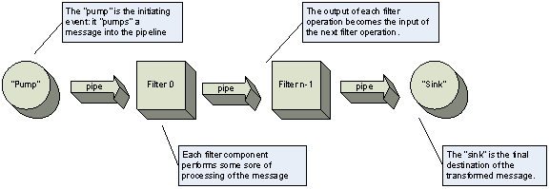
Data Stream processing may be subdivided into stages
May recombine stages
Non adjacent stages do not share information
May desire different stages to be on different processors
Standardized data structure between stages

Slide 16
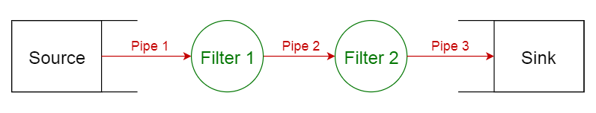

Slide 17
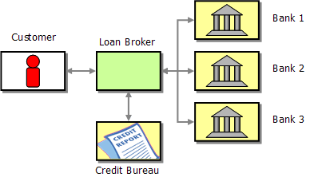
5. Broker pattern
This pattern is used to structure distributed systems with decoupled components.
These components can interact with each other by remote service invocations.
A broker component is responsible for the coordination of communication among components.
Servers publish their capabilities (services and characteristics) to a broker.
Clients request a service from the broker, and the broker then redirects the client to a suitable service from its registry.
Usage
Message broker software such as Apache ActiveMQ, Apache Kafka, RabbitMQ and JBoss Messaging.

Slide 18
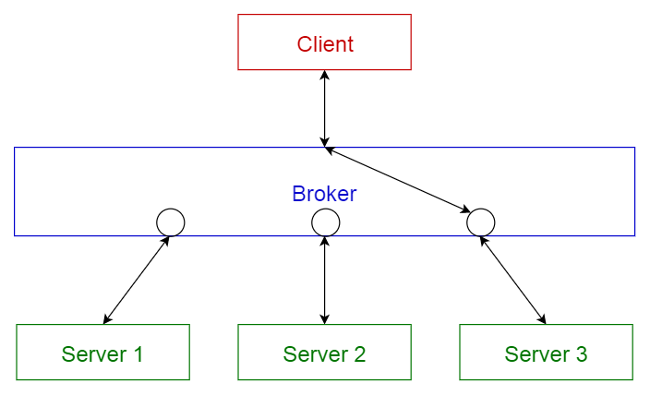

Slide 19
6. Peer-to-peer pattern
In this pattern, individual components are known as peers.
Peers may function both as a client, requesting services from other peers, and as a server, providing services to other peers.
A peer may act as a client or as a server or as both, and it can change its role dynamically with time.
Usage
File-sharing networks such as Gnutella and G2)
Multimedia protocols such as P2PTV and PDTP.
Proprietary multimedia applications such as Spotify.

Slide 20
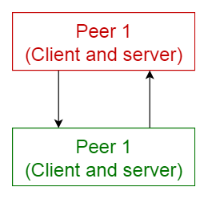

Slide 21
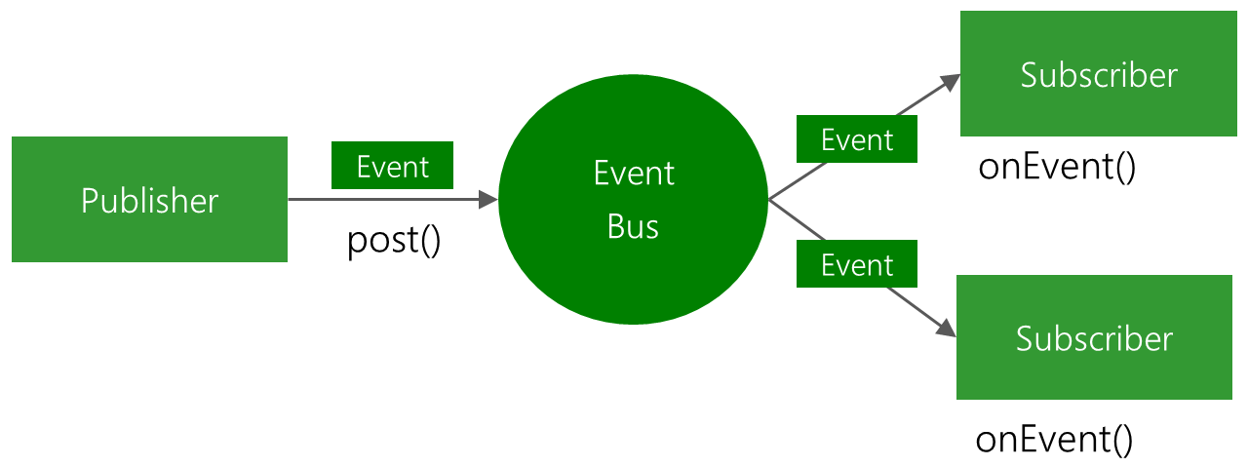
7. Event-bus pattern
This pattern primarily deals with events and has 4 major components;
  event source,
  event listener,
  channel and
  event bus.
Sources publish messages to particular channels on an event bus.
Listeners subscribe to particular channels.
Listeners are notified of messages that are published to a channel to which they have subscribed before.
Usage
Android development
Notification services

Slide 22
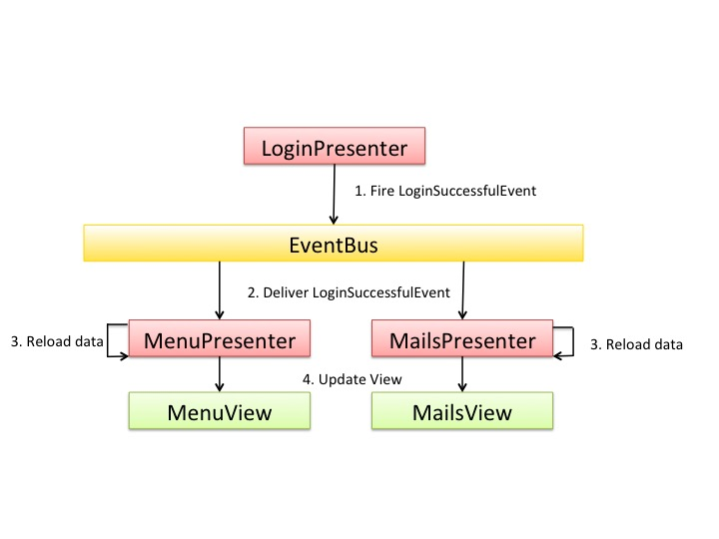
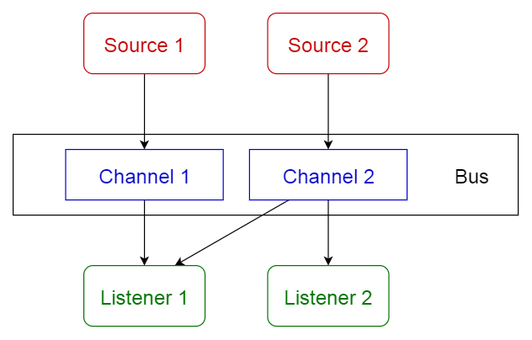

Slide 23
8. Model-view-controller pattern
This pattern, also known as MVC pattern, divides an interactive application in to 3 parts as,
model — contains the core functionality and data
view — displays the information to the user (more than one view may be defined)
controller — handles the input from the user
This is done to separate internal representations of information from the ways information is presented to, and accepted from, the user. It decouples components and allows efficient code reuse.
Usage
Architecture for World Wide Web applications in major programming languages.
Web frameworks such as Django and Rails.

Slide 24
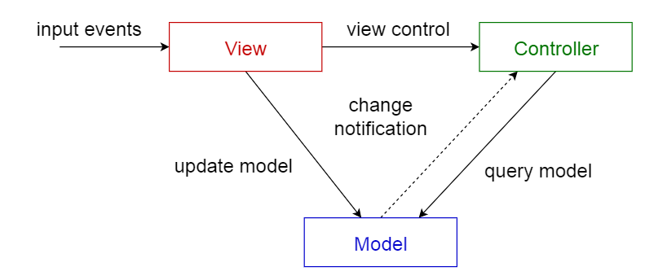

Slide 25
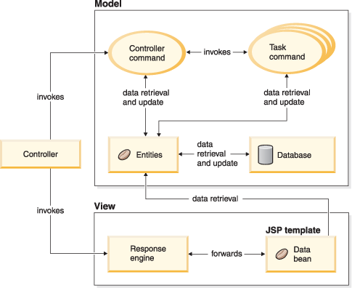

Slide 26
9. Blackboard pattern
This pattern is useful for problems for which no deterministic solution strategies are known. The blackboard pattern consists of 3 main components.
  blackboard — a structured global memory containing objects from the solution space
  knowledge source — specialized modules with their own representation
  control component — selects, configures and executes modules.
All the components have access to the blackboard.
Components may produce new data objects that are added to the blackboard.
Components look for particular kinds of data on the blackboard, and may find these by pattern matching with the existing knowledge source.
Usage
Speech recognition
Vehicle identification and tracking
Protein structure identification
Sonar signals interpretation.

Slide 27
Problem solvers work independently on part of the problem
Share common data structure
Central controller manages access to the blackboard
Blackboard may be strcured in levels of abtraction to allow work at different levels
Blackbpard contain original input and partial solutions

Slide 28
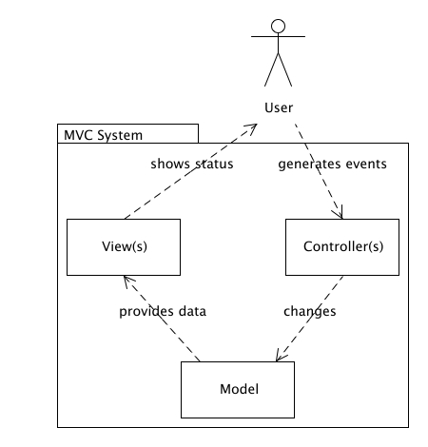
Difficult to test
Difficult to guarantee an optimal solution
Control strategy often heuristic
May be computationally expensive
Parallelism possible

Slide 29
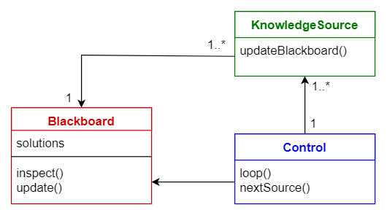

Slide 30
10. Interpreter pattern
This pattern is used for designing a component that interprets programs written in a dedicated language.
It mainly specifies how to evaluate lines of programs, known as sentences or expressions written in a particular language.
The basic idea is to have a class for each symbol of the language.
Usage
Database query languages such as SQL.
Languages used to describe communication protocols.

Slide 31
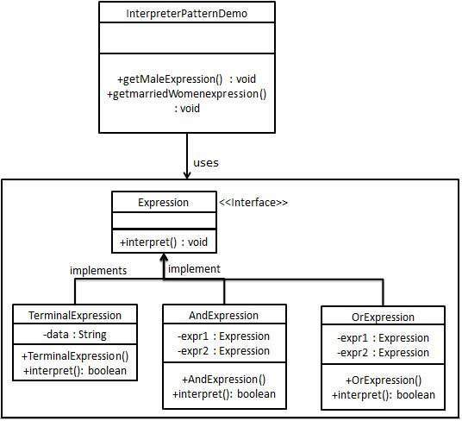
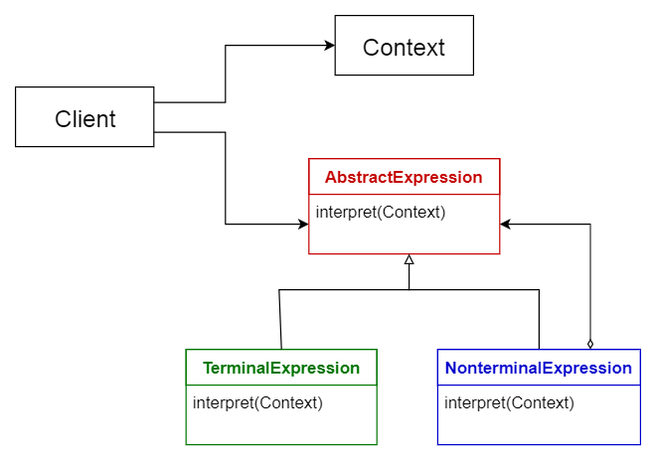

Slide 32
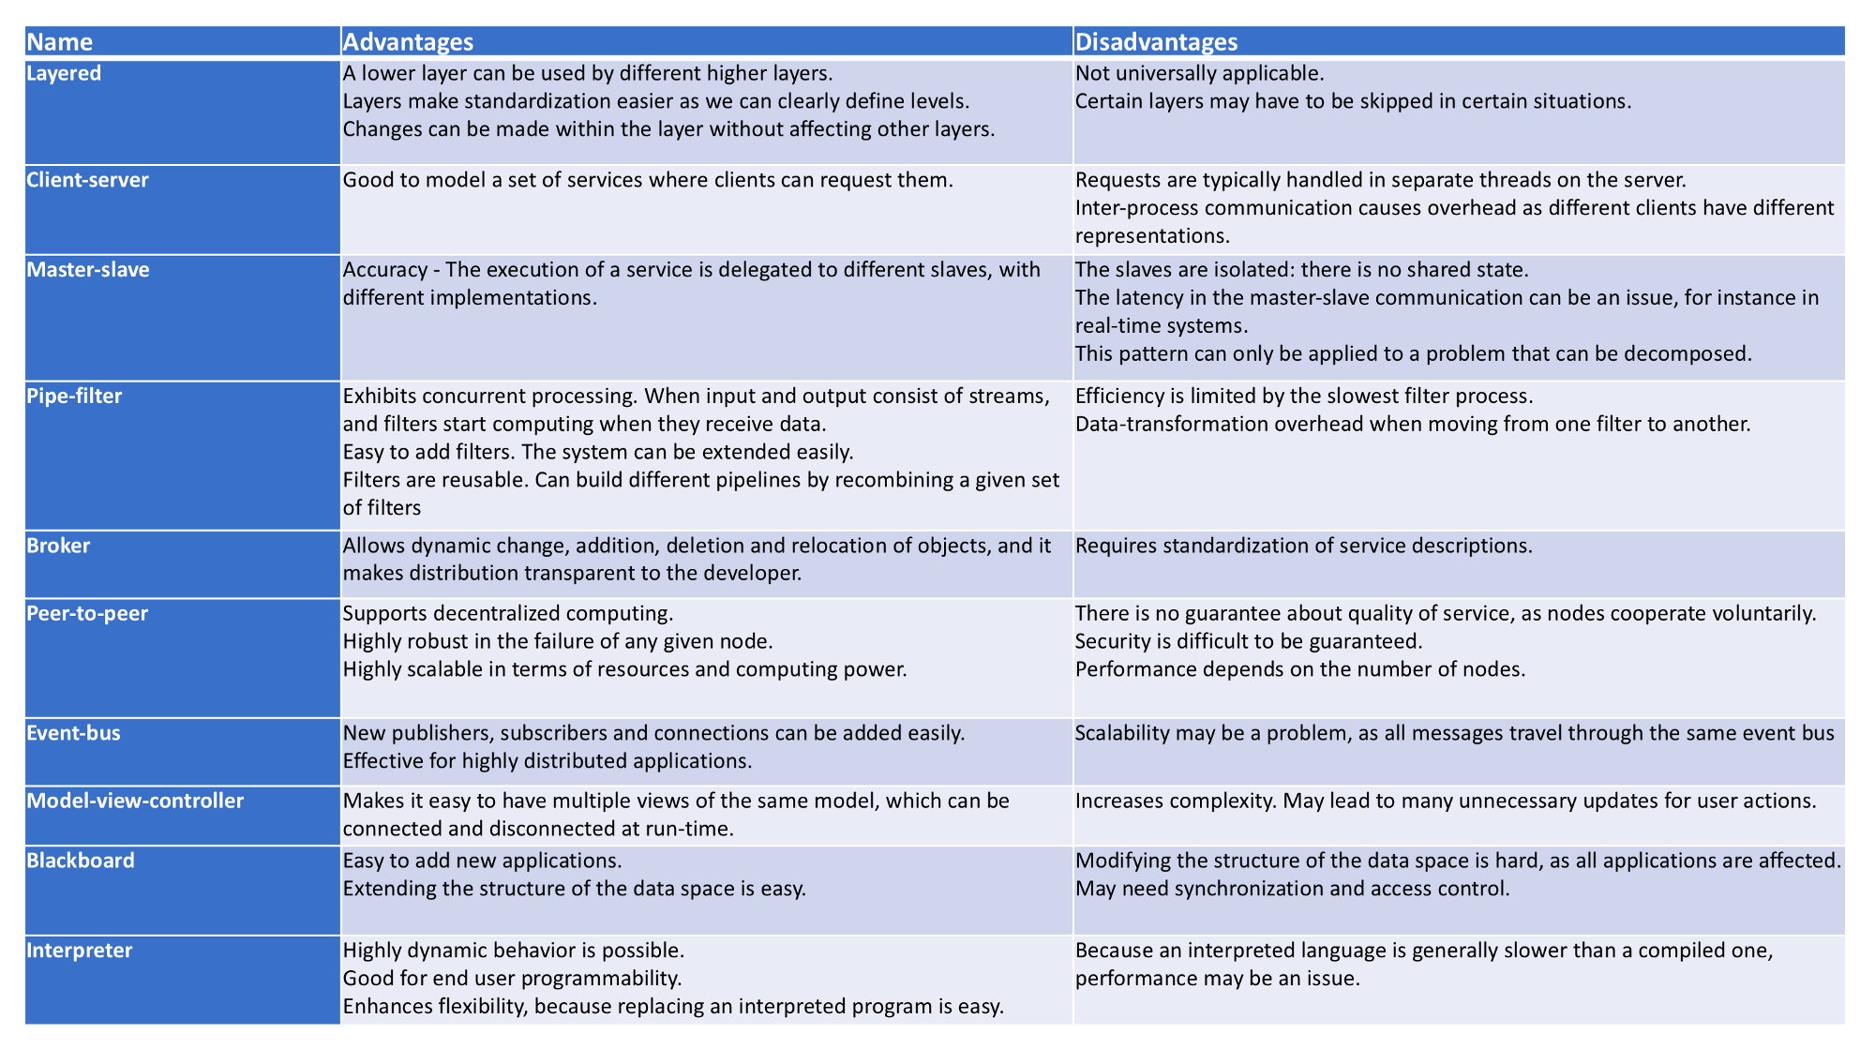

Slide 33
https://towardsdatascience.com/10-common-software-architectural-patterns-in-a-nutshell-a0b47a1e9013

