Slide 1
Agile Software Development
Subtitle

Slide 2
Rapid software development
Rapid development and delivery is now often the most important requirement for software systems
  Businesses operate in a fast –changing requirement and it is practically impossible to produce a set of stable software requirements
  Software has to evolve quickly to reflect changing business needs.
Rapid software development
  Specification, design and implementation are inter-leaved
  System is developed as a series of versions with stakeholders involved in version evaluation
  User interfaces are often developed using an IDE and graphical toolset.

Slide 3
Agile methods
Dissatisfaction with the overheads involved in software design methods of the 1980s and 1990s led to the creation of agile methods. These methods:
  Focus on the code rather than the design
  Are based on an iterative approach to software development
  Are intended to deliver working software quickly and evolve this quickly to meet changing requirements.
The aim of agile methods is to reduce overheads in the software process (e.g. by limiting documentation) and to be able to respond quickly to changing requirements without excessive rework.

Slide 4
Rationale for Agile Development
Changes do occur
  Understanding comes from doing – You know it when you try it
  Business changes, world changes – What is right today is not tomorrow
  ”Much wants more”
Money takes an end
  ”The stomach is full before the eyes”
Meet customer’s expectations
  Get to running results
  Be prepared for change
Apply lean practices
  Put effort into a requirement only when you know it is needed
  Develop only what you can specify
  Specify only what you need to at any given instance in time
Notes:
4
Wanted = needed and someone is willing to pay for it

Slide 5
Lean Development – Avoid the Seven Wastes
Waste is
  Anything that interferes with giving customers what they value
    At the time and place where it will provide the most value
Partially Done Work
  Uncoded documentation, unsynched, untested, undocumented, or undeployed code
Extra Features
  ”It is better for developers to be surfing than writing code that won't be needed”
  Jeff Sutherland, CTO PatientKeeper [YAGNI]
Relearning
  Benefit from and preserve experiences, improve product and process
Task Switching
  Takes time, distracts from the results, delays all of the tasks in delivering value
Notes:
5
2: The whole quote: “Every line of code costs money to write and more money to support. It is better for the developers to be surfing than writing code that won't be needed. If they write code that ultimately is not used, I will be paying for that code for the life of the system, which is typically longer than my professional life. If they went surfing, they would have fun, and I would have a less expensive system and fewer headaches to maintain.”

Slide 6
Lean Development – Avoid the Seven Wastes (Continued)
Waste is
  Anything that interferes with giving customers what they value
    At the time and place where it will provide the most value
Handoffs
  Tacit knowledge is lost in hand offs. Like giving a bicycle and an instruction book to someone not knowing how to ride. Use integrated teams, experience, and talking.
Delays
  Developers make critical decisions every 15 minutes. Make information available.
  Other delays: Projects approval, people, change approval, functionality, testing.
Defects
  Test is Design. Make defects unusual. Discover defects early. Test automatically and manually, early and often. Final verification should not routinely discover new defects
Notes:
6
2: The whole quote: “Every line of code costs money to write and more money to support. It is better for the developers to be surfing than writing code that won't be needed. If they write code that ultimately is not used, I will be paying for that code for the life of the system, which is typically longer than my professional life. If they went surfing, they would have fun, and I would have a less expensive system and fewer headaches to maintain.”

Slide 7
What Is Agile
Agile --readiness for motion, nimbleness, activity, dexterity in motion
Agility
  The ability to both create and respond to change in order to profit in a turbulent business environment
    Companies need to determine the amount of agility they need to be competitive
Chaordic
  Exhibiting properties of both chaos and order
    The blend of chaos and order inherent in the external environment and in people themselves, argues against the prevailing wisdom about predictability and planning
    Things get done because people adapt, not because they slavishly follow processes

Slide 8
Agile Software Development
Agile software development is a group of software development methods based on iterative and incremental development, where requirements and solutions evolve through collaboration between self-organizing, cross-functional teams.
  Methods
  Iterative
  incremental
It promotes adaptive planning, evolutionary development and delivery, a time-boxed iterative approach, and encourages rapid and flexible response to change.
It is a conceptual framework that promotes foreseen interactions throughout the development cycle.
The Agile Manifesto[ introduced the term in 2001. (Wiki, 21 Aug 12)
Let’s take this definition apart.

Slide 9
a. Software Development Method
A software development methodology or system development methodology in software engineering is a framework that is used to structure, plan, and control the process of developing an information system.

Slide 10
b. Software Engineering / Software Development
Software Engineering (WIKI) (SE) is the application of a systematic, disciplined, quantifiable approach to the design, development, operation, and maintenance of software, and the study of these approaches; that is, the application of engineering to software.
Software Development, a much used and more generic term, does not subsume the engineering paradigm.
  The field's future looks bright according to Money Magazine and Salary.com, which rated "software engineer" as the best job in the United States in 2006.
  In 2012, software engineering was again ranked as the best job in the United States, this time by CareerCast.com.

Slide 11
c. Information System
An information system (IS) - is any combination of information technology (IT) and people's activities that support operations, management and decision making.
In a very broad sense, the term information system is frequently used to refer to the interaction between people, processes, data and technology.
In this sense, the term is used to refer
  not only to the information and communication technology (ICT) that an organization uses,
  but also to the way in which people interact with this technology in support of business processes. (Wiki)

Slide 12
d. Iterative and Incremental Development
Iterative and Incremental development is at the heart of a cyclic software development process developed in response to the weaknesses of the waterfall model.
It starts with an initial planning and ends with deployment with the cyclic interactions in between.
Iterative and incremental development are essential parts of the Rational Unified Process, Extreme Programming and generally the various agile software development frameworks.
It follows a similar process to the “plan-do-check-act” cycle of business process improvement.

Slide 13
e. Time-Boxed Approach
In time management, a time box allots a fixed period of time for an activity.
Timeboxing plans activity by allocating time boxes.

Slide 14
Agile Alliance
Several individuals, The Agile Alliance,
  motivated to constrain activities
  such that certain outputs and artifacts are predictably produced.
  Around 2000, these notables got together to address common development problems.
Goal: outline values and principles to allow software teams to
  develop quickly and
  respond to change.
Notes:
Fears regarding software development led to a number of pioneers / industry experts to develop the Agile Manifesto based up some firm values and principles.
Practitioners had become afraid that repeated software failures could not be stopped without some kind of guiding process to guide development activities.

Slide 15
These activities arose in large part to runaway processes.
  Failure to achieve certain goals was met with ‘more process.’ Schedules slipped; budgets bloated, and processes became even larger.
The Alliance (17) created a statement of values: termed the manifesto of the Agile Alliance.
They then developed the 12 Principles of Agility.
Notes:
Practitioners were afraid that
The project will produce the wrong product
The project will produce a product of inferior quality
The project will be late
We’ll have to work 80 hour weeks
We’ll have to break commitments
We won’t be having fun.

Slide 16
What is “Agility”?
Effective (rapid and adaptive) response to change
Effective communication among all stakeholders
Drawing the customer onto the team
Organizing a team so that it is in control of the work performed
Yielding …
Rapid, incremental delivery of software
Agile software development

Slide 17
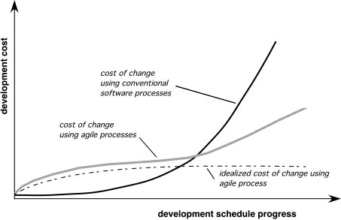
Agility and the Cost of Change

Slide 18
An Agile Process
Is driven by customer descriptions of what is required (scenarios)
Recognizes that plans are short-lived
Develops software iteratively with a heavy emphasis on construction activities
Delivers multiple ‘software increments’
Adapts as changes occur

Slide 19
The Manifesto for
Agile Software Development
“We are uncovering better ways of developing software by doing it and helping others do it. Through this work we have come to value:
  Individuals and interactions over processes and tools
  Working software over comprehensive documentation
  Customer collaboration over contract negotiation
  Responding to change over following a plan
That is, while there is value in the items on the right, we value the items on the left more.”
Kent Beck et al
Agile software development
Notes:
Principle
Description
Customer involvement
Customers should be closely involved throughout the development process. Their role is provide and prioritize new system requirements and to evaluate the iterations of the system.
Incremental delivery
The software is developed in increments with the customer specifying the requirements to be included in each increment.
People not process
The skills of the development team should be recognized and exploited. Team members should be left to develop their own ways of working without prescriptive processes.
Embrace change
Expect the system requirements to change and so design the system to accommodate these changes.
Maintain simplicity
Focus on simplicity in both the software being developed and in the development process. Wherever possible, actively work to eliminate complexity from the system.

Slide 20
Value 1: Individuals and Interactions over Processes and Tools
Strong players: a must, but can fail if don’t work together.
Strong player: not necessarily an ‘ace;’ work well with others!
  Communication and interacting is more important than raw talent.
‘Right’ tools are vital to smooth functioning of a team.
Start small. Find a free tool and use until you can demo you’ve outgrown it. Don’t assume bigger is better. Start with white board; flat files before going to a huge database.
Building a team more important than building environment.
  Some managers build the environment and expect the team to fall together.
  Doesn’t work.
  Let the team build the environment on the basis of need.

Slide 21
Value 2: Working Software over Comprehensive Documentation
Code – not ideal medium for communicating rationale and system structure.
  Team needs to produce human readable documents describing system and design decision rationale.
Too much documentation is worse than too little.
  Take time; more to keep in sync with code; Not kept in sync? it is a lie and misleading.
Short rationale and structure document.
  Keep this in sync; Only highest level structure in the system kept.

Slide 22
Value 2: Working Software over Comprehensive Documentation
How to train newbees if short & sweet?
  Work closely with them.
  Transfer knowledge by sitting with them; make part of team via close training and interaction
Two essentials for transferring info to new team members:
  Code is the only unambiguous source of information.
  Team holds every-changing roadmap of systems in their heads; cannot put on paper.
  Best way to transfer info- interact with them.
Fatal flaw: Pursue documentation instead of software:
Rule: Produce no document unless need is immediate and significant.

Slide 23
Value 3: Customer Collaboration over Contract Negotiation
(1 of 2)
Not possible to describe software requirements up front and leave someone else to develop it within cost and on time.
Customers cannot just cite needs and go away
Successful projects require customer feedback on a regular and frequent basis – and not dependent upon a contract
Notes:
or SOW.

Slide 24
Value 3: Customer Collaboration over Contract Negotiation
(2 of 2)
Best contracts are NOT those specifying requirements, schedule and cost.
  Become meaningless shortly.
Far better are contracts that govern the way the development team and customer will work together.
Key is intense collaboration with customer and a contract that governed collaboration rather than details of scope and schedule
  Details ideally not specified in contract.
  Rather contracts could pay when a block passed customer’s acceptance tests.
  With frequent deliverables and feedback, acceptance tests never an issue.

Slide 25
Value 4: Responding to Change over Following a Plan
Our plans and the ability to respond to changes is critical!
Course of a project cannot be predicted far into the future.
  Too many variables; not many good ways at estimating cost.
Tempting to create a PERT or Ghant chart for whole project.
  This does Not give novice managers control.
  Can track individual tasks, compare to actual dates w/planned dates and react to discrepancies.
  But the structure of the chart will degrade
  As developers gain knowledge of the system and as customer gains knowledge about their needs, some tasks will become unnecessary; others will be discovered and will be added to ‘the list.’
  In short, the plan will undergo changes in shape, not just dates.

Slide 26
Value 4: Responding to Change over Following a Plan
Better planning strategy – make detailed plans for the next few weeks, very rough plans for the next few months, and extremely crude plans beyond that.
Need to know what we will be working on the next few weeks; roughly for the next few months; a vague idea what system will do after a year.
Only invest in a detailed plan for immediate tasks; once plan is made, difficult to change due to momentum and commitment.
  But rest of plan remains flexible. The lower resolution parts of the plan can be changed with relative ease.

Slide 27
Agility Principles - I
Our highest priority is to satisfy the customer through early and continuous delivery of valuable software.
Welcome changing requirements, even late in development. Agile processes harness change for the customer's competitive advantage.
Deliver working software frequently, from a couple of weeks to a couple of months, with a preference to the shorter timescale.
Business people and developers must work together daily throughout the project.
Build projects around motivated individuals. Give them the environment and support they need, and trust them to get the job done.
The most efficient and effective method of conveying information to and within a development team is face–to–face conversation.

Slide 28
Agility Principles - II
Working software is the primary measure of progress.
Agile processes promote sustainable development. The sponsors, developers, and users should be able to maintain a constant pace indefinitely.
Continuous attention to technical excellence and good design enhances agility.
Simplicity – the art of maximizing the amount of work not done – is essential.
The best architectures, requirements, and designs emerge from self–organizing teams.
At regular intervals, the team reflects on how to become more effective, then tunes and adjusts its behavior accordingly.

Slide 29
Principle 1: Our Highest Priority is to Satisfy the Customer through Early and Continuous Delivery of Valuable Software
Number of practices have significant impact upon quality of final system:
1. Strong correlation between quality and early delivery of a partially functioning system.
  The less functional the initial delivery, the higher the quality of the final delivery.
2. Another strong correlation exists between final quality and frequently deliveries of increasing functionality.
  The more frequent the deliveries, the higher the final quality.
Agile processes deliver early and often.
  Rudimentary system first followed by systems of increasing functionality every few weeks.
  Customers my use these systems in production, or
  May choose to review existing functionality and report on changes to be made.
  Regardless, they must provide meaningful feedback.

Slide 30
Principle 2: Welcome Changing Requirements, even late in Development. Agile Processes harness change for the Customer’s Competitive Advantage.
This is a statement of attitude.
Participants in an agile process are not afraid of change.
  Requirement changes are good;
  Mean team has learned more about what it will take to satisfy the market.
Agile teams work to keep the software structure flexible, so requirement change impact is minimal.
Moreso, the principles of object oriented design help us to maintain this kind of flexibility.

Slide 31
Principle 3: Deliver Working Software Frequently
(From a couple of weeks to a couple of months with a preference to the shorter time scale.
We deliver working software.
  Deliver early and often.
  Be not content with delivering bundles of documents, or plans.
  Don’t count those as true deliverables.
The goal of delivering software that satisfies the customer’s needs.

Slide 32
Principle 4: Business People and Developers Must Work Together Daily throughout the Project.
For agile projects, there must be significant and frequent interaction between the
  customers,
  developers, and
  stakeholders.
An agile project must be continuously guided.

Slide 33
Principle 5: Build Projects around Motivated Individuals. (Give them the environment and support they need, and trust them to get the job done.)
An agile project has people the most important factor of success.
  All other factors, process, environment, management, etc., are considered to be second order effects, and are subject to change if they are having an adverse effect upon the people.
Example: if the office environment is an obstacle to the team, change the office environment.
If certain process steps are obstacles to the team, change the process steps.

Slide 34
Principle 6: The Most Efficient and Effective Method of Conveying Information to and within a Development Team is face-to-face Communications.
In agile projects, developers talk to each other.
  The primary mode of communication is conversation.
  Documents may be created, but there is no attempt to capture all project information in writing.
An agile project team does not demand written specs, written plans, or written designs.
  They may create them if they perceive an immediate and significant need, but they are not the default.
  The default is conversation.

Slide 35
Principle 7: Working Software is the Primary Measure of Progress
Agile projects measure their progress by measuring the amount of working software.
  Progress not measusred by phase we are in, or
  by the volume of produced documentation or
  by the amount of code they have created.
Agile teams are 30% done when 30% of the necessary functionality is working.

Slide 36
Principle 8: Agile Processes promote sustainable developmt The sponsors, developers, and users should be able to maintain a constant pace indefinitely.
An agile project is not run like a 50 yard dash; it is run like a marathon.
  The team does not take off at full speed and try to maintain that speed for the duration.
  Rather they run at a fast, but sustainable, pace.
Running too fast leads to burnout, shortcuts, and debacle.
Agile teams pace themselves.
  They don’t allow themselves to get too tired.
  They don’t borrow tomorrow’s energy to get a bit more done today.
  They work at a rate that allows them to maintain the highest quality standards for the duration of the project.

Slide 37
Principle 9: Continuous Attention to Technical Excellence and Good Design enhances Agility.
High quality is the key to high speed.
  The way to go fast is to keep the software as clean and robust as possible.
  Thus, all agile team-members are committed to producing only the highest quality code they can.
  They do not make messes and then tell themselves they’ll clean it up when they have more time.
  Do it right the first time!

Slide 38
Principle 10: Simplicity – the art of maximizing the amount of work not done – is essential.
Agile teams take the simplest path that is consistent with their goals.
  They don’t anticipate tomorrow’s problems and try to defend against them today.
  Rather they do the simplest and highest quality work today, confident that it will be easy to change if and when tomorrows problems arise.

Slide 39
Principle 11: The Best Architectures, Requirements, and Designs emerge from Self-Organizing Teams
An agile team is a self organizing team.
  Responsibilities are not handed to individual team members from the outside.
  Responsibilities are communicated to the team as a whole, and the team determines the best way to fulfill them.
Agile team members work together on all project aspects.
  Each is allowed input into the whole.
  No single team member is responsible for the architecture, or the requirements, or the tests, etc.
  The team shares those responsibilities and each team member has influence over them.

Slide 40
Principle 12: At regular Intervals, the Team reflects on how to become more effective, then tunes and adjusts its behavior accordingly.
An agile team continually adjusts its organization, rules, conventions, relationships, etc.
An agile team knows that its environment is continuously changing, and knows that they must change with that environment to remain agile.

Slide 41
Conclusions
The professional goal of every software engineer, and every development team, is to deliver the highest possible value to our employers and customers.
  And yet, our projects fail, or fail to deliver value, at a dismaying rate.
Though well intentioned, the upward spiral of process inflation is culpable for at least some of this failure.
The principles and values of agile software development were formed as a way
  to help teams break the cycle of process inflation, and
  to focus on simple techniques for reaching their goals.
At the time of this writing there were many agile processes to choose from. These include
  SCRUM,
  Crystal,
  Feature Driven Development (FDD),
  Adaptive Software Development (ADP), and most significantly,
  Extreme Programming (XP).
  Others…

Slide 42
Agile method applicability
Product development where a software company is developing a small or medium-sized product for sale.
Custom system development within an organization, where there is a clear commitment from the customer to become involved in the development process and where there are not a lot of external rules and regulations that affect the software.
Because of their focus on small, tightly-integrated teams, there are problems in scaling agile methods to large systems.

Slide 43
Problems with agile methods
It can be difficult to keep the interest of customers who are involved in the process.
Team members may be unsuited to the intense involvement that characterises agile methods.
Prioritising changes can be difficult where there are multiple stakeholders.
Maintaining simplicity requires extra work.
Contracts may be a problem as with other approaches to iterative development.

Slide 44
Agile methods and software maintenance
Most organizations spend more on maintaining existing software than they do on new software development. So, if agile methods are to be successful, they have to support maintenance as well as original development.
Two key issues:
  Are systems that are developed using an agile approach maintainable, given the emphasis in the development process of minimizing formal documentation?
  Can agile methods be used effectively for evolving a system in response to customer change requests?
Problems may arise if original development team cannot be maintained.

Slide 45
Plan-driven and agile development
Plan-driven development
  A plan-driven approach to software engineering is based around separate development stages with the outputs to be produced at each of these stages planned in advance.
  Not necessarily waterfall model – plan-driven, incremental development is possible
  Iteration occurs within activities.
Agile development
  Specification, design, implementation and testing are inter-leaved and the outputs from the development process are decided through a process of negotiation during the software development process.

Slide 46
Plan-driven and agile specification

Slide 47
Human Factors
the process molds to the needs of the people and team, not the other way around
key traits must exist among the people on an agile team and the team itself:
  Competence.
  Common focus.
  Collaboration.
  Decision-making ability.
  Fuzzy problem-solving ability.
  Mutual trust and respect.
  Self-organization.

Slide 48
Basic Agile Guiding Principles
Deliver Frequently
Specify Before Implementation
  Test-driven / Behaviour-driven / Example-driven development
Use Executable Specifications
Adapt as you go
  Requirements
  Process
  Methods and practices
  Architecture
  Design

Slide 49
Principle – Deliver Frequently
Short iterations
  Small increments
Always deliverable
  Continous integration
Metric: Running, Tested Features (RTF)
  Running Tested Features should start showing up in the first week or two of the project, and should be produced in a steady stream from that day forward.

Slide 50
Principle – Specify Before Implementation
Design, then implement
No Big Design Up-front

Slide 51
Principle – Use Executable Specifications
Specifications in non computer-readable document ”always” get out of sync
  Describe what the system was thought to do at some point in time
  Redundant, but not forcibly synchronized
Executable specifications are always kept correct
  Describe what the system actually does
  Redundant, but forcibly synchronized
    Are continuously executed
Notes:
With a test-driven development (TDD) approach, your tests effectively become detailed specifications which are created on a just-in-time (JIT) basis.
Like it or not most programmers don't read the written documentation for a system, instead they prefer to work with the code.
When trying to understand a class or operation most programmers will first look for sample code that already invokes it.
Well-written unit/developers tests do exactly this – they provide a working specification of your functional code – and as a result unit tests effectively become a significant portion of your technical documentation.
Similarly, acceptance tests can form an important part of your requirements documentation.
This makes a lot of sense when you stop and think about it. Your acceptance tests define exactly what your stakeholders expect of your system, therefore they specify your critical requirements.

Slide 52
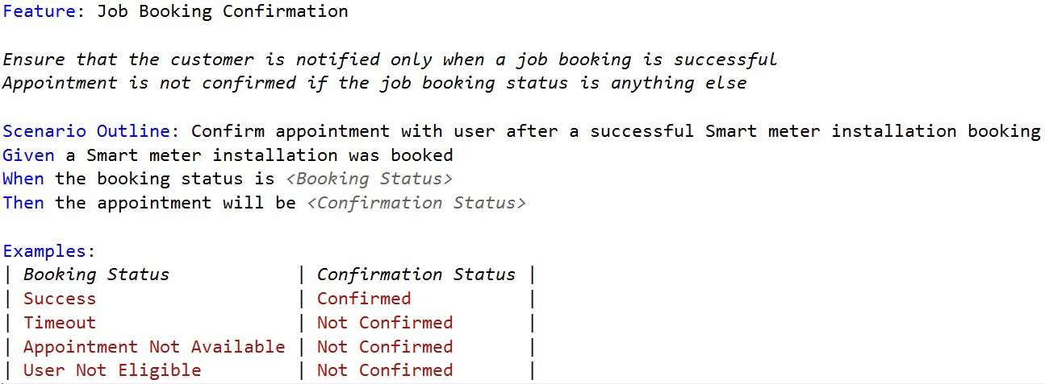

Slide 53
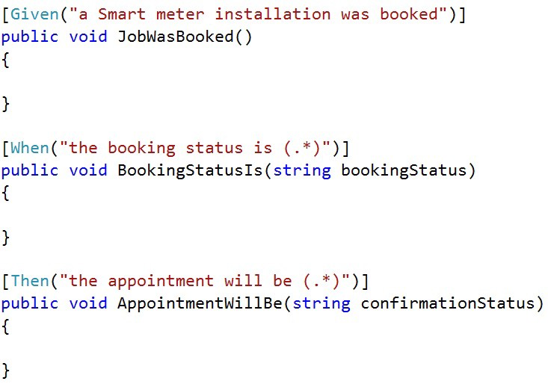

Slide 54
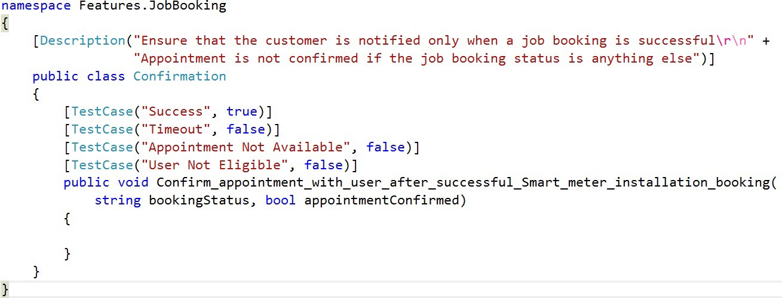

Slide 55
Principle – Adapt As You Go
Big Specification Up Front seldom survives long
  Specifications change
  Design changes
  Architecture changes
  Most suitable working process changes
Prescriptive processes and methods less suitable when need changes
Adaptive processes and methods adjust themselves as need changes
  Retrospective meeting after each iteration
  Team in charge

Slide 56
Processes, Methods and Practices
Process, Methodology – A description of project activities and their order
  Examples: Waterfall, Spiral, Scrum
Method – A description of the way a developer works
  Examples: XP, architecture and design modeling
Practice – A description of how the developer solves his day-to-day work
  Examples: Design by Contract, TDD, Pair Programming, UML modeling
Tool – Software, equipment, standard to help the developer do his job
  Examples: VS IDE, NUnit, FitNesse, VSS CMS, MSBuild, CC, UML
And then again, there is not always a distinct difference between process, method and practice

Slide 57
Processes
Waterfall
RUP
Scrum

Slide 58

What is a Software Development Process
Defines Who is going to do What
When to do it, and
How to reach a certain goal
New or changed requirements
Software Development Process
New or changed System
With the permission of ProgramUtvikling as
Notes:
58

Slide 59
Characteristics of a Software Development Process
Characteristics of a good process
  Provides guidelines for efficient development of quality software
  Reduces risk and increases predictability
  Promotes a common vision and culture
  Presents the currently best practice
We will look at three processes
  Waterfall
  Unified Process (UP, USDP, RUP)
  Scrum
    One of several agile methods
    XP, DSDM, Crystal, Evo, FDD, Lean
Processes have different properties
  Choose one that fits your project
Notes:
59
XP: eXtreme Programming, Kent Beck et al
DSDM: Dynamic System Development Method, DSDM Consortium, UK
Crystal: Crystal Clear and other Crystal methods by Alistair Cockburn
Evo: Evolutionary development, Tom Gilb
FDD: Feature Driven Development, Jeff De Luca
Lean: Lean Software Development, Mary and Tom Poppendieck

Slide 60
Processes – Waterfall
Phases:
  Requirements capture
  Requirements analysis
  System analysis
  Design
  Implementation, unit testing
  Integration, integration testing, system testing
  Acceptance, acceptance testing
  Deployment
  Maintenance
One phase is closed and approved before the next one is started
  Various models for iterating back to adjust previous phases

Slide 61
The Waterfall Model
Stepwise model from a requirements phase to finished product
  A major improvement compared to earlier two phase ”code and fix”
  Assumedly defined in 1970 by Dr. Winston W. Royce working at TRW
    Managing the Development of Large Software Systems
  Recognised the need for feedback loops between stages
  “I believe in this concept, but the implementation described above is risky and invites failure”
    Because of corrections coming from running the system
Requirement
Design
Coding and unit test
System Integration
Maintenance
[Royce 70]
Notes:
61

Slide 62
Waterfall Advantages and Drawbacks
Easy to understand, linear
  Everything is well planned before producing
  Avoids surprises by features not thought of
Assumes world and understanding is static
  Adapts badly to changes in understanding and environment during development
  Adapts badly to limited resources, all requirements are approved and need to be delivered, although sufficient value for money may be obained with less
[Waterfall]

Slide 63
The Unified Process: Key Points
Use case driven development
  Describes the functionality of the system seen from the users’ perspective
Object oriented technology
  Uses UML as an integrated part for making visual models
Controlled iterative, incremental development
  Implementation split up in iterations
  Identifies and controls risks
Strong emphasis on software architecture & design
  That implements requirements and reduces risks
  Traditional phases, now called workflows or disciplines
  Across all RUP phases, with varying intensity
Suitable for well understood problems
Notes:
63

Slide 64
RUP Phases
Inception
  Establish a business vision and scope
  Identify the basic functionality
Elaboration
  Establish technical vision and detail requirements
  Do high level analysis and design
  Identify risks and create development plan
Construction
  Build iterations of production-quality, tested and integrated software
Transition
  Beta test and train users in the field
  Identify and correct deficiencies
All disciplines are applied in all phases
  Requirements, Analysis, Design, Implementation, Test
Notes:
64

Slide 65
Unified Process – Overview
Phases
Disciplines
Inception Elaboration Construction Transition
Requirements
Analysis
Architecture and Design
Implementation
Test
Iterations Iter #1 #2 Iter #3 #4 #5 #6 Iter #7 #8
Notes:
65

Slide 66
Scrum
Originally proposed by Schwaber and Beedle
Scrum—distinguishing features
  Development work is partitioned into “packets”
  Testing and documentation are on-going as the product is constructed
  Work occurs in “sprints” and is derived from a “backlog” of existing requirements
  Meetings are very short and sometimes conducted without chairs
  “demos” are delivered to the customer with the time-box allocated

Slide 67
Process – Scrum
Uses an empirical rather than defined approach
  Suitable for development of unique products from unique specifications
  As opposed to repetitive manufacturing of a designed product
Basic principles for the agile method Scrum
  Self-organization – Leave responsibility to self-organizing teams
  Transparency – Let anybody know what happens at any time
    Good news as well as bad ones are visible early
    So that intelligent people can take informed decisions about what to do
  Feedback – Work in a tight, empiric loop with the ”product owner” (customer)
    ”Sprints” of 2 – 4 weeks
  Self-assessment – Team retrospective after each sprint

Slide 68
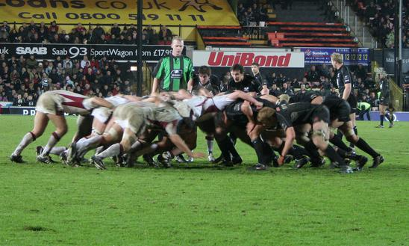
Scrum – The Art of the Possible
In English rugby football, a scrum is a way to put the ball into play
  The whole team is responsible for moving the ball towards the target
  Sometimes they succeed completely, sometimes only partially
http://commons.wikimedia.org/wiki/Image:Scrum_rugby.jpg
Notes:
68

Slide 69
Scrum Highlights
Scrum roles
  Product owner (PO) responsibilities to describe and prioritize requirements
  Team responsibilities to produce within a time boxed ”sprint” (iteration)
  Scrum master (SM) responsibilities to enable team working conditions
Scrum practices
  Micro feedback, like daily scrum, sprint backlog, burn-down charts
  Macro feed-back and prioritization by product owner on every sprint,
    Product backlog
Scrum does not prescribe
  Solutions techniques, working methods, project progress plans
  These are up to the team to discover and adapt according to need
Suitable for projects with uncertain goals or moving targets
  Or where the way to get there is not completely known
Notes:
69

Slide 70
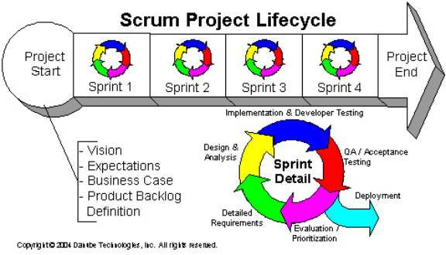
Scrum

Slide 71
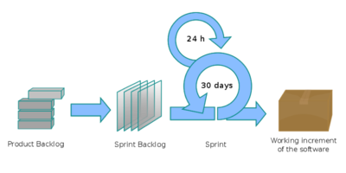

Slide 72
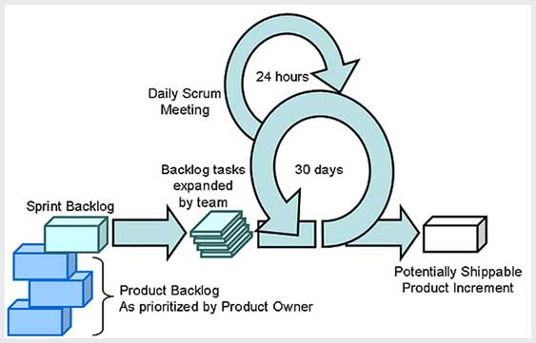

Slide 73
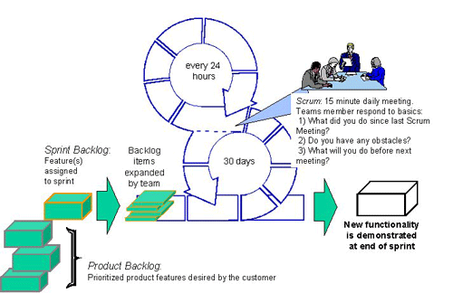

Slide 74
Scrum Practices
Time boxing
  The incremental value of an activity decreases over time
  80/20 benefit achieved within time box
Potentially installable results
  Iterations (”sprints”) time boxed to 30 days (or shorter)
  Every iteration shall deliver custom value and production quality
Reduce initial elaboration (one day)
  Specify ”all” overall requirements for initial product backlog
    Main Use cases with scenarios, alt. user stories
    Primary actor roles
Prioritize and reprioritize
  Only work on what may be completed during next sprint (iteration)
  Specification and planning time box: one day
Notes:
74

Slide 75
Scrum – Overview
Disciplines
Pre-project
Initial
requirements
Sprints
Requirements
Analysis
Architecture and Design
Implementation
Test
Sprints #1 #2 #3 #4
Notes:
75

Slide 76
Major Milestones
~15 %
2-6 weeks per iteration
RUP
Scrum
Inception
Elaboration
Construction
Transition
time
Vision
Baseline
Architecture
Initial
Capability
Product
Release
1 day
30 days per sprint
Initial
Requirements
Sprints
Pre-project
time
Vision
Initial, high-level
Product Backlog
Any number of
potential Product
Releases
Any number of
potential Product
Releases
Notes:
76

Slide 77
RUP meets Scrum
RUP provides
  Working disciplines:
    Business, requirements, analysis, design modeling
    Implementation, testing, deployment
    Configuration management, environment
Scrum emphasizes
  Empirical, adaptive practices
  No hand-over, the team is cross-functional and complete
  Specify next sprint only
Both encourage
  Iterative work
  Visual modelling using UML
Notes:
77

Slide 78
Extreme Programming (XP)
The most widely used agile process, originally proposed by Kent Beck
XP Planning
  Begins with the creation of “user stories”
  Agile team assesses each story and assigns a cost
  Stories are grouped to for a deliverable increment
  A commitment is made on delivery date
  After the first increment “project velocity” is used to help define subsequent delivery dates for other increments
Notes:
Anti-stories are things the user does not want to happen, commonly for safety or security reasons. For example,
No way we let an ILOVEYOU EMail worm in our System!
Compare the following two stories.
Here is the first user story: The user supplies the identifier of a user and will be given information about that identified user including their full name, last login date, and if they have unanswered Email. If online, information will also be presented showing how to contact them online.
And here is the second user anti-story that should go with it: No user, however stupid or malicious, will be able to gain control of the queried computer system.
Now the original implementation of finger and fingerd (the daemon that supported finger) satisfied the first story and was a great success. It did not satisfy the second story, the anti-story, and as such spawned some nasty exploits, hacks, and worms.

Slide 79
User Stories
Who (often called role) and what
Why (optional)
Easy to understand
Short
Indicates measures of success
#pmineflconf2015
@LewisCindy

Slide 80
User Story Examples (1 of 2)
As a smart phone user, I want to be able to install the application.
As a smart phone user, I want to be able to uninstall the application.
As a business owner, I want to be able to accept credit cards.
As a business owner, I want to be able to receive confidential customer feedback.
#pmineflconf2015
@LewisCindy

Slide 81
User Story Examples (2 of 2)
As a dog owner, I want the dog to notify me when it needs to go out.
As a dog owner, I want the dog to sit when asked.
As a dog owner, I don’t want the dog to bite humans.
As a dog owner, I want the dog to come when called.
#pmineflconf2015
@LewisCindy

Slide 82
Extreme Programming (XP)
XP Design
  Follows the KIS principle
  Encourage the use of CRC cards
  For difficult design problems, suggests the creation of “spike solutions”—a design prototype
  Encourages “refactoring”—an iterative refinement of the internal program design
XP Coding
  Recommends the construction of a unit test for a store before coding commences
  Encourages “pair programming”
XP Testing
  All unit tests are executed daily
  “Acceptance tests” are defined by the customer and excuted to assess customer visible functionality

Slide 83
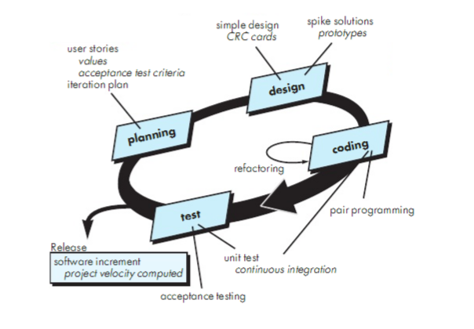
Extreme Programming (XP)

Slide 84
Adaptive Software Development
Originally proposed by Jim Highsmith
ASD — distinguishing features
  Mission-driven planning
  Component-based focus
  Uses “time-boxing”
    A timebox is a previously agreed period of time during which a person or a team works steadily towards completion of some goal.
  Explicit consideration of risks
  Emphasizes collaboration for requirements gathering
  Emphasizes “learning” throughout the process

Slide 85
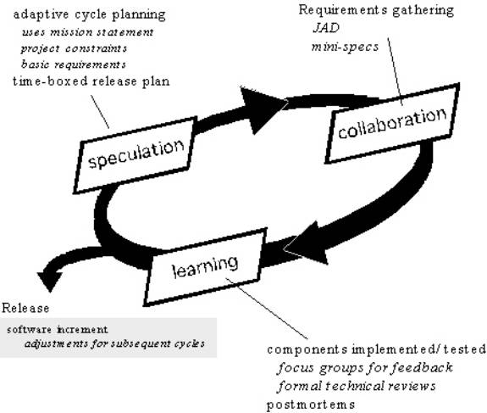
Adaptive Software Development

Slide 86
Dynamic Systems Development Method
Promoted by the DSDM Consortium (www.dsdm.org)
DSDM—distinguishing features
  Similar in most respects to XP and/or ASD
  Nine guiding principles
    Active user involvement is imperative.
    DSDM teams must be empowered to make decisions.
    The focus is on frequent delivery of products.
    Fitness for business purpose is the essential criterion for acceptance of deliverables.
    Iterative and incremental development is necessary to converge on an accurate business solution.
    All changes during development are reversible.
    Requirements are baselined at a high level
    Testing is integrated throughout the life-cycle.

Slide 87
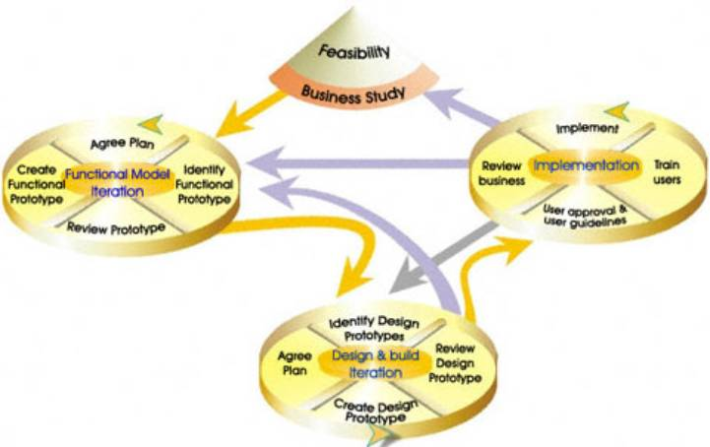
Dynamic Systems Development Method
DSDM Life Cycle (with permission of the DSDM consortium)

Slide 88
Crystal
Proposed by Cockburn and Highsmith
Crystal—distinguishing features
  Actually a family of process models that allow “maneuverability” based on problem characteristics
  Face-to-face communication is emphasized
  Suggests the use of “reflection workshops” to review the work habits of the team

Slide 89
Feature Driven Development
Originally proposed by Peter Coad et al
FDD—distinguishing features
  Emphasis is on defining “features”
    a feature “is a client-valued function that can be implemented in two weeks or less.”
  Uses a feature template
    <action> the <result> <by | for | of | to> a(n) <object>
  A features list is created and “plan by feature” is conducted
  Design and construction merge in FDD

Slide 90
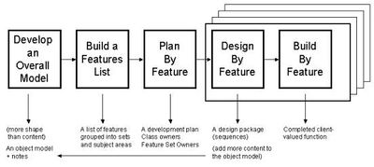
Feature Driven Development
Reprinted with permission of Peter Coad

Slide 91
