Slide 1
Software Life Cycle
Main issues:
Discussion of different life cycle models
Maintenance or evolution

Slide 2
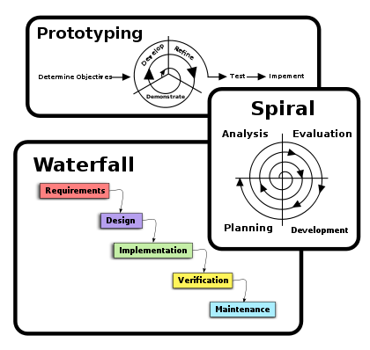

Slide 3
Introduction
software development projects are large and complex
a phased approach to control it is necessary
traditional models are document-driven: there is a new pile of paper after each phase is completed
evolutionary models recognize that much of what is called maintenance is inevitable
latest fashion: agile methods, eXtreme Programming
life cycle models can be explicitly modeled, in a process modeling language

Slide 4
Simple life cycle model
problem
requirements engineering
reqs specification
design
design
implementation
system
testing
working system
maintenance

Slide 5
Simple Life Cycle Model
document driven, planning driven, heavyweight
milestones are reached if the appropriate documentation is delivered (e.g., requirements specification, design specification, program, test document)
much planning upfront, often heavy contracts are signed
problems
  feedback is not taken into account
  maintenance does not imply evolution
Notes:
Important point to make: this is a management instrument, to control progress, rather than a development model

Slide 6
Waterfall Model
reqs engineering
V & V
design
V & V
implementation
V & V
testing
V & V
maintenance
V & V
Notes:
The waterfall model emphasizes iteration, caused by verification and validation steps.
This model became widely known after Boehm’s 1976 article, but goes back to the sixties.
The model is meant for salmon, not for people

Slide 7
V-Model
reqs eng
acceptance
testing
global design
integration
testing
det. design
unit testing
coding

Slide 8
Waterfall Model (cntd)
includes iteration and feedback
validation (are we building the right system?) and verification (are we building the system right?) after each step
user requirements are fixed as early as possible
problems
  too rigid
  developers cannot move between various abstraction levels

Slide 9
Activity versus phase
Implementation
Integration
testing
Acceptance
testing
Phase
Design
Activity
Integration
testing
4.7
43.4
26.1
25.8
Implementation
(& unit testing)
6.9
70.3
15.9
6.9
Design
49.2
34.1
10.3
6.4
Notes:
This is from Zelkowitz 88. The rows denote the actual activity, of designing, implementation, etc. The columns denote the (official) phases. So during the implementation phase, about 34% of the time is still spent on design.
Note the findings of Guindon: design is an opportunistic process, whereby designers hop up and down between different levels of abstraction

Slide 10
Lightweight (agile) approaches
prototyping
incremental development
RAD, DSDM
XP
Notes:
XP = eXtreme Programming is a software development methodology which is intended to improve software quality and responsiveness to changing customer requirements. As a type of agile software development,[1][2][3] it advocates frequent "releases" in short development cycles, which is intended to improve productivity and introduce checkpoints at which new customer requirements can be adopted.
DSDM =Dynamic systems development method (DSDM) is an agile project delivery framework, primarily used as a software development method. First released in 1994, DSDM originally sought to provide some discipline to the rapid application development (RAD) method.
Rapid application development (RAD) is both a general term used to refer to alternatives to the conventional waterfall model of software development as well as the name for James Martin's approach to rapid development. In general, RAD approaches to software development put less emphasis on planning and more emphasis on process. In contrast to the waterfall model, which calls for rigorously defined specification to be established prior to entering the development phase, RAD approaches emphasize adaptability and the necessity of adjusting requirements in response to knowledge gained as the project progresses. Prototypes are often used in addition to or sometimes even in place of design specifications.f

Slide 11
The Agile Manifesto
Individuals and interactions over processes and tools
Working software over comprehensive documentation
Customer collaboration over contract negotiation
Responding to change over following a plan
Notes:
Agility: readiness for motion”, “nimbleness”

Slide 12
Prototyping
requirements elicitation is difficult
  software is developed because the present situation is unsatisfactory
  however, the desirable new situation is as yet unknown
prototyping is used to obtain the requirements of some aspects of the system
prototyping should be a relatively cheap process
  use rapid prototyping languages and tools
  not all functionality needs to be implemented
  production quality is not required
Notes:
Of the old-fashioned pushdown telephone,about 2000 prototypes were developed: with different arrangements of the keys, different sizes of the keys, different weights of the receiver, etc.

Slide 13
Prototyping as a tool for requirements engineering
reqs engineering
design
design
implementation
implementation
testing
testing
maintenance

Slide 14
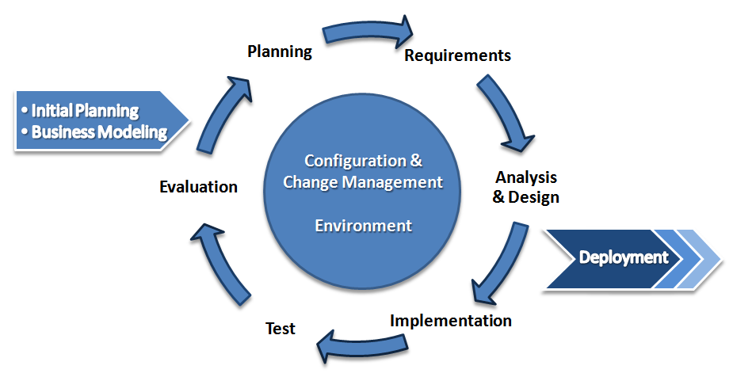

Slide 15
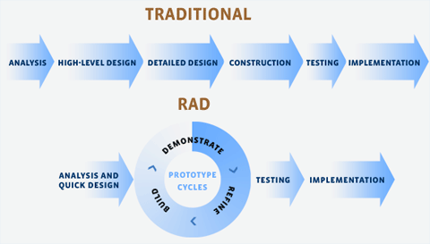

Slide 16
Prototyping (cntd)
throwaway prototyping: the n-th prototype is followed by a waterfall-like process (as depicted on previous slide)
evolutionary prototyping: the nth prototype is delivered

Slide 17
Prototyping, advantages
The resulting system is easier to use
User needs are better accommodated
The resulting system has fewer features
Problems are detected earlier
The design is of higher quality
The resulting system is easier to maintain
The development incurs less effort

Slide 18
Prototyping, disadvantages
The resulting system has more features
The performance of the resulting system is worse
The design is of less quality
The resulting system is harder to maintain
The prototyping approach requires more experienced team members
Notes:
Not that some entries on these lists are the same, I.e. some things are listed as both an advantage and as a disadvantage.

Slide 19
Prototyping, recommendations
the users and the designers must be well aware of the issues and the pitfalls
use prototyping when the requirements are unclear
prototyping needs to be planned and controlled as well

Slide 20
Incremental Development
a software system is delivered in small increments, thereby avoiding the Big Bang effect
the waterfall model is employed in each phase
the user is closely involved in directing the next steps
incremental development prevents overfunctionality
Notes:
Overfunctionality: bells and whistles are hard to judge. In this type of process, they are postponed to the next iteration, so not developed if not really needed.

Slide 21
RAD: Rapid Application Development
evolutionary development, with time boxes: fixed time frames within which activities are done;
time frame is decided upon first, then one tries to realize as much as possible within that time frame;
other elements: Joint Requirements Planning (JRP) and Joint Application Design (JAD), workshops in which users participate;
requirements prioritization through a triage;
development in a SWAT team: Skilled Workers with Advanced Tools
Notes:
Triage: split requirements in 3 sets: to be done now, to be done later, and things that will be done now if time permits it.
SWAT teams are discussed in chapter 5 as well, a bit.
RAD has much in common with the Scandinavian school, because they both value the role of users in the development process.

Slide 22
DSDM
Dynamic Systems Development Method, #1 RAD framework in UK
Fundamental idea: fix time and resources (timebox), adjust functionality accordingly
One needs to be a member of the DSDM consortium

Slide 23
DSDM phases
Feasibility: delivers feasibility report and outline plan, optionally fast prototype (few weeks)
Business study: analyze characteristics of business and technology (in workshops), delivers a.o. System Architecture Definition
Functional model iteration: timeboxed iterative, incremental phase, yields requirements
Design and build iteration
Implementation: transfer to production environment

Slide 24
DSDM practices
Active user involvement is imperative
Empowered teams
Frequent delivery of products
Acceptance determined by fitness for business purpose
Iterative, incremental development
All changes are reversible
Requirements baselined at high level
Testing integrated in life cycle
Collaborative, cooperative approach shared by all stakeholders is essential

Slide 25
XP – eXtreme Programming
Everything is done in small steps
The system always compiles, always runs
Client as the center of development team
Developers have same responsibility w.r.t. software and methodology

Slide 26
13 practices of XP
Whole team: client part of the team
Metaphor: common analogy for the system
The planning game, based on user stories
Simple design
Small releases (e.g. 2 weeks)
Customer tests
Pair programming
Test-driven development: tests developed first
Design improvement (refactoring)
Collective code ownership
Continuous integration: system always runs
Sustainable pace: no overtime
Coding standards

Slide 27
RUP
Rational Unified Process
Complement to UML (Unified Modeling Language)
Iterative approach for object-oriented systems, strongly embraces use cases for modeling requirements
Tool-supported (UML-tools, ClearCase)

Slide 28
RUP phases
Inception: establish scope, boundaries, critical use cases, candidate architectures, schedule and cost estimates
Elaboration: foundation of architecture, establish tool support, get all use cases
Construction: manufacturing process, one or more releases
Transition: release to user community, often several releases

Slide 29
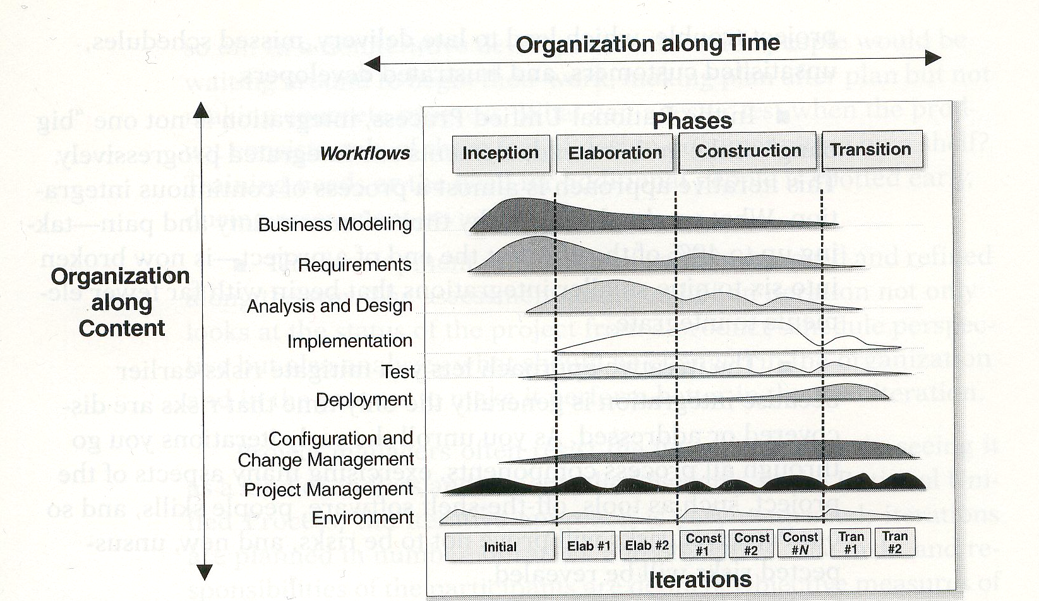
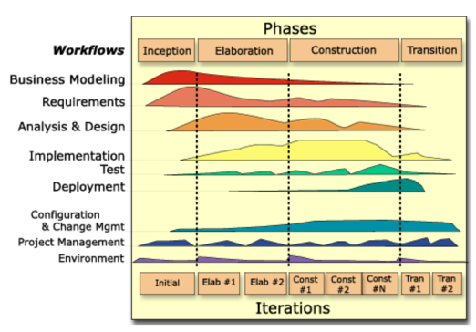
Two-dimensional process structure of RUP

Slide 30
Differences for developers
Agile: knowledgeable, collocated, collaborative
Heavyweight: plan-driven, adequate skills, access to external knowledge

Slide 31
Differences for customers
Agile: dedicated, knowledgeable, collocated, collaborative, representative, empowered
Heavyweight: access to knowledgeable, collaborative, representative, empowered customers

Slide 32
Differences for requirements
Agile: largely emergent, rapid change
Heavyweight: knowable early, largely stable

Slide 33
Differences for architecture
Agile: designed for current requirements
Heavyweight: designed for current and foreseeable requirements

Slide 34
Differences for size
Agile: smaller teams and products
Heavyweight: larger teams and products

Slide 35
Differences for primary objective
Agile: rapid value
Heavyweight: high assurance

Slide 36
The advantages of screen wipers
Notes:
A funny story, about the importance to prepare oneself for a maintenance phase.
In communist Russia, factories had to produce a certain number of cars per month. So everything was done to fulfill this requirement. No one required them to produce spare parts as well, and so they didn’t. Spare parts thus became a scarce commodity. Also spare screen wipers. So people removed these from their cars, to prevent them from being stolen, and put them back on when it started to rain.

Slide 37
MDA – Model Driven Architecture
model
model
maintenance
implementation
transformation
code
code
maintenance
Notes:
First termed MDD: Model-Driven Development: much better name, but the acronym already existed.

Slide 38
Essence of MDA
Platform Independent Model (PIM)
Model transformation and refinement
Resulting in a Platform Specific Model (PSM)
Notes:
Platform is e.g. .NET, CORBA, hardware topology, etc.
One can then define a transformation (refinement) from the PIM to one or more platform specific models. E.g. Java,

Slide 39
Maintenance or Evolution
some observations
  systems are not built from scratch
  there is time pressure on maintenance
the five laws of software evolution
  law of continuing change
  law of increasing complexity
  law of program evolution
  law of invariant work rate
  law of incremental growth limit
Notes:
So there is a gradual difference between development and evolution, where the emphasis is on different things. A green field situation is seldom found in software development.
So: design for change;
continuing change: if a system is used, it changes, until it becomes cost-effective to replace the whole system
increasing complexity: entropy increases
program evolution: growth rate is self-regulating (see next slide)
invariant work rate: a few extra people don’t make a big difference (Brooks Law, see also chapter 7)
incremental growth limit: system “determines” its own growth rate, if you go too fast, you get into trouble
Explanation in terms of progressive and anti-regressive activities

Slide 40
Illustration third law of Software Evolution
system
attributes
time
Notes:
The line is almost straight. The regular hops can be explained as follows: for a while, as many user wishes as possible are implemented. This increases functionality/size/function points/number of modules more than linearly. Then the team gets into trouble, and has to go slower: first, the structure of the system has to be taken care of, documentation has to be updated etc.
So Conclusion:
be alert during maintenance:it is a balancing act between adding new features and securing the future;
periods with a progressive focus are followed by periods with an anti-regressive focus.
software is not built, it grows

Slide 41
Software Product Lines
developers are not inclined to make a maintainable and reusable product, it has additional costs
this viewpoint is changed somewhat if the product family is the focus of attention rather than producing a single version of a product
two processes result: domain engineering, and application engineering

Slide 42
Process modeling
we may describe a software-development process, or parts thereof, in the form of a “program” too. E.G.:
  function review(document, threshold): boolean;
  begin prepare-review;
  hold-review{document, no-of-problems);
  make-report;
  return no-of-problems < threshold
  end review;
Notes:
Here, the review process is described in terms of the activities that have to be done

Slide 43
STD of review process
coding
ready
ready for
next step
submit
re-review
review
prepare
do
make
ready
done
report ready
report
Notes:
This is the same review process, but now emphasis is on the states, and state transitions.
This figures uses the UML notation for state diagrams

Slide 44
Petri-net view of the review process
code
ready
hold
review
code
update
from
revised
code
end
next
step
coding
from
management
scheduled
minutes
Notes:
Petri nets allow for the modeling of nondeterminism and parallellism.
Petri nets have places (the circles), which are either marked or unmarked. A transition if a vertical line. Transitions have inputs and outputs, the arrows.
If all input paces to a transition are marked, in may “fire”. All marks are then removed form the input places, and all output places are marked.
So, in the above example, the review can only be held if the code is ready for review, and management has scheduled the review.

Slide 45
Purposes of process modeling
Faciliitates understanding and communication by providing a shared view of the process
Supports management and improvement; it can be used to assign tasks, track progress, and identify trouble spots
Serves as a basis for automated support (usually not fully automatic)
Notes:
For example, the Petri-net type of models can be used to drive the review process, whereby testers automatically get a warning when certain code is ready, managers get information about testing time, number of bugs found, etc.

Slide 46
Caveats of process modeling
not all aspects of software development can be caught in an algorithm
a model is a model, thus a simplification of reality
progression of stages differs from what is actually done
some processes (e.g. learning the domain) tend to be ignored
no support for transfer across projects
Notes:
So what tends to be modeled are the “easy” parts.
As for stages versus what is really done, see earlier slide with the numbers from Zelkowitz.

Slide 47
Summary
Traditional models focus on control of the process
There is no one-size-fits-all model; each situation requires its own approach
A pure project approach inhibits reuse and maintenance
There has been quite some attention for process modeling, and tools based on such process models

