Slide 1
IENG513 Probabilistic Models
Computing Variance by Conditioning
Instructor:
Assist. Prof. Dr. Sahand Daneshvar
Presented by:
Maryam Hachimi El Alaoui

Slide 2
Outline
Computing Variance using Conditional Expectation
Example 3.17: Variance of the Geometric Random Variable
Proposition 3.1: The Conditional Variance Formula
Example 3.18: The variance of a Compound Random Variable

Slide 3
Computing Variance using Conditional Expectation
Conditional expectations can be used to compute variance of a random variable.
We use the follwing formula:
$$Var(X)=E[X^{2}]−(E[{X])}^{2}$$
Then, use conditioning to obtain both $E[X]$and $E[X^{2}]$, we know that;
$$E[X]=E[E\left[X | Y\right]]$$
And
$$E[X^{2}]=E[E\left[X^{2} | Y\right]]$$

Slide 4
Example 3.17: Variance of the Geometric Random Variable
Question:
Independent trials, each resulting in a success with probability p, are performed in sequence. Let N be the trial number of the first success. Find Var(N).

Slide 5
Example 3.17: Variance of the Geometric Random Variable
Solution :
Let $Y=1$ if the first trial results in a success, and $Y=0$ otherwise,
We have;
$$Var(N)=E[N^{2}]−(E[{N])}^{2}$$
And
$$E[N^{2}]=E[E\left[N^{2} | Y\right]]$$

Slide 6
Example 3.17: Variance of the Geometric Random Variable
If the first trial is success;
$$E\left[N^{2} | Y=1\right]=1$$
Because, clearly $N=1$, thus $N^{2}=1$
If the first trial is failure;
$E\left[N^{2} | Y=0\right]=E[({1+N)}^{2}$]
Because, if the the first trial is failure, then total number of trials necessary for the first success is equal to one (the first trial that results in failure) plus the necessary number of additional trials (N)

Slide 7
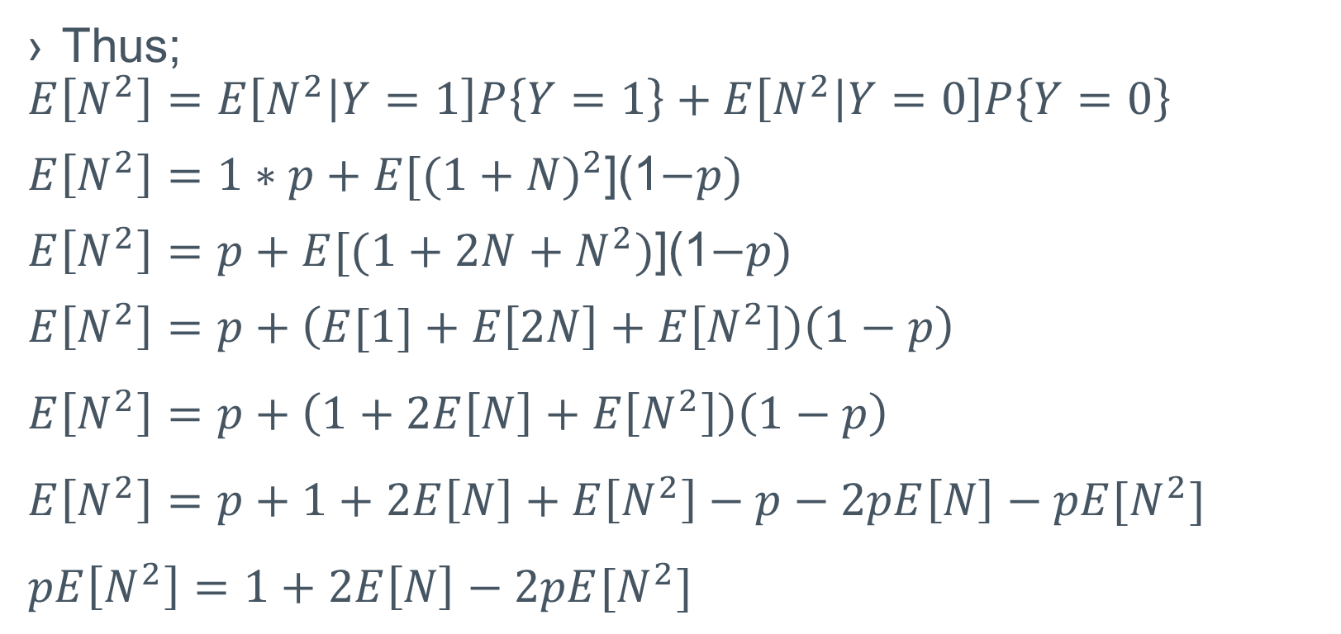
Example 3.17: Variance of the Geometric Random Variable
Thus;
$$E\left[N^{2}\right]=E\left[N^{2} | Y=1\right]P\left\{Y=1\right\}+E\left[N^{2} | Y=0\right]P\left\{Y=0\right\}$$
$E\left[N^{2}\right]=1∗p+E[({1+N)}^{2}$](1$−p)$
$E\left[N^{2}\right]=p+E[({1+2N+N}^{2})$](1$−p)$
$$E\left[N^{2}\right]=p+\left(E[1]+E\left[2N\right]+E\left[N^{2}\right]\right)\left(1−p\right)$$
$$E\left[N^{2}\right]=p+\left(1+2E\left[N\right]+E\left[N^{2}\right]\right)\left(1−p\right)$$
$$E\left[N^{2}\right]=p+1+2E\left[N\right]+E\left[N^{2}\right]−p−2pE\left[N\right]−pE[N^{2}]$$
$$pE\left[N^{2}\right]=1+2E\left[N\right]−2pE[N^{2}]$$

Slide 8
Example 3.17: Variance of the Geometric Random Variable
We previously found in Example 3.11(The mean of a Geometric Distribution) that $E[N]=\frac{1}{p}$
Thus;
$$pE\left[N^{2}\right]=1+\frac{2}{p}−\frac{2p}{p}=\frac{2}{p}−1=\frac{1−p}{p}$$
$$E\left[N^{2}\right]=\frac{2−p}{p^{2}}$$
Hence;
$Var(N)=\frac{2−p}{p^{2}}−\frac{1}{p^{2}}=\frac{1−p}{p^{2}}$

Slide 9
Proposition 3.1: The Conditional Variance Formula
Another way to use Conditioning to obtain the Variance of a random variable is to apply the Conditional Variance formula
The conditional variance of $X$ given that $Y=y$ is defined by:
$$Var(X|Y=y)=E[(X−E\left[X | Y=y\right])^{2}|Y=y]$$
Expending the right side of the preceding and taking expectation term by term yields:
$$Var\left(X | Y=y\right)=E[X^{2}|Y=y]−(E\left[X | Y=y\right])^{2}$$

Slide 10
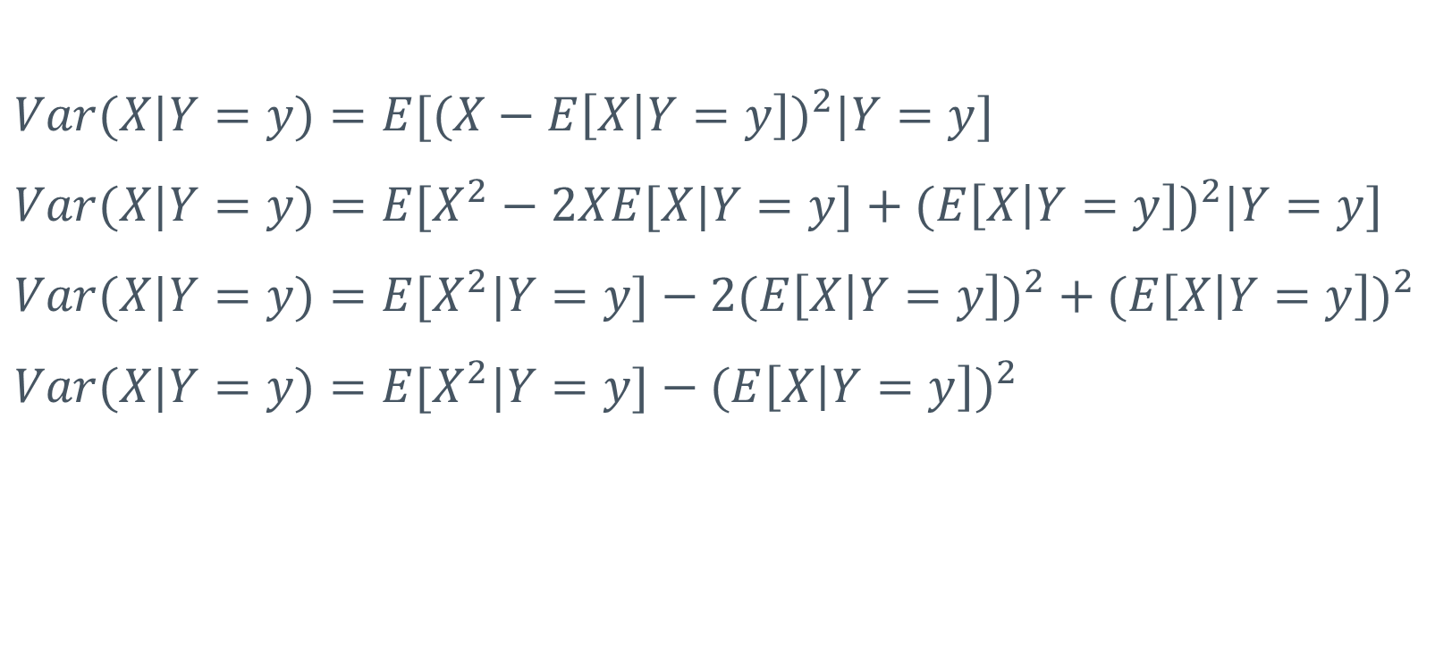
Proposition 3.1: The Conditional Variance Formula
$$Var(X|Y=y)=E[(X−E\left[X | Y=y\right])^{2}|Y=y]$$
$$Var(X|Y=y)=E[X^{2}−2XE[X|Y=y]+(E\left[X | Y=y\right])^{2}|Y=y]$$
$$Var(X|Y=y)=E[X^{2}|Y=y]−2(E\left[X | Y=y\right])^{2}+(E\left[X | Y=y\right])^{2}$$
$$Var(X|Y=y)=E[X^{2}|Y=y]−(E\left[X | Y=y\right])^{2}$$

Slide 11
Proposition 3.1: The Conditional Variance Formula
Letting $Var(X|Y)$ denote that function of $Y$ whose value $Y=y$ is $Var\left(X | Y=y\right)$, we have the Conditional Variance Formula (Proposition 3.1);
$$Var\left(X\right)=E\left[Var\left(X | Y\right)\right]+Var\left(E\left[X | Y\right]\right)$$

Slide 12
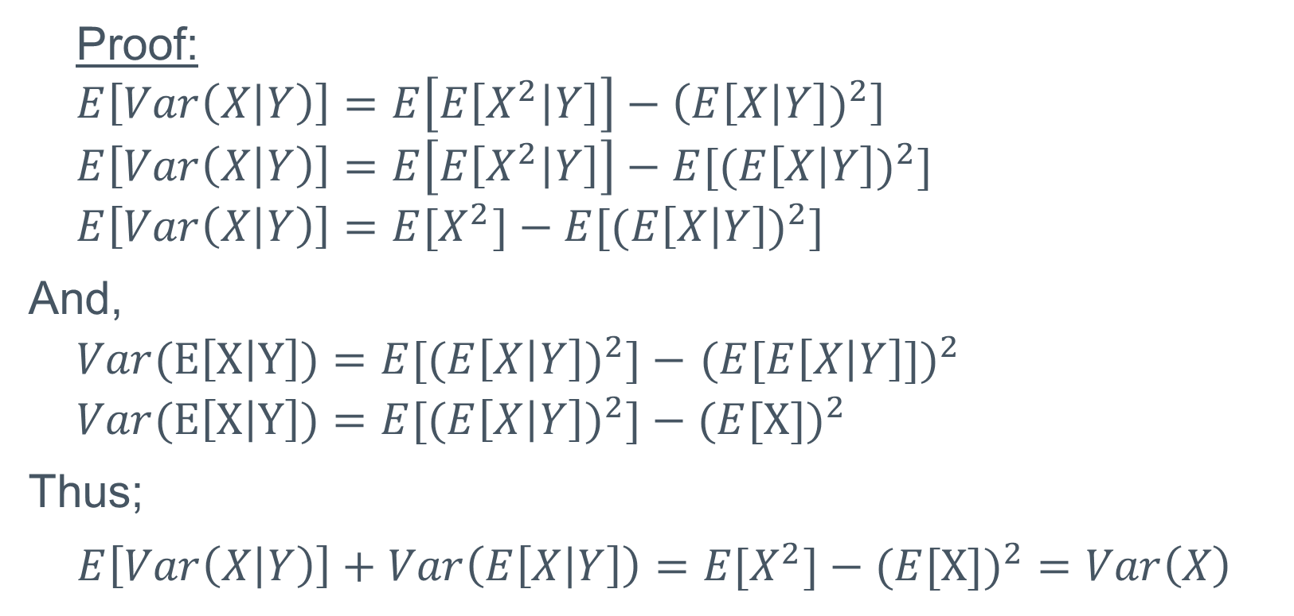
Proposition 3.1: The Conditional Variance Formula
Proof:
$$E\left[Var\left(X | Y\right)\right]=E\left[E\left[X^{2} | Y\right]\right]−\left(E\left[X | Y\right])^{2}\right]$$
$$E\left[Var\left(X | Y\right)\right]=E\left[E\left[X^{2} | Y\right]\right]−E[(E\left[X | Y\right])^{2}]$$
$$E\left[Var\left(X | Y\right)\right]=E[X^{2}]−E[(E\left[X | Y\right])^{2}]$$
And,
$Var(E\left[X | Y\right])=$ $E[(E\left[X | Y\right])^{2}]−$ $(E[E\left[X | Y\right]])^{2}$
$Var(E\left[X | Y\right])=$ $E[(E\left[X | Y\right])^{2}]−(E[X{])}^{2}$
Thus;
$E\left[Var\left(X | Y\right)\right]+Var\left(E\left[X | Y\right]\right)$ $=E[X^{2}]−(E[X{])}^{2}=Var\left(X\right)$

Slide 13
Example 3.18: The variance of a Compound Random Variable
Question:
Let $X_{1},X_{2}…$ be independent and identically distributed random variables with distribution $F$having mean $μ$ and variance ${σ }^{2}$, and assume that they are independent of the nonnegative integer valued random variable $N$. As noted in Example 3.10, where its expected value was determined, the random variable $S=\sum_{i=1}^{N}{X_{i}}$ is called a compound random variable. Find its variance.

Slide 14
Example 3.18: The variance of a Compound Random Variable
Solution:
The conditional variance formula is:
$$Var\left(X\right)=E\left[Var\left(X | Y\right)\right]+Var\left(E\left[X | Y\right]\right)$$
Therefore, we write;
$$Var\left(S\right)=E\left[Var\left(S | N\right)\right]+Var\left(E\left[S | N\right]\right)$$
We have
$S=(\sum_{i=1}^{N}{X_{i}}$)

Slide 15
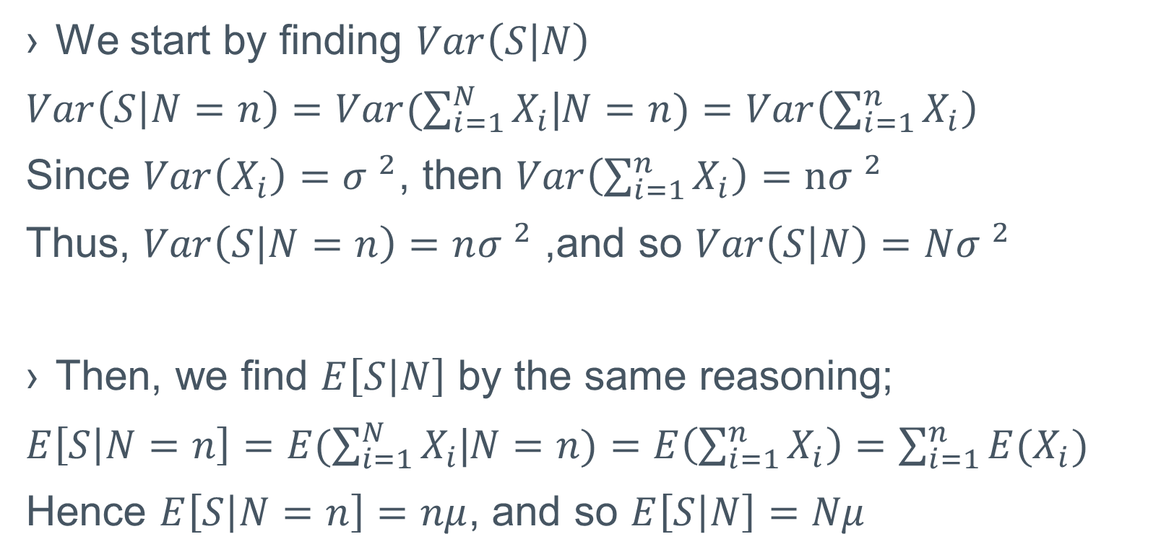
Example 3.18: The variance of a Compound Random Variable
We start by finding $Var\left(S | N\right)$
$Var\left(S | N=n\right)=Var(\sum_{i=1}^{N}{X_{i}}$|$N=n)=Var\left(\sum_{i=1}^{n}{X_{i}}\right)$
Since $Var\left(X_{i}\right)={σ }^{2}$, then $Var\left(\sum_{i=1}^{n}{X_{i}}\right)=n{σ }^{2}$
Thus, $Var\left(S | N=n\right)=n{σ }^{2}$ ,and so $Var\left(S | N\right)=N{σ }^{2}$
Then, we find $E\left[S | N\right]$ by the same reasoning;
$E\left[S | N=n\right]=E(\sum_{i=1}^{N}{X_{i}}$|$N=n)=E\left(\sum_{i=1}^{n}{X_{i}}\right)=\sum_{i=1}^{n}{{E(X}_{i})}$
Hence $E\left[S | N=n\right]=nμ$, and so $E\left[S | N\right]=Nμ$

Slide 16
Example 3.18: The variance of a Compound Random Variable
We substitute in the original formula;
$$Var\left(S\right)=E\left[Var\left(S | N\right)\right]+Var\left(E\left[S | N\right]\right)$$
$$Var\left(S\right)=E\left[N{σ }^{2}\right]+Var\left(Nμ \right)$$
The conditional variance formula gives:
$$Var\left(S\right)={σ }^{2}E\left[N\right]+μ^{2}Var\left(N \right)$$

Slide 17
Example 3.18: The variance of a Compound Random Variable
If $N$ is a Poission random variable, then $S=\sum_{i=1}^{N}{X_{i}}$ is calles a compound Poission random variable
A Poisson random variable has;
$E\left(N\right)=Var\left(N\right)=\text{λ}$
Therefore,
$Var\left(S\right)={σ }^{2}\text{λ}+μ^{2}\text{λ}$ $=\text{λ}\text{(}σ^{2}+μ^{2})=\text{λ}E[X^{2}]$
Where $X$ has distribution$F$

