Slide 1
Minimum Spanning Tree
Name\Tareq Babaqi

Slide 2
What is a Minimum Spanning Tree?
The cost of the spanning tree is the sum of the weights of all the edges in the tree. There can be many spanning trees. Minimum spanning tree is the spanning tree where the cost is minimum among all the spanning trees. There also can be many minimum spanning trees.
Minimum spanning tree has direct application in the design of networks. It is used in algorithms approximating the travelling salesman problem, multi-terminal minimum cut problem and minimum-cost weighted perfect matching. Other practical applications are:
Cluster Analysis
Handwriting recognition
Image segmentation

Slide 3
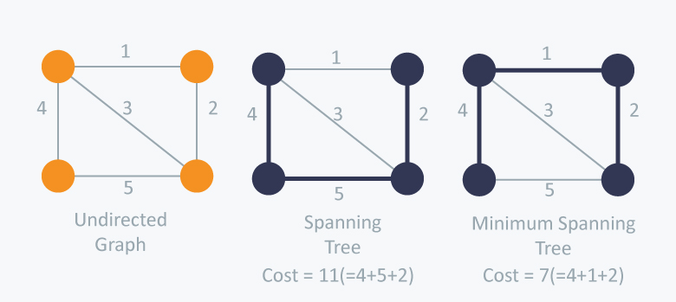

Slide 4
The Minimum Spanning Tree Problem
In the minimum spanning tree problem the minimum total weighted spanning tree is searched in a given network.
xij : if edge (i,j) is on the minimum spanning tree 1, otherwise 0.

Slide 5
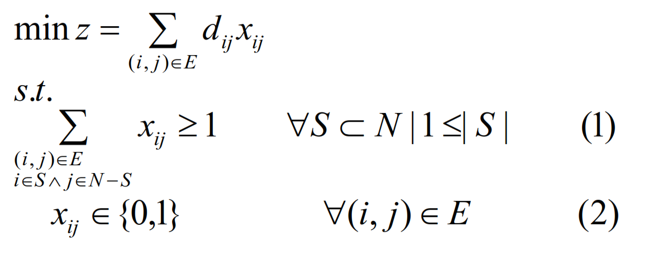
The Minimum Spanning Tree Problem

Slide 6
Prim Algorithm
Let Ck be the set of nodes that have been covered by the minimum spanning tree up to iteration k, and Uk be the set of remaining nodes.
Step 1: Select any node i in set N. Set C1= {i}, U1= N-{i}, k = 2.

Slide 7
Prim Algorithm
Step 2: Select the node j in the set Uk-1that yields the shortest edge to a node in This edge is an element of the minimum spanning tree. Set Ck=Ck-1+ {j}, and Uk=Uk-1 – {j}.
Step 3: If Ck=N STOP, otherwise k=k+1 and go to Step 2.

Slide 8
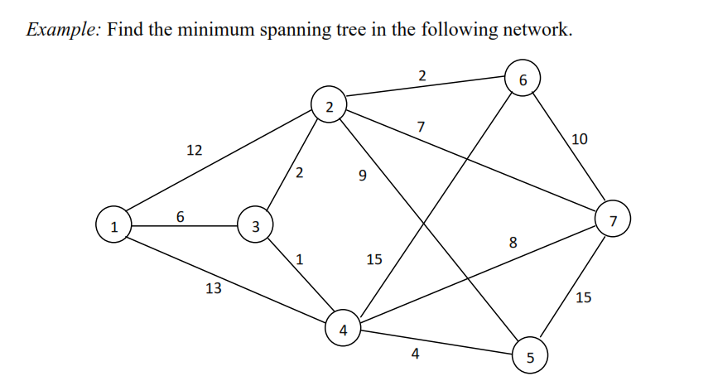

Slide 9
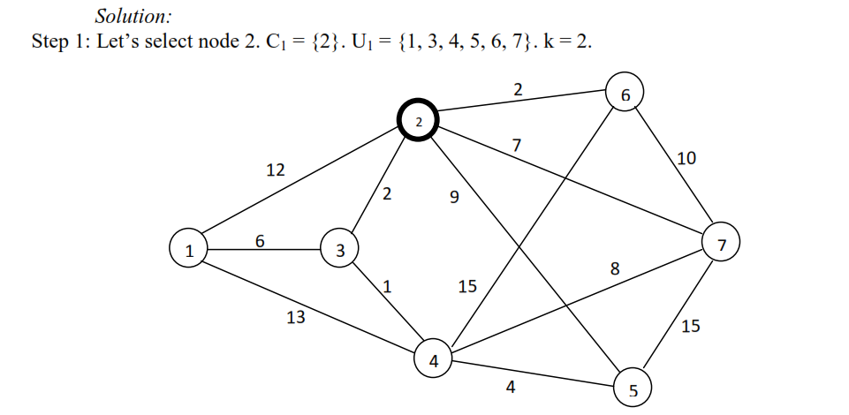

Slide 10
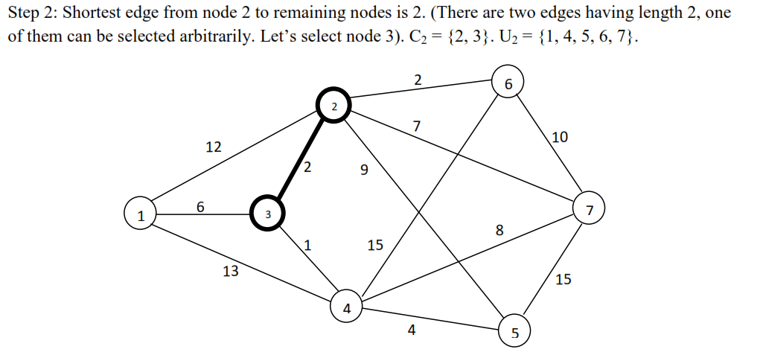

Slide 11
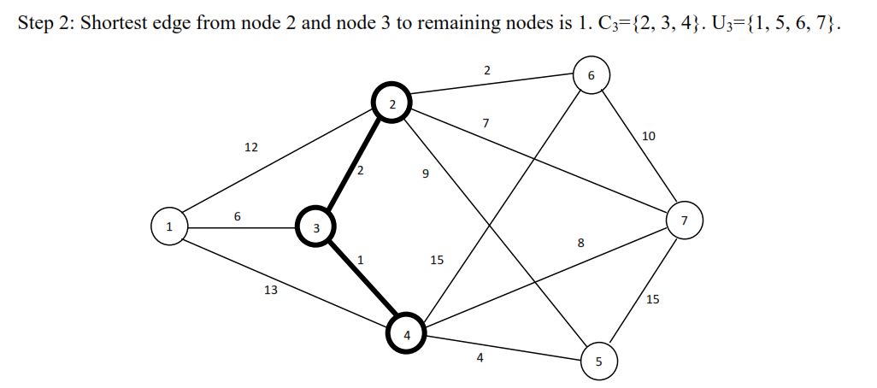

Slide 12
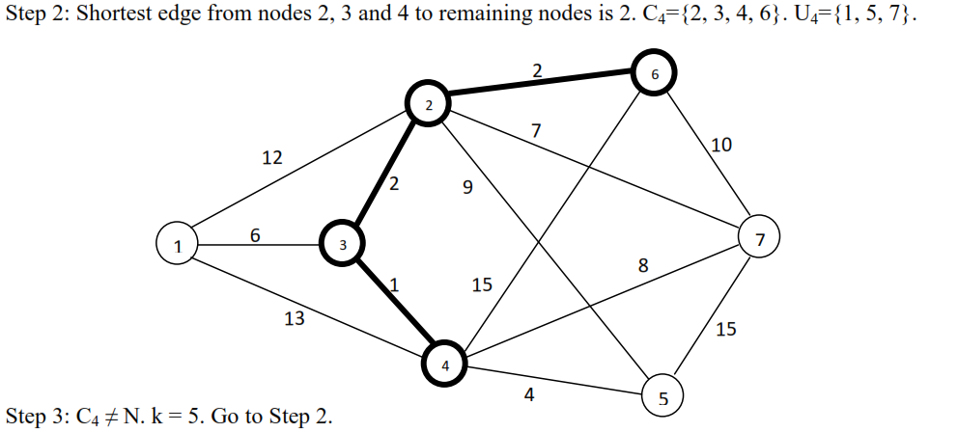

Slide 13
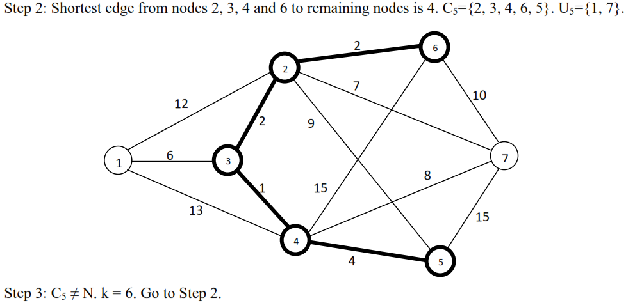

Slide 14
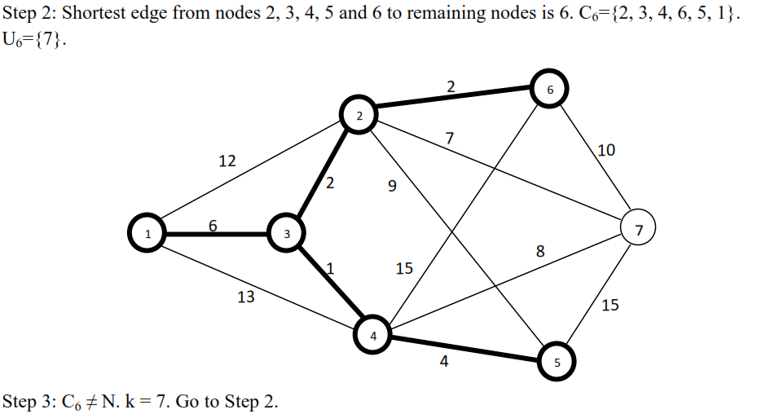

Slide 15
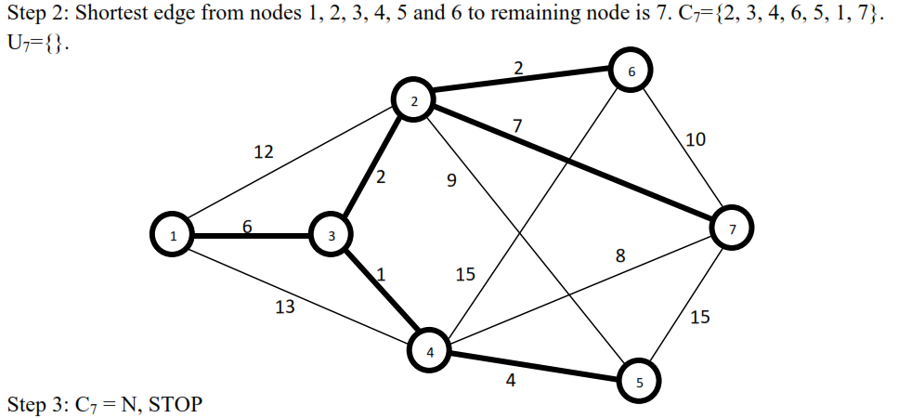

Slide 16
Thank You

