Slide 1
The assignment problem
IENG516 Network Flows
Presented by: Lutfiyah Alriqeeq 16500017
Submitted to: Prof. Dr. Sahand Daneshvar
Spring 2017

Slide 2
Definition:
An n x n assignment problem defined as:
Minimize $∑$ c_{ij} x_{ij} (i , j) Є A
Subject to:
$\sum_{j∈\left\{j:\left(i,j\right)∈A\right\}}{x_{ij=i∈I=\{ 1,2,…., n}}$}
$\sum_{i∈\{i:(i,j)∈A\}}{}x_{ij= 1, j∈J=\{ 1,2,…., n}$}
$x_{ij=≥0, (I,J)∈A}$
Where I is the set of origin nodes, J is the set of destination nodes, A is the set of arcs, and cij is the cost of a unit flow on arc (i , j) .
Notes:
Beginning course details and/or books/materials needed for a class/project.

Slide 3
Definition:
The dual of the assignment problem stated as:
Maximize $\sum_{i∈I }{}$ $R_{i }$+ $\sum_{j∈J }{}$Kj
Subject to:
$R_{i } + K_{j }≤ c_{iJ }, \left(i , j\right)∈A$
Where $R_{i }$ and $K_{j }$ are called the node potentials of the origin and destination nodes, respectively.
Notes:
A schedule design for optional periods of time/objectives.

Slide 4
The bases of an extreme point (simplex) method for solving an n x n assignment problem correspond to spanning tree with 2n-1 arcs.
A basic solution assign exactly n of the basic arcs a flow value of one and the other n-1 arcs of a flow value of zero (all nonbasic arcs receive flows of 0).
Therefore each basis solution is highly degenerate ( i.e contains a large number of zero flows on basic arcs
Notes:
Introductory notes.

Slide 5
Properties:
The direction of the links in the figure correspond to the orientation induced by the predecessor ordering and do not necessarity correspond to the direction of the basis arcs in the assignment problem.
Notes:
Objectives for instruction and expected results and/or skills developed from learning.

Slide 6
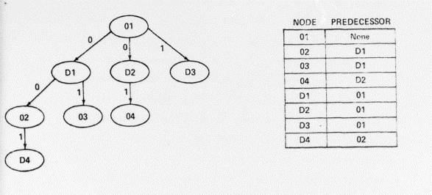
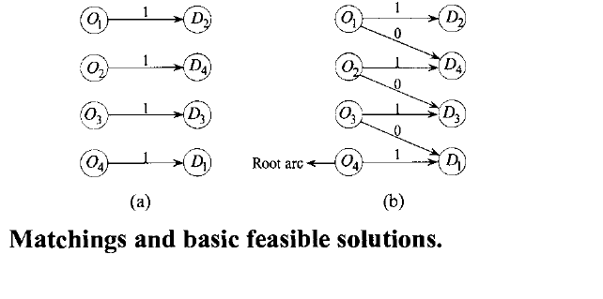
Properties:
In subsequent sections the term O-D link and D-O link is used to refer to links in a rooted basis tree that are directed from an origin node to a destination node and vice versa.
Basic arcs with a flow of one or zero is referred to as 1-link and 0-link respectively.
Notes:
Relative vocabulary list.

Slide 7
References:
The alternating basis algorithm for assignment problems
R. S. Barr
F. Glover
D. Klingman
Linear Programming
and Network Flows
M. S. Bazaraa، Hanif D. Sherali،John J. Jarvis
Notes:
A list of procedures and steps, or a lecture slide with media.

