Slide 1
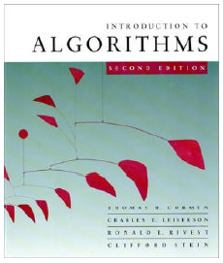
CMPE371 Analysis of Algorithms FALL 2023-2024 Lecture 5 Brute Force Approach

Slide 2
Brute Force Approach
A straightforward approach of trying exhaustively all possible potential alternatives for the solution of the given problem, usually based directly on the problem’s statement and definitions of the concepts involved.
Example: Selection sort algorithm.

Slide 3
Brute-Force Sorting Algorithm
Selection Sort Scan the array to find its smallest element and swap it with the first element. Then, starting with the second element, scan the elements to the right of it to find the smallest among them and swap it with the second elements. Generally, on pass i (0 ≤ i ≤ n-2), find the smallest element in A[i..n-1] and swap it with A[i]: A[0] ≤ . . . ≤ A[i-1] | A[i], . . . , A[min], . . ., A[n-1]
in their final positions
Example: 7 3 2 5

Slide 4
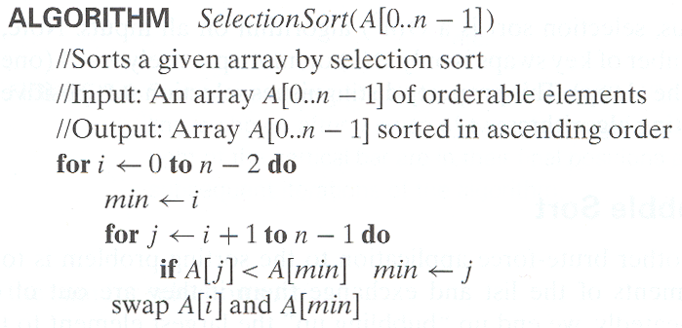
Analysis of Selection Sort
Time efficiency:
Space efficiency:
Θ(n²)
Θ(n).

Slide 5
Brute-Force String Matching
pattern: a string of m characters to search for
text: a (longer) string of n characters to search in
problem: find a substring in the text that matches the pattern
Brute-force algorithm
Step 1 Align pattern at beginning of text
Step 2 Moving from left to right, compare each character of pattern to the corresponding character in text until
all characters are found to match (successful search); or
a mismatch is detected
Step 3 While pattern is not found, and the text is not yet exhausted, realign pattern one position to the right and repeat Step 2

Slide 6
Pseudocode and Efficiency
Time efficiency: θ(m.n) in the worst case.

Slide 7
Examples of Brute-Force String Matching
Pattern: 001011 Text: 10010101101001100101111010
Pattern: happy Text: It is never too late to have a happy childhood.

Slide 8
Brute-Force Polynomial Evaluation
Problem: Find the value of polynomial
p(x) = a_{n}x^{n} + a_{n-1}x^{n-1} +… + a₁x¹ + a₀
at a point x = x₀
Brute-force algorithm
Efficiency: θ(n²)
p ← 0.0
for i ← n downto 0 do
power ← 1
for j ← 1 to i do //compute x^{i}
power ← power ∗ x
p ← p + a[i] ∗ power
return p

Slide 9
Polynomial Evaluation: Improvement
We can do better by evaluating from right to left:
Better brute-force algorithm
Efficiency:
p ← a[0]
power ← 1
for i ← 1 to n do
power ← power ∗ x
p ← p + a[i] ∗ power
return p
Θ(n) multiplications

Slide 10
Brute-Force Strengths and Weaknesses
Strengths
wide applicability
simplicity
yields reasonable algorithms for some important problems (e.g., matrix multiplication, sorting, searching, string matching)
Weaknesses
rarely yields efficient algorithms
some brute-force algorithms are unacceptably slow
not as constructive as some other design techniques

Slide 11
Exhaustive Search
A brute force solution to a problem involving search for an element with a special property, usually among combinatorial objects such as permutations, combinations, or subsets of a set.
Method:
generate a list of all potential solutions to the problem in a systematic manner
evaluate potential solutions one by one, disqualifying infeasible ones and, for an optimization problem, keeping track of the best one found so far
when search ends, announce the solution(s) found

Slide 12
Example : Traveling Salesman Problem

