Slide 1
CMPE/CMSE371 Analysis of Algoritms Summer 2023-2024 Lecture 6: Greedy Algorithms

Slide 8
WHAT ARE GREEDY ALGORITHMS?

Slide 13
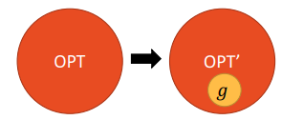

Slide 14
ACTIVITY SELECTION PROBLEM

Slide 15
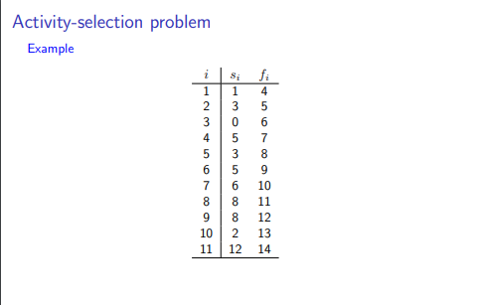

Slide 18
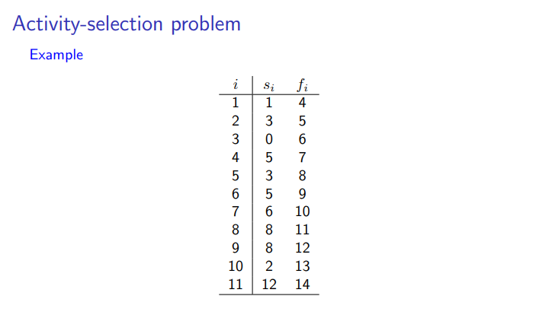

Slide 20
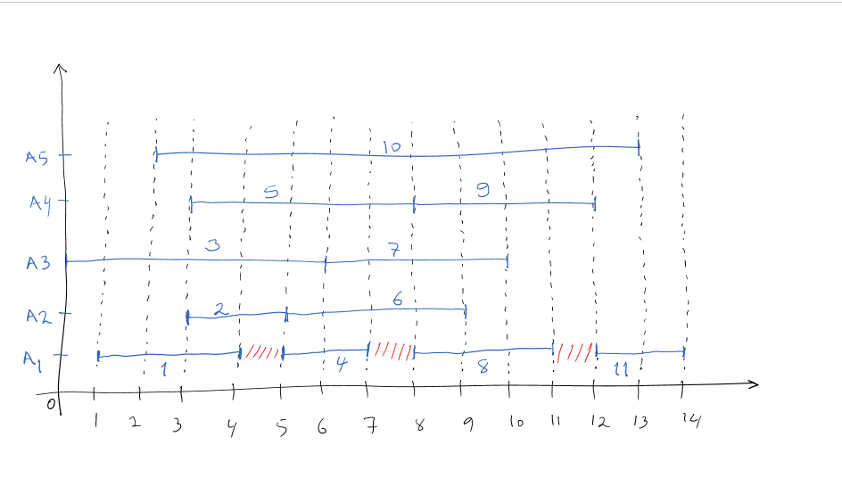

Slide 21
Do we have optimal substructure?
optimal solution = first choice + optimal solution for subproblem ?
yes!
optimal solution = first activity + optimal selection from activities that do not overlap first activity

Slide 23
Do we have greedy-choice property?
Can we select first activity “greedily” and still get optimal solution?
yes!
first activity = activity that ends first

Slide 24
A = {a1,…, an }: set of n activities
Let ai be an activity in A that ends first. Then there is an optimal solution to the Activity-Selection Problem for A that includes ai.
Proof: The steps we need to prove are:
take optimal solution
if OPT contains greedy choice, then done
otherwise modify OPT so that it contains greedy choice, without decreasing the quality of the solution

Slide 25
Let OPT be an optimal solution for A.
If OPT includes ai then the claim obviously holds, so assume OPT does not include ai. We will show how to modify OPT into a solution OPT* such that
(i) OPT* is a valid solution
(ii) OPT* includes ai
(iii) size(OPT*) = size(OPT). Thus OPT* is an optimal solution including ai, and so the claim holds.
To modify OPT we proceed as follows.

Slide 27
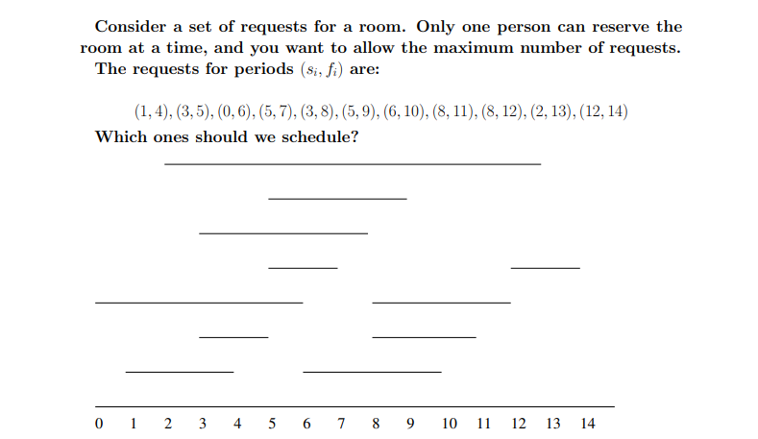

Slide 28
Fractional Knapsack Problem
Knapsack capacity: W
There are n items: the i-th item has value v_{i} and weight w_{i}
Goal:
find x_{i} such that for all 0 ≤ x_{i} ≤ 1, i = 1, 2, .., n
∑ w_{i}x_{i} ≤ W and
∑ x_{i}v_{i} is maximum

Slide 29
FRACTIONAL KNAPSACK PROBLEM
There is a collection of n items, with item i being worth vi dollars and weighing wi kilograms. You have a knapsack that will hold W kilograms of weight. Which items or parts of items should you place in the knapsack to maximize the value of the items carried?
Here a fraction f of an item can be taken, 0 ≤ f ≤ 1. The item could be “a kilogram of flour” and you might take “1/3 of a kilogram of flour”.

Slide 30
To solve the fractional problem, first compute the value per kilogram
vi /wi for each item. Assume the items are sorted by this value:
item 1 has the highest vi /wi , etc.
Then take as much of the first item as the knapsack will hold. If the knapsack holds all of the first item, add as much of item 2 as will fit. Then as much of item 3 as will fit, etc. Until the knapsack is filled with no empty space.

Slide 31
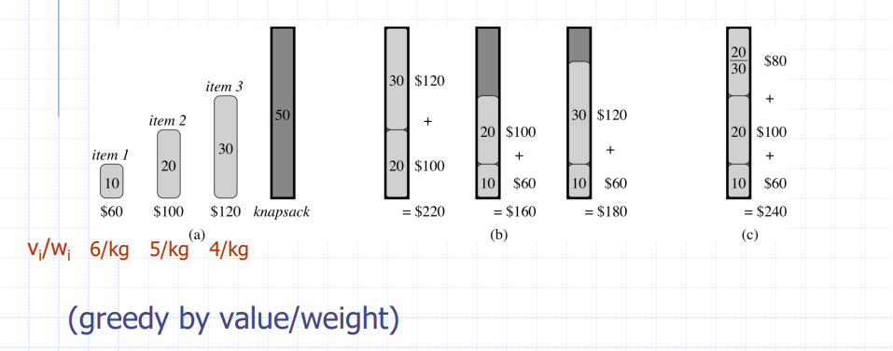

Slide 32
Fractional knapsack problems have the optimal substructure property. Consider the knapsack capacity as W units and it is filled with the optimal value. Assume that a fraction fj of item j is in the knapsack.
if we remove the fraction fj of item j that was in the knapsack, the remaining value in the knapsack must be the optimal value weighing at most W – fjwj , taken from all items except j.
If not, take the optimal value of the remaining problem and add the removed amount of item j to it, getting an even more valuable load. This is a contradiction.

