Slide 1
Java Review CMSE419

Slide 2
Java
Java is an object-oriented language, with a syntax similar to C
Structured around objects and methods
A method is an action or something you do with the object
Avoid those overly complicated features of C++:
Operator overloading, pointer, templates, friend class, etc.

Slide 3
How it works…!
Compile-time
Run-time
Class Loader
Java Class
Libraries
Java
Source
(.java)
Java
Bytecodes
move locally
or through
network
Java
Interpreter
Just in Time
Compiler
Java
Compiler
Java
Virtual
machine
Java
Bytecode
(.class )
Runtime System
Operating System
Hardware

Slide 4
Getting and using java
JDK freely download from https://www.oracle.com/java/technologies/javase-downloads.html
All text editors support java
Vi/vim, emacs, notepad, wordpad
Just save to .java file
Eclipse IDE
Eclipse
http://www.eclipse.org

Slide 5
Compile and run an application
Write java class HolaWorld containing a main() method and save in file ”HolaWorld.java”
The file name MUST be the same as class name
Compile with: javac HolaWorld.java
Creates compiled .class file: HolaWorld.class
Run the program: java HolaWorld
Notice: use the class name directly, no .class!

Slide 6
Hola World!
File name: HolaWorld.java
/* Our first Java program – HolaWorld.java */
public class HolaWorld {
//main()
public static void main ( String[] args ) {
System.out.println( ”Hola world!" );
}
}
Command line arguments
Standard output, print with new line

Slide 7
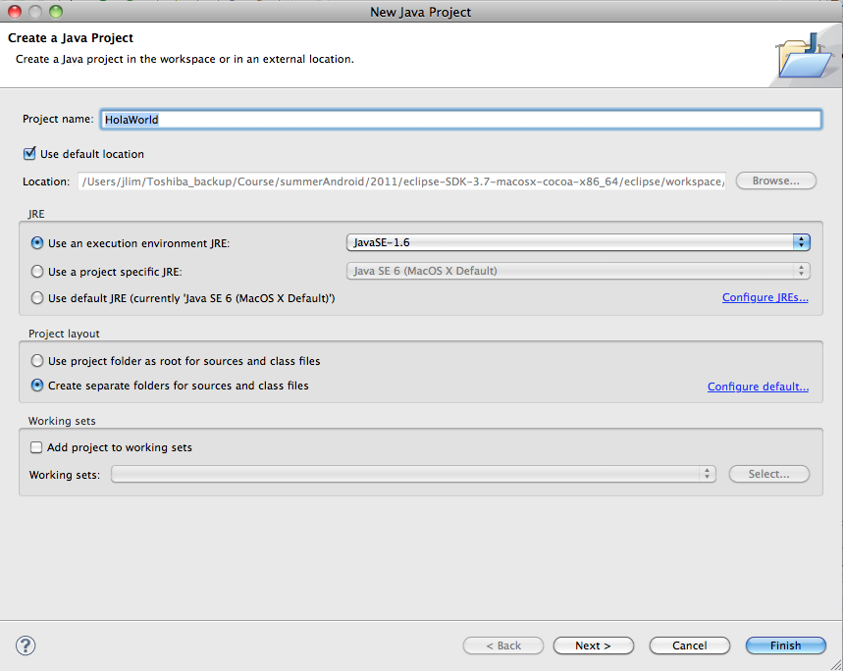
HolaWorld in Eclipse – create a new project
File > New > Java Project
Project Name : HolaWorld

Slide 8
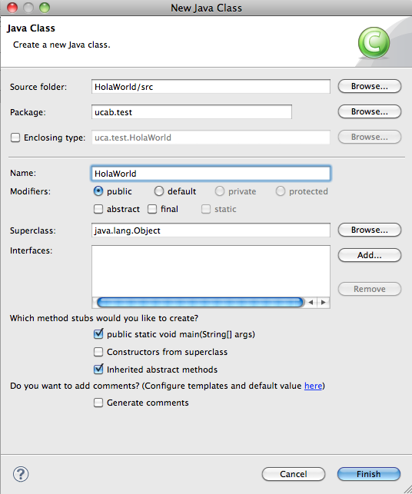
HolaWorld in Eclipse – add a new class
File > New > Class
source folder : HolaWorld/src
Package : ucab.test
Name : HolaWorld
check "public static void main (String[] args)

Slide 9
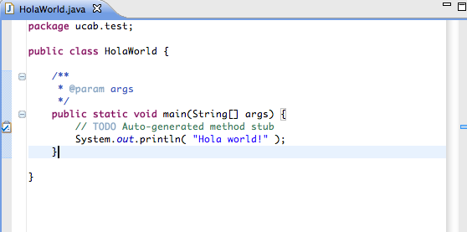
HolaWorld in Eclipse – write your code
Add your code
System.out.println(“Hola world!”);

Slide 10
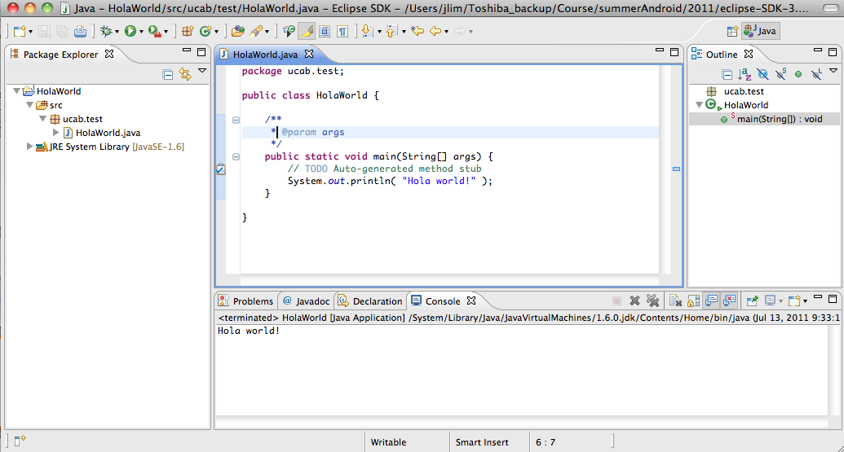
HolaWorld in Eclipse – run your program
Run > Run As > Java Application

Slide 11
Object-Oriented
Java supports OOP
Polymorphism
Inheritance
Encapsulation
Java programs contain nothing but definitions and instantiations of classes
Everything is encapsulated in a class!

Slide 12
The three principles of OOP
Encapsulation
Objects hide their functions (methods) and data (instance variables)
Inheritance
Each subclass inherits all variables of its superclass
Polymorphism
Interface same despite different data types
car
Super class
manual
auto-
matic
Subclasses
draw()
draw()

Slide 13
About class
Fundamental unit of Java program
All java programs are classes
A class is a template or blueprint for objects
A class describes a set of objects that have identical characteristics (data elements) and behaviors (methods).
Existing classes provided by JRE
User defined classes
Each class defines a set of fields (variables), methods or other classes

Slide 14
What is an object?
An object is an instance of a class
An object has state, behavior and identity
Internal variable: store state
Method: produce behavior
Unique address in memory: identity

Slide 15
What does it mean to create an object?
An object is a chunk of memory:
holds field values
holds an associated object type
All objects of the same type share code
they all have same object type, but can have different field values.

Slide 16
class: keyword
import ……
class ClassName{
/* class body goes here */
}

Slide 17
Class Person: definition
class Person {
String name;
int height; //in inches
int weight; //in pounds
public void printInfo(){
System.out.println(name+" with height="+height+", weight="+weight);
}
}
Variables
Method

Slide 18
Class Person: usage
Person john; //declaration
john = new Person();//create an object of Person
john.name= “John Kim”;//access its field
Person sam = new Person();
sam.name=“Sam George”;
john.printInfo(); // call method
sam.printInfo();

Slide 19
Class Person: reference
Name: John Kim
height: 0
weight: 0
john
Name: Sam George
height: 0
weight: 0
sam
References
Objects allocated in memory

Slide 20
Reference
Person john;
//only created the reference, not an object. It points to nothing now (null).
john = new Person();
//create the object (allocate storage in memory), and john is initialized.
john.name=“John”;
//access the object through the reference

Slide 21
Primitive types
Primitive type | Size | Minimum | Maximum | Wrapper type
boolean | 1-bit | — | — | Boolean
char | 16-bit | Unicode 0 | Unicode 2¹⁶- 1 | Character
byte | 8-bit | -128 | +127 | Byte
short | 16-bit | -2¹⁵ | +2¹⁵-1 | Short
int | 32-bit | -2³¹ | +2³¹-1 | Integer
long | 64-bit | -2⁶³ | +2⁶³-1 | Long
float | 32-bit | IEEE754 | IEEE754 | Float
double | 64-bit | IEEE754 | IEEE754 | Double

Slide 22
Reference vs. primitive
Java handle objects and arrays always by reference.
classes and arrays are known as reference types.
Class and array are composite type, don’t have standard size
Java always handle values of the primitive types directly
Primitive types have standard size, can be stored in a fixed amount of memory
Because of how the primitive types and objects are handles, they behave different in two areas:
copy value and compare for equality

Slide 23
Copy
Primitive types get copied directly by =
int x= 10; int y=x;
Objects and arrays just copy the reference, still only one copy of the object existing.
john
Name: John
height: 0
weight: 0
Person john = new Person();
john.name=”John";
Person x=john;
x.name="Sam";
System.out.println(john.name); // print Sam!
x

Slide 24
Scoping: in a class
public class VisibilityDemo {
private int classVar1;
private int classVar2;
public int method1(int x) {
int local = 0;
for (int i = 0; i < x; i++){
local += i;
}
return local;
}
public void method2 ( int x) {
classVar1 = x + 10;
classVar2 = method1(classVar1);
}
}
The red identifiers denote class varialbes and methods. They have visibility anywhere inside the outermost pair of red curly brackets
The blue identifiers are local to a single block (identified by blue brackets). They are not visible to anything outside of their block, but are visible inside blocks nested inside of the blue bracketed block.
The gray identifiers are found inside the for-loop. The gray variable i is visible only inside the loop.
Parameters are denoted by green. They are visible everywhere inside the method in which they appear, but only in that method

Slide 25
Access control
Access to packages
Java offers no control mechanisms for packages.
If you can find and read the package you can access it
Access to classes
All top level classes in package P are accessible anywhere in P
All public top-level classes in P are accessible anywhere
Access to class members (in class C in package P)
Public: accessible anywhere C is accessible
Protected: accessible in P and to any of C’s subclasses
Private: only accessible within class C
Package: only accessible in P (the default)

Slide 26
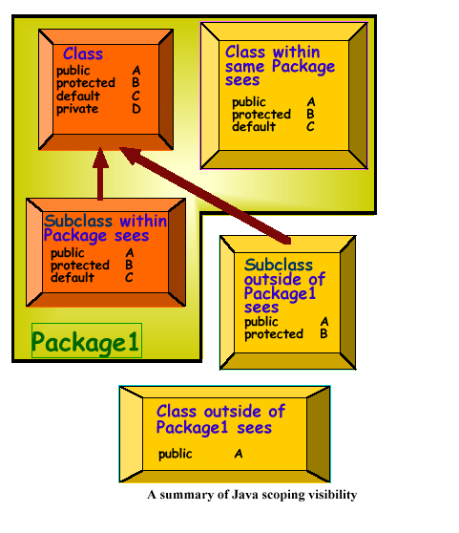
Scoping: visibility between classes

Slide 27
The static keyword
Java methods and variables can be declared static
These exist independent of any object
This means that a Class’s
static methods can be called even if no objects of that class have been created and
static data is “shared” by all instances (i.e., one value per class instead of one per instance
class StaticTest {static int i = 47;}
StaticTest st1 = new StaticTest();
StaticTest st2 = new StaticTest();
// st1.i == st2.i == 47
StaticTest.i++; // or st1.i++ or st2.i++
// st1.i == st2.i == 48

Slide 28
The boolean Type
The boolean type represents truth values. This type has only two possible values, representing the two boolean states: on or off, yes or no, true or false. Java reserves the words true and false to represent these two boolean values.
C and C++ programmers should note that Java is quite strict about its boolean type: boolean values can never be converted to or from other data types. In particular, a boolean is not an integral type, and integer values cannot be used in place of a boolean. In other words, you cannot take shortcuts such as the following in Java:
if (0) {
while(i) { }
}
Instead, Java forces you to write cleaner code by explicitly stating the comparisons you want:
if (0 != null) {
while(i != 0) { }
}

Slide 29
Declaring Variables
dataType identifier [ = Expression]:
Example variable declarations and initializations:
int x; // Declare x to be an
// integer variable;
double radius; // Declare radius to
// be a double variable;
char a; // Declare a to be a
// character variable;

Slide 30
Declaring and Initializing in One Step
int x = 1;
double d = 1.4;
float f = 1.4;
int x; x=5;
boolean b = true;
String x = “how are you?”;

Slide 31
Variable (name, value, data type, size)
Content may change during program execution.
Must be declared before it can be used.
May not be automatically initialized.
If new value is assigned, old one is destroyed.
Value can only be changed by an assignment statement or an input (read) statement.
Example
double amountDue;
int counter;
char ch;
int x, y;

Slide 32
Character Type - char
A char variable holds a single character.
A char constant is surrounded by single quotes.
Example char constants:
'B', '1', ':'
Example code fragment:
char first, middle, last;
first = 'J';
middle = 'S';
last = 'D';
System.out.println("Hello, " + first + middle +
last + '!');
What does this code fragment print?

Slide 33
Escape Sequences
Escape sequences are char constants for hard-to-print characters such as the enter character and the tab character.
An escape sequence is comprised of a backslash (\) and another character.
Common escape sequences:
\n newline – go to first column in next line
\t move the cursor to the next tab stop
\\ print a backslash
\" print a double quote
\' print a single quote
Provide a one-line print statement that prints these tabbed column headings followed by two blank lines:
ID NAME
Note that you can embed escape sequences inside strings the same way that you would embed any characters inside a string. For example, provide an improved one-line print statement for the above heading.

Slide 34
Assignments Between Different Types
Assigning an integer value into a floating-point variable works just fine. Note this example:
double bankAccountBalance = 1000;
On the other hand, assigning a floating-point value into an integer variable is like putting a large object into a small box. By default, that's illegal. For example, this generates a compilation error:
int temperature = 26.7;
This statement also generates a compilation error:
int count = 0.0;

Slide 35
Named constant
Cannot be changed during program execution.
Declared by using the reserved word final.
Initialized when it is declared.
Example
final double CENTIMETERS_PER_INCH = 2.54;
final int NO_OF_STUDENTS = 20;
final char BLANK = ' ';
final double PAY_RATE = 15.75;

Slide 36
Constants
final datatype CONSTANTNAME = VALUE;
final double PI = 3.14159;
final int SIZE = 3;

Slide 37
Reference data types
we manipulate these objects by implicitly handling
their memory address, or reference
→ a variable which is declared as being a certain object
actually contains the address of this object
= abuse of notation, formally wrong but very useful !
BUT the value of this address is never directly accessible to us and we cannot know the size of the object
→ unlike C, no pointer arithmetic, no sizeof → no more memory errors!
data handled by reference: object (instance of a class) , array , string
strings are instances of class String
→ treated in a dedicated way
if a variable which is declared as an object (or array, string) does not actually refer to any object (or array, string), then its value is null
ALL data handled by reference -even arrays- are allocated in the dynamic memory and not in the stack of function calls as local variables.

Slide 38
Object and Reference Variables
int x; //Line 1
String str; //Line 2
x = 45; //Line 3
str = "Java Programming"; //Line 4

Slide 39
String Basics
Example code for basic string manipulations:
String s1;
String s2 = "and I say hello";
s1 = "goodbye";
s1 = "You say " + s1;
s1 += ", " + s2 + '.';
System.out.println(s1);
Trace the above code.
declaration
initialization
assignment
concatenation, then assignment
concatenation, then compound assignment

Slide 40
String Methods
String's charAt method:
Returns the character in the given string at the specified position.
The positions of the characters within a string are numbered starting with position zero.
What's the output from this example code?
String animal = "cow";
System.out.println("Last character: " + animal.charAt(2));
To use a method, include the reference variable, dot, method name, parentheses, and argument(s).

Slide 41
String Methods
To compare strings for equality, use the equals method. Use equalsIgnoreCase for case-insensitive equality.
Trace this program:
public class Test
{
public static void main(String[] args)
{
String animal1 = "Horse";
String animal2 = "Fly";
String newCreature;
newCreature = animal1 + animal2;
System.out.println(newCreature.equals("HorseFly"));
System.out.println(newCreature.equals("horsefly"));
System.out.println(newCreature.equalsIgnoreCase("horsefly"));
} // end main
} // end class Test

Slide 42
Object and Reference Variables
Primitive type variables directly store data into their memory space.
Reference variables store the address of the object containing the data.
An object is an instance of a class and the operator new is used to instantiate an object.

Slide 43
garbage collection:
the JVM automatically detects when an object is no longer referenced by any variable
→ the JVM deallocates the place occupied in memory by this object
→ the programmer is no longer in charge of deallocation (no more free)

Slide 44
stack of local variables
dynamic memory
free space
garbage collecting
free space
object no longer referenced
free space
null
free space
free space
null
free space
free space

Slide 45
Order of Precedence
* / % (same precedence)
+ - (same precedence)
Operators in 1 have a higher precedence than operators in 2.
When operators have the same level of precedence, operations are performed from left to right.

Slide 46
Expressions
Integral expressions
Floating-point or decimal expressions
Mixed expressions

Slide 47
Integral Expressions
All operands are integers.
Examples:
2 + 3 * 5
3 + x – y / 7
x + 2 * (y – z) + 18

Slide 48
Floating-Point Expressions
All operands are floating-point numbers.
Examples:
12.8 * 17.5 – 34.50
x * 10.5 + y - 16.2

Slide 49
Mixed Expressions
Operands of different types.
Examples:
2 + 3.5
6 / 4 + 3.9
Integer operands yield an integer result; floating-point numbers yield floating-point results.
If both types of operands are present, the result is a floating-point number.
Precedence rules are followed.

Slide 50
Type Conversion (Casting)
Used to avoid implicit type coercion.
Syntax:
(dataTypeName) expression
Expression evaluated first, then type converted to: dataTypeName
Examples:
(int)(7.9 + 6.7) = 14
(int)(7.9) + (int)(6.7) = 13

Slide 51
boolean expression:
formula whose result is a boolean (true or false)
= must be used for all tests of conditional statements!
→ operators:
== , !=
on arithmetic expressions or references of objects
< , <= , > , >=
on arithmetic expressions
! , && , | |
on boolean expressions

Slide 52
The Assignment Statement
variable = expression;
Example
int i, j;
double sale;
char first;
String str;
i = 4;
j = 4 * 5 - 11;
sale = 0.02 * 1000;
first = 'D';
str = "It is a sunny day.";

Slide 53
comment:
// rest of line
or /* . . . . . */ (cannot be nested)
declaration :
type variable;
or type variable1, … variablen;
at any place in the code, unlike in C (where declarations must be the first statements of a block)

Slide 54
assignment:
variable = expression;
or variable operator expression;
with operator being += , -= , *= , /= , %=
or variable++;
or variable--;
declaration - assignment:
type variable = expression;
or type variable1 , variable2 = expression , variable3;

Slide 55
Control Structures
Three methods of processing a program:
In sequence
Branching
Looping
Branch: Altering the flow of program execution by making a selection or choice.
Loop: Altering the flow of program execution by repeating statements.

Slide 56
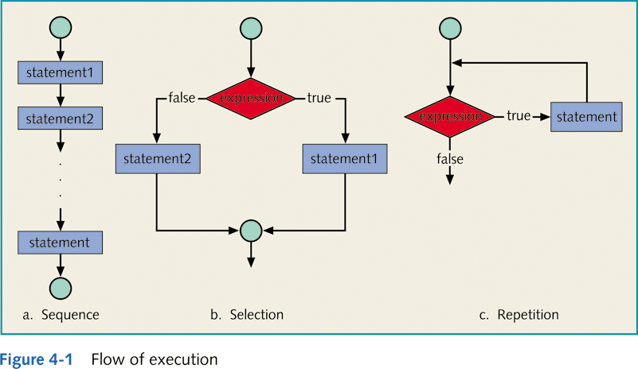

Slide 57
Relational Operators
Relational operator:
Allows you to make comparisons in a program.
Binary operator.
Condition is represented by a logical expression in Java.
Logical expression: An expression that has a value of either true or false.

Slide 58
conditional constructs:
if (boolean) statement;
if (boolean) { block of statements }
if (boolean) . . . . . else . . . . .
int x; .... if (x) . . . . . and if (1) . . . . . are not allowed !

Slide 59
Example
if (hours > 40.0)
wages = 40.0 * rate +1.5 * rate * (hours - 40.0);
else
wages = hours * rate;

Slide 60
Compound (Block of) Statements
Syntax:
{
statement1
statement2
.
.
.
statementn
}

Slide 61
Compound (Block of) Statements
if (age > 18)
{
System.out.println("Eligible to vote.");
System.out.println("No longer a minor.");
}
else
{
System.out.println("Not eligible to vote.");
System.out.println("Still a minor.");
}

Slide 62
The Ternary Operator ? :
The conditional if:
if (n1 > n2)
max = n1;
else
max = n2;
Can be expressed using the ternary operator:
max = (n1 > n2) ? n1 : n2
This gives an identical action to the usual conditional if.

Slide 63
Multiway if-else Statement
if (Boolean_Expression)
Statement_1
else if (Boolean_Expression)
Statement_2
else if (Boolean_Expression_n)
Statement_n
else
Statement_For_All_Other_Possibilities
. . .

Slide 64
Multiway if-else Statement
Consider the following:
(a < b < c) ?
(b < c) ?
true
false
true
(a < c < b) ?
true
(a < c) ?
false
(a < b) ?
(c < a < b) ?
false
(b < a < c ) ?
true
false
(b < c < a) ?
(a < c) ?
true
(b < c) ?
false
(c < b < a) ?

Slide 65
Multiway if-else Statement
The compiler always matches the else to the latest unmatched if:
If (a<b)
if (b<c) System.out.println(“a<b<c”);
else
if (a<c) System.out.println(“a<c<b”);
else System.out.println(“c<a<b”);
else
if (a<c) System.out.println(“b<a<c”);
else
if (b<c) System.out.println(“b<c<a”);
else System.out.println(“c<b<a”);

Slide 66
switch
switch according to the value
of an expression of type byte, char, short, int or long :
switch (expression)
{
case value1 : . . . . . break;
. . . . . . . . . .
case valuen : . . . . . break;
default: . . . . . break;
}

Slide 67
The switch Statement
Note, each branch statement in a switch statement starts with the reserved word
case,
followed by a constant called a case label, then a sequence of statements
Each case label must be of the same type as the controlling expression
Case labels need not be listed in order or span a complete interval, but each one may appear only once
Each sequence of statements may be followed by a break statement ( break;)

Slide 68
The switch Statement
Note
When the computer executes the statements after a case label, it continues until a break statement is reached
If the break statement is omitted, then after executing the code for one case, the computer will go on to execute the code for the next case
If the break statement is omitted inadvertently, the compiler will not issue an error message
There can also be a section labeled default:
The default section is optional, and is usually last
Even if the case labels cover all possible outcomes in a given switch statement, it is still a good practice to include a default section
It can be used to output an error message

Slide 69
Flow of Control
(loops)

Slide 70
Loops
Loops in Java are used to repeat the action of a section of code.
Java has three types of loop statements: the: while,
do-while,
for.
The code that is repeated in a loop is called the body of the loop
Each repetition of the loop body is called an iteration of the loop

Slide 71
The for Statement
for (Initializing; Boolean_Expression; Update)
{code to be repeated}
Usually, the total number of repeats are known.
The first expression tells how the control variable or variables are initialized or declared and initialized before the first iteration
The second expression determines when the loop should end, based on the evaluation of a Boolean expression before each iteration
The third expression tells how the control variable or variables are updated after each iteration of the loop body

Slide 72
The for Statement Syntax
for (Initializing; Boolean_Expression; Update)
{code to be repeated}
The Body may consist of a single statement or a list of statements enclosed in a pair of brackets ({ })
Note that the three control expressions are separated by two semicolons
Note that there is no semicolon after the closing parenthesis at the beginning of the loop

Slide 73
The Comma in for Statements
A for loop can contain multiple initialization actions separated with commas
eg
imax=6;
jmin =6;
for(i=1, j=10; (i<imax) && (j>jmin); i=i+1,j=j-1)
{code to be repeated}
A for loop can contain multiple update actions, separated with commas
However, a for loop can contain only one Boolean expression to test for ending the loop

Slide 74
for (i = 0 ; i < n ; i++) . . . . .
initialize two loop variables:
for (i = 0 , j = 0 ; i < n ; i++ , j++) . . . . .
declare and initialize the loop variable:
for (int i = 0 ; i < n ; i++) . . . . .
declare and initialize two loop variables:
for (int i = 0 , j = 0 ; i < n ; i++ , j++) . . . . .
note: we cannot mix multiple initializations
with multiple declarations(-initializations)
get out of the nearest enclosing loop construct: break;
continue to the next iteration: continue;
example:
for (int i = 0 , j = 6 ; i < j ; i++ , j--)
{
System.out.println(“ i=” + i + “ j=” + j);
if (i + 2 == j) break;
}
→ i=0 j=6
i=1 j=5
i=2 j=4

Slide 75
Example for-loop to produces an average
import java.util.Scanner;
public class summation {
public static void main(String[ ] args)
{
int sum=0, n, nextTerm;
double average;
Scanner keyboard = new Scanner(System.in);
System.out.println("How many numbers do you wish to average? ");
n = keyboard.nextInt( );
for( int j = 1; j <= n; j = j + 1 ) // Repeat n times
{
System.out.println("Enter number: ");
nextTerm = keyboard.nextInt( );
sum = sum + nextTerm;
}
average = sum / (double) n;
System.out.print( "Average of " + n + " numbers is " + average );
}
}

Slide 76
loop constructs:
while (boolean) statement;
while (boolean) { block of statements }
do . . . . . while (boolean);
example:
double x = 0.0;
while (x < 4.0) { System.out.println(“x=” + x);
x += 1.0; }
→ x=0.0
x=1.0
x=2.0
x=3.0
int x;
. . . . . while (x) . . . . .
and while (1) . . . . . are not allowed !

Slide 77
Input and Output
Input – the Scanner Class
Sun provides a pre-written class named Scanner, which allows you to get input from a user.
To tell the compiler you want to use the Scanner class, insert the following import statement at the very beginning of your program (right after your prologue section and above the main method):
import java.util.Scanner;
At the beginning of your main method, insert this initialization statement:
Scanner stdIn = new Scanner(System.in);
After declaring stdIn as shown above, you can read and store a line of input by calling the nextLine method like this:
<variable> = stdIn.nextLine();

Slide 78
Input – the Scanner Class
/*********************************************************
* FriendlyHello.java
* Dean & Dean
*
* This program displays a personalized Hello greeting.
*********************************************************/
import java.util.Scanner;
public class FriendlyHello
{
public static void main(String[] args)
{
Scanner stdIn = new Scanner(System.in);
String name;
System.out.print("Enter your name: ");
name = stdIn.nextLine();
System.out.println("Hello " + name + "!");
} // end main
} // end class FriendlyHello
These two statements create a keyboard-input connection.
This gets a line of input.
Use the print method (no “ln”) for most prompts.

Slide 79
Input – the Scanner Class
In addition to the nextLine method, the Scanner class contains quite a few other methods that get different forms of input. Here are some of those methods:
nextInt()
Skip leading whitespace until an int value is found. Return the int value.
nextLong()
Skip leading whitespace until a long value is found. Return the long value.
nextFloat()
Skip leading whitespace until a float value is found. Return the float value.
nextDouble()
Skip leading whitespace until a double value is found. Return the double value.
next()
Skip leading whitespace until a token is found. Return the token as a String value.
nextLine()
Returns the rest of the current line, excluding any line separator at the end.
close() closes the scanner.

Slide 80
Input – the Scanner Class
What is whitespace?
Whitespace refers to all characters that appear as blanks on a display screen or printer. This includes the space character, the tab character, and the newline character.
The newline character is generated with the enter key.
Leading whitespace refers to whitespace characters that are at the left side of the input.
What is a token?
A token is a sequence of non-whitespace characters.
What happens if the user provides invalid input for one of Scanner’s method calls?
The JVM prints an error message and stops the program.
For example, 45g and 45.0 are invalid inputs if nextInt() is called.

Slide 81
Input – the Scanner Class
Here's a program that uses Scanner’s nextDouble and nextInt methods:
import java.util.Scanner;
public class PrintPO
{
public static void main(String[] args)
{
Scanner stdIn = new Scanner(System.in);
double price; // price of purchase item
int qty; // number of items purchased
System.out.print("Price of purchase item: ");
price = stdIn.nextDouble();
System.out.print("Quantity: ");
qty = stdIn.nextInt();
System.out.println("Total purchase order = $" + price * qty);
} // end main
} // end class PrintPO

Slide 82
Input – the Scanner Class
Here's a program that uses Scanner’s next method:
import java.util.Scanner;
public class PrintInitials
{
public static void main(String[] args)
{
Scanner stdIn = new Scanner(System.in);
String first; // first name
String last; // last name
System.out.print(
"Enter first and last name separated by a space: ");
first = stdIn.next();
last = stdIn.next();
System.out.println("Your initials are " +
first.charAt(0) + last.charAt(0) + ".");
} // end main
} // end class PrintInitials

Slide 83
For example, given the following code segment and data
int number = in.nextInt();
float real = in.nextFloat();
long number2 = in.nextLong();
double real2 = in.nextDouble();
String string = in.next();
44 23
2222222222
22222.33 End
44 would be stored in number; 23.0 would be stored in real; 2222222222 would be stored in number2; 22222.33 would be stored in real2; and ≥End≤ would be stored in string. Notice that method nextFloat reads an integer and stores it as a float value. This is legal because an integer value can be stored exactly as a real value; there is no ambiguity. If we had keyed a decimal point after the 44, the system would have thrown a InputMismatchException (a checked exception) regardless of whether or not a non-zero value followed the decimal point. An arbitrary real number cannot be stored exactly as an integer; it is ambiguous. Remember that anything ambiguous is illegal.
nextLine reads the rest of the line and returns it as a string. The carriage return is consumed but is not appended to the string. The numeric reads do not consume the whitespace, so if a nextLine is issued at after a numeric read and the numeric value is at the end of the line, nextLine returns the empty string. nextLine never jumps over a carriage return to get the next line of input. For example, the following code fragment
int number = in.nextInt();
String string = in.nextLine();
float real = in.nextFloat();
String string2 = in.nextLine();
and the data shown above, string would contain ≥23≤ and string2 would contain the empty string.

Slide 84
Boolean Methods
We said that the Scanner methods that read numeric data throw a InputMismatchException exception if the next value isnot what the method expects. We can avoid that problem using Boolean methods. Here are four useful Boolean methods that allow us to check to be sure that the next value is what we expect.
Let's write a code fragment that instantiates a scanner and reads and prints an integer value and a second integer value if there is one.
Scanner in = new Scanner(System.in);
System.out.println(in.nextInt());
if (in.hasNextInt())
System.out.println(in.nextInt());
Method | Returns
boolean hasNextLine() | Returns true if the scanner has another line in its input; false otherwise.
boolean hasNextInt() | Returns true if the next token in the scanner can be interpreted as an int value.
boolean hasNextFloat() | Returns true if the next toke in the scanner can be interpreted as afloat value.

Slide 85
Methods and passing of arguments
Java method is quite similar to C function
but a Java method is ALWAYS defined as a member of a certain class and we have either instance methods or static methods...
the order in which the methods are written in the file has strictly no importance (unlike in C)
There are many predefined packages, classes, and methods in Java.
Library: A collection of packages.
Package: Contains several classes.
Class: Contains several methods.
Method: A set of instructions.

Slide 86
Creating a Method:
In general, a method has the following syntax:
modifier returnValueType methodName(list of parameters) {
// Method body;
}
A method definition consists of a method header and a method body. Here are all the parts of a method:
Modifiers: The modifier, which is optional, tells the compiler how to call the method. This defines the access type of the method.
Return Type: A method may return a value. The returnValueType is the data type of the value the method returns. Some methods perform the desired operations without returning a value. In this case, the returnValueType is the keyword void.
Method Name: This is the actual name of the method. The method name and the parameter list together constitute the method signature.
Parameters: A parameter is like a placeholder. When a method is invoked, you pass a value to the parameter. This value is referred to as actual parameter or argument. The parameter list refers to the type, order, and number of the parameters of a method. Parameters are optional; that is, a method may contain no parameters.
Method Body: The method body contains a collection of statements that define what the method does.

Slide 87
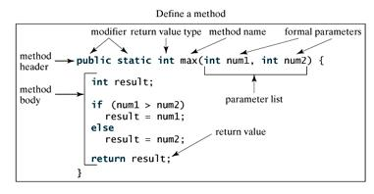

Slide 88
method returning nothing:
modifier(s) void method_name ( type1 arg1 , . . . . . , typen argn )
{
. . . . .
}
Example:
public void swap(int x, int y)
{ int temp = x;
x = y;
y = temp; }

Slide 89
method returning value:
modifier(s) return_type method_name ( type1 arg1 , . . . . . , typen argn)
{
. . . . .
return value;
}
Example:
// Method definition
public int mult(int x, int y)
{ return x * y;
}

Slide 90
modifier:
modifier keyword | meaning
none | accessible only within its package
public | accessible anywhere (if the class is also public)
private | accessible only within its class (or a class within its class) (and not within a subclass)
protected | accessible only within its package and within subclasses of its class (that may be outside its package)
static | static or class method
final | may not be overridden (redefined)
abstract | no body provided for the method (must be overridden)

Slide 91
passing of arguments:
argument is of a
primitive data type (int, double, ...)
→ we directly pass its value
argument is of a
reference data type (object, array,)
→ we implicitly pass the value of its reference
we DO NOT have to specify that what we pass is the address (like in C)

Slide 92
Example:
Java: C:
Object a; struct Object a;
. . . . . . . . . . . .
method(a); func(&a);
. . . . . . . . . . . .
void method(Object a) void func(struct Object *pa)
{ . . . . . . } { . . . . . . }

Slide 93
Object a;
method(a);
System.out.println(a.x); → prints 25
. . . . . .
void method(Object x)
{ x.a = 25; }
→ we DO NOT recopy the whole object, array or string!

Slide 94
Passing Primitive Types
public static void tryPrimitives(int i, double f, char c, boolean test) {
i += 10; //This is legal, but the new values
c = 'z'; //won't be seen outside tryPrimitives.
if(test==false) test = false;
else test = true;
f = 1.5; }
If tryPrimitives is called within the following code, what will the final print statement produce?
int ii = 1;
double ff = 1.0;
char cc = 'a';
boolean bb = false;
// Try to change the values of these primitives:
tryPrimitives(ii, ff, cc, bb);
System.out.println("ii = " + ii + ", ff = " + ff +", cc = " + cc + ", bb = " + bb);

Slide 95
Return Values
public static int power(int a, int b) {
int i; int total = 1;
for(i = 0; i < b; i++)
total = total * a;
return total; }
Now when we call the method power, number gets assigned the value that power returns.
int number = 2; int exponent = 4;
number = power(number, exponent);
System.out.println("New value of number is " + number);

Slide 96
Example 1: Will the values from main be changed after being sent to this method??
int num = 10; double decimal = 5.4; NumberManeuvers(num, decimal); System.out.println("num = " + num + "and decimal = " + decimal);
----------------------------------------------------------------
public static void NumberManeuvers(int i, double j) { if (i == 10)
j = 6.2;
i = 12; }
// ANSWER: In this case, NO. The output will be: num = 10 and decimal = 5.4

Slide 97
Example 2:
int a = 2, b = 7, c = 4, answer = 2; answer = discriminant(a, b, c); System.out.println("The discriminant is " + answer); ------------------------------------------------------------ public static int discriminant(int x, int y, int z) { int disc; disc = y*y - 4*x*z; return disc; }
answer will be 17

Slide 98
Example 3.
String dog = "My dog has fleas." dog = SpeciesChange(dog); System.out.println(dog); public static String SpeciesChange(String pet) { pet = "My cat has fleas."; return (pet); }
Pet will be My cat has fleas

Slide 99
Example
public static void tryString(String s) {
s = "a different string"; }
When the following code is executed, what does the print statement produce?
String str = "This is a string literal.";
tryString(str);
System.out.println("str = " + str);
str = "This is a string literal.";

Slide 100
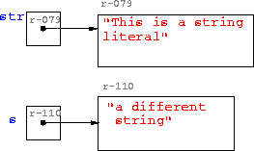

Slide 101
Passing Parameters
public static void nPrintln(String message, int n) {
for (int i = 0; i < n; i++)
System.out.println(message);
}
Suppose you invoke the method using
nPrintln(“Welcome to Java”, 5);
What is the output?
Suppose you invoke the method using
nPrintln(“Computer Science”, 15);
What is the output?

Slide 102
Example
public class TestMax {
/** Main method */
public static void main(String[] args) {
int i = 15;
int j = 2;
int k = max(i, j);
System.out.println("The maximum between " + i + " and " + j + " is " + k);
}
/** Return the max between two numbers */
public static int max(int num1, int num2) {
int result;
if (num1 > num2)
result = num1;
else
result = num2;
return result;
}
}

Slide 103
Trace Method Invocation
i is now 5

Slide 104
Trace Method Invocation
j is now 2

Slide 105
Trace Method Invocation
invoke max(i, j)

Slide 106
Trace Method Invocation
invoke max(i, j)
Pass the value of i to num1
Pass the value of j to num2

Slide 107
Trace Method Invocation
declare variable result

Slide 108
Trace Method Invocation
(num1 > num2) is true since num1 is 5 and num2 is 2

Slide 109
Trace Method Invocation
result is now 5

Slide 110
Trace Method Invocation
return result, which is 5

Slide 111
Trace Method Invocation
return max(i, j) and assign the return value to k

Slide 112
Trace Method Invocation
Execute the print statement

Slide 113
CAUTION
A return statement is required for a nonvoid method. The following method is logically correct, but it has a compilation error, because the Java compiler thinks that this method does not return any value.
public static int sign(int n) {
if (n > 0) return 1;
else if (n == 0) return 0;
else if (n < 0) return –1;
}
To fix this problem, delete if (n<0) in the code.

Slide 114
Reuse Methods from Other Classes
NOTE: One of the benefits of methods is for reuse. The max method can be invoked from any class besides TestMax. If you create a new class Test, you can invoke the max method using ClassName.methodName (e.g., TestMax.max).

Slide 115
Pass by Value
public class TestPassByValue {
/** Main method */
public static void main(String[] args) {
// Declare and initialize variables
int num1 = 1;
int num2 = 2;
System.out.println("Before invoking the swap method, num1 is " +
num1 + " and num2 is " + num2);
// Invoke the swap method to attempt to swap two variables
swap(num1, num2);
System.out.println("After invoking the swap method, num1 is " +
num1 + " and num2 is " + num2);
}
/** Swap two variables */
public static void swap(int n1, int n2) {
System.out.println("\tInside the swap method");
System.out.println("\t\tBefore swapping n1 is " + n1
+ " n2 is " + n2);
// Swap n1 with n2
int temp = n1;
n1 = n2;
n2 = temp;
System.out.println("\t\tAfter swapping n1 is " + n1
+ " n2 is " + n2);
}
}

Slide 116
Pass by Value, cont.

Slide 117
Overloading Methods
Overloading the max Method
public static double max(double num1, double num2) {
if (num1 > num2)
return num1;
else
return num2;
}

Slide 118
Example
public class TestMax {
/** Main method */
public static void main(String[] args) {
int i = 15;
int j = 2;
int k = max(i, j);
System.out.println("The maximum between " + i + " and " + j + " is " + k);
}
/** Return the max between two numbers */
public static int max(int num1, int num2) {
int result;
if (num1 > num2)
result = num1;
else
result = num2;
return result;
}
}
public static double max(double num1, double num2) {
double result;
if (num1 > num2)
result = num1;
else
result = num2;
return result;
}

Slide 119
Ambiguous Invocation
Sometimes there may be two or more possible matches for an invocation of a method, but the compiler cannot determine the most specific match. This is referred to as ambiguous invocation. Ambiguous invocation is a compilation error.

Slide 120
Ambiguous Invocation
public class AmbiguousOverloading {
public static void main(String[] args) {
System.out.println(max(1, 2));
}
public static double max(int num1, double num2) {
if (num1 > num2)
return num1;
else
return num2;
}
public static double max(double num1, int num2) {
if (num1 > num2)
return num1;
else
return num2;
}
}

Slide 121
Scope of Local Variables
A local variable: a variable defined inside a method.
Scope: the part of the program where the variable can be referenced.
The scope of a local variable starts from its declaration and continues to the end of the block that contains the variable. A local variable must be declared before it can be used.

Slide 122
Scope of Local Variables, cont.
You can declare a local variable with the same name multiple times in different non-nesting blocks in a method, but you cannot declare a local variable twice in nested blocks.

Slide 123
Scope of Local Variables, cont.
A variable declared in the initial action part of a for loop header has its scope in the entire loop. But a variable declared inside a for loop body has its scope limited in the loop body from its declaration and to the end of the block that contains the variable.

Slide 124
ARRAYS

Slide 125
What is an Array
An array is a block of consecutive memory locations that hold values of the same data type.
Individual locations are called array’s elements.
When we say “element” we often mean the value stored in that element.
1.39
1.69
1.74
0.0
An array of doubles

Slide 126
Arrays
an array is handled by reference (like in C)
it is always allocated in dynamic memory
it is automatically deallocated when no longer referred to
number of elements of the array: array_name.length = can only be read
index starts from 0: 0 ≤ index < array_name.length

Slide 127
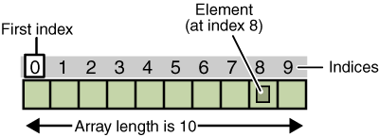
Arrays

Slide 128
element of index i: array_name[i]
3 steps:
♦ declaration of the reference variable
♦ creation of the array = allocation of a place in memory
♦ initialization of the elements of the array
reference variable
array
a[0]
a[1]
a[2]
a[3]
a[4]

Slide 129
declaration:
element_type array_name[];
or element_type[] array_name;
(preferred)
public class MyProg
{
public static void main(String[] arg)
{
int[] a;
...
}
}

Slide 130
creation:
array_name = new element_type[n]; (after declaration)
public class MyProg
{
public static void main(String[] arg)
{
int[] a;
a = new int[3];
....
}
}

Slide 131
declaration and creation:
element_type[] array_name = new element_type[n];
public class MyProg
{
public static void main(String[] arg)
{
int[] a = new int[3];
...
}
}

Slide 132
declaration, creation and initialisation:
element_type[] array_name = { element0 , . . . , elementn-1 };
(arbitrary expressions for the values of the elements)
public class MyProg
{
public static void main(String[] arg)
{
int[] a = {3, 4, 6};
...
}
}

Slide 133
creation and initialization:
→ anonymous array
= not necessary to declare a variable containing the array reference!
new element_type[] { element0 , . . . . . . , elementn-1 }
System.out.println(“element 1 = “ + (new int[] { 10 , 20 , 30 , 40 })[1] );
→ element 1 = 20

Slide 134
Arrays of Primitive Data Types
Array Declaration
<data type> [ ] <variable> //variation 1
<data type> <variable>[ ] //variation 2
Array Creation
<variable> = new <data type> [ <size> ]
Example
Variation 1
Variation 2
double[ ] rainfall;
rainfall
= new double[12];
double rainfall [ ];
rainfall
= new double[12];
An array is like an object!

Slide 135
Examples
short[] a;
a = new short[5];
int[] b = new int[a.length];
int[] c = { 100 , 101 , 102 , 103 , 104 };
for (int i=0 ; i<c.length ; i++)
{
b[i] = c[i];
a[i] = (short )b[i];
}

Slide 136
Accessing Individual Elements
Individual elements in an array accessed with the indexed expression.
double[] rainfall = new double[12];
rainfall
0
1
2
3
4
5
6
7
8
9
10
11
This indexed expression refers to the element at position #2
The index of the first
position in an array is 0.
rainfall[2]

Slide 137
Array Processing – Sample1
Scanner scanner = new Scanner(System.in);
double[] rainfall = new double[12];
double annualAverage,
sum = 0.0;
for (int i = 0; i < rainfall.length; i++) {
System.out.print("Rainfall for month " + (i+1));
rainfall[i] = scanner.nextDouble( );
sum += rainfall[i];
}
annualAverage = sum / rainfall.length;
The public constant length returns the capacity of an array.

Slide 138
public class MyProg
{
public static void main(String[] arg)
{
int[] a = new int[3];
a[0] = 3; a[1] = 23; a[2] = 35;
for (int i = 0 ; i < a.length ; i++)
System.out.println("a[" + i + "] = " + a[i]);
}
}
a[0] = 3
a[1] = 23
a[2] = 35

Slide 139
Array Processing – Sample 2
Scanner scanner = new Scanner(System.in);
double[] rainfall = new double[12];
String[] monthName = new String[12];
monthName[0] = "January";
monthName[1] = "February";
…
double annualAverage, sum = 0.0;
for (int i = 0; i < rainfall.length; i++) {
System.out.print("Rainfall for " + monthName[i] + ": ");
rainfall[i] = scanner.nextDouble();
sum += rainfall[i];
}
annualAverage = sum / rainfall.length;
The same pattern for the remaining ten months.
The actual month name instead of a number.

Slide 140
Array Initialization
Like other data types, it is possible to declare and initialize an array at the same time.
int[] number = { 2, 4, 6, 8 };
double[] samplingData = { 2.443, 8.99, 12.3, 45.009, 18.2,
9.00, 3.123, 22.084, 18.08 };
String[] monthName = { "January", "February", "March",
"April", "May", "June", "July",
"August", "September", "October",
"November", "December" };
number.length samplingData.length monthName.length
4
9
12

Slide 141
Variable-size Declaration
In Java, we are not limited to fixed-size array declaration.
The following code prompts the user for the size of an array and declares an array of designated size:
Scanner scanner = new Scanner(System.in);
int size;
int[] number;
System.out.print("Size of an array:"));
size= scanner.nextInt( );
number = new int[size];

Slide 142
Passing Arrays to Methods
As other objects, an array is passed to a method as a reference.
The elements of the original array are not copied and are accessible in the method’s code.
// Swaps a [ i ] and a [ j ]
public void swap (int [ ] a, int i, int j)
{
int temp = a [ i ];
a [ i ] = a [ j ];
a [ j ] = temp;
}

Slide 143
Passing Arrays to Methods - 1
Code
A
public int searchMinimum(float[] number))
{
…
}
minOne
= searchMinimum(arrayOne);
At before searchMinimum
A
arrayOne
A. Local variable number does not exist before the method execution
State of Memory
Notes:
When an array is passed to a method, only its reference is passed. A copy of the array is NOT created in the method.
public int searchMinimum(float[] number)
{
int indexOfMinimum = 0;
for (int i = 1; i < number.length; i++) {
if (number[i] < number[indexOfMinimum]) { //found a
indexOfMinimum = i; //smaller element
}
}
return indexOfMinimum;
}

Slide 144
Passing Arrays to Methods - 2
Code
public int searchMinimum(float[] number))
{
…
}
B
minOne
= searchMinimum(arrayOne);
The address is copied at
B
arrayOne
arrayOne
number
B. The value of the argument, which is an address, is copied to the parameter.
State of Memory

Slide 145
Passing Arrays to Methods - 3
Code
public int searchMinimum(float[] number))
{
…
}
minOne
= searchMinimum(arrayOne);
C
While at inside the method
C
arrayOne
number
C. The array is accessed via number inside the method.
State of Memory

Slide 146
Passing Arrays to Methods - 4
Code
public int searchMinimum(float[] number))
{
…
}
minOne
= searchMinimum(arrayOne);
D
At after searchMinimum
At after searchMinimum
D
D
arrayOne
arrayOne
number
D. The parameter is erased. The argument still points to the same object.
State of Memory

Slide 147
Returning Arrays from Methods (cont’d)
public double[ ] solveQuadratic(double a, double b, double c)
{
double d = b * b - 4 * a * c;
if (d < 0) return null;
d = Math.sqrt(d);
double[ ] roots = new double[2];
roots[0] = (-b - d) / (2*a);
roots[1] = (-b + d) / (2*a);
return roots;
}
Or simply:
return new double [ ]
{ (-b - d) / (2*a),
(-b + d) / (2*a) };

Slide 148
method(new double[] { 11.1 , 22.2 , 33,3 });
. . . . . .
void method(double[] a)
{ . . . . . . }

Slide 149
multi-dimensional arrays:
1D array (leftmost dimension) of 1D arrays (of 1D arrays…)
the size may vary for each array element of the primary array:

Slide 150
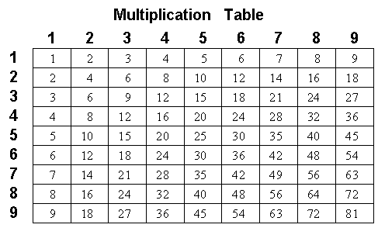
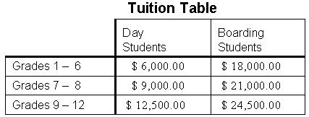
Two-Dimensional Arrays
Two-dimensional arrays are useful in representing tabular information.
Notes:
In Java, data may be organized in a two-dimensional array.
A table is an example of a two-dimensional array.
In a two-dimensional array, two indices (in a table, one for the row and one for the column) are used to refer to the array element.

Slide 151
Declaring and Creating a 2-D Array
Declaration
<data type> [][] <variable> //variation 1
<data type> <variable>[][] //variation 2
Creation
<variable> = new <data type> [ <size1> ][ <size2> ]
Example
payScaleTable
0
1
2
3
4
0
double[][] payScaleTable;
payScaleTable
= new double[4][5];
1
2
3
Notes:
payScaleTable = new double[4][5];
is really a shorthand for
payScaleTable = new double[4][ ];
payScaleTable[0] = new double[5];
payScaleTable[1] = new double[5];
payScaleTable[2] = new double[5];
payScaleTable[3] = new double[5];
which is equivalent to
payScaleTable = new double[4][ ];
for (int i = 0; i < 4; i++) {
payScaleTable[i] = new double[5];
}

Slide 152
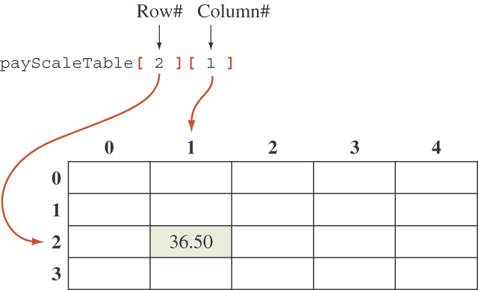
Accessing an Element
An element in a two-dimensional array is accessed by its row and column index.

Slide 153
Sample 2-D Array Processing
Find the average of each row.
double[ ] average = { 0.0, 0.0, 0.0, 0.0 };
for (int i = 0; i < payScaleTable.length; i++) {
for (int j = 0; j < payScaleTable[i].length; j++) {
average[i] += payScaleTable[i][j];
}
average[i] = average[i] / payScaleTable[i].length;
}

Slide 154
Java Implementation of 2-D Arrays
The sample array creation
payScaleTable = new double[4][5];
is really a shorthand for
payScaleTable = new double [4][ ];
payScaleTable[0] = new double [5];
payScaleTable[1] = new double [5];
payScaleTable[2] = new double [5];
payScaleTable[3] = new double [5];
Notes:
The concept of the two-dimensional array in Java is just that: a concept. There is no explicit structure called the “two-dimensional array” in Java.
The two-dimensional array concept is implemented by using an array of arrays.

Slide 155
Two-Dimensional Arrays
Subarrays may be different lengths.
Executing
triangularArray = new double[4][ ];
for (int i = 0; i < 4; i++)
triangularArray[i] = new double [i + 1];
results in an array that looks like:
Notes:
An array that is part of another array is called a subarray.
An array of arrays may be initialized when it is created.

Slide 156
element of indices i,j: array_name[i][j]
element_type[][] array_name = new element_type[n][m];

Slide 157
initially, we can allocate either all the dimensions
or, partially, only some left side dimensions (at least the leftmost one!)
→ the remaining dimensions shall be allocated later:
element_type[][] array_name = new element_type[n][];
then, for each value of the first index i:
array_name[0] = new element_type[m0];
. . . . . . . . .
array_name[n-1] = new element_type[mn-1];

Slide 158
examples:
float[][][] a = new float[2][][];
a[0] = new float[10][100];
a[1] = new float[3][];
a[1][0] = new float[10000];
a[1][1] = new float[1000];
a[1][2] = new float[2000];

Slide 159
int[][] triangle = new int[4][];
for (int i=0 ; i<triangle.length ; i++)
{
triangle[i] = new int[i+1];
for (int j=0 ; j<triangle[i].length ; j++)
triangle[i][j] = i+j;
}
→ { { 0 }
, { 1 , 2 }
, { 2 , 3 , 4 }
, { 3 , 4 , 5 , 6 } }

Slide 160
int[][] array = { { a , b , c }
, { d }
, { e , f , g , h , k , l } };
→ array.length == 3
array[0].length == 3
array[1].length == 1
array[2].length == 6

Slide 161
Strings
a string is an object instance of the String class
general handling of String objects follows the object oriented approach
declaration of a String variable: String s;
concatenation operator: s1 + s2

Slide 162
Concatenation of Strings
Concatenation: Using the + operator on two strings in order to connect them to form one longer string
If greeting is equal to "Hello ", and javaClass is equal to "class", then greeting + javaClass is equal to "Hello class”
Any number of strings can be concatenated together
When a string is combined with almost any other type of item, the result is a string
"The answer is " + 42 evaluates to
"The answer is 42"

Slide 163
a String is immutable:
once created in dynamic memory, a String object cannot be modified
→ we must create a new String object for each new modification
printing:
System.out.print(string);
or System.out.println(string); (newline added at the end)
in general, the string is of the form
string + number + string + object + number ……
→ automatic conversion of the objects and primitive data types
into their string representations

Slide 164
example:
String s = “abcd”; String s1 = s + “ef”; String s2 = “AA” + s1;
int i=123; double x=123.456;
System.out.println(“s2 = “ + s2 + “ ; i = ” + i + “ ; x = “ + x);
→ s2 = AAabcdef ; i = 123 ; x = 123.456

Slide 165
String Methods
The String class contains many useful methods for string-processing applications
A String method is called by writing a String object, a dot, the name of the method, and a pair of parentheses to enclose any arguments
String greeting = "Hello";
int count = greeting.length();
Length is a method applied to the String value greeting. Length returns the value 5.
Thus count = 5;
Always count from zero when referring to the position or index of a character in a string

Slide 166
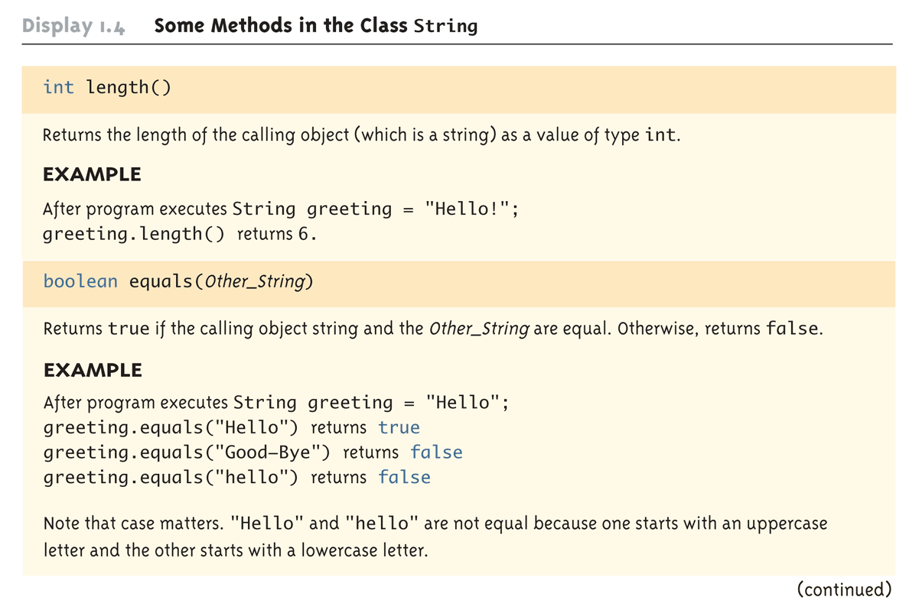
Some Methods in the Class String (Part 1 of 8)

Slide 167
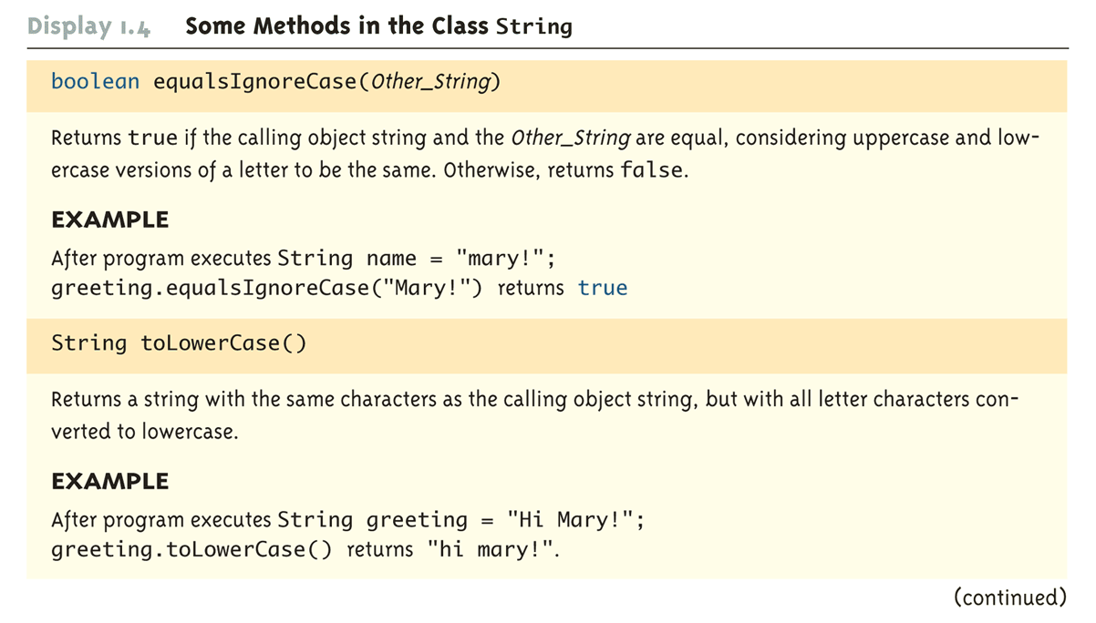
Some Methods in the Class String

Slide 168
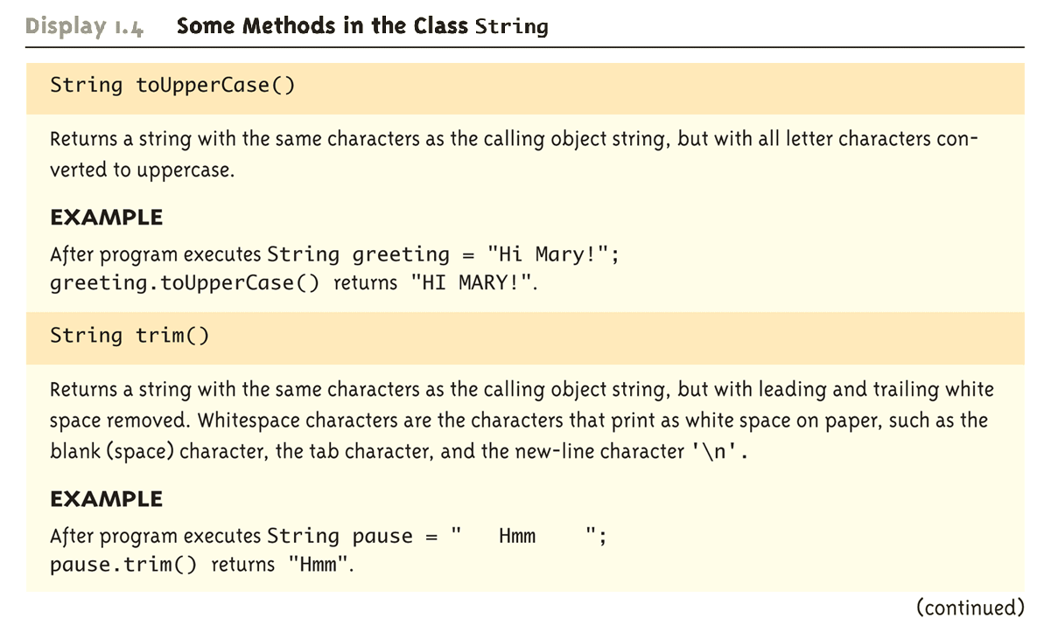
Some Methods in the Class String

Slide 169
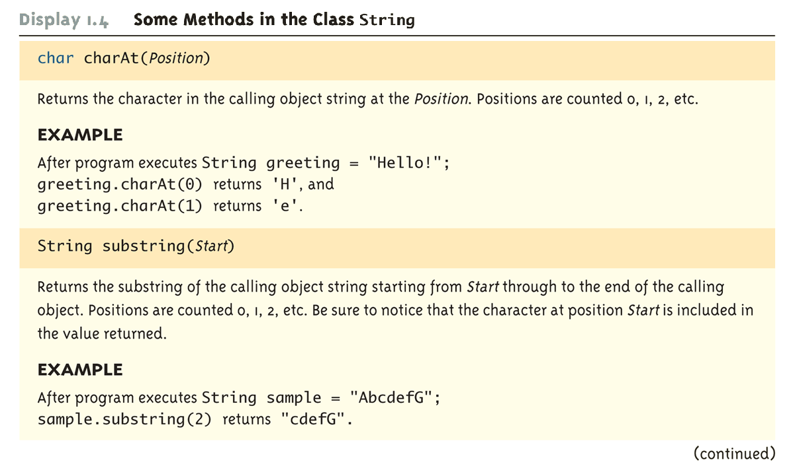
Some Methods in the Class String

Slide 170
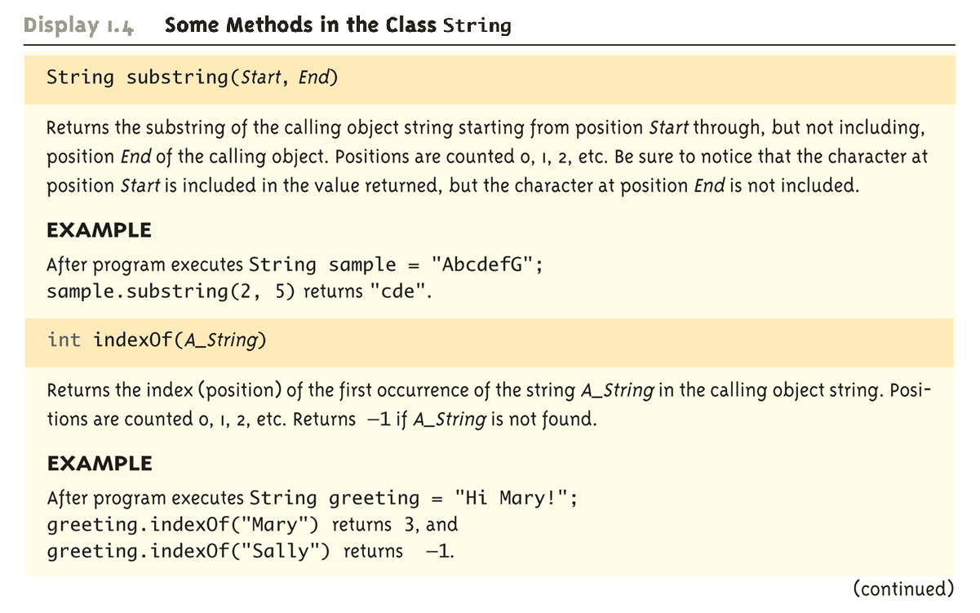
Some Methods in the Class String

Slide 171
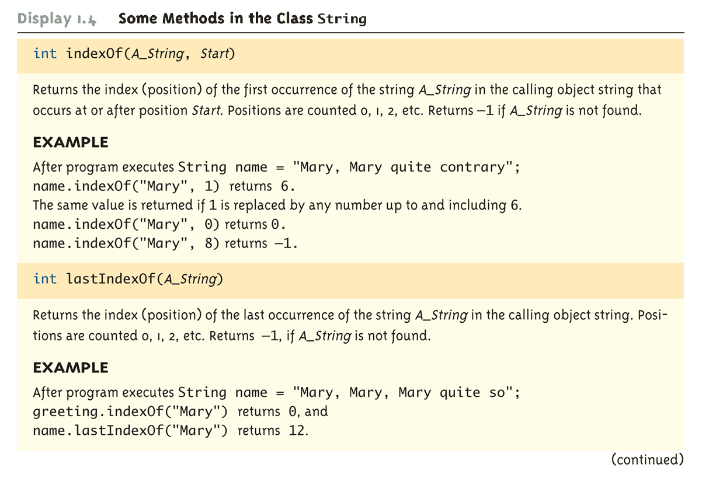
Some Methods in the Class String

Slide 172
Some Methods in the Class String

Slide 173
Some Methods in the Class String

Slide 174
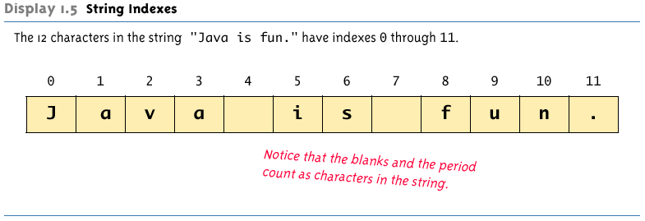
String Indexes

Slide 175
Main method
execution of a program with n arguments:
java program_name arg0 … argn-1
→ call to the main method with an array of strings as argument:
public static void main(String[] arg)
{
. . . . . .
}
number of arguments: arg.length
argument n. i coded as a string: arg[i]

Slide 176
example:
java toto ab cd ef
public static void main(String[] arg)
{
for (int i=0 ; i<arg.length ; i++)
System.out.println(“argument “ + i + “ = “ + arg[i]);
}
argument 0 = ab
argument 1 = cd
argument 2 = ef

Slide 177
Supplemental reading
Getting Started
http://java.sun.com/docs/books/tutorial/getStarted/index.html
Nuts and bolts of the Java Language
http://java.sun.com/docs/books/tutorial/java/nutsandbolts/index.html
Compiling and Running a Simple Program
http://developer.java.sun.com/developer/onlineTraining/Programming/BasicJava1/compile.html

Slide 178
Collections
collection: an object that stores data; a.k.a. "data structure"
the objects stored are called elements
some collections maintain an ordering; some allow duplicates
typical operations: add, remove, clear, contains (search), size
examples found in the Java class libraries:
ArrayList, LinkedList, HashMap, TreeSet, PriorityQueue
all collections are in the java.util package
import java.util.*;

Slide 179
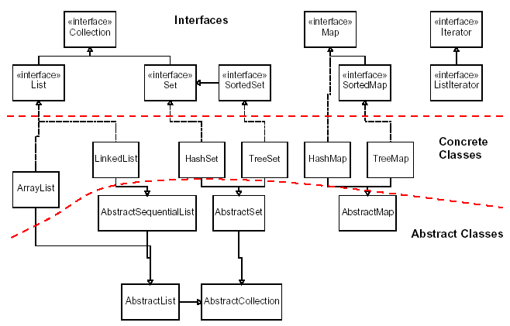
Java collection framework

Slide 180
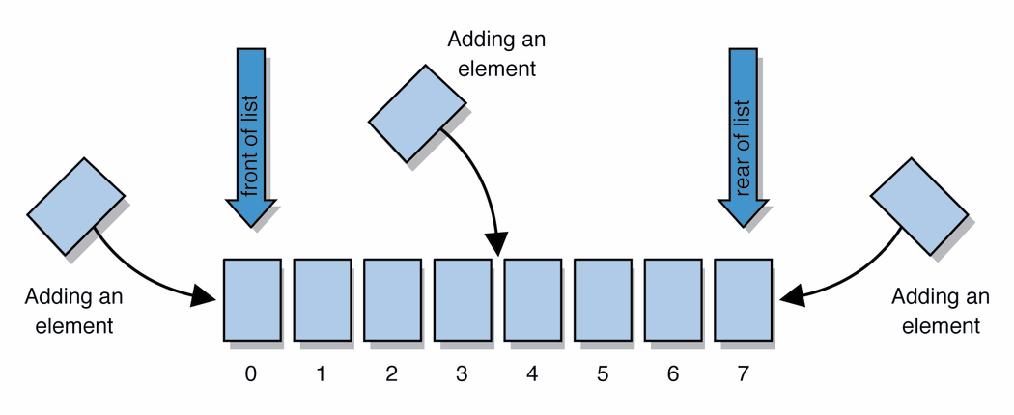
Lists
list: a collection storing an ordered sequence of elements
each element is accessible by a 0-based index
a list has a size (number of elements that have been added)
elements can be added to the front, back, or elsewhere
in Java, a list can be represented as an ArrayList object
Notes:
use jGRASP/DrJava Interactions window to create a list and add some elements, get them, check size

Slide 181
Idea of a list
Rather than creating an array of boxes, create an object that represents a "list" of items. (initially an empty list.)
[]
You can add items to the list.
The default behavior is to add to the end of the list.
[hello, ABC, goodbye, okay]
The list object keeps track of the element values that have been added to it, their order, indexes, and its total size.
Think of an "array list" as an automatically resizing array object.
Internally, the list is implemented using an array and a size field.

Slide 182
ArrayList methods
add(value) | appends value at end of list
add(index, value) | inserts given value just before the given index, shifting subsequent values to the right
clear() | removes all elements of the list
indexOf(value) | returns first index where given value is found in list (-1 if not found)
get(index) | returns the value at given index
remove(index) | removes/returns value at given index, shifting subsequent values to the left
set(index, value) | replaces value at given index with given value
size() | returns the number of elements in list
toString() | returns a string representation of the list such as "[3, 42, -7, 15]"

Slide 183
ArrayList methods 2
addAll(list) addAll(index, list) | adds all elements from the given list to this list (at the end of the list, or inserts them at the given index)
contains(value) | returns true if given value is found somewhere in this list
containsAll(list) | returns true if this list contains every element from given list
equals(list) | returns true if given other list contains the same elements
iterator() listIterator() | returns an object used to examine the contents of the list (seen later)
lastIndexOf(value) | returns last index value is found in list (-1 if not found)
remove(value) | finds and removes the given value from this list
removeAll(list) | removes any elements found in the given list from this list
retainAll(list) | removes any elements not found in given list from this list
subList(from, to) | returns the sub-portion of the list between indexes from (inclusive) and to (exclusive)
toArray() | returns the elements in this list as an array

Slide 184
Type Parameters (Generics)
ArrayList<Type> name = new ArrayList<Type>();
When constructing an ArrayList, you must specify the type of elements it will contain between < and >.
This is called a type parameter or a generic class.
Allows the same ArrayList class to store lists of different types.
ArrayList<String> names = new ArrayList<String>();
names.add("Marty Stepp");
names.add("Stuart Reges");

Slide 185
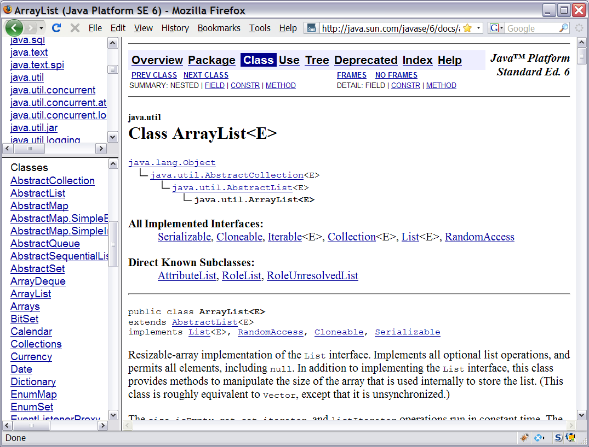
Learning about classes
The Java API Specification is a huge web page containing documentation about every Java class and its methods.
The link to the API Specs is on the course web site.

Slide 186
ArrayList vs. array
construction
String[] names = new String[5];
ArrayList<String> list = new ArrayList<String>();
storing a value
names[0] = "Jessica";
list.add("Jessica");
retrieving a value
String s = names[0];
String s = list.get(0);

Slide 187
ArrayList vs. array 2
doing something to each value that starts with "B"
for (int i = 0; i < names.length; i++) {
if (names[i].startsWith("B")) { ... }
}
for (int i = 0; i < list.size(); i++) {
if (list.get(i).startsWith("B")) { ... }
}
seeing whether the value "Benson" is found
for (int i = 0; i < names.length; i++) {
if (names[i].equals("Benson")) { ... }
}
if (list.contains("Benson")) { ... }

Slide 188
Exercise, revisited
Write a program that reads a file and displays the words of that file as a list.
First display all words.
Then display them in reverse order.
Then display them with all plurals (ending in "s") capitalized.
Then display them with all plural words removed.

Slide 189
Exercise solution (partial)
ArrayList<String> allWords = new ArrayList<String>();
Scanner input = new Scanner(new File("words.txt"));
while (input.hasNext()) {
String word = input.next();
allWords.add(word);
}
System.out.println(allWords);
// remove all plural words
for (int i = 0; i < allWords.size(); i++) {
String word = allWords.get(i);
if (word.endsWith("s")) {
allWords.remove(i);
i--;
}
}

Slide 190
ArrayList as parameter
public static void name(ArrayList<Type> name) {
Example:
// Removes all plural words from the given list.
public static void removePlural(ArrayList<String> list) {
for (int i = 0; i < list.size(); i++) {
String str = list.get(i);
if (str.endsWith("s")) {
list.remove(i);
i--;
}
}
}
You can also return a list:
public static ArrayList<Type> methodName(params)

Slide 191
ArrayList of primitives?
The type you specify when creating an ArrayList must be an object type; it cannot be a primitive type.
// illegal -- int cannot be a type parameter
ArrayList<int> list = new ArrayList<int>();
But we can still use ArrayList with primitive types by using special classes called wrapper classes in their place.
// creates a list of ints
ArrayList<Integer> list = new ArrayList<Integer>();

Slide 192
Wrapper classes
Primitive Type | Wrapper Type
int | Integer
double | Double
char | Character
boolean | Boolean
A wrapper is an object whose sole purpose is to hold a primitive value.
Once you construct the list, use it with primitives as normal:
ArrayList<Double> grades = new ArrayList<Double>();
grades.add(3.2);
grades.add(2.7);
...
double myGrade = grades.get(0);

Slide 193
Exercise
Write a program that reads a file full of numbers and displays all the numbers as a list, then:
Prints the average of the numbers.
Prints the highest and lowest number.
Filters out all of the even numbers (ones divisible by 2).

Slide 194
Exercise solution (partial)
ArrayList<Integer> numbers = new ArrayList<Integer>();
Scanner input = new Scanner(new File("numbers.txt"));
while (input.hasNextInt()) {
int n = input.nextInt();
numbers.add(n);
}
System.out.println(numbers);
filterEvens(numbers);
System.out.println(numbers);
...
// Removes all elements with even values from the given list.
public static void filterEvens(ArrayList<Integer> list) {
for (int i = list.size() - 1; i >= 0; i--) {
int n = list.get(i);
if (n % 2 == 0) {
list.remove(i);
}
}
}

Slide 195
Other exercises
Write a method reverse that reverses the order of the elements in an ArrayList of strings.
Write a method capitalizePlurals that accepts an ArrayList of strings and replaces every word ending with an "s" with its uppercased version.
Write a method removePlurals that accepts an ArrayList of strings and removes every word in the list ending with an "s", case-insensitively.

