Slide 1
OOP & GUI

Slide 2
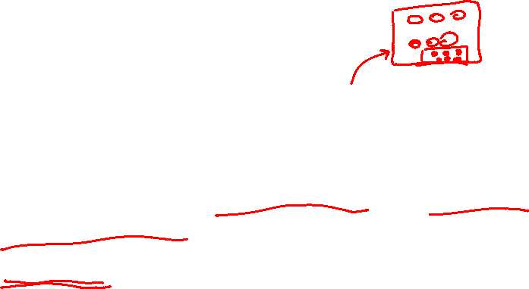
Graphical User Interfaces in Java
Introduction
Elements of a GUI
GUI hierarchy of containers and components
Blueprint for the definition of a GUI
Tuning the aspect of the GUI
Some available containers and atomic components
Events created by containers and components
Examples: how to use the containers and atomic components
Elaborate GUIs (Mode variables, Dynamically evolving GUIs)
Examples: elaborate GUIs

Slide 3
Graphical input and output with JOptionPane

Slide 4
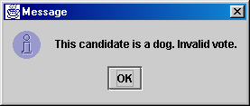
JOptionPane
An option pane is a simple dialog box for graphical input/output
advantages:
  simple
  flexible (in some ways)
  looks better than the black box of death
disadvantages:
  created with static methods;
  not very object-oriented
  not very powerful (just simple dialog boxes)

Slide 5
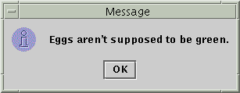

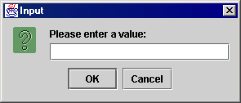
Types of JOptionPanes
showMessageDialog(<parent>, <message>)
Displays a message on a dialog
with an OK button.
showConfirmDialog(<parent>, <message>)
Displays a message and list of
choices Yes, No, Cancel;
returns user's choice as an int with one
of the following values:
  JOptionPane.YES_OPTION
  JOptionPane.NO_OPTION
  JOptionPane.CANCEL_OPTION
showInputDialog(<parent>, <message>)
Displays a message and text
field for input; returns the user's
value entered as a String.
  can pass null for the parent to all methods

Slide 6
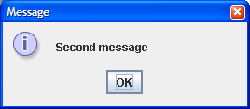
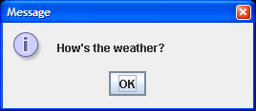
JOptionPane examples 1
showMessageDialog analogous to System.out.println for displaying a simple message
import javax.swing.*;
public class MessageDialogExample {
public static void main(String[] args) {
JOptionPane.showMessageDialog(null,"How's the weather?");
JOptionPane.showMessageDialog(null, "Second message");
}
}

Slide 7
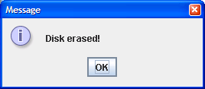
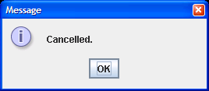
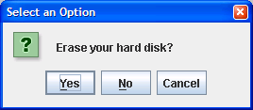
JOptionPane examples 2
showConfirmDialog analogous to a System.out.print that prints a question, then reading an input value from the user (can only be one of the provided choices)
import javax.swing.*;
public class ConfirmDialogExample {
public static void main(String[] args) {
int choice = JOptionPane.showConfirmDialog(null, "Erase your hard disk?");
if (choice == JOptionPane.YES_OPTION) {
JOptionPane.showMessageDialog(null, "Disk erased!");
}
else {
JOptionPane.showMessageDialog(null, "Cancelled.");
}
}
}

Slide 8
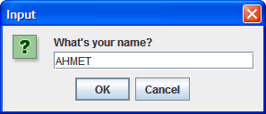
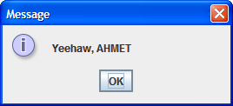
JOptionPane examples 3
showInputDialog analogous to a System.out.print that prints a question, then reading an input value from the user (can be any value)
import javax.swing.*;
public class InputDialogExample {
public static void main(String[] args) {
String name = JOptionPane.showInputDialog(null,"What's your name?");
JOptionPane.showMessageDialog(null, "Yeehaw, " + name);
}
}

Slide 9
Introduction
Graphical User Interface:
collection of input / output devices (buttons, …) inserted into one or more windows
these windows and IO devices are displayed on the screen
also, the IO devices react to actions over the keyboard and mouse
two predefined packages:
old package: Abstract Windowing Toolkit (AWT)
new package built over AWT: Swing
always include these imports at the start of your program:
  import java.awt.*; import java.awt.event.*;
  import javax.swing.*; import javax.swing.event.*;
if you use AffineTransform (see geometric transformations in next chapter), then include as well:
import java.awt.geom.*;

Slide 10
Swing vs. AWT
So why do the GUI component classes have a prefix J? Instead of JButton, why not name it simply Button? In fact, there is a class already named Button in the java.awt package.
When Java was introduced, the GUI classes were bundled in a library known as the Abstract Windows Toolkit (AWT). For every platform on which Java runs, the AWT components are automatically mapped to the platform-specific components through their respective agents, known as peers. AWT is fine for developing simple graphical user interfaces, but not for developing comprehensive GUI projects. Besides, AWT is prone to platform-specific bugs because its peer-based approach relies heavily on the underlying platform. With the release of Java 2, the AWT user-interface components were replaced by a more robust, versatile, and flexible library known as Swing components. Swing components are painted directly on canvases using Java code, except for components that are subclasses of java.awt.Window or java.awt.Panel, which must be drawn using native GUI on a specific platform. Swing components are less dependent on the target platform and use less of the native GUI resource. For this reason, Swing components that don’t rely on native GUI are referred to as lightweight components, and AWT components are referred to as heavyweight components.

Slide 11
example: a basic GUI in Java with Swing and AWT

Slide 12
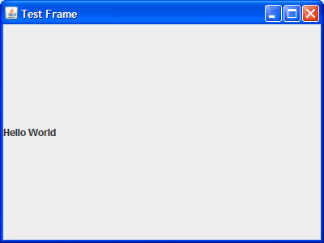
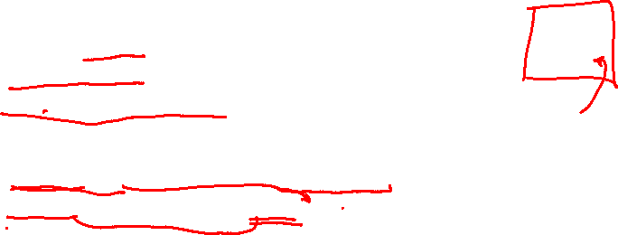
import java.awt.*; import java.awt.event.*;
import javax.swing.*; import javax.swing.event.*;
public class MyFrame
{
public static void main(String[] args)
{
JFrame frame = new JFrame("Test Frame");
frame.setSize(400, 300);
frame.setVisible(true);
//Add the ubiquitous "Hello World" label.
JLabel label = new JLabel("Hello World");
frame.getContentPane().add(label);
// Add a button into the frame
//frame.getContentPane().add(new JButton("OK"));
frame.setDefaultCloseOperation(JFrame.EXIT_ON_CLOSE);
}
}

Slide 13
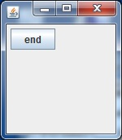

  import java.awt.*; import java.awt.event.*;
  import javax.swing.*; import javax.swing.event.*;
  public class P
  { public static void main(String[] arg)
  { Gui gui = new Gui(); } }
  class Gui
  {
  JFrame f; JButton b;
  Gui()
  {
  f = new JFrame(); f.setFocusable(true); f.setVisible(true);
  f.getContentPane().setLayout(new FlowLayout(FlowLayout.LEFT));
  b = new JButton(); b.setText("end");
  f.getContentPane().add(b);
  b.addActionListener(new ActionListener()
  { public void actionPerformed(ActionEvent e)
  { System.exit(0); } } );
  f.setSize(new Dimension(150 + 16 , 150 + 38));
  }
  }

Slide 14
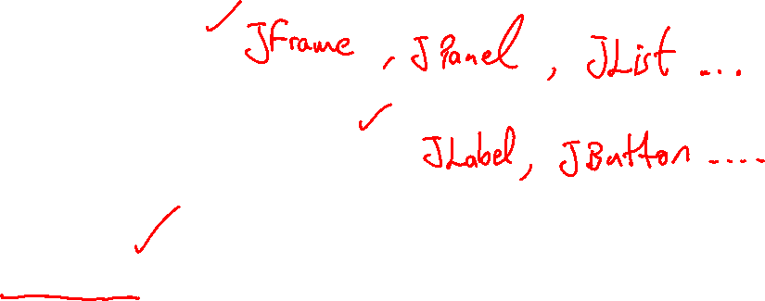
Elements of a GUI
Containers
Atomic components
Events
GUI managing thread

Slide 15
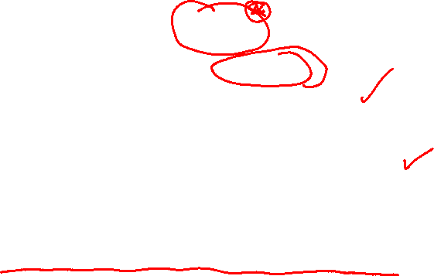
Containers:
rectangular area containing other containers and/or atomic components
top-level container: window containing the GUI
can be a frame (in fact, we can have several frames) or an applet
contains a content pane (special container) and eventually a menu bar
general-purpose container = panel

Slide 16
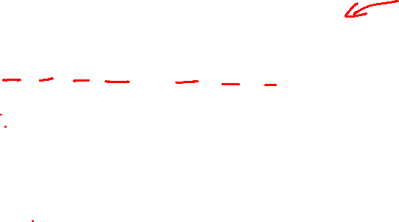
frame
menu bar
panels
content pane

Slide 17
Frames
Frame is a window that is not contained inside another window. Frame is the basis to contain other user interface components in Java GUI applications.
The JFrame class can be used to create windows.
For Swing GUI programs, use JFrame class to create windows.

Slide 18
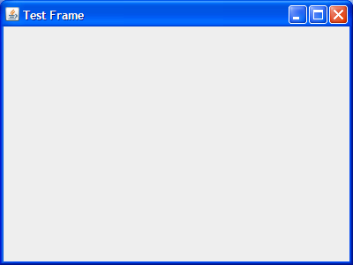
Creating Frames
  import javax.swing.*;
  public class MyFrame {
  public static void main(String[] args) {
  //Create and set up the window.
  JFrame frame = new JFrame("Test Frame");
  frame.setSize(400, 300);
  frame.setDefaultCloseOperation(JFrame.EXIT_ON_CLOSE);
  //Display the window.
  frame.setVisible(true);
  }
}

Slide 19
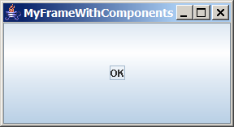
Adding Components into a Frame
Title bar
Content pane
// Add a button into the frame
frame.getContentPane().add(new JButton("OK"));

Slide 20
Content Pane Delegation in JDK
// Add a button into the frame
frame.getContentPane().add(new JButton("OK"));
Title bar
// Add a button into the frame
frame.add( new JButton("OK"));
Content pane

Slide 21
JFrame Class

Slide 22
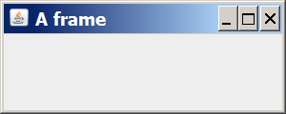
A simple program that creates and shows a JFrame:
  import java.awt.*;
  import javax.swing.*;
  public class SimpleFrame {
  public static void main(String[] args) {
  JFrame frame = new JFrame();
  frame.setForeground(Color.WHITE);
  frame.setDefaultCloseOperation(JFrame.EXIT_ON_CLOSE);
  frame.setSize(new Dimension(300, 120));
  frame.setTitle("A frame");
  frame.setVisible(true);
  }
  }

Slide 23
atomic components:
elaborate input / output device
label (text and/or icon) , tool tip (a component's property) , button (with text and/or icon)
menubar , menu , menu item
check box , radio button
text field , text area
combo box , list , file chooser
slider
option pane

Slide 24
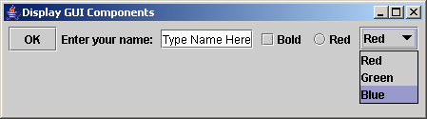
Creating GUI Objects
// Create a button with text OK
JButton jbtOK = new JButton("OK");
// Create a label with text "Enter your name: "
JLabel jlblName = new JLabel("Enter your name: ");
// Create a text field with text "Type Name Here"
JTextField jtfName = new JTextField("Type Name Here");
// Create a check box with text bold
JCheckBox jchkBold = new JCheckBox("Bold");
// Create a radio button with text red
JRadioButton jrbRed = new JRadioButton("Red");
// Create a combo box with choices red, green, and blue
JComboBox jcboColor = new JComboBox(new String[]{"Red",
"Green", "Blue"});
Label
Text field
Check Box
Radio Button
Button
Combo Box

Slide 25
events:
due to the user manipulating the GUI (button clicked, …)
, a container or atomic component (event source object) may produce an event object
→ in response to this event object
, an event method will be called to process the request of the user.

Slide 26
GUI managing thread:
"in parallel" with the thread of the program , the GUI managing thread:
handles the events triggered by the containers and atomic components
→ it executes the event methods associated with the events
carries out the painting of the containers and atomic components

Slide 27
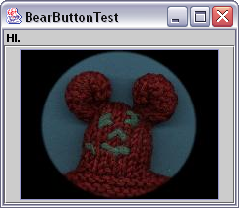
The GUI
Container: JFrame
Layout: BorderLayout
North
Center
Components: JLabel JButton, containing
  an ImageIcon

Slide 28
GUI hierarchy of containers and atomic components
the top-level container (frame or applet) contains:
♦ eventually, a menu bar (we include it with setJMenuBar() )
♦ always, a content pane (created automatically with the frame or
applet and obtained with getContentPane() )
the content pane contains:
♦ several panels and/or atomic components
(we include them with add() and remove them with remove() )
each panel contains:
♦ eventually, nothing (reserved area for graphics)
♦ or several panel containers and/or atomic components
(we include them with add() and remove them with remove() )

Slide 29
frame
frame.setJMenuBar(menu_bar);
frame.getContentPane()
menu_bar
content_pane
frame.getContentPane().add(panel);
frame.getContentPane().add(panel);
frame.getContentPane().add(button);
panel₁
button
panel₂
panel₁.add(label);
panel₁.add(text_field);
label
text_field

Slide 30
Swing component inheritance hierarchy
    Component defines methods that can be used in its subclasses (for example, paint and repaint)
    Container - collection of related components
      When using JFrames, attach components to the content pane (a Container)
      Method add to add components to content pane
    JComponent - superclass to most Swing components
    Much of a component's functionality inherited from these classes
java.lang.Object
java.awt.Component
java.awt.Container
javax.swing.JComponent

Slide 31
GUI Class Hierarchy (Swing)

Slide 32
Container Classes
Container classes can contain other GUI components.

Slide 33
GUI Helper Classes
The helper classes are not subclasses of Component. They are used to describe the properties of GUI components such as graphics context, colors, fonts, and dimension.

Slide 34
Swing GUI Components

Slide 35
Blueprint for the definition of a GUI
we describe the Graphical User Interface through the definition of the class Gui:
declare the containers and atomic components as instance variables of Gui
eventually, if we want to draw graphics in one or several panel or atomic component
, subclass its class and override its paintComponent method
= such subclasses are defined as member classes of Gui
inside the constructor of Gui:
create the containers (including one -or several- frame)
for each frame, do:
frame.setFocusable(true); frame.setVisible(true);
create the atomic components, menu elements and establish their hierarchy (what contains what)
define event listeners for some containers, atomic components, menu elements
= reflex reactions to some events
= it is ONLY WITHIN these reflex reactions that the containers or atomic components,
the hierarchy of the GUI and the menu can be modified
(add / remove an atomic component, reorganize the GUI, create another frame)
At the end of the constructor, ONCE all the elements of a frame have been defined, we must enforce the layout:
frame.setSize(new Dimension(width , height)); (enforce a given frame size)
or
frame.pack(); (frame size automatically set to pack up all components)

Slide 36
  class Gui
  {
  JFrame frame; . . . . . .
  JButton b1; . . . . . .
  subclass(es) of JPanel with paintComponent method overriden.
  Gui()
  {
  //create the containers, atomic components, menu elements
  //and build their hierarchy:
  frame = new JFrame(); frame.setFocusable(true); frame.setVisible(true);
  b1 = new JButton(); . . . . . .
  frame.getContentPane().add(b1 , …);
  . . . . . .
  //define event listeners on some of these containers, atomic //components
  // and menu elements to respond to events triggered by them.
  // for each frame:
  frame.setSize(new Dimension(width , height)); or frame.pack();
  }
  }

Slide 37
import java.awt.*;
import java.awt.event.*;
import javax.swing.*;
/**
* A simple GUI program that creates and opens a JFrame containing
* the message "Hello World" and an "OK" button. When the user clicks
* the OK button, the program ends.
*/
public class HelloWorldGUI2 {
/**
* An object of type HelloWorldDisplay is a JPanel that displays
* the message "Hello World!".
*/
private static class HelloWorldDisplay extends JPanel {
public void paintComponent(Graphics g) {
super.paintComponent(g);
g.drawString( "Hello World!", 20, 30 );
}
}

Slide 38
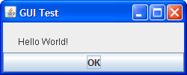
/**
* An object of type ButtonHandler can "listen" for ActionEvents
* (the type of event that is generated when the user clicks a
* button). When the event occurs, the ButtonHandler responds
* by exiting the program.
*/
private static class ButtonHandler implements ActionListener {
public void actionPerformed(ActionEvent e) {
System.exit(0);
}
}
/**
* The main program creates a window containing a HelloWorldDisplay
* and a button. A ButtonHandler is created that will end the program
* when the user clicks the button.
*/
public static void main(String[] args) {
HelloWorldDisplay displayPanel = new HelloWorldDisplay();
JButton okButton = new JButton("OK");
ButtonHandler listener = new ButtonHandler();
okButton.addActionListener(listener);
JPanel content = new JPanel();
content.setLayout(new BorderLayout());
content.add(displayPanel, BorderLayout.CENTER);
content.add(okButton, BorderLayout.SOUTH);
JFrame window = new JFrame("GUI Test");
window.setContentPane(content);
window.setSize(250,100);
window.setLocation(100,100);
window.setVisible(true);
}
}

Slide 39
creation of the GUI inside main():
Gui gui= new Gui();
creation of the GUI inside a method of a class:
class MyClass
{
Gui gui;
. . . . . .
. . . myMethod(. . .)
{
gui = new Gui();
. . . . . .
}
}

Slide 40
termination of the program:
reaching the end of main() is not enough to terminate the program!
indeed, the program consists of two threads:
♦ the default thread that executes main()
♦ the GUI managing thread that keeps displaying the GUI
and answering events by executing event methods
→ to terminate the program, call System.exit(0); either in main() or in an event method

Slide 41
Steps to build a GUI
1. import package
2. set up top level container
(e.g. JFrame)
3. apply layout
(e.g. BorderLayout)
4. add components
(e.g. Label, Button)
5. REGISTER listeners
6. show it to the world !

Slide 42
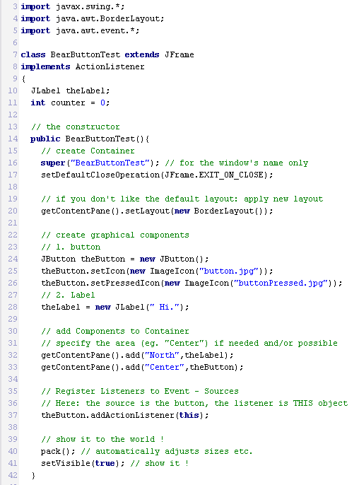
The Source
1. import package
2. set up top level container
(e.g. JFrame)
3. apply layout
(e.g. BorderLayout)
4. add components
(e.g. Label, Button)
5. REGISTER listeners
6. show it to the world !

Slide 43
Tuning the aspect of the GUI
GUI basics
  Graphical input and output with JOptionPane
  Frames, buttons, labels, and text fields
  Changing a frame's layout
  Handling an action event
Laying out components
  FlowLayout, GridLayout, and BorderLayout
Additional components and events
  Keyboard and mouse events

Slide 44
Swing Components
Top Level Containers
General Purpose Containers
Special Purpose Containers
Basic Controls
Uneditable Information Displays
Interactive Displays of Highly Formatted Information

Slide 45
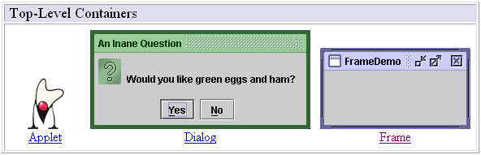
Top Level Containers
Your application usually extends one of these classes !

Slide 46
Swing provides three generally useful top-level container classes: JFrame,
JDialog, and
JApplet.
When using these classes, you should keep these facts in mind:
To appear onscreen, every GUI component must be part of a containment hierarchy. A containment hierarchy is a tree of components that has a top-level container as its root. We'll show you one in a bit.
Each GUI component can be contained only once. If a component is already in a container and you try to add it to another container, the component will be removed from the first container and then added to the second.
Each top-level container has a content pane that, generally speaking, contains (directly or indirectly) the visible components in that top-level container's GUI.
You can optionally add a menu bar to a top-level container. The menu bar is by convention positioned within the top-level container, but outside the content pane. Some look and feels, such as the Mac OS look and feel, give you the option of placing the menu bar in another place more appropriate for the look and feel, such as at the top of the screen.

Slide 47
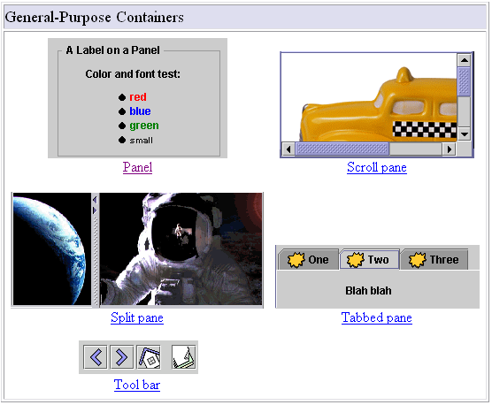
General Purpose Containers

Slide 48
General Purpose Containers
typically used to collect Basic Controls (JButton, JChoiceBox…)
Added to layout of top-level containers
JFrame
JPanel

Slide 49
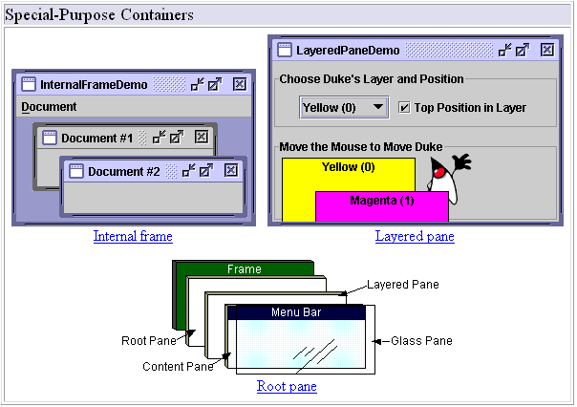
Special Purpose Containers

Slide 50
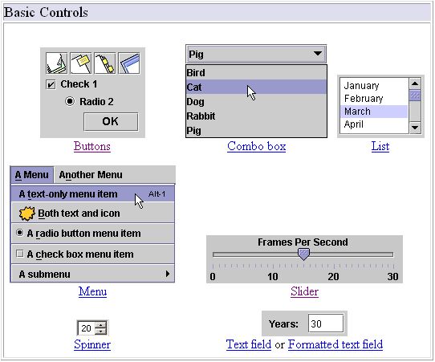
Basic Controls

Slide 51
Basic Controls
Unlike ‘passive’ containers, controls are the ‘active’ part of your GUI
Remark: containers aren’t only ‘passive’, they are also ‘active’ sources of events,
eg. Mouse-events.
Being the visible part of your interface, controls bring your application to life
Controls are event sources !
Objects of your application register to controls to handle the events

Slide 52
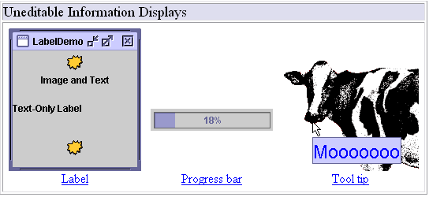
Uneditable Information Displays

Slide 53
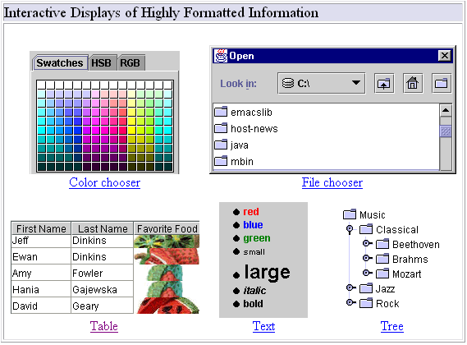
Interactive Displays of Highly Formatted Information

Slide 54
Interactive Displays of Highly Formatted Information
Define standard interfaces for frequently needed tasks

Slide 55
Creating GUI Objects
// Create a button with text OK
JButton jbtOK = new JButton("OK");
// Create a label with text "Enter your name: "
JLabel jlblName = new JLabel("Enter your name: ");
// Create a text field with text "Type Name Here"
JTextField jtfName = new JTextField("Type Name Here");
// Create a check box with text bold
JCheckBox jchkBold = new JCheckBox("Bold");
// Create a radio button with text red
JRadioButton jrbRed = new JRadioButton("Red");
// Create a combo box with choices red, green, and blue
JComboBox jcboColor = new JComboBox(new String[]{"Red",
"Green", "Blue"});
Label
Text field
Check Box
Radio Button
Button
Combo Box

Slide 56
Top Level Containers
JFrame Class

Slide 57
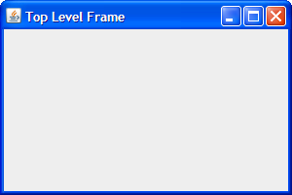
import java.awt.*; import java.awt.event.*;
import javax.swing.*; import javax.swing.event.*;
public class CMPE419_GUI1
{ public static void main(String[] arg)
{ Gui gui = new Gui(); } }
class Gui
{
JFrame f;
Gui()
{ //Create and set up the window.
f = new JFrame("Top Level Frame");
f.setDefaultCloseOperation(JFrame.EXIT_ON_CLOSE);
//Display the window.
//f.pack();
f.setSize(new Dimension(300 , 200));
f.setLocationRelativeTo(null);
f.setFocusable(true);
f.setVisible(true);
}}

Slide 58
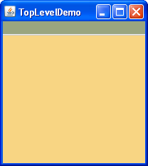
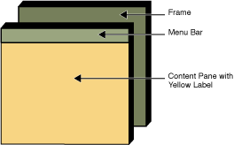
Here's a picture of a frame created by an application. The frame contains a green menu bar (with no menus) and, in the frame's content pane, a large blank, yellow label.

Slide 59
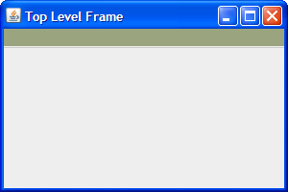
public class CMPE419_GUI1
{ public static void main(String[] arg)
{ Gui gui = new Gui(); } }
class Gui
{ JFrame f; JMenuBar m;
Gui()
{ //Create and set up the window.
f = new JFrame("Top Level Frame");
f.setDefaultCloseOperation(JFrame.EXIT_ON_CLOSE);
//Create the menu bar. Make it have a green background.
m = new JMenuBar();
m.setOpaque(true);
m.setBackground(new Color(154, 165, 127));
m.setPreferredSize(new Dimension(200, 20));
f.setJMenuBar(m);
//Display the window.
//f.pack();
f.setSize(new Dimension(300 , 200));
f.setLocationRelativeTo(null);
f.setVisible(true); }}

Slide 60
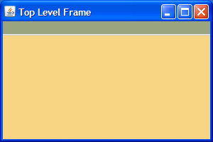
import java.awt.*; import java.awt.event.*;
import javax.swing.*; import javax.swing.event.*;
public class CMPE419_GUI1
{ public static void main(String[] arg)
{ Gui gui = new Gui(); } }
class Gui
{ JFrame f; JMenuBar m; JLabel yl;
Gui()
{ //Create and set up the window.
f = new JFrame("Top Level Frame");
f.setDefaultCloseOperation(JFrame.EXIT_ON_CLOSE);
//Create the menu bar. Make it have a green background.
m = new JMenuBar();
m.setOpaque(true);
m.setBackground(new Color(154, 165, 127));
m.setPreferredSize(new Dimension(200, 20));
//Create a yellow label to put in the content pane.
yl = new JLabel();
yl.setOpaque(true);
yl.setLayout(new BorderLayout());
yl.setBackground(new Color(248, 213, 131));
yl.setPreferredSize(new Dimension(200, 180));
//Set the menu bar and add the label to the content pane.
f.setJMenuBar(m);
f.getContentPane().add(yl, BorderLayout.CENTER);
//Display the window.
//f.pack();
f.setSize(new Dimension(300 , 200));
f.setLocationRelativeTo(null);
f.setVisible(true);
}
}

Slide 61
Tuning the aspect of the GUI
font:
Font font = new Font(name , style , size);
with name = "Serif" (equivalent to "TimesRoman")
or "SansSerif" (equivalent to "Helvetica")
or "Monospaced" (equivalent to "Courier")
style = Font.PLAIN or Font.BOLD or Font.ITALIC
or Font.BOLD+Font.ITALIC (combination)
size = from 10 to 72
impose a font to the text inside a container, atomic component or menu element:
c.setFont(font);

Slide 62
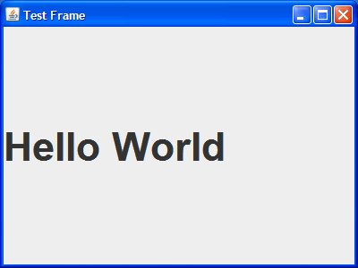
import java.awt.*; import java.awt.event.*;
import javax.swing.*; import javax.swing.event.*;
public class MyFrame {
public static void main(String[] args) {
JFrame frame = new JFrame("Test Frame");
frame.setSize(400, 300);
frame.setVisible(true);
//Add the ubiquitous "Hello World" label.
JLabel label = new JLabel("Hello World");
frame.getContentPane().add(label);
Font font = new Font("SansSerif", Font.BOLD , 45);
label.setFont(font);
frame.setLocationRelativeTo(null);
frame.setDefaultCloseOperation(JFrame.EXIT_ON_CLOSE);
}
}

Slide 63
color:
color corresponding to given intensities of red, green, blue:
Color color = new Color( (float ) 0.0 to 1.0
, (float ) 0.0 to 1.0
, (float ) 0.0 to 1.0);
predefined colors (class variables):
Color.black , Color.white
Color.darkGray , Color.gray , Color.lightGray
Color.red , Color.green , Color.blue
Color.orange
Color.pink
Color.yellow
set the background color of a container, atomic component or menu element:
c.setBackground(color); (color behind text)
set the foreground color of a container, atomic component or menu element:
c.setForeground(color); (color of text)

Slide 64
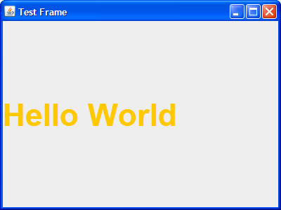
import java.awt.*; import java.awt.event.*;
import javax.swing.*; import javax.swing.event.*;
public class MyFrame {
public static void main(String[] args) {
JFrame frame = new JFrame("Test Frame");
frame.setSize(400, 300);
frame.setVisible(true);
//Add the ubiquitous "Hello World" label.
JLabel label = new JLabel("Hello World");
frame.getContentPane().add(label);
Font font = new Font("SansSerif", Font.BOLD , 45);
label.setFont(font);
label.setForeground(Color.orange);
frame.setLocationRelativeTo(null);
frame.setDefaultCloseOperation(JFrame.EXIT_ON_CLOSE);
}
}

Slide 65
border:
draw a line border around the container or atomic component (single line of a certain color =
  Color.black , Color.gray , Color.blue , . . .):
c.setBorder(BorderFactory.createLineBorder(color));
draw an etched border around the container or atomic component (thin furrow):
c.setBorder(BorderFactory.createEtchedBorder());
draw a raised bevel border around the container or atomic component (gives the illusion that the cont. or comp. is above the surrounding level):
c.setBorder(BorderFactory.createRaisedBevelBorder());
draw a lowered bevel border around the container or atomic component (gives the illusion that the cont. or comp. is below the surrounding level):
c.setBorder(BorderFactory.createLoweredBevelBorder());

Slide 66
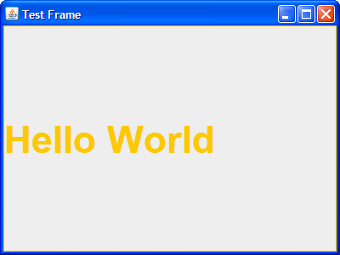

label.setBorder(BorderFactory.createLineBorder(Color.orange));
label.setBorder(BorderFactory.createEtchedBorder());

Slide 67
icon:
image which is:
♦ loaded from a .jpeg or .gif file
♦ inserted within a label, a button or a menu item, eventually beside some text
may be either a full scale image or a tiny graphic symbol
(evoking the functionality of the button)
ImageIcon icon = new ImageIcon(filename.jpeg or filename.gif);
→ icon is passed as an argument to the constructor
of the label, button or menu item

Slide 68
Layout Managers
Layout managers
  Provided to arrange GUI components in a container
  Provide basic layout capabilities
  Implement the interface LayoutManager

Slide 69

FlowLayout
FlowLayout
  Simplest layout manager
  Components are placed left to right in the order they are added
  Components can be left aligned, centered or right aligned

Slide 70
FlowLayout = default for panel
if we are not satisfied with the default layout of a container:
c.setLayout(new FlowLayout());
or c.setLayout(new FlowLayout(alignment));
or c.setLayout(new FlowLayout(alignment , horizontal_gap, vertical_gap));
with alignment = FlowLayout.LEFT
or FlowLayout.CENTER
or FlowLayout.RIGHT
then, we add the element:
c.add(container or atomic component);

Slide 71
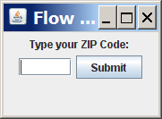

FlowLayout example
  import java.awt.*;
  import javax.swing.*;
  public class FlowLayoutExample {
  public static void main(String[] args) {
  JFrame frame = new JFrame();
  frame.setDefaultCloseOperation(JFrame.EXIT_ON_CLOSE);
  frame.setSize(new Dimension(320, 75));
  frame.setTitle("Flow layout");
  frame.setLayout(new FlowLayout());
  frame.add(new JLabel("Type your ZIP Code: "));
  frame.add(new JTextField(5));
  frame.add(new JButton("Submit"));
  frame.setVisible(true);
  }
  }

Slide 72
BorderLayout = default for content pane
we can lay the containers and/or atomic components in 5 areas:
CENTER (takes as much space as possible)
, WEST , EAST
, SOUTH , NORTH
NORTH
WEST
CENTER
EAST
SOUTH

Slide 73
if we are not satisfied with the default layout of a container:
c.setLayout(new BorderLayout());
or
c.setLayout(new BorderLayout(horizontal_gap,vertical_gap));
then, we add the element to a certain area:
c.add(container or atomic component , area);
with area = BorderLayout.CENTER
or BorderLayout.WEST
or BorderLayout.EAST
or BorderLayout.SOUTH
or BorderLayout.NORTH
DO NOT forget the extra argument area to add if the policy is BorderLayout!

Slide 74
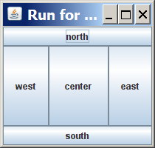
BorderLayout example
  import java.awt.*;
  import javax.swing.*;
  public class BorderLayoutExample {
  public static void main(String[] args) {
  JFrame frame = new JFrame();
  frame.setDefaultCloseOperation(JFrame.EXIT_ON_CLOSE);
  frame.setSize(new Dimension(210, 200));
  frame.setTitle("Run for the border");
  frame.setLayout(new BorderLayout());
  frame.add(new JButton("north"), BorderLayout.NORTH);
  frame.add(new JButton("south"), BorderLayout.SOUTH);
  frame.add(new JButton("west"), BorderLayout.WEST);
  frame.add(new JButton("east"), BorderLayout.EAST);
  frame.add(new JButton("center"),
  BorderLayout.CENTER);
  frame.setVisible(true);
  }
  }

Slide 75
GridLayout
the containers and/or atomic components are laid in a grid of equally sized cases
the grid is filled row after row, from the upper to the lower,
each row being filled from left to right
first
element
second
element
third
element
fourth
element
fifth
element
sixth
element
seventh
element
eigth
element

Slide 76
if we are not satisfied with the default layout of a container:
c.setLayout(new GridLayout(rows , columns));
or
c.setLayout(new GridLayout(rows , columns , horizontal_gap , vertical_gap));
if rows = 0 , the number of rows is adaptive
if columns = 0 , the number of columns is adaptive
(but we CANNOT have simultaneously rows = columns = 0 )
then, we add the element:
c.add(container or atomic component);

Slide 77
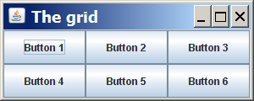
GridLayout example
  import java.awt.*;
  import javax.swing.*;
  public class GridLayoutExample {
  public static void main(String[] args) {
  JFrame frame = new JFrame();
  frame.setDefaultCloseOperation(JFrame.EXIT_ON_CLOSE);
  frame.setSize(new Dimension(300, 120));
  frame.setTitle("The grid");
  // 2 rows, 3 columns
  frame.setLayout(new GridLayout(2, 3));
  for (int i = 1; i <= 6; i++) {
  JButton button = new JButton();
  button.setText("Button " + i);
  frame.add(button);
  }
  frame.setVisible(true);
  }
  }

Slide 78
Some available containers and atomic components
panel: JPanel class
a panel is a common container whose default layout is FlowLayout
it may contain atomic components and/or other panels or just serve for graphics
create the panel object:
JPanel panel = new JPanel();

Slide 79
add to or remove from the panel another panel or an atomic component:
panel.add(panel or atomic comp.);
(if not BorderLayout)
panel.add(panel or atomic comp. , area);
(if BorderLayout)
panel.remove(panel or comp.);
panel.removeAll();
eventually, set the size of the panel:
panel.setPreferredSize(new Dimension(width , height));
in fact, just a wish that may not be strictly followed by the layout manager...

Slide 80
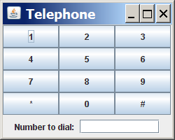
Composite layout example
  import java.awt.*;
  import javax.swing.*;
  public class TelephonePad {
  public static void main(String[] args) {
  JFrame frame = new JFrame();
  frame.setDefaultCloseOperation(JFrame.EXIT_ON_CLOSE);
  frame.setSize(new Dimension(250, 200));
  frame.setTitle("Telephone");
  frame.setLayout(new BorderLayout());
  JPanel centerPanel = new JPanel(new GridLayout(4, 3));
  for (int i = 1; i <= 9; i++) {
  centerPanel.add(new JButton("" + i));
  }
  centerPanel.add(new JButton("*"));
  centerPanel.add(new JButton("0"));
  centerPanel.add(new JButton("#"));
  frame.add(centerPanel, BorderLayout.CENTER);
  JPanel southPanel = new JPanel(new FlowLayout());
  southPanel.add(new JLabel("Number to dial: "));
  southPanel.add(new JTextField(10));
  frame.add(southPanel, BorderLayout.SOUTH);
  frame.setVisible(true);
  }
  }

Slide 81
label: JLabel class
a label is a rectangular area which contains a string text and/or an icon:
label
BIG QUESTION
icon
text

Slide 82
create the label object: label = new JLabel();
set the text and/or the icon: label.setText(text);
label.setIcon(icon);
if both text and icon, precise the position of the text relative to the icon:
label.setHorizontalTextPosition( JLabel.LEFT
or JLabel.CENTER
or JLabel.RIGHT);
label.setVerticalTextPosition( JLabel.TOP
or JLabel.CENTER
or Label.BOTTOM);

Slide 83
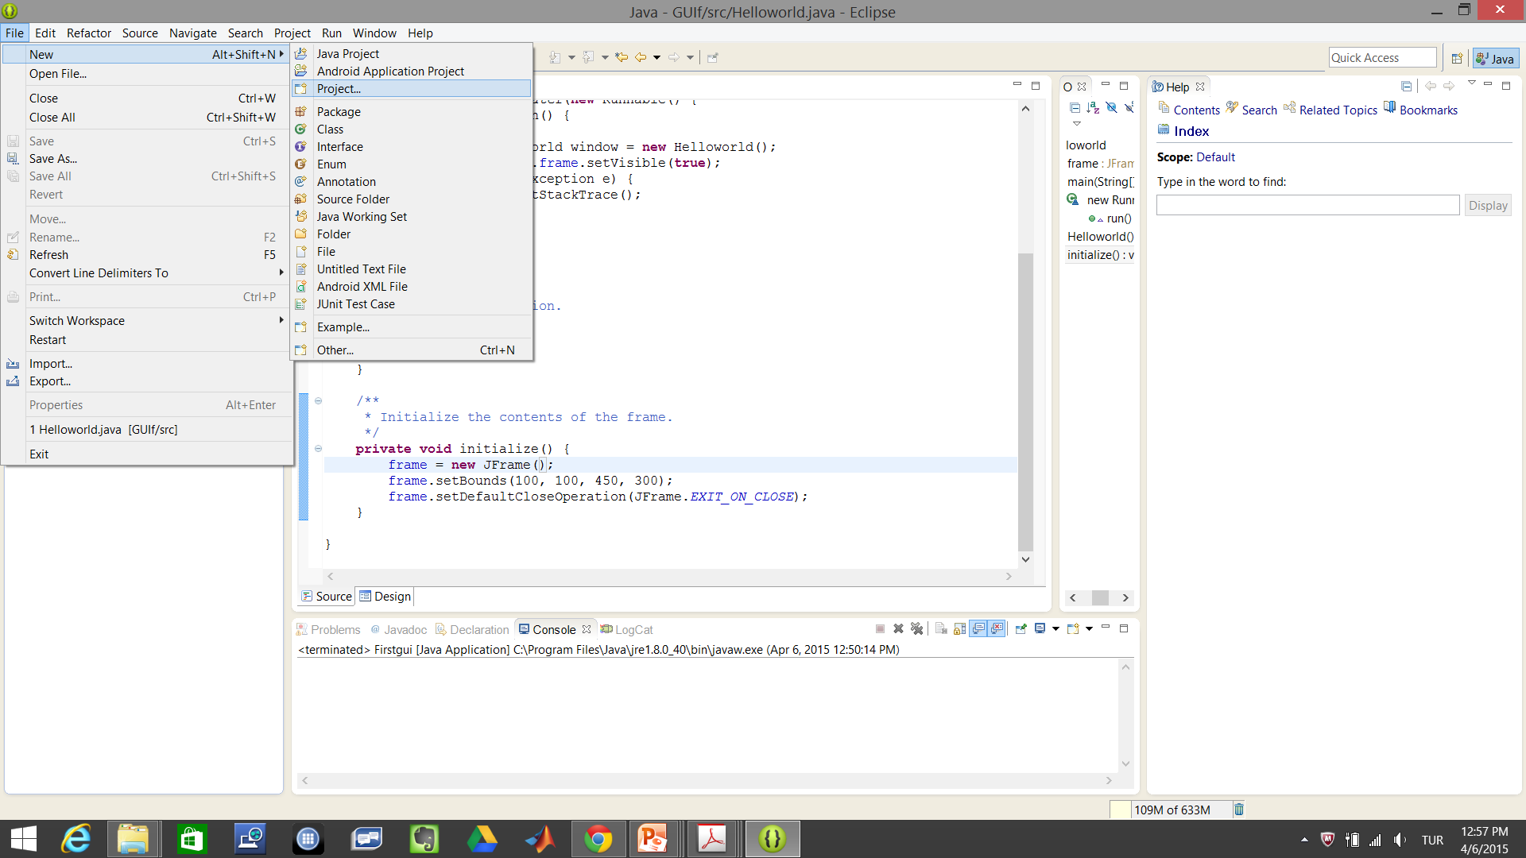
CREATE A PROJECT

Slide 84
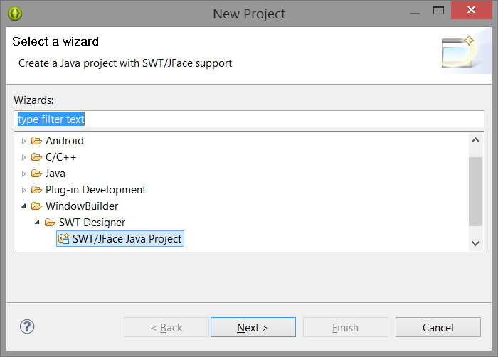

Slide 85
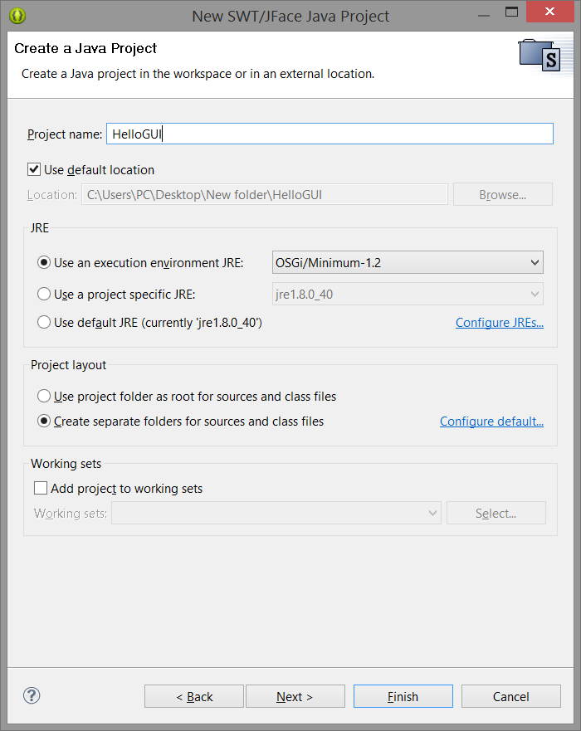

Slide 86
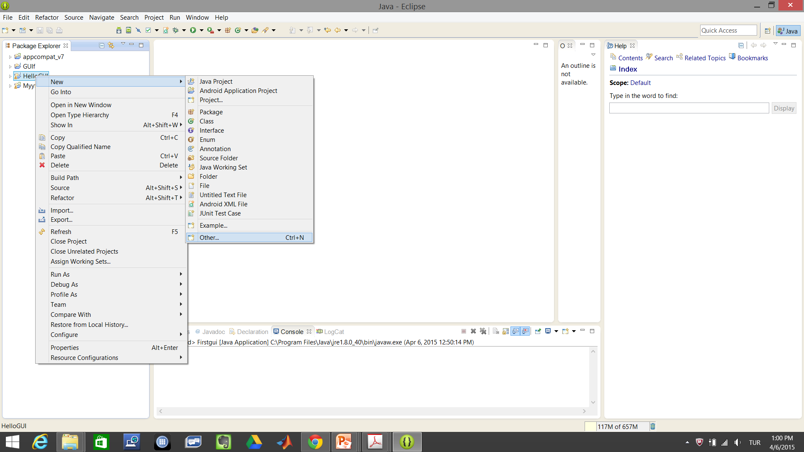

Slide 87
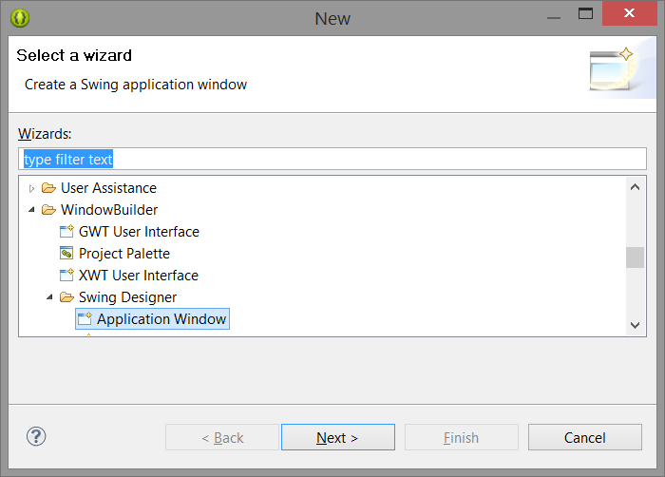

Slide 88
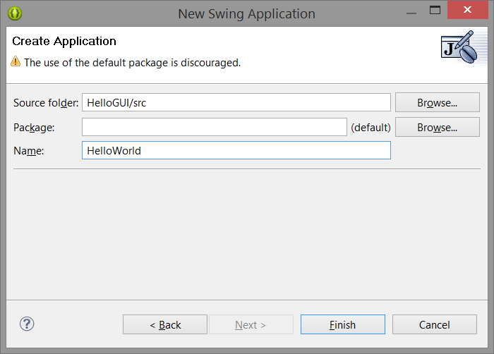

Slide 89
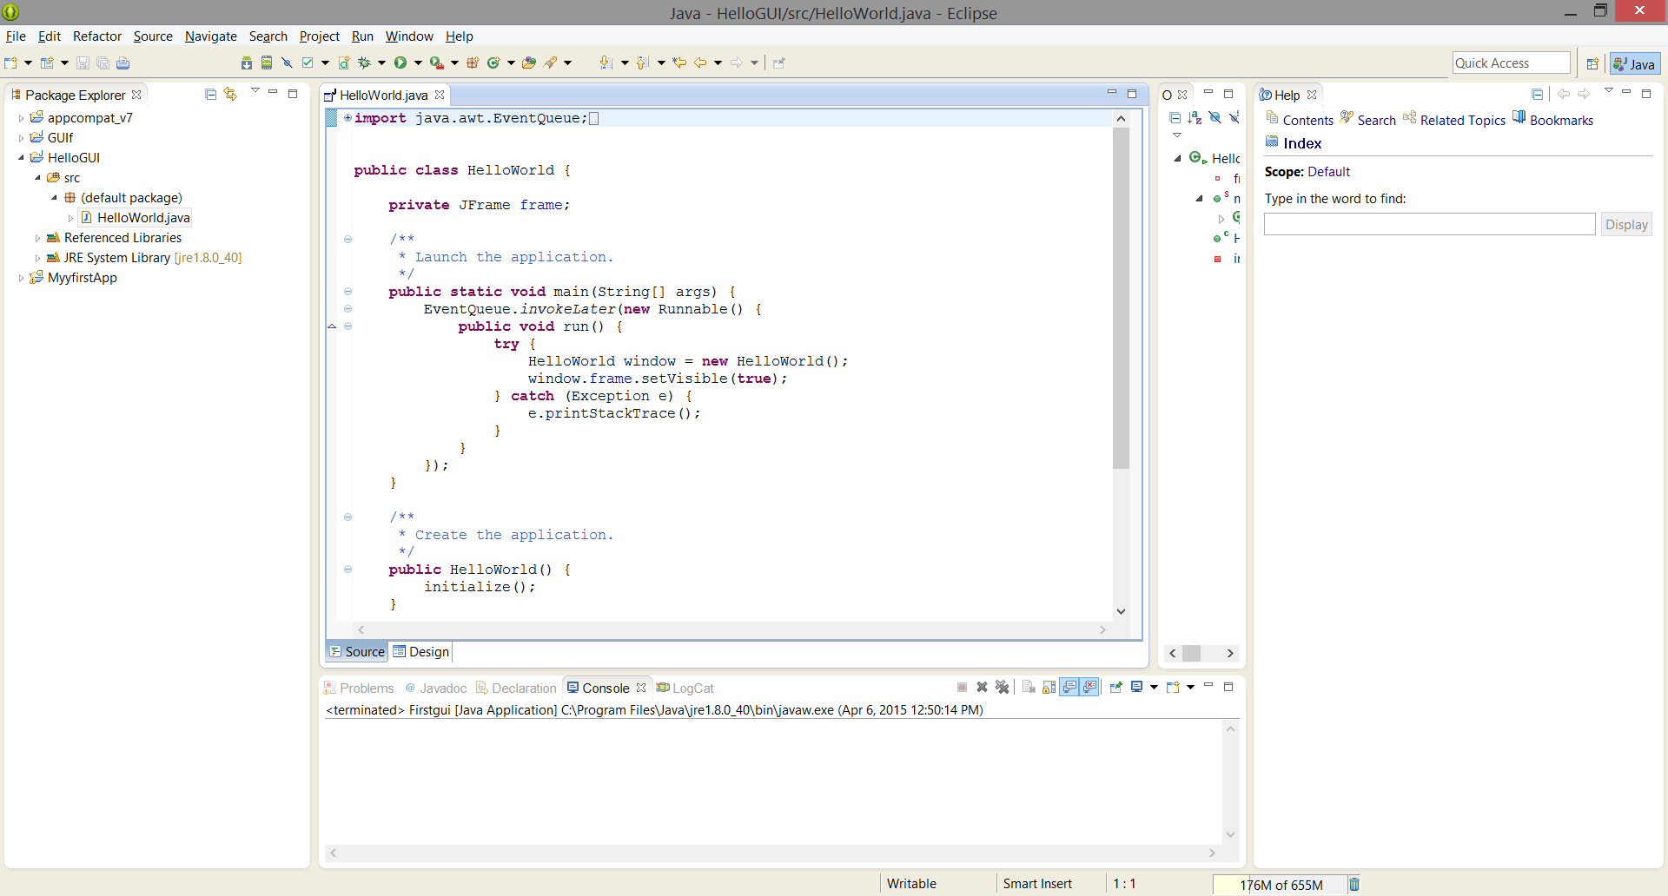

Slide 90
