Slide 1
CMPE 412 Software Engineering
Asst.Prof.Dr.Duygu Çelik Ertuğrul
Room: CMPE 206
Email: duygu.celik@emu.edu.tr

Slide 2
Software Development Life Cycle (SDLC)
“You’ve got to be very careful if you don’t know where you’re going, because you might not get there.”
Yogi Berra

Slide 3
SDLC Model
A framework that describes the activities performed at each stage of a software development project.

Slide 4
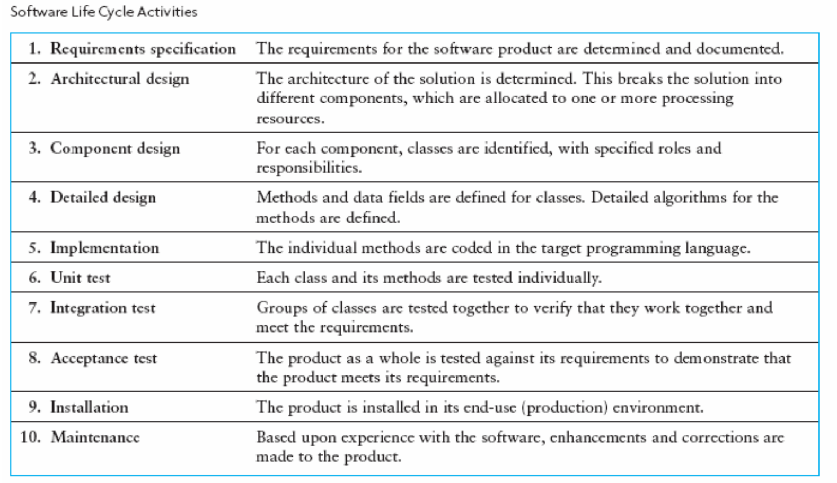

Slide 5
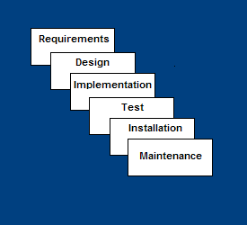
Waterfall Model
Requirements – defines needed information, function, behavior, performance and interfaces.
Design – data structures, software architecture, interface representations, algorithmic details.
Implementation – source code, database, user documentation, testing.
It is plan-driven
https://www.youtube.com/watch?v=5A5XCuWMG4o

Slide 6
Waterfall Strengths
Easy to understand, easy to use
Provides structure to inexperienced staff
Milestones are well understood
Sets requirements stability
Good for management control (plan, staff, track)
Works well when quality is more important than cost or schedule

Slide 7
Waterfall Deficiencies
All requirements must be known at beginning
Can give a false impression of progress
Does not reflect problem-solving of software development – iterations of phases
Integration is one big bang at the end
Little opportunity for customer to preview the system (until it may be too late)

Slide 8
When to use the Waterfall Model
Requirements are very well known
Product definition is stable
Technology is understood
New version of an existing product
Carrying an existing product to a new platform (i.e. diff language).

Slide 9
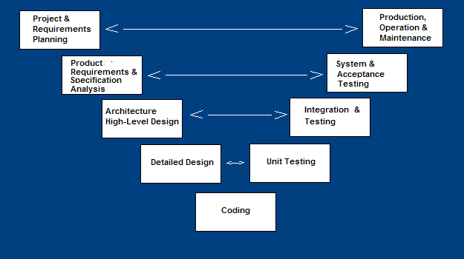
V-Shaped SDLC Model
It is plan-driven
A modified of the Waterfall model that highlights the verification and validation of the product.
Testing of the product is planned in parallel with a corresponding phase of development

Slide 10
V-Shaped Steps
Production, operation and maintenance – provide for enhancement and corrections
System and acceptance testing – check the entire software system in its environment (client environment)
Integration and Testing – check that modules interconnect correctly
Unit testing – check that each module acts as expected
Coding – transform algorithms into software
Project and Requirements Planning – allocate resources
Product Requirements and Specification Analysis – complete specification of the software system
Architecture or High-Level Design – defines how software functions fulfill the design
Detailed Design – develop algorithms for each architectural component

Slide 11
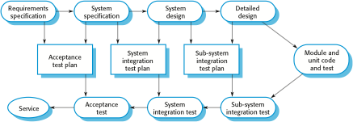
Testing phases in a plan-driven software process
Seven Testing Principles: https://www.youtube.com/watch?v=rFaWOw8bIMM
How to write a Test Case: https://www.youtube.com/watch?v=BBmA5Qp6Ghk
Unit Testing Example: https://www.youtube.com/watch?v=lj5nnGa_DIw
Integration Testing Example: https://www.youtube.com/watch?v=QYCaaNz8emY
System Testing & Acceptance Testing: https://www.youtube.com/watch?v=N8-qNMHOVyw
Top 5 Software Testing Interview Questions: https://www.youtube.com/watch?v=Vb0_bY1tHfQ

Slide 12
V-Shaped Strengths
Stress planning for verification and validation of the product in early stages of product development
Why testing is important?
Each deliverable must be testable
Project management can track progress by milestones…
Easy to use

Slide 13
V-Shaped Weaknesses
Does not easily handle concurrent events/tasks, because tasks are created plan-driven…
Does not handle iterations or phases
Does not easily handle dynamic changes in requirements (diffucult to change plans in any time!!!)
Does not contain risk analysis activities

Slide 14
When to use the V-Shaped Model
Excellent choice for systems requiring high reliability – e.g. hospital patient control applications
All requirements are known clearly
If solution and technology are known well

Slide 15
Structured Evolutionary Prototyping Model
Developers build a prototype during the requirements phase
Prototype is evaluated by end users
Users give corrective feedback
Developers improve the prototype
When the user is satisfied, the prototype code is brought up to the standards needed for a final product. (End of Project!!!)

Slide 16
Structured Evolutionary Prototyping Steps
A preliminary project plan is developed
A partial high-level paper model is created
The model is source for a partial requirements specification
A prototype is built with basic and critical attributes
The designer builds
the database
user interface
algorithmic functions
The designer demonstrates the prototype, the user evaluates for problems and suggests improvements.
This loop continues until the user is satisfied
https://www.youtube.com/watch?v=bAEnaGG8Otc

Slide 17
Structured Evolutionary Prototyping Strengths
Customers can “see” the system requirements as they are being gathered
Developers learn from customers
A more accurate end product
Unexpected requirements accommodated/considered
Allows for flexible design and development
Steady, visible signs of progress produced
Interaction with the prototype provides to awareness of additional needed functionality

Slide 18
Structured Evolutionary Prototyping Weaknesses
Overall maintainability may be unnoticed.
The customer may want the prototype delivered.
Process may continue forever (scope creep-sürünerek ilerler), Namely, Process is improving gradually

Slide 19
When to use Structured Evolutionary Prototyping
If Requirements are unstable or have to be clarified
Develop user interfaces
Short-life demonstrations
New, original development

Slide 20
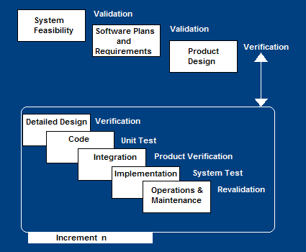
Incremental SDLC Model
Construct a partial implementation of a total system
Then slowly add increased functionality
The incremental model prioritizes requirements of the system and then implements them in groups.
Each subsequent release of the system:
→ adds function to the previous release, until all designed functionality has been implemented.
https://www.youtube.com/watch?v=gcpOZi6Hz38
Notes:
https://www.youtube.com/watch?v=gcpOZi6Hz38

Slide 21
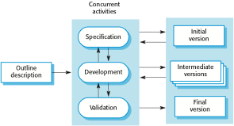
Incremental development
http://moodle.autolab.uni-pannon.hu/Mecha_tananyag/szoftverfejlesztesi_folyamatok_angol/ch03.html

Slide 22
Incremental Model Strengths
You can develop high-risk or major functions first
Each release delivers an operational product
Customer can respond to each build from each increment
Uses “divide and conquer” breakdown of tasks
Lowers initial delivery cost
Initial product delivery is faster
Customers get important functionality early
Risk of changing requirements is reduced

Slide 23
Incremental Model Weaknesses
Requires good planning and design
Requires early definition of a complete and fully functional system to allow for the definition of increments
Well-defined module interfaces are required (some will be developed long before others)
Total cost of the complete system is not lower

Slide 24
When to use the Incremental Model
Most of the requirements are known up-front but are expected to evolve over time
A need to get basic functionality to the market early
On projects which have long development schedules
On a project with new technology

Slide 25
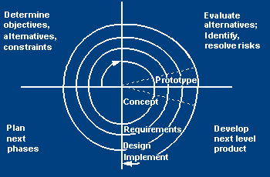
Spiral SDLC Model
Adds risk analysis and RAD prototyping to the waterfall model
Each cycle involves the same sequence of steps as the waterfall process model
https://www.youtube.com/watch?v=mp22SDTnsQQ

Slide 26
Spiral Quadrant Determine objectives, alternatives and constraints
Objectives: functionality, performance, hardware/software interface, critical success factors, etc.
Alternatives: build, reuse, buy, sub-contract, etc.
Constraints: cost, schedule, interface, etc.

Slide 27
Spiral Quadrant Evaluate alternatives, identify and resolve risks
Study alternatives relative to objectives and constraints
Identify risks (lack of experience, new technology, tight schedules, poor process, etc.
Resolve (Analyze) risks (evaluate if money could be lost by continuing system development

Slide 28
Spiral Quadrant Develop next-level product
Typical activites:
Create a design
Review design
Develop code
Examine code
Test product

Slide 29
Spiral Quadrant Plan next phase
Typical activities
Review the project
Develop the next phase plan

Slide 30
Spiral Model Strengths
Provides early indication of possible risks, without much cost
Users see the system early because of rapid prototyping tools
high-risk or critical functions of customer are developed first
The design does not have to be perfect
Users can be closely tied to all lifecycle steps
Early and frequent feedback from users (in each cycle prototyping)
Cumulative costs assessed frequently

Slide 31
Spiral Model Weaknesses
Time spent for evaluating risks too large for small or low-risk projects
Time spent planning, resetting objectives, doing risk analysis and prototyping may be may be unnecessary
The model is complex
Risk assessment expertise is required
Spiral may continue indefinitely
Developers must be reassigned/moved during non-development phase activities (idle time)
May be hard to define objective, demonstrable milestones that indicate possibility to proceed to the next iteration

Slide 32
When to use Spiral Model
When creation of a prototype is necessary for any SW prj
When costs and risk evaluation is important (e.g., patient service program…)
For medium to high-risk projects
When Users are unsure of their needs
Requirements are complex
When new product sector (requirments are unknown yet)
Significant and various changes are expected (research and exploration)

Slide 33
The Rational Unified Process
https://www.youtube.com/watch?v=YgkhFH8g0J4
RUP brings together aspects of the 3 generic process models (‘waterfall’ model, incremental development, and reuse-oriented development).
RUP involves 3 perspectives:
A dynamic perspective that shows phases over time:
Inception (scope,estimations),
Elaboration (design architecture),
Construction (implementation),
Transtion (all tasks after implementation to production)
A static perspective that shows process activities
Businnes Modelling,
Requirements,
Analysis&Design,
Implementation,
Test,
Deployment
A practice perspective that suggests good practice.

Slide 34
Phases in the Rational Unified Process

Slide 35
RUP phases
Inception
Establish the business case for the system(define scope, estimations).
Elaboration
Develop an understanding of the problem domain and the system architecture.
Construction
System design, programming and testing.
Transition
Deploy the system in its operating environment.

Slide 36
RUP iteration
There are two iteration types in RUP:
In-phase iteration
Each phase is iterative with results developed incrementally.
Cross-phase iteration
As shown by the loop in the RUP model, the whole set of phases may be passed incrementally.

Slide 37
Static workflows in the Rational Unified Process
Workflow | Description
Business modelling | The business processes are modelled using business use cases.
Requirements | Actors who interact with the system are identified and use cases are developed to model the system requirements.
Analysis and design | A design model is created and documented using architectural models, component models, object models and sequence models.
Implementation | The components in the system are implemented and structured into implementation sub-systems. Automatic code generation from design models helps accelerate this process.

Slide 38
Static workflows in the Rational Unified Process
Workflow | Description
Testing | Testing is an iterative process it is carried out in conjunction with implementation. System testing follows the completion of the implementation.
Deployment | A product release is created, distributed to users and installed in their workplace.
Configuration and change management | This supporting workflow managed changes to the system (see Chapter 25).
Project management | This supporting workflow manages the system development (see Chapters 22 and 23).
Environment | This workflow is about making appropriate software tools available to the software development team.

Slide 39
Agile SDLC’s
Speed up or bypass one or more life cycle phases
Usually less formal and reduced scope
Used for time-critical applications
Used in organizations that employ disciplined methods

Slide 40
Some Agile Methods
Adaptive Software Development (ASD)
Feature Driven Development (FDD)
Crystal Clear
Dynamic Software Development Method (DSDM)
Rapid Application Development (RAD)
Extreme Programming (XP)

Slide 41
Rapid Application Development Model (RAD) https://www.youtube.com/watch?v=Iuuj-GgJtXU&spfreload=10
Requirements planning phase (a workshop applying structured discussion of business problems)
User description phase – automated tools used to collect information from users
Construction phase – productivity tools, such as code generators, screen generators, etc. inside a time-box. (“Do until done”)
Cutover phase -- installation of the system, user acceptance testing and user training
https://www.youtube.com/watch?v=gPgsKLtwJ68&spfreload=10
https://www.youtube.com/watch?v=X6QzyHiSPf0
https://www.youtube.com/watch?v=BoQzy_N7U2w

Slide 42
RAD Strengths
Reduced cycle time and improved productivity with fewer people → means lower costs
Time-box approach will be useful for cost and schedule risk of project
Customer involved throughout the complete cycle minimizes risk of not achieving customer satisfaction and business needs
Focus moves from documentation to code….
Uses modeling concepts to capture information about business, data, and processes.

Slide 43
RAD Weaknesses
Accelerated development process must give quick responses to the user
Hard to use with legacy (older) systems
Requires a system that can be modularized
Developers and customers must be dedicated to rapid-fire activities in an shortened time frame.

Slide 44
When to use RAD
If you know reasonably well-known requirements of new system
If it is possible→User involved throughout the life cycle
If the project can be time-boxed
If the functionality of project is delivered in increments
High performance not required
Low technical risks
System can be modularized

Slide 45
Extreme Programming - XP
When it is considered? For small-to-medium-sized teams developing software with unclear or rapidly changing requirements
Coding is the key activity throughout a software project
Communication among team-mates is done with code
Life cycle and behavior of complex objects defined in test cases – again in code

Slide 46
XP Practices (1-6)
Planning game – determine scope of the next release by combining business priorities and technical estimates
Small releases – put a simple system into production, then release new versions in very short cycle
Metaphor – all development is guided by a simple shared story of how the whole system works
Simple design – system is designed as simply as possible (extra complexity removed as soon as found)
Testing – programmers continuously write unit tests; but customers write tests for features
Refactoring – programmers continuously restructure the system without changing its behavior to remove duplication and simplify

Slide 47
XP Practices (7 – 12)
Pair-programming -- all production code is written with two programmers at one machine
Collective ownership – anyone can change any code anywhere in the system at any time.
Continuous integration – integrate and build the system many times a day – every time a task is completed.
40-hour week – work no more than 40 hours a week as a rule
On-site customer – a user is on the team and available full-time to answer questions
Coding standards – programmers write all code in accordance with rules emphasizing communication through the code

