Slide 1
Chapter 1- Introduction

Slide 2
Topics covered
Professional software development
  What is meant by software engineering.
Software engineering ethics
  A brief introduction to ethical issues that affect software engineering.
Case studies
  An introduction to FOUR examples that are used in later chapters in the book.

Slide 3
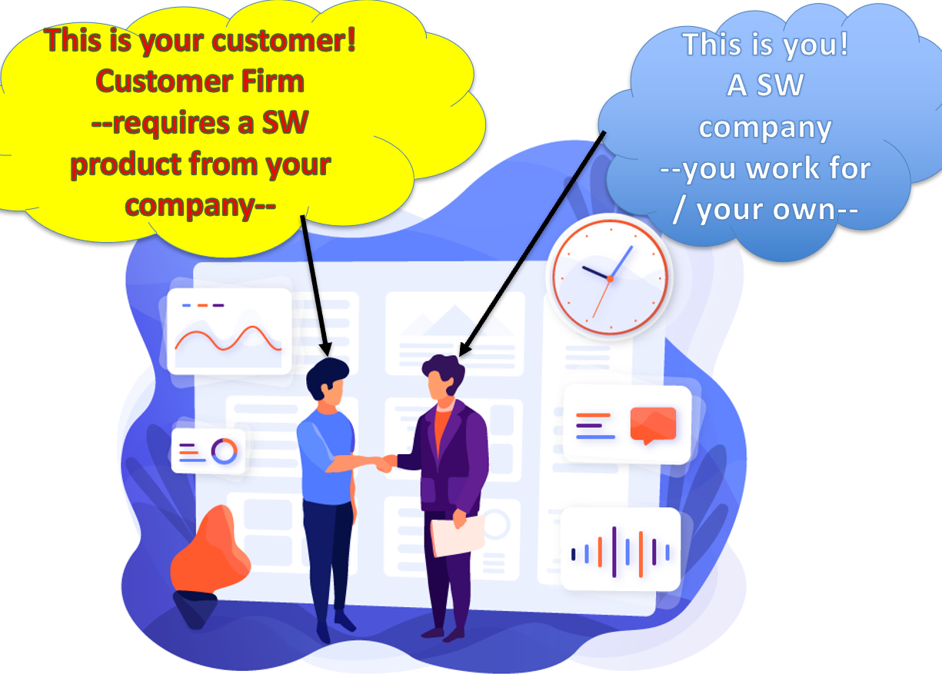
Software engineering
The economies of ALL developed nations/countries are
dependent on software.
More and more systems are software controlled anymore…
Software engineering is related with theories, methods and tools for professional software development.
Software expenditure/costs represents a significant portion of Gross national product (GNP) in all developed countries.
Notes:
Gross national product (GNP) is an estimate of total value of all the final products and services turned out in a given period by the means of production owned by a country's residents.

Slide 4
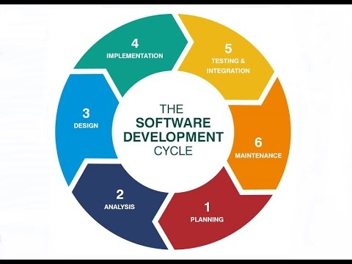
Software costs
The costs of software on a PC are often greater than the hardware cost.
MAINTENANCE cost is generally more than DEVELOPING cost of a SW prj.
  For systems with a long life, maintenance costs may be several times development costs.
Software engineering is about cost-effective software development.

Slide 5
Software project failure
Due to increased competition in markets, we know that the SW products complexity is increasing day by day.
New software engineering techniques help us:
    To create larger systems,
    To create more complex systems,
    Satisfy the demands changes in many sectors.
Therefore, many sectors expectations:
    SWs have to be built and delivered more quickly;
    Larger and more complex SWs are required;
    SWs must have new capabilities/features.
      These features were previously considered to be impossible.

Slide 6
Software project failure
Due to failure to use SE methods
Companies want to develop their own SWs without using SE methods, tools and techniques. But this is wrong way!
Because the software products are too expensive!
Today, many companies have started to develop their SWs for performing their business processes.
However, since this is not their expertise, so they cannot use SE methods,tools & techniques very well.
  For example. Health sector: hospitals, clinics, etc.
As a result, their SWs produced are often more expensive and less reliable than it should be.

Slide 7
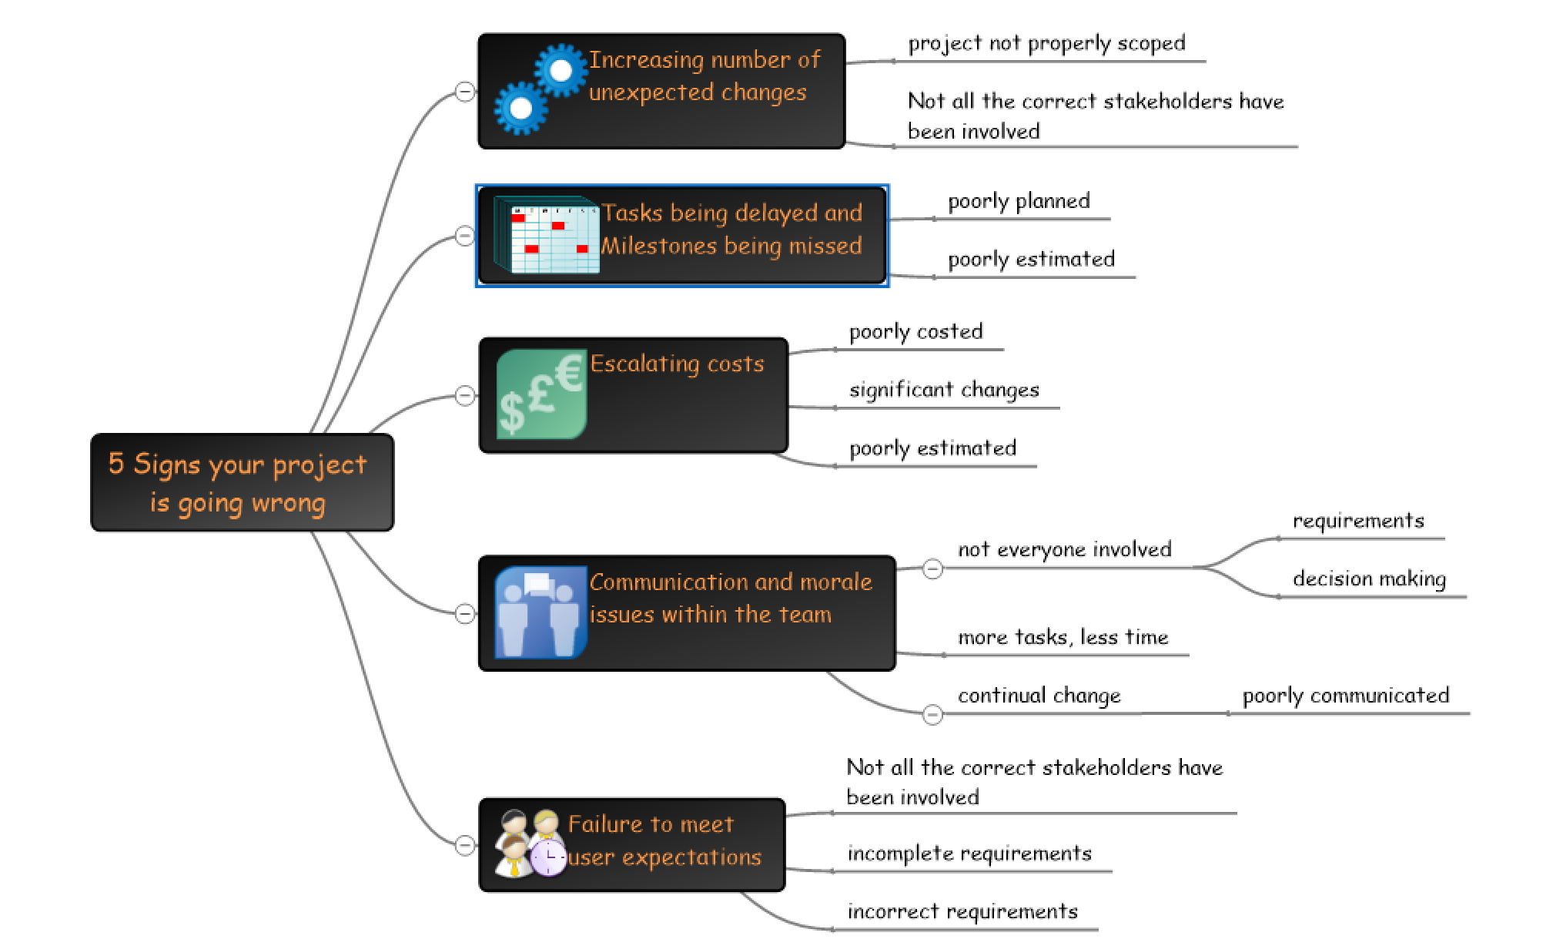
5 Signs your Project is Going Wrong
If you notice that too much changes are required…
If you notice you start to being late to finish some tasks
If you notice your cost increasing day by day
If you notice comm problems in team
If you can’t satisfy customer due to changes

Slide 8
Professional software development

Slide 9
Frequently asked questions about SE
Question | Answer
What is software? | Computer programs and related documentation. Software products may be developed for a particular customer or may be developed for a general market.
What are the attributes of good software? | Good software should deliver the required functionality and performance to the user. Good software should be maintainable, dependable and usable.
What is software engineering? | Software engineering is an engineering discipline that is concerned with all aspects of software production.
What are the fundamental software engineering activities? | 1-Software specification, 2-software development, 3-software validation and 4-software evolution.
What is the difference between software engineering and computer science? | Computer science focuses on theory and fundamentals; software engineering is concerned with the practices of developing and delivering useful software.
What is the difference between software engineering and system engineering? | System engineering is about with all aspects of computer-based systems development including hardware, software and process engineering. Software engineering is part of this more general process.

Slide 10
Frequently asked questions about software engineering
Question | Answer
What are the key challenges facing software engineering? | Coping with increasing diversity, Demands for reduced delivery times and Developing reliable software.
What are the costs of software engineering? | Roughly 60% of software costs are development costs, 40% are testing costs. For custom software, evolution costs often exceed development costs.
What are the best software engineering techniques and methods? | While all software projects have to be professionally managed and developed, different techniques are suitable for different types of system. For example, games should always be developed using a series of prototypes whereas safety critical control systems require a complete and analyzable specification to be developed. You can’t, therefore, say that one method is better than another.
What differences has the web made to software engineering? | The web has led to the availability of software services and the possibility of developing highly distributed service-based systems. Web-based system development provides to important advances in programming languages and software reuse.

Slide 11
Software products
Generic products
  Stand-alone systems that are marketed and sold to any customer who wishes to buy them.
  Examples – PC software such as graphics programs, project management tools; CAD software; software for specific markets such as appointments systems for dentists.
Customized products
  Software that is used by a specific customer to meet their own needs.
  Examples – embedded control systems, air traffic control software, traffic monitoring systems.

Slide 12
Product specification
Generic products
  “What the software will do” depends on the software developer.
  Decisions about software change are made by the developer.
Customized products
  “What the software will do” depends on customers (needs).
  Decisions about software change (requirements) are made by the customers.

Slide 13
Crucial attributes of a good software
Product characteristic | Description
Maintainability | Software should be written/developed in such a way so that it can evolve to meet the changing needs of customers. This is a critical attribute because software change is an inevitable requirement of a changing business environment.
Dependability (trustworthy) and Security | Software dependability includes some characteristics; 1- Reliability, 2- Security & Safety. Dependable software should not cause physical or economic damage in the event of system failure. Malicious users should not be able to access or damage the system.
Efficiency | Software should not make wasteful use of system resources such as memory and processor cycles. Efficiency therefore includes responsiveness, processing time, memory utilisation, etc.
Acceptability | Software must be acceptable by the end users, which is designed for them. This means that it must be understandable, usable and compatible with other systems used in the customer company.

Slide 14
Software engineering
1- Software engineering is an engineering discipline that is about with all aspects of software production from the early stages of system specification through to maintaining the system after it has gone into use.
2- Engineering discipline ?
  uses appropriate theories and methods to solve problems by considering organizational and financial constraints.
3- What are the aspects of software production ?
  Don't think of producing software as just program coding!
  Also→ project management and the development of tools, methods etc. to supports to software production.

Slide 15
Importance of software engineering
More and more individuals and society want to trust advanced software systems.
So, we need to be able to produce reliable and trustworthy systems economically and quickly.
It is usually cheaper, in the long run, to use SE methods and techniques for software systems rather than just write the programs as if it was a personal programming project.
For most types of SW systems, the major costs are the costs of changing the software after starting use it.

Slide 16
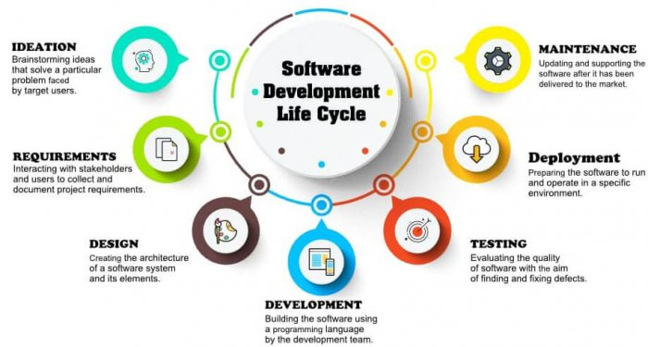
SOFTWARE PROCESS ACTIVITIES
EVOLUTION
SPECIFICATION
VALIDATION
DEVELOPMENT
Software specification, where customers and engineers define the software details that is to be produced and the constraints on its operation.
Software development, where the software is designed and programmed.
Software validation, where the software is checked to ensure that it is what the customer requires.
Software evolution, where the software is modified to reflect changing customer and market requirements.

Slide 17
General issues that affect software
Reasons for changes in organizations?
Heterogeneity
  Increasingly, systems are required to operate/run as distributed systems across networks that may include different types of computers and mobile devices such as: smart phones, smart watchs, smart TVs etc...
Business and social change
  Business and society are changing incredibly quickly;
    as emerging economies develop and
    as new technologies become available.
  So, companies/sectors need to change their existing software and need to rapidly develop new software.

Slide 18
General issues that affect software
3. Security and trust
  As software is effected for all aspects of our lives, it is essential that we can trust that software (e.g. e-trade, credit card use & corruption, malware SW)
4. Scale
  Software has to be developed in a very wide range of scales;
    from very small embedded systems in portable or wearable devices through
    to Internet-scale, cloud-based systems that serve a global community.

Slide 19
Software engineering diversity
There are many different types of software systems and there is no universal set of software techniques/ methods that is applicable to all of these.
Used SE methods and tools change acc to;
  1) the type of application being developed,
  2) the requirements of the customer and,
  3) the background of the development team.

Slide 20
Application types
Stand-alone applications
  These are application systems that run on a local computer, such as a PC. They include all necessary functionality and do not need to be connected to a network.
Interactive transaction-based applications
  Applications that execute on a remote computer and are accessed by users from their own PCs or terminals. These include web applications such as e-commerce applications.
Embedded control systems
  These are software control systems that control and manage hardware devices. Numerically, there are probably more embedded systems than any other type of system.

Slide 21
Application types
4. Batch processing systems
  These are business systems that are designed to process data in large batches.
  They process large numbers of individual inputs to create corresponding outputs.
5. Entertainment systems
  These are systems that are primarily for personal use and which are intended to entertain the user.
6. Systems for modeling and simulation
  These are systems that are developed by scientists and engineers to model physical processes or situations, which include many, separate, interacting objects.

Slide 22
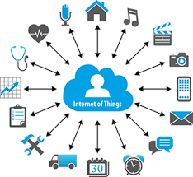
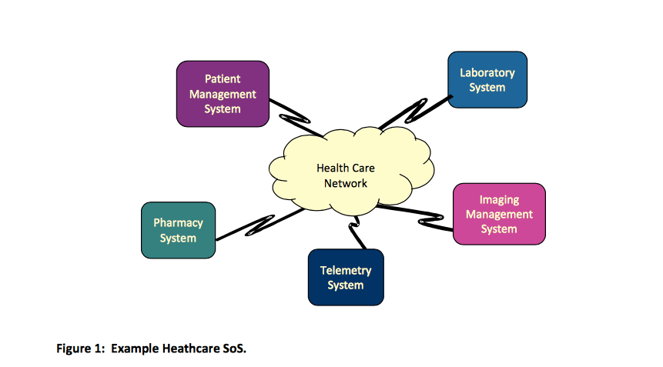
Application types
7. Data collection systems
  These are systems that collect data from their environment using a set of sensors and send that data to other systems for processing.
8. Systems of systems
  These are systems that are composed of a number of other software systems.

Slide 23
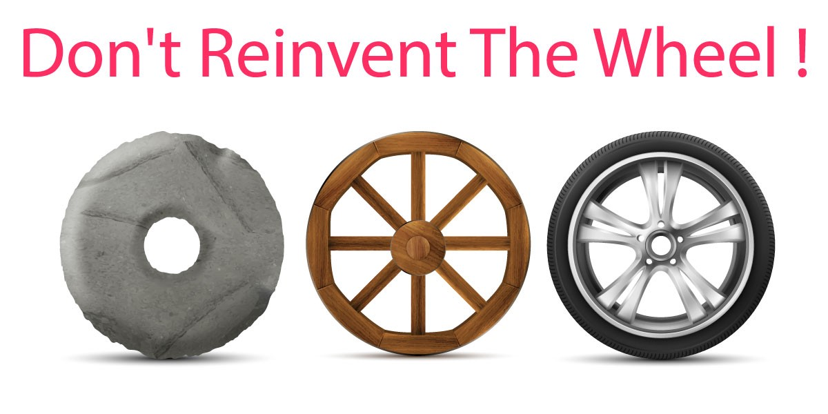
Software Engineering Principles
Some basic principles we need to apply to all types of software systems (not related with development techniques used):
  SELECT A SDLC MODEL: Systems should be developed by using a well-defined and managed development process. Of course, different processes are used for different types of software.
  Dependability and performance are important for all types of system.
  UNDERSTAND YOUR CUSTOMER: Understanding and managing the software specification and requirements (what the software should do) are important.
  REUSE COMPONENTS: Where appropriate, you can reuse software that has already been developed rather than write a new software.

Slide 24
Internet software engineering
The Web is now a platform for running application and organizations are increasingly developing web-based systems rather than local systems.
Web services allow application functionality to be accessed over the web.
Cloud computing is an approach to the provision of computer services where applications run remotely on the ‘cloud’.
  Users do not buy software but pay according to use.

Slide 25
Web-based software engineering
Web-based systems are complex distributed systems
  however, the basic principles of SE mentioned earlier are also suitable for Web-based systems as well as other systems.
    Let's remember the SE principles:
      A managed and understood development process is necessary.
      Dependability and performance are important criterias.
      Understanding and managing requirements is necessary.
      You can reuse software.
The fundamental ideas of SE apply to web-based systems in the same way that they apply to other types of SW system.

Slide 26
Web software engineering
Software reuse
  Software reuse is the dominant approach for constructing web-based systems.
  When building a Web system, you think about how you can combine the system from pre-existing software components and systems. (e.g. Credit card payment module)
Incremental and agile development
  Web-based systems should be developed and delivered incrementally → when it is impossible to specify all the requirements in advance for such systems.

Slide 27
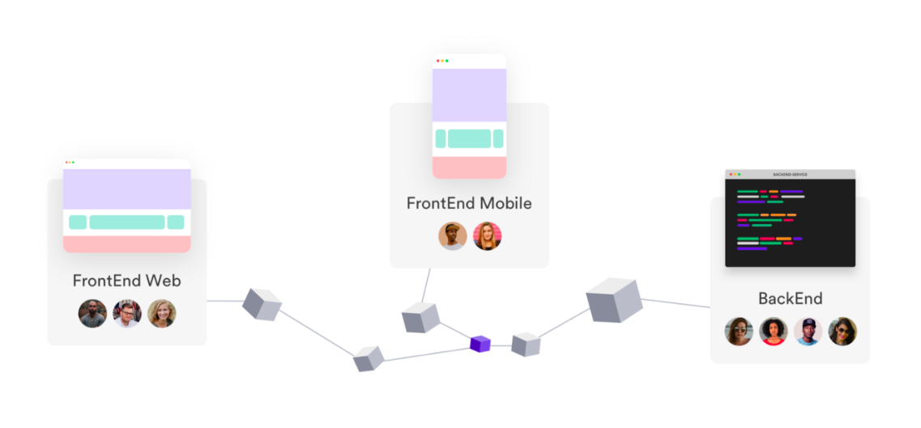
Web software engineering
Web Service Oriented: Software is implemented using service-oriented software engineering, where the software components are Web Services.
Rich interfaces: Interface development technologies such as AJAX and HTML5 have emerged that support the creation of rich interfaces within a web browser.
Service-oriented Software Example

Slide 28
Software engineering ethics

Slide 29
Software engineering ethics
Software engineering involves wider responsibilities than simply the application of technical skills.
Software engineers must behave in an honest and ethically responsible way if they are to be respected as professionals.
Ethical behaviour is more than simply continuation the law but involves following a set of principles that are morally correct.

Slide 30
Issues of professional responsibility
Confidentiality (privacy)
    Engineers should normally respect the confidentiality of their employers or customers irrespective of whether or not a formal confidentiality agreement (NDA) has been signed.
Competence (yetkinlik)
    Engineers in a company should not misrepresent their level of competence.
    They should not accept a work which is out with their competence.

Slide 31
Issues of professional responsibility
Intellectual Property Rights (Fikri Mülkiyet Hakları)
  Engineers should be aware of local laws governing the use of intellectual property such as patents, copyright, etc.
  They should be careful to ensure that the intellectual property of employers and clients is protected.
Computer misuse
  Software engineers should not use their technical skills to misuse others’ computers (kötüye kullanmamalıdır).
  Computer misuse ranges; from relatively trivial (game playing on an employer’s machine, say) to extremely serious (dissemination of viruses).

Slide 32
ACM/IEEE Code of Ethics
The professional societies in the US have cooperated to produce a code of ethical practice.
Members of these organisations sign up to the code of practice when they join.
The Code contains eight Principles related to the behaviour of and decisions made by professional software engineers, including practitioners, educators, managers, supervisors and policy makers, as well as trainees and students of the profession.

Slide 33
Rationale/reason of the code of ethics
  Computers have a central and growing role in commerce, industry, government, medicine, education, entertainment and society at large.
  Software engineers are those who contribute by direct participation or by teaching, to the analysis, specification, design, development, certification, maintenance and testing of software systems.
  Because of their roles in developing software systems, software engineers have significant opportunities to do good or cause harm, to enable others to do good or cause harm, or to influence others to do good or cause harm.
  To ensure, as much as possible, that their efforts will be used for good, software engineers must promise themselves to making SE a beneficial and respected profession.

Slide 34
The ACM/IEEE Code of Ethics
Software Engineering Code of Ethics and Professional Practice
(Yazılım Mühendisliği Etik Kuralları ve Mesleki Uygulama)
ACM/IEEE-CS Joint Task Force on Software Engineering Ethics and Professional Practices
PREAMBLE
The short version of the code summarizes aspirations at a high level of the abstraction; the clauses that are included in the full version give examples and details of how these aspirations change the way we act as software engineering professionals. Without the aspirations, the details can become legalistic and tedious; without the details, the aspirations can become high sounding but empty; together, the aspirations and the details form a cohesive code.
Software engineers shall commit themselves to making the analysis, specification, design, development, testing and maintenance of software a beneficial and respected profession. In accordance with their commitment to the health, safety and welfare of the public, software engineers shall adhere to the following Eight Principles:
Notes:
Yazılım mühendisleri, yazılımın analizini, özelliklerini, tasarımını, geliştirilmesini, test edilmesini ve bakımını yararlı ve saygın bir meslek haline getirmeyi taahhüt ederler. Halkın sağlığı, güvenliği ve refahı konusundaki taahhütlerine uygun olarak, yazılım mühendisleri aşağıdaki Sekiz İlkeye bağlı kalacaktır:

Slide 35
Ethical principles
1. PUBLIC - SEs shall act consistently with the public interest.
2. CLIENT AND EMPLOYER - SEs shall act in a manner that is in the best interests of their client and employer consistent with the public interest.
3. PRODUCT - SEs shall ensure that their products and related modifications meet the highest professional standards possible.
4. JUDGMENT - SEs shall maintain integrity and independence in their professional judgment.
5. MANAGEMENT – SE managers and leaders shall subscribe to and promote an ethical approach to the management of software development and maintenance.
6. PROFESSION – SEs shall advance the integrity and reputation of the profession consistent with the public interest.
7. COLLEAGUES - SEs shall be fair to and supportive of their colleagues.
8. SELF - SEs shall participate in lifelong learning regarding the practice of their profession and shall promote an ethical approach to the practice of the profession.
Notes:
1. KAMU - Yazılım mühendisleri halkın ilgisi ile tutarlı hareket eder.
2. MÜŞTERİ VE İŞVEREN - Yazılım mühendisleri, müşterileri ve işverenlerinin yararına, kamu yararı ile tutarlı bir şekilde hareket eder.
3. ÜRÜN - Yazılım mühendisleri, ürünlerinin ve ilgili değişikliklerin mümkün olan en yüksek profesyonel standartlara uygun olmasını sağlamalıdır.
4. YARGI - Yazılım mühendisleri, mesleki yargılarında dürüstlük ve bağımsızlığı koruyacaklardır.
5. YÖNETİM - Yazılım mühendisliği yöneticileri ve liderleri, yazılım geliştirme ve bakım yönetimine etik bir yaklaşıma abone olmalı ve onu teşvik etmelidir.
6. MESLEĞİ - Yazılım mühendisleri, mesleğin bütünlüğünü ve itibarını halkın ilgisine uygun şekilde ilerletmelidir.
7. YAZILIMLAR - Yazılım mühendisleri, meslektaşlarına karşı adil ve destekleyici olacaktır.
8. SELF - Yazılım mühendisleri mesleğinin pratiğine ilişkin yaşam boyu öğrenmeye katılacak ve mesleğin pratiğine etik bir yaklaşım getireceklerdir.

Slide 36
Ethical dilemmas (etik ikilemler)
Disagreement in principle with the policies of senior management in the company you worked for.
Your employer acts in an unethical way and releases a safety-critical system without finishing the testing of the system (e.g. a medical SW).
Participation in the development of military weapons systems or nuclear systems.

Slide 37
Case studies

Slide 38
Case studies
A personal insulin pump
  An embedded system in an insulin pump used by diabetics to maintain blood glucose control.
A mental health case patient management system
  Mentcare. A system used to keep records of people receiving care for mental health problems.
A wilderness weather station
  A data collection system that collects data about weather conditions in remote areas.
iLearn: a digital learning environment
  A system to support learning in schools

Slide 39
1-Insulin pump control system
Collects data from a blood sugar sensor and calculates the amount of insulin required to be injected.
Calculations are based on the rate of change of blood sugar levels.
Sends signals to a micro-pump to deliver the correct dose of insulin.
  low blood sugars can lead to brain malfunctioning, coma and death;
  high-blood sugar levels have long-term consequences such as eye and kidney damage.

Slide 40
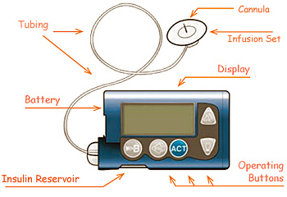

Slide 41
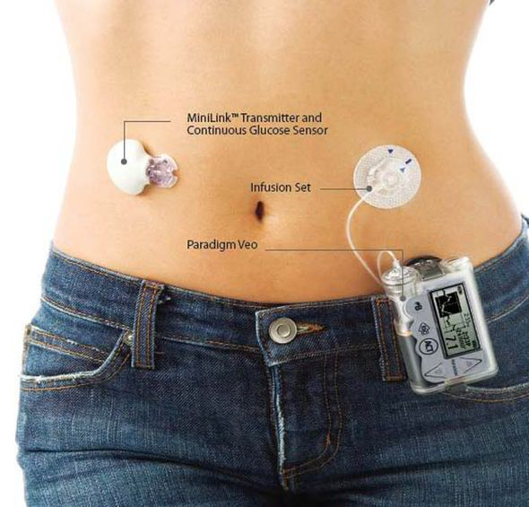
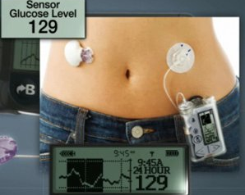

Slide 42
Insulin pump hardware architecture
iğne düzeneği
canulla

Slide 43
Activity diagram of the insulin pump

Slide 44
Essential high-level requirements
Customer Expectations:
The system shall be available to deliver insulin when insulin is required.
The system shall perform reliably and deliver the correct amount of insulin to counteract the current level of blood sugar.
The system must therefore be designed and implemented to ensure that the system always meets these requirements.

Slide 45
2-Mentcare: A patient information system for mental health care
A patient information system to support mental health care is a Medical Information System that keeps information about patients suffering from mental health problems and the treatments that they have received.
Most mental health patients do not require dedicated hospital treatment but need to attend specialist clinics regularly where they can meet a doctor who has detailed knowledge of their problems.
To make it easier for patients to attend, these clinics are not just run in hospitals. They may also be held in local medical practices or community centres (toplum merkezleri,sağlık ocağı vb).

Slide 46
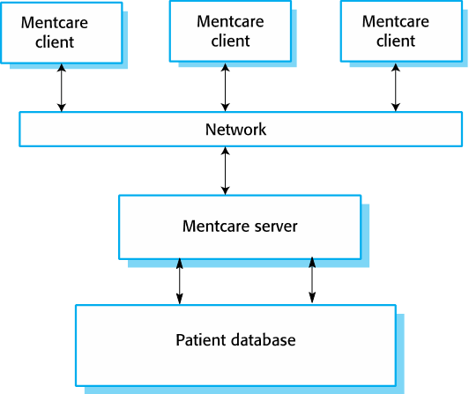
Mentcare
Mentcare is an IS that is intended for use in clinics.
It makes use of a centralized database of patient information but has also been designed to run on a PC, so that it may be accessed and used from sites that do not have secure network connectivity.
When the local systems have secure network access, they use patient information in the database, but they can download and use local copies of patient records when they are disconnected.

Slide 47
Mentcare system goals
To generate management information that allows health service managers to assess performance against local and government targets.
To provide medical staff with timely information to support the treatment of patients.

Slide 48
The organization of the Mentcare system
An example for client-server architectural model

Slide 49
Key features of the Mentcare system
Individual care management
  Clinicians can create records for patients, edit the information in the system, view patient history, etc.
  The system supports/show data summaries so that doctors can quickly learn about the key problems and treatments that have been prescribed.
Patient monitoring
  The system monitors the records of patients that are involved in treatment and issues warnings if problems are detected.
Administrative reporting
  The system generates monthly management reports showing;
    the number of patients treated at each clinic,
    the number of patients who have entered and left the care system,
    number of patients sectioned,
    the drugs prescribed and their costs, etc.

Slide 50
Mentcare system concerns
Privacy
  It is essential that patient information is confidential and
  It is never shared to anyone except authorised medical staff and the patient themselves.
Safety
  Some mental illnesses cause patients to become suicidal or a danger to other people.
  Wherever possible, the system should warn medical staff about potentially suicidal or dangerous patients.
  The system must be available when needed
    Otherwise, safety may be compromised/under risk and
    it may be impossible to give the correct medication to patients.

Slide 51
3-Wilderness weather station
Some countries have large areas of wilderness (geniş vahşi doğa alanları olan ülkeler…)
Their government may decide to placed several hundred weather stations in remote areas.
Weather stations collect data from a set of instruments that measure temperature and pressure, sunshine, rainfall, wind speed and wind direction.
  The weather station includes a number of instruments (e.g. sensors) that measure weather parameters such as the wind speed and direction, the ground and air temperatures, the barometric pressure and the rainfall over a 24-hour period.
  Each of these instruments is controlled by a software system that takes parameter readings periodically and manages the data collected from the instruments.

Slide 52
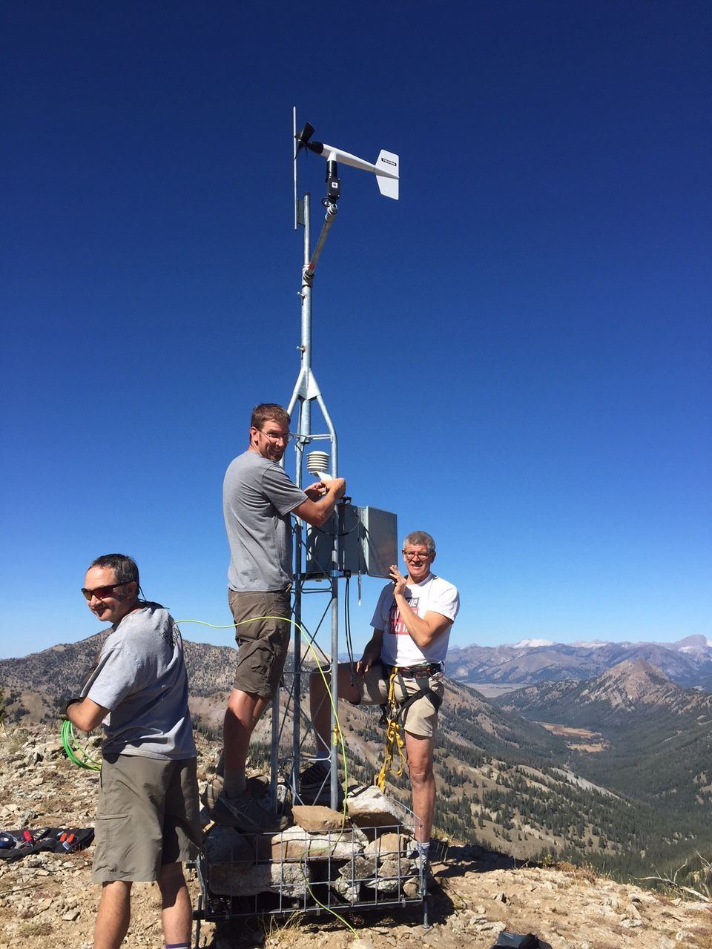
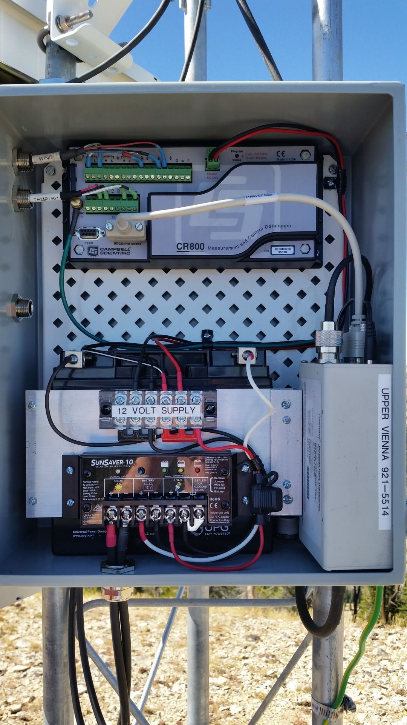
Measure temperature and pressure, sunshine, rainfall, wind speed and wind direction

Slide 53
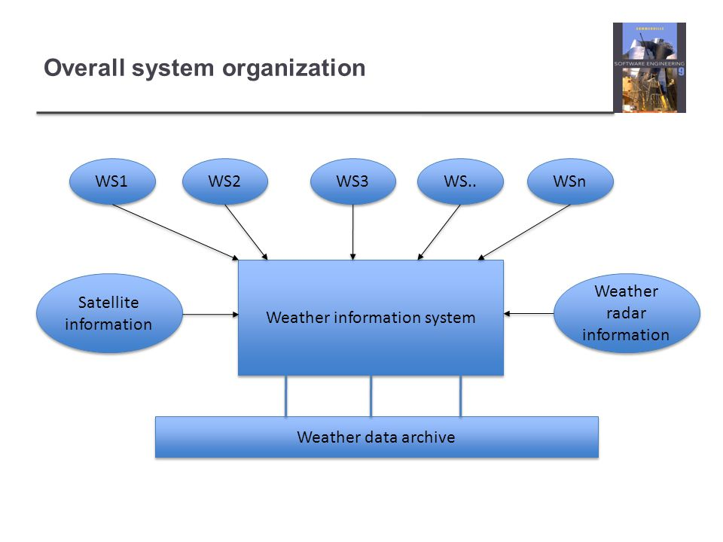

Slide 54
The weather station’s environment
Bakım Sistemi
It can communicate with all weather stations via satellite

Slide 55
Weather information system
The weather station system
  This is responsible for collecting weather data,
  Carrying out some initial data processing and
  Transmitting it to the Data Management System.
The Data Management and Archiving System
  This system collects the data from all of the weather stations,
  Perfoms data processing and analysis
  then archives the data.
The Station Maintenance System
  This system can communicate with all stations by satellite to monitor the health of these systems and provide reports of problems.

Slide 56
Additional software functionality
Monitor the instruments, power and communication hardware and report faults to the management system.
Manage the system power, ensuring that batteries are charged whenever the environmental conditions permit but also that generators are shut down in potentially damaging weather conditions, such as high wind.
Support dynamic reconfiguration where parts of the software are replaced with new versions and where backup instruments are switched into the system in the event of system failure.

Slide 57
4- iLearn: A digital learning environment
iLearn is a digital learning environment
It is a framework which may involve a set of general-purpose and specially designed tools for learning
The tools may be embedded and a set of applications that are presented to the learners using the system.
The tools included in each version of the environment
The tools are chosen by teachers and learners to meet their specific needs.
  These can be general applications such as spreadsheets, learning management applications such as a Virtual Learning Environment (VLE) to manage homework submission and assessment, games and simulations.

Slide 58
Service-oriented systems
iLearn system is a service-oriented system with all system components considered to be a replaceable service.
This allows the system to be updated incrementally as new services become available.
It also makes it possible to rapidly configure the system to create versions of the environment for different groups such as very young children who cannot read, senior students, etc.

Slide 59
iLearn services
Utility services that provide basic application-independent functionality and which may be used by other services in the system (e.g. search, loging,).
Application services that provide specific applications such as email, conferencing, photo sharing etc. and access to specific educational content such as scientific films or historical resources (e.g. email, simulation, video storage, spreatsheet, etc. ).
Configuration services that are used to adapt the environment with a specific set of application services and do define how services are shared between students, teachers and their parents. (e.g. group management, applications management, identity management, etc. ).

Slide 60
iLearn layered base architecture

Slide 61
iLearn service integration
Integrated services are services
  which offer an API (application programming interface) and
  which can be accessed by other services through that API.
  Direct service-to-service communication is therefore possible.
Independent services are services
  which are simply accessed through a browser interface and
  which operate independently of other services.
  Information can only be shared with other services through some user actions such as copy and paste;
  re-authentication may be required for each independent service.

Slide 62
Key points
Software engineering is an engineering discipline that is concerned with all aspects of software production.
Essential software product attributes are maintainability, dependability and security, efficiency and acceptability.
The high-level activities of specification, development, validation and evolution are part of all software processes.
The fundamental notions of software engineering are universally applicable to all types of system development.

Slide 63
Key points
There are many different types of system, and each system requires appropriate SE tools and techniques for their development.
The fundamental ideas of SE are applicable to all types of software system.
Ses have responsibilities to the engineering profession and society. They should not simply be concerned with technical issues.
Professional societies publish codes of conduct (davranış kuralları) which shows the standards of behaviour expected of their members.

