Slide 1
Chapter 4- Project Management

Slide 2
Topics covered
Risk management
Managing people
Teamwork

Slide 3
Software project management
It involves a set of activities to finish a planned software project on time and on schedule and in according to the
requirements of the organisations.
Project management is needed/important
  Because software development is always related with budget and schedule constraints that are set by the organisation when developing the software.

Slide 4
Success criteria of project management
Deliver the software to the customer at the agreed time.
Keep overall costs within budget.
Deliver software that meets the customer’s expectations.
Maintain a consistent and well-functioning development team.

Slide 5
Software management distinctions
A software product is intangible.
  Software cannot be seen or touched.
  Software project managers cannot see progress by simply looking at the artefact/product that is being constructed.
Many software projects are 'one-off' projects (bir defalık).
  Large software projects are usually different in some ways from previous projects.
  Even managers who have lots of previous experience may find it difficult to guess possible problems.
Software processes are variable and organization specific.
  We still cannot reliably predict when a particular software process is possibly cause development problems.

Slide 6
Factors influencing project management
Company size
Software customers
Software size
Software type
Organizational culture
Software development processes
These factors mean that project managers in different organizations may work in quite different ways.

Slide 7
Universal project management activities
Project planning
  Project managers are responsible for planning, estimating and scheduling project development and assigning people to tasks.
Risk management
  Project managers assess the risks that may affect a project, monitor these risks and take action when problems arise.
People management
  Project managers have to choose people for their team and establish ways of working that leads to effective team performance.
Reporting
  Project managers are usually responsible for reporting on the progress of a project to customers and to the managers of the company developing the software.
Proposal writing
  The first stage in a software project may involve writing a proposal to win a contract to carry out an item of work.
  The proposal describes the objectives of the project and how it will be carried out.

Slide 8
Risk management

Slide 9
Risk management
Risk management is concerned with identifying risks and define strategies/plans to minimise their effect on a project.
Software risk management is important because of the uncertainties in software development.
These uncertainties cause from;
    Poorly defined requirements,
    Requirements changes due to unexpected changes in customer needs,
    Difficulties in estimating the time and resources required for software development, and
    Differences in individual skills in team.
You have to foreseen the risks, understand the impact of these risks on the project, on the product, and on the business, and take steps to avoid these risks.

Slide 10
Risk classification
There are TWO dimensions of risk classification:
  Type of Risk (technical, organizational, ..)
  What is AFFECTED by the risk? (Riskten neler etkilenir?)
Project risks affect project schedule or resources;
Product risks affect the product quality or performance of the software
Business risks affect the organisation developing or procuring the software.

Slide 11
Examples of project, product, and business risks
Risk | Affects | Description
Staff turnover/leave | Project | Experienced staff will leave the project before it is finished.
Management change | Project | There will be a change of organizational management with different priorities.
Hardware unavailability | Project | Hardware that is essential for the project will not be delivered on schedule.
Requirements change | Project and product | There will be a larger number of changes to the requirements than expected.
Specification delays | Project and product | Specifications of essential interfaces are not available on schedule.
Size underestimate | Project and product | The size of the system has been underestimated.
CASE tool underperformance | Product | CASE tools, which support the project, do not perform as expected/anticipated.
Technology change | Business | The underlying technology on which the system is built is outdated by new technology.
Product competition | Business | Another competitive product is marketed before the system is completed.

Slide 12
Boehm’s Top Ten Risk Items
Personnel shortfalls/deficits
Unrealistic schedules and budgets
Developing the wrong functions
Developing the wrong user interfaces
Continuing flow of requirements changes
Shortfalls in externally-performed tasks
Shortfalls in externally-furnished components
Real-time performance shortfalls
Forcing computer science capabilities
Gold-plating

Slide 13
Four risk management process
Risk identification
  Identify (1) project, (2) product and (3) business type of risks;
Risk analysis
  Assess the probability and consequences of these risks;
Risk planning (strategic)
  Create plans to avoid or minimise the effects of the risk;
Risk monitoring
  Monitor the risks throughout the project;

Slide 14
The risk management process
probability & consequences
Create plans

Slide 15
1-Risk identification
Risk identification may be a team activities or based on the individual project manager’s experience.
A checklist of common (type) risks for software projects may be used to identify risks in a project:
  Technology risks.
  Organizational risks.
  People risks.
  Requirements risks.
  Estimation risks.

Slide 16
1-Examples of different risk types
Risk type | Possible risks
Estimation | The time required to develop the software is underestimated. (12) The rate of defect repair is underestimated. (13) The size of the software is underestimated. (14)
Organizational | The organization is restructured so that different management are responsible for the project. (6) Organizational financial problems force reductions in the project budget. (7)
People | It is impossible to recruit staff with the skills required. (3) Key staff are ill and unavailable at critical times. (4) Required training for staff is not available. (5)
Requirements | Changes to requirements that require major design rework are proposed. (10) Customers don’t understand the impact of requirements changes. (11)
Technology | The database used in the system cannot process as many transactions per second as expected. (1) Reusable software components contain defects that mean they cannot be reused as planned. (2)
Tools | The code generated by software code generation tools is inefficient. (8) Software tools cannot work together in an integrated way. (9)

Slide 17
2-Risk analysis
Measure probability and importance of each risk.
Probability may be;
  very low,
  low,
  moderate,
  high,
  very high.
Risk consequences might be;
  catastrophic,
  serious,
  tolerable,
  insignificant.

Slide 18
Risk types and examples
Risk | Probability | Effects
Organizational financial problems force reductions in the project budget (7). | Low | Catastrophic
It is impossible to recruit staff with the skills required for the project (3). | High | Catastrophic
Key staff are ill at critical times in the project (4). | Moderate | Serious
Faults in reusable software components have to be repaired before these components are reused. (2). | Moderate | Serious
Changes to requirements that require major design rework are proposed (10). | Moderate | Serious
The organization is restructured so that different management are responsible for the project (6). | High | Serious
The database used in the system cannot process as many transactions per second as expected (1). | Moderate | Serious

Slide 19
Risk types and examples
Risk | Probability | Effects
The time required to develop the software is underestimated (12). | High | Serious
Software tools cannot be integrated (9). | High | Tolerable
Customers fail to understand the impact of requirements changes (11). | Moderate | Tolerable
Required training for staff is not available (5). | Moderate | Tolerable
The rate of defect repair is underestimated (13). | Moderate | Tolerable
The size of the software is underestimated (14). | High | Tolerable
Code generated by code generation tools is inefficient (8). | Moderate | Insignificant

Slide 20
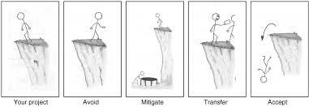
3-Risk planning
Accept/ Ignore

Slide 21
3-Risk planning
Project managers or organizations consider each risk and develop a strategy to manage that risk.
Define Avoidance strategies (Kaçınma stratejileri)
  Take actions to prevent from a particular risk
  By making changes in the project plan, try to stay away from those risks that may arise.
  Briefly search for other ways of doing same task. Find another ways…
Define Minimization strategies (Küçültme stratejileri)
  AIM: create a plan to respond to possible risks.
  Taking additional precautions to reduce the impact or probability of those risks.
Accept/Ignore Risk- Risk Neutral Decision-makers (Riski tarafsız karar alma)
  If you try to take necessary actions for all identified risks can increase the budget a lot.
  Therefore, the risks results (that may be ignored) are accepted by the project partners.
Execute Contingency plans
  If the risk happen/arises, execute your contingency plans (acil durum)

Slide 22
Risk Response Planning
Transfer the risk (Transfer the risk to another institution or individual. In this application, the risk will not be destroyed, only the responsibility of the risk will be assigned to someone else.)
Avoid the risk (Keep away from risk by making changes to the project plan)
Reduce the risk (taking extra engineers for project that reduce the risk of delay)
Have contingency plan (taking additional actions to reduce the impact or probability of occurrence of risks).
Accept risk (Acceptance is also a risk response plan. Trying to take actions against all of the identified risks can greatly increase budget. Therefore, some risks can be ignored, If those risks are happen, manager can activate other response plans)
Notes:
Kaçınma : Proje planında değişiklikler yaparak, ortaya çıkabilecek riskten uzak durma. Kısaca işi gerçekleştirmenin başka yollarını arama.
Transfer Etme : Riski bir başka kuruma veya bireye devretme. Bu uygulamada aslında risk yokedilmiş olmayacaktır, sadece riskin sorumluluğunun başkası tarafından yüklenilmesi sağlanacaktır. Bu şekilde risk yanıtlama planı hazırlanırken sigorta firmaları da projenin bir yüklenicisi konumundadır.
Azaltma : Karşılaşılabilecek riskler tanımlandıktan sonra bu risklerin etkisini veya gerçekleşme olasılıklarını azaltmak için ek önlemler alarak, riske yanıt verme planı oluşturma çalışmasıdır. Proje süresinin gecikme riskine karşılık ek insan kaynağı alarak (bütçeyi artırarak) riskin gerçekleşme ihtimalini azaltabiliriz.
Kabullenme : Kabullenme de bir risk yanıtlama planıdır. Tanımlanan risklerin tümüne önlem almaya çalışmak proje bütçesini bir hayli yükseltebilir. Bu yüzden gözardı edilebilecek riskler proje taraflarınca kabul edilir. Bu durumda proje tarafları bu tür riskleri proje boyunca izlerler ve projeyi etkileme olasılığı yükseldiğinde diğer yanıtlama planlarını devreye sokarlar.

Slide 23
A method to define risks: What-if questions
What if several engineers are ill at the same time?
What if an economic downturn leads to budget cuts of 20% for the project?
What if the performance of open-source software is inadequate and the only expert on that open source software leaves?
What if the company that supplies and maintains software components goes out of business?
What if the customer fails to deliver the revised requirements as predicted?

Slide 24
Strategies to help manage risk
Risk | Strategy
Organizational financial problems | Prepare a briefing document for senior management showing how the project is making a very important contribution to the goals of the business and presenting reasons why cuts to the project budget would not be cost-effective.
Recruitment problems | Alert customer to potential difficulties and the possibility of delays; investigate buying-in components.
Staff illness | Reorganize team so that there is more overlap of work and people therefore understand each other’s jobs.
Defective components | Replace potentially defective components with bought-in components of known reliability.
Requirements changes | Obtain traceability information to assess the impact of requirement change; maximize the information stored in the design.

Slide 25
Strategies to help manage risk
Risk | Strategy
Organizational restructuring | Prepare a briefing document for senior management showing how the project is making a very important contribution to the goals of the business.
Database performance | Investigate the possibility of buying a higher-performance database.
Underestimated development time | Investigate buying-in components; investigate use of a program generator.

Slide 26
4-Risk monitoring
Assess/monitor each identified risks regularly to decide whether or not it is becoming less or more possible.
Also assess whether the effects of the risk have changed.
Each key risk should be discussed at management progress meetings.

Slide 27
Risk indicators
Risk type | Potential indicators
Estimation | Failure to meet agreed schedule (deviation from plan); Failure to remove the defects reported before.
Organizational | Organizational gossip; Lack of action by senior management.
People | Poor staff morale; poor relationships amongst team members; high staff turnover.
Requirements | Many requirements change requests; Customer complaints.
Technology | Late delivery of hardware or support software; Many reported and observed technology problems.
Tools | Unwillingness by team members to use tools; Complaints about CASE tools; Demands for higher-powered workstations.

Slide 28
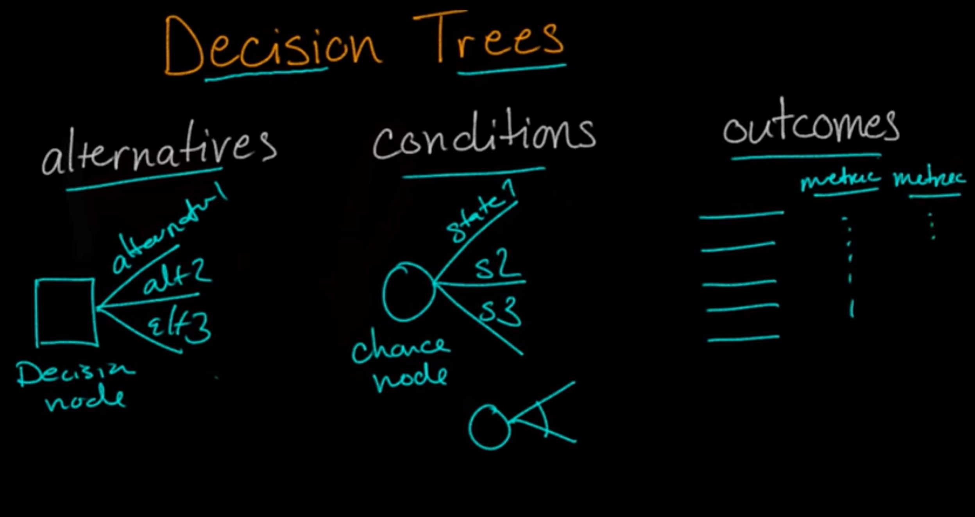
Using Decision Trees for Risk Analysis
https://www.youtube.com/watch?v=-f5I99Q9hwY

Slide 29
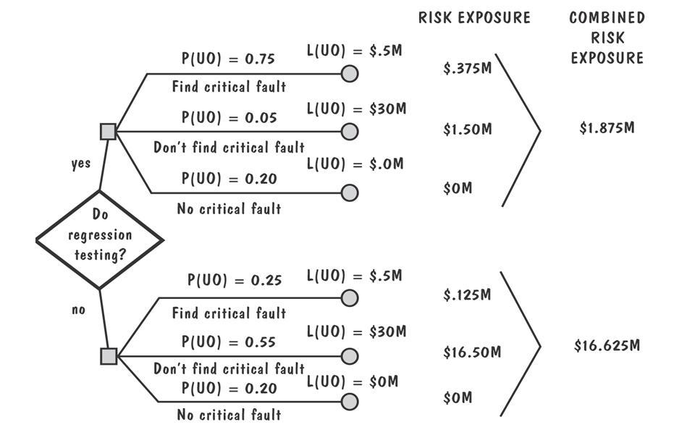
Risk Management Activities
Example of risk exposure/arise calculation
  PU: prob. of unwanted result
  LU: lost if the unwanted result observed
CONDITIONS
There is
ctitical fault
NO
ctitical fault
REGRESSION TESTING is defined as a type of software testing to confirm that a recent program/code change has not adversely affected existing features.
Find
Not
Find

Slide 30
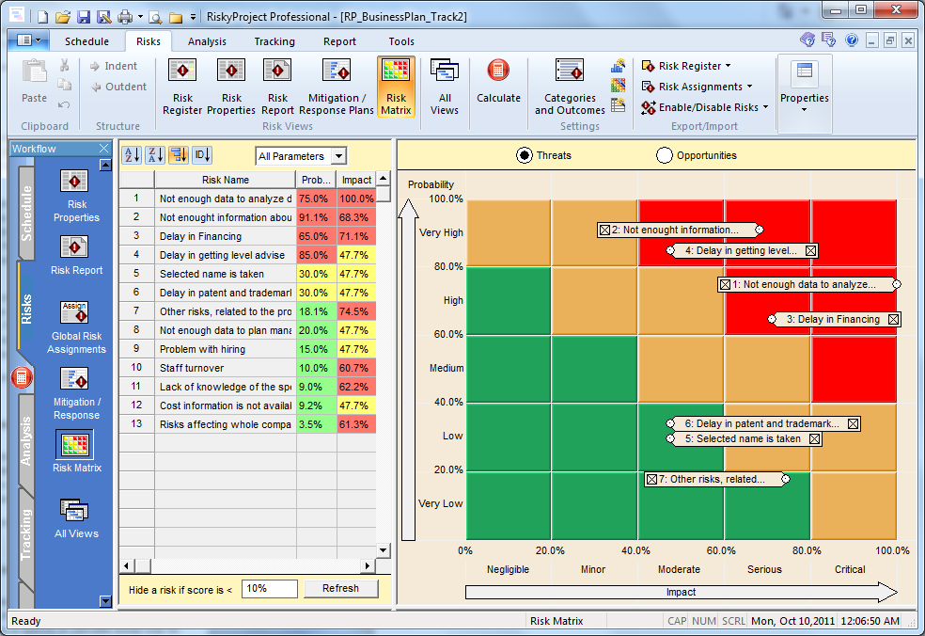
Risk Registers & Risk Matrix

Slide 31
Managing people

Slide 32
Managing people
People are an organisation’s most important assets.
The tasks of a manager are essentially people-oriented.
  Management will be difficult without understanding people.
Failure in managing people makes a significant contribution to the failure of the project.

Slide 33
People management factors
Consistency
  Team members should all be treated equally!
  Should no favourites or discrimination in team members (favoriler/ayrımcılık olmamalı).
Respect
  Different team members may have different skills and these differences should be respected.
Inclusion
  Involve all team members and make sure that people’s opinions are considered and have a value.
Honesty
  You should always be honest about:
    what is going well and
    what is going bad in the project.

Slide 34
Motivating people
An important role of a manager is to motivate the people working on a project.
Motivation means organizing the work and the working environment to encourage people to work effectively.
  If people are not motivated, they will not be interested in the work they are doing.
  They will work slowly, be more likely to make mistakes and will not contribute to the goals of the team or the organization.
Motivation is a complex issue
There are different types of motivation factors based on:
  Basic needs (e.g. food, sleep, etc.);
  Social needs (e.g. to be accepted as part of a group).
  Personal needs (e.g. respect, self-esteem);

Slide 35
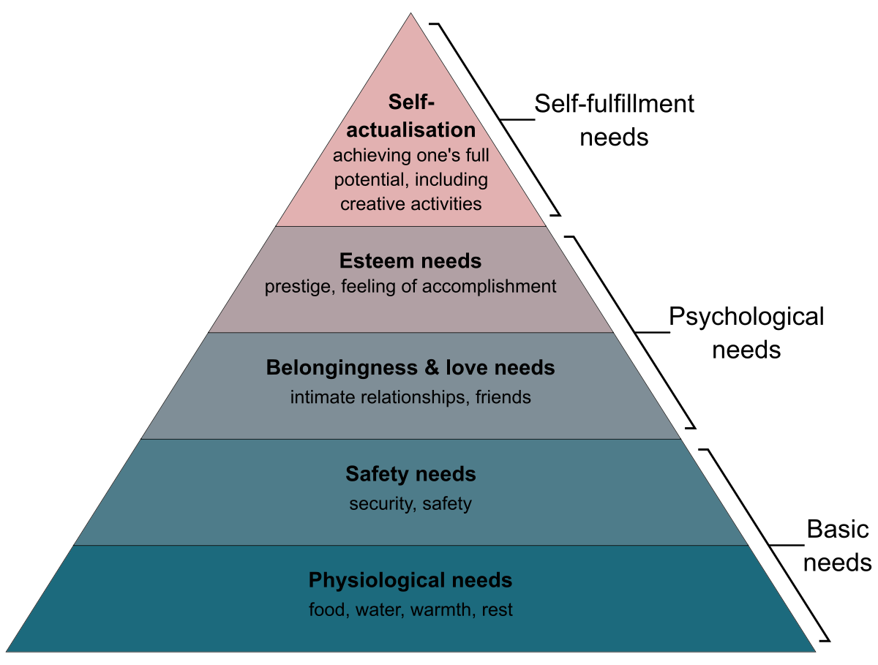
Human needs hierarchy
In software development teams,
basic needs (physiological & safety) are not an issue.

Slide 36
Need satisfaction
Social needs:
  What you can do for your team?
  Provide communal facilities / common areas for your team;
  Allow informal communications e.g. via social networking
Esteem needs
  Recognition of individuals achievements;
  Give appropriate rewards.
Self-realization needs
  Allow Training – people may want to learn more;
  Give responsibility.

Slide 37
Case study: Individual motivation
Alice is a software project manager working in a company that develops alarm systems. This company wishes to enter the growing market of assistive technology to help elderly and disabled people live independently. Alice has been asked to lead a team of 6 developers than can develop new products based around the company’s alarm technology.
Alice’s assistive technology project starts well. Good working relationships develop within the team and creative new ideas are developed. The team decides to develop a peer-to-peer messaging system using digital televisions linked to the alarm network for communications. However, some months into the project, Alice notices that Dorothy, a hardware design expert, starts coming into work late, the quality of her work deteriorates and, increasingly, that she of the team does not appear to be communicating with other members
Alice talks about the problem informally with other team members to try to find out if Dorothy’s personal circumstances have changed, and if this might be affecting her work. They don’t know of anything, so Alice decides to talk with Dorothy to try to understand the problem.
Notes:
Just let student’s read this. Don’t try to read it out in class. Talk around the issues discussed in the book.

Slide 38
Case study: Individual motivation
After some initial denials that there is a problem, Dorothy admits that she has lost interest in the job. She expected that she would be able to develop and use her hardware interfacing skills. However, because of the product direction that has been chosen, she has little opportunity for this. Basically, she is working as a C programmer with other team members.
Although she admits that the work is challenging, she is concerned that she is not developing her interfacing skills. She is worried that finding a job that involves hardware interfacing will be difficult after this project. Because she does not want to upset the team by revealing that she is thinking about the next project, she has decided that it is best to minimize conversation with them.

Slide 39
Comments on case study
If you don’t solve the problem of unacceptable work (like Dorothy effort), the other group members will become dissatisfied and feel that they are doing an unfair share of the work.
Personal difficulties affect motivation because people can’t concentrate on their work.
They need time and support to resolve these issues,
  Although you should clearly say them that they still have a responsibility to their firm/employer.
A SOLUTION FOR THE SCENARIO:
Alice gives Dorothy more design autonomy and
Alice also organizes some training courses in software engineering that will give her more opportunities after her current project has finished.

Slide 40
Personality types
Motivation considers different personality types:
TASK-ORIENTED PEOPLE:
  They are motivated by the work they do.
  For this type of people, the motivation for doing the work is the work itself.
INTERACTION-ORIENTED PEOPLE:
  They are motivated by the presence and actions of co-workers.
  People go to work because they like to go to
  work.
SELF-ORIENTED PEOPLE:
  They are principally motivated by personal success and recognition.
  Work is a means to an end/a finish point which is the achievement of individual goals - e.g. to get rich, to play tennis, to travel etc.

Slide 41
Teamwork

Slide 42
Teamwork
Most software engineering is a group activity
  Significant software projects cannot be completed by a single person.
A good group is consistent and has a team spirit.
  The people involved are motivated by the success of the group as well as by their own personal goals.
Group interaction is a key factor of group performance.
Flexibility in group composition is limited.
  Managers must do the best they can with available people.

Slide 43
Group cohesiveness (Grup bağlılığı)
Team members consider the group to be more important than any individual in the team.

Slide 44
The advantages of a consistent group are:
Team members learn from each other and get to know each other’s work.
Knowledge is shared. So, continuity can be preserved if a group member leaves.
Refactoring and continual improvement is encouraged.
Group members work collectively to deliver high quality results and fix problems, without considering the individuals who originally created the design or program.
Group quality standards can be developed by the group members.

Slide 45
Team spirit
Alice, an experienced project manager, understands the importance of creating a cohesive group. As they are developing a new product, she takes the opportunity of involving all group members in the product specification and design by getting them to discuss possible technology with elderly members of their families. She also encourages them to bring these family members to meet other members of the development group.
Alice also arranges monthly lunches for everyone in the group. These lunches are an opportunity for all team members to meet informally, talk around issues of concern, and get to know each other. At the lunch, Alice tells the group what she knows about organizational news, policies, strategies, and so forth. Each team member then briefly summarizes what they have been doing and the group discusses a general topic, such as new product ideas from elderly relatives.
Every few months, Alice organizes an ‘away day’ for the group where the team spends two days on ‘technology updating’. Each team member prepares an update on a relevant technology and presents it to the group. This is an off-site meeting in a good hotel and plenty of time is scheduled for discussion and social interaction.
Notes:
Same as before – best not to read this out. Talk around the issues after students have had 2 minutes to read it.

Slide 46
The effectiveness of a team
The people in the group
  You need a MIX TYPE OF PEOPLE in a group as software development projects involves various activities such as negotiating with clients, programming, testing and documentation.
The group organization
  A group should be ORGANIZED so that individuals can contribute to the best of THEIR ABILITIES AND TASKS can be completed as expected.
Technical and managerial communications
  GOOD COMMUNICATION is essential: between group members, and between the software engineering team and other project stakeholders.

Slide 47
Selecting group members
A manager/team leader’s job is to create a cohesive group so that they can work together effectively.
When creating a cohesive group, the right balance of technical skills and personalities must be considered.

Slide 48
Assembling a team
Sometimes, may not be possible to hire the ideal people to work on your project. Because,
  Project budget may not allow for the use of highly-paid staff;
  Staff with the appropriate experience may not be available;
  An organisation may wish to develop employee skills on a software project.
Managers have to work within these constraints especially when there are shortages of trained staff.

Slide 49
Group composition
Group members who share the same motivation can be problematic due to:
  Task-oriented - everyone wants to do their own thing/work;
  Self-oriented - everyone wants to be the boss;
  Interaction-oriented - too much chatting, not enough work.
Therefore, an effective group should have a balance of all types.
Balance in software teams can be difficult because software engineers are often task-oriented.
Interaction-oriented people are very important due to they can detect and resolve problems/tensions in team members if arise.

Slide 50
Group composition
In creating a group for assistive technology development, Alice is aware of the importance of selecting members with complementary personalities. When interviewing potential group members, she tried to assess whether they were task-oriented, self-oriented, or interaction-oriented.
She felt that she was primarily a self-oriented type because she considered the project to be a way of getting noticed by senior management and possibly promoted. She therefore looked for one or perhaps TWO INTERACTION-ORIENTED personalities, with TASK-ORIENTED INDIVIDUALS to complete the team. The final assessment that she arrived at was:
Alice—self-oriented
Brian—task-oriented
Bob—task-oriented
Carol—interaction-oriented
Dorothy—self-oriented
Ed—interaction-oriented
Fred—task-oriented
Notes:
Same as before – discuss the issues around this rather than reading it out.

Slide 51
Group organization
Group organization is critical activity and effects:
  the all decisions taken by the group,
  information sharing and
  the interaction between the development team and project stakeholders.
Key questions include:
    Should the project manager be the technical leader of the group?
    Who will be involved in making critical technical decisions, and how will these be made?
    How will interactions with stakeholders and senior company management be handled?
    How can knowledge be shared across the group?

Slide 52
Group organization
Small software engineering groups are usually organised informally.
For large software projects, there may be a hierarchical structure where different teams are responsible for different sub-projects.
Agile development is always based around an informal group on the principle →because formal structure avoid information exchange in team.

Slide 53
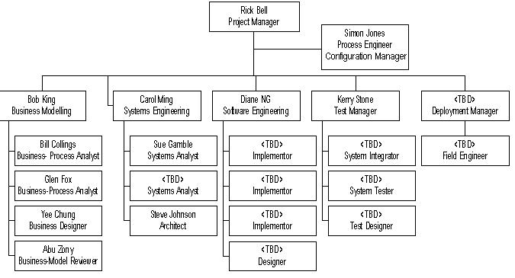
Example group organization

Slide 54
Informal groups
The group acts as a whole
There is consensus in team on decisions affecting the system.
The group leader serves as the external interface of the group but does not allocate specific work items.
Rather, work is discussed by the group as a whole and tasks are allocated according to ability and experience.
This approach is successful for groups where all members are experienced and capable.
Notes:
Grup lideri, grubun dış arayüzü olarak görev yapar, ancak belirli iş kalemleri tahsis etmez

Slide 55
Group communications
Good communications are essential for effective group working.
Information must be shared on the status of work, design decisions and changes to previous decisions.
Good communications also rise group consistency due to it helps understanding between team members.

Slide 56
Factors effect group communications
Group size
  The larger the group, it is harder to communicate for people with other group members.
Group structure
  Communication is better in INFORMALLY STRUCTURED GROUPS than in HIERARCHICALLY STRUCTURED GROUPS.
Group composition
  Communication is BETTER when there are DIFFERENT PERSONALITY TYPES in a group and when groups are mixed rather than single sex.
The physical work environment
  GOOD WORKPLACE ORGANISATION can help encourage communications.

Slide 57
Key points
Good project management is essential if software engineering projects are to be developed on schedule and within budget.
Software management is distinct from other engineering management. Software is intangible. Projects may be novel or innovative with no body of experience to guide their management. Software processes are not as mature as traditional engineering processes.
Risk management involves identifying and assessing project risks to establish the probability that they will occur and the consequences for the project if that risk does arise. You should make plans to avoid, manage or deal with likely risks if or when they arise.

Slide 58
Key points
People management involves choosing the right people to work on a project and organizing the team and its working environment.
People are motivated by interaction with other people, the recognition of management and their peers, and by being given opportunities for personal development.
Software development groups should be fairly small and cohesive. The key factors that influence the effectiveness of a group are the people in that group, the way that it is organized and the communication between group members.
Communications within a group are influenced by factors such as the status of group members, the size of the group, the gender composition of the group, personalities and available communication channels.

