Slide 1
Chapter 5- Project planning

Slide 2
Topics covered
Software pricing
Plan-driven development
Project scheduling

Slide 3
Project planning
Project planning involves:
  Breaking down the work into parts and
  Assign these works to project team members,
  Predict problems that might arise and
  Prepare tentative solutions to those problems.
The project plan, which is created at the start of a project, is used to communicate how the work will be done to the project team and customers, and to help assess progress on the project.

Slide 4
Planning stages
You will start to planning at the proposal stage (when you are bidding for a contract to develop a software system).
During the project startup phase, you have to plan:
  who will work on the project,
  how the project will be broken down into increments,
  how resources will be allocated across your company, etc.
Periodically entire the project, you may need to modify your plan in the light of experience gained and information from monitoring works.

Slide 5
Proposal planning
Proposal planning may be necessary with only OUTLINE REQUIREMENTs
Proposal documentation aim is to provide information that will be used in setting a PRICE of the planned system and showing to your customers.
Project pricing involves estimating:
  How much the software will COST to develop, Taking the FACTORS such as staff costs, hardware costs, software costs, etc.

Slide 6
Project startup planning
At this stage, you know more about the system requirements but do not have design or implementation information yet.
Create a plan with enough detail to make decisions about the project budget and staffing.
  This plan is the basis for project resource allocation
The startup plan should also define project monitoring mechanisms
A startup plan is still needed for agile development to allow resources to be allocated to the project

Slide 7
Development planning
The plan should be regularly edited/updated as your project progresses and you know more about the software and its development.
(1) project schedule,
(2) cost-estimate and
(3) risk table have to be regularly revised!!!

Slide 8
Software pricing

Slide 9
Software pricing
Estimates are made to discover the cost, to the developer, of producing a software system.
  You take into account, hardware, software, travel, training and effort costs.
There is not a simple relationship between the development cost and the price charged to the customer.
Broader organisational, economic, political and business considerations effect THE PRICE CHARGED for the planned project.

Slide 10
Pricing strategies
Assume that you will propose a price to a customer firm for developing a software project, what will be your strategy?
Under pricing (if you offer a low price)
  REASONS FOR UNDER PRICING:
    Your SW company can support that project to win the contract that allows them to hire/keep their IT staff for future opportunities.
    Your SW company can support the system to win the contract that allows to gain access to a new market area.
Increased pricing (if you offer a high price)
  REASONS FOR INCREASED PRICING:
    The price may be increased when the customer firm wishes a fixed-price contract and so your SW company can increase the price to prevent themselves unexpected risks.

Slide 11
Pricing to win
The software project is priced according to what the software company believes the buyer is willing to pay.
If this is less that the development costs (bid cost < dev cost), the software functionality may be reduced accordingly with a view to extra functionality being added in a later release
Additional costs may be added as the requirements change and these may be priced at a higher level to make up the shortfall in the original price.

Slide 12
Plan-driven development

Slide 13
Plan-driven development
Plan-driven or plan-based development is an approach to software engineering where the development process is planned in detail.
A project plan is created that records the work to be done, who will do it, the development schedule and the work products.
Managers use the plan to support project decision making and as a way of measuring progress.

Slide 14
Project plans
In a plan-driven development project, a project plan presents
  The resources available to the project,
  The work breakdown and
  A schedule for carrying out the work.
Plan sections (remember your first report: PPM)
  Introduction
  Project organization
  Risk analysis
  Hardware and software resource requirements
  Work breakdown
  Project schedule
  Monitoring and reporting mechanisms

Slide 15
Project plan supplements
Plan | Description
Configuration management plan | Describes the configuration management procedures and structures to be used.
Deployment plan | Describes how the software and associated hardware (if required) will be deployed in the customer’s environment. This should include a plan for migrating data from existing systems.
Maintenance plan | Estimations of the maintenance requirements, costs, and effort.
Quality plan | Describes the quality procedures and standards that will be used in a project.
Validation plan | Describes the approach, resources, and schedule used for system validation.

Slide 16
The planning process
Project planning is an iterative process that starts when you create an initial project plan during the project startup phase.
Plan changes are inevitable.
  As more information about the system and the project team becomes available during the project, you should regularly revise the plan to reflect requirements, schedule and risk changes.
  Changing business goals also leads to the changes in project plans.
  As business goals change, this could affect all projects, which may then have to be re-planned.

Slide 17
The project planning process

Slide 18
Planning assumptions
You should make realistic rather than optimistic assumptions when you are defining a project plan.
Problems will always arise during a project, and these causes project delays.
Your initial assumptions and scheduling should also consider unexpected problems.
You should include contingency in your plan so that if things go wrong, then your product delivery schedule is not seriously disrupted.

Slide 19
Risk mitigation
If there are serious problems during the development work that are likely to cause significant delays, you need to initiate risk mitigation actions to reduce the risks of project failure.
When you perform these risk mitigation actions, you also have to re-plan the project.
  e.g. for a HW & SW project, you can order two sensors instead of ordering one. Because one of them may not work
This may involve renegotiating about the project constraints and deliverables with your customer.
A new schedule of when work should be completed also has to be prepared and agreed with the customer.

Slide 20
Project scheduling

Slide 21
Project scheduling
Project scheduling is the process of deciding how the work in a project will be organized as separate tasks, and when and how these tasks will be executed.
You estimate the calendar time needed to complete each task, the effort required and who will work on the tasks that have been identified.
You also have to estimate the resources needed to complete each task, such as;
The disk space required on a server,
The time required to order of a specialized hardware, e.g. sensors, a simulator, and
What the travel budget will be.

Slide 22
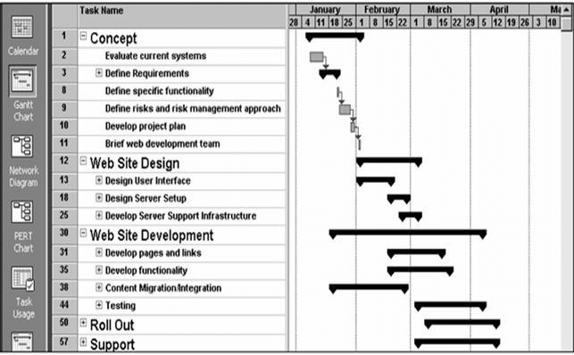
Project scheduling activities
Split project into tasks and estimate time and resources required to complete of each task.
Organize tasks concurrently to make optimal
use of workforce.
Minimize task dependencies to avoid delays
caused by one task waiting for another to complete.
Scheduling dependent on project managers intuition and experience.

Slide 23
The project scheduling process

Slide 24
Schedule presentation methods
Graphical notations are normally used to illustrate the project schedule.
These show the project breakdown into tasks.
Tasks should not be too small.
  They should take about a week or two.
2. Calendar-based
  Bar charts are the most well known representation for schedules.
  They show the schedule as activities or resources against time.
3. Activity networks
  Show task dependencies

Slide 25
Project activites
Project activities (tasks) are the basic planning element. Each activity has:
  A duration in calendar days or months,
  An effort estimate, which shows the number of person-days or person-months to complete the work,
  A deadline by which the activity should be complete,
  A defined end-point, which might be a document, the holding of a review meeting, the successful execution of all tests, etc.

Slide 26
Milestones and deliverables
Milestones are the points in the plan where you can evaluate progress, for example, the handover of the system for testing.
Deliverables are work products that are delivered to the customer, e.g. a requirements document (SRS) for the system.

Slide 27
Tasks, durations, and dependencies
Task | Effort (person-days) | Duration (days) | Dependencies
T1 | 15 | 10
T2 | 8 | 15
T3 | 20 | 15 | T1 (M1)
T4 | 5 | 10
T5 | 5 | 10 | T2, T4 (M3)
T6 | 10 | 5 | T1, T2 (M4)
T7 | 25 | 20 | T1 (M1)
T8 | 75 | 25 | T4 (M2)
T9 | 10 | 15 | T3, T6 (M5)
T10 | 20 | 15 | T7, T8 (M6)
T11 | 10 | 10 | T9 (M7)
T12 | 20 | 10 | T10, T11 (M8)

Slide 28
Activity network
25.04.22
12.05.22
M4
T6 5
M5
T9 15
18.04.22
M1
06.06.22
04.04.22
T1 10
T3 15
M7
start
25.04.22
27.05.22
T2 15
M3
M6
T11 10
T5 10
18.04.22
T4 10
M2
T7 20
T10 15
L1=10+5+15+10+10=50
L2=10+15+15+10+10=60
L3=10+20+15+10=55
L4=15+5+15+10+10=55
L5=15+10=25
L6=10+10=20
L7=10+25+15+10=60
T8 25
20.06.22
M8
04.07.22
finish
T12 10
P1=(T1,T6,T9,T11,T12);P2=(T1,T3,T9,T11,T12); P3=(T1,T7,T10,T12),P4=(T2,T6,T9,T11,T12), P5=(T2,T5),P6=(T4,T5), P7=(T4,T8,T10,T12)

Slide 29
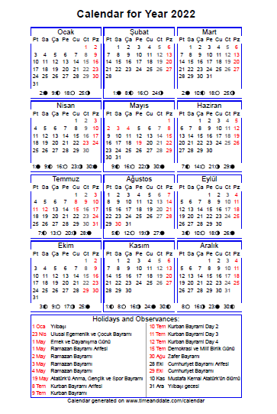

Slide 30
Activity bar chart

Slide 31
Staff allocation chart

Slide 32
GANTT CHART on MS Project or OPEN Project
Here Gantt chart is in Microsoft Project tool.

Slide 33
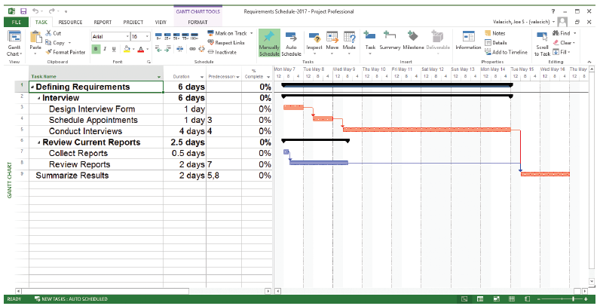
Developing a Preliminary Schedule
hierarchy of tasks, subtasks,
sub-subtasks, , summary tasks, durations and dependencies, etc
WBS
FIGURE 3-10. Gantt chart showing project tasks, duration times for those tasks, and predecessors (Source: Microsoft Corporation.). You can use either the WBS of the Gantt chart or both as you set up the project Schedule!
Notes:
This is a typical Microsoft Project screen. The left part of this screen is a Work Breakdown Structure (WBS), which shows the hierarchy of tasks, subtasks, sub-subtasks, etc. The boldfaced tasks are summary tasks, and their durations are based on the durations and dependencies of their subtasks. MS Project automatically calculates project duration based on how you set the task durations and dependencies.
The durations and dependencies between these tasks are shown graphically in the Gantt chart to the right. You can use either the WBS of the Gantt chart or both as you set up the project schedule.

Slide 34
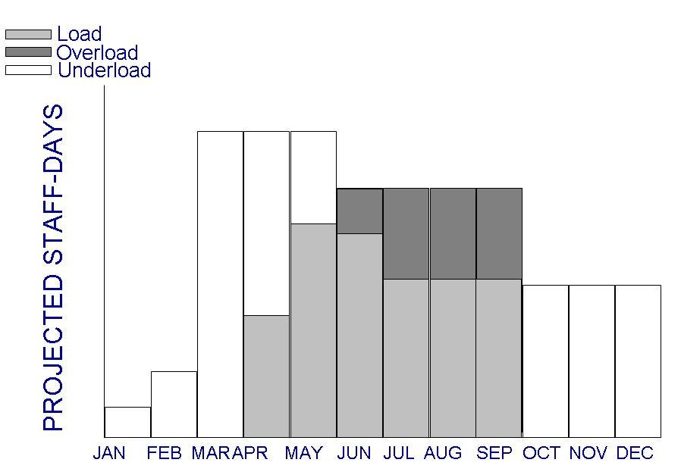
Tools: Resources on Histogram
Shows people assigned to the project and those needed for each stage of development

Slide 35
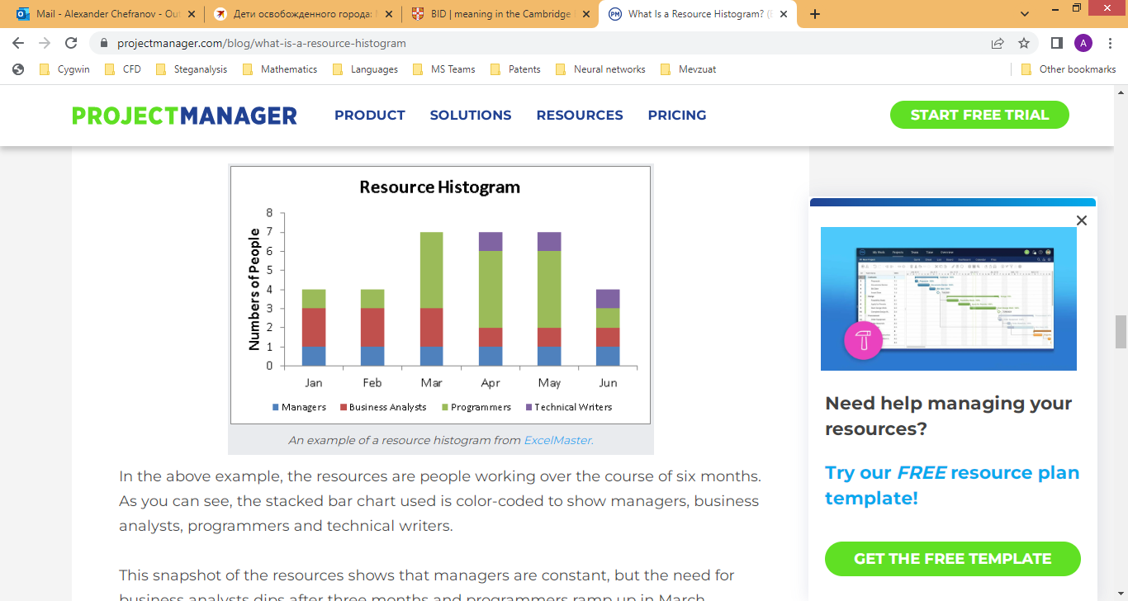

Slide 36
Learn GANTT CHART via MS PROJECT: https://www.youtube.com/watch?v=sSS1tu1yQ-Q

Slide 37
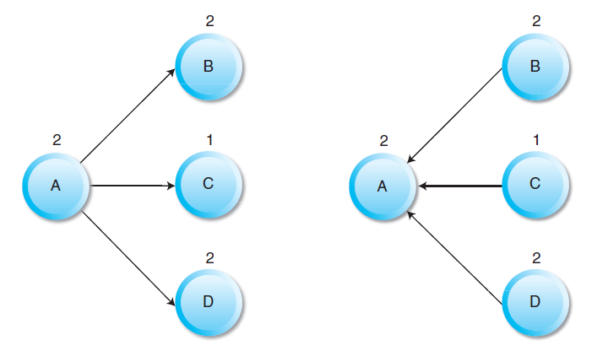
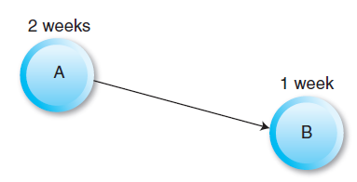
USING ACTIVITY NETWORKS FOR SCHEDULING
Precedence Diagramming Method (PDM)

Slide 38
Precedence Diagramming Method (PDM)
Activity: a specific task or set of tasks that is part of the scope of a project
Path: sequence of activities
Event: Beginning and End of activity
LS: Late Start time ES: Early Start time -----FORWARD PASS
LF: Late Finish time EF: Early Finish time ---BACKWARD PASS
Slack: Amount of play in the system;
Difference between critical path time and time required for a given path.
=LS-ES or LF-EF
Crashing: reducing overall time required to complete project
  It includes the cost of additional resources to complete the project in less time.

Slide 39
EXAMPLE 1

Slide 40
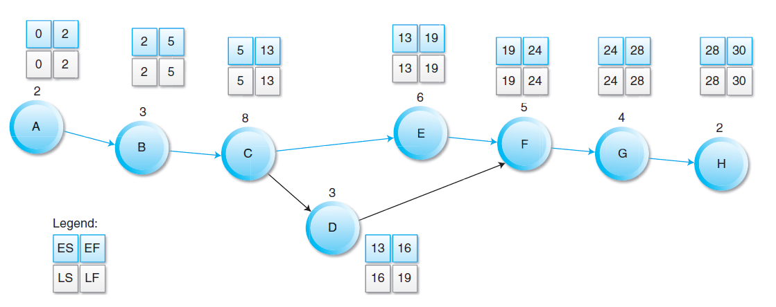
Network Example
Activity | Description | Activity Predecessor | Duration (Weeks)
A | Scope documentation |  | 2
B | Project planning | A | 3
C | Buy materials | B | 8
D | Prototype design | C | 3
E | Prototype analysis | C | 6
F | Prototype implementation | D, E | 5
G | Testing of prototype | F | 4
H | Presenting prototype to customer | G | 2
Max
=LS-ES or LF-EF
EF→ES
Slack: 3 weeks (16-13) or (19-16)
Critical Path: A-B-C-E-F-G-H

Slide 41
Network Example
Activity | Description | Activity Predecessor | Duration (Weeks)
A | Scope documentation |  | 2
B | Project planning | A | 3
C | Buy materials | B | 8
D | Prototype design | C | 3
E | Prototype analysis | C | 6
F | Prototype implementation | D, E | 5
G | Testing of prototype | F | 4
H | Presenting prototype to customer | G | 2
Min
=LS-ES or LF-EF
LF←LS
3
3
Slack: 3 weeks (16-13) or (19-16)
Critical Path: A-B-C-E-F-G-H

Slide 42
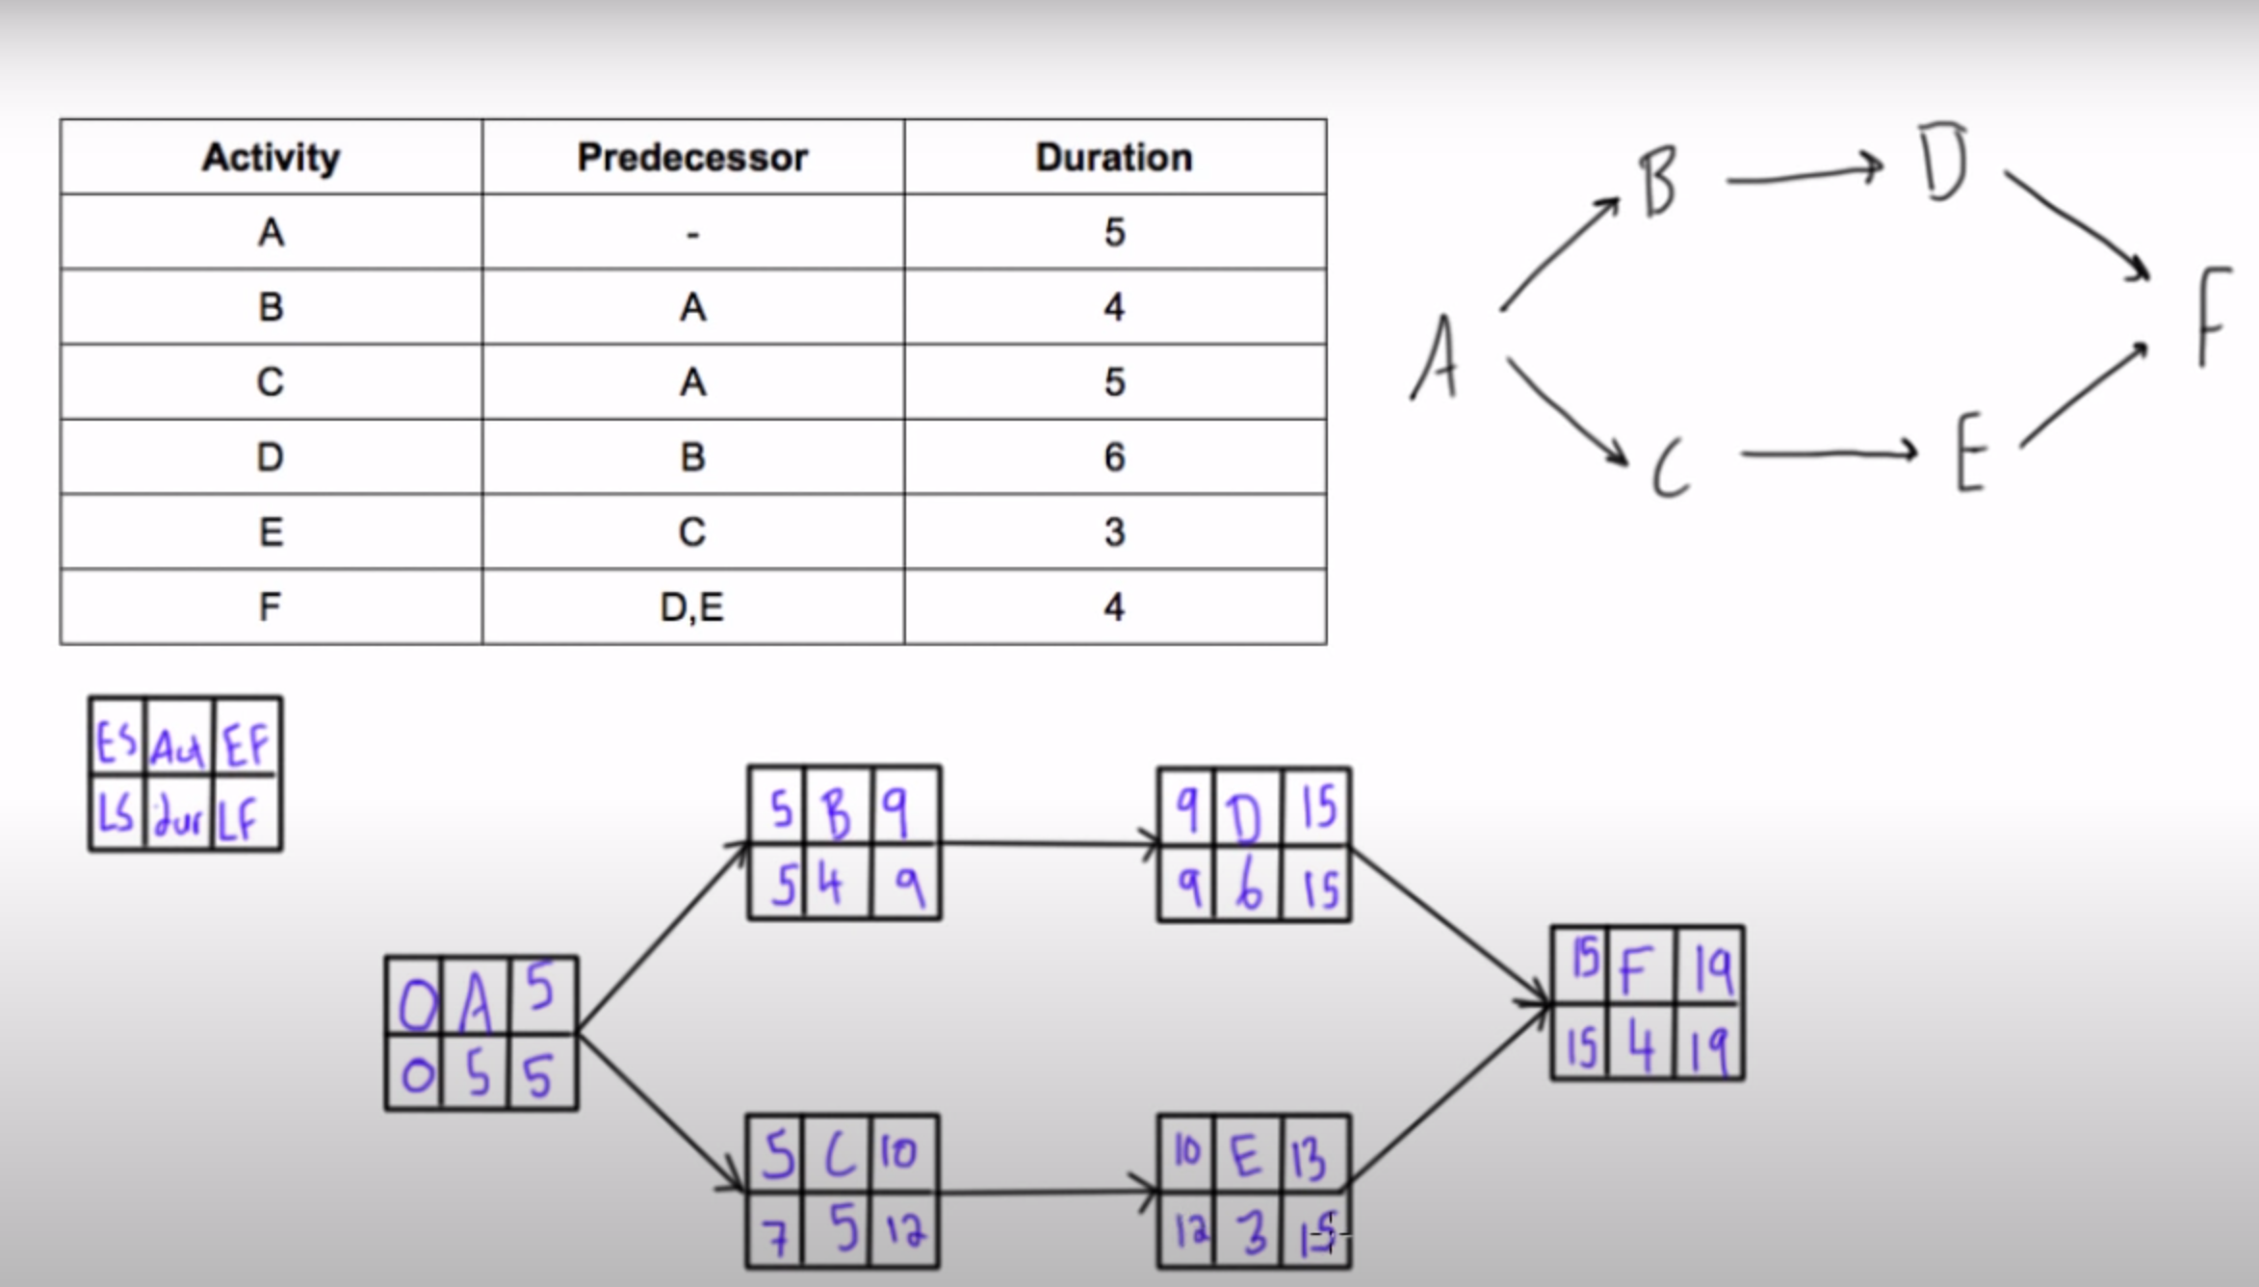
Calculate Slack Time
https://www.youtube.com/watch?v=GRlXRYok3oQ
https://www.youtube.com/watch?v=bobDz_Bh3tI

Slide 43
EXAMPLE 2

Slide 44
CPM Example
Solve the following questions for the given WBS in below.
Tasks | Description | Predicates | Estimated Duration
Task A | Requirements Collection | - | 4
Task B | Screen Design | A | 6
Task C | Report Design | A | 2
Task D | Database Design | A | 3
Task E | User Documentation | B, C | 5
Task F | Programming | D | 6
Task G | Testing | F | 6
Task H | Maintenance | G, J | 3
Task J | Project Close | E | 7

Slide 45
Full Critical Path Calculation Example (Cont.)
Draw its Network Diagram?
B,6
E,5
J,7
A,4
C,2
H,3
G,6
F,6
D,3
Tasks | Description | Predicates | Estimated Duration
Task A | Requirements Collection | - | 4
Task B | Screen Design | A | 6
Task C | Report Design | A | 2
Task D | Database Design | A | 3
Task E | User Documentation | B, C | 5
Task F | Programming | D | 6
Task G | Testing | F | 6
Task H | Maintenance | G, J | 3
Task J | Project Close | E | 7

Slide 46
Full Critical Path Calculation Example (Cont.)
Find ES, EF, LF, and Slack Times for each activity according to estimated time?
B,6
E,5
J,7
A,4
C,2
H,3
G,6
F,6
D,3
Tasks | Description | Predicates | Estimated Duration | ES | EF | LF | Slack Time
Task A | Requirements Collection | - | 4 | ? | ? | ? | ?
Task B | Screen Design | A | 6 | ? | ? | ? | ?
Task C | Report Design | A | 2 | ? | ? | ? | ?
Task D | Database Design | A | 3 | ? | ? | ? | ?
Task E | User Documentation | B, C | 5 | ? | ? | ? | ?
Task F | Programming | D | 6 | ? | ? | ? | ?
Task G | Testing | F | 6 | ? | ? | ? | ?
Task H | Maintenance | G, J | 3 | ? | ? | ? | ?
Task J | Project Close | E | 7 | ? | ? | ? | ?

Slide 47
Full Critical Path Calculation Example (Cont.)
Find ES, EF, LF, and Slack Times for each activity according to estimated time?
4 | B | 10
4 | 6 | 10
10 | E | 15
10 | 5 | 15
15 | J | 22
15 | 7 | 22
0 | A | 4
0 | 4 | 4
B,6
E,5
J,7
22 | H | 25
22 | 3 | 25
A,4
4 | C | 6
8 | 2 | 10
C,2
H,3
G,6
F,6
4 | D | 7
7 | 3 | 10
D,3
13 | G | 19
16 | 6 | 22
7 | F | 13
10 | 6 | 16
Slack Time=LS-ES or LF-EF
Tasks | Description | Predicates | Estimated Duration | ES | EF | LF | Slack Time
Task A | Requirements Collection | - | 4 | 0 | 4 | 4 | 0
Task B | Screen Design | A | 6 | 4 | 10 | 10 | 0
Task C | Report Design | A | 2 | 4 | 6 | 10 | 4
Task D | Database Design | A | 3 | 4 | 7 | 10 | 3
Task E | User Documentation | B, C | 5 | 10 | 15 | 15 | 0
Task F | Programming | D | 6 | 7 | 13 | 16 | 3
Task G | Testing | F | 6 | 13 | 19 | 22 | 3
Task H | Maintenance | G, J | 3 | 22 | 25 | 25 | 0
Task J | Project Close | E | 7 | 15 | 22 | 22 | 0

Slide 48
Full Critical Path Calculation Example (Cont.)
Compute estimated completion time of each path?
Show its Critical Path(s), and which tasks are on the Critical Path(s)?
B,6
E,5
J,7
A,4
C,2
G,6
H,3
F,6
D,3
Paths | Calculations | Total Estimated Path Duration
ABEJH | 4+6+5+7+3 | 25 C.P
ACEJH | 4+2+5+7+3 | 21
ADFGH | 4+3+6+6+3 | 22

Slide 49
APPLY
PERT
TO FIND
EXPECTED TIME
OF EACH TASK & PATHS

Slide 50
Estimating Task Duration
PERT: Program Evaluation and Review Technique
Provides a simple formula to estimate the time for a task based on our “optimistic”, “realistic”, and “pessimistic” judgments.
Technique that uses:
  optimistic (o),
  pessimistic (p), and
  realistic/most likely (r) time
estimates to determine expected task duration
Formula:
Notes:
This is a simple formula to estimate the time for a task based on our “optimistic”, “realistic”, and “pessimistic” judgments. Each of the detailed tasks in a project can be estimated this way.

Slide 51
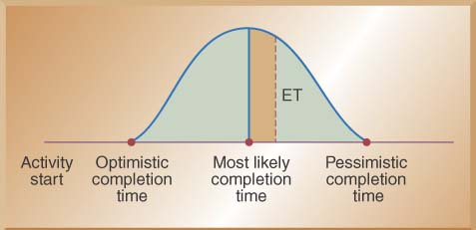
Using Beta Probability Distribution in PERT
A typical beta distribution is shown below, note that it has definite end points
The expected time for finishing of an activity is a weighted average.

Slide 52
CPM Example
Solve the same question by using PERT.
Tasks | Description | Predicates | Estimated Duration
Task A | Requirements Collection | - | 4
Task B | Screen Design | A | 6
Task C | Report Design | A | 2
Task D | Database Design | A | 3
Task E | User Documentation | B, C | 5
Task F | Programming | D | 6
Task G | Testing | F | 6
Task H | Maintenance | G, J | 3
Task J | Project Close | E | 7
B,6
E,5
J,7
A,4
C,2
G,6
H,3
F,6
D,3

Slide 53
Full Critical Path Calculation Example (Cont.)
Calculate the expected time for each activity and each path according to PERT analysis?
Write the PERT Expected Time formula? ET=(O+4R+P)/6
Tasks | Predicates | O (min) | M (most likely) | P (max) | Duration (Expected Time)
Task A | - | 2 | 4 | 6 | ?
Task B | A | 3 | 6 | 9 | ?
Task C | A | 1 | 2 | 5 | ?
Task D | A | 2 | 3 | 7 | ?
Task E | B, C | 3 | 5 | 8 | ?
Task F | D | 3 | 6 | 10 | ?
Task G | F | 3 | 6 | 8 | ?
Task H | G, J | 1 | 3 | 6 | ?
Task J | E | 4 | 7 | 10 | ?

Slide 54
Full Critical Path Calculation Example (Cont.)
Draw its new Network Diagram based on the expected time found after PERT Analysis?
Tasks | Predicates | O (min) | M (most likely) | P (max) | Duration (Expected Time)
Task A | - | 2 | 4 | 6 | 4,00
Task B | A | 3 | 6 | 9 | 6,00
Task C | A | 1 | 2 | 5 | 2,33
Task D | A | 2 | 3 | 7 | 3,50
Task E | B, C | 3 | 5 | 8 | 5,17
Task F | D | 3 | 6 | 10 | 6,17
Task G | F | 3 | 6 | 8 | 5,83
Task H | G, J | 1 | 3 | 6 | 3,17
Task J | E | 4 | 7 | 10 | 7,00
Expected Time = (1o + 4r + 1p)/6
B,?
E,?
J,?
A,?
C,?
H,?
G,?
F,?
D,?

Slide 55
Full Critical Path Calculation Example (Cont.)
Draw its new Network Diagram based on the expected time found after PERT Analysis?
Tasks | Predicates | O (min) | M (most likely) | P (max) | Duration (Expected Time)
Task A | - | 2 | 4 | 6 | 4,00
Task B | A | 3 | 6 | 9 | 6,00
Task C | A | 1 | 2 | 5 | 2,33
Task D | A | 2 | 3 | 7 | 3,50
Task E | B, C | 3 | 5 | 8 | 5,17
Task F | D | 3 | 6 | 10 | 6,17
Task G | F | 3 | 6 | 8 | 5,83
Task H | G, J | 1 | 3 | 6 | 3,17
Task J | E | 4 | 7 | 10 | 7,00
Expected Time = (1o + 4r + 1p)/6
B,6
E,5.17
J,7
A,4
C,2.33
H,3.17
G,5.83
F,6.17
D,3.503

Slide 56
Full Critical Path Calculation Example (Cont.)
Compute estimated completion time of each path?
Show its Critical Path(s), and which tasks are on the Critical Path(s)?
B,6
E,5.17
J,7
A,4
C,2.33
H,3.17
G,5.83
F,6.17
D,3.503
Paths | Calculations | Total Estimated Path Duration
ABEJH | 4+6+5.17+7+3.17 | 25.34 C.P.
ACEJH | 4+2.33+5.17+7+3.17 | 21.67
ADFGH | 4+3.503+6.17+5.83+3.17 | 22.67

Slide 57
EXAMPLE 3

Slide 58
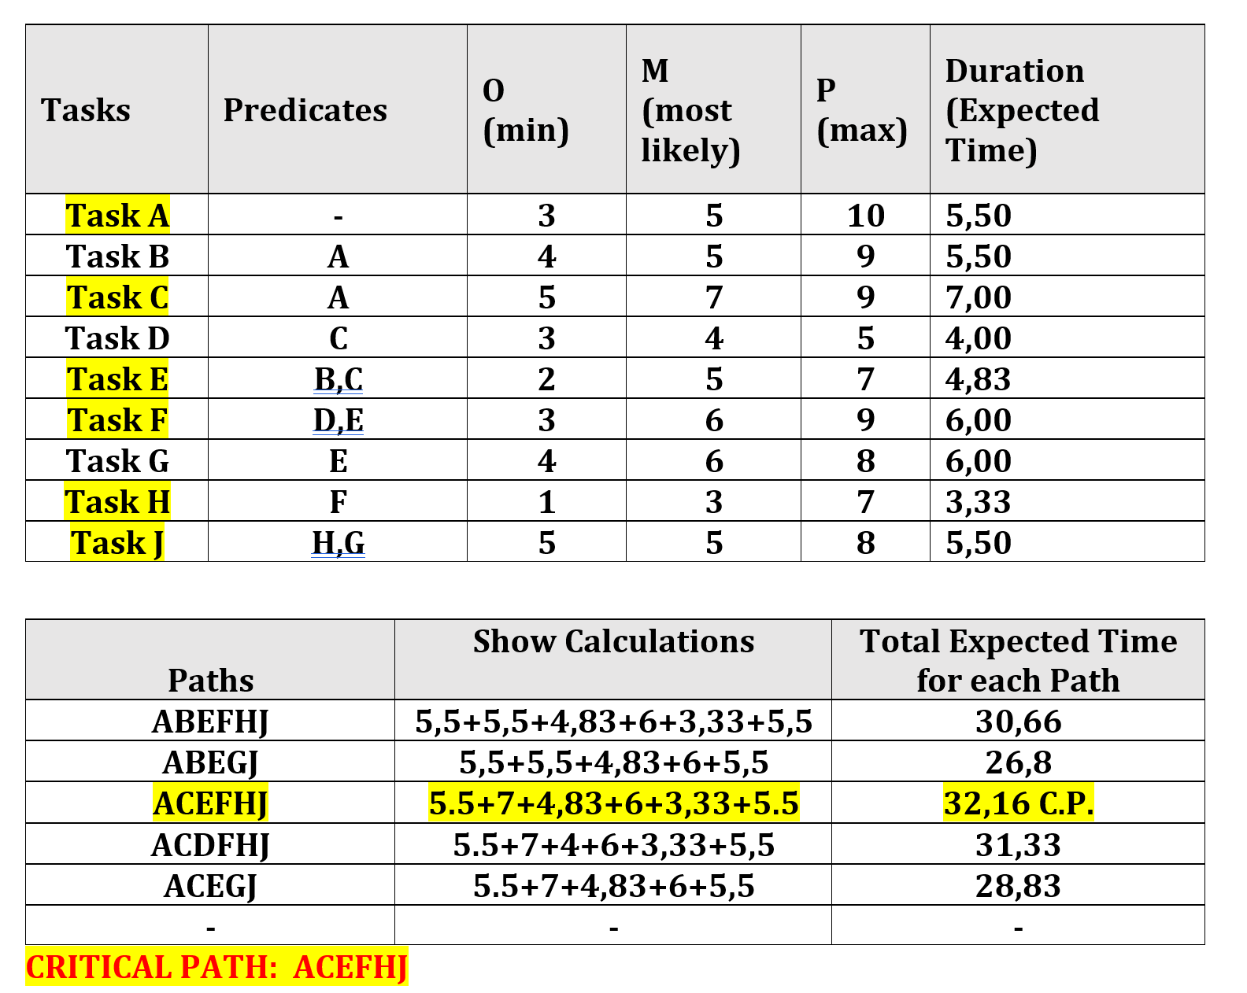
For the following tasks, calculate expected time for each activity and each path according to PERT analysis?
Write the PERT Expected Time formula?

Slide 59
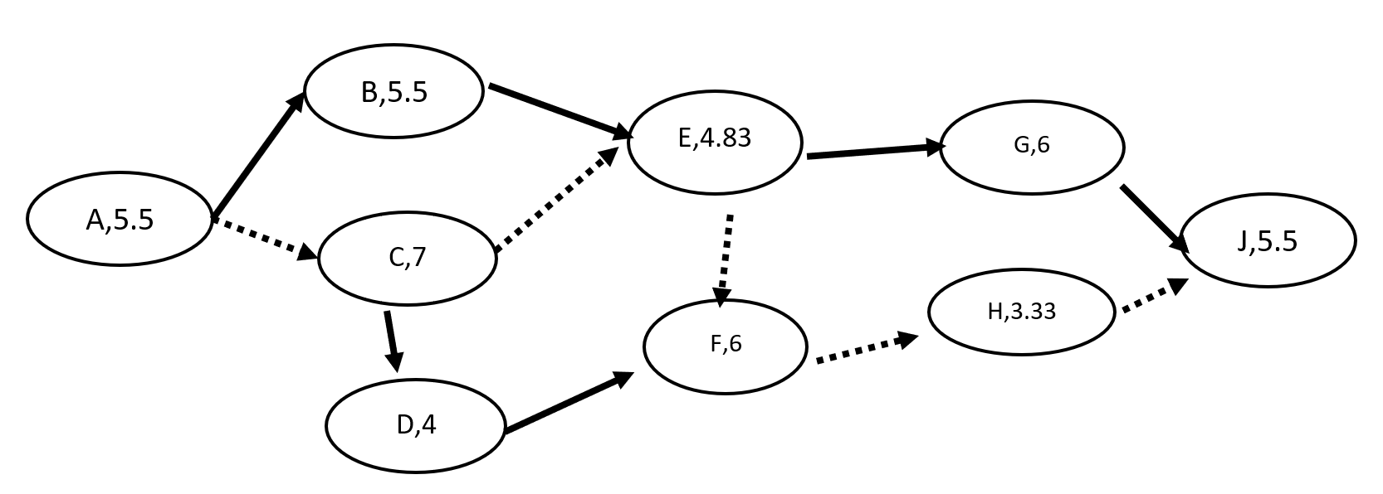
Draw its Network Diagram based on the Expected Time?
Show its Critical Path?

Slide 60
Key points
The price charged for a system does not just depend on its estimated development costs and the profit required by the development company. Organizational factors may mean that the price is increased to compensate for increased risk or decreased to gain competitive advantage.
Software is often priced to gain a contract and the functionality of the system is then adjusted to meet the estimated price.
Plan-driven development is organized around a complete project plan that defines the project activities, the planned effort, the activity schedule and who is responsible for each activity.

Slide 61
Key points
Project scheduling involves the creation of various graphical representations of part of the project plan. Bar charts, which show the activity duration and staffing timelines, are the most commonly used schedule representations.
A project milestone is a predictable outcome of an activity or set of activities. At each milestone, a formal report of progress should be presented to management. A deliverable is a work product that is delivered to the project customer.

