Slide 1
Amplifiers
Lecture-1

Slide 2
1.1 Amplifiers and Amplifier Characteristics
The output signals from Transducers are weak (in microvolts (µV) or milivolts (mV) rage) and posses a very small amoutt of energy.
These signals are generally too small in magnitude to be processed reliably to perform any usefull function. Signal processing is much easier if the magnitude of the signal is large (in the range of volts). Amplifiers are used almost in every electronic system to increase the strength of a weak signal.
An amplifier consist of one or more amplifiying devices and the complexity of an amplifier depends on the number of amplifiying devices.

Slide 3
An amplifier may be considered a two-port network with an input port and output port. Its function is conveniently represented by the circuit symbols in the Fig 1.10 (a). The symbol clearly distinguishes the input and output ports and indicates the direction of the flow of the signal.
A more common situation is illustrated in Fig 1.10 (b), where a common terminal exist between the input and output ports of the amplifier.
(a)
Fig.1.10
(b)

Slide 4

Signal Convention
$I_{C}:DC component or bias value$
$I_{c}:Amplitude of the small −signal or AC component (assumed to be sinosoidal)$
$i_{c}:Instantaneous value of the small −signal or Ac component$
$i_{C}:Total value of the signal i_{C}\left(t\right)=I_{C}+i_{c}(t)$

Slide 5
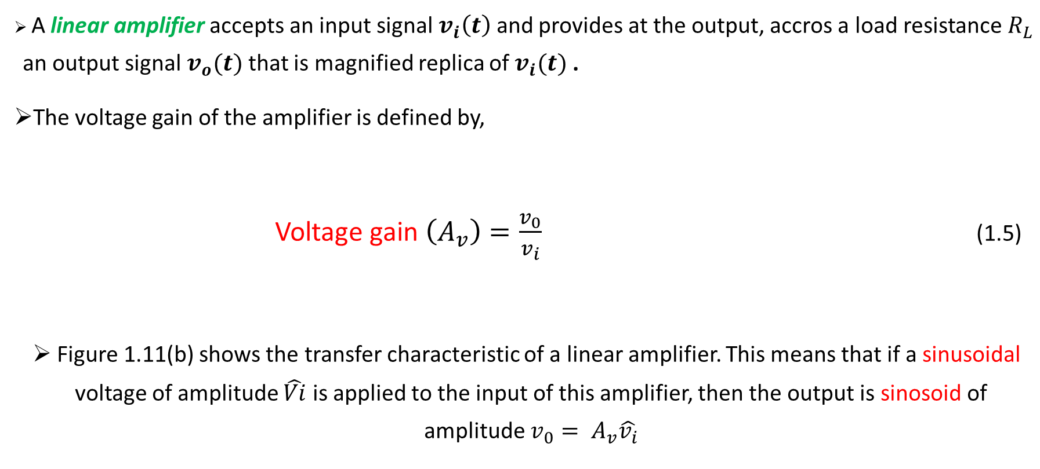
1.1.1 Voltage gain
A linear amplifier accepts an input signal $v_{i}\left(t\right)$ and provides at the output, accros a load resistance $R_{L}$ an output signal $v_{o}(t)$ that is magnified replica of $v_{i}(t)$ .
The voltage gain of the amplifier is defined by,
      Voltage gain $\left(A_{v}\right)=\frac{v_{0}}{v_{i}}$ (1.5)
Figure 1.11(b) shows the transfer characteristic of a linear amplifier. This means that if a sinusoidal voltage of amplitude $\hat{Vi}$ is applied to the input of this amplifier, then the output is sinosoid of amplitude $v_{0}= A_{v}\hat{v_{i}}$

Slide 6

Voltage amplifier
Fig. 1.11 (a) a voltage amplifier fed with a signal $v_{i}\left(t\right)$ and connected to a load resistance $R_{L}$. (b) transfer characteristic of a linear voltage amplifier with voltage gain $A_{v}$

Slide 8
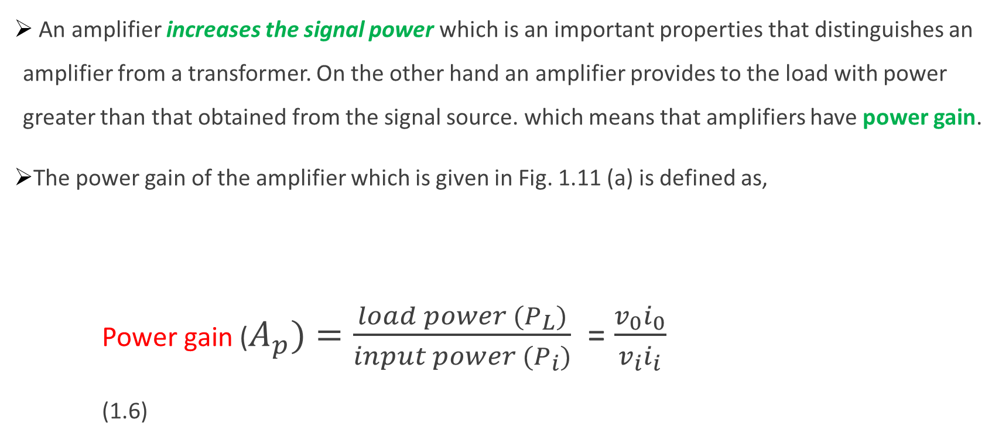
1.1.2 Power Gain and Current Gain
An amplifier increases the signal power which is an important properties that distinguishes an amplifier from a transformer. On the other hand an amplifier provides to the load with power greater than that obtained from the signal source. which means that amplifiers have power gain.
The power gain of the amplifier which is given in Fig. 1.11 (a) is defined as,
Power gain ($A_{p})=\frac{load power (P_{L})}{input power {(P}_{i})}$ = $\frac{v_{0}i_{0}}{v_{i}i_{i}}$ (1.6)

Slide 9
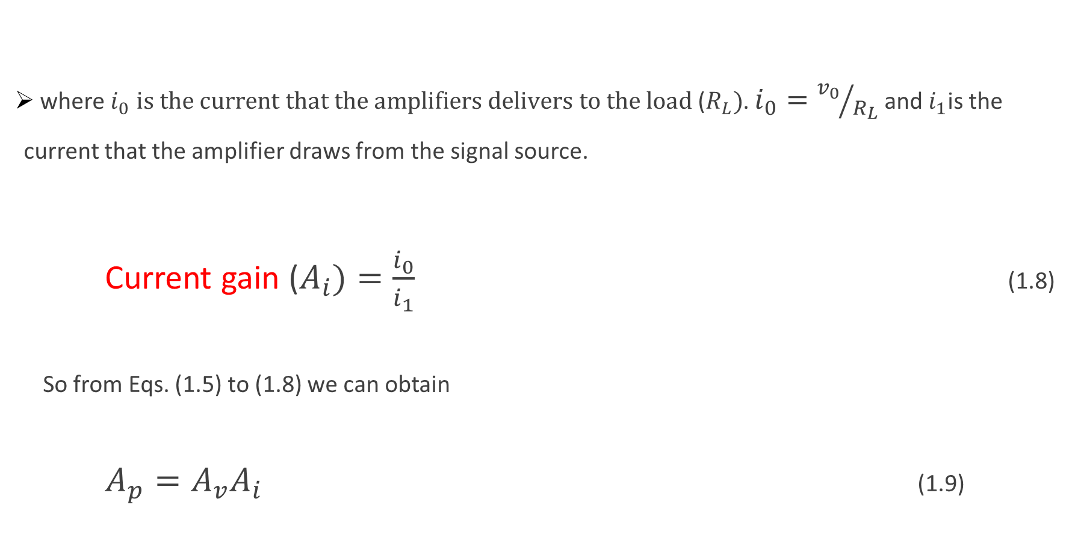
where $i_{0}$ $is the current that the amplifiers delivers to the load$ ($R_{L})$. $i_{0}={v_{0}}/{R_{L}}$ and $i_{1}$is the current that the amplifier draws from the signal source.
Current gain ($A_{i})=\frac{i_{0}}{i_{1}}$ (1.8)
So from Eqs. (1.5) to (1.8) we can obtain
$A_{p}=A_{v}A_{i}$ (1.9)

Slide 10

1.1.3
Expressing Gain in Decibels
if R_{L}=R_{I} ,

Slide 11
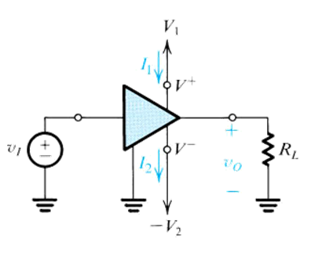

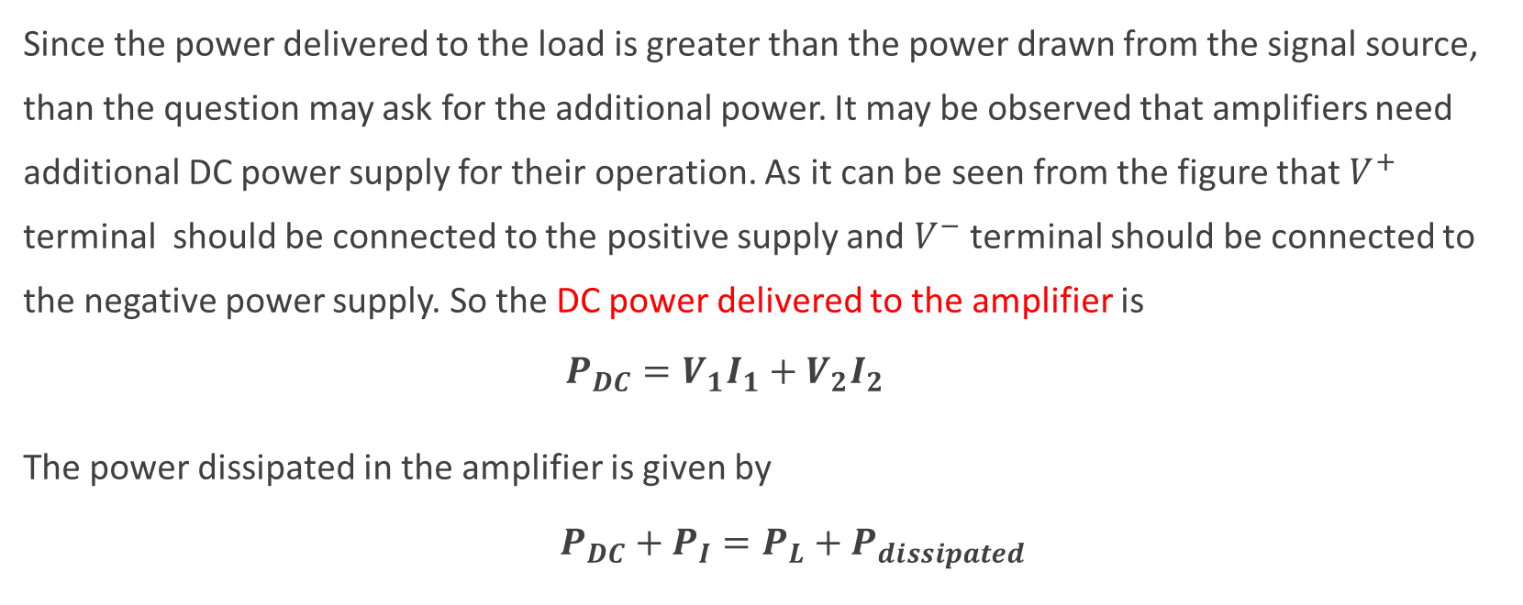
1.1.4 The Amplifier power supplies
Since the power delivered to the load is greater than the power drawn from the signal source, than the question may ask for the additional power. It may be observed that amplifiers need additional DC power supply for their operation. As it can be seen from the figure that $V^{+}$ terminal should be connected to the positive supply and $V^{−}$ terminal should be connected to the negative power supply. So the DC power delivered to the amplifier is
    $$P_{DC}=V_{1}I_{1}+V_{2}I_{2}$$
The power dissipated in the amplifier is given by
                $P_{DC}+P_{I}=P_{L}+P_{dissipated}$
Energy conservation
Amplifier efficiency

Slide 12
Fig. 1.12 An amplifier that requires dual power supply for operations

Slide 13
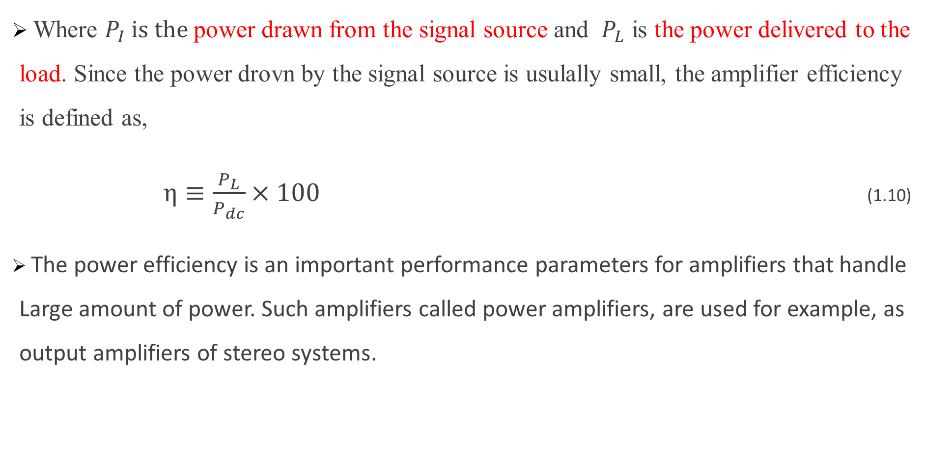
Where $P_{I} is the$ power drawn from the signal source and $P_{L}$ is the power delivered to the load. Since the power drovn by the signal source is usulally small, the amplifier efficiency is defined as,
$η≡\frac{P_{L}}{P_{dc}}×100$ (1.10)
The power efficiency is an important performance parameters for amplifiers that handle Large amount of power. Such amplifiers called power amplifiers, are used for example, as output amplifiers of stereo systems.

Slide 14
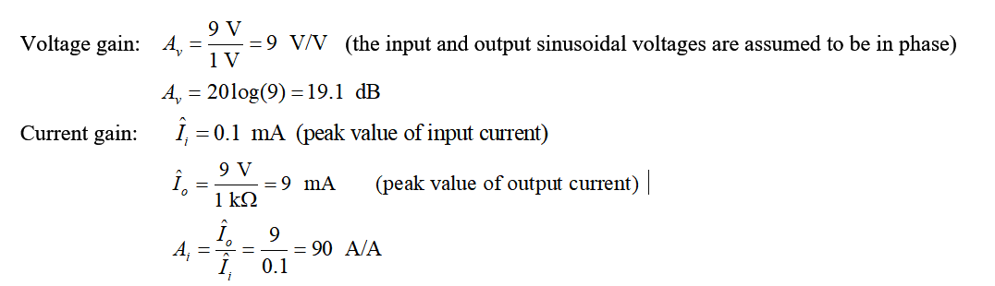
Example 1.1:
Consider an amplifier operating from ± 10-V power supplies. It is fed with a sinusoidal voltage having 1 V peak and delivers a sinusoidal voltage output of 9 V peak to a 1-kOhm load. The amplifier draws a current of 9.5 mA from each of its two power supplies. The input current of the amplifier is found to be sinusoidal with 0.1 mA peak. Find the voltage gain, the current gain, the power gain, the power drawn from the dc supplies, the power dissipated in the amplifier, and the amplifier efficiency.
Solution 1.1:

Slide 15
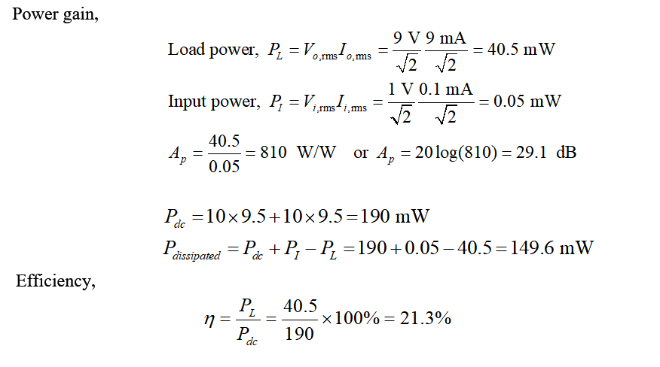

Slide 16
Practice Problem 1.1:
An amplifier operating from a single 15 V supply provides 12 V peak to peak sine wave signal to a 1kΩ load and draws negligible input current from the signal source. The dc current drawn from the 15 V supply is 8mA. What is the power dissipated in the amplifier and what is the amplifier efficiency?
Ans. 102 mW ; 15 %

Slide 17
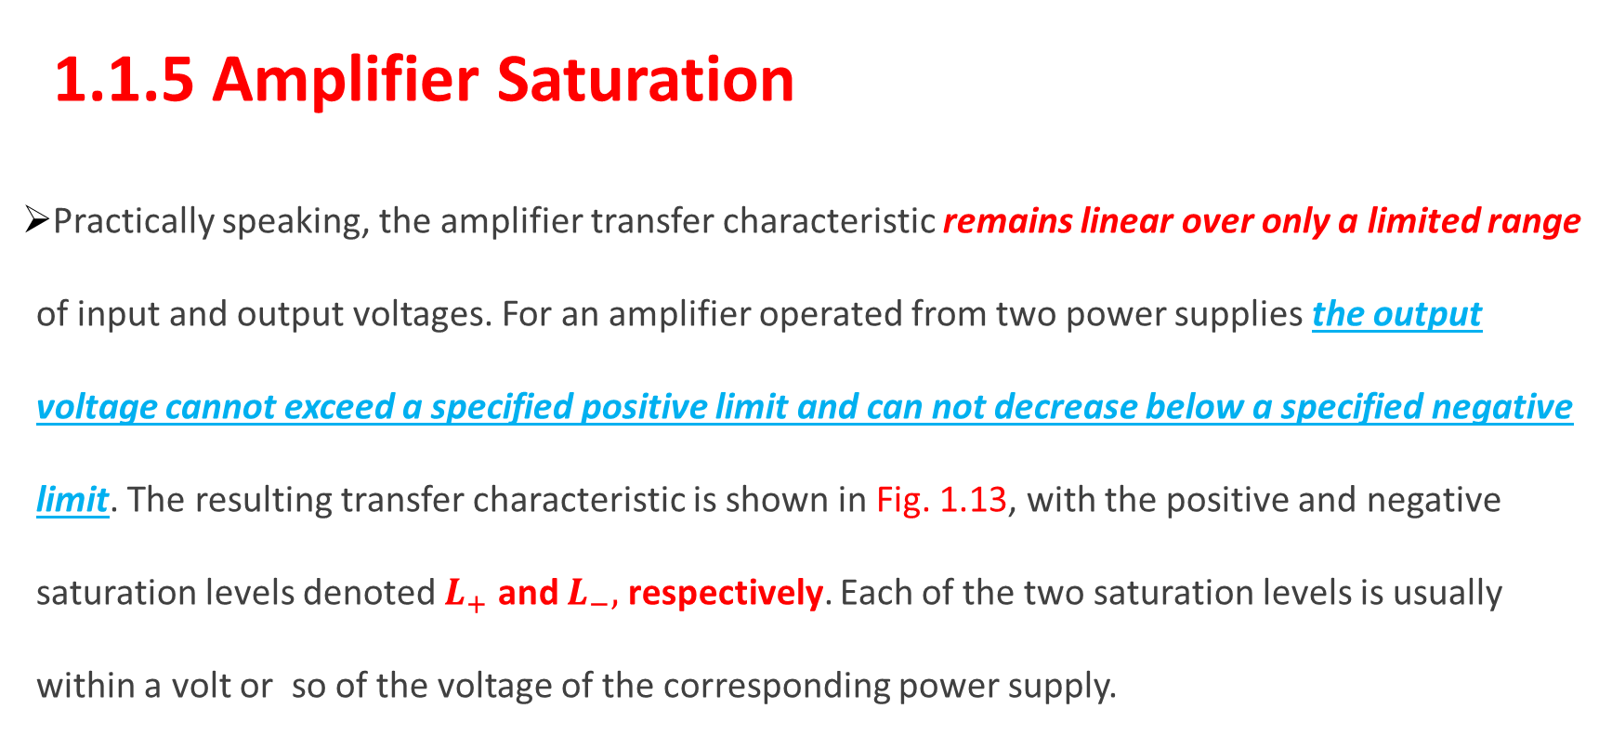
  1.1.5 Amplifier Saturation
Practically speaking, the amplifier transfer characteristic remains linear over only a limited range of input and output voltages. For an amplifier operated from two power supplies the output voltage cannot exceed a specified positive limit and can not decrease below a specified negative limit. The resulting transfer characteristic is shown in Fig. 1.13, with the positive and negative saturation levels denoted $L_{+}$ and $L_{−},$ respectively. Each of the two saturation levels is usually within a volt or so of the voltage of the corresponding power supply.

Slide 18





Obviously, in order to avoid distorting the output signal waveform, the input signal swing must be kept within the linear range of operation.
$$\frac{L_{+}}{A_{v}}$$
$${(L}_{+})$$
$$\frac{L_{−}}{A_{v}}$$
$$\frac{L_{−}}{A_{v}}≤V_{i}≤\frac{L_{+}}{A_{v}}$$
$${(L}_{−})$$
Fig.1 13 An amplifier transfer characteristics that is linear except for output saturation

Slide 19
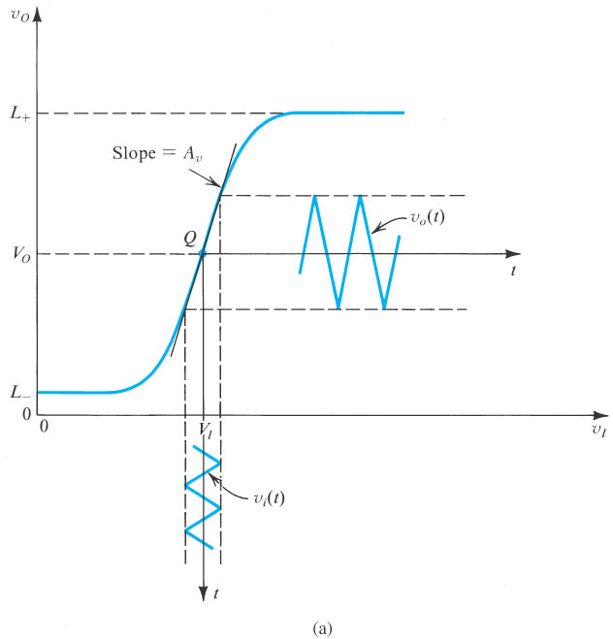
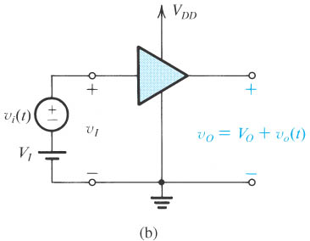
1.1.6 Nonlinear Transfer Characteristic and Biasing
In practical amplifiers the transfer characteristic may exhibit nonlinearity other than the output saturation.
Let’s consider an amplifier that is operated from a single positive power.

Slide 20
DC bias point
= Quiescent point
Small signal approximation
Otherwise, distortion in output signal!
Figure 1.14 (a) An amplifier transfer characteristic that shows considerable nonlinearity. (b) To obtain linear operation the amplifier is biased as shown, and the signal amplitude is kept small. Observe that this amplifier is operated from a single power supply, V_{DD}.

Slide 21
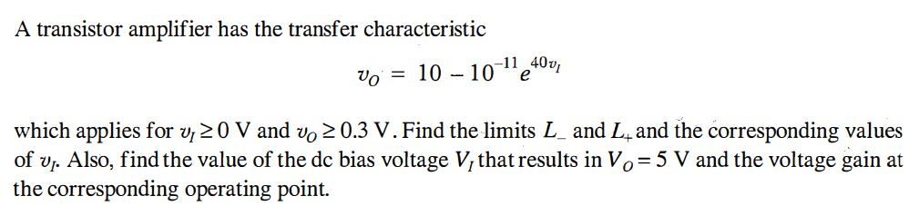
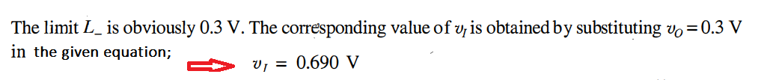
Example 1.2:
Solution 1.2:

Slide 22
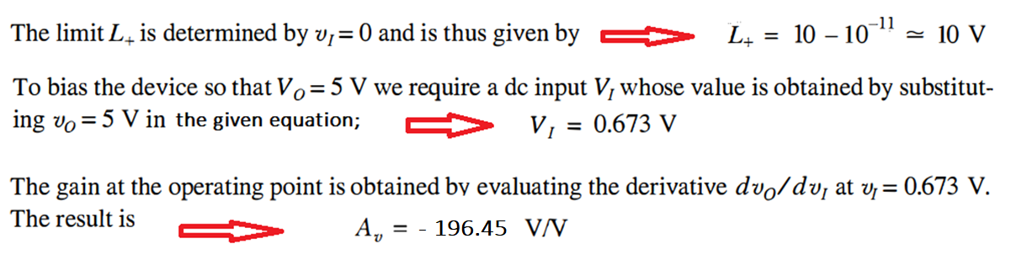
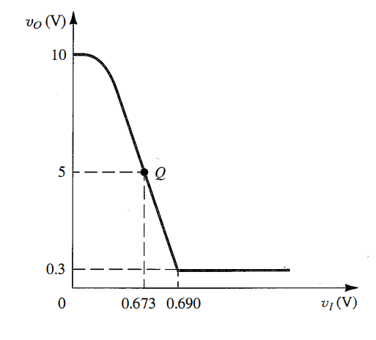
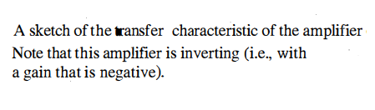

Slide 23
1.2 Circuit Models for Amplifiers and Amplifier Types
The input signal to an amplifier can be either a voltage source or current source. The output of an amplifier can be either a voltage source or current source. Therefore there are four possible input and output combinations: v – v, i – i, v – i, and i – v. Based on the input and output relationships amplifiers can be classified into four types:
Voltage amplifiers
Current amplifiers
Transconductance amplifiers
Transimpedance amplifiers

Slide 24

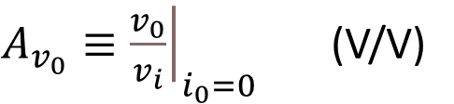


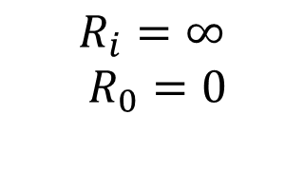
i) Voltage Amplifier
An amplifier whose output voltage is proportional to its input voltage is called voltage amplifier
A circuit model is a circuit which represents a complex one in terms of a set of parameters and the associated components relevant to the operation of that circuit.
Open – Circuit Voltage Gain
Ideal characteristic
$A_{v_{0}}≡{\left.\frac{v_{0}}{v_{i}}\right|}_{i_{0}=0}$ (V/V)
$$R_{i}=∞$$
$$R_{0}=0$$
$$v_{o}=i_{0}R_{L}=A_{v_{0}}v_{i}\frac{R_{L}}{R_{0}+R_{L}}$$
$$v_{i}=v_{s}\frac{R_{i}}{R_{i}+R_{s}}$$

Slide 25
Amplifier model with an input signal source
and load connected
By voltage division
The voltage accross the input terminals of the amplifier
Overal voltage gain of the amplifier

Slide 26
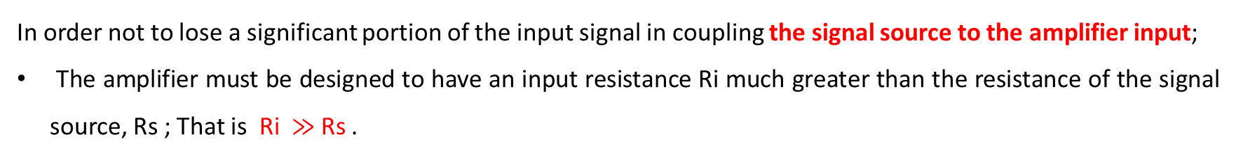
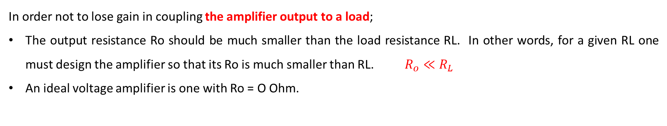
In order not to lose gain in coupling the amplifier output to a load;
The output resistance Ro should be much smaller than the load resistance RL. In other words, for a given RL one must design the amplifier so that its Ro is much smaller than RL. $R_{o}≪R_{L}$
An ideal voltage amplifier is one with Ro = O Ohm.
If a load resistance is not specified, it is normally assumed that the given voltage gain is the open-circuit gain Avo.
In order not to lose a significant portion of the input signal in coupling the signal source to the amplifier input;
The amplifier must be designed to have an input resistance Ri much greater than the resistance of the signal source, Rs ; That is Ri $≫$Rs .
In such a case, one requires an amplifier with a high input resistance (much greater than the source resistance) and a low output resistance (much smaller than the load resistance) but with a modest voltage gain (or even unity gain). Such an amplifier is referred to as a buffer amplifier.

Slide 27
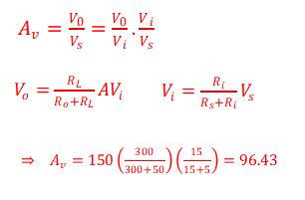
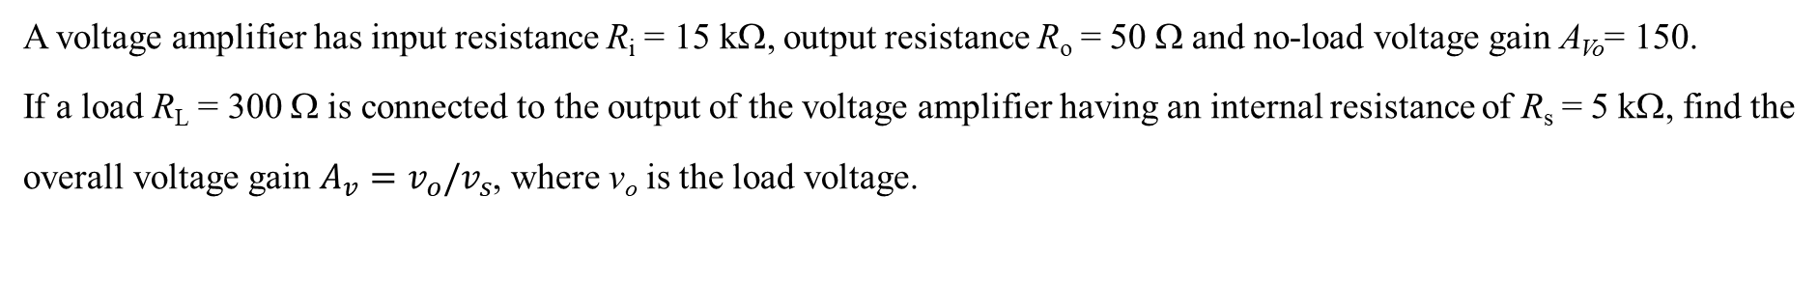
Example 1.2:
A voltage amplifier has input resistance R_{i} = 15 kΩ, output resistance R_{o} = 50 Ω and no-load voltage gain A_{Vo}= 150.
If a load R_{L} = 300 Ω is connected to the output of the voltage amplifier having an internal resistance of R_{s} = 5 kΩ, find the
overall voltage gain $A_{v}=v_{o}/v_{s}$, where v_{o} is the load voltage.
Solution 1.2:

Slide 28
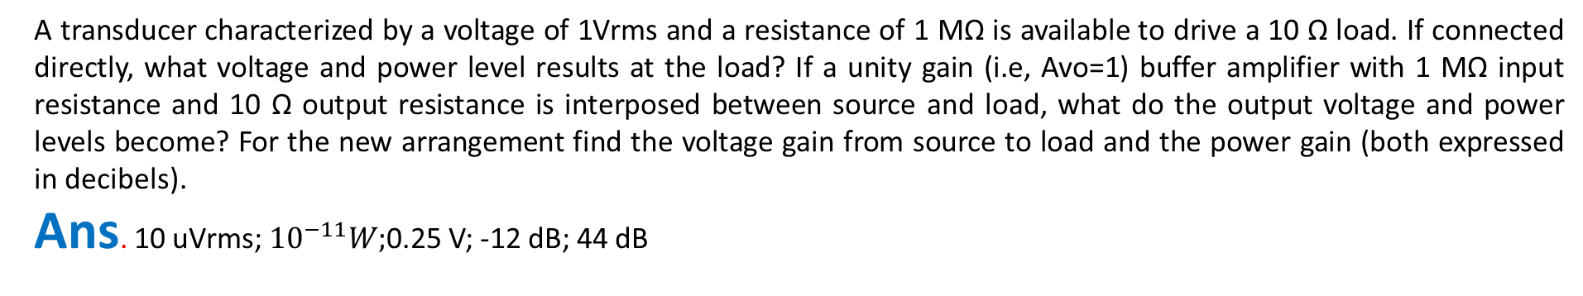
Practice Problem 1. 2:
A transducer characterized by a voltage of 1Vrms and a resistance of 1 MΩ is available to drive a 10 Ω load. If connected directly, what voltage and power level results at the load? If a unity gain (i.e, Avo=1) buffer amplifier with 1 MΩ input resistance and 10 Ω output resistance is interposed between source and load, what do the output voltage and power levels become? For the new arrangement find the voltage gain from source to load and the power gain (both expressed in decibels).
Ans. 10 uVrms; ${10}^{−11}W;$0.25 V; -12 dB; 44 dB
Practice Problem 1.3:
An amplifier with a voltage gain of +40 dB, an input resistance is 10 kΩ and an output resistance is 1k Ω is used to drive 1k Ω load. What is the value of Avo? Find the value of power gain in dB?
Ans. 100 V/V; 44 dB
Practice Problem 1.4:
The output voltage of a voltage amplifier has been found to decrease by 20% when a load resistance of 1 kΩ is connected. What is the value of the amplifier output resistance?
Ans. 250 Ω

Slide 29
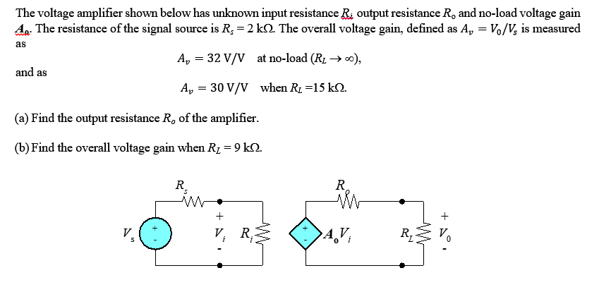

Practice Problem 1.5:
${\text{Ans} R}_{o}=1 \text{k}Ω,Av=28.8$ V/V

Slide 30
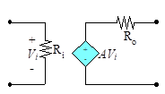
Cascaded Amplifiers
To meet given amplifier specifications the need often arises to design the amplifier as a cascade of two or more stages. The stages are usually not identical; rather, each is designed to serve a specific purpose. For instance, the first stage is usually required to have a large input resistance, and the final stage in the cascade is usually designed to have a low output resistance.

Slide 31
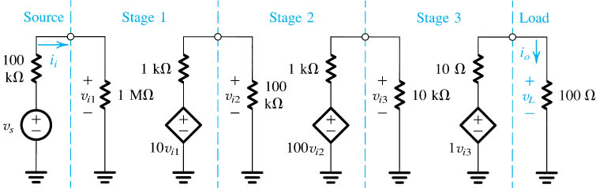
Example 1.3:
Evaluate the overall voltage gain, that is, VL /Vs , the current gain, and the power gain
Solution 1.3:

Slide 33
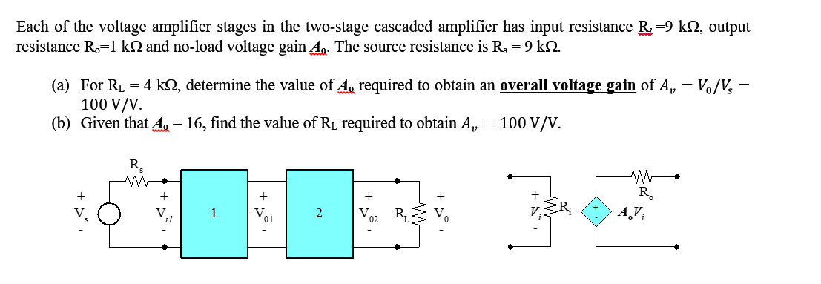

Practice Problem 1.6:
Ans: $A_{o}=16.67 and{ R}_{L}=6.58 \text{k}Ω$

Slide 34
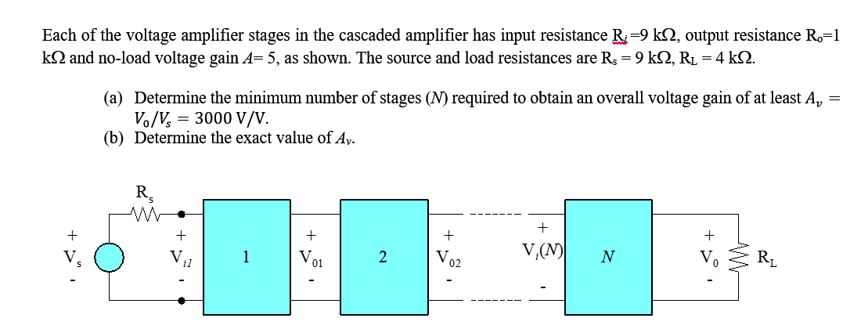
Example 1.4:

Slide 35
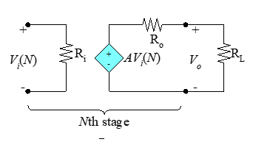
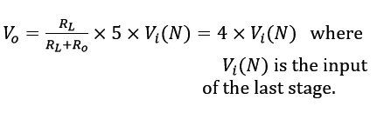
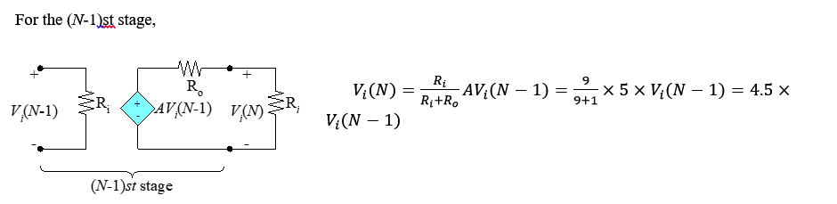
Solution 1.4:
The output of the last stage is given below.

Slide 36
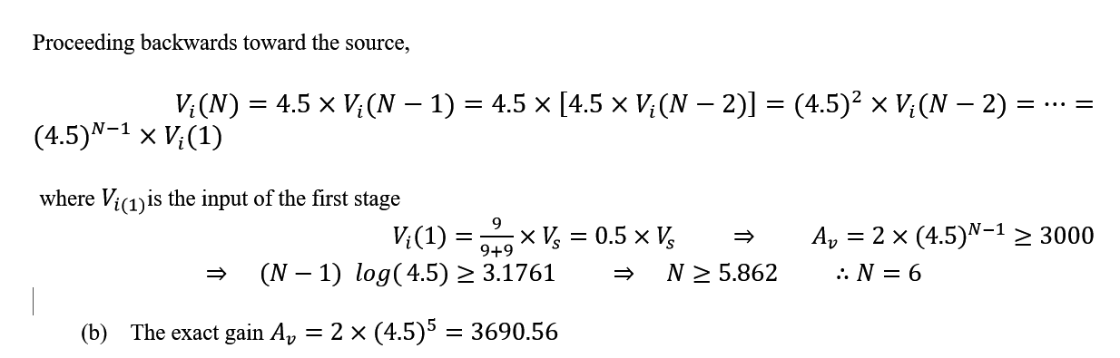

Slide 37



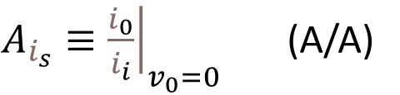

(ii) Current Amplifier
An amplifier whose output current is proportional to its input current is called current amplifier
Short – Circuit Current Gain
Ideal characteristic
$A_{i_{s}}≡{\left.\frac{i_{0}}{i_{i}}\right|}_{v_{0}=0}$ (A/A)
$$R_{i}=0$$
$$R_{0}=∞$$
$$i_{s}$$
$$i_{0}=A_{i_{s}}i_{i}\frac{R_{0}}{R_{0}+R_{L}}$$
$$i_{i}=i_{s}\frac{R_{s}}{R_{i}+R_{s}}$$

Slide 38
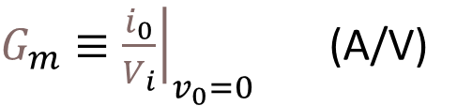



(iii) Transconductance Amplifier
An amplifier that recieve a voltage signal as input and provides current signal as output is called transconductance amplifier
Short – Circuit
Transconductance
Ideal characteristic
$$R_{i}=∞$$
$$R_{0}=∞$$
$G_{m}≡{\left.\frac{i_{0}}{V_{i}}\right|}_{v_{0}=0}$ (A/V)
$$i_{0}=G_{m_{s}}v_{i}\frac{R_{0}}{R_{0}+R_{L}}$$
$$v_{i}=v_{s}\frac{R_{i}}{R_{i}+R_{s}}$$

Slide 39




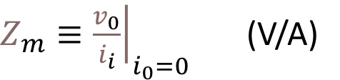
(iv) Transresistance Amplifier
The input signal to an transimpedance amplifier is a current source, and its output is a voltage source. Such an amplifier is called current controlled voltage source. The gain parameter $Z_{m0}$ is the ratio open – circuit output voltage to the input current, and is called Open – Circuit transimpedance.
Open – Circuit
Transimpedance
Ideal characteristic
$$R_{i}=0$$
$$R_{0}=0$$
$Z_{m}≡{\left.\frac{v_{0}}{i_{i}}\right|}_{i_{0}=0}$ (V/A)
$$v_{0}=Z_{m_{0}}i_{i}\frac{R_{L}}{R_{0}+R_{L}}$$
$$i_{i}=i_{s}\frac{R_{s}}{R_{i}+R_{s}}$$

Slide 40

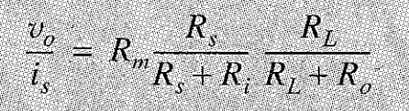

Practice Problem 1.7:
(a) Consider the current amplifier having the model shown.
Show that the overall current gain is given by
$$i_{s}$$
(b) Show that overall gain for the given transresistance amplifer model is given by

Slide 41
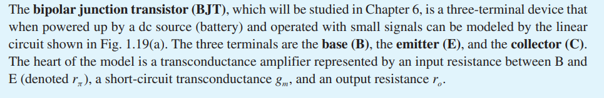
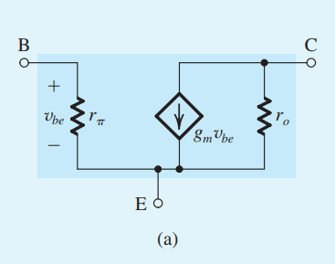
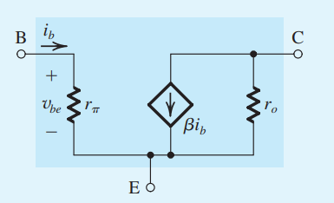
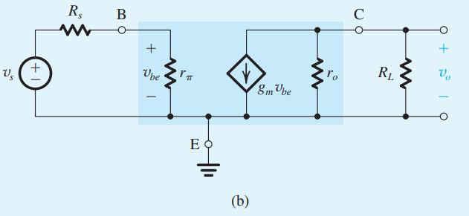
Small-signal circuit model for a bipolar junction transistor (BJT).
(c)

Slide 42
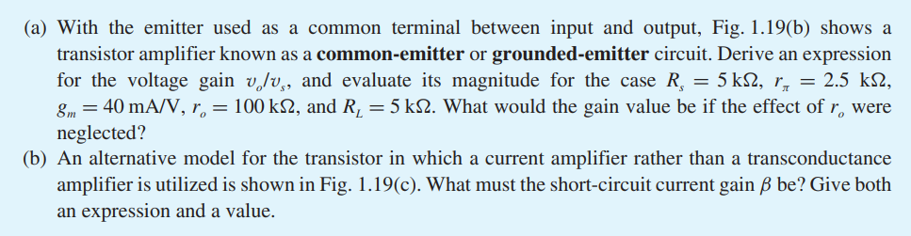

Slide 43
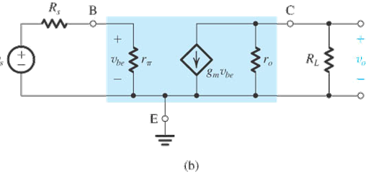




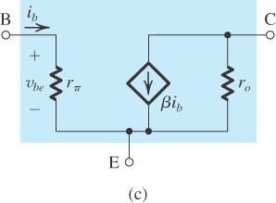

(b) The BJT connected as an amplifier with the emitter as a common terminal between input and output (called a common-emitter amplifier).
(c) An alternative small-signal circuit model for the BJT.

Slide 44
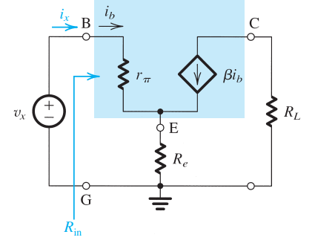

Practice Problem 1.8:

Slide 45


1.3 Frequency Responce of Amplifiers
An important characterization of an amplifier is in terms of its response to input sinosoids of different frequencies. Such a characterisation of amplifier performance is known as the amplifier frequency responce. Frequency response is related with how the amplitude and phase of the output signal changes when the frequency of the input signal is changed while keeping its amplitude fixed.
Measuring amplifier frequency response:
$V_{i}$ is kept constant $f=\frac{w}{2π}$ of the input signal is changed over a large range. The output voltage amplitude, $V_{0},$ and phase ɸ, are recorded as function of frequency.

Slide 46

So the Amplifier transfer function is,
                $$T\left(w\right)=\frac{V_{0}(w)}{V_{i}(w)}$$
$V_{0}(w)$ and $V_{i}(w)$ are the phasor representing input and the output voltages as sinusoids. Therefore $T(w)$ is a complex funjtion of frequency in general (has real and imaginary part, or magnitude and angle).
magnitude response;
phase response

Slide 47




Low frequency range midband range high frequency range
$w_{1}$:
lover cutoff frequency, where gain is 3dB less than the maximum value (or the midband value)
$w_{2}$:
uper cutoff frequency
Bandwith
$${=w}_{2}−w_{1}$$

Slide 48
In general, the frequency response can be divided into three bands:
  The low frequency band: due to the effect of the coupling and bypass capacitors. As the signal frequency is lowered the reactances of these capacitors increases. The net effect is a reduction in the overall gain.
  The midband: In this band the effects of the coupling etc. capacitors are negligible (i.e. they can be taken to be short-circuits at the frequencies of this band). The internal (parasitic) capacitances of the transistor, which are very small in general, have very high reactances at the midband frequencies. Hence, they can be taken to be open-circuits. The amplifier gain in this band is almost constant.
  The high frequency band: Here, the parasitic capacitances begin to have low reactances, thus reducing the gain.

Slide 49

Classification of Amplifiers Based on Frequency Response
Amplifiers can be classified based on the shape of their magnitude-response curve.
The gain remains constant over a wide frequency range but falls off at low and high frequencies. This is a common type of frequency response found in audio amplifiers.
The internal capacitances in the device (a transistor) cause the falloff of gain at high frequencies. On the other hand, the falloff of gain at low frequencies is usually caused by coupling capacitors used to connect one amplifier stage to another, as indicated in
A capacitively coupled amplifier

Slide 50


There are many applications in which it is important that the amplifier maintain its gain at low frequencies down to dc. Furthermore, monolithic integrated-circuit (IC) technology does not allow the fabrication of large coupling capacitors. Thus IC amplifiers are usually designed as directly coupled or dc amplifiers
A direct-coupled amplifier,
A tuned or bandpass amplifier.
In a number of applications, such as in the design of radio and TV receivers, the need arises for an amplifier whose frequency response peaks around a certain frequency (called the center frequency) and falls off on both sides of this frequency,.
Amplifiers with such a response are called tuned amplifiers, bandpass amplifiers, or bandpass filters

Slide 51


Single-Time-Constant (STC) Networks
In analyzing amplifier circuits to determine their frequency response, one is greatly aided by knowledge of the frequency response characteristics of single-time-constant (STC) networks. An STC network is one that is composed of, or can be reduced to, one reactive component (inductance or capacitance) and one resistance.
An STC network formed of an inductance L and a resistance R has a time constant $τ$ = L / R. The time constant $τ$ of an STC network composed of a capacitance C and a resistance R is given by $τ$= CR.
Low-pass circuit (b) High-pass circuit

Slide 52

Transfer function for the low-pass circuit

Slide 54


a) Amplitude Response b) Phase Response

Slide 55

Example 1.4:
Consider a voltage amplifier having a frequency response of the low-pass STC type with a dc gain of 60 dB and a 3-dB frequency of 1000 Hz. Find the gain in dB at f = 10 Hz, 10 kHz, 100 kHz, and 1 MHz.
Ans. 60 dB; 40 dB; 20 dB; 0 dB
Solution 1.3:
where K is gain at w=0

Slide 56



60 = 20 log K
K = 1000
$\left|T(10)\right|$=$\frac{1000}{\sqrt{1+(\frac{{10}^{2}}{{1000}^{2}})}}$ = 1000
20 log 1000 = 60 dB
$\left|T(10000)\right|$=$\frac{1000}{\sqrt{1+(\frac{{10000}^{2}}{{1000}^{2}})}}$ = 100
20 log 100 = 40 dB

Slide 57


Transfer function for the high-pass circuit

Slide 58



$$\left|T\left(w\right)\right|= \frac{w/{w_{o}}}{\sqrt{1+w^{2}/{w^{2}}_{o}}}$$
$$∅\left(w\right)= {90}^{o}− \tan^{−1}{(\frac{w}{w_{0}})}$$
Amplitude Response
Phase Response
T(w)

