Slide 1
Chapter 5 – Transistors
So far, we have made use of a few passive components. That is,
we have used components that do not amplify. Diodes can't
amplify on their own. They can only block current from flowing
in one direction. And resistors, capacitors, and inductors can only
attenuate.
In this chapter, you will.
Learn about how to use transistors
Make use of transistors in applications.
The most basic amplifier imaginable would act much like a valve. Imagined that way, a huge flow of water could be controlled by a
small turn of a valve. A transistor is a three terminal device that can control a large current with a tiny current. So they may be thought of as valves in this respect

Slide 2
Chapter 5.1: The Bipolar Junction Transistor (BJT)
We met the diode in the last chapter, which is a PN junction. But suppose we wanted to control the current in the diode with another, much smaller current. The solution is to add another semiconductor junction, forming a “PNP or NPN sandwich.” By doing so, we create special devices called transistors.
These are referred to as bipolar junction transistors, or BJTs. A bipolar junction transistor is a three terminal device that can switch large currents with a small control current. Figure 5.1 shows common transistor packages, and the schematic symbols for PNP and NPN transistors.

Slide 3
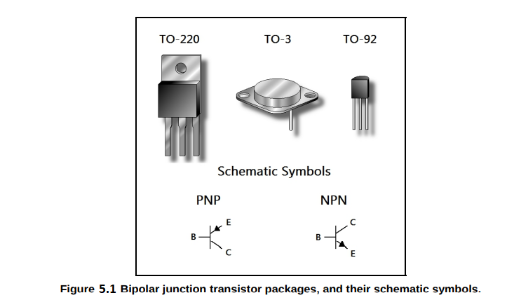
The schematic symbols in the figure are marked with the letters E, B, and C, which stand for emitter, base, and collector, respectively. You can see a resemblance to the diode's schematic symbol.
This gives some idea of the polarity of the transistor. An NPN transistor needs a positive base voltage to turn on, and a PNP transistor needs a negative base voltage.
But for now, just think of a transistor as a switch, as this is the most basic use of a transistor. In order to “turn on” a transistor, we must supply a small current to the base of the transistor.

Slide 4
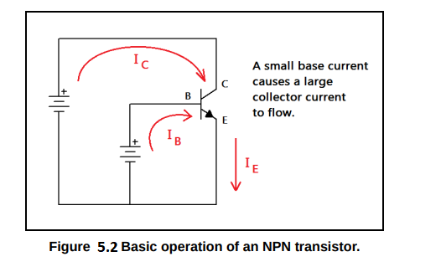
In Figure 5.2, we have an NPN transistor showing the flow of current in order to turn the transistor on.
Transistors have a property called gain. For bipolar junction transistors, this is referred to as beta gain, represented by the Greek symbol beta (β). Beta is the current gain, because the collector current may be expressed as the product of the base current and this amplifying factor.

Slide 5
A gain of 100 – 300 is typical for small signal transistors. Let's say we have a gain of 100 and a base
current of 10 mA. The collector current is given by the following equation
So we can cause a current of one ampere to flow in the collector of the transistor with a tiny current of 0.01 amperes flowing in the base of the transistor. Current gain is also denoted by hFE in transistor datasheets. You should read the component datasheet so you can use the transistor safely and effectively in your circuits.
Datasheets can also tell us the pinout of the part. However, there is a fairly common standard for transistor pin designations, as shown in Figure 5.3. The common pinouts for TO-220 and TO-92 devices are given. (TO means “transistor outline” and refers to package style.)

Slide 6
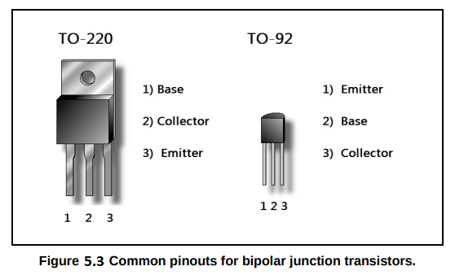
Basic Bipolar Junction Transistor Operation
Bipolar junction transistors can be used for a wide variety of applications. Let's cover a little theory before we move on to common transistor circuits. The maximum collector current is controlled by whatever resistance is in the current path of the transistor's collector.
In other words, there is a point where the transistor ideally looks like a short circuit from emitter to collector, called saturation, where collector current is maximum. This maximum current is set by the collector resistance RC.

Slide 7
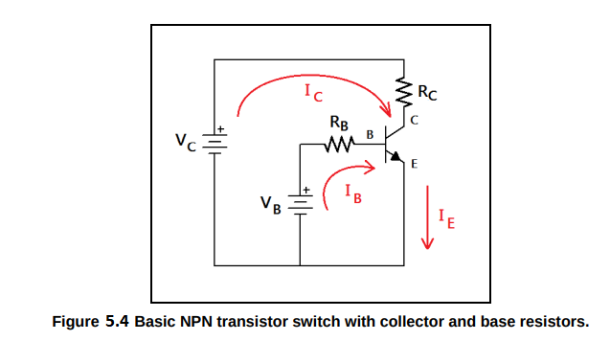
There is another point called cutoff, where the transistor is completely turned off. Since there is a diode drop from the emitter to the base, if we do not apply greater than +0.7 V to the base, no current flows and the transistor is completely turned off. Because the transistor can be operated either fully saturated, or in full cutoff, it looks much like a switch. Let's look at Figure 5.4 to see why that is.
Calculating maximum collector current is as critical design step. If the transistor is in full saturation, then we can assume it acts as a short circuit from collector to emitter (an ideal transistor.) We can compute the base current that will give rise to this condition, given the other parameters in the circuit.

Slide 8
The maximum collector current may be computed by assuming that the transistor acts as a short circuit between the collector and the emitter.
relay controller circui

