Slide 1
Architecture and Hardware (ITEC582 )
Eastern Mediterranean University
School of Computing and Technology
Master of Technology
Chapter 16
Instruction-Level Parallelism and Superscalar Processors

Slide 2
After studying this chapter, you should be able to:
Explain the difference between superscalar and superpipelined approaches.
Define instruction-level parallelism.
Discuss dependencies and resource conflicts as limitations to instruction-level parallelism
Present an overview of the design issues involved in instruction-level parallelism.

Slide 3
1. Introduction
A superscalar implementation of a processor architecture is one in which common instructions—(integer and floating-point arithmetic, loads, stores, and conditional branches)—can be initiated simultaneously and executed independently
The superscalar approach can be used on either a RISC or CISC architecture.
It is more appropriate to use in RISC architecture.

Slide 4
What is the essential characteristic of the superscalar approach to processor design

Slide 5
Introduction
A superscalar processor typically fetches multiple instructions at a time and then attempts to find nearby instructions that are independent of one another and can therefore be executed in parallel.
Once such dependencies have been identified, the processor may issue and complete instructions in an order that differs from that of the original machine code.
Notes:
22

Slide 6
Superscalar
The term superscalar, first coined in 1987, refers to a machine that is designed to improve the performance of the execution of scalar instructions.
In most applications, the bulk of the operations are on scalar quantities.
The essence of the superscalar approach is the ability to execute instructions independently and concurrently in different pipelines.
The concept can be further exploited by allowing instructions to be executed in an order different from the program order.

Slide 7
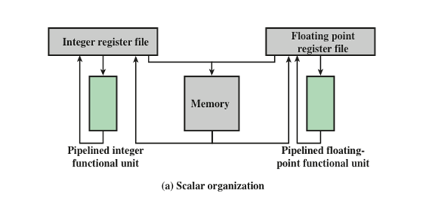
In a traditional scalar organization, there is a single pipelined functional unit for integer operations and one for floating-point operations.
Parallelism is achieved by enabling multiple instructions to be at different stages of the pipeline at one time.

Slide 8
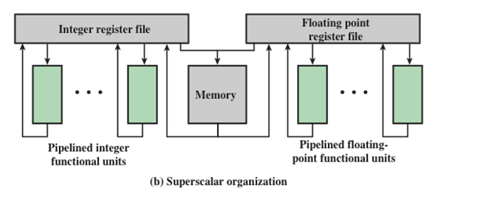
In the superscalar organization, there are multiple functional units, each of which is implemented as a pipeline.
It is the responsibility of the hardware, in conjunction with the compiler, to assure that the parallel execution does not violate the intent of the program

Slide 9
Superscalar vs. Superpipeline
An alternative approach to achieving greater performance is referred to as superpipelining, a term first coined in 1988.
What is the difference between the superscalar and superpipelined approaches?
Superpipelining exploits the fact that many pipeline stages perform tasks that require less than half a clock cycle.
Thus, a doubled internal clock speed allows the performance of two tasks in one external clock cycle. one example of this approach with the MIPS R4000.

Slide 10
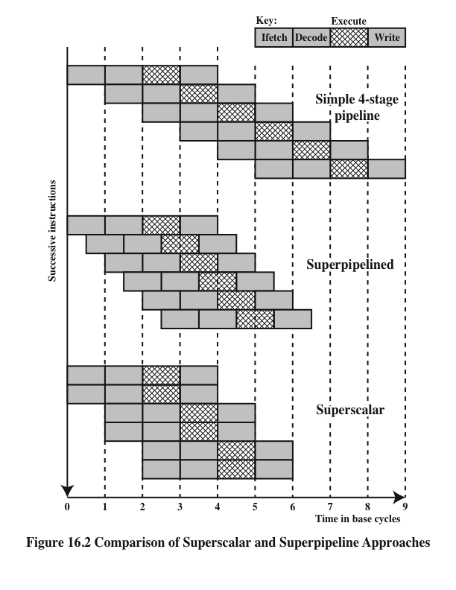
Comparison of Superscalar and Superpipeline Approaches

Slide 11
The upper part of the diagram issues one instruction per clock cycle and can perform one pipeline stage per clock cycle.
The execution stage is crosshatched for clarity. Note that although several instructions are executing concurrently, only one instruction is in its execution stage at any one time.

Slide 12
The next part of the diagram shows a superpipelined implementation that is capable of performing two pipeline stages per clock cycle.
A superpipeline implementation that behaves in this fashion is said to be of degree 2
An alternative way of looking at this is that the functions performed in each stage can be split into two non-overlapping parts and each can execute in half a clock cycle.

Slide 13
Finally, the lowest part of the diagram shows a superscalar implementation capable of executing two instances of each stage in parallel.
Higher-degree superpipeline and superscalar implementations are of course possible.

Slide 14
Constraints
The superscalar approach depends on the ability to execute multiple instructions in parallel.
What is instruction-level parallelism?
Instruction level parallelism refers to the degree to which the instructions of a program can be executed in parallel.
A combination of compiler based optimization and hardware techniques can be used to maximize instruction level parallelism.

Slide 15
Before examining the design techniques used in superscalar machines to increase instruction-level parallelism, we need to look at the fundamental limitations to parallelism with which the system must cope. Researcher lists five limitations
Limitations are:
True data dependency
Procedural dependency
Resource conflicts
Output dependency
Antidependency

Slide 16
True Data Dependency [RAW]
Consider the following instructions sequence:
I : R2 <- R1 + R3
J : R4 <- R2 + R3
The second instruction J can be fetched and decoded but cannot execute until the first instruction I executes. The reason is that the second instruction needs data produced by the first instruction.
This situation is referred to as a true data dependency (also called flow dependency or read after write [RAW] dependency).

Slide 17
Procedural Dependency
The presence of branches in an instruction sequence complicates the pipeline operation.
The instructions following a branch (taken or not taken) have a procedural dependency on the branch and cannot be executed until the branch is executed.
This type of procedural dependency also affects a scalar pipeline.

Slide 18
Can not execute instructions after a branch until the branch is executed. (effect of a branch on a superscalar pipeline of degree 2, I1 is a branch)

Slide 19
Resource Conflict
A resource conflict is a competition of two or more instructions for the same resource at the same time.
Examples of resources include memories, caches, buses, register-file ports, and functional units (e.g. ALU adder).

Slide 20
In terms of the pipeline, a resource conflict exhibits similar behavior to a data dependency. However, resource conflicts can be overcome by duplication of resources, whereas a true data dependency cannot be eliminated.

Slide 21
Output dependency: (Write after Write –WAW)
Two instructions update the same register, so the later instruction must update later. if I2 completes before I0, the contents of R3 will be wrong to I3
Antidependency: ( Write after read-WAR)
A second instruction destroys a value that the first instruction uses
I2 can NOT complete before I1 starts, since I1 needs a value in R3 and I2 changes R3.

Slide 22
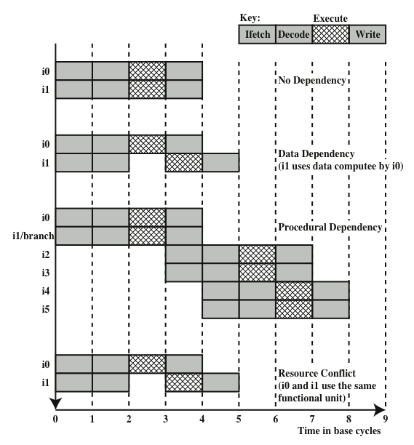
Effect of dependencies
With degree 2

Slide 23
2. Design Issues
Instruction level parallelism exists when instructions in a sequence are independent and thus can be executed in parallel by overlapping.
Example:
The three instructions on the left are independent, and in theory all three could be executed in parallel.

Slide 24
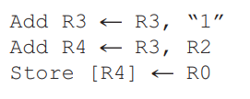
The three instructions on the right cannot be executed in parallel. Because the second instruction uses the result of the first, and the
third instruction uses the result of the second.
The degree of instruction-level parallelism is determined by the frequency of true data dependencies and procedural dependencies in the code.
These factors, in turn, are dependent on the instruction set architecture and on the application.

Slide 25
Machine parallelism
It is a measure of the ability of the processor to take advantage of instruction-level parallelism. Machine parallelism is determined by the number of instructions that can be fetched and executed at the same time (the number of parallel pipelines) and by the speed and sophistication of the mechanisms that the processor uses to find independent instructions

Slide 26
Design Issues
Both instruction-level and machine parallelism are important factors in enhancing performance.
The use of a fixed-length instruction set architecture, as in a RISC, enhances instruction-level parallelism.
On the other hand, limited machine parallelism will limit performance no matter what the nature of the program.

Slide 27
Instruction Issue Policy
Machine parallelism is not simply a matter of having multiple
instances of each pipeline stage. The processor must also be able to identify instruction-level parallelism and orchestrate the fetching, decoding, and execution of instructions in parallel.
Instruction issue refer to the process of initiating instruction execution in the processor’s functional units and the term instruction issue policy refer to the protocol used to issue instructions.

Slide 28
In general, we can say that instruction issue occurs when instruction moves from the decode stage of the pipeline to the first execute stage of the pipeline.
The processor is trying to look ahead of the current point of execution to locate instructions that can be brought into the pipeline and executed.
Three types of orderings are important :
The order in which instructions are fetched
The order in which instructions are executed
The order in which instructions update the contents of register and memory locations

Slide 29
To optimize utilization of the various pipeline elements, the processor will need to alter one or more of these orderings with respect to the ordering to be found in a strict sequential execution.
The one constraint on the processor is that the result must be correct. Thus, the processor must accommodate the various dependencies and conflicts discussed earlier.

Slide 30
Instruction Issue Policy
Superscalar instruction issue policies can be grouped into the following categories:
In-order issue with in-order completion
In-order issue with out-of-order completion
Out-of-order issue with out-of-order completion

Slide 31
In-order issue with in-order completion
The simplest instruction issues policy is to issue instractions in the exact order that would be achieved by sequential execution (in-order issue) and to write results in that same order (in-order completion).

Slide 32
We assume a superscalar pipeline capable of fetching and decoding two instructions at a time, having three separate functional units and having two instances of the write-back pipeline stage.
In-order issue with in-order completion
The example assumes the following constraints on a six-instruction code fragment:
I1 requires two cycles to execute.
I3 and I4 conflict for the same functional unit.
I5 depends on the value produced by I4.
I5 and I6 conflict for a functional unit.

Slide 33
In-order issue with in-order completion
Instructions are fetched two at a time and passed to the decode unit.
Because instructions are fetched in pairs, the next two instructions must wait until the pair of decode pipeline stages has cleared.
To guarantee in-order completion, when there is a conflict for a functional unit or when a functional unit requires more than one cycle to generate a result, the issuing of instructions temporarily stalls.
In this example, the elapsed time from decoding the first instruction to writing the last results is eight cycles.

Slide 34
In-order issue with out-of-order completion
This policy is used in scalar RISC processors to improve the performance of instructions that require multiple cycles.
Instruction I2 is allowed to run to completion prior to I1.
This allows I3 to be completed earlier, with the net result of a savings of one cycle.
With out-of-order completion, any number of instructions may be in the execution stage at any one time, up to the maximum degree of machine parallelism across all functional units.

Slide 35
Instruction issuing is stalled by a resource conflict, a data dependency, or a procedural dependency.
In addition to the aforementioned limitations, a new dependency, which we referred to earlier as an output dependency (also called write after write [WAW] dependency)arises.

Slide 36
Example:
Instruction I2 cannot execute before instruction I1, because it needs the result in register R3 produced in I1; this is an example of a true data dependency. [RAW]
Similarly, I4 must wait for I3, because it uses a result produced by I3. [RAW]
There is no data dependency between I1 and I3. However, if I3 executes to completion prior to I1, then the wrong value of the contents of R3 will be fetched for the execution of I4. Consequently, I3 must complete after I1 to produce the correct output values. [WAW]

Slide 37
Out-of-order issue with out-of-order completion
To allow out-of-order issue, it is necessary to decouple the decode and execute stages of the pipeline.
This is done with a buffer referred to as an instruction window.
With this organization, after a processor has finished decoding an instruction, it is placed in the instruction window.
As long as this buffer is not full, the processor can continue to fetch and decode new instructions.
When a functional unit becomes available in the execute stage, an instruction from the instruction window may be issued to the execute stage.

Slide 38
What is the purpose of an instruction window?
For an out-of-order issue policy, the instruction window is a buffer that holds decoded instructions. These may be issued from the instruction window in the most convenient order.

Slide 39
Out-of-order issue with out-of-order completion
During each of the first three cycles, two instructions are fetched into the decode stage.
During each cycle, subject to the constraint of the buffer size, two instructions move from the decode stage to the instruction window.
In this example, it is possible to issue instruction I6 ahead of I5 (recall that I5 depends on I4, but I6 does not).
Thus, one cycle is saved in both the execute and write-back stages.

Slide 40
Out-of-order issue with out-of-order completion
The result of this organization is that the processor has a look ahead capability, allowing it to identify independent instructions that can be brought into the execute stage.
Instructions are issued from the instruction window with little regard for their original program order.

Slide 41
Out-of-order issue with out-of-order completion
An instruction cannot be issued if it violates a dependency or conflict.
The difference is that more instructions are available for issuing, reducing the probability that a pipeline stage will have to stall.
In addition, a new dependency, which we referred to earlier as an antidependency arises[write after read (WAR)]
.

Slide 42
Out-of-order issue with out-of-order completion
Example:
Instruction I3 cannot complete execution before instruction I2 begins execution and has fetched its operands. This is so because I3 updates register R3, which is a source operand for I2. [WAR]
The term antidependency is used because the constraint is similar to that of a true data dependency, but reversed: Instead of the first instruction producing a value that the second instruction uses, the second instruction destroys a value that the first instruction uses.

Slide 43
Out-of-order completion
Out-of-order completion requires more complex instruction issue logic than in-order completion.
In addition, it is more difficult to deal with instruction interrupts and exceptions.
One common technique that is used to support out-of-order completion is the reorder buffer.
The reorder buffer is temporary storage for results completed out of order that are then committed to the register file in program order.

Slide 44
Register Renaming
When out-of-order instruction issuing and/or out-of-order instruction completion are allowed, we have seen that this gives rise to the possibility of WAW dependencies and WAR dependencies.
Antidependencies and output dependencies are both examples of storage conflicts
What is register renaming and what is its purpose?
Registers are allocated dynamically by the processor hardware, and they are associated with the values needed by instructions at various points in time.

Slide 45
When a new register value is created (i.e., when an instruction executes that has a register as a destination operand), a new register is allocated for that value.
Subsequent instructions that access that value as a source operand in that register must go through a renaming process: the register references in those instructions must be revised to refer to the register containing the needed value.
Thus, the same original register reference in several different instructions may refer to different actual registers, if different values are intended

Slide 46
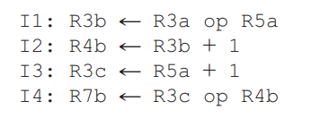
Example:
RAW WAR WAW
I1-I2 - -
I3-I4
I2-I4
RAW WAR WAW
I1-I2 I2-I3 I1-I3
I3-I4
I2-I4
Renaming removes WAW/WAR, leaves RAW intact!
The creation of register R3c in instruction I3 avoids the WAR dependency on the second instruction and the WAW on the first instruction.
The result is that I3 can be issued immediately; without renaming, I3 cannot be issued until the first instruction is complete and the second instruction is issued.

Slide 47
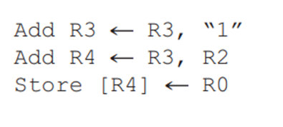
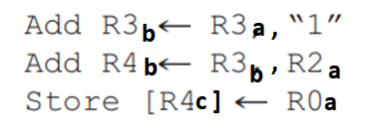
Renaming removes WAW/WAR, leaves RAW intact!

Slide 48
Identify the write-read [RAW], write-write [WAW], and read-write [WAR] dependencies in the following instruction sequence:
I1: R1 = R2 + R4
I2: R2 = R4 – 25
I3: R4 = R1 + R3
I4: R1 = R1 + 30
RAW WAR WAW
I1-I3 I2-I1 I1-I4
I1-I4 I3-I2
I4-I3
Rename the registers from part (a) to prevent dependency problems. Identify references to initial register values using the subscript “a” to the register reference
I1: R1b = R2a + R4a
I2: R2b = R4a – 25
I3: R4b = R1b + R3a
I4: R1c = R1b + 30
RAW WAR WAW
I1-I3 - -
I1-I4 -
-
Renaming removes WAW/WAR, leaves RAW intact!

Slide 49
ADD R2, R1, R3
ADD R4, R2, R3
ADD R1, R4, R3
ADD R4, R2, R3
ADD R4, R1, R3
ADD R4, R2, R3

Slide 50
Superscalar Execution
Conceptual depiction of superscalar processing

Slide 51
Superscalar Execution
The program to be executed consists of a linear sequence of instructions. This is the static program as written by the programmer or generated by the compiler.
The instruction fetch process, which includes branch prediction, is used to form a dynamic stream of instructions. This stream is examined for dependencies, and the processor may remove artificial dependencies.

Slide 52
Superscalar Execution
The processor then dispatches the instructions into a window of execution. In this window, instructions no longer form a sequential stream but are structured according to their true data dependencies.
The processor performs the execution stage of each instruction in an order determined by the true data dependencies and hardware resource availability.

Slide 53
Superscalar Execution
Finally, instructions are conceptually put back into sequential order and their results are recorded which is referred to as committing, or retiring, the instruction.
This step is needed since the use of parallel, multiple pipelines, instructions may complete in an order different from that shown in the static program.

Slide 54
What are the key elements of a superscalar processor organization?
(1)
Instruction fetch strategies that simultaneously fetch multiple instructions, often by predicting the outcomes of, and fetching beyond, conditional branch instructions. These functions require the use of multiple pipeline fetch and decode stages, and branch prediction logic.
(2)
Logic for determining true dependencies involving register values, and mechanisms for communicating these values to where they are needed during execution.

Slide 55
(3)
Mechanisms for initiating, or issuing, multiple instructions in parallel.
(4)
Resources for parallel execution of multiple
instructions, including multiple pipelined functional units and memory hierarchies
capable of simultaneously servicing multiple memory references. (5)
Mechanisms for committing the process state in correct order

