Slide 1
ITEC397 – Macro Coding
02 – What is VBA

Slide 2
The VBA is standing on the name Visual Basic for Application
VBA is derived from BASIC (Beginner’s All-purposed Symbolic Instruction Code) programming language
VBA is used for developing macro scripts for MS Office documents since 1995
VBScript is a cousin of VBA, used for coding client-side controls on a WEB application.
VB is a big brother programming language.
VB (Visual Basic) is a language that enables you to create standalone executable applications.
VB, VBA and VBScripts are Object Oriented
Programming Languages

Slide 3
VBA is a fully Object Oriented Programming Language
Worksheetbook, printer, screen are all objects
All are having properties, events and methods
VBA is shared by all Office applications and can be accesed easily from any Office application
Example, you can use Outlook, Excell, Access and Word togather within the same application with VBA.
VBA is mostly used within Excel. Hence macro coding solutions are also named as «Spreadsheet Applications»

Slide 4
What VBA can do for you?
Automate a Recurring Task
Automate a Repetitive Task
Running a Macro Automatically if another action take place
You can create your own Worksheet functions
Simplifying the Workbook’s look and feel for other users
Controling other Office Applicaions from Excel

Slide 5
Liabilities of the VBA
Each version of Office, VBA commands can changed without advanced warning
VBA does not run uniformly in all operating systems
With VBA, malicious content can be developed. Hence, many companies have set interan policies that forbid empoyees to download and obtain executables.
The most popular malicious content already developed with macro coding are ransomware and blackmailing.

Slide 6
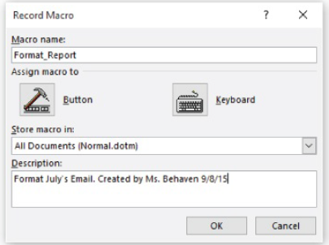
Where to store macro
In Word, to restrict availability of the macro to just the current template (.dotm file) or document (.docm file).
For all documents (Normal.dotm)
In Excel, you can choose to store the macro in
This workbook (active workbook) or a new workbook or
Personal Macro Workbook (Personal.xlsb) to make them avalable to any of your procedures

Slide 7
Security Issues
Office applications are saving current works as .DOCX, .XLSX as indicating macro coding features disabled for protecting users from malwares
Macro added works have to be saved as .DOCM, .XLSM
Even the macro included files are abled to be opened after getting approval

