Slide 1
ITEC397 Macro Coding
05 –Strıngs, functıons, and message boxes

Slide 2
Strings
String is a data type that is a combination of alphabetic, numeric, and special characters. Some examples:
“ab345%^4ddd”
“_!?45ABcd0=+-*”
There are many VBA functions for string manipulation, construction and presentation.
If a string is not carried within a variant type variable, you can not directly use it in any arithmetic calculation !!!

Slide 3
String Functions - Concatenation
Concatenation is the process of joining strings together.
Generally, & signs are used between strings for joining them.
Examples:
MsgBox “Name: “ & u_name & “Surname :” & U_sname
String str = “Hello “ & u_name & “ “ & u_sname

Slide 4
String Functions - Splitting Strings
Sometimes, you may need only a part of a string, to be processed.
There are many useful VBA functions, you can use for splitting a string, but the Mid is the most preferred one.
String2 = Mid(string1, start, length)
The Mid function is having three arguments,
The first is the string which will be split,
The second is the position where the splitting will start,
The third is how many characters will be split.
The third argument is optional and if it is not used, splitting is done until the last character.

Slide 5
String Functions - Splitting Strings
Examples:
MsgBox Mid(“123Cem456”,4,3) ‘ Displays “Cem”
MsgBox Mid(“123Cem456”,4) ‘ Displays “Cem456”
MsgBox Mid(“123Cem456”,1,3) ‘ Displays “123”
MsgBox Mid(“123Cem456”,7,3) ‘ Displays “456”

Slide 6
String Functions - Splitting Strings
VBA is quite forgiving; if the split part is only composed of digits – it is kept as variant and used in an arithmetic operation.
Example:
MsgBox Mid(“12Cem”,1,2)+3
The output will be 15
But if you really need to convert the data type of a string to integer, you can use Val function
Dim iValue as Integer
iValue = Val(“15”)

Slide 7
String Functions
Left and Right functions
Another way of splitting a string is using Left or Right functions.
Left(string1, lng) ‘returns lng characters from the left side
MsgBox Left(“12Cem34”,2) ‘ returns 12
Rigth(string2, lng) ‘returns lng characters from the right side
MsgBox Right(“12Cem34”,2) ‘ returns 34

Slide 8
Changing the Appearance of Strings
UCase and LCase functions
Ucase converts the string to UPPERCASE.
MsgBox UCase(“Hello World 12) ‘ Displays HELLO WORLD 12
Lcase converts the string to LOWERCASE
MsgBox LCase(“Hello World 12) ‘ Displays hello world 12

Slide 9
Searching Strings
Searching a string within another is a frequently used process in many applications.
In VBA, Instr is the function used for this purpose.
The syntax of Instr is:
InStr([start, ]string1, string2[, compare])
Instr is having two compulsory and two optional arguments

Slide 10
Searching Strings
InStr([start, ]string1, string2[, compare])
start is the first optional argument indicating the position which the search will be start from.
string1 is the string the search will be within. It is the first compulsory argument.
string2 is the string being sought. It is the second compulsory argument.
compare is the way of search (vbBinaryCompare - case sensitive or vbTextCompare - case insensitive search)
The default compare is binary !!!

Slide 11
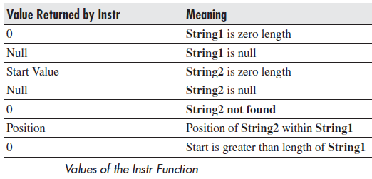
Searching Strings
InStr returns a value with respect to the search

Slide 12
Searching Strings
The InStrRev is the reverse version of InStr
It is searching the string2 within string1 from last character to the first (in right to left order)
Example:
MsgBox InStrRev("12Cem Yagli Cem 34", "Cem") ‘ Will return 13,
‘13 is the position of the first occurrence of “Cem”
‘ from the right to left search

Slide 13
Functions
Len
Len returns the number of characters in a string.
MsgBox Len("abc") ‘ The output is 3
Msgbox Len("shepherd") ‘ The output is 8
Abs
Abs stands for absolute value and returns a value of the unsigned magnitude.
MsgBox Abs(1) ‘ The output is 1
MsgBox Abs(-1) ‘ The output is again 1

Slide 14
Functions
Int
Int is returning the integer part of a real number. It does not round to the nearest whole number.
MsgBox Int(1.2) ‘ The output is 1
MsgBox Int(1.9) ‘ The output is still1
Sqr
Sqr returns the square root of a number.
MsgBox Sqr(4) ‘ The output is 4
MsgBox Sqr(3) ‘ The output is 1.734
MsgBox Sqr(100) ‘ The output is 10

Slide 15
Functions
Asc
Asc gives the ASCII (American Standard Code for Information Interchange) code for a given character. Values are from 0 to 255. The following will give the value of 65:
MsgBox Asc("A") ‘ The output is 65
MsgBox Asc("i") ‘ The output is 105
Note that this only works on the first character of the string:
MsgBox Asc("richard")
This will give 114, as this is the ASCII code for ‘r’.

Slide 16
Functions
Chr
Chr is the reverse of Asc; it takes an ASCII code number and converts it to a character.
MsgBox Chr(65) ‘ The output is “A”
MsgBox Chr(105) ‘ The output is “i”
Because this deals with the entire character set, it also includes nonprintable characters.
For example, ASCII code 13 is a carriage return, which can be useful if you want to force a carriage return on something like a message box:
MsgBox "This is " & Chr(13) & "a carriage return"

Slide 17
Conversion Functions
Conversion functions are used to convert a value from one format to another.
CStr
Cstr converts a value to a string.
str = Cstr(1234) ‘this statement produces the string "1234":
CInt
CInt converts a value or a string to an integer (2 bytes).
CInt does not work like the Int function, it rounds to the nearest whole number
If there are any non-numerical characters in the expression, you will get a Type Mismatch error.
MsgBox CInt (1.95) ‘ The output is 2
MsgBox CInt (“1.95”) ‘ The output is 2
MsgBox CInt("1.45") ‘ The output is 1

Slide 18
Conversion Functions
CLng
CLng converts a value or a string to a long integer (4 bytes).
MsgBox CLng(123456789.45) ‘ The output is 123456789
MsgBox CLng(“123456789.45”) ‘ The output is 123456789
MsgBox CLng(123456789.95) ‘ The output is 123456790
CDbl
CDbl converts a value or a string to a double-precision floating point number (eight bytes) where decimal places are allowed:
Dbl_var= CDbl("123.56789") ‘ assigns the value 123.56789.
Within CDbl, CLng, Cint functions, if there are any non-numeric characters in the expression, you will get a Type Mismatch error.

Slide 19
Conversion Functions
Val
Val converts a string to a value. It is more forgiving than CInt or CLng because it will accept nonnumeric characters:
intVar= Val("123") ‘ It assigns 123 to intVar
realVar= Val("123.45") ‘It assigns 123.45 to realVar
intVar = Val("12richard") ‘ It assigns 12 to intVar
intVar = Val("richard") ‘It assigns the value 0 to intVar,
‘meaning there are no numeric characters to evaluate

Slide 20
Format Function
The Format function does exactly the same thing as formatting a number or a date within a cell in a spreadsheet, except it does so from within the code itself.
If you wish to display a number in a message box or on a user form, this function is very useful for making it readable, particularly if it is a large number:
MsgBox Format(1234567.89, "#,###.#") ‘ It displays the value as 1,234,567.9

Slide 21
Format Function
In the format string, each # represents a digit placeholder.
The comma is used as thousands separator.
The full stop indicates the position of the decimal point.
You can also use the predefined format names as the format string
MsgBox Format(1234567.89, "Currency")
This will give the displayed result of $1,234,567.89, depending on the currency symbol in the Windows settings (e.g. pound sign for England or a euro sign for Europe.).

Slide 22
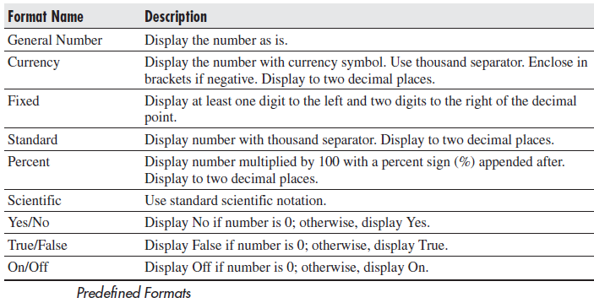
Format Function

Slide 23
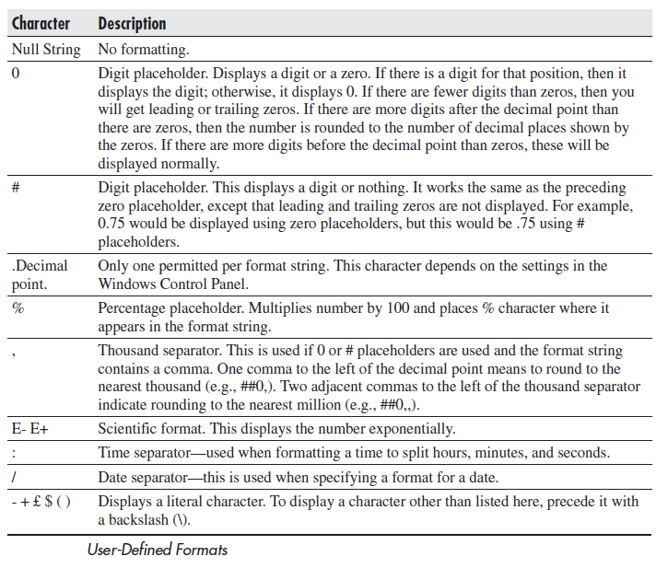
Format Function
There are a number of characters that can be used to define a user-defined format

Slide 24
Format Function
The format string can have up to four sections separated by semicolons (;).
These are so that different formats can be applied to different values, such as to positive and negative numbers. For example, you may wish to show brackets around a negative value:
MsgBox Format(-12345.67,"$#,##0;($#,##0)")

Slide 25
Format Function
The details depending on the number of sections of FORMAT function are listed here:

Slide 26
Date – Time Format Functions
There are also predefined date and time formats.
These are controlled by the time and date settings in the Windows Control Panel.
There are a number of characters that you can use to create user-defined date and time formats.
Here is an example of formatting the current time to hours, minutes, and seconds:
MsgBox Format(Now(), "hh:mm:ss AM/PM")

Slide 27
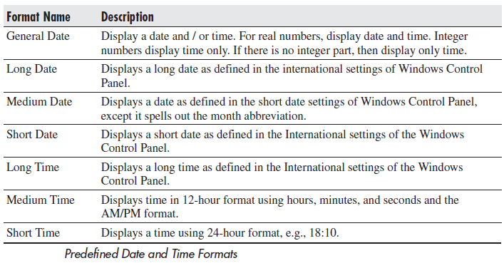
Date – Time Format Functions

Slide 28
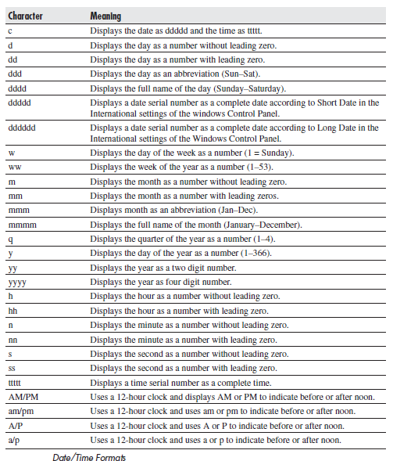
Date – Time Format Function
MsgBox Format(Now(), "hh:mm:ss AM/PM")
User Defined Format

Slide 29
Date – Time Format Function
Date formats, like number formats, can use sections.
One section only applies to all data;
Two sections means that the first section applies to all data and the second to zero-length strings and null.

Slide 30
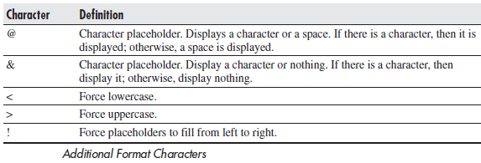
Format Function
You can also use the certain characters within your formatting string.
Some examples of the use of the Format function on numbers and strings are shown here:
MsgBox "This is " & Format("1000", "@@@,@@@")
MsgBox "This is " & Format("1000", "&&&,&&&")
MsgBox Format("richard", ">")

Slide 31
Date – Time Functions
Now
The Now function returns the current date and time:
MsgBox Now
This displays the short date and time formats from the Windows Control Panel.
Date
Date returns the current date in short format as defined in the Windows Control Panel:
MsgBox Date
Time
The Time function returns the current system time:
MsgBox Time

Slide 32
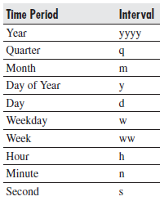
Date – Time Format Function
DateAdd
DateAdd allows the addition and subtraction of a specified time interval to a date.
The syntax is as follows:
DateAdd (interval, number, date)
Interval is a string that expresses the interval of time you want to add.
Number is a numeric that determines the number of intervals you want to add. A negative value is allowed and will cause subtraction from the date.
Date is the date being added to or the name of a variant containing the date.

Slide 33
Date – Time Format Function
DateAdd
This example will add one month to January and return 1-Feb-03:
MsgBox DateAdd ("m",1,"1-Jan-03")
The following will add two weeks and return
15-Jan-03 (depending on your date format):
MsgBox DateAdd ("ww",2,"1-Jan-03")
The following will subtract two days from
1 January 2003 and return 30-Dec-02:
MsgBox DateAdd ("d", -2, "1-Jan-03")

Slide 34
Date – Time Format Function
DateDiff
The DateDiff function returns the number of time intervals between two specified dates:
DateDiff (interval, date1, date2)
The date1 string indicates the start date, and date2 the end date.
MsgBox DateDiff("m", "1-jan-03", "15-mar-03")
This will return the result 2 because there are two months between 1-jan-03 and 15-mar-03.
Note that it rounds to the lower month.
If date2 was 30-mar-03, it would still return 2.
Only when date2 is 1-apr-03 , it will return 3.

Slide 35
Date – Time Format Function
DatePart
The DatePart function returns a specified part of a given date:
The DatePart syntax is as follows:
DatePart (interval, date)
MsgBox DatePart("q", "1-mar-03")
This will return the result 1 because 1-Mar-03 is in quarter 1.
MsgBox DatePart("m", "1-mar-03")
This will return the result 3 because March is the third month:

Slide 36
Date – Time Format Function
DateSerial
DateSerial returns the date serial for a specific year, month, and day entered as integers.
The date serial is the actual number representing that date:
DateSerial (year, month, day)
Year is a number between 100 and 9999 or a numeric expression
Month is a number between 1 and 12 or a numeric expression;
Day is a number between 1 and 31 or a numeric expression.

Slide 37
Date – Time Format Function
DateSerial
MsgBox CDbl(DateSerial(2003, 3, 6)) ‘ The output is 37686
You need to use CDbl (convert to double) in this code,
Or the message box will display the date as per the format in the Windows Control Panel rather than as an actual number.
DateValue
This function converts a date into a value.
the following will return the value 37686, which is the date 6-Mar-2003:
Msgbox CDbl(DateValue("06-Mar-2003"))

Slide 38
Date – Time Format Function
Day
This will return an integer between 1 and 31, representing the day of the month for the date expression given, as seen here:
Day (dateexpression)
Dateexpression can be a date string or it can be a numeric expression representing a date.
Both of the following return the value 6 for the sixth day of March because they represent the same date:
Msgbox Day(37686)
Msgbox Day("6-Mar-2003")

Slide 39
Date – Time Format Function
Hour
Hour returns an integer between 0 and 23 representing the hour of the day for the date expression:
Hour(dateexpression)
An example of a dateexpression could be “31-Dec-2002 12:00” or could be a time without the date, such as “09:00”:
MsgBox Hour("17:50")
This will return a value of 17 for the seventeenth hour.

Slide 40
Date – Time Format Function
Hour
The following will return a value of 16 because 4:30 in the afternoon is the sixteenth hour:
MsgBox Hour("6-Mar-2003 4:30pm")
The following will return the value of 11
11 divided by 24 is equal to .458333, which is the time value for 11:00 A.M.:
MsgBox Hour(11 / 24)

Slide 41
Date – Time Format Function
Month
Month returns an integer between 1 and 12, based on the date expression:
Month (dateexpression)
An example of a dateexpression could be “31-Dec-2002 12:00” or could be a time without the date, such as “09:00.”
The following will both return the value of 3 because both date expressions represent 6-Mar-2003:
Msgbox Month(37686)
Msgbox Month("6-Mar-2003")

Slide 42
Date – Time Format Function
Second
The Second function returns an integer between 0 and 59 based on the timeexpression representing the seconds of a minute:
Second(timeexpression)
An example of a timeexpression could be “31-Dec-2002 12:00” or could be a time without the date, such as “09:00.”
The following will return the value 48:
Msgbox Second("4:35:48pm")

Slide 43
Date – Time Format Function
Minute
The Minute function returns an integer from a time expression representing the actual minute of that time.
Msgbox Minute(11.27 / 24)
This will return the value 16, since 11.27 is 11:16:12 A.M.
This may look confusing because we are dealing with decimal parts of an hour.
The expression 11.27 is a decimal of an hour, so .27 is just over a quarter of an hour.
Msgbox Minute("4:35pm")
Msgbox Minute(11.25 / 24)

Slide 44
Date – Time Format Function
Year
The Year function returns an integer from a date expression representing the actual year value of that date:
Msgbox Year(37686)
Msgbox Year("6-Mar-2003")
Weekday
The Weekday function returns an integer between 1 (Sunday) and 7 (Saturday) that represents the day of the week for a date expression:
Weekday (dateexpression)
MsgBox WeekDay("6-Mar-2003")
This will return the value 5, which is Thursday.

Slide 45
Message Boxes
The message box is an easiest way to communicate with the user.
It only needs one command, and the line of text that you wish to display to provide a professional-looking message box onscreen.
MsgBox "Hello World“
You can very easily customize the message box’s title bar and icon to suit your needs.
MsgBox “Text", Type
This will cause the message box to look more professional, with a proper icon and a meaningful title.

Slide 46
Message Boxes
The Type variable can be any one of the following constants
MsgBox "Hello World", vbInformation

Slide 47
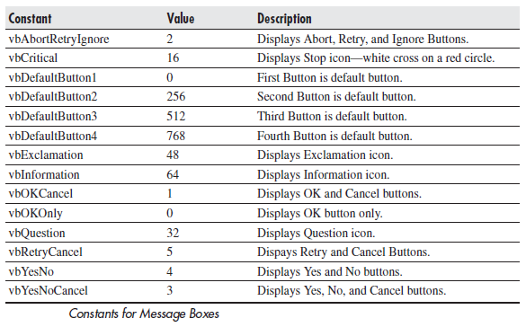
Message Boxes
If you want to add more or different buttons, such as Yes and No? Microsoft has built in a number of constants to allow for different button combinations and icons.

Slide 48
Message Boxes
The following is an example of the message box with Yes and No buttons and a defined caption:
MsgBox "Test message", vbYesNo, "My message“
You can combine icon and button constants with the Or operator:
x = MsgBox("Test Message", vbAbortRetryIgnore Or vbCritical)
This will display a message box with the Abort, Retry, and Ignore buttons and a Critical message icon.

Slide 49
Message Boxes
Displaying the buttons is relatively easy, but how do you detect when the user clicks a particular button?
You still need to write code to deal with the button that has been clicked.
You do this by collecting the response in a variable:
x = MsgBox ("Test Yes No",vbYesNo,"Test")
Msgbox x
Note that in this instance you use x = and put parentheses around the parameters. Without the brackets, you will get an error because you are calling a function, which needs the parentheses to show the parameters

Slide 50
Message Boxes
This example will show a two-button message box (Yes and No).
If Yes is clicked, the following message box will show 6 (vbYes).
If No is clicked, the message box will show 7 (vbNo).
You can then write your code to specify what will happen according to which action is taken:
If x = vbYes Then Action1 Else Action2

Slide 51
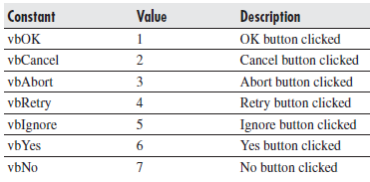
Message Boxes

