Slide 1
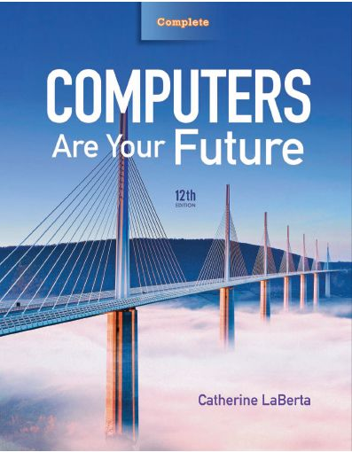
Computers Are Your Future Twelfth Edition
Chapter 3: Input/Output and Storage

Slide 2
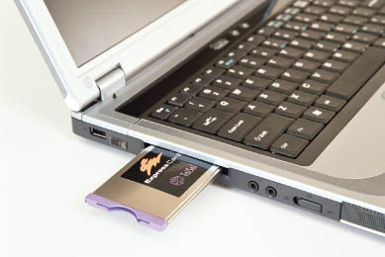
Input/Output & Storage

Slide 3
Objectives
Explain the various types of keyboards and the purpose of the special keys on the keyboard, identify the commonly used pointing devices, and list alternative input devices.
List the types of monitors and the characteristics that determine a monitor’s quality.

Slide 4
Objectives
Identify the two major types of printers and indicate the advantages and disadvantages of each.
Distinguish between memory and storage.
Discuss how storage media and devices are categorized and how data is stored on a hard drive.

Slide 5
Objectives
List factors that affect hard disk performance.
Explain how data is stored on flash drives.

Slide 6
Objectives
List and compare the various optical storage media and devices available for personal computers.
Describe solid-state storage devices and compare them with other types of storage devices.

Slide 7
Input Devices: Giving Commands
Input
Data or instructions entered into a computer
Input device
Hardware that gives users the ability to enter data and instructions into the computer’s random access memory (RAM)

Slide 8
Input Devices: Giving Commands
Input device (con’t.)
Keyboard
Most common input device—enables data and instruction entry through the use of a variety of keys
Enhanced keyboards—additional keys, such as media control buttons to adjust speaker volume, or Internet control buttons that open e-mail, a browser, or a search window with a single keystroke

Slide 9
Input Devices: Giving Commands

Slide 10
Input Devices: Giving Commands
Key matrix
Grid of circuits located under the keys
Character map
Chart that tells the processor what key has been pressed

Slide 11
Input Devices: Giving Commands
Insertion point
Blinking vertical line, underscore, or highlighted box
Wireless keyboards
Connect to the computer through infrared (IR), radio frequency (RF), or Bluetooth connections

Slide 12
Input Devices: Giving Commands
Keyboards
Connect with:
Universal Serial Bus (USB) connector
PS/2 cable
Infrared
Radio frequency
Bluetooth

Slide 13
Input Devices: Giving Commands
Special keyboard keys include:
Cursor movement keys (arrow keys)—set of four keys that move the cursor up, down, right, or left
Toggle keys—either on or off
Function keys—perform specific actions depending on the program
Modifier keys—used for shortcuts

Slide 14
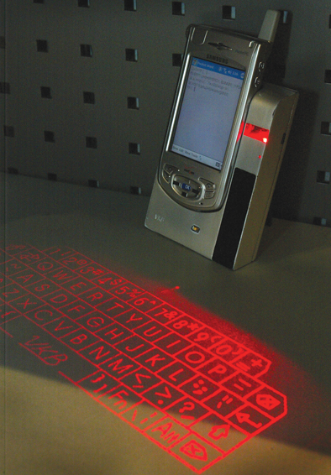
Input Devices: Giving Commands
Alternate keyboards
Virtual (soft keyboard or on-screen keyboard)—a touch-sensitive screen; accepts input with a stylus or finger
Smartphone
Mini-keyboard—keys for each letter of the alphabet; option on many smartphones
Keypad—smaller, more compact, has keys that represent multiple letters
Virtual laser—used with devices as smartphones, an alternate way to do e-mail, word processing, spreadsheets

Slide 15
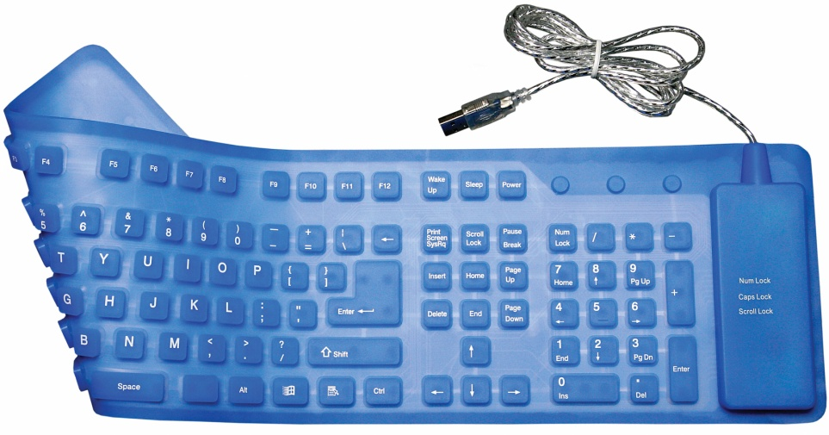
Input Devices: Giving Commands
Alternate keyboards (con’t.)
Flexible keyboards—full-sized, lightweight portable devices
Wireless keyboards for media center PCs—allow users to control media components

Slide 16
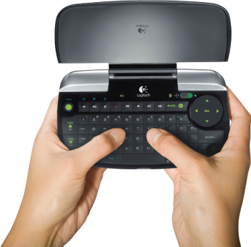
Input Devices: Giving Commands
Media center PCs
All-in-one entertainment devices
Make it easy to access photos, TV, movies, and online media by using a remote control
Uses
Remote controls
Remote miniature keyboards

Slide 17
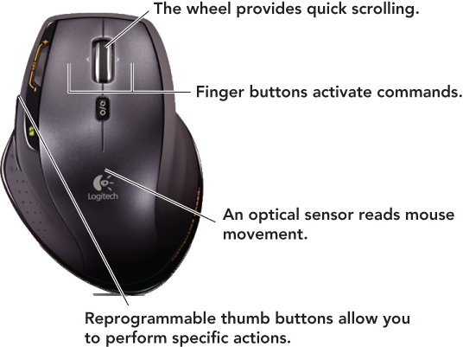
Input Devices: Giving Commands
Pointing device
Controls an on-screen pointer’s movements
Pointer
On-screen symbol that signifies the command, input, or possible response

Slide 18
Input Devices: Giving Commands
Mice
Optical—most popular pointing device
Travel—all the capabilities of a normal mouse, half the size
Wheel—has a wheel for easy vertical scrolling
Wireless—connects through an infrared or radio signal (RF)
Air—does not need to work on a surface, works as it moves through the air

Slide 19
Input Devices: Giving Commands
Mice alternatives
Trackball
Pointing stick
Touchpad (also called a trackpad)
Click wheel
Joystick
Stylus
Touch screen

Slide 20
Input Devices: Giving Commands
Alternative input devices include:
Microphones for speech or voice recognition
Scanner for optical character recognition (OCR)
Bar code reader
Optical mark reader (OMR)
Radio frequency identification (RFID reader)
Magnetic-ink character recognition (MICR reader)
Magnetic stripe care reader
Biometric input device
Digital cameras and digital video cameras
Webcams

Slide 21
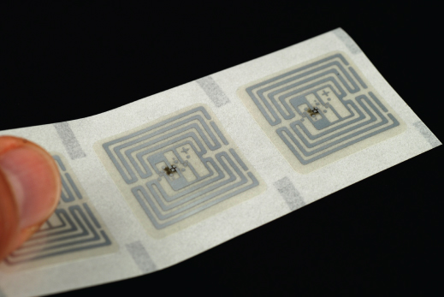
Input Devices: Giving Commands

Slide 22
Output Devices: Engaging Our Senses
Output devices
Enable users to see, hear, or feel the end result of processing operations
The two most popular output devices
Monitors (also called displays)
Printers

Slide 23
Output Devices: Engaging Our Senses
Monitors
Display a temporary copy (soft copy) of processed data
Types of monitors include:
Cathode-ray tube (CRT)—legacy technology
Liquid crystal display (LCD)

Slide 24
Output Devices: Engaging Our Senses
Monitors (con’t.)
LCD (flat-panel) displays:
Have a thin profile
Are used with newer desktops and notebooks
Have largely replaced CRT monitors
May accommodate high-definition video

Slide 25
Output Devices: Engaging Our Senses
Monitors (con’t.)
Passive-matrix (Also known as dual scans)
Least expensive
Too slow for full-motion video
Electrical current charges groups of pixels
Active-matrix (also known as thin-film transistor [TFT] technology)
Used for better on-screen color quality
Charges each pixel individually as needed

Slide 26
Output Devices: Engaging Our Senses
Monitors (con’t.)
Size is diagonal measurement
Size is straightforward for LCDs but more complex for CRTs.
Quoted size—the size of the screen
Viewable area—the area unobstructed by the housing
Both must be disclosed by the manufacturer.

Slide 27
Output Devices: Engaging Our Senses
Resolution
Refers to the sharpness of an image
Number of pixels (picture elements) controls the resolution
Video Graphics Array (VGA)—lowest resolution standard (640 × 480)
Extended Graphics Array (XGA)—most used by computers today (1024 × 768)

Slide 28
Output Devices: Engaging Our Senses
Field-emission displays (FEDs)
Considered more rugged; better in harsh environments
Operate similar to an LCD monitor
Tiny stationary carbon nanotubes illuminate each on-screen pixel
Televisions as monitors
High-definition (HDTVs)
Higher resolution (usually 1920 × 1080 or better)
Require a HDTV tuner
Needs a video card with digital video interface (DVI) or high-definition multimedia interface (HDMI) port on PC

Slide 29
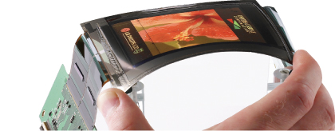
Output Devices: Engaging Our Senses
Organic light emitting diode (OLED) displays
Emit light rather than modulate transmitted or reflected light
Flexible OLED displays (FOLED)
Can be paper thin and appear as posters on the wall
Can be worn on wrist and used to watch movies or surf the Web

Slide 30
Output Devices: Engaging Our Senses
Printers
Supply a hard copy of output displayed on a computer’s monitor
Types include:
Inkjet
Laser
Dot-matrix
Thermal-transfer (sometimes called dye sublimation printers)
Photo
Plotters

Slide 31
Output Devices: Engaging Our Senses
Printers (con’t.)
Inkjet (nonimpact)—popular with home users
Provide excellent images—made up of small dots
Advantages:
Inexpensive
Generate professional color output
Disadvantages:
Relatively slow

Slide 32
Output Devices: Engaging Our Senses
Printers (con’t.)
Laser (nonimpact)
Use electrostatic reproductive technology to produce high-quality output
Advantages:
High-resolution
Print faster than inkjet printers
Black-and-white printing costs less per page than inkjet printing
Disadvantages
Color laser printers more expensive

Slide 33
Output Devices: Engaging Our Senses
Printers (con’t.)
Dot-matrix (impact)
Older, less popular
Used mostly for printing multipart forms and backup copies
Advantages
Able to print 3,000 lines per minute
Disadvantages
Poor print quality
Noisy

Slide 34
Output Devices: Engaging Our Senses
Printers (con’t.)
Thermal-transfer (dye sublimation printers)
Thermal-wax or direct thermal
Use heat process
Advantages
High-quality images from the high-quality thermal-wax printers
Popular for mobile printing
Disadvantages
High-quality thermal printers expensive

Slide 35
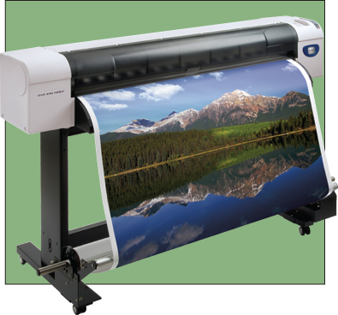
Output Devices: Engaging Our Senses
Printers (con’t.)
Photo
Uses special ink and paper
Often are inkjet printers
Prints directly from a digital camera or memory card
Plotters
Produce images through moving ink pens
Used for making oversized prints (i.e., maps, charts, blueprints)

Slide 36
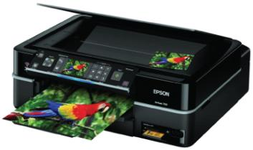
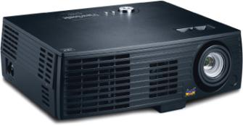
Output Devices: Engaging Our Senses
Other output devices include:
Speakers
LCD projectors
DLP (digital light-processing) projectors
Multifunction devices

Slide 37
Storage: Holding Data for Future Use
Storage
Process of saving software and data
Also called mass storage, auxiliary storage, or secondary storage

Slide 38
Storage: Holding Data for Future Use
Storage devices
Hardware that contains the tools to place data on the recording media
Recording media—hold data
Hard disks
Floppy disks
Flash memory
CDs and DVDs

Slide 39
Storage: Holding Data for Future Use

Slide 40
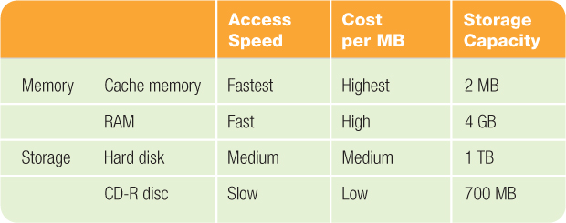
Storage: Holding Data for Future Use
Memory (RAM) versus storage
Storage devices retain data even if power is turned off
Data stored in memory (RAM) will be lost
Storage devices are less expensive than memory

Slide 41
Storage: Holding Data for Future Use
Memory (RAM)
Primary memory
Temporary holding area for items in use
Primary storage
Storage devices
Required during the computer system’s start-up operations
Used as an output device for saving data

Slide 42
Storage: Holding Data for Future Use
Hard disk drive (hard drive)
Most important storage device
High-capacity, high-speed device
Considered secondary storage (online; fixed storage), compared with memory/RAM, which is categorized as primary storage
Random access storage devices—permit direct retrieval of desired data
Contain a coating of magnetic material used for data storage

Slide 43
Storage: Holding Data for Future Use
Platters—rapidly rotating disks on which programs, data, and processed results are stored
Tracks—concentric bands on which data is recorded
Are divided into sectors
Two or more sectors is a cluster.

Slide 44
Storage: Holding Data for Future Use

Slide 45
Storage: Holding Data for Future Use
The computer’s operating system stores a file’s name and its location on the disk in a table.
New technology file system (NTFS)
The present system used for tracking file locations in:
Windows NT
Windows 2000
Windows XP
Windows Vista
Windows 7

Slide 46
Storage: Holding Data for Future Use
Partitions
Portion of a hard disk set aside as if it were a physically separate disk
Often used to house different operating systems
Allows users to use programs developed for different systems

Slide 47
Storage: Holding Data for Future Use
Hard disk performance
Affected by bad sectors—damaged portions of the disk that cannot reliably hold data
Positioning performance—how quickly the read/write head can get into position to transfer data
Transfer performance—how quickly the transfer is made from the disk to storage

Slide 48
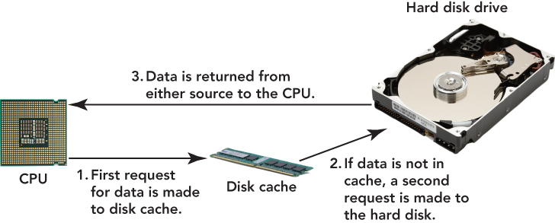
Storage: Holding Data for Future Use
Hard disk performance (con’t.)
Disk cache—type of cache memory
CPU looks here first before the hard disk
Using the disk cache speeds up data retrieval

Slide 49
Storage: Holding Data for Future Use
Network attached storage (NAS)
Permits retrieval or storage of data by any computer connected to the network
Remote storage (Internet hard drive)
Storage on a server that is available through the Internet

Slide 50
Storage: Holding Data for Future Use
Flash drive (solid-state drive [SSD])
Storage devices that use solid-state circuitry; have no moving parts
Increasing in use
Flash memory
Nonvolatile electronic memory stored in blocks on a chip
Limited to 100,000 write cycles

Slide 51
Storage: Holding Data for Future Use
Hybrid hard drives (HHDs)
Incorporate flash technology to speed up the boot process
USB flash drives (memory stick, thumb drive, jump drive)
Popular portable or removable storage devices
Replace legacy technology of floppy disks and Zip disks
Do not require a device driver
Should be removed only when not actively in use

Slide 52
Storage: Holding Data for Future Use
CD drives and DVD drives
Optical storage devices
Use laser beams to store data through:
Pits, the indentations, a binary 0
Lands, the flat reflective areas, a binary 1
Optical discs
CD-ROM or DVD-ROM (compact or digital video disc read-only memory)
Data can be read, not altered
Most popular, least expensive

Slide 53
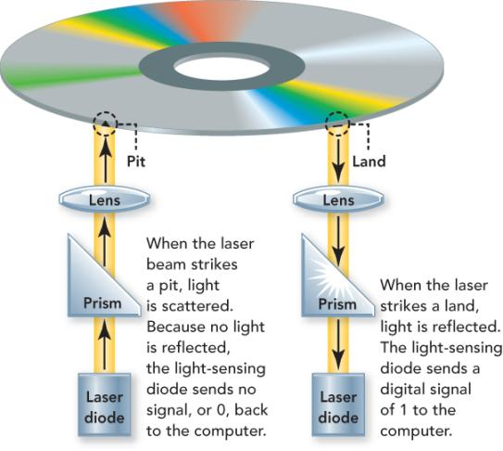
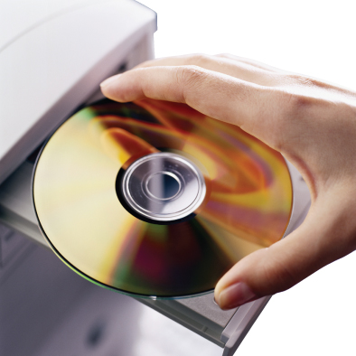
Storage: Holding Data for Future Use

Slide 54
Storage: Holding Data for Future Use
Additional types of optical storage
CD-R (CD-recordable)
CD-RW (CD-rewritable)
DVD+R (DVD recordable; plus)
DVD-R (DVD recordable; dash)
DVD+RW (DVD rewritable; plus)
DVD-RW (DVD rewritable; dash)
BD-ROM (Blu-ray Disc read only)
BD-R (BD recordable)
BD-RE (BDisc rewritable)

Slide 55
Storage: Holding Data for Future Use
Protect your discs
Do not expose discs to excessive heat or sunlight.
Do not touch the underside of the disc—hold the edges.
Do not write on the label side of the disc with a hard implement.
Do not stack discs.
Store discs in cases when not in use.

Slide 56
Storage: Holding Data for Future Use
Solid-state storage devices
No moving parts
Nonvolatile
ExpressCard
Notebook accessory—size of a credit card
Can be used as a modem, as extra memory, or as a network adapter

Slide 57
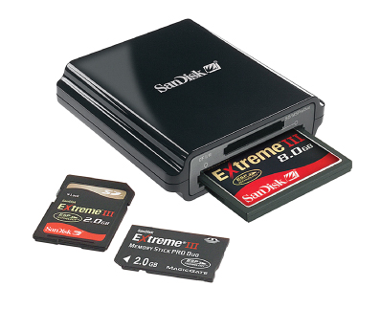
Storage: Holding Data for Future Use
Flash memory cards
Solid-state storage device
Used with MP3 players, smartphones, digital cameras
Flash memory reader
Slot or compartment allows access to files stored on the card

Slide 58
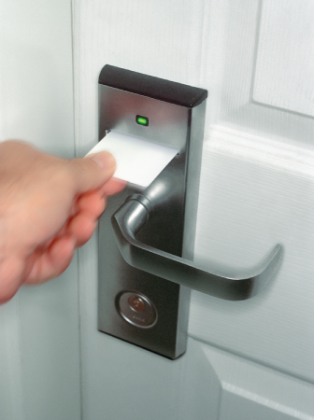
Storage: Holding Data for Future Use
Smart card/chip card/integrated circuit card (ICC)
Combines flash memory with a small microprocessor
Stores and processes information
Digital cash system—smart card application enables users to purchase a prepaid amount of electronically stored money

Slide 59
Storage: Holding Data for Future Use
Holographic storage
May make high-density storage possible
Able to create 3-D images
Eye-Fi wireless memory card
Combines standard flash memory card features with wireless circuitry
Enables a direct wireless network connection to devices such as digital cameras

Slide 60
Storage: Holding Data for Future Use
Racetrack memory
Under development—possible replacement for flash memory and hard drives
Will operate at higher speeds and consume less power

Slide 61
Storage: Holding Data for Future Use
Backup
Copy of programs, data, and information created in one secondary storage medium duplicated to another
Secondary storage devices, such as USB drives and portable (external) hard drives, can be damaged or “lost.”
Prevents permanent loss of programs, data, and information
Keep on a regular schedule

Slide 62
Summary
Explain the various types of keyboards and the purpose of the special keys on the keyboard, identify the commonly used pointing devices, and list alternative input devices.
List the types of monitors and the characteristics that determine a monitor’s quality.

Slide 63
Summary
Identify the two major types of printers and indicate the advantages and disadvantages of each.
Distinguish between memory and storage.
Discuss how storage media and devices are categorized and how data is stored on a hard drive.

Slide 64
Summary
List factors that affect hard disk performance.
Explain how data is stored on flash drives.

Slide 65
Summary
List and compare the various optical storage media and devices available for personal computers.
Describe solid-state storage devices and compare them with other types of storage devices.

Slide 66
All rights reserved. No part of this publication may be reproduced, stored in a retrieval system, or transmitted, in any form or by any means, electronic, mechanical, photocopying, recording, or otherwise, without the prior written permission of the publisher. Printed in the United States of America.
Copyright © 2012 Pearson Education, Inc.
Publishing as Prentice Hall

