Slide 1
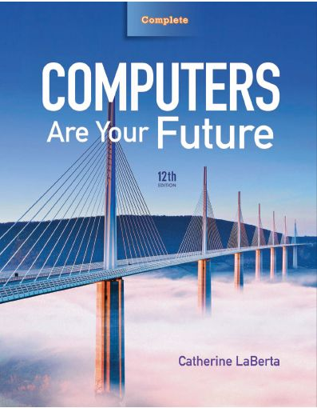
Computers Are Your Future Twelfth Edition
Chapter 1: Computers and You

Slide 2
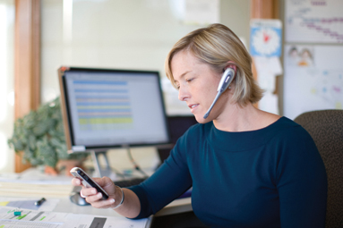
Computers and You

Slide 3
Objectives
List some important milestones in computer evolution.
Define the word computer and name the four basic operations that a computer performs.
Describe the two main components of a computer system: hardware and software.

Slide 4
Objectives
Provide examples of hardware devices that handle input, processing, output, and storage tasks.
Give an example of the information processing cycle in action.
Discuss the two major categories and the various types of computers.

Slide 5
Objectives
Explain the advantages and disadvantages of computer use.
Recognize the ethical and societal impacts of computer usage.
Discuss how computers affect employment.
List ways to be a responsible computer user.

Slide 6
Computers: Yesterday, Today, and Tomorrow
Computers
Integral to our daily lives
Millions use computers daily.
Applications
Word processors
Internet
Online banking
Online classes
GPS systems
ATM machines
Mobile phones
Weather prediction

Slide 7
Computers: Yesterday, Today, and Tomorrow
Computers (con’t.)
Used at:
Home
Work
School
Embedded into:
Cars
Phones
Cameras

Slide 8
Computers: Yesterday, Today, and Tomorrow
History of Computers 1939–1981
Hewlett-Packard founded–1939
ENIAC unveiled (increased computing speed by 1,000x)–1946
Commodore Business Machines founded–1965
Xerox opens Palo Alto Research Center–1970
Steve Wozniak designed the Apple I–1976
IBM introduced the PC–1981

Slide 9
Computers: Yesterday, Today, and Tomorrow
History of Computers 1990–2009
HTML developed; World Wide Web born–1990
Netscape and Yahoo founded–1994
Microsoft releases Windows 95–1995
Microsoft’s Bill Gates resigns–2000
YouTube founded; Windows Vista announced–2005
Amazon releases the Kindle; Google releases Android–2007
Microsoft releases Windows 7–2009

Slide 10
Computers: Yesterday, Today, and Tomorrow
Before computers
There were
No telephone answering machines
No handheld calculators
No fax machines
No personal computers
People
Wrote letters by hand or with a typewriter
Kept track of data and numbers in ledgers
Communicated in person or over the telephone

Slide 11
Why learn about computers?
Pervasive computing
Also known as ubiquitous computing
Computers have become an integral part of our lives
Basic computer literacy
Knowing about and understanding computers and their uses is an essential skill today for everyone

Slide 12
Before 1980
Computers were large, expensive
Very few people had access to them
Computers were mostly used for high-volume processing tasks
Microcomputers in the early 80s
Inexpensive personal computers
Computer use increased dramatically

Slide 13
Today
More than 80% of US households include a computer, and most use computers at work
Electronic devices are converging into single units with multiple capabilities
Computer is no longer an isolated productivity tool
Check e-mail on living room television
View internet content on mobile phone or other mobile device
Computer literacy
Knowing about and understanding computers and their uses is an essential skill for everyone

Slide 14
Computers used for a variety of tasks:
Looking up information and news
Exchanging e-mail
Shopping and paying bills
Watching TV and videos
Downloading music and movies
Organizing digital photographs
Playing games
Making vacation plans

Slide 15
Wireless networking
Computers can be used in nearly any location
Smart appliances
Traditional appliances with built-in computer or communication technology
Smart homes
Household tasks are monitored and controlled by a main computer in the house

Slide 16
The computer as we know it is a fairly recent invention
The history of computers is often referred to in terms of generations
Each new generation is characterized by a major technological development
Precomputers and early computers (before 1946)
Abacus, slide rule, mechanical calculator
Punch Card Tabulating Machine and Sorter

Slide 18
First-generation computers (1946-1957)
Enormous and powered by vacuum tubes
Used a great deal of electricity and generated a lot of heat
ENIAC and UNIVAC
Second-generation computers (1958-1963)
Used transistors
Computers were smaller, more powerful, cheaper, more energy-efficient, and more reliable
Punch cards and magnetic tape were used to input and store data

Slide 20
Third-generation computers (1964-1970)
Used integrated circuits (ICs)
Keyboards and monitors introduced
Fourth-generation computers (1971-present)
Use microprocessors
IBM PC, Apple Macintosh
Use keyboards, mice, monitors, and printers
Use magnetic disks, flash memory, and optical disks for storage
Computer networks, wireless technologies, Internet introduced

Slide 21
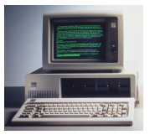

Slide 22
Fifth-generation (now and the future)
Infancy stage
No precise classification
May be based on artificial intelligence (AI)
Will likely use voice and touch input
May be based on optical computers and utilize nanotechnology

Slide 23
Computer Fundamentals
Computer—device that performs the information-processing cycle
Information-processing cycle
Consists of four basic operations:
Input
Processing
Output
Storage

Slide 24
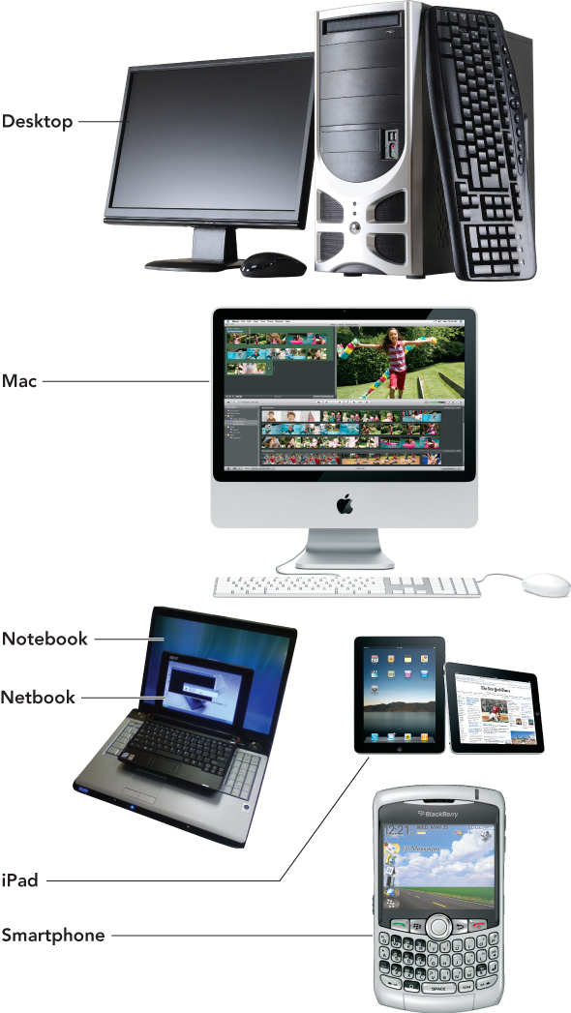
Computer Fundamentals

Slide 25
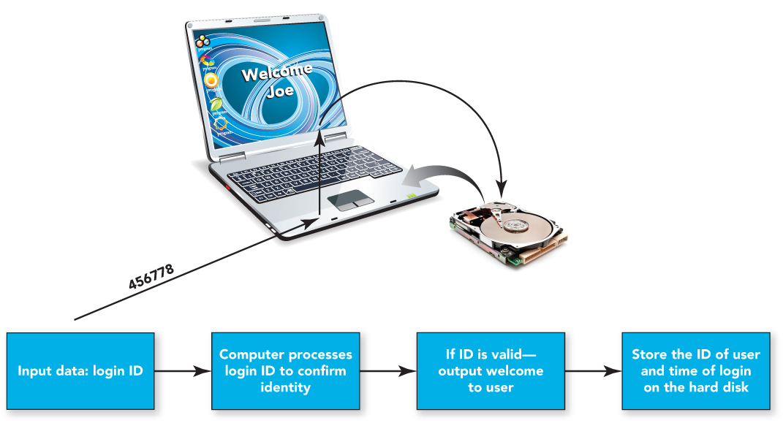
Computer Fundamentals

Slide 26
Computer Fundamentals
Computer system—group of associated components that work together
Hardware
Software

Slide 27
Computer Fundamentals
Hardware
Physical parts of the computer
Includes such components as the system unit, monitor, keyboard, and printer
Motherboard
Circuit board that connects the central processing unit(s) to the other system components

Slide 28
Computer Fundamentals
System unit
Base unit of the computer—made up of the plastic or metal enclosure, the motherboard, and the integrated peripherals

Slide 29
Computer Fundamentals
Input
First operation of the information-processing cycle, enables the computer to accept data
Data
Facts that are raw and unorganized
Entered into the computer for processing through the use of input devices such as a keyboard or mouse

Slide 30
Computer Fundamentals
Processing
Second operation of the information-processing cycle, converts data into information
Information refers to consolidated, organized, processed data.
The central processing unit (CPU) processes data into information.
Random access memory (RAM) temporarily stores programs and data needed by the CPU.

Slide 31
Computer Fundamentals
Output
Third operation of the information-processing cycle, requires output devices, such as monitors and printers to display results for people to see or hear

Slide 32
Computer Fundamentals
Storage
Fourth operation of the information-processing cycle, holds programs, software, and data that the computer system uses
Storage devices
Hard drives, CD and DVD drives, and media card readers—used with USB drives and flash memory cards

Slide 33
Computer Fundamentals

Slide 34
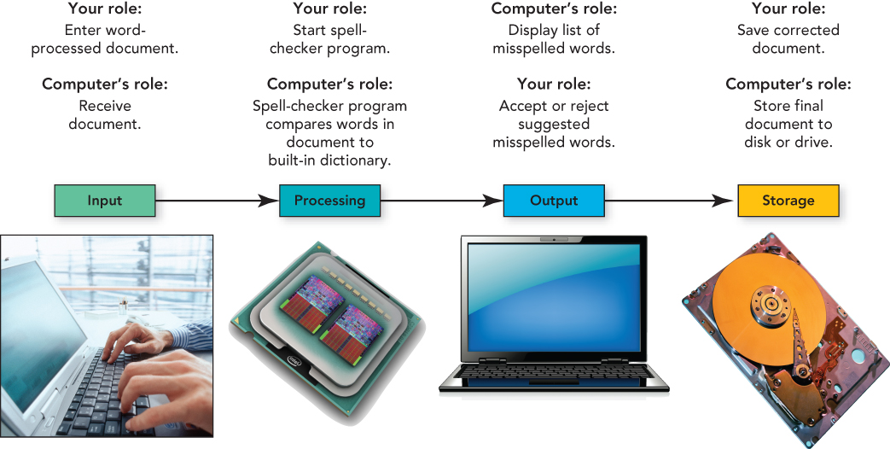
Computer Fundamentals

Slide 35
Computer Fundamentals
Communications
High-speed movement of data or information
Communication device
Hardware component that moves data in and out of a computer
Network
Connects two or more computers to share input/output devices and other resources through the use of a network interface card

Slide 36
Types of Computers
Computers can be separated into two main types:
Individual—designed for one user at a time
Organization—designed to be used by many people at the same time

Slide 37
Types of Computers
Individual computers
Personal computers (PCs)—either Mac (Apple’s Macintosh) systems or IBM-compatible systems
Desktop computers—designed for home or office use, now include all-in-one computers that combine the system unit and the monitor
Portable computers include notebooks, subnotebooks, and table PCs
Notebooks—small enough for easy computer mobility
Subnotebooks—run full desktop operating systems but have fewer components than notebooks, weigh less, are smaller
Tablet PCs—input data with a keyboard or mouse; can write on the monitor with a special pen or stylus

Slide 38
Types of Computers
Individual computers (con’t.)
Wireless devices—handheld computers, netbooks, personal digital assistants (PDAs), smartphones, e-books
Netbooks—small, inexpensive notebooks designed primarily for wireless Web browsing and e-mail
Smartphones—combine the capabilities of handheld computers, such as PDAs, and mobile phones
Professional workstations—intended for technical applications that need powerful processing and output

Slide 39
Types of Computers

Slide 40
Types of Computers
Organization computers
Servers—enable users connected to a computer network to have access to the network’s programs, hardware, and data
Clients—include the user computers connected to the network
Client/server network—includes the use of client computers with centralized servers

Slide 41
Types of Computers
Organization computers (con’d.)
Minicomputers (midrange servers)—designed to meet the needs of smaller companies or businesses
Mainframes—very large processing jobs to meet the needs of large companies or agencies of the government
Supercomputers—able to perform extremely high-speed processing and show underlying patterns

Slide 42
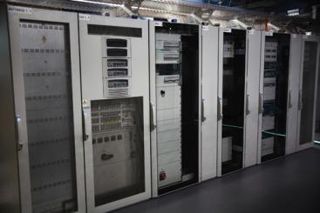
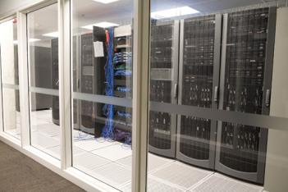
Types of Computers

Slide 43
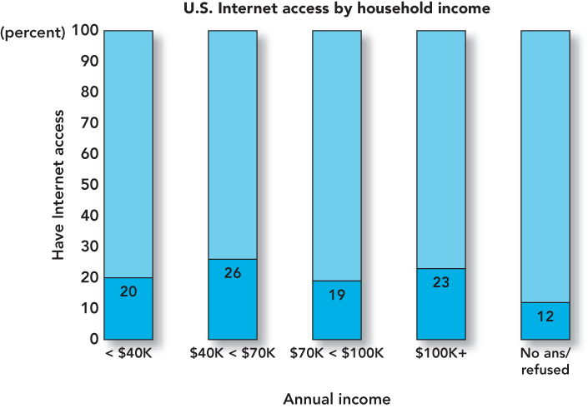
Computers, Society, and You
The Digital Divide

Slide 44
Computers, Society, and You
Web-based applications
Internet messaging (IM)—free, real-time connection
Two or more parties can use a buddy list to identify and restrict the contacts the person wishes to communicate with
Social networks—include Facebook, MySpace, LinkedIn, and Twitter

Slide 45
Computers, Society, and You
Collaborative work
Computer forensics—branch of forensic science that deals with legal evidence found on computers, and is used to find and apprehend criminals
Collaborative software includes:
Google Docs—free Web-based word processor and spreadsheet
Wiki—collection of Web pages designed to let anyone with access contribute or modify content
Google Groups—free service that helps users connect, share information, and communicate effectively over the Web

Slide 46
Computers, Society, and You
Advantages and Disadvantages of Computer Use

Slide 47
Computers, Society, and You
When using computer hardware:
Do not plug too many devices into electrical outlets.
Use surge protectors.
Place hardware where it can’t fall or be damaged.
Provide adequate space for air circulation around hardware.
Securely fasten computer cables, cords, and wires.

Slide 48
Computers, Society, and You
Ergonomics—field of study concerned with the fit between people and their work environment
Carpal tunnel syndrome (repetitive strain injury or cumulative trauma disorder)—caused by repeated motions that damage nerves in hands, wrists, and arms

Slide 49
Computers, Society, and You
Promote safety and comfort
Position top of your monitor at eye level
Tilt the monitor back 10 to 20 degrees
Place it at least 20” from your eyes
Keep your wrists flat—use a wrist rest if needed
Rest your eyes often by focusing on an object 20 or more feet away
Stand and stretch periodically

Slide 50
Computers, Society, and You
Software programs
Contain flaws
Errors cause programs to run slowly or miscalculate.
Bugs are almost impossible to eliminate completely.

Slide 51
Computers, Society, and You
Computer ethics
Moral dilemmas relating to computer usage
Digital piracy
Unauthorized reproduction and distribution of computer-based media
Unethical behavior
Sending viruses, stealing credit card information, computer stalking, and installing illegitimate copies of software on computers

Slide 52
Computers, Society, and You
Computers provide those who are disabled and disadvantaged with added support and opportunities
E-learning
Learning without requiring students to be at a specific location at a specific time

Slide 53
Computers, Society, and You
Automation
Replacement of people by machines and computers
Outsourcing
Subcontracting of portions of a job to a third party to reduce cost, time, and energy.
Computer technology
Aided globalization and the resulting outsourcing of jobs, as well as structural unemployment—the obsolescence of certain jobs.

Slide 54
Computers, Society, and You
Be a responsible computer user:
Understand how your computer use affects others.
Obey laws and conform to requests regarding use of cell phones.
Be aware of e-waste and the proper disposal of outdated computer hardware.

Slide 55
Computers, Society, and You
Advances in computer technology
Upgrade software to obtain the latest software features.
Stay informed to help avoid computer viruses.

Slide 56
Summary
Define the word computer and name the four basic operations that a computer performs.
Describe the two main components of a computer system: hardware and software.

Slide 57
Summary
Provide examples of hardware devices that handle input, processing, output, and storage tasks.
Give an example of the information processing cycle in action.
Discuss the two major categories and the various types of computers.

Slide 58
Summary
Explain the advantages and disadvantages of computer use.
Recognize the ethical and societal impacts of computer usage.
Discuss how computers affect employment.
List ways to be a responsible computer user.

Slide 59
All rights reserved. No part of this publication may be reproduced, stored in a retrieval system, or transmitted, in any form or by any means, electronic, mechanical, photocopying, recording, or otherwise, without the prior written permission of the publisher. Printed in the United States of America.
Copyright © 2012 Pearson Education, Inc.
Publishing as Prentice Hall

