Slide 1
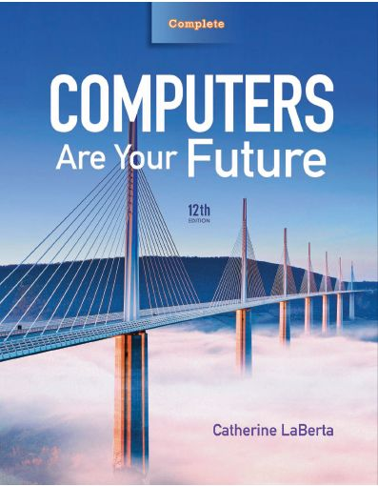
Computers Are Your Future Twelfth Edition
Spotlight 1: Ethics

Slide 2
Ethics

Slide 3
Computer Ethics for Computer Users
Computer ethics
Take basic ethical principles and applies them to daily computer use
Ethical principle
Justification used to determine whether a rule or act is morally right or wrong
Uses standards that promote trust, fairness, good behavior, and kindness

Slide 4
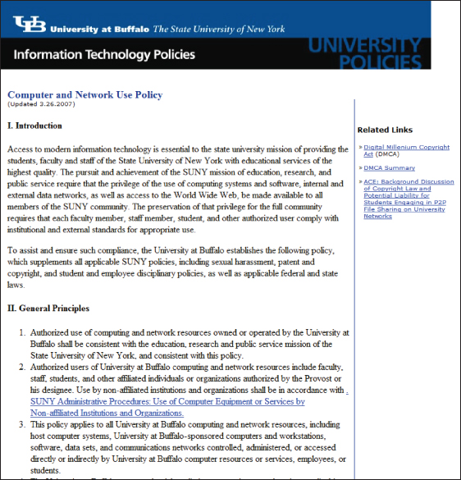
Computer Ethics for Computer Users
Follow your school’s code of conduct:
Acceptable-use policy (code of conduct)—set of rules to follow when using computers at school or a place of business

Slide 5
Computer Ethics for Computer Users
Rules for using school and business computers:
Respect yourself
Don’t give account passwords to others
Don’t use the Internet inappropriately
Respect others
Do not threaten or harass anyone
Share computer resources
Act professionally

Slide 6
Computer Ethics for Computer Users
Rules (con’t.)
Respect academic integrity
Cite text copied from the Internet
Obtain permission to use pictures from the Internet
Don’t copy or distribute software unless you have permission to do so
Classroom computer etiquette is an important academic issue

Slide 7
Computer Ethics for Computer Users
Ten Commandments for Computer Ethics—Background
Developed by the Computer Ethics Institute of the Brookings Institution
Applicable for computer programmers, system designers, and all computer users

Slide 8
Computer Ethics for Computer Users
Ten Commandments:
Do not use a computer to harm other people
Do not interfere with other people’s computer work
Do not snoop around in other’s computer files
Do not use a computer to steal
Do not use a computer to bear false witness

Slide 9
Computer Ethics for Computer Users
Ten Commandments (con’t.):
Do not copy or use proprietary software for which you have not paid
Do not use other’s computer resources without authorization or proper compensation
Do not appropriate other’s intellectual output
Do think about social consequences of the program you are writing or system you are designing
Always use a computer in ways that ensure consideration and respect for your fellow human beings

Slide 10
Computer Ethics for Computer Users
Netiquette
Guidelines for using the Internet
More respectful environment
Discussion Forums
Postings should be helpful or ask question
Never post in anger

Slide 11
Computer Ethics for Computer Users
Netiquette (con’t.)
E-mail
Check daily
E-mail is not private; be professional
Instant Messages
Ideal for brief conversations
Don’t share bad news or major announcements
Chat Rooms
Follow rules
Respect others; avoid foul language

Slide 12
Computer Games: Too Much Violence?
Video gaming
Growing
Psychologists are not in agreement regarding the effects of playing violent computer video games
Are becoming more violent

Slide 13
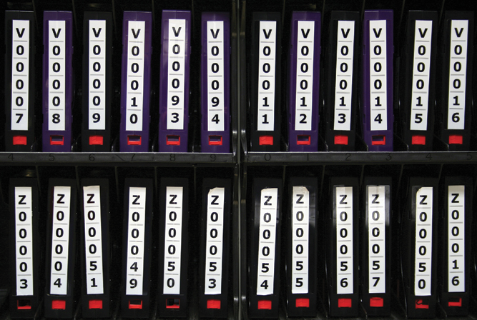
Computer Ethics for Organizations
Employees—should not conduct personal business on computers at work
Businesses should protect data
From being lost or damaged and from inaccuracies and misuse
Backup procedures
Continuous backups

Slide 14
Computer Ethics for Computer Professionals
Codes of conduct
ACM
Institute for Certification of Computing Professionals
Code of ethics for computer professionals are:
Protecting human life
Safeguarding others from harm or injury

Slide 15
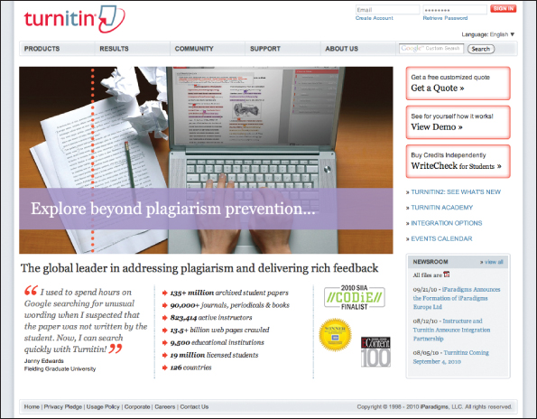
It’s Not Just Unethical, It’s Illegal Too
Plagiarism
Use of another’s ideas, writings, or intellectual property without permission; unethical and illegal
Practiced for a long time; it’s now easier—because of the Internet

Slide 16
It’s Not Just Unethical, It’s Illegal Too
Copyright infringement
When copyrighted material is plagiarized
Fair use
Allows limited use of copyrighted material for research, education, and commentary
Brief selection for purpose of commentary, parody, news reporting, research, and education
Do not compromise the commercial value of the original work

Slide 17
It’s Not Just Unethical, It’s Illegal Too
Libel
Publication of false statements about a person or business that results in injury to the person or business
Ease of computer use increases cases of libel
Posting a document on the Internet is publishing it
Be sure that anything you publish is true

Slide 18
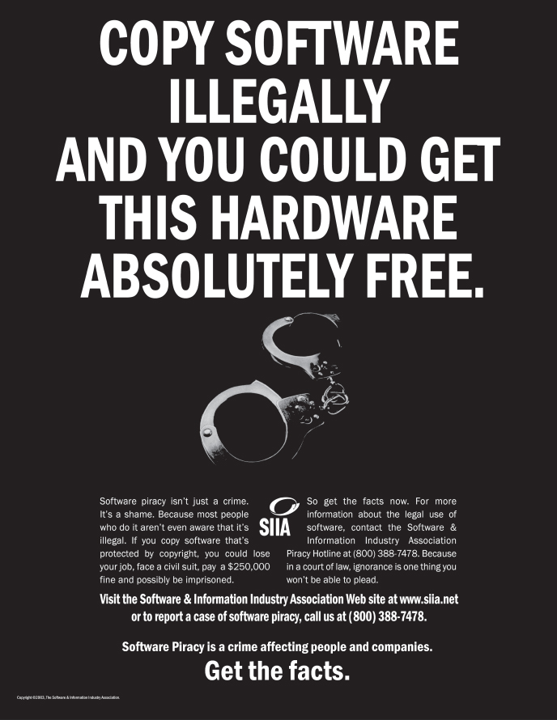
It’s Not Just Unethical, It’s Illegal Too
Software piracy
Copying or distributing copyrighted software
Industry loses billions a year
Software license
Grants the right to back up and install the software
Determines how many computers
Making copies for others is illegal

Slide 19
It’s Not Just Unethical, It’s Illegal Too
Public domain software
Free to users
May be copied and modified
Shareware
Users may use during a trial or evaluation period
Users must buy the software to continue use
Registration fee

Slide 20
It’s Not Just Unethical, It’s Illegal Too
General Public License (GPL)
Under the auspices of the Free Software Foundation
Users may copy, use, and modify as long as software is not sold
Site license
Contract that permits the installation of software on multiple computers at a reduced cost
Copyright protection schemes
Thwart illegal use of programs
Software becoming machine dependent

Slide 21
It’s Not Just Unethical, It’s Illegal Too
Illegal:
To use shareware past expiration date without paying registration fee
To violate terms of software license
To make copies of site-licensed programs for home
To give or sell copies of commercial software to others
To incorporate all or part of GPL program offered for sale
Protect yourself
Make sure you have a product registration key

Slide 22
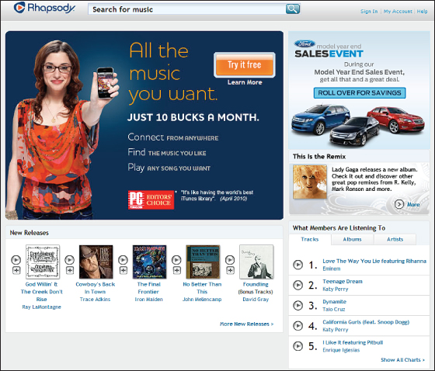
It’s Not Just Unethical, It’s Illegal Too
File Sharing
May result in fines or jail terms
Refers to either downloading copyrighted files or uploading the files to share
Lost income, loss of jobs, earnings, and tax revenue

Slide 23
All rights reserved. No part of this publication may be reproduced, stored in a retrieval system, or transmitted, in any form or by any means, electronic, mechanical, photocopying, recording, or otherwise, without the prior written permission of the publisher. Printed in the United States of America.
Copyright © 2012 Pearson Education, Inc.
Publishing as Prentice Hall

