Slide 1
Understanding Computers
in a Changing Society
5e
Deborah Morley
Chapter 6
Ethics and Intellectual Property Rights

Slide 2
Learning Objectives
Understand the different types of intellectual property rights and how they relate to computer use.
Explain what is meant by the term “ethics.”
Provide several examples of unethical behavior in the use of intellectual property and in computer-related matters.
Explain what computer hoaxes and digital manipulation are and how they relate to computer ethics.
Understand how ethics can impact business practices and decision making.
Discuss the current status of legislation related to intellectual property rights and ethics.
2

Slide 3
Overview
This chapter covers:
Various types of intellectual property rights
A discussion of ethics in the context of computer use and specifically:
Ethical use of copyrighted materials
Ethical use of resources and information
Unethical use of digital manipulation
Ethical business practices and decision making
Impact of cultural differences
Legislation related to these issues
3

Slide 4
Intellectual Property Rights
Intellectual Property Rights
Legal rights to which creators of original creative works are entitled
Indicates who has the right to use, perform, or display a creative work and what can legally be done with that work
Copyrights
Form of protection available to the creator of original artistic or literary works
Last until 70 years after creator’s death

Slide 5
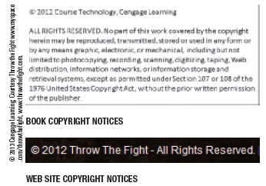
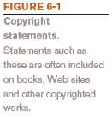
Intellectual Property Rights
Corporate copyrights or anonymous works last 95 years from date of publication or 120 years from date of creation, whichever is shorter
Can be registered with U.S. Copyright Office

Slide 6
Intellectual Property Rights
Once a copyrighted item is purchased, the material cannot be legally duplicated or portrayed as your own creation
Digital Watermarks
Subtle alteration of digital content that is not noticeable but that can identify the copyright holder
Digital Rights Management (DRM) Software
Controls use of the copyrighted work
Can limit who can view, print, or copy a document
Can control use of downloaded content (number of devices a file can be copied to, expiration of VOD movie, etc.)

Slide 7
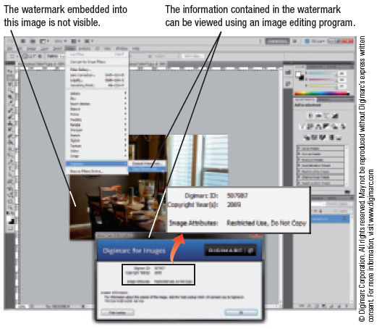
Intellectual Property Rights

Slide 8
Intellectual Property Rights
Trademarks
A word, phrase, symbol, or design that identifies goods or services
If used to identify a service is also called a service mark
Trademarks claimed but not registered with the U.S. Patent and Trademark Office can use the mark ™
Nonregistered service marks can use the symbol SM
Trademarks last 10 years and are renewable
Includes protection for domain names (cybersquatting and typosquatting)
Domain name disputes can be brought to the World Intellectual Property Organization (WIPO)

Slide 9
Intellectual Property Rights

Slide 10
Intellectual Property Rights
Patents
Protect inventions
Lasts for 20 years
Can also protect a business practice or procedure
Priceline.com’s name-your-own-price
Amazon.com’s one-click purchase
Difficult, expensive, and hard to get but can be very lucrative

Slide 11
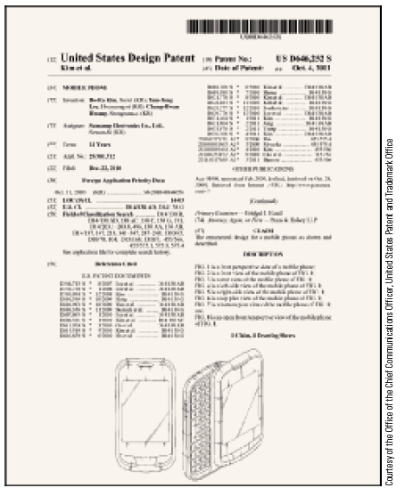
Intellectual Property Rights

Slide 12
Ethics
Ethics
Overall standards of moral conduct
Can vary with individual and religious beliefs, country, race, or culture
Personal Ethics
Guide an individual’s personal behavior
Business Ethics
Guide a business’s policies, decisions, and actions
Computer Ethics
Concern moral conduct related to computer use
Individuals and businesses need to make ethical decisions every day

Slide 13
Ethics
Ethical Use of Copyrighted Material
Books and Web-based Articles
Plagiarism
Presenting someone else’s work as your own
Violation of the copyright law and an unethical act
Need to properly credit sources to avoid plagiarism
Colleges and universities have strict consequences for plagiarism
Online tests for plagiarism are available and widely used by schools

Slide 14
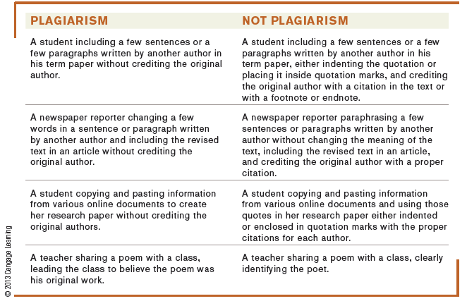
Ethics

Slide 15
Ethics
Music
Debate began with Napster
Still concerns surrounding P2P file sharing sites
Copying purchased songs for personal use usually considered fair use
In the past, DRM controls were used to prevent downloaded songs from being copied to other devices
Many downloads today are DRM-free MP3 format
RIAA is still suing individuals for violating music copyrights

Slide 16
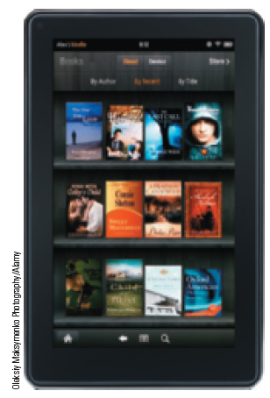
Ethics
E-books
Relatively new technology that has become widely popular
Legal and ethical issues similar to those found in the digital music industry exist
Piracy of e-books is growing rapidly

Slide 17
Ethics
Movies
Movie piracy is high (illegal copies, recording pre-release movies to create DVDs, etc.)
Distributing bootleg copies of movies is illegal and unethical
Often happens via the Internet
DRM controls on downloaded movies can slow piracy
Legal prosecution for copyright violations for both music and movies is increasing
Family Entertainment and Copyright Act of 2005
Illegal to transmit or record a movie during a performance at a U.S. movie theatre
Typically aimed at bootleggers and cammers

Slide 18
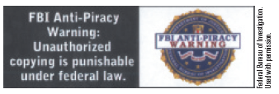
Ethics
To help identify and prosecute a cammer, invisible digital watermarks are embedded in each print released to a theatre
Distributing bootleg copies of movies via the Internet is illegal and unethical
FBI Piracy Warning Seal used as a reminder

Slide 19
Ethics
Ethical Use of Resources and Information
Ethical Use of School or Company Resources
Code of Conduct
Policy that specifies allowable use of resources by students or employees
Students and employees should be familiar with what is considered acceptable use of resources
Code of Ethics
Policy, typically for an industry or organization, that specifies overall moral guidelines adopted by that industry or organization

Slide 20
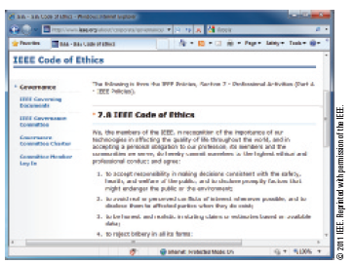
Ethics
Whistleblowers have some protection under the law
Sarbanes-Oxley Act

Slide 21
Ethics
Ethical Use of Employee and Customer Information
Businesses need to decide what is ethical use of employee and customer information and what is not
Business schools are including corporate business ethics in their training
Some businesses make ethics training mandatory
Cheating and Falsifying Information
Cheating at high schools and colleges is rampant
Can be reduced by academic honor codes
Résumé padding is dishonest and unethical and is widespread

Slide 22
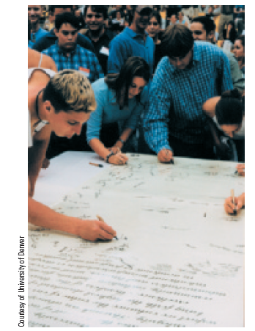
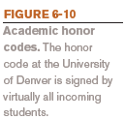
Ethics

Slide 23
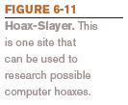
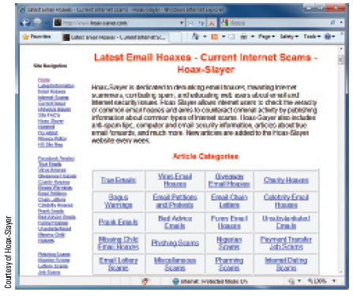
Ethics
Computer Hoaxes and Digital Manipulation
Computer Hoaxes
An inaccurate statement or story spread through the use of computers
Often sent via e-mail
Often related to viruses, health issues, political issues, etc.
Double-check information before passing on to others

Slide 24
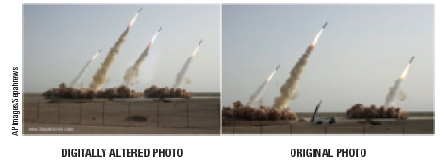
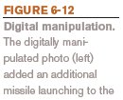
Ethics
Data Manipulation
Digitally altering text, images, photographs, music, and other digital content
Some beneficial ethical uses (aging photos of runaways, altering photos of wanted criminals, etc.)
Use by media is more controversial
Difficult to tell in the future if a historical photo was manipulated

Slide 25
Ethics
Ethical Business Practices and Decision Making
Fraudulent Reporting and Other Scandalous Activities
Sarbanes-Oxley Act of 2002
Includes provisions to improve the quality of financial reporting, independent audits, and accounting services for public companies
Increases penalties for corporate wrongdoing
Protects the objectivity and independence of securities analysts
Requires CEOs and CFOs to vouch personally for the truth and fairness of their company’s disclosures

Slide 26
Ethics
Ethically Questionable Products or Services
To sell or not sell products or services some individuals find objectionable
How, if at all, to monitor customer uploaded content
Implementation of age verification systems
Social networking sites are strongly encouraged to add such systems to protect children from on-line predators
To comply with state and federal laws, adult internet sites should also implement age verification systems

Slide 27
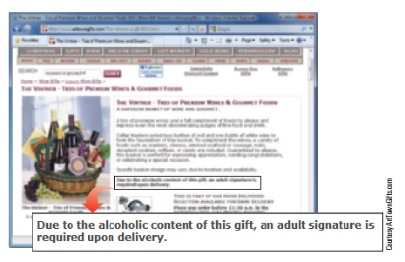
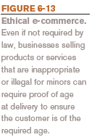
Ethics

Slide 28
Ethics
Vaporware
Announced hardware and software products that are not yet and may never be available
Workplace Monitoring
Majority of businesses monitor employees in some way
Ethically, employees should be made aware of such monitoring

Slide 29
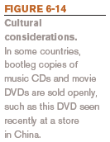
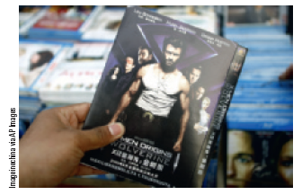
Ethics
Cultural Considerations
Ethics vary within a country as well as from country to country
Some acts may be socially acceptable or ethical in one country, but not another
Laws also vary from country to country
Individuals and businesses need to consider both legal and ethical issues in global transactions
Some business schools and corporations are including diversity and cross-cultural training

Slide 30
Related Legislation
Legislation to Protect Intellectual Property Rights
Family Entertainment and Copyright Act of 2005 (FECA)
U.S. Anticybersquatting Consumer Protection Act
Copyright Term Extension Act
Digital Millennium Copyright Act (DMCA)
Ethical Legislation
More difficult to pass or keep once passed
Communications Decency Act (1996)
Children’s Online Privacy Protection Act
Sarbanes-Oxley Act (Corporate Responsibility Act)

Slide 31
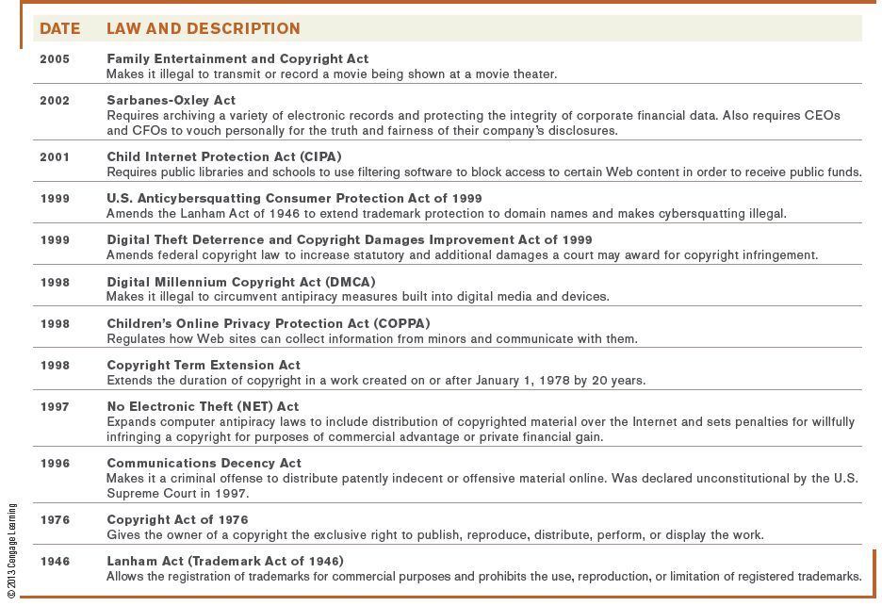
Related Legislation

Slide 32
Summary
Intellectual Property Rights
Ethics
Related Legislation

