Slide 1
Advanced object oriented

Slide 2
java
Programming languages
Procedural PL
Object oriented PL

Slide 3
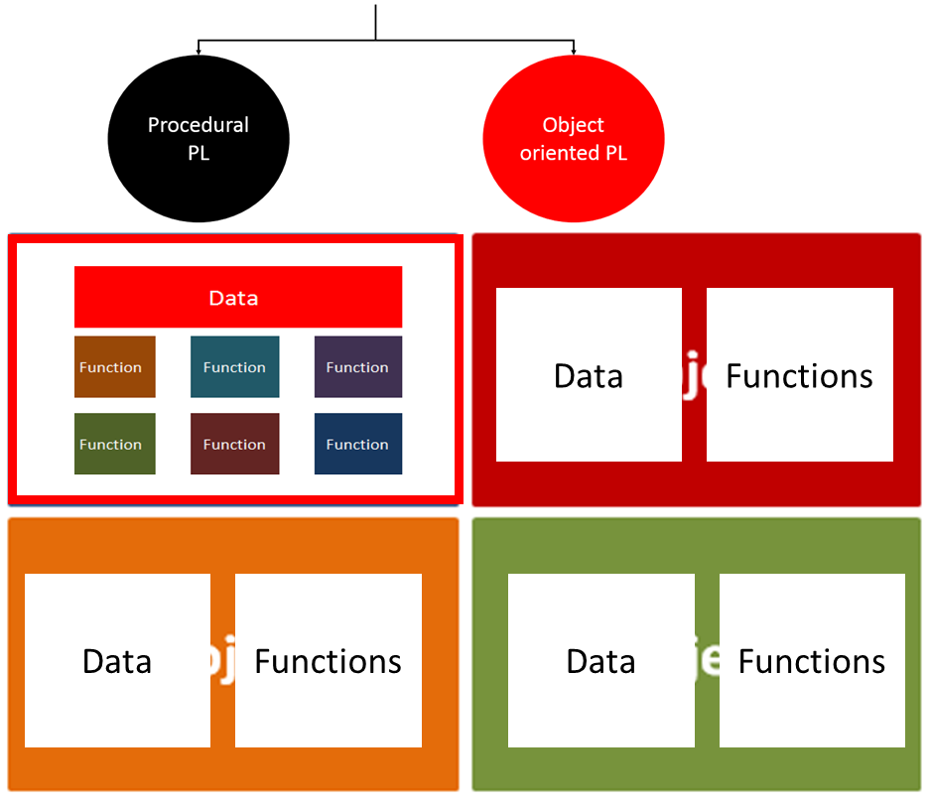
Programming languages
java

Slide 4
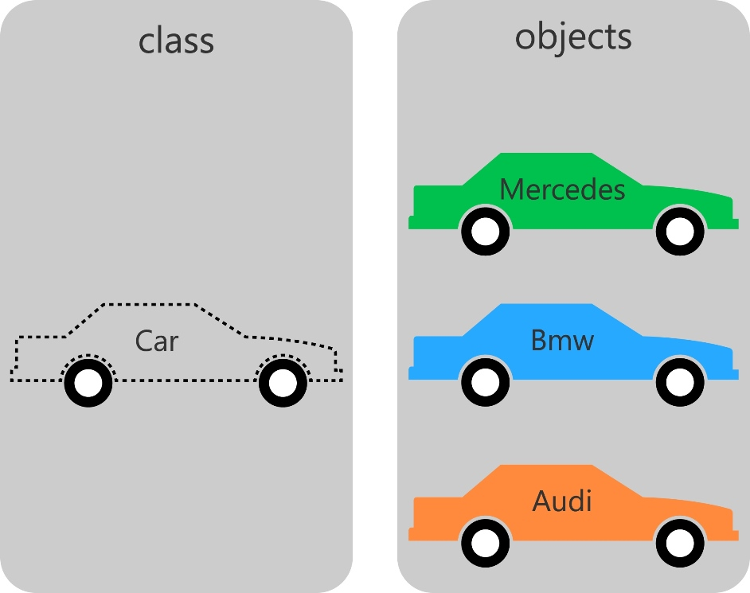
Review of object oriented concepts
java

Slide 5
Review of object oriented concepts
java
Private/public/protected members
Accessor/Mutator Mehods
Constructors
Abstraction
Exception
Encapsulation
Polymorphism
Inheritence
Composition

Slide 6
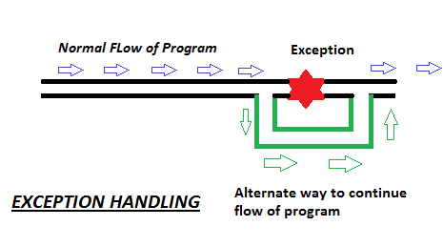
java
Review of object oriented concepts
Exception in Java
is an indication of a problem that occurs during a program’s execution. The name “exception” implies that the problem occurs infrequently

Slide 7
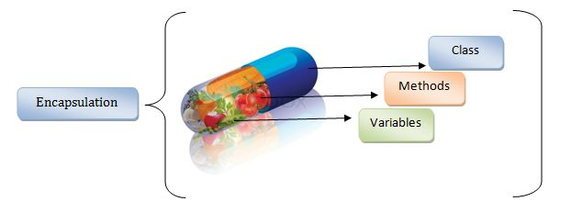
Review of object oriented concepts
java

Slide 8
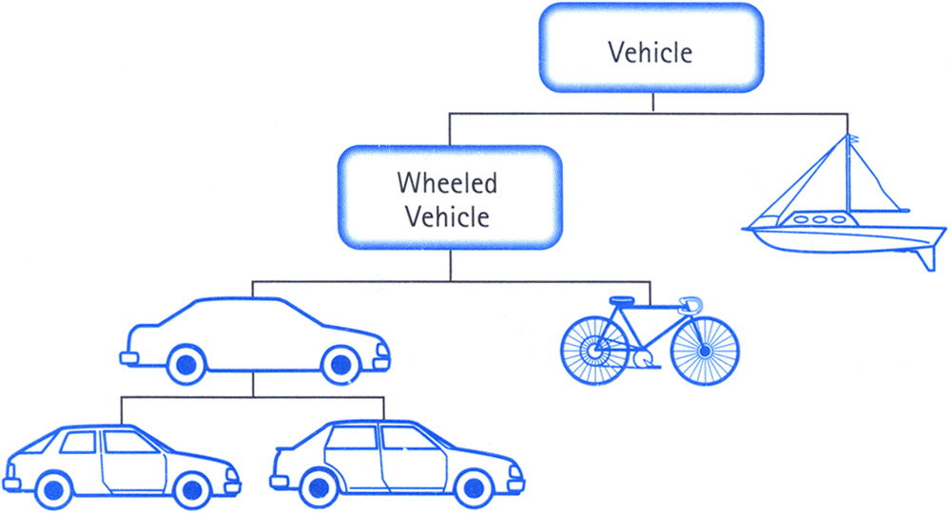
Review of object oriented concepts (inheritance)
java

Slide 9
Review of object oriented concepts (composition)
java

Slide 10
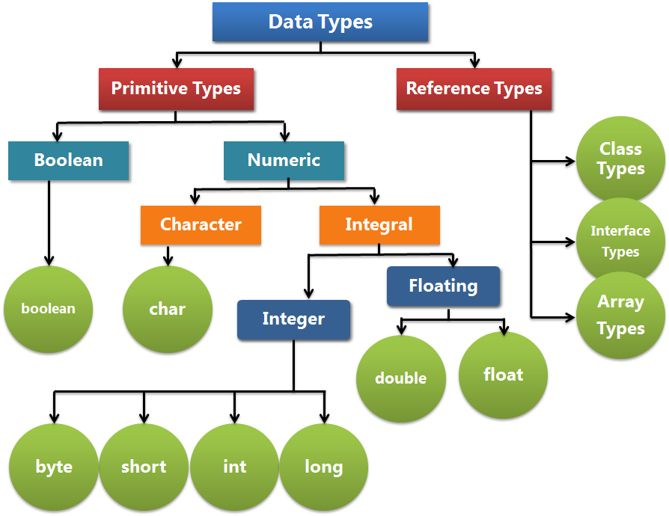
Review of object oriented concepts
java
Variables

Slide 11
Class Fields (Data)
java
Instance variables
Static variables
Local variables
Methods

Slide 12
EXAMPLE: Implement the time of the day
java
java
Data (instance variables)
Operations (methods)

Slide 13
Implement the time of the day
java
java
To represent time in computer memory, we use three int variables : one to represent the hours, one to represent the minutes, and one to represent the seconds.
We need the following methods over the data.
1. Set the time.
2. Retrieve the hour.
3. Retrieve the minutes.
4. Retrieve the seconds.
5. Print the time.
6. Compare two times equality.
Remember: Each class declaration that begins with keyword public must be stored in a file that has the same name as the class and ends with the .java file-name extension.

Slide 14
REMARKS
java
java
Recall that main is a special method that is always called automatically by the Java Virtual Machine (JVM) when you execute an application.
A class that contains method main is a Java application.

