Slide 1
ITEC 420
Framework Based Internet Application

Slide 2
Creating Websites
When MS Visual Studio first loads, it shows a start page which includes a list of recently opened projects and the sampe page also includes links to online developer content from Microsoft’s MSDN website.
If you are new in ASP.NET than below is agood address to start with
http://msdn.microsoft.com/en-us/asp.net/default.aspx

Slide 3
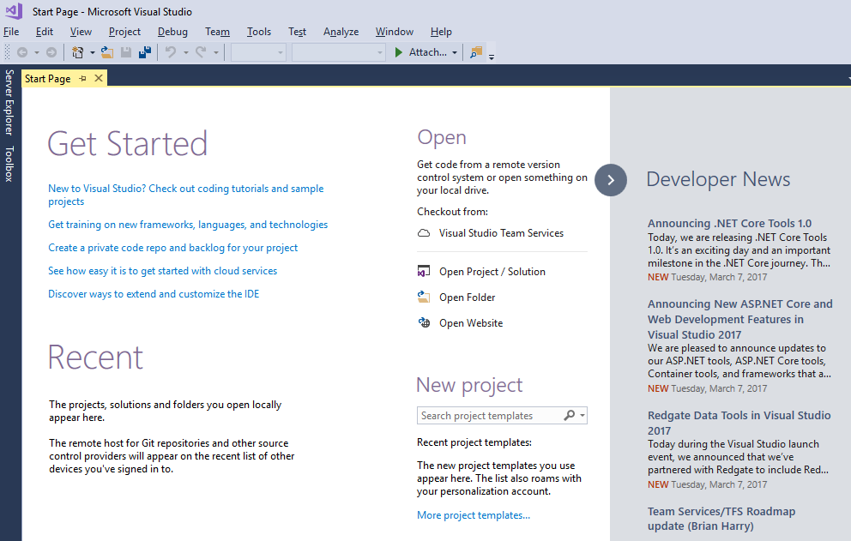
Visual Studio 2017 Community Edition

Slide 4
Creating New Web Application
Select File →New → WebSite from the Visual Studio menu.
From the web site dialog, to build an ordinary ASP.NET application, select the ASP.NET Empty Web Site Template.
Note: Other templates start you off with additional files or configuration settings that help you build more specialized type of website (where some will be discussed later) (WFC stands for Windows communication Foundation).
Then choose the version of .NET that you want to use. We will use 4.6.1 in Visual Studio 2017 which is the latest one.
Choose the location for the web site, to store website files.

Slide 5
Web Sites and Web Projects
You can create a web project by choosing File→New→Project and then choosing the ASP.NET Web Application template.
With this kind of creation an extra project file (csproj) will be created.
Old way of creating web applications from VS 2005.
Starting from VS 2008, projectless development is in charge where no additional project file is created.

Slide 6
Hidden Solution Files
VS version 2010 creates a solution file for each website that you are creating.
Each solution has two solution files with extentions .sln and .suo (.config in latest version)
These files are typically located at c:\Users\[User Name]\My Documents\Visual Studio 2008\Projects\[WebsiteFolderNAme]
The solution files store some Visual studio specific details that aren’t directly related too ASP.NET, such as debugging and view settings.The solution files are not essential.
The solution file contains a single projectless website in its simplest case.

Slide 7
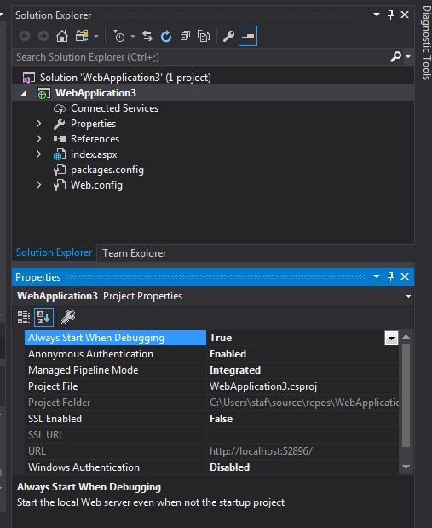
The Solution Explorer
This explorer lists all the files in your web application directory (for projectless web site).
No hidden files. To list the up-to-date content sometimes you will need to refresh the explorer (if you add additional files from outside the VS environment)

Slide 8
Adding Web Forms
As you build your website you will need to add new pages or other items.
To add these choose website→Add new Item from the VS menu. Then through the dialog box appeared you can create various types of files to your web application.
The most common ingredient will be “web forms” – ASP.NET web pages powered with C# code.
From the dialog that is appeared “Place code in seperate file option” allows you to choose the coding model for your web page.
If checked, two seperate files for HTML and C# will be generated otherwise in the same (single) file both HTML and C# code must exists. Two use seperate files is preferrable, due to code management simplicity.

Slide 9
Adding Web Forms
There exists another check box named Select Master Page, which allows you to create a page that uses the layout you’ve standardized in a seperate file. But at the moments do not mind it.
.aspx extension is for web page markup
.aspx.cs is the extension of the file used to store the source code for the page.

Slide 10
Designing a Web Page
To Start, in the solution explorer, double-click the web page you want to design.
Visual Studio Givew three ways to look at an .aspx page:
Design View
graphical representation of what your page looks like.
Source View
The underlying markup, with the HTML for the page and the ASP.NET control tags.
Split View
Both design and split views are displayed

Slide 11
Adding Web Controls
To add an ASP.NET web control, drag the control you want from the toolbox on the left and drop it on your web page.
You can drag-drop both in design and source view however to do it in design view is more practical.
Like in word elements will be positioned line by line, to add a new line just hit Enter
To resize some of the object is not possible.
From the source view it is possible to check the markup generated.

Slide 12
Adding Web Controls
To add controls or to edit properties such as color of a label or text on a button is also possible through the source view.
The intellisense feature of the (source) editor will give you hints about the code that you are trying to type.
Also Outlining is another feature of the editor where the code could be grouped and hide through a + - sign on left hand-side.

Slide 13
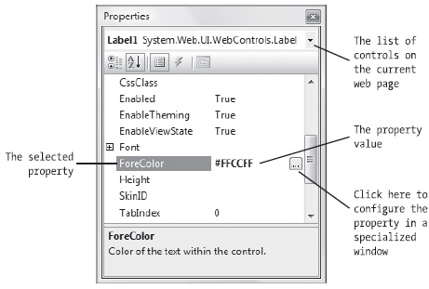
The Properties Window
Instead of using the source editor it is also possible to access the properties of a control through the properties window.
Choose the control first by clicking on it (focus on the control) and then use properties window to reach the properties.

Slide 14
Anatomy of a Web Form
Using the design view it is possible to assemble a basic web page without any HTML knowledge.
However it will not be long before you dip into the source view.

Slide 15
The Web Form Markup
The source of an ASP.NET web form is not 100% HTML. It is an HTML page with extra ingredients-ASP.NET web controls.
Along with standard HTML, you can add ASP.NET-only elements to our web pages.
Ex:
<asp:Button > represents a clickable button that triggers a task on web server.
When you add such an ASP.NET web control, you create an object that you can interact with in your web page code.

Slide 16
Sample
1 <%@ Page Language="C#" AutoEventWireup="true"
2 CodeFile="Default.aspx.cs" Inherits="_Default" %>
3 <!DOCTYPE html PUBLIC "-//W3C//DTD XHTML 1.0 Transitional//EN"
4 "http://www.w3.org/TR/xhtml1/DTD/xhtml1-transitional.dtd">
5 <html xmlns="http://www.w3.org/1999/xhtml">
6 <head runat="server">
7 <title>Untitled Page</title>
8 </head>
9 <body>
10 <form ID="form1" runat="server">
11 <div>
12 <asp:Label ID="Label1" runat="server"
13 Text="Type something here:" />
14 <asp:TextBox ID="TextBox1" runat="server" />
15 <br />
16 <asp:Button ID="Button1" runat="server" Text="Button" />
17 </div> </form> </body> </html>
Note : Highlighted text is not part of HTML

Slide 17
Page Directive
Lines 1-2:
All ASP.NET web forms, consists of three sections. The first section is the page directive.
<%@ Page Language="C#" AutoEventWireup="true"
CodeFile="Default.aspx.cs" Inherits="_Default" %>
You dont need to modify the page directive by hand because VS maintains it for you.
Pay attention the language is specified.
If seperate files used code file is also specified

Slide 18
Doc Type
Lines 3-4:
<!DOCTYPE html PUBLIC "-//W3C//DTD XHTML 1.0 Transitional//EN"
"http://www.w3.org/TR/xhtml1/DTD/xhtml1-transitional.dtd">
The doctype indicates the type of markup (HTML or XHTML) that you’re using to create your web page. Technically, the doctype is optional, but VS adds it automatically (in master page if you are using one).
The doctype is also important because it influences how a browser interprets your web page.

Slide 19
The Essentials of XHTML
When the page is processed by the web server, the ASP.NET web controls are converted to XHTML markup (rendering) and inserted into the page. The final is a standard XHTML document that is sent back to the browser.
This design gives you the best of both worlds—you can mix ordinary XHTML markup for the parts of your page that don’t change, and use handy ASP.NET web controls for the parts that need to be interactive (such as buttons, lists, text boxes, and so on) or the parts that you need to update with new information (for example, a block of dynamic text). This design also suggests that ASP.NET developers should have a solid understanding of XHTML basics before they begin coding web forms.

Slide 20
Elements
The XHTML language defines a small set of elements that you can use—in fact, there are fewer than you probably expect. XHTML also defines the syntax for using these elements. A typical element consists of three pieces: a start tag, some content, and an end tag. Here’s an example:
<p>This is a sentence in a paragraph.</p>
As a different case, the <br> element represents a line break. Rather than writing <br></br>, you can simply use <br />, as shown here:
<p>This is line one.<br />
This is line three.</p>
Note that every tag have to be closed in XHTML

Slide 21
Some of the most commonly used XHTML elements. The Type column distinguishes between two types of XHTML—those that typically hold content or other nested elements (containers), and those that can be used on their own with the empty tag syntax you just considered (standalone).
Elements

Slide 22
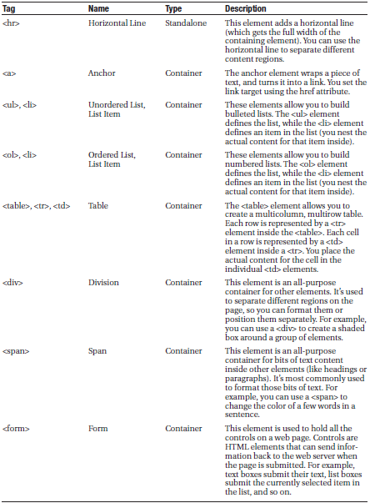

Slide 23
Attributes of Elements
Every XHTML document fuses together two types of information: the document content, and information about how that content should be presented.
Attributes are individual pieces of information that you attach to an element, inside the start tag.
As an example:
The <a> anchor element is an example of an element that uses attributes and takes content.
The content inside the <a> element is the blue, underline text of the hyperlink. The href attribute defines the destination that the browser will navigate to when the link is clicked.
<p> Click <a href="http://www.prosetech.com">here</a> to visit my website. </p>

Slide 24
Typical Structure in VS web Forms
<!DOCTYPE html PUBLIC "-//W3C//DTD XHTML 1.0 Transitional//EN« "http://www.w3.org/TR/xhtml1/DTD/xhtml1-transitional.dtd">
<html xmlns="http://www.w3.org/1999/xhtml">
<head>
<title>Untitled Page</title>
</head>
<body>
<form ID="form1" runat="server" >
<div>...</div>
</form>
</body>
</html>
runat="server" the control into a server control.

Slide 25
Writing Code
Many of Visual Studio’s most welcome enhancements appear when you start to write the code that supports your user interface. To start coding, you need to switch to the code-behind view.
To switch back and forth, you can use two View Code or View Designer buttons, which appear just above the Solution Explorer window.
Another approach that works just as well is to doubleclick either the .aspx page in the Solution Explorer (to get to the designer) or the .aspx.cs page (to get to the code view). The “code” in question is the C# code, not the HTML markup in the .aspx file.

Slide 26
The Code-Behind Class
When you switch to code view, you’ll see the page class for your web page. For example, if you’ve created a web page named SimplePage.aspx, you’ll see a code-behind class that looks like this:
using System;
.
.
public partial class SimplePage: System.Web.UI.Page
{
protected void Page_Load(object sender, EventArgs e)
{
}
}
Just before your page class, Visual Studio imports a number of core .NET namespaces. These namespaces give you easy access to many commonly used ASP.NET classes.
Inside your page class you can place methods, which will respond to control events. For example, you can add a method with code that reacts when the user clicks a button.

Slide 27
Adding Event Handlers
Most of the code in an ASP.NET web page is placed inside event handlers that react to web control events. Using Visual Studio, you have three easy ways to add an event handler to your code:
Type it in manually: In this case, you add the subroutine directly to the page class. You must specify the appropriate parameters.
Double-click a control in Design view: In this case, Visual Studio will create an event handler for that control’s default event, if it doesn’t already exist. For example, if you double-click a Button control, it will create an event handler for the Button.Click event.
Choose the event from the Properties window: Just select the control, and click the lightning bolt in the Properties window. You’ll see a list of all the events provided by that control. Double-click next to the event you want to handle, and Visual Studio will automatically generate the event handler in your page class. Or choose from the drop-down list.

Slide 28
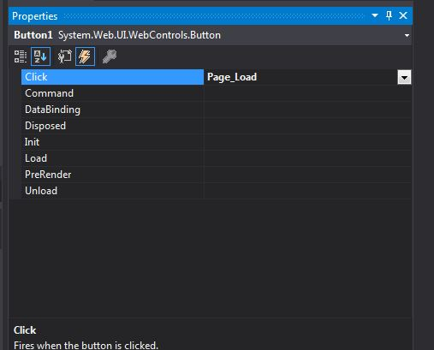
Adding Event Handlers

Slide 29
Adding Event Handlers
When you use Visual Studio to attach or create an event handler, it adjusts the control tag so that it’s linked to the appropriate event:
<asp:Button ID="Button1" runat="server" Text="Button" OnClick="Button1_Click“ />
Inside your event handler method, you can interact with any of the control objects on your web page using their IDs. For example, if you’ve created a TextBox control named TextBox1, you can set the text using the following line of code:
protected void Button1_Click(object sender, EventArgs e)
{
TextBox1.Text = "Here is some sample text.";
}
This is a simple event handler that reacts when Button1 is clicked and updates the text inTextBox1.

Slide 30
Visual Studio Environment
Intellisense
Lists the command guessed that you will type.
Outlining
Collapses a portion of a code.
Error Underlining
Detects and underlines errors such as undefined variables before you run the page.

Slide 31
Visual Studio Debugging
Once you’ve created an application, you can compile and run it by choosing
Debug -> Start Debugging from the menu or by clicking the Start Debugging button on the toolbar (which looks like a DVD-style play button).
Visual Studio launches your default web browser and requests the page that’s currently selected in the Solution Explorer. This is a handy trick—if you’re in the middle of coding SalesPage1.aspx, you’ll see SalesPage1.aspx appear in the browser, not the Default.aspx home page.

Slide 32
Debugging Details
The first time you launch a web application, Visual Studio will ask you whether you want to configure your web application to allow debugging by adjusting its configuration file.
Choose “Modify the Web.config file to enable debugging.” and click OK.
Visual Studio may also warn you that script debugging is disabled, depending on your browser preferences. Script debugging is a useful tool that works with Visual Studio to help you debug pages that use ASP.NET AJAX (javascript)

Slide 33
Visual Studio Web Server
When you run a web application, Visual Studio starts its integrated web server. Behind the scenes, ASP.NET compiles the code for your web application, runs your web page, and then returns the final HTML to the browser. The first time you run a web page, you’ll see a new icon appear in the system tray at the bottom-right corner of the taskbar. This icon is Visual Studio’s test web server, which runs in the background hosting your website. The test server only runs while Visual Studio is running, and it only accepts requests from your computer (so other users can’t connect to it over a network).
When you run a web page, you’ll notice that the URL in the browser includes a port number. For example, if you run a web application in a folder named OnlineBank, you might see a URL like http://localhost:4235/OnlineBank/Default.aspx. This URL indicates that the web server is running on your computer (localhost), so its requests aren’t being sent over the Internet. It also indicates that all requests are being transmitted to port number 4235. That way, the requests won’t conflict with any other applications that might be running on your computer and listening for requests. Every time Visual Studio starts the integrated web server, it randomly chooses an available port.

Slide 34
Visual Studio Web Server
Visual Studio’s built-in web server also allows you to retrieve a listing of all the files in your website. This means if you create a web application named SampleSite, you can request it in the form http://localhost:port/SampleSite (omitting the page name) to see a list of all the files in your web application folder. Then, just click the page you want to test.
This trick won’t work if you have a Default.aspx page. If you do, any requests that don’t indicate the page you want are automatically redirected to this page.

Slide 35
Single Step Debugging
1. Find a location in your code and by clicking the margin put a breakpoint (red dot)
2. Start (run) your program (F5 shortkey)
When execution comes to the point where you have placed the red dot( breakpoint), execution stops, and waits for you to choose from the commands available in break mode.

Slide 36
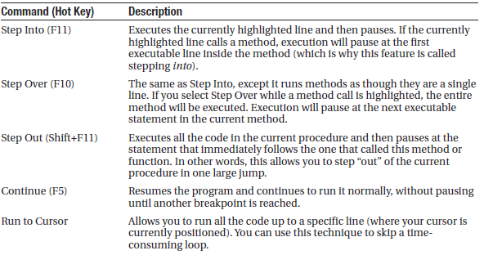
Break mode commands

Slide 37
Break Mode Commands Cntd.
You can switch your program into break mode at any point by clicking the Pause button in the toolbar or selecting Debug -> Break All. This might not stop your code where you expect, however, so you’ll need to rummage around to get your bearings.
When debugging a large website, you might place breakpoints in different places in your code and in multiple web pages. To get an at-a-glance look at all the breakpoints in your web application, choose Debug -> Windows -> Breakpoints. You’ll see a list of all your breakpoints. You can jump to the location in code where a breakpoint is placed by double-clicking it in the list. You can also remove a breakpoint (select it and press Delete) or temporarily disable a breakpoint (by removing the check mark next to it). This allows you to keep a breakpoint to use in testing later, without leaving it active.

Slide 38
Variable Watches
In some cases, you might want to track the status of a variable without switching into break mode repeatedly. In this case, it’s more useful to use the Autos, Locals, and Watch windows, which allow you to track variables across an entire application.
If you are missing one of the Watch windows, you can show it manually by seecting it from the Debug->Windows submenu.

