Slide 1
ITEC 420
The C# Language

Slide 2
C# Language Basics
Case sensitivity
Some languages are case sensitive, while others are not. C#,C,C++ and Java are all examples of case-sensitive languages. Visual Basic is not.
Commenting
Comments are descriptive text that is ignored by the compiler.
// A single line comment
/* A multiline
comment */

Slide 3
C# Language Basics
XML-based commenting syntax.
With XML comments, you use special tags that indicate whether your comment applies to a class, method, parameter and so on. In the example summary of the application is provided.
///<summary>
/// This is the
/// summary.
///</summary>
XML comments always start with three slashes. The benefit is that later automated tools can extract the comments from your code and use them to build help references and other types of documentation.

Slide 4
C# Language Basics
State Termination
C# uses a semicolon (;) as a statement-termination character.
// a code splitted into two lines
myValue=myValue1+
myValue2;
// single line
myValue=myValue1+myValue2;

Slide 5
C# Language Basics
Blocks
Curly braces group multiple code statements together.
{
// your code goes here
}
These are the begin ‘{‘ and end ‘}’ keywords.

Slide 6
C# Language Basics
Variables
As with all programming languages, you keep track of data in C# using variables.
To declare a variable you start the line with the data type, followed by the name you want to use. A final semicolon to end the statement.
int myAge;
string myName;

Slide 7
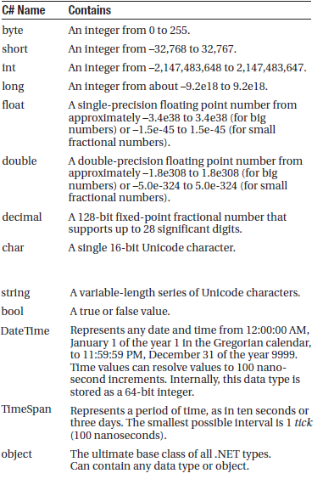
C# Language Basics
Common Data Types

Slide 8
C# Language Basics
Assignment and Initializers
// Declare variables.
int errorCode;
string myName;
// Assign values.
errorCode = 10;
myName = "Matthew";
You can also assign a value to a variable in the same line that you declare it. This example compresses four lines of code into two:
int errorCode = 10;
string myName = "Matthew";

Slide 9
C# Language Basics
C# safeguards you from errors by restricting you from using uninitialized variables. This means the following code will not succeed:
int number; // Number is uninitialized.
number = number + 1; // This causes a compile error.
The proper way to write this code is to explicitly initialize the number variable to an appropriate value, such as 0, before using it:
int number = 0; // Number now contains 0.
number = number + 1; // Number now contains 1.

Slide 10
C# Language Basics
C# also deals strictly with data types. For example, the following code statement won’t work as written:
decimal myDecimal = 14.5;
The problem is that the literal 14.5 is automatically interpreted as a double, and you can’t convert a double to a decimal without using casting syntax. To get around this problem, C# defines a few special characters that you can append to literal values to indicate their data type so that no conversion will be required. These are as follows:
• M (decimal)
• D (double)
• F (float)
• L (long)
For example, you can rewrite the earlier example using the decimal indicator as follows:
decimal myDecimal = 14.5M;

Slide 11
C# Language Basics
Interestingly, if you’re using code like this to declare and initialize your variable in one step, and if the C# compiler can determine the right data type based on the value you’re using, you don’t need to specify the data type. Instead, you can use the all-purpose var keyword in place of the data type. That means the previous line of code is equivalent to this:
var myDecimal = 14.5M;
Here, the compiler realizes that a decimal data type is the most appropriate choice for the myDecimal variable, and uses that data type automatically. There is no performance difference. The myDecimal variable that you create using an inferred data type behaves in exactly the same way as a myDecimal variable created with an explicit data type. In fact, the low-level code that the compiler generates is identical. The only difference is that the var keyword saves some typing.
Many C# programmers feel uneasy with the var keyword because it makes code less clear.

Slide 12
C# Language Basics
Strings and Escaped Characters
C# treats text a little differently than other languages. It interprets any embedded backslash (\) as the start of a special character escape sequence. For example, \n means add a new line (carriage return). The most useful character literals are as follows:
\" (double quote)
\n (new line)
\t (horizontal tab)
\\ (backward slash)
You can also insert a special character based on its hex code using the syntax \x123. This inserts a single character with hex value 123.
Note that in order to specify the actual backslash character (for example, in a directory name), you require two slashes. Here’s an example:
// A C# variable holding the
// c:\MyApp\MyFiles path.
path = "c:\\MyApp\\MyFiles";
Alternatively, you can turn off C# escaping by preceding a string with an @ symbol, as shown here:
path = @"c:\MyApp\MyFiles";

Slide 13
C# Language Basics
Arrays
Arrays allow you to store a series of values that have the same data type.
All arrays start with a fixed lower bound of 0. Because counting starts at 0, the highest index is actually one fewer than the number of elements.
// Create an array with four strings (from index 0 to index 3).
// You need to initialize the array with the
// new keyword in order to use it.
string[] stringArray = new string[4];
// Create a 2x4 grid array (with a total of eight integers).
int[,] intArray = new int[2, 4];

Slide 14
C# Language Basics
By default, if your array includes simple data types, they are all initialized to default values (0 or false), depending on whether you are using some type of number or a Boolean variable. You can also fill an array with data at the same time that you create it. In this case, you don’t need to explicitly specify the number of elements, because .NET can determine it automatically:
// Create an array with four strings, one for each number from 1 to 4.
string[] stringArray = {"1", "2", "3", "4"};
The same technique works for multidimensional arrays, except that two sets of curly brackets are required:
// Create a 4x2 array (a grid with four rows and two columns).
int[,] intArray = {{1, 2}, {3, 4}, {5, 6}, {7, 8}};

Slide 15
C# Language Basics
To access an element in an array, you specify the corresponding index number in square brackets: []. Array indices are always zero-based. That means that myArray[0] accesses the first cell in a one-dimensional array, myArray[1] accesses the second cell, and so on:
// Access the value in row 0 (first row), column 1 (second column).
int element;
element = intArray[0, 1]; // Element is now set to 2.

Slide 16
C# Language Basics
ArrayList
C# arrays do not support redimensioning. This means that once you create an array, you can not change its size.
However, if you need a dynamic array-like list, you can use one of the collection classes provided to all .NET languages through the .NET class library. One of the simplest collection classes that .NET offers is the ArrayList, which always allows dynamic resizing. Here’s a snippet of C# code that uses an ArrayList:

Slide 17
C# Language Basics
// Create an ArrayList object. It's a collection, not an array,
// so the syntax is slightly different.
ArrayList dynamicList = new ArrayList();
// Add several strings to the list.
// The ArrayList is not strongly typed, so you can add any data type
// although it's simplest if you store just one type of object
// in any given collection.
dynamicList.Add("one");
dynamicList.Add("two");
dynamicList.Add("three");
// Retrieve the first string. Notice that the object must be converted to a
// string, because there's no way for .NET to be certain what it is.
string item = Convert.ToString(dynamicList[0]);

Slide 18
C# Language Basics
Enumarations
An enumaration is a group of related constants, each of which is given a descriptive name. Each value in an enumaration corresponds to a preset integer.
// Define an enumeration type named UserType with three possible values.
enum UserType
{
Admin, Guest, Invalid
}
// Create a new value and set it equal to the UserType.Admin constant.
UserType newUserType = UserType.Admin;

Slide 19
C# Language Basics
Internally, enumerations are maintained as numbers. In the preceding example, 0 is automatically assigned to Admin, 1 to Guest, and 2 to Invalid. You can set a number directly in an enumeration variable, although this can lead to an undetected error if you use a number that doesn’t correspond to one of the defined values.

Slide 20
C# Language Basics
In some scenarios, you might want to control what numbers are used for various values in an enumeration. This technique is typically used when the number has some specific meaning or corresponds to some other piece of information. For example, the following code defines an enumeration that represents the error code returned by a legacy component:
enum ErrorCode
{
NoResponse = 166, TooBusy = 167, Pass = 0
}
Now you can use the ErrorCode enumeration with a function that returns an integer representing an error condition, as shown here:
ErrorCode err;
err = DoSomething();
if (err == ErrorCode.Pass)
{
// Operation succeeded.
}
Clearly, enumerations create more readable code. They also simplify coding, because once you type in the enumeration type name (ErrorCode) and add the dot (.), Visual Studio will pop up a list of possible values using IntelliSense.

Slide 21
C# Language Basics
Variable Operations
You can use all the standard types of variable operations in C#.
int number;
number = 4 + 2 * 3;
// number will be 10.
number = (4 + 2) * 3;
// number will be 18.

Slide 22
C# Language Basics
C# also allows you to use the addition operator (+) to join two strings:
// Join three strings together.
myName = firstName + " " + lastName;,
In addition, C# also provides special shorthand assignment operators. Here are a few examples:
// Add 10 to myValue. This is the same as myValue = myValue + 10;
myValue += 10;
// Multiple myValue by 3. This is the same as myValue = myValue * 3;
myValue *= 3;
// Divide myValue by 12. This is the same as myValue = myValue / 12;
myValue /= 12;

Slide 23
C# Language Basics
Advanced Math
To use the math operations, you invoke the methods of the System.Math class. These methods are static, which means they are always available and ready to use. The following code snippet shows some sample calculations that you can perform with the Math class:
double myValue;
myValue = Math.Sqrt(81); // myValue = 9.0
myValue = Math.Round(42.889, 2); // myValue = 42.89
myValue = Math.Abs(-10); // myValue = 10.0
myValue = Math.Log(24.212); // myValue = 3.18.. (and so on)
myValue = Math.PI; // myValue = 3.14.. (and so on)
This list is a very limited one.

Slide 24
C# Language Basics
Type Conversions
Explicit type conversion
int count32 = 1000;
short count16;
// Convert the 32-bit integer to a 16-bit integer.
// If count32 is too large to fit, .NET will discard some of the
// information you need, and the resulting number will be incorrect.
count16 = (short)count32;

Slide 25
C# Language Basics
int mySmallValue;
long myLargeValue;
myLargeValue = Int32.MaxValue;
myLargeValue++;
// This will appear to succeed (there won't be an error at runtime),
// but your data will be incorrect because mySmallValue cannot
// hold a value this large.
mySmallValue = (int)myLargeValue;
checked
{
// This will cause an exception to be thrown.
mySmallValue = (int)myLargeValue;
}

Slide 26
C# Language Basics
Advanced Conversions
One option is to use the static methods of the Convert class, which support many common data types such as strings, dates, and numbers:
string countString = "10";
// Convert the string "10" to the numeric value 10.
int count = Convert.ToInt32(countString);
// Convert the numeric value 10 into the string "10".
countString = Convert.ToString(count);

Slide 27
C# Language Basics
The Convert class is a good all-purpose solution, but you’ll also find other static methods that can do the work, if you dig around in the .NET class library. The following code uses the static Int32.Parse() method to perform the same task:
int count;
string countString = "10";
// Convert the string "10" to the numeric value 10.
count = Int32.Parse(countString);

Slide 28
C# Language Basics
The String Type
The following code snippet shows several ways to manipulate a string using its object nature:
string myString = "This is a test string ";
myString = myString.Trim(); // = "This is a test string"
myString = myString.Substring(0, 4); // = "This"
myString = myString.ToUpper(); // = "THIS"
myString = myString.Replace("IS", "AT"); // = "THAT"
int length = myString.Length; // = 4
You can even use the string methods in succession in a single (rather ugly) line:
myString = myString.Trim().Substring(0, 4).ToUpper().Replace("IS", "AT");
Or, to make life more interesting, you can use the string methods on string literals just as easily as string variables:
myString = "hello".ToUpper(); // Sets myString to "HELLO"

Slide 29
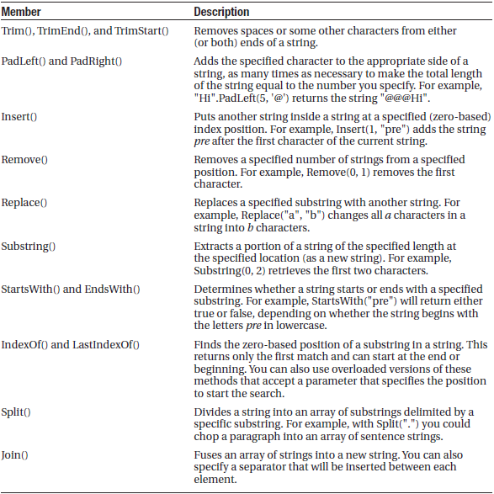
C# Language Basics
Useful String Members

Slide 30
C# Language Basics
The DateTime and TimeSpan Types
DateTime myDate = DateTime.Now;
myDate = myDate.AddDays(100);
string dateString = myDate.Year.ToString();
The next example shows how you can use a TimeSpan object to find the total number of minutes between two DateTime objects:
DateTime myDate1 = DateTime.Now;
DateTime myDate2 = DateTime.Now.AddHours(3000);
TimeSpan difference;
difference = myDate2.Subtract(myDate1);
double numberOfMinutes;
numberOfMinutes = difference.TotalMinutes;
The DateTime and TimeSpan classes also support the + and – arithmetic operators, which do the same work as the built-in methods. That means you can rewrite the example shown earlier like this:
// Adding a TimeSpan to a DateTime creates a new DateTime.
DateTime myDate1 = DateTime.Now;
TimeSpan interval = TimeSpan.FromHours(3000);
DateTime myDate2 = myDate1 + interval;
// Subtracting one DateTime object from another produces a TimeSpan.
TimeSpan difference;
difference = myDate2 - myDate1;

Slide 31
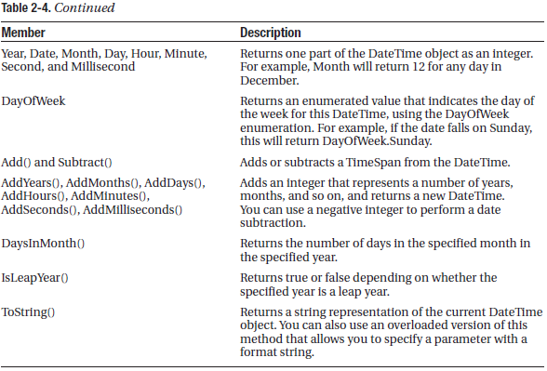
C# Language Basics

Slide 32
C# Language Basics

Slide 33
C# Language Basics
The Array Type
int[] myArray = {1, 2, 3, 4, 5};
int numberOfElements;
numberOfElements = myArray.Length; // numberOfElements = 5
You can also use the GetUpperBound() method to find the highest index number in an array. The following code snippet shows this technique in action:
int[] myArray = {1, 2, 3, 4, 5};
int bound;
// Zero represents the first dimension of an array.
bound = myArray.GetUpperBound(0); // bound = 4
// Create a 4x2 array (a grid with four rows and two columns).
int[,] intArray = {{1, 2}, {3, 4}, {5, 6}, {7, 8}};
int rows = intArray.GetUpperBound(0); // rows = 4
int columns = intArray.GetUpperBound(1); // columns = 2

Slide 34
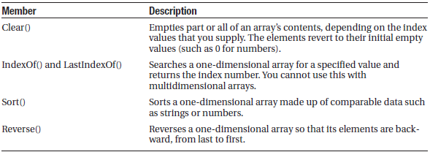
C# Language Basics
The Array Type

Slide 35
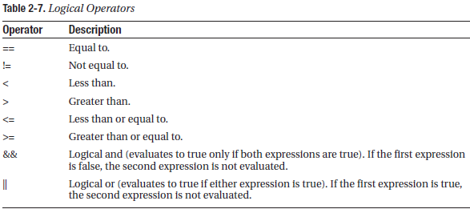
C# Language Basics
Conditional Logic
All conditional logic starts with a condition: a simple expression that can be evaluated to true or false.

Slide 36
C# Language Basics
Conditional Logic
You can use all the comparison operators with any numeric types. With string data types, you can use only the equality operators (== and !=). C# doesn’t support other types of string comparison operators—instead, you need to use the String.Compare() method.
int result;
result = String.Compare("apple", "attach"); // result = -1
result = String.Compare("apple", "all"); // result = 1
result = String.Compare("apple", "apple"); // result = 0
// Another way to perform string comparisons.
string word = "apple";
result = word.CompareTo("attach"); // result = -1

Slide 37
C# Language Basics
If Statement
if (myNumber > 10)
{
// Do something.
}
else if (myString == "hello")
{
// Do something.
}
else
{
// Do something.
}
else if and else parts are optional

Slide 38
C# Language Basics
Switch Statement (is a replacement for if statements)
switch (myNumber)
{
case 1:
// Do something.
break;
case 2:
// Do something.
break;
default:
// Do something.
break;
}
switch (myNumber)
{
case 1:
case 2:
// This code executes if myNumber is 1 or 2.
break;
default:
// Do something.
break;
}
Default works like else part of if statement and optional.
The only limitation is that the variable you’re evaluating must be an integer-based data type, a bool, a char, a string, or a value from an enumeration. Other data types aren’t supported.

Slide 39
C# Language Basics
For Loop
for (int i = 0; i < 10; i++)
{
// This code executes ten times.
System.Diagnostics.Debug.Write(i);
}
If you run this code using a tool such as Visual Studio, it will write the following numbers in the Debug window:
0 1 2 3 4 5 6 7 8 9
string[] stringArray = {"one", "two", "three"};
for (int i = 0; i < stringArray.Length; i++)
{
System.Diagnostics.Debug.Write(stringArray[i] + " ");
}
This code produces the following output:
one two three

Slide 40
C# Language Basics
foreach Loop
C# also provides a foreach loop that allows you to loop through the items in a set of data. With a foreach loop, you don’t need to create an explicit counter variable. Instead, you create a variable that represents the type of data for which you’re looking. Your code will then loop until you’ve had a chance to process each piece of data in the set. The foreach loop is particularly useful for traversing the data in collections and arrays.

Slide 41
C# Language Basics
foreach Loop
string[] stringArray = {"one", "two", "three"};
foreach (string element in stringArray)
{
// This code loops three times, with the element variable set to
// "one", then "two", and then "three".
System.Diagnostics.Debug.Write(element + " ");
}
The foreach loop has one key limitation: it’s read-only. For example, if you wanted to loop through an array and change the values in that array at the same time, foreach code wouldn’t work. Here’s an example of some flawed code:
int[] intArray = {1,2,3};
foreach (int num in intArray)
{
num += 1;
}
In this case, you would need to fall back on a basic for loop with a counter.

Slide 42
C# Language Basics
while Loop
Finally, C# supports a while loop that tests a specific condition before or after each pass through the loop. When this condition evaluates to false, the loop is exited.
int i = 0;
do
{
i += 1;
// This code executes ten times.
}
while (i < 10);
int i = 0;
while (i < 10)
{
i += 1;
// This code executes ten times.
}
Both of these examples are equivalent, unless the condition you’re testing is false to start. In that case, the while loop will skip the code entirely. The do . . . while loop, on the other hand, will always execute the code at least once, because it doesn’t test the condition until the end.

Slide 43
C# Language Basics
Methods
Methods are the most basic building block you can use to organize your code. Essentially, a method is a named grouping of one or more lines of code. Ideally, each method will perform a distinct, logical task. By breaking your code down into methods, you not only simplify your life, but you also make it easier to organize your code into classes and step into the world of object-oriented programming.
When you declare a method in C#, the first part of the declaration specifies the data type of the return value, and the second part indicates the method name. If your method doesn’t return any information, you should use the void keyword instead of a data type at the beginning of the declaration.

Slide 44
C# Language Basics
Methods
Here are two examples—one method that doesn’t return anything, and one that does:
// This method doesn't return any information.
void MyMethodNoReturnedData()
{
// Code goes here.
}
// This method returns an integer.
int MyMethodReturnsData()
{
// As an example, return the number 10.
return 10;
}

Slide 45
C# Language Basics
Methods
Notice that the method name is always followed by parentheses. This allows the compiler to recognize that it’s a method.
In this example, the methods don’t specify their accessibility. This is just a common C# convention. You’re free to add an accessibility keyword (such as public or private) as shown here:
private void MyMethodNoReturnedData()
{
// Code goes here.
}
The accessibility determines how different classes in your code can interact. Private methods are hidden from view and are available only locally, whereas public methods can be called by all the other classes in your application.

Slide 46
C# Language Basics
Methods
Invoking your methods is straightforward—you simply type the name of the method, followed by parentheses. If your method returns data, you have the option of using the data it returns or just ignoring it:
// This call is allowed.
MyMethodNoReturnedData();
// This call is allowed.
MyMethodReturnsData();
// This call is allowed.
int myNumber;
myNumber = MyMethodReturnsData();
// This call isn't allowed.
// MyMethodNoReturnedData() does not return any information.
myNumber = MyMethodNoReturnedData();

Slide 47
C# Language Basics
Methods-Parameters
Methods can also accept information through parameters. Parameters are declared in a similar way to variables. By convention, parameter names always begin with a lowercase letter in any language.
Here’s how you might create a function that accepts two parameters and returns their sum:
private int AddNumbers(int number1, int number2)
{
return number1 + number2;
}
When calling a method, you specify any required parameters in parentheses or use an empty set of parentheses if no parameters are required:
// Call a method with no parameters.
MyMethodNoReturnedData();
// Call a method that requires two integer parameters.
MyMethodNoReturnedData2(10, 20);
// Call a method with two integer parameters and an integer return value.
int returnValue = AddNumbers(10, 10);

Slide 48
C# Language Basics
Method Overloading
C# supports method overloading, which allows you to create more than one method with the same name, but with a different set of parameters. When you call the method, the CLR automatically chooses the correct version by examining the parameters you supply.
This example provides two overloaded versions for the GetProductPrice() method:
private decimal GetProductPrice(int ID)
{
// Code here.
}
private decimal GetProductPrice(string name)
{
// Code here.
}

Slide 49
C# Language Basics
Now you can look up product prices based on the unique product ID or the full product name, depending on whether you supply an integer or string argument:
decimal price;
// Get price by product ID (the first version).
price = GetProductPrice(1001);
// Get price by product name (the second version).
price = GetProductPrice("DVD Player");
You cannot overload a method with versions that have the same signature—that is, the same number of parameters and parameter data types—because the CLR will not be able to distinguish them from each other. When you call an overloaded method, the version that matches the parameter list you supply is used. If no version matches, an error occurs.

