Slide 1
ITEC 202 Operating Systems
EASTERN MEDITERRANEAN UNIVERSITY
SCHOOL OF COMPUTING AND TECHNOLOGY
Memory Management

Slide 2
Memory Management
Memory management is the process of coordinating and controlling the use of memory in a computer system.
It is the task of subdividing memory to accommodate multiple processes.

Slide 3
Uni Programming
System
Kernel (OS)
Program (user)
Just one large area
Kernel
(OS)
Program
(user)
Uni Programming
System

Slide 4
Multi Programming
System
Kernel (OS)
Program (user)
The large area is sub-divided further to have more then one program active in the main memory; which is basically memory management.
Kernel
(OS)
Program 1
Program 2
.
.
.
Program n
Multi Programming
System

Slide 5
Kernel
(OS)
Kernel
(OS)
Program
(user)
Program 1
Program 2
.
.
.
Program n
Uni Programming
System
Multi Programming
System

Slide 6
Memory Management Requirements
Relocation
Protection
Sharing
Logical organization
Physical organization

Slide 7
Relocation
In a multiprogramming system, the available memory is generally shared among a number of processes.
The operating system is managing memory and is responsible for bringing processes into main memory.

Slide 8
Relocation
Programmer does not know where the program will be placed in memory when it is executed.
In addition, while the program is executing, it may be swapped to disk and returned to main memory at a different location (relocation).

Slide 9
Protection
Data integrity is essential; therefore, each process area should be protected against any undesired interferences.
Processes should not be able to reference memory locations in another process for reading or writing purpose without permission.
Normally, a user process cannot access any point of the operating system, neither program nor data.

Slide 10
Protection
The memory protection requirement must be satisfied by the processor (hardware) rather than the operating system (software).
This is because the operating system cannot predict all of the memory references that a program will make.

Slide 11
Sharing
Protection does not mean that when necessary two or more processes should not be able to access a common area.
Sharing allows several processes to access the same portion of memory.
For example, if a number of processes are executing the same program, it is better to allow each process access to the same copy of the program rather than have its own separate copy.

Slide 12
Logical Organization
Physical main memory is a sequence of bytes. Memory division should be such that it should reflect a logic.
Most programs are written in modules that brings advantages:
Modules can be written and compiled independently
Different degrees of protection given to modules (read-only, execute-only)
Share modules among processes

Slide 13
Physical Organization
Computer memory is organized into at least two levels
main memory
secondary memory
Task of moving information between the two levels is a major system concern
virtual memory

Slide 14
Memory Partitioning
Fixed partitioning
Equal-size partitions
Unequal-size partitions
Dynamic partitioning
Buddy system
Paging
Segmentation

Slide 15
Fixed partitioning
In this scheme, available memory is divided into fixed areas.
Main memory use is inefficient.
Any program, no matter how small, occupies an entire partition. This is called internal fragmentation.

Slide 16
Fixed partitioning Equal-size partitions
Any process whose size is less than or equal to the partition size can be loaded into an available partition.
If all partitions are full, the operating system can swap a process out of a partition.
A program may not fit in a partition. Thus, the programmer must design the program with overlays.

Slide 17
Fixed partitioning placement algorithms
Equal-size partitions
because all partitions are of equal size, it does not matter which partition is used
10 M
Process
10 M
6 M
Internal
Fragmentation
6M

Slide 18
Fixed partitioning placement algorithms
Unequal-size partitions
can assign each process to the smallest partition within which it will fit to minimize wasted memory within a partition
Process
10 M
10 M
2 M
Internal
Fragmentation
2M

Slide 19
Dynamic partitioning
Partitions are of variable length and number.
Process is allocated exactly as much memory as required.
Eventually get holes in the memory. This is called external fragmentation.
Must use compaction to shift processes so they are continuous and all free memory is in one block.

Slide 20
Dynamic partitioning
When a process brought into main memory, it is allocated exactly as much memory as required.
Assume 64 Mbytes of main memory is available for the processes:
P1
20 M
P2
14 M
P3
18 M
P4
8 M

Slide 21
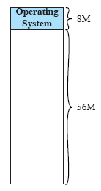
Dynamic partitioning
Initially, main memory is empty, except for the operating system

Slide 22
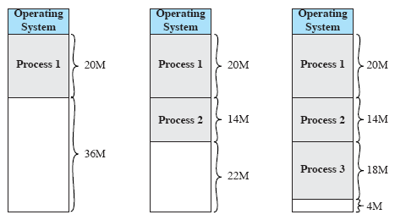
Dynamic partitioning
The first three processes are loaded in, starting where the operating system ends and occupying just enough space for each process.
This leaves a “hole” at the end of memory that is too small for fourth process that needs 8 Mbytes.
At some point, some of the processes in memory is not ready.
The operating system swaps out process 2, which leaves sufficient room to load a new process, process 4.
P4
8 M

Slide 23
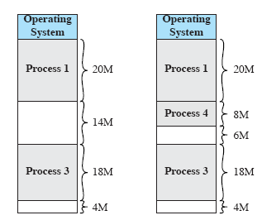
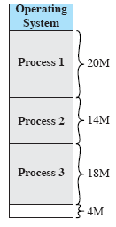
Dynamic partitioning
The operating system swaps out process 2, which leaves sufficient room to load a new process, process 4.
Because process 4 is smaller than process 2, another small hole is created.

Slide 24
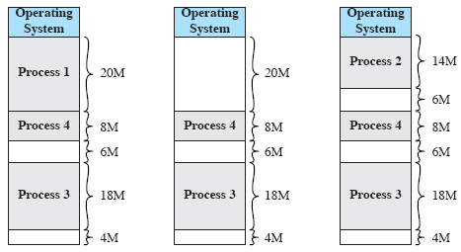
Dynamic partitioning
Later, a point is reached at which none of the processes in main memory is ready, but process 2, in the Ready-Suspended state, is available.
Because there is insufficient room in memory for process 2, the operating system swaps process 1 out and swaps process 2 back in.

Slide 25
Dynamic partitioning
As seen in the example, this method eventually leaves holes in the memory. This is called external fragmentation.
One technique to overcome external fragmentation is compaction:
From time to time operating system shifts processes so they are contiguous and all free memory is together in one block.

Slide 26
Memory Compaction Process
Compaction will result in a block of free memory of length 16 Mbytes.
The difficulty with compaction is that it is a time consuming procedure and wasteful of processor time.

Slide 27
Dynamic partitioning placement algorithms
Because memory compaction is time consuming, the operating system must decide cleverly which free block to allocate to a process.
Best-Fit
First-Fit
Next-Fit

Slide 28
Dynamic partitioning placement algorithms
Best-fit algorithm
Chooses the block that is closest in size to the request
Worst performer overall
Since smallest block is found for process, the smallest amount of fragmentation is left
Memory compaction must be done more often

Slide 29
Dynamic partitioning placement algorithms
First-fit algorithm
Scans memory form the beginning and chooses the first available block that is large enough
Fastest
May have many process loaded in the front end of memory that must be searched over when trying to find a free block

Slide 30
Dynamic partitioning placement algorithms
Next-fit
Scans memory from the location of the last placement
More often allocate a block of memory at the end of memory where the largest block is found
The largest block of memory is broken up into smaller blocks
Compaction is required to obtain a large block at the end of memory

Slide 31
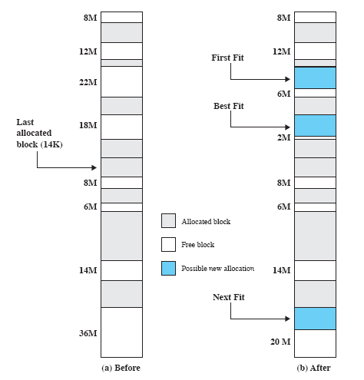
Example: Dynamic partitioning placement algorithms
16 M
16-Mbyte allocation request.
Best-fit will search the entire list of available blocks and make use of the 18-Mbyte block, leaving 2-Mbyte fragment.
First-fit results in a 6-Mbyte fragment.
Next-fit results in a 20-Mbyte fragment.

Slide 32
Buddy Systems
Fixed partitioning scheme uses available space inefficiently.
Dynamic partitioning scheme is complex
Compaction is required
An interesting alternative is Buddy System
In each step available memory is divided into two equal parts (buddy) to provide requested space.

Slide 33
Example: Buddy Systems
Assume 1 Mbytes of Memory is available and there is a request for 100 Kbytes memory allocation.
1 Mbytes= 1024 Kbytes
128 K
128 K
256 K
1 M
128 K
256 K
512 K
512 K
100 Kbytes can be
allocated into this location

Slide 34
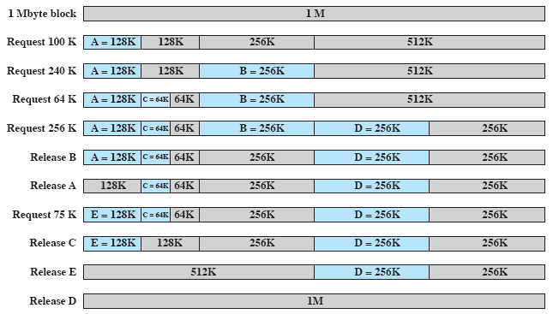
Example: Buddy Systems

Slide 35
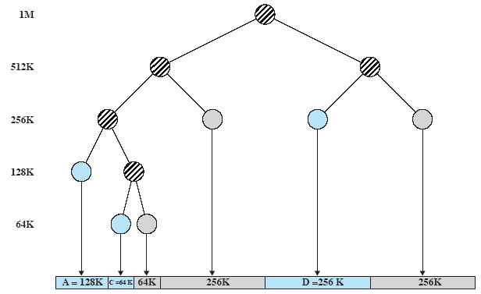
Tree Representation of Buddy System
Figure shows a binary tree representation of the buddy allocation immediately after the Release of request B.

Slide 36
Relocation
When programs are loaded into memory the actual (absolute) memory locations are determined
A process may occupy different partitions which means different absolute memory locations during execution (from swapping)
Compaction will also cause a program to occupy a different partition which means different absolute memory locations

Slide 37
Addresses
Logical
Reference to a memory location independent of the current assignment of data to memory
Translation must be made to the physical address
Relative
Address expressed as a location relative to some known point
Physical
The absolute address or actual location in main memory

Slide 38
Relative and absolute addressing

Slide 39
Registers used during execution
Base register
Starting address for the process
Bounds register
Ending location of the process
These values are set when the process is loaded or when the process is swapped in

Slide 40
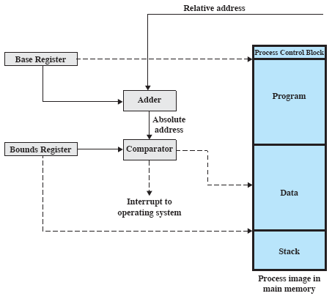
Hardware support for relocation
The value of the base register is added to a relative address to produce an absolute address
The resulting address is compared with the value in the bounds register If the address is not within bounds, an interrupt is generated to the operating system

Slide 41
Paging
Both unequal fixed-size and variable-size portions are inefficient in the use of memory.
External and Internal fragmentations
To overcome these problems the process is broken into small equal pieces called pages and the memory is divided into small pieces called frames.
The size of frame is equal to that of page.

Slide 42
Example: Paging
Assignments of two processes to free frames in main memory.

Slide 43
Example: Paging
Another example will be given to illustrate the use of frames and pages.
The processes were divided into pages:.
Process A 4 pages
Process B 3 pages
Process C 4 pages
Process D 5 pages.
At any given time, some of the frames in memory are in use and some of them are free.
A list of free frames is also maintained by the operating system.

Slide 44
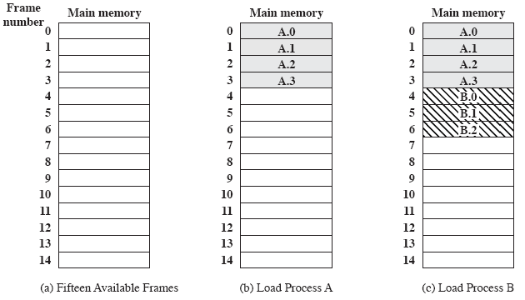
Example: Paging
needs 4 frames
needs 3 frames
Process A, stored on disk, consists of 4 frames. When time comes to load this process, the operating system finds four free frames and loads the four pages of process A into the four frames as shown

Slide 45
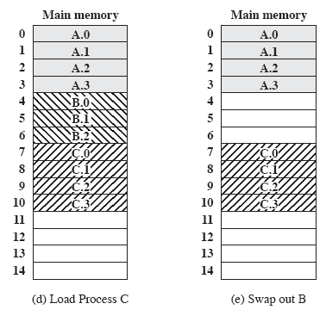
Example: Paging
needs 4 frames
After the Process B is swapped out, the operating system needs to bring a new process, Process D, which consists of five pages. In the shown example, there are not sufficient unused continuous frames to hold the process

Slide 46
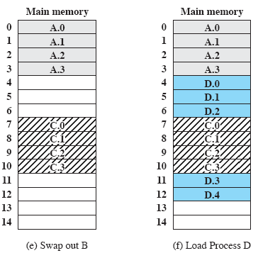
Example: Paging
In that case, the concept of logical address can be used.
D needs 5 frames

Slide 47
Paging
Operating system maintains a page table for each process
Contains the frame location for each page in the process
Memory address consist of a page number and offset within the page
(page no, offset)

Slide 48
Figure shows the various page tables for the given example. Each page table entry contains the number of frames in main memory. Operating system also maintains a single free frame list of all frames in main memory that are currently unoccupied and available for pages.
0
1
2
3
0
1
2
3
0
1
2
-
-
-
0
1
2
3
7
8
9
10
0
1
2
3
4
4
5
6
11
12
13
14
Process B
page table
Free frame
list
Process A
page table
Process C
page table
Process D
page table
Page Tables for Example

Slide 49
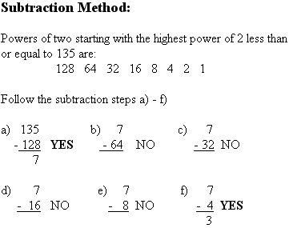
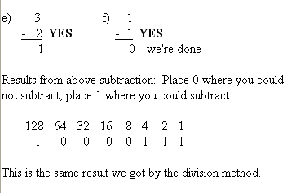
Decimal to Binary Conversion:
135 = 10000111
Read lecture notes for more info about Decimal to Binary conversion…

Slide 50
Example, Paging with page size 1Kbytes
Address space = 16 Bits, (2¹⁶=64 Kbytes memory)
Since page size is 1 Kbytes (2¹⁰=1024) an offset field of 10 bit is needed.
That’s leave 16-10=6 bits for page numbers.
Thus, program can consist of maximum 2⁶=64 pages of 1 Kbytes each.

Slide 51
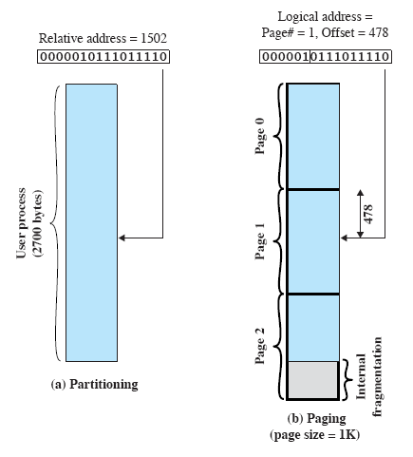
Logical addresses
Relative address=1502 User Process = 2700 Bytes
1024+478=1502
(1,478)

Slide 52
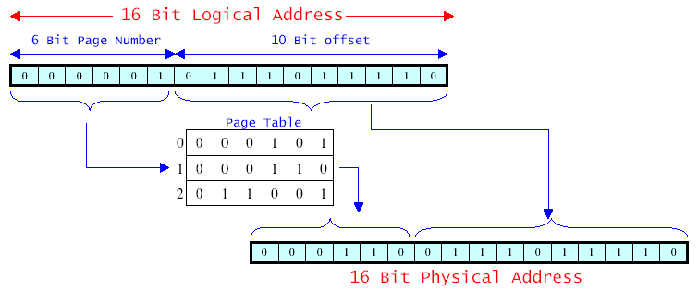
Example of Paging Logical-to-Physical Address Translation
Suppose that this page is residing in main memory frame 6 (in binary 000110).
Logical address → 0000010111011110 Page number 1 (000001) and offset 478 (0111011110). Physical address frame number 6 (000110) , offset 478 (0111011110)

Slide 54
Segmentation
Similar to paging another option is to divide the program into segments of varying sizes
Segments should not exceed a maximum segment size.
A simple segmentation scheme uses a segmentation table for each process and a list of free memory blocks.

Slide 55
Segmentation
All segments of all programs do not have to be of the same length
There is a maximum segment length
Addressing consist of two parts
a segment number
an offset
Since segments are not equal, segmentation is similar to dynamic partitioning

Slide 56
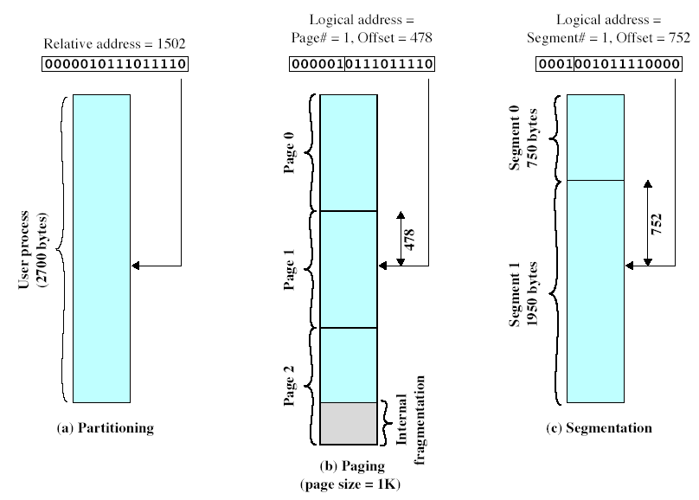
Example Segmentation
4 bits for Segment no
12 bits for Offset
750+752=1502
Starting address
of Segment + Offset

Slide 57
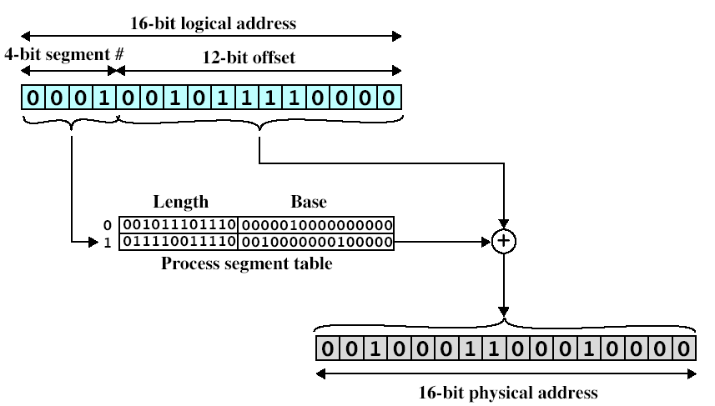
Example of Segmentation Logical-to-Physical Address Translation
011110011110=1950
Length of Segment 1
Suppose that this segment is residing in memory starting at physical address 0010000000100000 (8224).
8224+752=8976
Logical address → 0001001011110000 Segment number 1 (0001) and offset 752 (001011110000). Physical address → 0010000000100000+001011110000 =0010001100010000 (8224+752=8976)

Slide 58
Example 1
A dynamic partitioning scheme is being used, and the following is the memory configuration at a given point in time. The shaded areas are allocated blocks and the white areas are free blocks. Assume next four memory request are for 250K, 419K, 205K and 330K. Indicate the starting address (position on the given memory configuration) for each of the four blocks using the following placement algorithms.
First-fit
Best-fit

Slide 59
First-Fit
Initial State
Allocation of 250K
Allocation of 419K
Allocation of 205K
Last Allocation for 330K fails!!!

Slide 60
Best-Fit
Initial State
Allocation of 250K
Allocation of 419K
Allocation of 205K
Allocation of 330K

Slide 61
Example 2
Assume we have a memory that have the following holes in increasing memory start address order: Hole1 = 20 KB, Hole2 = 8 KB, Hole3 = 40 KB, Hole4 = 36 KB, Hole5 = 14 KB, Hole6 = 18 KB, Hole7 = 24 KB, Hole8 = 30 KB. Which hole is taken for successive segment requests of 24 KB, 20 KB and 18 KB, if we use the following partitioning algorithms.
Best-Fit
First-Fit
Next-Fit

Slide 62
First-Fit
24 Kbytes →
20 Kbytes →
18 Kbytes →
Hole 3 (16 Kbytes free)
Hole 1 (Full)
Hole 4 (18 Kbytes free)

Slide 63
Best-Fit
24 Kbytes →
20 Kbytes →
18 Kbytes →
Hole 7 (Full)
Hole 1 (Full)
Hole 6 (Full)

Slide 64
Next-Fit
24 Kbytes →
20 Kbytes →
18 Kbytes →
Hole 3 (16 Kbytes free)
Hole 4 (16 Kbytes free)
Hole 6 (Full)

Slide 65
Example 3
Consider a simple segmentation system that has the following segment table.
Starting Address (Base) | Length (Bytes)
660 | 248
1752 | 422
222 | 198
996 | 604
For each of the following logical addresses, determine the physical address or indicate if segment fault occurs.

Slide 66
Example 3
Starting Address (Base) | Length (Bytes)
660 | 248
1752 | 422
222 | 198
996 | 604
For each of the following logical addresses, determine the physical address or indicate if segment fault occurs.
0
1
2
3
Physical address = offset+ starting address of the segment
 | Logical address | Physical address
a) | 0,198
b) | 2,156
c) | 1,530
d) | 3,455
e) | 0,252
198+660=858
156+222=378
Segment fault
455+996=1451
Segment fault

Slide 67
Memory Management
Ahmet Rizaner
11 April 2008

