Slide 1
EASTERN MEDITERRANEAN UNIVERSITY DEPARTMENT OF INDUSTRIAL ENGINEERING INFORMATION SYSTEMS AND TECHNOLOGY IENG 372 / MANE 372 – Tutorial 2 Fall 2021-2022
Lecturer : Khaoula Chnina

Slide 2
Case Study
A company that sells telephones online wants to create an information system to track orders. The following system requirement were collected during SDLC phase2:
They can purchase different products from the same supplier, but they don’t buy the same product from different suppliers.
They have ONE supplier in each country.
Some products may be produced in many countries, and a given country may produce many products.
customers may buy different products at one time, and any product can be purchased by many customers.
They record accounting related data for each product in the accounting table once.
And the orders table contains the history of the orders.

Slide 3
Questions :
1- Create An E-R diagram for this information system.
Identifyting Entitites
Attributes
Identifying Relationships
Drawing the ERD
2- Which entities are in 2NF, which ones are in 3NF (normal form) ?
3- Draw the ERD that you will use un physical design phase. (20 minutes)
(represent the relationships to be done in Ms Access)

Slide 4
Answers
A- Identifyting Entitites
ENTITIES - Draft
Storage ( capacity , stock)
Order
Supplier
Customer
Product
Country
Accounting
ENTITIES – Selected
Product
Supplier
Customer
Country
Order
Accounting

Slide 5
B- Identifying Attributes
DRAFT
Products (Product Id, Features, Colors,price)
Supplier( Supplier ID, Name, phone, address)
Country ( Number, Name,Zip code)
Order (Order number, Place, Customer Id, Price, Products,date,Payment,shippement)
Accounting ( Product Id, benefit, Sold items,stock)
Customer(customer Id, Name,telephone, address)
Products (Product Id, Features, Colors,price)
Supplier( Supplier ID, Name, phone, address)
Country ( Number, Name,Zip code)
Order (Order number, Customer Id, Products,date,Payment,shippement)
Accounting ( Product Id, benefit, Sold items,stock)
Customer(customer Id, Name,telephone, address)

Slide 6
C-Identifying Relationships
Supplier-Product : one-to-many/ Optionality: one-to-one
Supplier-Country: One-to-one / one-to-one
Product-Country: Many-to-Many/Zero-to-one
Customer-Product: Many-to-Many/Zero-to-Zero
Accounting-Product: One-to-one/ one-to-one
Order-Product: Many-to-many/zero-to-one
Customer-order: One-to-many/one-to-zero
They can purchase different products from the same supplier, but they don’t buy the same product from different suppliers.
They have ONE supplier in each country.
Some products may be produced in many countries, and a given country may produce many products.
customers may buy different products at one time, and any product can be purchased by many customers.
They record accounting related data for each product in the accounting table once.
And the orders table contains the history of the orders.

Slide 7
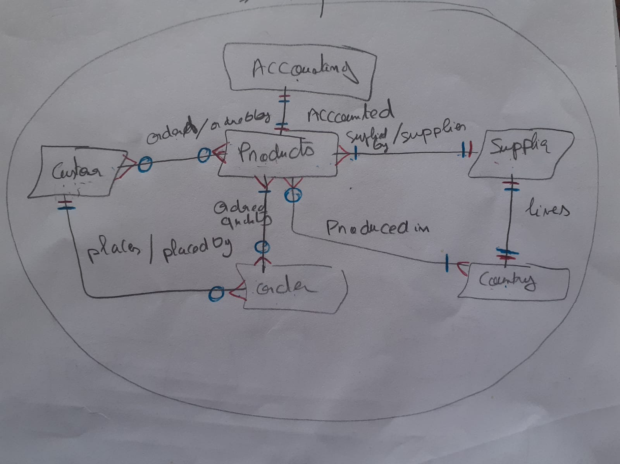
D- First ERD

Slide 8
ALL ARE IN 3NF

Slide 9
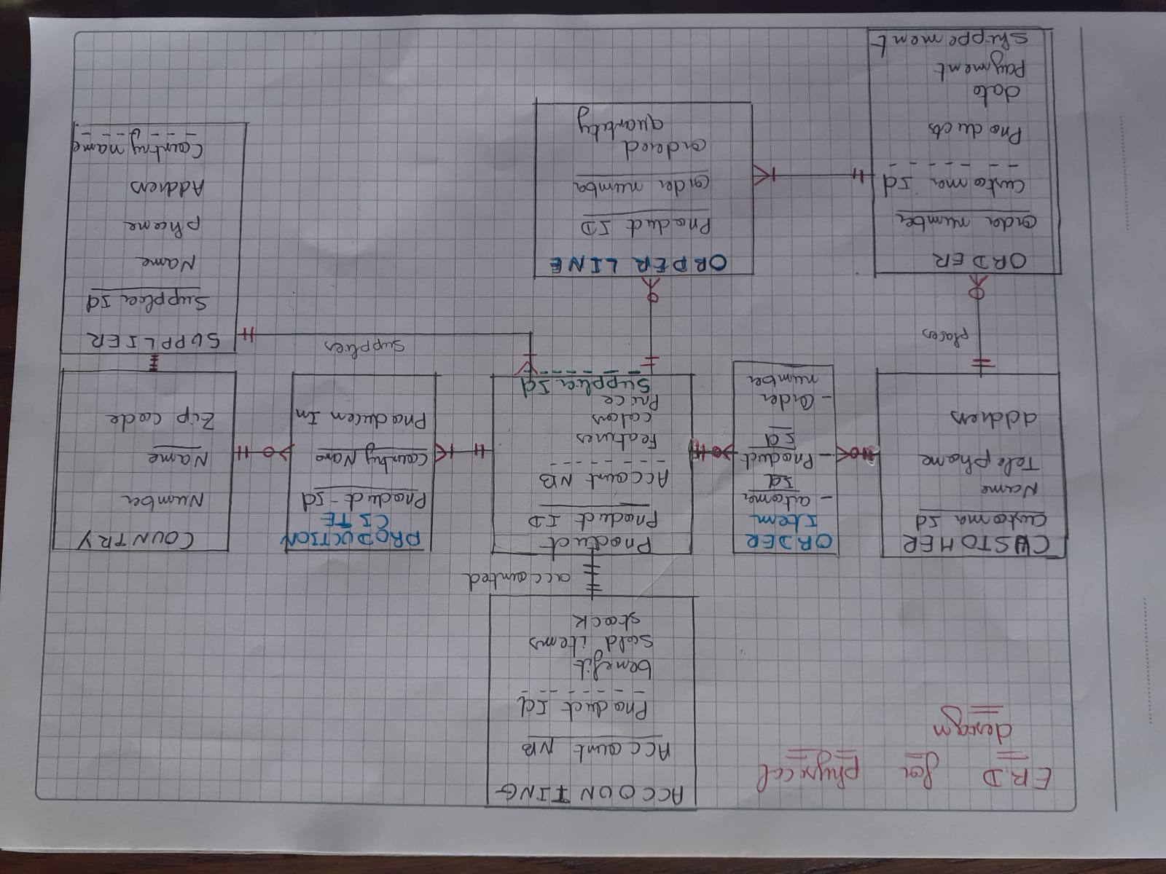

Slide 10
Final Sets of relationships after normalization and merging
Products (Product Id, Features, Colors,price,Supplier ID, Account NB)
Supplier( Supplier ID, Name, phone, address, Country Name)
Country ( Number, Country Name,Zip code)
Order (Order number, Customer Id, Products,date,Payment,shippement)
Accounting ( Account NB,Product Id, benefit, Sold items,stock)
Customer(customer Id, Name,telephone, address)
Order Item (customer Id, Product Id, Order number)
Order Line (Product Id, Order number, Ordered Quantity)
Production Cite (Product Id, Country Name, Produced in)

