Slide 1
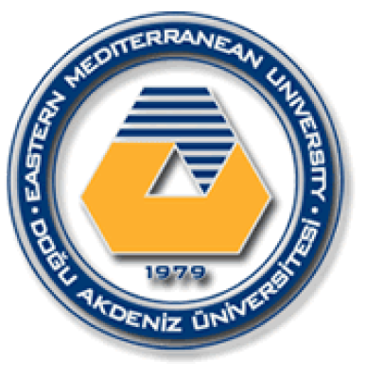
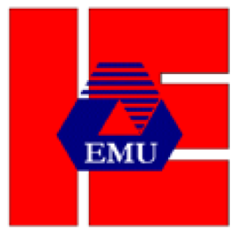
EASTERN MEDITERRANEAN UNIVERSITY DEPARTMENT OF INDUSTRIAL ENGINEERING
INFORMATION SYSTEMS AND TECHNOLOGY
IENG 372 / MANE 372
Spring 2021-2022
Chapter 1
Lecturer : Ms. Khaoula Chnina

Slide 2
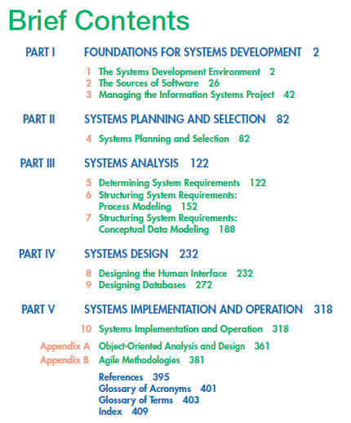

Slide 3
The Systems Development Environment
What Is Information Systems Analysis and Design?
Definition of a System and Its Parts
Systems Analysis and Design: Core Concepts
Your Role in Systems Development
Phase 4: Systems Implementation and Operation
Prototyping
Systems
Important System Concepts
A Modern Approach to Systems Analysis and Design
Developing Information Systems and the Systems Development Life Cycle
Phase 1: Systems Planning and Selection
Phase 3: Systems Design
Phase 2: Systems Analysis
Alternative Approaches to Development
Computer-Aided Software Engineering (CASE) Tools
Joint Application Design
Rapid Application Development
Participatory Design
Agile Methodologies
Chapter 1

Slide 4
Learning Objectives
Define information systems analysis and design
Discuss the modern approach to systems analysis and design that combines both process and data views of systems
List alternatives to the systems development life cycle, including a description of the role of computer-aided software engineering (CASE) tools in systems development
Describe the role of the systems analyst in information systems development
Describe the information systems development life cycle (SDLC)
Describe 3 types of information systems:
1- Transaction Processing Systems (TPS)
2- Management Information Systems (MIS)
3- Decision Support Systems (DSS)

Slide 5
1- Information Systems Analysis and Design
Definition :
Systems analysis and design is a method used by companies to create and maintain information systems that perform basic business functions such as keeping track of customer names and addresses, processing orders, and paying employees.
It is a proven methodology that helps both large and small businesses reap the rewards of utilizing information to its full capacity.
Goal:
to improve organizational systems, by applying software solutions that help employees accomplish key business tasks more easily and efficiently.
Systems analyst Role:
Systems analysts are at the center of developing this software and they perform analysis and design of information systems based on:
- understanding of the organization’s objectives, structure, and processes
- knowledge of how to exploit information technology for advantage
>> A structured approach must be used in order to ensure success : The Systems Development Life Cycle (SDLC)

Slide 6
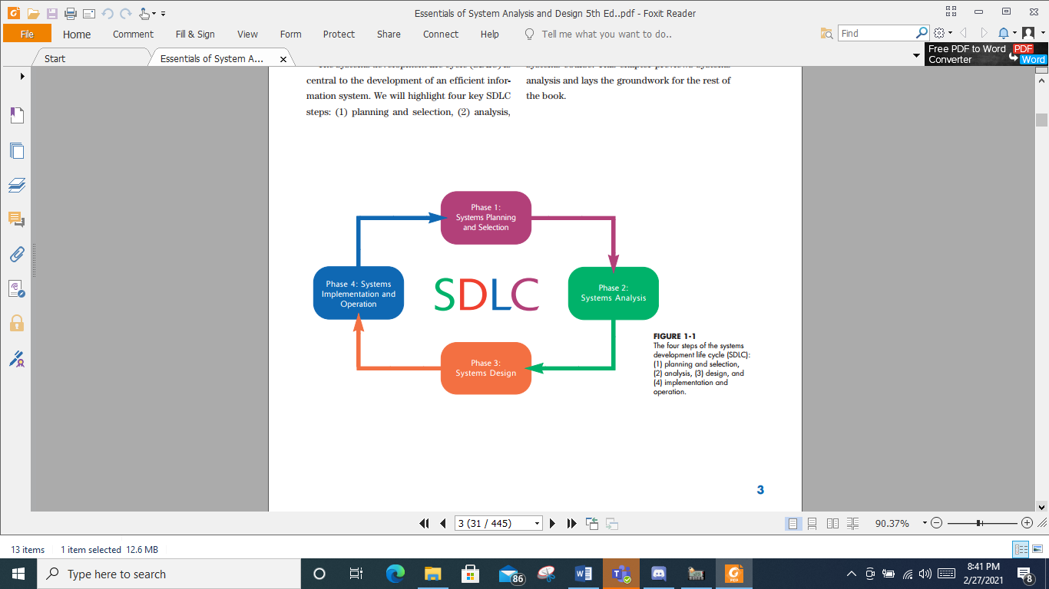
The Systems Development Life Cycle (SDLC)
It is central to the development of an efficient information system.
It is a four-phased approach to identifying, analyzing, designing, and implementing an information system.
SDLC steps are :
  planning and selection,
  analysis,
  design,
  implementation and operation.

Slide 7
2- Systems Analysis and Design: Core Concepts
Goal:
The major goal of systems analysis and design is to improve organizational systems by developing or acquiring application software and training employees to use it.
Application software:
The goal of application software (also called a system) is to turn data into information. And it is designed to support a specific organizational function or process, such as inventory management, payroll, or market analysis.
The application software helps the user perform tasks such as writing a paper, preparing a spreadsheet, and linking to the Internet. A variety of application software exist in the market like WordPerfect, Excel, and PowerPoint. However, they may not fit the needs of a particular organization, so the organization must develop its own application.
Examples of Application Software:
Software developed for the inventory department at a bookstore may keep track of the number of books in stock of the latest best seller.
Software for the payroll department may keep track of the changing pay rates of employees.

Slide 8
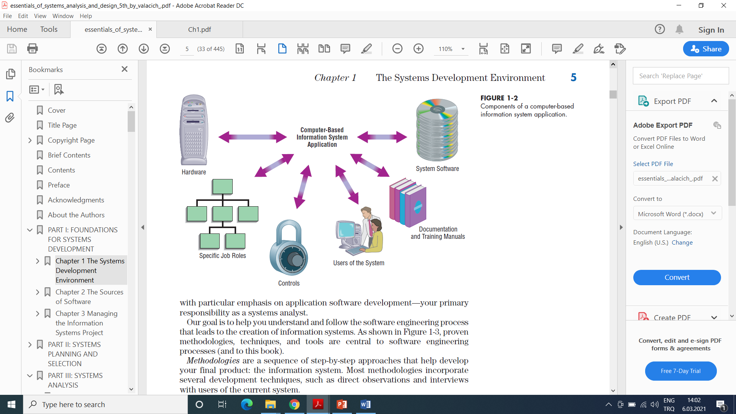
The basic components of computer-based information systems:
Hardware: The machinery and equipment including the computer and all of its support equipment like the monitor, processor, printer, and keyboard.
In pre-computer information systems, the hardware might include ledger books and ink.
System Software: The computer programs that allow the hardware to process the data and assure the computer function.
The "software" for pre-computer information systems included how the hardware was prepared for use
(e.g., column headings in the ledger book) and instructions for using them (the guidebook for a card catalog).
>> the application software runs on the hardware and systems software <<
/
Documentation and training materials, which are materials created by the systems analyst to help employees use the software they’ve helped create.
The specific job roles associated with the overall system, including the people who run the computers and keep the software operating, in addition to those who maintain the data, and support the network of computers.“
Users of the system, The people who use the software in order to do their jobs.
Controls, which are parts of the software written to help prevent fraud and theft.
How to create an information system ???

Slide 9
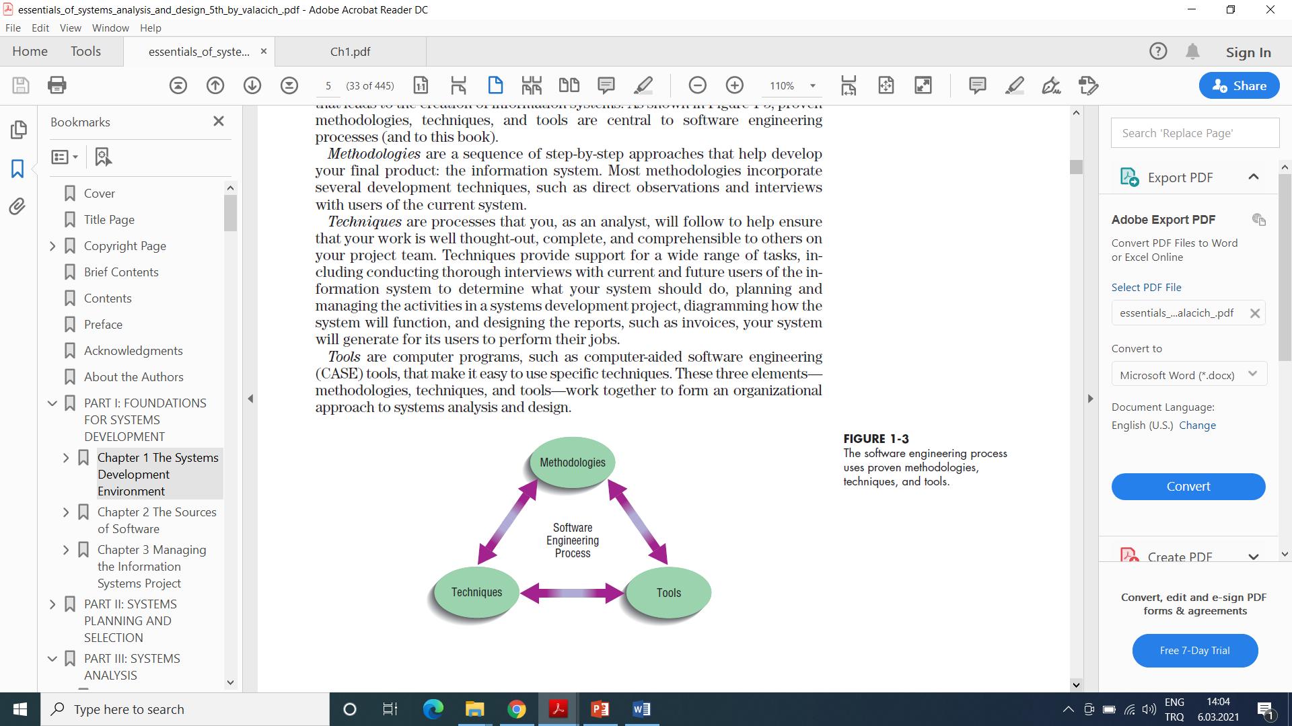
The software engineering process
The software engineering process is a process used to create an information system. It consists of proven methodologies, techniques, and tools that work together to form an organizational approach to systems analysis and design.
Methodologies are a sequence of step-by-step approaches that help develop the information system. They incorporate several development techniques, such as direct observations and interviews with users of the current system.
Techniques are processes that an analyst follows to ensure a well thought-out, complete, and comprehensible analysis and design.
Tools are computer programs, such as computer-aided software engineering (CASE) tools, that aid in applying techniques.

Slide 10
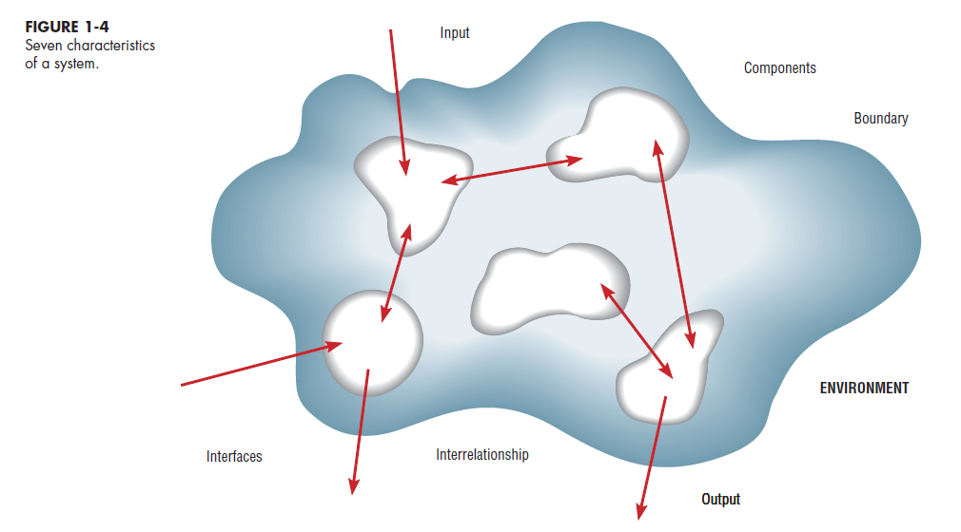
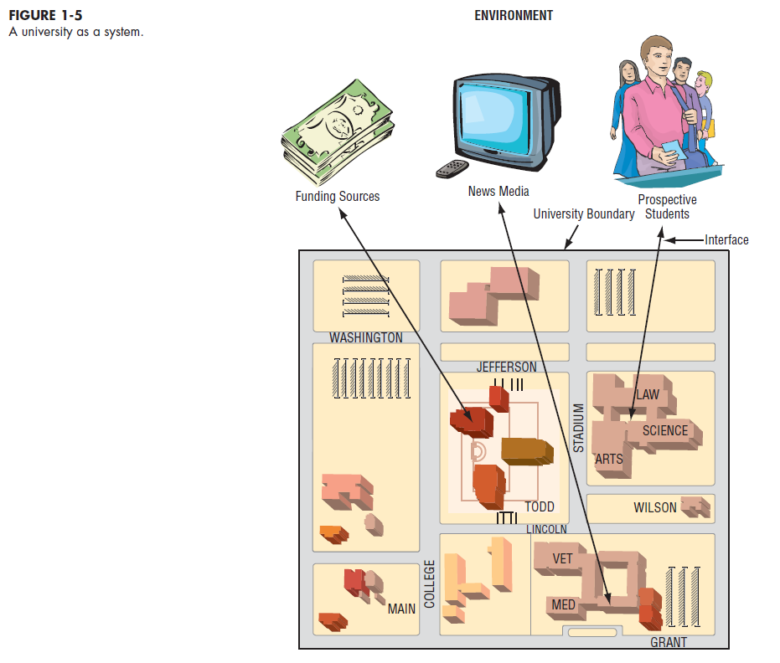
3- Systems
Definition
A system is an interrelated set of business procedures used within one business unit working together for a purpose.
A system has nine characteristics
A system exists within an environment
A boundary separates a system from its environment
The system takes input from outside, processes it, and sends the resulting output back to its environment.
Characteristics of a System
1. Components : An irreducible part or aggregation of parts that makes up a system; also called a subsystem.
2. Interrelated components : Dependence of one part of the system on one or more other system parts.
3. Boundary : The line that marks the inside and outside of a system and that sets off the system from its environment.
4. Purpose : The overall goal or function of a system.
5. Environment : Everything external to a system that interacts with the system.
6. Interfaces : Point of contact where a system meets its environment or where subsystems meet each other.
7. Constraints : A limit to what a system can accomplish.
8. Input : Data and information received from the environment.
9. Output : Results of system functioning returned to environment.

Slide 11
Decomposition
● known as functional decomposition. It is The process of breaking down a system into smaller components.
●Allows the systems analyst to :
Modularity
● Process of dividing a system into modules of a relatively uniform size
● Modules simplify the system understanding, design and building.
Coupling
The extent to which subsystems depend on each other.
Subsystems that are dependent upon each other are coupled (highly dependent - tightly coupled)
Cohesion
Focus on one area at a time, without interference from other areas
Concentrate on component pertinent to one group of users without confusing users with unnecessary details
Build different components at independent times and have the help of different analysts
Extent to which a subsystem performs a single function
Break a system into small, manageable and understandable subsystems
Important System Concepts

Slide 12
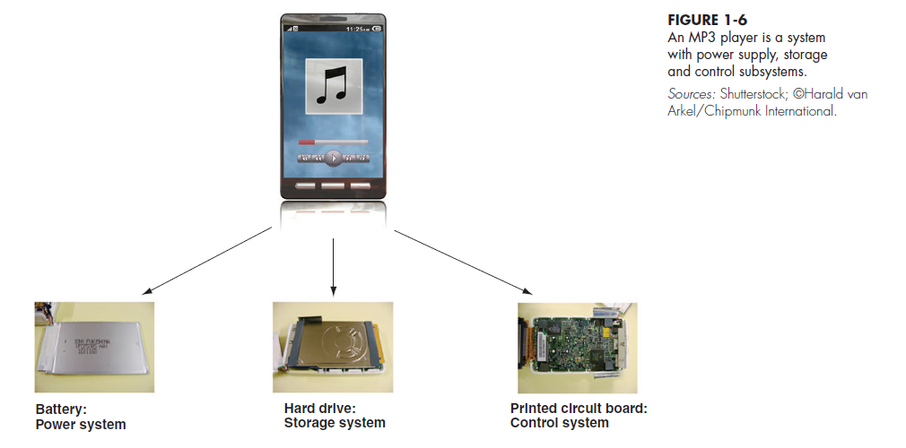
System
Tightly Coupled because of the PCB
Coherent Subsystem
( single Function)
Subsystems

Slide 13
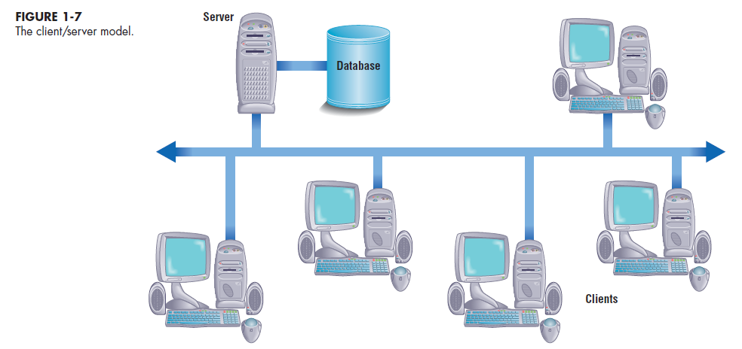
4- A Modern Approach to Systems Analysis and Design
Systems Integration approach
Allows hardware and software from different vendors to work together
Enables procedural language systems (old) to work with visual programming systems (new).
Developers use visual programming environments to design the user interfaces for systems that run on client/server platforms.

Slide 14
Your Role in Systems Development
The roles of the system analyst include:
Study problems and needs of an organization Determine best approach to improving organization through use of:
- People
- Methods
- Information technology
Help system users and managers define their requirements for new or enhanced information systems
Play intermediate role between users, programmers, and other systems professionals
A systems analyst needs to develop skills including :
Analytical skills
Technical skills
Managerial skills
Interpersonal skills
Knowledge of programming languages such as C__ and Java, various operating systems such as Windows and Linux, and computer hardware platforms such as IBM and Mac.

Slide 15
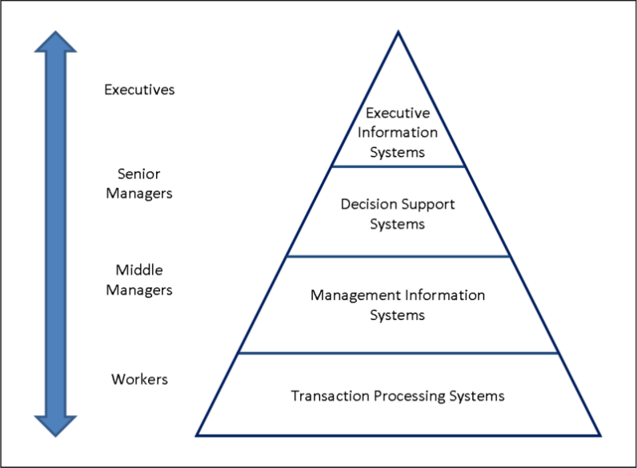
Types of Information Systems and Systems Development
Transaction Processing Systems (TPS) : Automate handling of data about business activities (transactions)
Management Information Systems (MIS): Convert raw data from transaction processing system into meaningful form
Decision Support Systems (DSS) : Designed to help decision makers and Provide interactive environment for decision making
Executive dashboard: They provide rapid access to timely information and direct access to structured information in the form of reports.

Slide 16
Other Types of information system
social information systems
process control system
intelligent system
enterprise systems
data warehouses
enterprise resource planning
computing platform
expert systems
search engines
geographic information system
global information system
multimedia information system
Other Types of information system
computing platform
expert systems
search engines
geographic information system
global information system
multimedia information system
office automation.
electronic commerce system.
supply chain management system
knowledge management systems,
learning management systems,
database management systems,

Slide 17
5- Developing Information Systems and the Systems Development Life Cycle
Systems development methodology
A standard process followed in an organization to conduct all the steps necessary to analyze, design, implement, and maintain information systems. the development of information systems often follows a life cycle.
Systems development life cycle (SDLC)
The series of steps used to manage the phases of development for an information system.
Every organization uses a slightly different life-cycle model to model these steps, from three to almost twenty identifiable phases.
life cycle is not necessarly a sequentially ordered set of phases, it is possible to complete some activities in parallel from different phases, go back to a previous step…
phases can be repeated
each phase has specific outcomes and deliverables that feed importantinformation to other phases.

Slide 18
Phases of the Systems development life cycle (SDLC)
Phase 1: Systems planning and selection
Two primary activities.
Identification of the need for a new or enhanced system.
Information needs of the organization are examined, analyzed arranged , and projects to meet these needs are identified (Investigation and determination of scope).
The organization’s information system needs may result from:
- Requests to deal with problems in current procedures
- The desire to perform additional tasks
- The realization that information technology could be used to capitalize on an existing opportunity
A feasibility study is conducted before the second phase of the SDLC to determine
the economic and organizational impact of the system.

Slide 19
Phase 2 : Systems Analysis
Study of current procedures and information systems and suggestion of alternative replacement systems.
Analysis has several subphases :
Determining the requirements of the system: what the users want from a proposed system. This subphase involves a careful study of any current systems, manual and computerized, that might be replaced or enhanced as part of this project.
Study and Structure of the requirements according to their interrelationships, eliminating any redundancies. And generate alternative initial designs to match the requirements.
Compare the alternatives to determine which best meets the requirements within the cost, labor, and technical levels the organization is willing to commit to the development process.
Description and recommendation of best alternative solution

Slide 20
Phase 3: Systems Design
Logical design (Theory):
The system could be implemented on any hardware and systems software.
concentrates on the business aspects of the system and how it will impact the functional units within the organization.
Physical design (Practice):
Turn the logical design into physical, or technical, specifications.
Convert diagrams into a structured systems design that can be converted to instructions written in a programming language.
Decision of the programming languages, database systems and file structures
Decision of hardware platform, operating system, and network environment the system will run under.

Slide 21
Phase 4: Systems Implementation and Operation
It is a two-step process:
Systems implementation:
Coding, testing, and installation.
Application software is installed, or loaded, on existing or new hardware.
Documentation, training programs, and ongoing user assistance
Operation:
Programmers correct the errors and make the changes that users ask for and modify the system to reflect changing business conditions.
System obsolescence, begin designing the system’s replacement, thereby completing the loop and starting the life cycle over again.

Slide 22
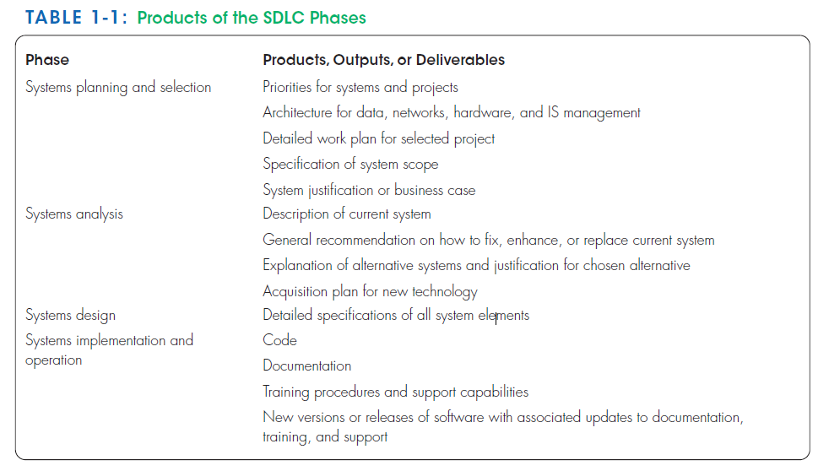

Slide 23
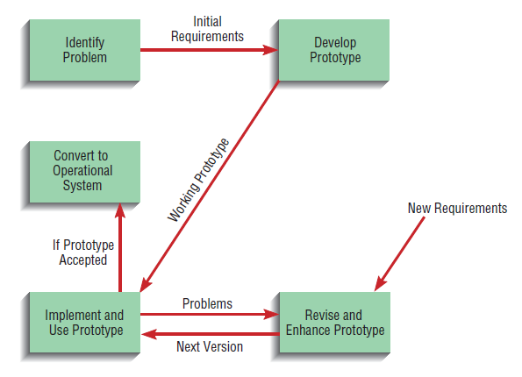
6- Alternative Approaches to Development
A- Prototyping
Designing and building a scaled-down but working version of a desired system
A prototype of the final system may be developed in an early phase of the SDLC to help the analysts identify the user requirements.
A prototype can be developed with a CASE tool.
The analyst uses the users’ feedback to improve the prototype and takes the new version back to the users.
Advantages of the prototyping technique:
(1) Users are involved in analysis and design
(2) It captures requirements in concrete, rather than verbal or abstract, form.
1
2
5
3
4
Repeat Until Acceptance

Slide 24
B- Computer-Aided Software Engineering (CASE) Tools
Software tools that provide automated support for some portion of the systems development process.
can be used to automate or support activities throughout the SDLC
CASE assists systems builders in managing the complexities of information system projects and helps ensure that high-quality systems are constructed on time and within budget.
Product and tool integration is provided through repository.
A repository is an integrated and standard database.
The general types of CASE tools include:
Diagramming tools ( graphic respresentation)
Computer display (or Form) and report generators (help prototype And identification of data requirements and relationships).
Analysis tools ( check for incomplete, inconsistent, or incorrect specifications in diagrams, forms, and reports).
A central repository (enables the integrated storage of specifications,diagrams, reports, and project management information) .
Documentation generators (production of technical and user Documentation).
Code generators ( enable the generation of program and database definition code) .

Slide 25
C- Joint Application Design (JAD)
Users, Managers and Analysts work together for several days
System requirements and designs are reviewed
intensive and Structured meetings
D- Rapid Application Development (RAD)
Systems development methodology created to decrease the time needed to design and implement information systems.
It is supported by Prototyping, CASE, and JAD
The principle RAD methodology is to delay producing detailed system design documents until after user requirements are clear.
RAD sacrifices computer efficiency for gains in human efficiency
can overlook important systems development principles, which may result in problems with systems developed this way.
Follows the same phases in the traditional SDLC, but they are combined and shortened
Focus on functional and user interface requirements at the expense of detailed business analysis and concern for system performance issues.

Slide 26
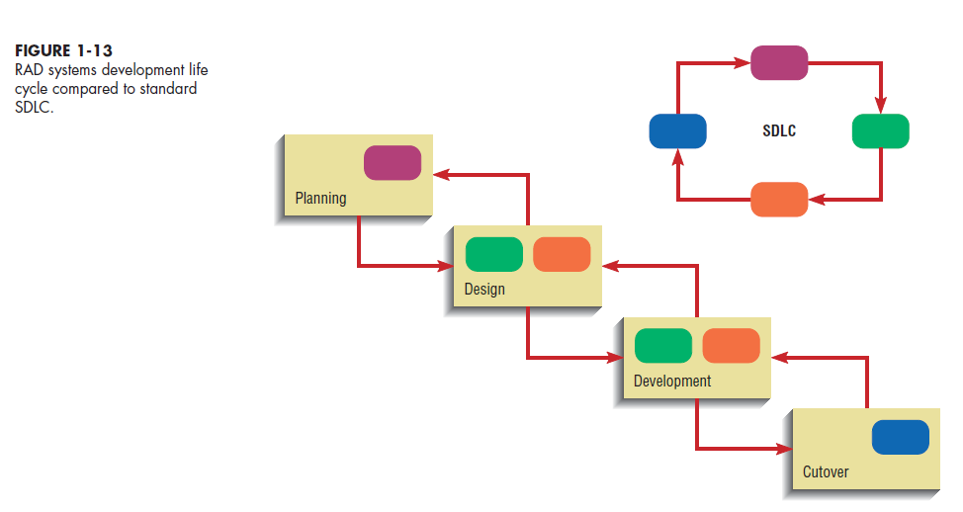

Slide 27
E- Participatory Design (PD)
PD is a viable alternative approach to the SDLC.
PD emphasizes the role of the user much more than do traditional structured analysis and structured design.
PD may involve the entire user community in the development process.
F- Agile Methodologies
Agile methodologies underlines the pioneer principles of a various set of alternative approaches, resulted from an agreement made by the proponents of the said approaches.
Agile methodologies are characterized by short iterative cycles and extensive testing; active involvement of users for establishing, prioritizing, and verifying requirements; and a focus on small teams of talented, experienced programmers.
The principles of Agile Methodologies iclude :
a focus on adaptive rather than predictive methodologies : Software are predictive so more adaptive methodologies are needed
a focus on people rather than roles: people are viewed as talented individuals, not people filling roles
a self-adaptive software development process.

Slide 28
Approaches to Systems Development
Process-Oriented Approach
  Focus is on flow, use and transformation of data in an information system
  Involves creating graphical representations such as data flow grams and charts
  Data are tracked from sources, through intermediate steps and to final destinations
  Natural structure of data is not specified
  Disadvantage: data files are tied to specific applications
Data-Oriented Approach
  Depicts ideal organization of data, independent of where and how data are used
  Data model describes kinds of data and business relationships among the data
  Business rules depict how organization captures and processes the data

Slide 29
Summary
Information systems analysis and design
Process of developing and maintaining an information system
Modern approach to systems analysis : Systems Integration
Process-oriented
Data-oriented
Role of Systems Analyst
perform analysis and design of information systems
act as liaisons between business users and technical personnel
Three types of information systems
Transaction Processing (TPS)
Management Information System (MIS)
Decision Support (DSS)
Systems Development Life Cycle (SDLC)
Systems Planning and Selection
Systems Analysis
Systems Design
Systems Implementation
Alternatives to Systems Development Life Cycle
Prototyping
Rapid Application Development (RAD)
CASE
Joint Application Design (JAD)
Participatory Design (PD)
Agile Methodologies

Slide 30
Thank you for your attention
Any Questions
???

