Slide 1
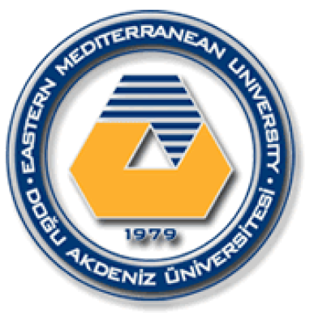
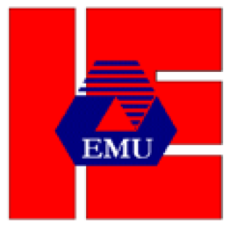
EASTERN MEDITERRANEAN UNIVERSITY DEPARTMENT OF INDUSTRIAL ENGINEERING
INFORMATION SYSTEMS AND TECHNOLOGY
IENG 372 / MANE 372
Spring 2021-2022
Chapter 2
Lecturer : Ms. Khaoula Chnina

Slide 2
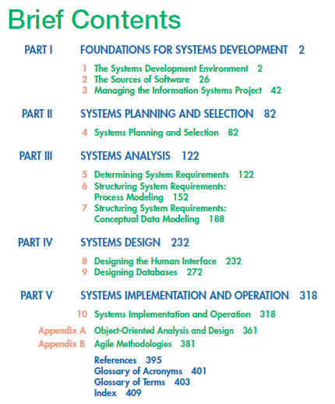

Slide 3
Chapter 2
The Sources of Software
Introduction
Systems Acquisition
Outsourcing
Sources of Software
Choosing Off-the-Shelf Software
Reuse

Slide 4
Learning Objectives
Understand Outsourcing
Describe six different sources of software
Discuss how to evaluate off-the-shelf software
Discuss reuse and its role in software development

Slide 5
1- Introduction
You performed analysis and design for your information system, now you need to put it into practice by choosing the appropriate software. How to choose your application software ?
A software written in-house by a company’s own systems analysts and programmers?
Or purchase a software available in the market ?
There are two cases
1- You work in a firm specialized in software production : the focus is exclusively on in-house development.
2- You work in the information systems department of a corporation : the focus is on where to obtain the many pieces and components to combine into the application system you want to create.

Slide 6
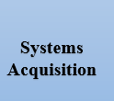
2- Systems Acquisition
In-house development has become a progressively smaller
Organizations today have many choices when seeking an information system.
They increased work on packaged applications and outsourcing .
Internal corporate information systems departments Spend less time, money and effort on software development and maintenance.
Outsourcing
Totally external system
Sources of Software
six different sources of software : Internal & External options
Choice of Off-The-Shelf Software

Slide 7
Outsourcing :
The practice of turning over responsibility for some or all of an organization’s information systems applications and operations to an outside firm.
Examples:
A firm develops and runs your application on its computers—you only supply input and take output. For example a company that runs payroll applications for clients, they provide employee payroll information to the company and, the company returns completed paychecks, payroll accounting reports, and tax and other statements for employees.
You hire a company to run your applications at your site on your computers. You will transfer information systems employees to the company brought in to run the organization’s computing.
Why would an organization outsource its information systems operations?
Cost effective.
To overcome operating problems in the information systems unit
An experienced computer-oriented company might achieve more effective computing than the organization’s management.
>> Outsourcing should be considered during systems analysis

Slide 8
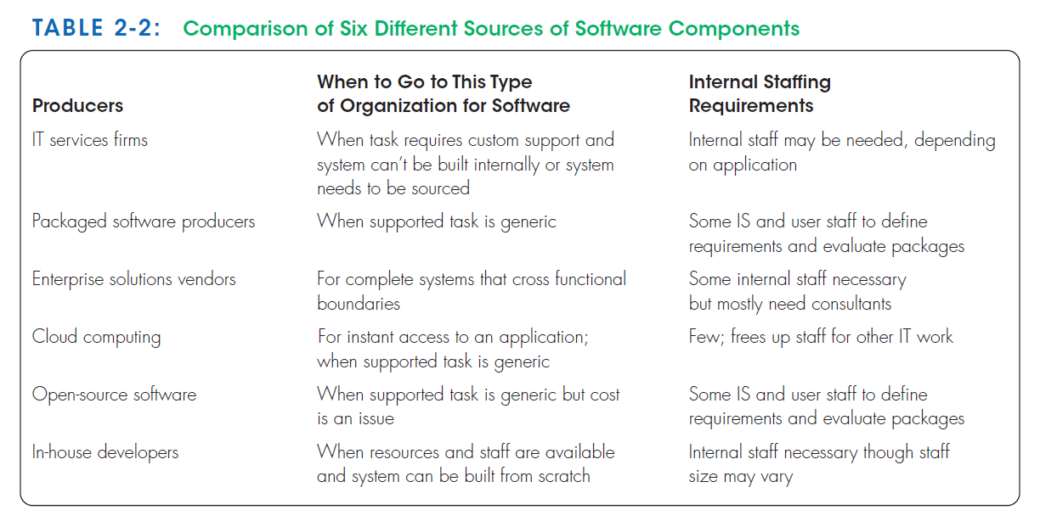
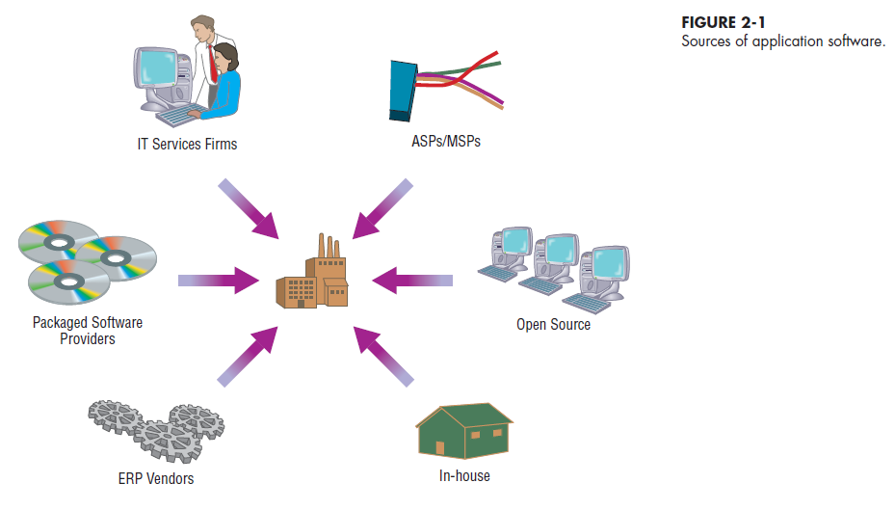
Sources of Software :
information technology services firms
packaged software providers
vendors of enterprise solutions software
cloud computing
Opensource software
in-house development

Slide 9
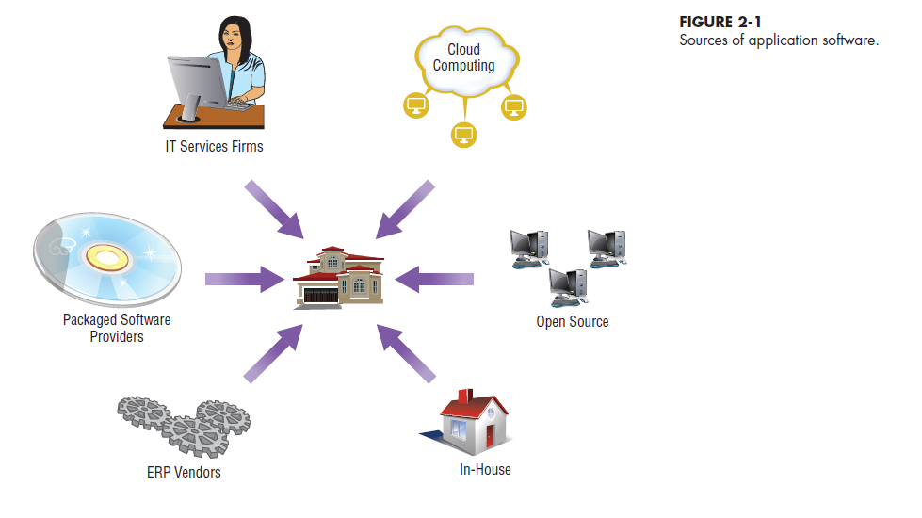

Slide 10
i- Information Technology Services Firms
Utilized when:
Organization lacks resources to develop in-house system
Suitable off-the-shelf solution is not available
Role:
help companies develop custom information systems for internal use:
they develop,
host, and run applications for customers,
they provide other services.
Their consultants are expert in the development of information systems. And may also have expertise in a specific business area.

Slide 11
ii- Packaged Software Producers
They Produce prepackaged or off-the-shelf systems.
software range from general, broad-based packages, such as general ledger, to more narrow, niche packages, such as software to help manage a day-care center.
software runs on many different computer platforms, from microcomputers to large mainframes.
Two types of off-the-shelf software systems:
Turnkey systems : cannot be modified to meet the specific, individual needs of a particular organization. The producer of a turnkey system can edit it when a substantial number of users ask for a specific change.
Non-Turnkey Systems: can be modified or extended by the producer or the user to fit the needs of the organization more closely.
off-the-shelf software can at best meet 70 percent of an organization’s needs.

Slide 12
iii- Enterprise Solutions Software ( Or enterprise resource planning (ERP) systems)
The ERP software solutions consist of a series of integrated modules. so that a single transaction occurs seamlessly within a single information system rather than several separate systems.
Each module supports an individual traditional business function, such as accounting, distribution, manufacturing, and human resources.
Example: a series of modules will support the entire order entry process, from receiving an order to adjusting inventory to shipping to billing to after-the-sale service.
The traditional approach | ERP system
It would use a series of disjointed, separate systems focused on business functional areas. such as a billing system in accounting and an inventory system in the warehouse. The focus is on one business functional areas | It would integrate all parts of a business process in a unified information system. All aspects of a single transaction occur seamlessly within a single information system the modules are integrated to focus on business processes

Slide 13
The benefits of the ERP approach | Disadvantages
a single repository of data for all aspects of a business process: ensures more consistent and accurate data, as well as less maintenance the flexibility of the modules: additional modules can be added as needed and they are immediately integrated into the existing system. | The systems are complex, so implementation time is extended. Reliance on consultants or employees of the software vendor,which can be expensive. Often, organizations must change their way to do business in order to shift toward enterprise solutions.
ERP vendors:
SAP AG, stands for Systems, Applications, and Products in Data Processing.
Oracle Corp
PeopleSoft (now acquired by Oracle)

Slide 14
iv- Cloud Computing
Cloud computing refers to the provision of applications over the Internet, where customers do not have to invest in the hardware and software resources needed to run and maintain the applications. They have access to the applications through the Internet or through virtual private networks (VPNs).
Cloud computing includes many areas of technology, including software as a service (SaaS),which includes Google Apps and Salesforce.com, and hardware as a service (IaaS) , which allows companies to order server capacity and storage on demand.
advantages.
(1) freeing internal IT staff,
(2) gaining access to applications faster than via internal development,
(3) achieving lower-cost access to corporate-quality applications.
Concerns: reliability, security and compliance with government regulations.

Slide 15
The application provider buys, installs, maintains, and upgrades the applications.
Application Service Providers (ASP)
License software to organizations
Applications are run at ASP site by organization
Mostly commercial applications, such as Oracle or Microsoft
Organizations pay per-use or monthly
Managed Software Providers (MSP)
Customized applications
Business processes
Engineering
Security
Maintenance

Slide 16
v- Open-Source Software
it is freely available
the source code is available
developed by a community of interested people instead of by employees of a particular company.
functions as commercial software, such as operating systems, e-mail, database systems, Web browsers
popular open-source software
Linux (the operating system),
mySQL (a database system),
Firefox (a Web browser).
Companies and individuals can make money with open source by:
providing maintenance and other services,
providing one version of the software for free and selling a more fully-featured version.

Slide 17
vi- In-House Development
in-house development need not entail development of all of the software that will compose the total system.
Hybrid solutions involving some purchased and some in-house software components are common.
Some in-house software components are reused.

Slide 18
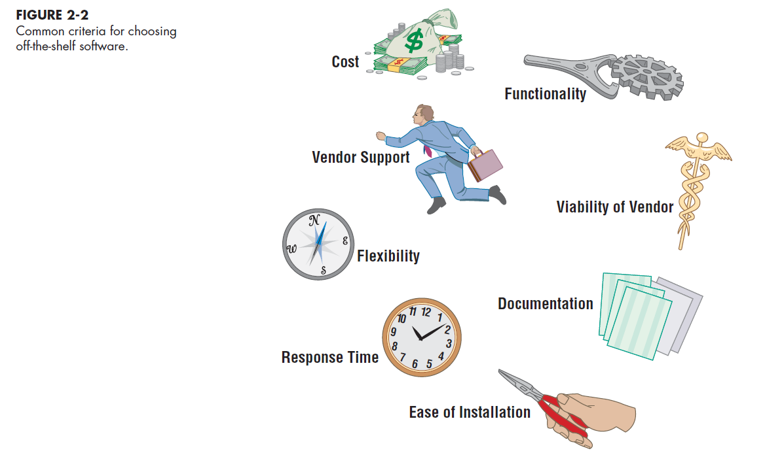
Choosing Off-the-Shelf Software :
You decided to purchase off-the-shelf software rather than write some or all of the software for your new system
Several criteria need consideration
an explicit comparison should be made between the software package and the process of developing the same application in-house.

Slide 19
Cost: comparing the cost of developing the same system in-house to the cost of purchasing or licensing the software package.
Functionality : the tasks the software can perform and the mandatory, essential, and desired system features.
vendor support : whether the vendor can provide support, and how much. Support includes assistance to install the software, to train user
the vendor’s viability: Keeping up with hardware and system software changes
Flexibility :how easy it is for you, or the vendor, to customize the software.
Documentation : the user’s manual and technical documentation should be understandable and up to date
Response time : how long it takes the software package to respond to the user’s requests in an interactive session and time needed by the software to complete a running a job.
Ease of installation : the difficulty of loading the software and making it operational

Slide 20
Validating Purchased Software Information
from the vendor.
in the software documentation
technical marketing literature.
questionnaire
request for proposal (RFP)
request for quote (RFQ)
process your organization requires
when major purchases are made.
Software test drive
feedback from other users
Independent software testing services

Slide 21
3- Reuse
Reuse is the use of previously written software resources in new applications.
Most often applied to object-oriented and component-based development
Advantages:
increase programmer productivity
decrease development time,
minimizing schedule overruns.
higher-quality software with lower defect rates,
decreasing maintenance costs.
Software reuse has three basic steps: abstraction, storage, and recontextualization.
Abstraction involves the design of a reusable piece of software, starting from existing software assets or from scratch.
Storage involves making software assets available for others to use
recontextualization, or making the reusable asset understandable to developers who want to use it in their systems

Slide 22
Four approaches to reuse
ad hoc reuse : individuals are free to find or develop reusable assets on their own
facilitated reuse : organization makes available some tools and techniques that enable the development and sharing of reusable assets, and one or more employees may be assigned the role of evangelist to publicize and promote the program
Managed reuse : the development, sharing, and adoption of reusable assets is mandated.
Designed reuse. The most expensive and extensive approach to reuse. In addition to mandating reuse and measuring its effectiveness, the designed reuse approach takes the extra step of mandating that assets be designed for reuse as they are being designed for specific applications. The focus is more on developing reusable assets than on finding existing assets that might be candidates
>> Successful reuse requires an understanding of how reuse fits within larger organizational goals and strategies as well as an understanding of the social and technical world into which the reusable assets must fit.

Slide 23
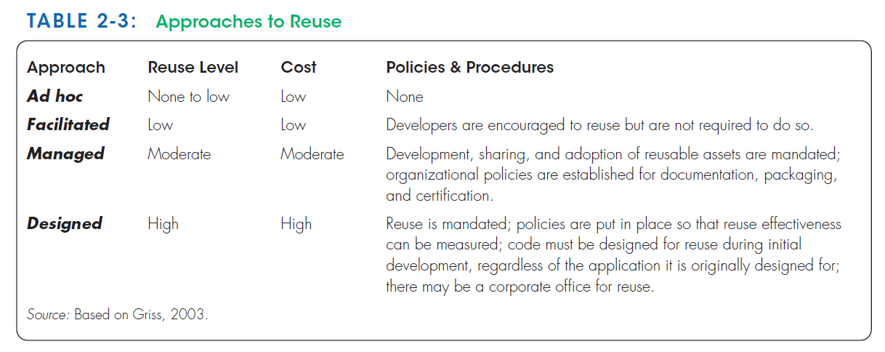

Slide 24
Summary
Outsourcing
Six different sources of software
Evaluation of off-the-shelf software
Reuse

Slide 25
Thank you for your attention
Any Questions
???

