Slide 1
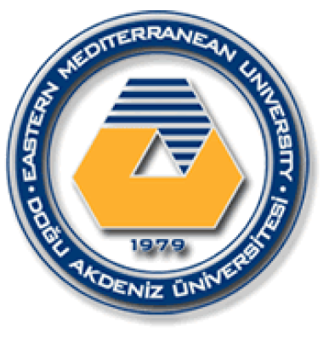
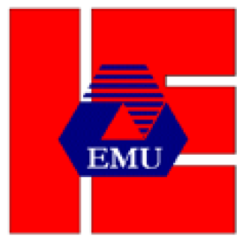
EASTERN MEDITERRANEAN UNIVERSITY DEPARTMENT OF INDUSTRIAL ENGINEERING
INFORMATION SYSTEMS AND TECHNOLOGY
IENG 372 / MANE 372
Spring 2021-2022
Chapter 05
Lecturer : Ms. Khaoula Chnina

Slide 2
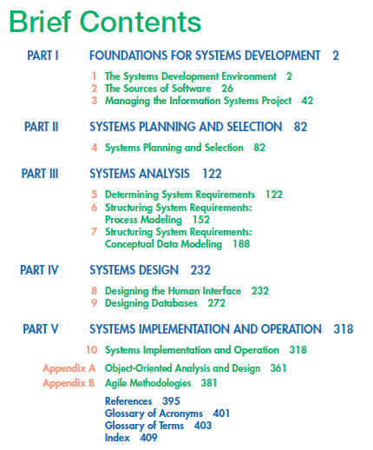

Slide 3
The Process of Determining Requirements
Performing Requirements Determination
Deliverables and Outcomes
Chapter 5
Requirements Structuring
Interviewing and Listening
Traditional Methods for Determining Requirements
Directly Observing Users
Analyzing Procedures and Other Documents
Determining System Requirements
Joint Application Design
Modern Methods for Determining System Requirements
Using Prototyping during Requirements Determination
Radical Methods for Determining System Requirements
Identifying Processes to Reengineer
Disruptive Technologies
System Layout and Navigation Characteristics
Pine Valley Furniture WebStore: Determining System Requirements
WebStore and Site Management System Capabilities
Customer and Inventory Information
System Prototype Evolution

Slide 4
Learning Objectives
Describe options for designing and
conducting interviews
Discuss planning an interview to
determine system requirements
Examine requirements determination for
Internet applications
Explain Business Process
Reengineering (BPR)
Learn about Joint Application Design
(JAD) and Prototyping
Explain advantages and disadvantages of observing workers and analyzing business documents to determine requirements
Discuss appropriate methods to elicit
system requests

Slide 5
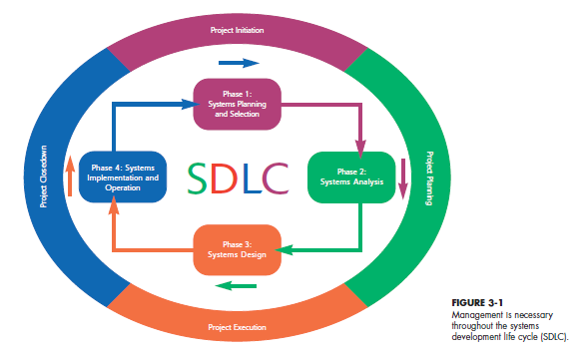
Project Management Process
Project Management Process |  | Stage 1 | Stage 2 |  | Stage 3 |  | Stage 4
SDLC |  | Phase 1 |  | Phase 2 | Phase 3 | Phase 4
.

Slide 6
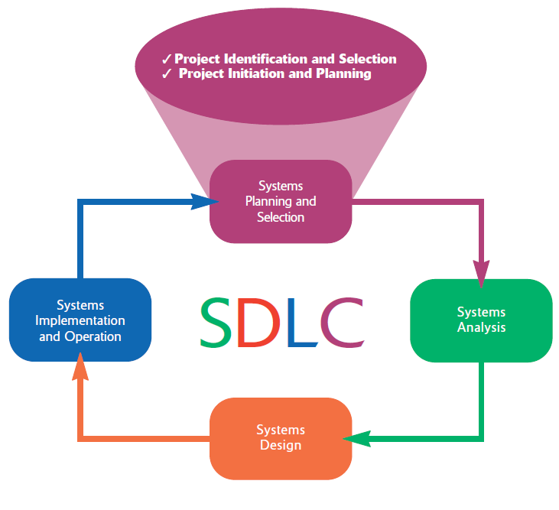
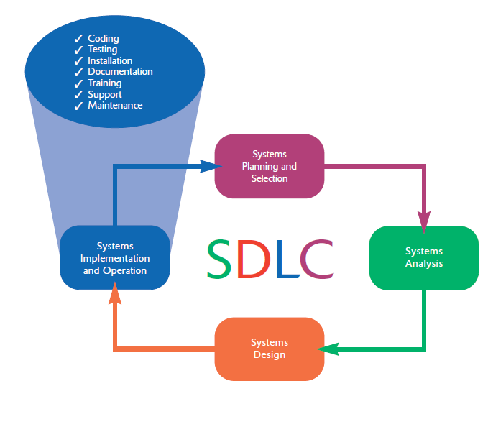
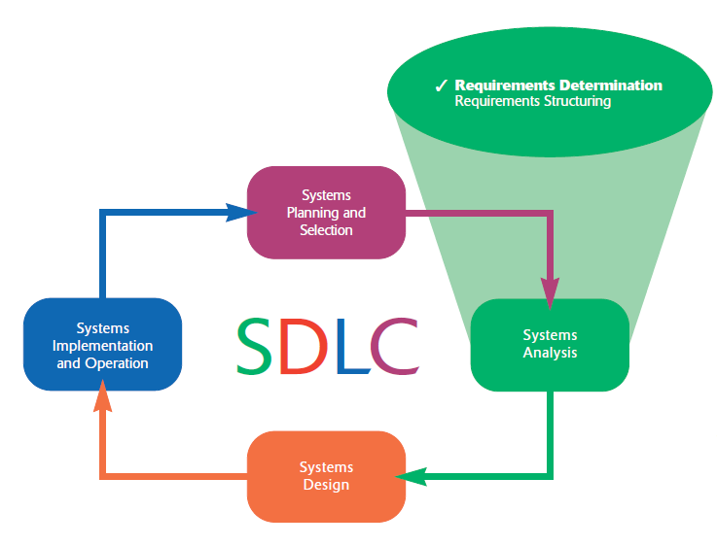
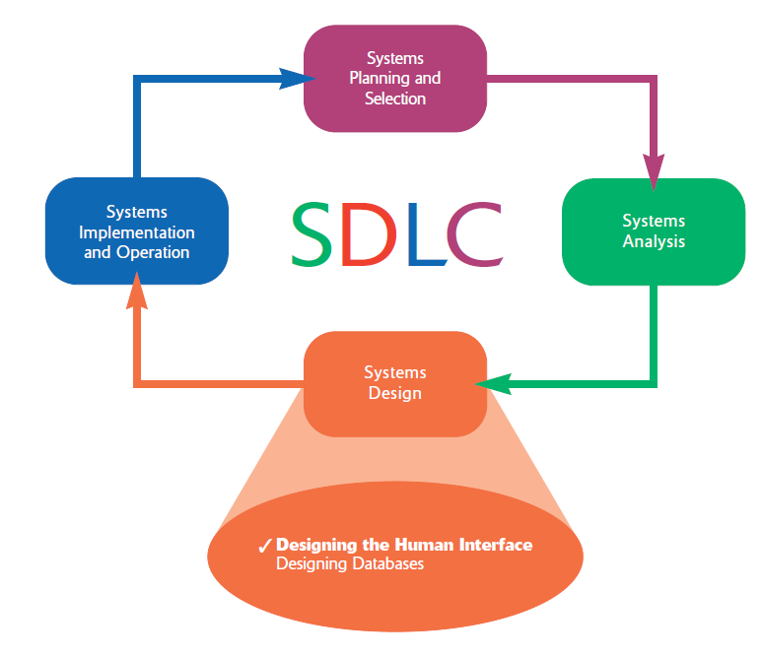
.

Slide 7
Stage 1 : Initiating the Project
Phase 1: Systems planning and selection
Two primary activities.
Identification of the need for a new or enhanced system.
Information needs of the organization are examined, analyzed arranged , and projects to meet these needs are identified (Investigation and determination of scope).
The organization’s information system needs may result from:
- Requests to deal with problems in current procedures
- The desire to perform additional tasks
- The realization that information technology could be used to capitalize on an existing opportunity
A feasibility study is conducted before the second phase of the SDLC to determine
the economic and organizational impact of the system.
activities are performed to assess the size, scope, and complexity of the project and to establish procedures to support later project activities:
The project initiation team
Relationship with the customer
The project initiation plan
Management procedures
Establish the project management environment
Develop the project charter

Slide 8
Stage 2: Planning the Project
Phase 2 : Systems Analysis
Study of current procedures and information systems and suggestion of alternative replacement systems.
Analysis has several subphases :
Determining the requirements of the system: what the users want from a proposed system. This subphase involves a careful study of any current systems, manual and computerized, that might be replaced or enhanced as part of this project.
Study and Structure of the requirements according to their interrelationships, eliminating any redundancies. And generate alternative initial designs to match the requirements.
Compare the alternatives to determine which best meets the requirements within the cost, labor, and technical levels the organization is willing to commit to the development process.
Description and recommendation of best alternative solution
focuses on defining clear, discrete activities and the work needed to complete each activity within a single project.
Describe project scope, alternatives and feasibility
Divide the project into manageable tasks
Estimate resources and create a resource plan
Develop a preliminary schedule
Develop a communication plan
Determine project standards and procedures
Identify and assess risk Identify sources of risk
Create a preliminary budget
Develop a project scope statement
Set a baseline project plan

Slide 9
Stage 3: Executing the Project
Phase 3: Systems Design
Logical design (Theory):
The system could be implemented on any hardware and systems software.
concentrates on the business aspects of the system and how it will impact the functional units within the organization.
Physical design (Practice):
Turn the logical design into physical, or technical, specifications.
Convert diagrams into a structured systems design that can be converted to instructions written in a programming language.
Decision of the programming languages, database systems and file structures
Decision of hardware platform, operating system, and network environment the system will run under.
The plans created in the prior phases (project initiation and planning) are put into action.
Executing the baseline project plan
Monitoring project progress against the baseline project plan
Managing changes to the baseline project plan.
Maintaining the project workbook.
Communicating the project status

Slide 10
Stage 4: Closing Down the Project
Phase 4: Systems Implementation and Operation
It is a two-step process:
Systems implementation:
Coding, testing, and installation.
Application software is installed, or loaded, on existing or new hardware.
Documentation, training programs, and ongoing user assistance
Operation:
Programmers correct the errors and make the changes that users ask for and modify the system to reflect changing business conditions.
System obsolescence, begin designing the system’s replacement, thereby completing the loop and starting the life cycle over again.
Project closedown Is The final phase of the project management process, which focuses on bringing a project to an end.
Closing down the project
Conducting postproject reviews
Closing the customer contract

Slide 11
1- Performing Requirements Determination
systems analysis
Determining requirements
Structuring requirements
- understand current problems and opportunities, as well as what is needed and desired in future systems.
- Gather information on what the system should do from as many sources as possible
Order the system requirement found in the determination step in tables, diagrams, and other formats that make them easier to translate into technical system specifications
Sources can be :
Users of the current system
Reports
Forms
Procedures
All of the system requirements are carefully documented and made ready for structuring
parallel and repetitive

Slide 12
Characteristics for Gathering Requirements
Impertinence
question everything
- Are all transactions processed the same way?
- Could anyone be charged something other than the standard price?
- Might we someday want to allow and encourage employees to work for more than one department?
Impartiality
find the best organizational solution
- Justify the purchase of new hardware
- Insist on incorporating what users think they want into the new system requirements
Relaxing of constraints
Attention to details
Reframing
Assume anything is possible and eliminate the infeasible
- Traditions are different from rules and policies
- Do not accept this statement: “We’ve always done it that way, so we have to continue the practice.”
an imprecise definition of who a customer is may mean that you purge customer data when a customer has no active orders; yet these past customers may be vital contacts for future sales.
Every fact must fit with every other fact
- Consider how each user views his or her requirements.
- Be careful not to jump to this conclusion:
“I worked on a system like that once—this new system must work the same way as the one I built before.”
View the organization in new ways and be creative

Slide 13
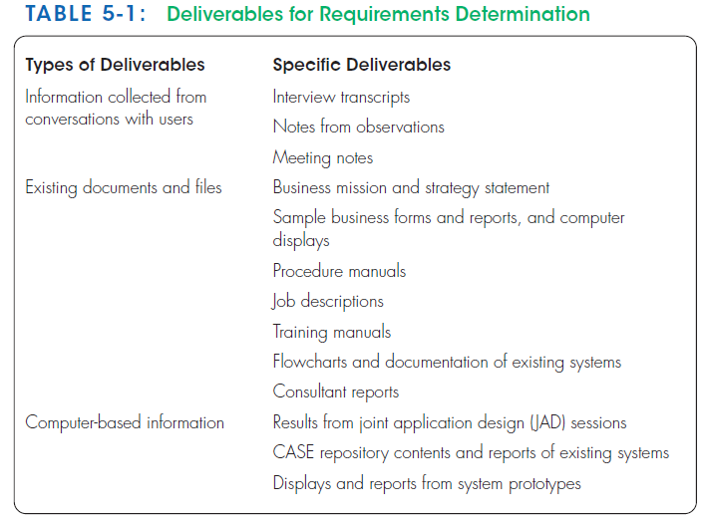
Deliverables and Outcomes
Anything collected as part of determining system requirements
The types of information gathered during the determination process in form of :
Transcripts of interviews
Notes from observation and analysis of documents
Sets of forms
Reports
Job description
Computer-generated output (prototypes...)

Slide 14
Understanding of organizational components
The business objectives : what and how work is done
The information needs : jobs’ Information
The data processing rules : When, how, and by whom or what the data are moved, transformed, and stored
Policies and guidelines : the nature of the business, the market, and the environment in which it operates
Key events : how they affect data values and when they occur

Slide 15
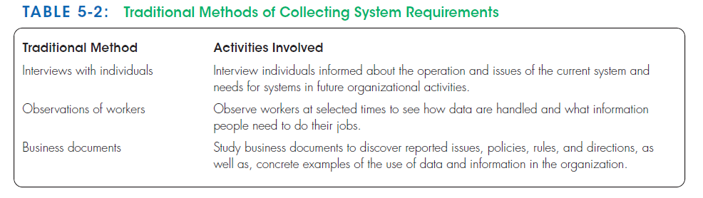
2- Traditional Methods for Determining Requirements

Slide 16
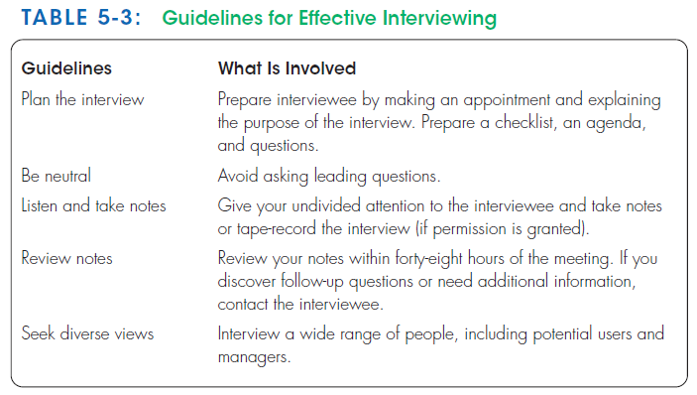
Traditional method 1- Interviewing and Listening
Interviewing people about their work, the information they use to do it, and the types of information processing that might supplement their work.
To understand organizational direction, policies, and expectations that managers have of the units they supervise
Gather facts, opinions, and speculations
Observe body language and emotions
Interview guidelines :

Slide 17
1 - Do not phrase a question in a way that implies a right or wrong answer.
Respondents must feel free to state their true opinions and perspectives and trust that their ideas will be considered.
Avoid wording that predefines a socially acceptable answer.
2- listen carefully to what is being said.
Take careful notes or, if possible, record the interview on a tape recorder (be sure to ask permission first!).
If you run out of time and still need more information, ask to schedule a follow-up interview.
3- once the interview is over, key in your notes within forty-eight hours ( Microsoft Word, Microsoft Excel).
If you recorded the interview, use the recording to verify your notes.
As you type and organize your notes, write down any additional questions that might arise from lapses in your notes or ambiguous information.
Separate facts from your opinions and interpretations.
Make a list of unclear points that need clarification.
Contact the person you interviewed and get answers to these new questions.
Contact the interviewed person to verify the accuracy of your notes.
make sure to thank the person for his or her time.

Slide 18
4- during the interview do not set expectations about the new or replacement
Choice of participants has to be from among many technically possible alternatives.
Let respondents know that their ideas will be carefully considered.
5- seek a variety of perspectives from the interviews.
Talk to several different people: potential users of the system, users of other systems that might be affected by this new system, managers and superiors, information systems staff, and others.
Encourage people to think about current problems and opportunities and what new information services might better serve the organization.
Try to understand all possible perspectives so that later you will have information on which to base a recommendation or design decision that everyone can accept.

Slide 19
Choosing Interview Questions
Types Of questions | Closed-ended questions | Open-ended questions
Definition | Questions in interviews and on questionnaires that ask those responding to choose from among a set of specified responses | Questions in interviews and on questionnaires that have no prespecified answers.
Examples | -True or false -Multiple choice -Rating a response or idea on some scale -Ranking items in order of importance | -“What would you say is the best thing about the information system you currently use to do your job?” - “List the three most frequently used menu options.”
When to use | -the major answers to questions are well known -You can include an “other” option to encourage the interviewee to add unexpected responses. | To probe for information when you cannot anticipate all possible responses or when you do not know the precise question to ask.
Advantages | -Do not require a large time commitment -more topics can be covered. -an easy way to begin an interview and to determine which line of open-ended questions to pursue. | -previously unknown information can surface -They put the interviewees at ease -They give interviewees more of a sense of involvement and control
Disadvantages | -useful information may be overlooked -the respondent tries to make a choice instead of providing the best answer | -The length of time -Difficult to summarize -You must react quickly to answers and determine whether any followup questions are needed.

Slide 20
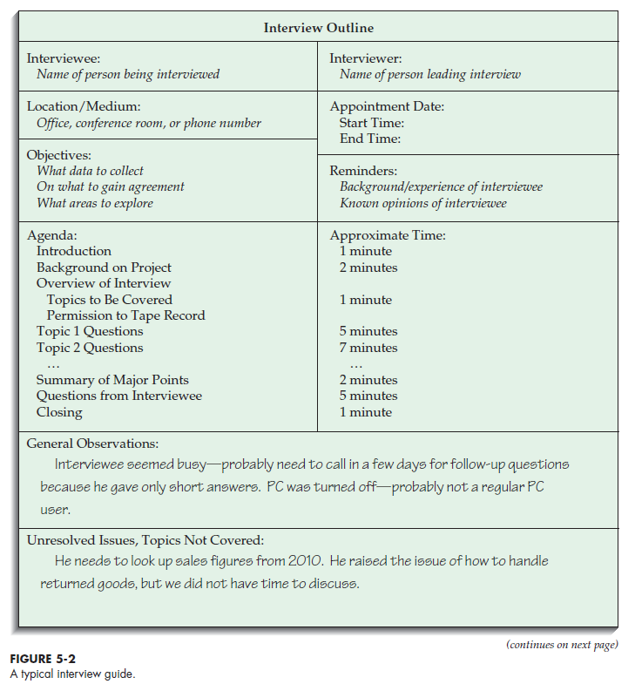
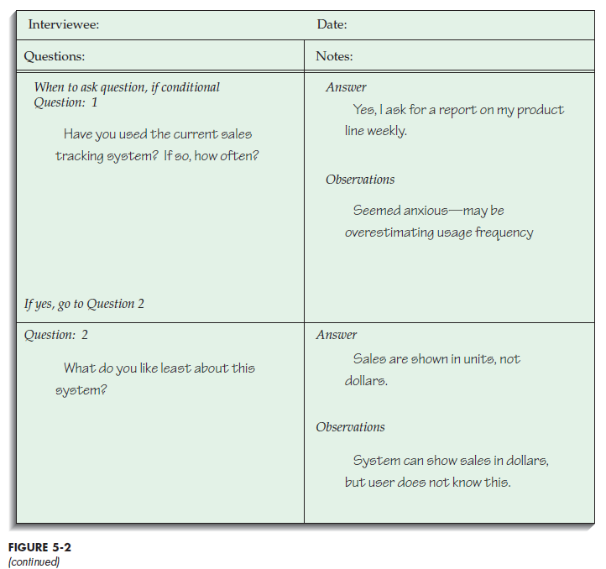

Slide 21
Chapter 5 – second hour (PART 2)

Slide 22
Traditional method 2- Directly Observing Users
watching people in work situations ( emails , calls).
obtain more firsthand and objective measures of employee interaction with information systems
Serves as a good method to supplement interviews (People are not always reliable )
not include important events or activities.
such methods are not always possible
these methods are not totally unbiased : People often work differently when being observed (nervous and make more mistakes/ follow procedures more carefully/ faster / slower
Not continuous, limited time, number of people, and number of sites (selection problem).
Observation yields only a small segment of data from a possibly vast variety of data sources
>> Pick both typical and atypical people and sites and observe during normal and abnormal conditions and times to receive the richest possible data from observation.

Slide 23
Traditional method 3- Analyzing Procedures and Other Documents
Interviewing and observing users for determining system requirements can be enhanced by examining system and organizational documentation to discover more details about current systems and the organization they support.
other important documents :
organizational mission statements (written work procedure)
business plans (business form)
reports from prior organizational studies
organization charts,
business policy manuals
Job descriptions
internal and external correspondence

Slide 24
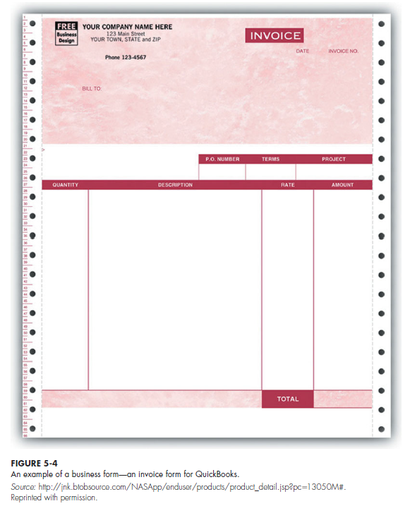



Slide 25
Types of Information to Be Discovered:
Problems with existing systems (e.g., missing information or redundant steps)
Opportunities to meet new needs (e.g., analysis of sales based on customer type)
Organizational direction (e.g., link customers and suppliers more closely)
Titles and names of key individuals (e.g., a sales manager)
Values of the organization or individuals (e.g., maintaining market share even if it means lower short-term profits)
Special information-processing circumstances that occur irregularly (e.g., special handling needed for a few large-volume customers who require use of customized customer ordering procedures)
The reason why current systems are designed as they are, suggest new ones (e.g., data about a customer’s purchase of competitors’ products not available when the current system was designed; these data now available from several sources)
Rules for processing data (e.g., each customer assigned exactly one sales department staff member as primary contact if customer has any questions)

Slide 26
Types of Problems
1- duplication of effort in two or more jobs.
2- missing procedure.
3- the procedure is out of date.
4- the difference between formal systems and informal systems.
Informal Systems : The way a system actually works; information collected from interviews, questionnaires, and observation about how the organization operates and what information is required.
Formal system : The official way a system works, as described in organizational documentation.
>> Informal systems develop because of inadequacies of formal procedures and individual work habits, preferences, and resistance to control.

Slide 27
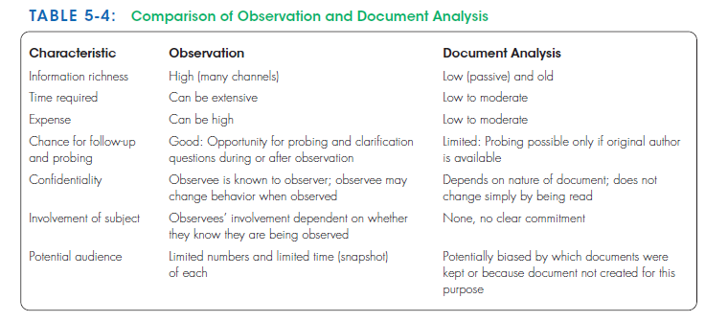

Slide 28
3- Modern Methods for Determining System Requirements
Joint application design (JAD) and prototyping are two modern techniques that can support effective information collection and structuring while reducing the amount of time required for analysis.

Slide 29
Modern method 1- Joint Application Design (JAD)
JAD started in the late 1970s at IBM .
It brings together the key users, managers, and systems analysts involved in the analysis of a current system.
The primary purpose of using JAD in the analysis phase is to collect systems requirements.
It allows analysts to see the areas of agreement and the areas of conflict.
It is an opportunity to resolve conflicts or to understand why a conflict may not be simple to resolve.
The result is an intense, structured, and highly effective process.
The end result of a completed JAD is a set of documents detailing the workings of the existing system and the features of a replacement system.
JAD sessions are usually conducted off-site, in order to limit distractions and help participants better concentrate on systems analysis.
held in special-purpose rooms where participants sit around horseshoe-shaped tables.
A JAD may last from four hours to an entire week and may consist of several sessions.
A JAD employs thousands of dollars (the time of the people involved, flying, hotels and feeding)

Slide 30
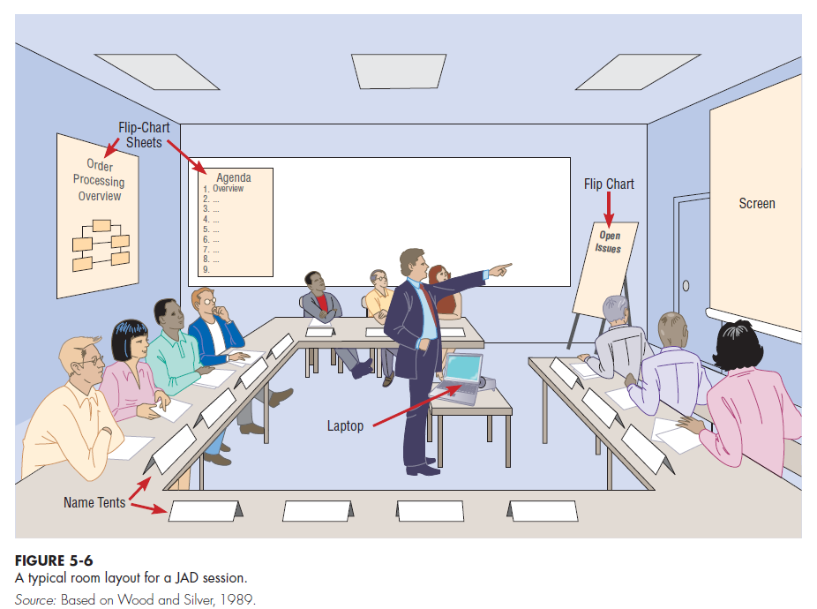
whiteboards (possibly electronic, with a printer)
magnetic symbols that can be easily rearranged
Flip-chart paper to track issues that are not resolved or require additional information.
Computers to create and display form, report designs or diagrams

Slide 31
Participants | Roles
Session leader | The trained individual who plans and leads joint application design sessions.
Users | key users understand what it means to use the system on a daily basis
Managers | provide insight into new organizational directions
Sponsor | a vice president or chief executive officer, Attends the sessions only at the beginning or the end
Systems analysts | learn from users and managers, but don’t run or dominate the process.
Scribe | makes detailed notes of the happenings at a JAD session.
IS staff | programmers,database analysts, IS planners, and data-center personnel. They learn from the discussion and can give their ideas on the technical feasibility of proposed ideas or on the technical limitations of current systems.

Slide 32
Modern method 2- Prototyping
Prototyping is a repetitive process in which analysts and users build a rudimentary version of an information system based on user feedback.
Prototyping could replace or augment the SDLC.
User quickly converts requirements to working version of system
Once the user sees requirements converted to system, will ask for modifications or will generate additional requests
The goal of prototyping is to develop concrete specifications for the ultimate system, not to build the ultimate system.
Most useful when:
User requests are not clear
Few users are involved in the system
Designs are complex and require concrete form to evaluate fully
History of communication problems between analysts and users
Tools are readily available to build prototype

Slide 33
Disadvantages
Systems Development Life Cycle (SDLC) checks are often bypassed (testing, bug checking is bypassed, security checks ignored)
A tendency to avoid creating formal documentation of system requirements, which can then make the system more difficult to develop into a fully working system.
Prototypes can become idiosyncratic to the initial user and difficult to diffuse or adapt to more general user audience
Prototypes are often built as stand-alone systems, thus Sharing data with other systems is often not considered

Slide 34
4 - Radical Methods for Determining System Requirements
The current way of doing things impacts the new system.
Management is looking for new ways to perform current tasks.
These ways may be radically different from how things are done now, but the payoffs may be enormous:
Fewer people may be needed to do the same work
Relationships with customers may improve dramatically
Processes may become much more efficient and effective
Profit increase
Business Process Reengineering (BPR) :
The overall process by which current methods are replaced with radically new methods
The search for, and implementation of, radical change in business processes to achieve breakthrough improvements in products and services (Golf Analogy Example) .
BPR will be a top IS priority in the future.

Slide 35
Goals of BPR :
Improve each business process
Reorganize the complete flow of data in major sections of an organization
Eliminate unnecessary steps
Combine steps
Become more responsive to future changes
BPR advocates suggest that:
Radical increases in the quality of business processes can be achieved through creatively applying information technologies.
Radical improvement cannot be achieved by making minor changes but rather by changing the way work is performed and the information is shared and stored (“If we were a new organization, how would we accomplish this activity?”)
Results of many BPR efforts are the development of information system maintenance requests, or requests for system replacement.
Some companies had great success in actively pursuing BPR efforts. Yet, many other companies have found difficulty in applying BPR principles.

Slide 36
BPR Step 1 - Identifying Processes to Reengineer
What processes need to change ??
what are the key business processes for the organization ??
First Step: Key business processes
The structured, measured set of activities designed to produce a specific output for a particular customer or market.
They are focused on some type of organizational outcome (the creation of a product or the delivery of a service)
They are customer focused
Include all activities used to design, build, deliver, support, and service a particular product for a particular customer.
The same techniques used for system requirements determination can be applied to discovering and understanding key business processes ( interviews, observing, documents, and JAD)
BPR requires the understanding of the activities that are part of the organization’s key business processes and then to alter the sequence and structure of activities to achieve radical improvements in speed, quality, and customer satisfaction.

Slide 37
Second Step: Specific activities identification
Identify specific activities that can be radically improved through BPR
ask three questions to identify activities for radical change:
1. How important is the activity to delivering an outcome?
2. How feasible is changing the activity?
3. How dysfunctional is the activity?
Those activities deemed important, changeable, yet dysfunctional, are primary candidates for alteration.
To identify dysfunctional activities, look for activities that involve excessive information exchanges between individuals, information that is redundantly recorded or needs to be rekeyed, excessive inventory buffers or inspections, and a lot of rework or complexity.

Slide 38
BPR Step 2 - Disruptive Technologies
Information technologies must be applied to improve business processes radically.
Organizations think “inductively” about information technology.
Induction is the process of reasoning from the specific to the general, which means that managers must learn about the power of new technologies and think of innovative ways to alter the way work is done.
This approach is contrary to deductive thinking, in which problems are first identified and solutions then formulated.
managers especially consider disruptive technologies when applying deductive thinking.
Disruptive technologies : Technologies that enable the breaking of long-held business rules that inhibit organizations from making radical business changes.
For example, Toyota is using production schedule databases and electronic data interchange (EDI)—an information system that allows companies to link their computers directly to suppliers

Slide 39
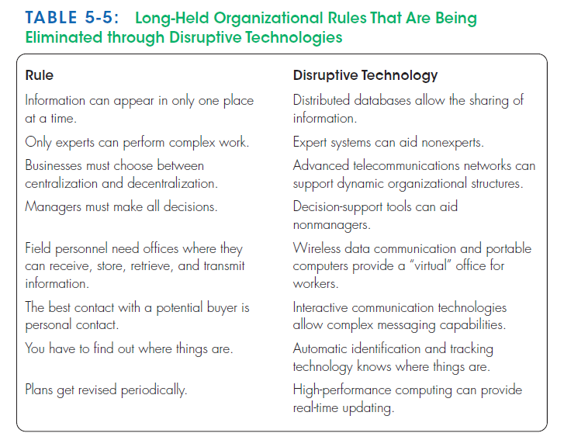

Slide 40
5- PVF WebStore: Determining System Requirements
The process followed by PVF to determine system requirements
Highlight some of the issues and capabilities to consider when developing an Internet-based application.

Slide 41
Pine Valley Furniture WebStore
Previous Step : Initiation and planning ( Chapter 4)
The board wants to incorporate all three target markets into its long-term EC plan :
Corporate furniture buying
Home-office furniture purchasing
Student furniture purchasing
Initially focus on the corporate furniture buying system
building block for moving into the customer-based markets.
The new EC system should integrate with two currently existing systems, Purchasing Fulfillment and Customer Tracking.
Initiating and Planning PVF’s E-Commerce System
1- Agreement about the proposed system project name “WebStore”.
2- Identifying potential benefits, costs, and feasibility concerns.
WebStore Project Walkthrough
1- An initial list of benefits and costs
2- several feasibility concerns
3- An initial project schedule.
4- presentation of the initial project plans in a walkthrough to PVF’s board of directors and senior management.
5- Approval was given to move the WebStore project on to the analysis phase.

Slide 42
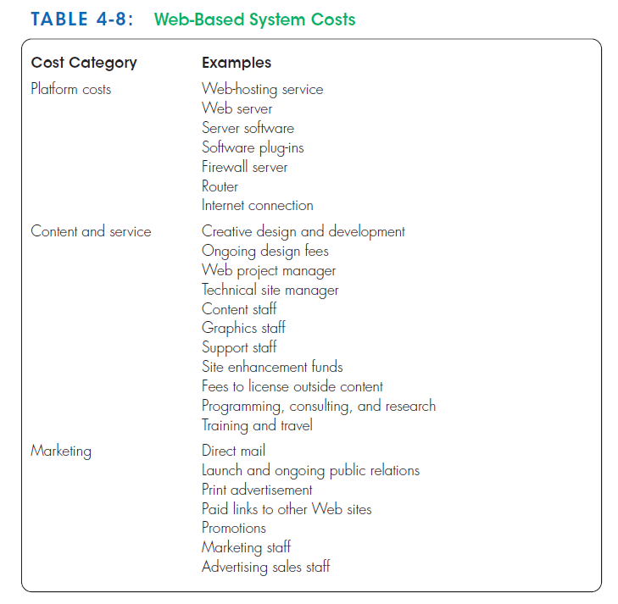
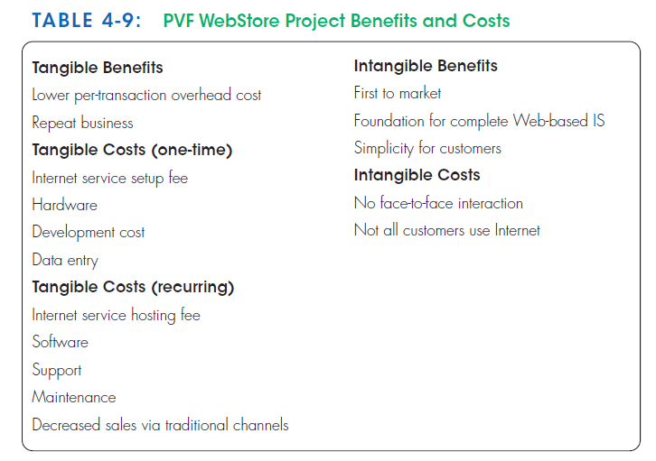
Previous Step : Initiation and planning ( Chapter 4)

Slide 43
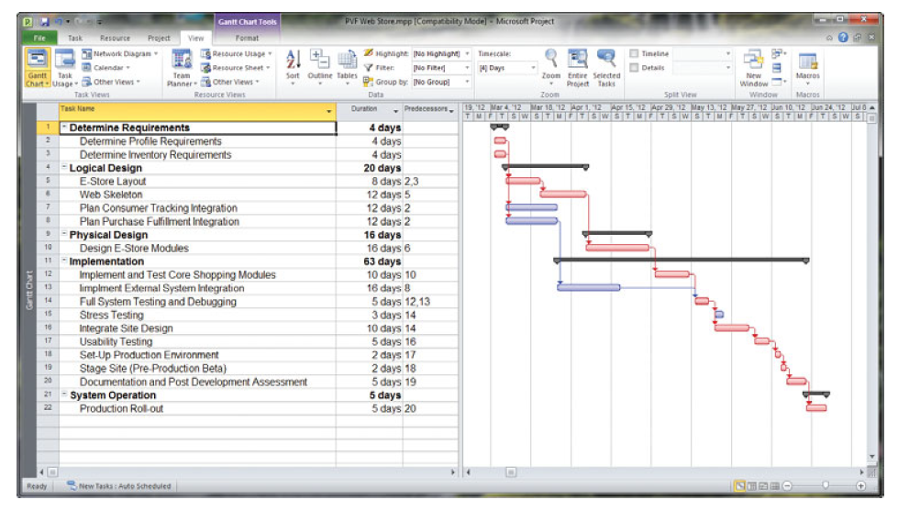
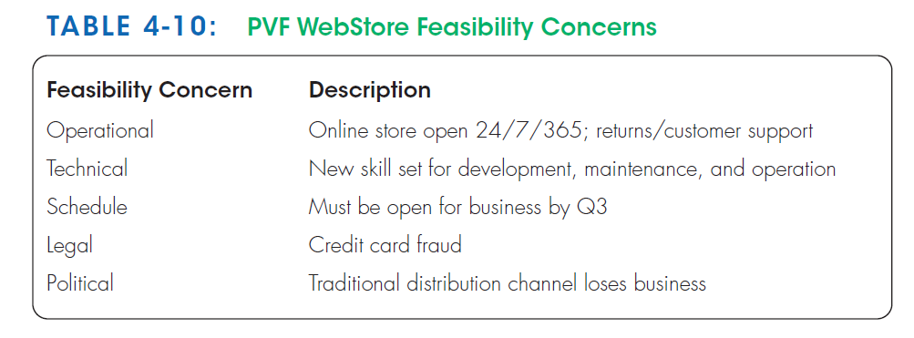
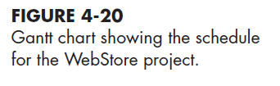
Previous Step : Initiation and planning ( Chapter 4)

Slide 44
Collection of the system requirements
Hold a three-day JAD session.
Participants:
Representatives from sales and marketing, operations, and information systems.
An experienced JAD facilitator who conducts the session.
Outputs of JAD:
An ambitious and detailed agenda for the session.
Their goal was to collect requirements on the following items:
System layout and navigation characteristics
WebStore and site management system capabilities
Customer and inventory information
System prototype evolution

Slide 45
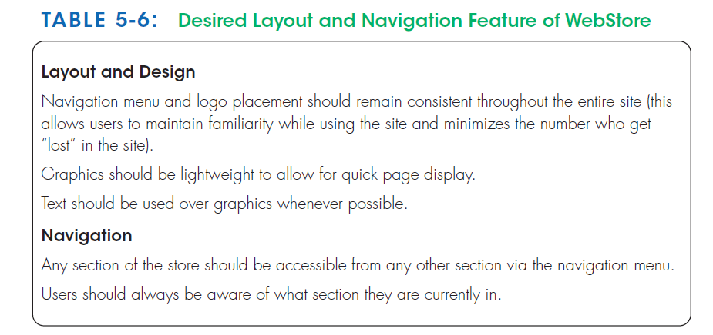
System Layout and Navigation Characteristics
As part of the process of preparing for the JAD session, all participants were asked to visit several established retail Web sites, including www.amazon.com, www.landsend.com, www.sony.com, and www.pier1.com.
At the JAD session, participants were asked to identify characteristics of these sites that they found appealing and those they found cumbersome (heavy) ; this allowed participants to identify and discuss those features that they wanted the WebStore to possess.

Slide 46
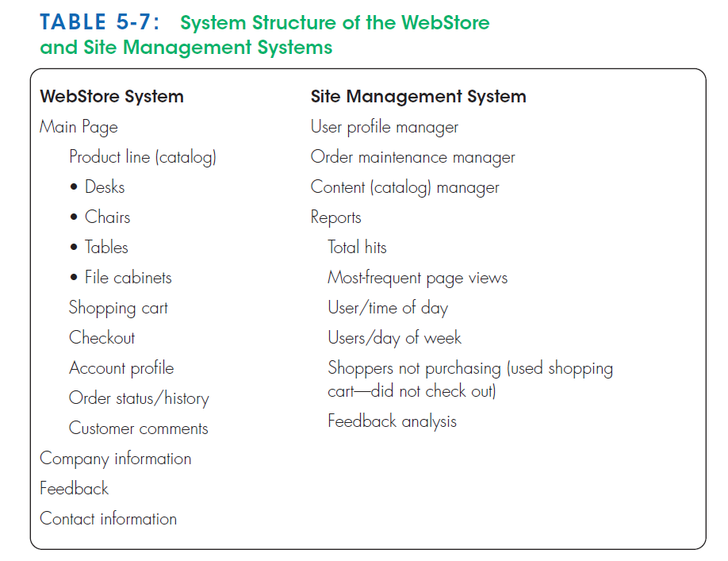
WebStore and Site Management System Capabilities
Systems analysts from IS department developed a draft skeleton of the WebStore based on the types of screens and capabilities of popular retail Web sites ( shopping cart)
Members of the sales and marketing department described several reports that would be necessary to manage customer accounts and sales transactions effectively. And they wants to be able to conduct detailed analyses of site visitors, sales tracking, and so on.
Members of the operations department expressed a need to update the product catalog easily.
These collective requests and activities were organized into a system design structure called the Site Management system.
The structures of both the WebStore and Site Management systems will be given to IS department as the baseline for further analysis and design activities.

Slide 47
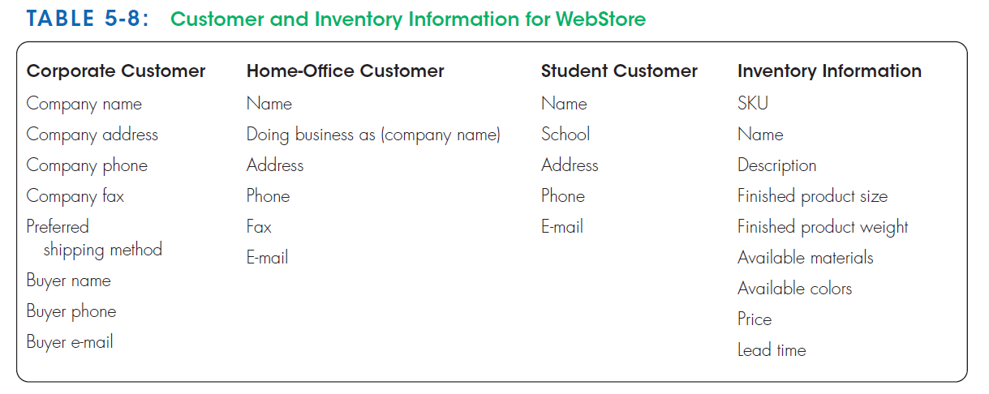
Customer and Inventory Information
The WebStore will be designed to support the furniture purchases of three distinct types of customers:
Corporate customers
Home-office customers
Student customers
To track the sales to these different types of customers effectively, the system must capture and store distinct information.
Orders reflect the range of product information that must be specified to execute a sales transaction.
Product and sales data must also be captured and stored.

Slide 48
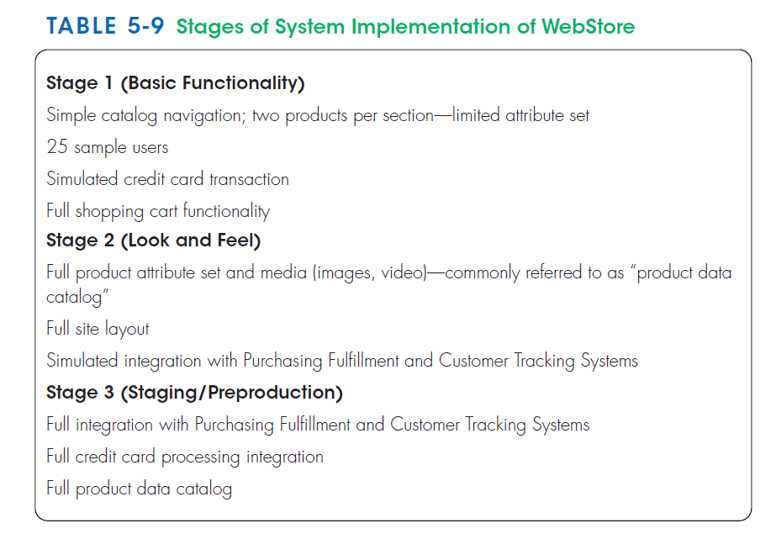
System Prototype Evolution
The JAD participants discussed, along with extensive input from the IS staff, how the system implementation should evolve.
After completing analysis and design activities, they agreed that the system implementation should progress in three main stages so that requirement changes could be more easily identified and implemented.
At the conclusion of the JAD session, They could begin to turn these lists of requirements into formal analysis and design specifications.
To show how information flows through the WebStore, They will produce data-flow diagrams (Ch6).
To show a conceptual model of the data used within the WebStore, they will generate an entity-relationship diagram (Ch7).
Both of these analysis documents will become the foundation for detailed system design and implementation.

Slide 49
summary
Interviews
Open-ended and close-ended questions
Preparation is key
Other means of gathering requirements are:
Observing workers
Analyzing business documents
Joint Application Design (JAD)
Prototyping
Business Process Reengineering (BPR)
Disruptive technologies

Slide 50
Thank you for your attention
Any Questions
???

