Slide 1
EASTERN MEDITERRANEAN UNIVERSITY DEPARTMENT OF INDUSTRIAL ENGINEERING INFORMATION SYSTEMS AND TECHNOLOGY IENG 372 / MANE 372 Spring 2021-2022 Summary of Chapter 1 -2 -3
Lecturer : Ms. Khaoula Chnina

Slide 2
Information Systems and Technology
>> Business success relies on the the ability of the organization to gather, organize, and interpret information.
>> Analyze, Design and Manage the information systems to deal with information.
>> Use Information Technology to improve the efficiency of information systems
By the mean of Information systems analysis and design
What Is Information Systems Analysis and Design???

Slide 3
Information Systems Analysis and Design
Definition :
Systems analysis and design is a method used by companies to create and maintain information systems that perform basic business functions such as keeping track of customer names and addresses, processing orders, and paying employees.
It is a proven methodology that helps both large and small businesses reap the rewards of utilizing information to its full capacity.
Goal:
to improve organizational systems, by applying software solutions that help employees accomplish key business tasks more easily and efficiently. And training employees to use it,
Application software:
The goal of application software (also called a system) is to turn data into information. And it is designed to support a specific organizational function or process, such as inventory management, payroll, or market analysis.
The application software helps the user perform tasks such as writing a paper, preparing a spreadsheet, and linking to the Internet.
Examples of Application Software:
Software developed for the inventory department at a bookstore may keep track of the number of books in stock of the latest best seller.
Software for the payroll department may keep track of the changing pay rates of employees.
WordPerfect, Excel, and PowerPoint.

Slide 4
Systems analyst Role:
Systems analysts are at the center of developing this software and they perform analysis and design of information systems based on: - understanding of the organization’s objectives, structure, and processes - knowledge of how to exploit information technology for advantage
The roles of the system analyst include:
Study problems and needs of an organization Determine best approach to improving organization through use of:
- People
- Methods
- Information technology
Help system users and managers define their requirements for new or enhanced information systems
Play intermediate role between users, programmers, and other systems professionals
A systems analyst needs to develop skills including :
Analytical skills
Technical skills
Managerial skills
Interpersonal skills
Knowledge of programming languages such as C__ and Java, various operating systems such as Windows and Linux, and computer hardware platforms such as IBM and Mac.

Slide 5
Information System
The basic components of computer-based information systems:
Hardware: The machinery and equipment including the computer and all of its support equipment like the monitor, processor, printer, and keyboard.
In pre-computer information systems, the hardware might include ledger books and ink.
System Software: The computer programs that allow the hardware to process the data and assure the computer function.
The "software" for pre-computer information systems included how the hardware was prepared for use
(e.g., column headings in the ledger book) and instructions for using them (the guidebook for a card catalog).
>> the application software runs on the hardware and systems software <<
/
Documentation and training materials, which are materials created by the systems analyst to help employees use the software they’ve helped create.
The specific job roles associated with the overall system, including the people who run the computers and keep the software operating, in addition to those who maintain the data, and support the network of computers.“
Users of the system, The people who use the software in order to do their jobs.
Controls, which are parts of the software written to help prevent fraud and theft.
Information system is an integration of a set of coordinated network of components that act together for retrieving, filtering, creating, distribution, storage and processing of data in order to provide information and contribute to knowledge. It is a resource for decision making.
Information systems are composed by four components: task, people, structure (or roles), and technology.
Important System Concepts :
- Decomposition
Modularity
Coupling
Cohesion

Slide 6
Characteristics of a System
1. Components : An irreducible part or aggregation of parts that makes up a system; also called a subsystem.
2. Interrelated components : Dependence of one part of the system on one or more other system parts.
3. Boundary : The line that marks the inside and outside of a system and that sets off the system from its environment.
4. Purpose : The overall goal or function of a system.
5. Environment : Everything external to a system that interacts with the system.
6. Interfaces : Point of contact where a system meets its environment or where subsystems meet each other.
7. Constraints : A limit to what a system can accomplish.
8. Input : Data and information received from the environment.
9. Output : Results of system functioning returned to environment.
Types of Information Systems and Systems Development
Transaction Processing Systems (TPS) (workers): Automate handling of data about business activities (transactions)
Management Information Systems (MIS) (Middle managers) : Convert raw data from transaction processing system into meaningful form
Decision Support Systems (DSS) (senior managers): Designed to help decision makers and Provide interactive environment for decision making
Executive dashboard: They provide rapid access to timely information and direct access to structured information in the form of reports.

Slide 7
Developing Information Systems and the Systems Development Life Cycle
A Modern Approach to Systems Analysis and Design : Systems Integration approach
Allows hardware and software from different vendors to work together
Enables procedural language systems (old) to work with visual programming systems (new).
Developers use visual programming environments to design the user interfaces for systems that run on client/server platforms.
Systems development methodology
A standard process followed in an organization to conduct all the steps necessary to analyze, design, implement, and maintain information systems. the development of information systems often follows a life cycle.
Systems development life cycle (SDLC)
The series of steps used to manage the phases of development for an information system.
Every organization uses a slightly different life-cycle
life cycle is not necessarly a sequentially ordered set of phases,
phases can be repeated
each phase has specific outcomes and deliverables

Slide 8
Phases of the Systems development life cycle (SDLC)
Phase 1: Systems planning and selection
Two primary activities.
Identification of the need for a new or enhanced system.
Information needs of the organization are examined, analyzed arranged , and projects to meet these needs are identified (Investigation and determination of scope).
A feasibility study is conducted before the second phase of the SDLC to determine
the economic and organizational impact of the system.
Phase 2 : Systems Analysis
Study of current procedures and information systems and suggestion of alternative replacement systems.
Analysis has several subphases :
Determining the requirements of the system: what the users want from a proposed system.
Study and Structure of the requirements according to their interrelationships, eliminating any redundancies. And generate alternative initial designs to match the requirements.
Compare the alternatives to determine which best meets the requirements within the cost, labor, and technical levels the organization is willing to commit to the development process.
Description and recommendation of best alternative solution

Slide 9
Phase 3: Systems Design
Logical design (Theory):
The system could be implemented on any hardware and systems software.
concentrates on the business aspects of the system and how it will impact the functional units within the organization.
Physical design (Practice):
Turn the logical design into physical, or technical, specifications.
Convert diagrams into a structured systems design that can be converted to instructions written in a programming language.
Decision of the programming languages, database systems and file structures
Decision of hardware platform, operating system, and network environment the system will run under.
Phase 4: Systems Implementation and Operation
It is a two-step process:
Systems implementation:
Coding, testing, and installation.
Application software is installed, or loaded, on existing or new hardware.
Documentation, training programs, and ongoing user assistance
Operation:
Programmers correct the errors and make the changes that users ask for and modify the system to reflect changing business conditions.
System obsolescence, begin designing the system’s replacement, thereby completing the loop and starting the life cycle over again.

Slide 10
Alternative Approaches to Development
A- Prototyping
Designing and building a scaled-down but working version of a desired system
Advantages of the prototyping technique:
(1) Users are involved in analysis and design
(2) It captures requirements in concrete, rather than verbal or abstract, form.
B- Computer-Aided Software Engineering (CASE) Tools
Software tools that provide automated support for some portion of the systems development process.
The general types of CASE tools include:
Diagramming tools ( graphic respresentation)
Computer display (or Form) and report generators (help prototype And identification of data requirements and relationships).
Analysis tools ( check for incomplete, inconsistent, or incorrect specifications in diagrams, forms, and reports).
A central repository (enables the integrated storage of specifications,diagrams, reports, and project management information) .
Documentation generators (production of technical and user Documentation).
Code generators ( enable the generation of program and database definition code) .

Slide 11
C- Joint Application Design (JAD)
Users, Managers and Analysts work together for several days
System requirements and designs are reviewed
intensive and Structured meetings
D- Rapid Application Development (RAD)
Systems development methodology created to decrease the time needed to design and implement information systems.
The principle RAD methodology is to delay producing detailed system design documents until after user requirements are clear.
RAD sacrifices computer efficiency for gains in human efficiency
can overlook important systems development principles, which may result in problems with systems developed this way.
Follows the same phases in the traditional SDLC, but they are combined and shortened
Focus on functional and user interface requirements at the expense of detailed business analysis and concern for system performance issues.

Slide 12
E- Participatory Design (PD)
PD emphasizes the role of the user much more than do traditional structured analysis and structured design.
PD may involve the entire user community in the development process.
F- Agile Methodologies
Agile methodologies underlines the pioneer principles of a various set of alternative approaches, resulted from an agreement made by the proponents of the said approaches.
Agile methodologies are characterized by short iterative cycles and extensive testing; active involvement of users for establishing, prioritizing, and verifying requirements; and a focus on small teams of talented, experienced programmers.
The principles of Agile Methodologies iclude :
a focus on adaptive rather than predictive methodologies : Software are predictive so more adaptive methodologies are needed
a focus on people rather than roles: people are viewed as talented individuals, not people filling roles
a self-adaptive software development process.

Slide 13
Sources of Software :
information technology services firms
packaged software providers
vendors of enterprise solutions software
cloud computing
Opensource software
in-house development

Slide 14
i- Information Technology Services Firms
Utilized when:
Organization lacks resources to develop in-house system
Suitable off-the-shelf solution is not available
Role:
help companies develop custom information systems for internal use:
they develop,
host, and run applications for customers,
they provide other services.
Their consultants are expert in the development of information systems. And may also have expertise in a specific business area.
ii- Packaged Software Producers
They Produce prepackaged or off-the-shelf systems.
software range from general, broad-based packages, such as general ledger, to more narrow, niche packages, such as software to help manage a day-care center.
software runs on many different computer platforms, from microcomputers to large mainframes.
Two types of off-the-shelf software systems:
Turnkey systems : cannot be modified to meet the specific, individual needs of a particular organization. The producer of a turnkey system can edit it when a substantial number of users ask for a specific change.
Non-Turnkey Systems: can be modified or extended by the producer or the user to fit the needs of the organization more closely.
off-the-shelf software can at best meet 70 percent of an organization’s needs.

Slide 15
iii- Enterprise Solutions Software ( Or enterprise resource planning (ERP) systems)
The ERP software solutions consist of a series of integrated modules. so that a single transaction occurs seamlessly within a single information system rather than several separate systems.
Each module supports an individual traditional business function, such as accounting, distribution, manufacturing, and human resources.
The benefits of the ERP approach | Disadvantages
a single repository of data for all aspects of a business process: ensures more consistent and accurate data, as well as less maintenance the flexibility of the modules: additional modules can be added as needed and they are immediately integrated into the existing system. | The systems are complex, so implementation time is extended. Reliance on consultants or employees of the software vendor,which can be expensive. Often, organizations must change their way to do business in order to shift toward enterprise solutions.
Example: a series of modules will support the entire order entry process, from receiving an order to adjusting inventory to shipping to billing to after-the-sale service.
The traditional approach | ERP system
It would use a series of disjointed, separate systems focused on business functional areas. such as a billing system in accounting and an inventory system in the warehouse. The focus is on one business functional areas | It would integrate all parts of a business process in a unified information system. All aspects of a single transaction occur seamlessly within a single information system the modules are integrated to focus on business processes

Slide 16
v- Open-Source Software
it is freely available
the source code is available
developed by a community of interested people instead of by employees of a particular company.
functions as commercial software, such as operating systems, e-mail, database systems, Web browsers
popular open-source software
Linux (the operating system),
mySQL (a database system),
Firefox (a Web browser).
Companies and individuals can make money with open source by:
providing maintenance and other services,
providing one version of the software for free and selling a more fully-featured version.
iv- Cloud Computing
Cloud computing refers to the provision of applications over the Internet, where customers do not have to invest in the hardware and software resources needed to run and maintain the applications. They have access to the applications through the Internet or through virtual private networks (VPNs).
Cloud computing includes many areas of technology, including software as a service (SaaS),which includes Google Apps and Salesforce.com, and hardware as a service (IaaS) , which allows companies to order server capacity and storage on demand.
advantages.
(1) freeing internal IT staff,
(2) gaining access to applications faster than via internal development,
(3) achieving lower-cost access to corporate-quality applications.
Concerns: reliability, security and compliance with government regulations.

Slide 17
vi-In-House Development
in-house development need not entail development of all of the software that will compose the total system.
Hybrid solutions involving some purchased and some in-house software components are common.
Some in-house software components are reused.
Choosing Off-the-Shelf Software :
an explicit comparison should be made between the software package and the process of developing the same application in-house.

Slide 18
Reuse
Four approaches to reuse
ad hoc reuse : individuals are free to find or develop reusable assets on their own
facilitated reuse : organization makes available some tools and techniques that enable the development and sharing of reusable assets, and one or more employees may be assigned the role of evangelist to publicize and promote the program
Managed reuse : the development, sharing, and adoption of reusable assets is mandated.
Designed reuse. The most expensive and extensive approach to reuse. In addition to mandating reuse and measuring its effectiveness, the designed reuse approach takes the extra step of mandating that assets be designed for reuse as they are being designed for specific applications. The focus is more on developing reusable assets than on finding existing assets that might be candidates
Reuse is the use of previously written software resources in new applications.
Most often applied to object-oriented and component-based development
Advantages:
increase programmer productivity
decrease development time,
minimizing schedule overruns.
higher-quality software with lower defect rates,
decreasing maintenance costs.
Software reuse has three basic steps: abstraction, storage, and recontextualization.

Slide 19
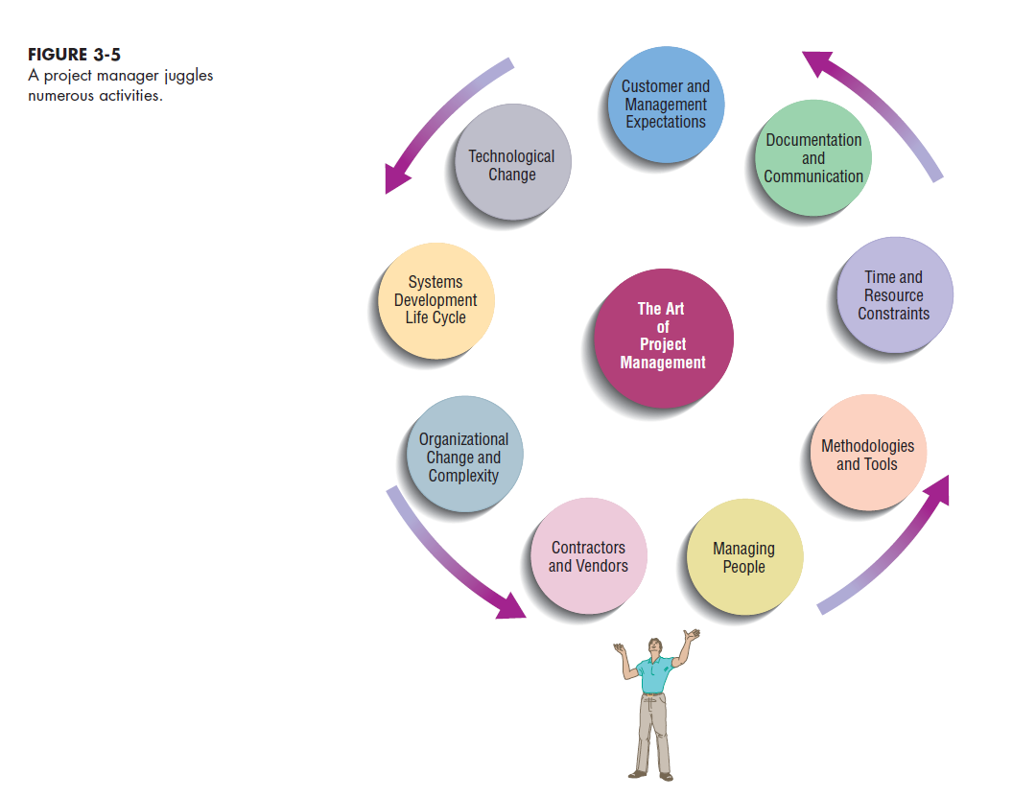
Managing the Information Systems Project
Project : Planned undertaking of related activities to reach an objective that has a beginning and an end
Reasons of systems development projects :
to take advantage of business opportunities: innovative service to customers (Web page)
to solve business problems: more accurate or timely information is provided (password-protected intranet site)
to spend resources, attain or pad budgets, keep people busy, or help train people and develop their skills.
Focus of Project Management : To assure that information system projects meet customer expectations
Delivered in a timely manner
Meet constraints and requirements
Project Manager : Systems Analyst responsible for Project initiation - Planning -Execution -Closing down
Requires diverse set of skills
Management (resource management)
Leadership
Technical
Conflict management
Customer relations

Slide 20
Phase 1 : Initiating the Project
Phase 2: Planning the Project
activities are performed to assess the size, scope, and complexity of the project and to establish procedures to support later project activities:
The project initiation team
Relationship with the customer
The project initiation plan
Management procedures
Establish the project management environment and Workbook
Develop the project charter
focuses on defining clear, discrete activities and the work needed to complete each activity within a single project.
Describe project scope, alternatives and feasibility Scope and Feasibility
Divide the project into manageable tasks
Estimate resources and create a resource plan
Develop a preliminary schedule (Gantt Chart and Network Diagram)
Develop a communication plan
Determine project standards and procedures
Identify and assess risk Identify sources of risk
Create a preliminary budget
Develop a project scope statement
Set a baseline project plan

Slide 21
Phase 3: Executing the Project
The plans created in the prior phases (project initiation and planning) are put into action.
Executing the baseline project plan
Monitoring project progress against the baseline project plan
Managing changes to the baseline project plan.
Maintaining the project workbook.
Communicating the project status
Phase 4: Closing Down the Project
Project closedown Is The final phase of the project management process, which focuses on bringing a project to an end.
Closing down the project
Conducting postproject reviews
Closing the customer contract

Slide 22
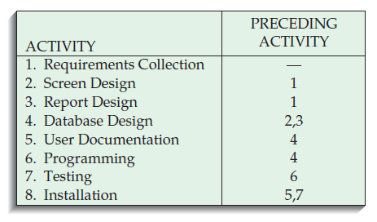
Constructing Gantt Chart And Network diagram:
Step 1: Identify each activity to be completed in the project.
Step 3: Determine the sequence of the activities and precedence relationships among all activities by constructing a Gantt chart and Network diagram.
Determine the Order and Relations between activities
Step 2 : Determine time estimates and calculate the expected completion time for each activity.
establishe optimistic, realistic, and pessimistic time estimates for each activity and compute the Expected completion Time (ET) for each activity

Slide 23
Step 4: Determine the critical path
The critical path of a Network diagram is represented by the sequence of connected activities that produces the shortest overall time period.
It is possible to have multiple critical paths
Any activity on the critical path that is delayed in completion delays the entire project.
Nodes not on the critical path can be delayed without delaying the final completion of the project. These nodes contain slack time and allow the project manager some flexibility in scheduling.
Slack time: The amount of time that an activity can be delayed without delaying the project.
Two types of slack are possible:
Free slack : without delaying the early start of any task immediately following.
Total slack : without delaying the completion of the project.
How to determine the critical path :
calculate the earliest expected completion time for each activity ($T_{E}$).
calculate the latest expected completion time for each activity ($T_{L}$).
Calculate the slack time for each activity.
All activities with a slack time equal to zero are on the critical path
How to calculate ($T_{E}$)
Start from the first activity, each activity’s earliest expected completion time ($T_{E}$) is the sum of the expected completion times (ET) of the activity and each preceding activity, in precedence order.
If two or more activities precede an activity, the largest expected completion time of these activities is used in calculating the new activity’s expected completion time.
The earliest expected completion time for the last activity of the project represents the amount of time the project should take to complet
How to calculate ($T_{L}$)
The latest expected completion time ($T_{L}$) refers to the time in which an activity can be completed without delaying the project.
Start from the last activity, and set $T_{L}$ equal to the final $T_{E}$
For each activity, Subtract the expected time (ET) from the latest expected completion time ($T_{L}$) of its succeding activity.
The slack time = $T_{L}$ - $T_{E}$

Slide 24
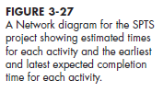
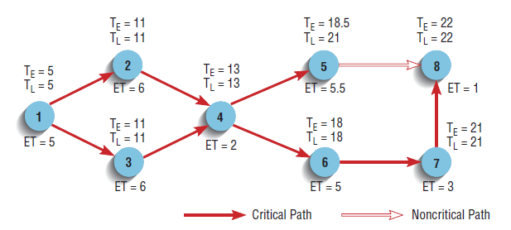
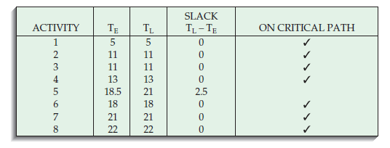
Notations:
For each activity t, let the preceding activities be t-1 and the succeeding activities t+1
n = number of activities
The earliest expected completion time ($T_{E}$)
Start from t =1 to t = n
$$T_{E}\left(t\right)=ET\left(t\right)+max⁡\{T_{E} \left(t−1\right)\}$$
The latest expected completion time ($T_{L}$)
Start from t=n to t=1
$$T_{L}\left(n\right)=T_{E}\left(n\right)$$
$$T_{L}\left(t\right)=min⁡\{T_{L}\left(t+1\right)−ET\left(t+1\right)\}$$
$$Slack (t)=T_{L}\left(t\right)− T_{E}\left(t\right)$$

Slide 25
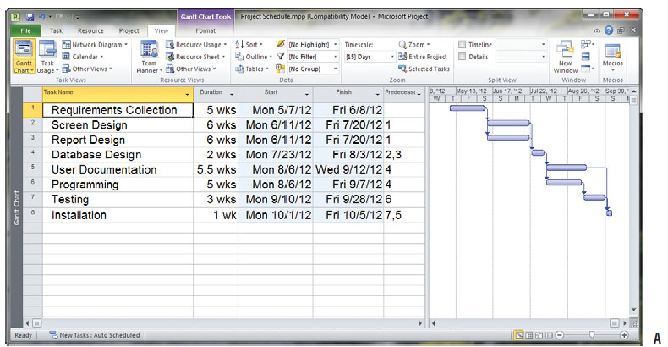
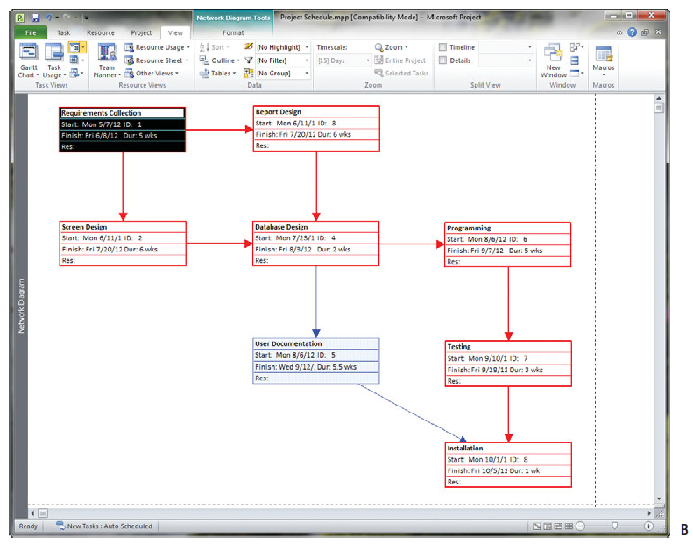
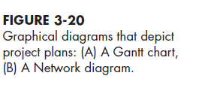

Slide 26
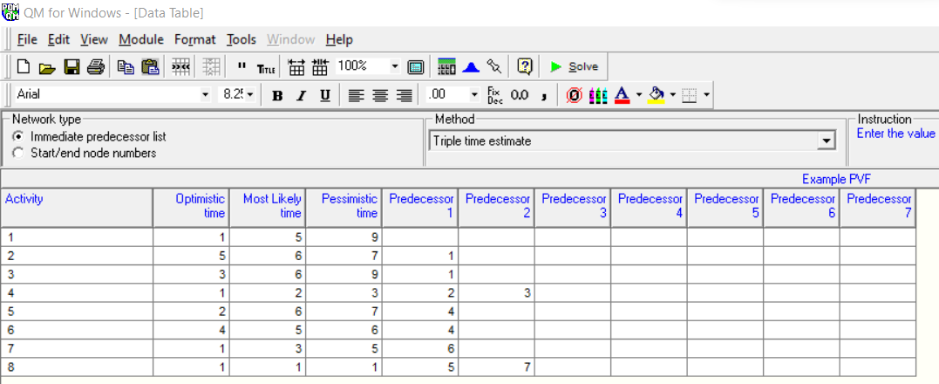
By POM-QM

Slide 27
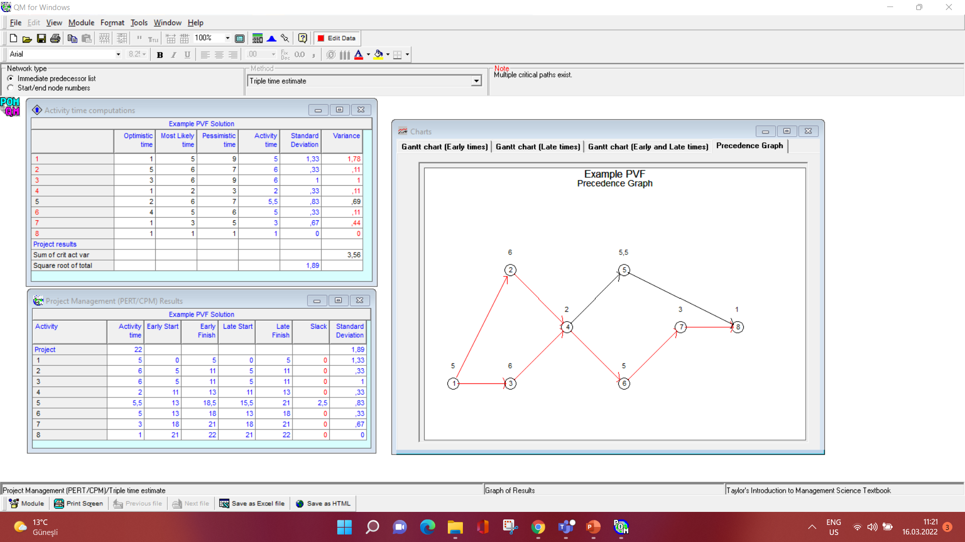

Slide 28
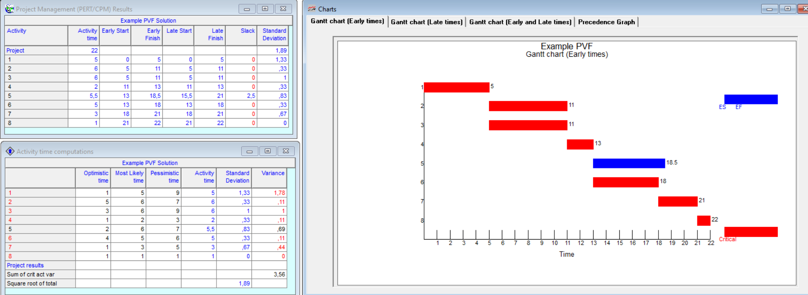

Slide 29
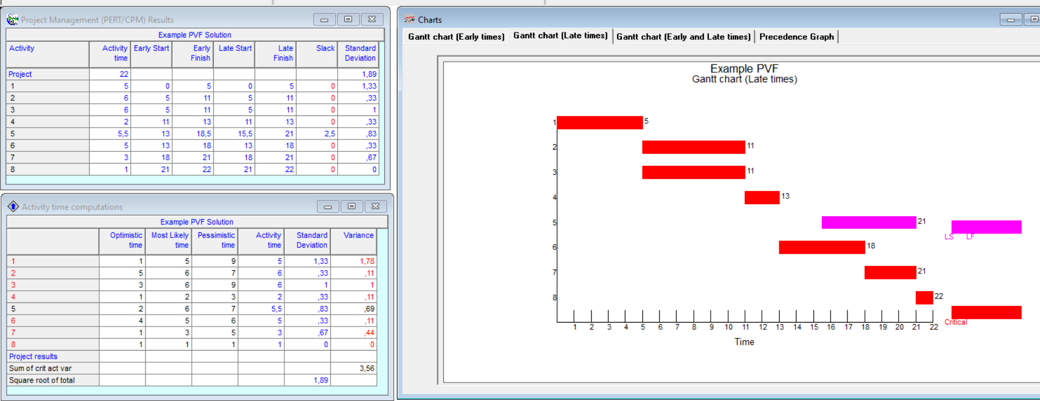

Slide 30
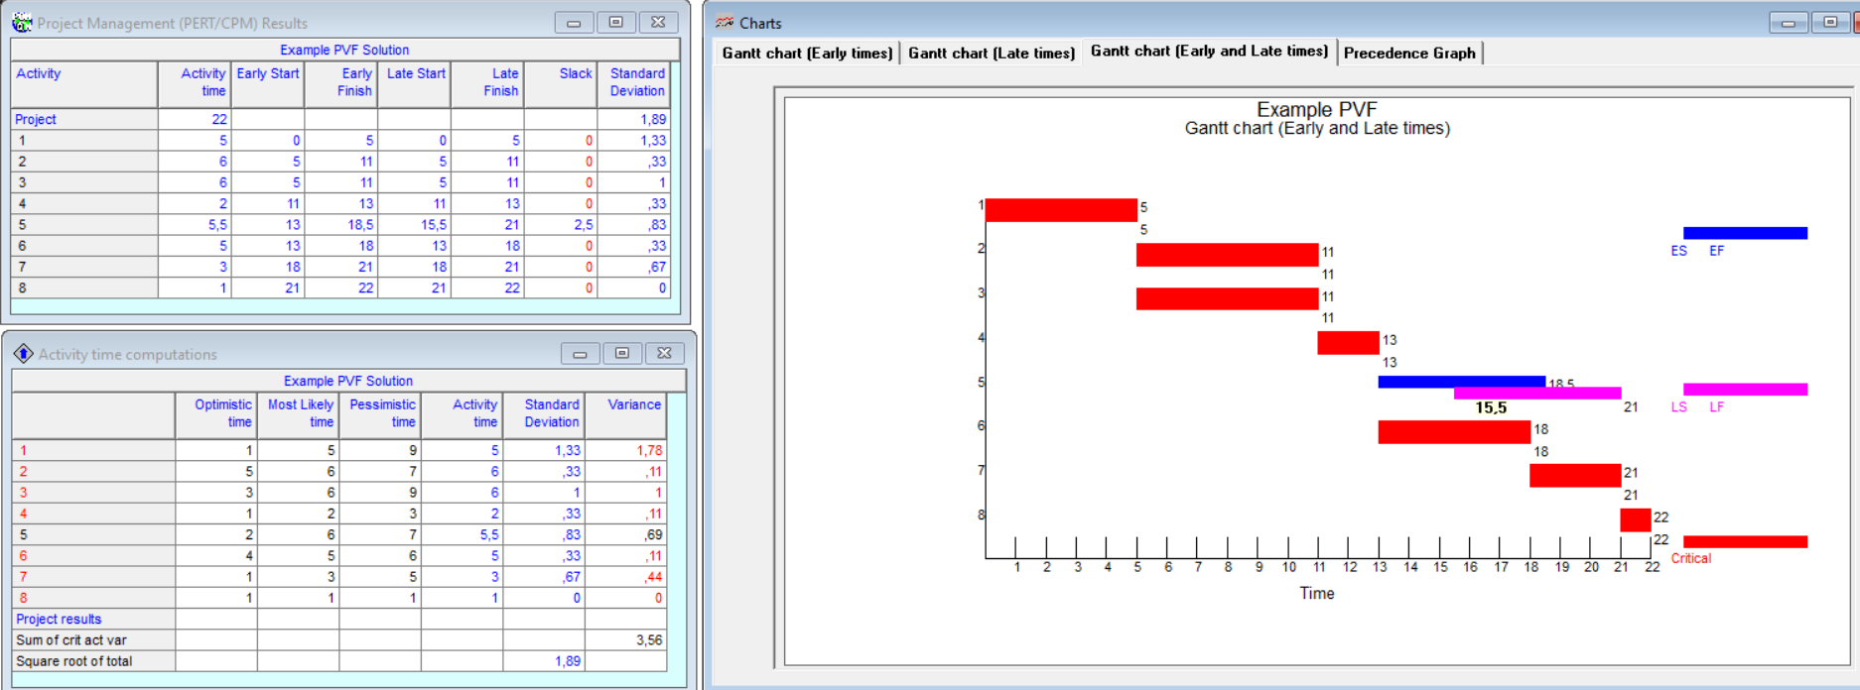

Slide 31
Thank you for your attention
Any Questions
???

