Slide 1
Measurement & Evaluation

Slide 2
Measurement and Evaluation
Measurement
Gathering information about student achievements and performance to improve student learning.
Evaluation
Judgments on the quality, value and amount of learning output
Feedback
Giving information to the students and parents about evaluation criteria

Slide 3
Formative vs Summative Evaluation
Formative Evaluation
It is not used for grading.
Examples; Personal interviews, product files, student feedback.
Summative Evaluation
It is used for grading
Examples; Report Cards

Slide 5
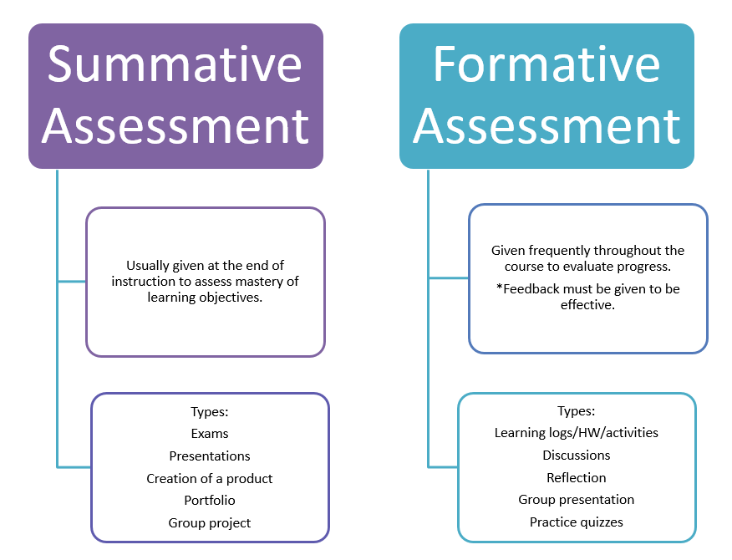

Slide 6
Traditional vs Contemporary (Alternative) Evaluation Techniques
Multiple-choice tests
True-false questions
Matching questions
Fill in the blanks type of questions
Short-answer type questions
Essay-type questions
Question-answer
Performance evaluation
Student portfolio
Project
Performance
Dram
Interview
Written reports
Demonstration
Poster
Concept Maps
Structured grid
Illustrative branch tree
Word associations
Group or peer evaluation
Self-evaluation

Slide 7
Multiple-choice questions
Multiple-choice tests usually consist of a question or statement to which you respond by selecting the best answer from among a number of choices.
Multiple-choice tests typically test what you know, whether or not you understand (comprehension), and your ability to apply what you have learned (application).

Slide 8
True-False Questions
True-false tests contain statements that the student marks as being either true or false.
In order to qualify as true, all parts of the statement must be true.
In general, true-false tests check your knowledge of facts.

Slide 9
Essay-Type Questions
Essay questions require students to write answers to statements or questions.
To complete a successful essay exam, you need to be able to recall relevant information and to organize it in a clear way, generating a thesis and building to a conclusion.
Instructors give essay tests to determine whether or not students can make connections among various ideas, apply course information to new situations, and (most importantly) demonstrate that they have made the information their own.

Slide 10
Essay-Type Questions
Essay exams are a useful tool for finding out if you are able to sort through a large body of information, figure out what is important, and explain why it is important.
Essay exams challenge you to come up with key course ideas and put them into your own words using the interpretive or analytical skills you've practiced in the course.

Slide 11
Essay-Type Questions
Essay questions are typically used to assess your ability to analyze or evaluate material, as well as to create (synthesize) new material based on your knowledge.

Slide 12
Short-Answer Questions
Short-answer questions or statements are similar to essay questions, except they can be answered with just a few words or sentences.
They test foundational knowledge which is usually factual.
When completing short-answer questions, it's important to pay attention to the directive words in each item.

Slide 13
Fill-in-the-blank Type Questions
Fill-in-the-blank items, also known as completion questions, provide students with a partial sentence or question and then require them to write the word (or words) in the blank that best completes the statement or question.
Fill-in-the-blank and short-answer questions test your ability to recollect facts you have learned.

Slide 14
Matching Questions
To complete a matching assessment activity, you must select one item from each of two columns. The two items must fit together correctly based on the assessment directions.

Slide 15
Student Portfolio
A student portfolio is a compilation of academic work and other forms of educational evidence assembled for the purpose of
evaluating coursework quality, learning progress, and academic achievement;
determining whether students have met learning standards or other academic requirements for courses, grade-level promotion, and graduation;
helping students reflect on their academic goals and progress as learners; and
creating a lasting archive of academic work products, accomplishments, and other documentation.

Slide 16
Student Portfolio
Portfolios can be a physical collection of student work that includes materials such as written assignments, journal entries, completed tests, artwork, lab reports, physical projects (such as dioramas or models), and other material evidence of learning progress and academic accomplishment, including awards, honors, certifications, recommendations, written evaluations by teachers or peers, and self-reflections written by students.

Slide 17
Presentations
the delivery of a topic, either individually or in groups, usually to your fellow students in small tutorial sessions. For example, computing students may be asked to present the design of a new information system. Presentations enable you to develop your team working and communication skills.

Slide 18
Project Work
Involves working on a problem in-depth, either individually or in groups to arrive at a solution, or answer to a set problem. Project work provides the opportunity to apply principles or methodologies in a different context, thus deepening your understanding.

Slide 19
Reports
written methods of relating your understanding of a particular subject. These might involve critically evaluating a topic and arriving at your own answers using various sources of evidence to support your conclusions. English students, for example, may be asked to write an analytical report on a particular aspect of a novel.

Slide 20
Research Projects, Dissertations and Independent Study
Each of these involves an in-depth critical study of a subject and the compilation of an extensive report. Research forms a major part of all postgraduate programmes, especially when undertaking a Masters degree.

Slide 21
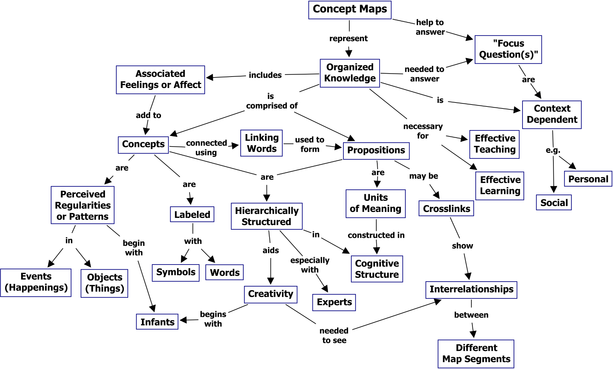
Concept Maps

Slide 22
Structured Grid

Slide 25
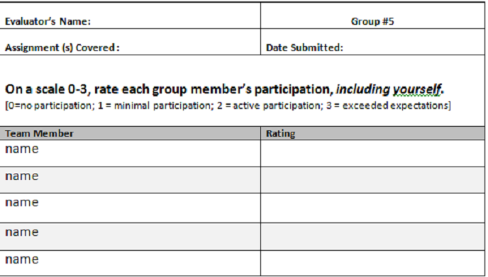

Slide 26
