Slide 1

Out-of-Kilter Algorithm
Network Flows IENG 516
Presented to: Assis.Prof.Dr. Sahand Daneshvar
Presented by: Yahya El Osman El Dandachi 15500727
Mohammad A. Kh. Hamdan 16500161

Slide 2
Introduction
The out of kilter algorithm is an example of a primal-dual algorithm.
It works on both the primal problem (edges of the network) and the dual problem (nodes) in successive phases to find a feasible solution, and then to optimize the problem.

Slide 3
What do we keep track of ?
We will have a variable for each node w_{i}, and the flows through each edge of the original network.
As well as these variables, each edge will be given a kilter state and a kilter number k_{ij}.
Edges are either “in kilter” or “out of kilter”.
We want all edges to be in kilter, so the algorithm keeps “in kilter” edges in kilter, and brings “out of kilter” edges into kilter.

Slide 4
THE OUT-OF-KILTER FORMULATION OF A MINIMAL-COST NETWORK FLOW PROBLEM
We shall assume that Cij, lij, and Uij are integers

Slide 5
Algorithm explained
We will have a variable for each node w_{i}, and the flows through each edge of the original network.
As well as these variables, each edge will be given a kilter state and a kilter number k_{ij}.
Edges are either “in kilter” or “out of kilter”.
We want all edges to be in kilter, so the algorithm keeps “in kilter” edges in kilter, and brings “out of kilter” edges into kilter.

Slide 6
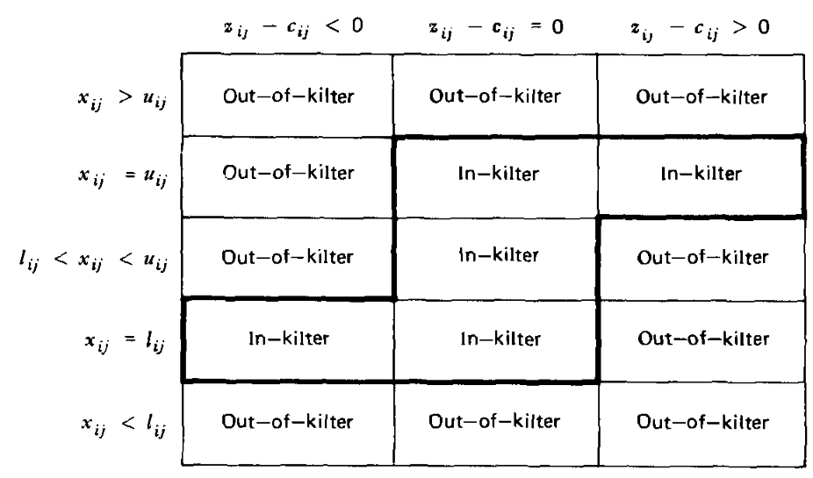
Kilter Numbers Rules

Slide 7
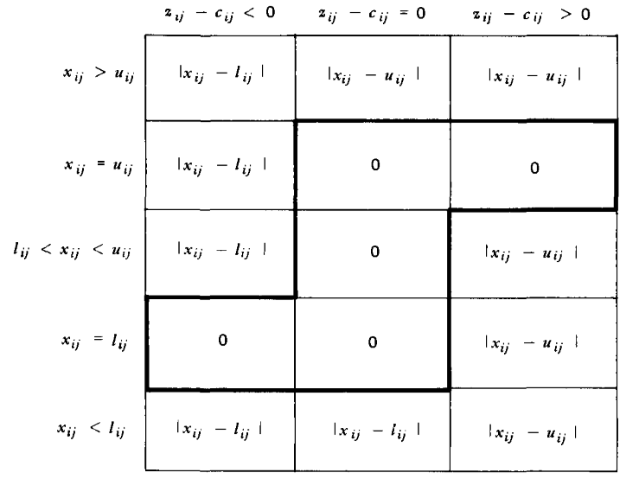

Slide 8
Starting the algorithm
When we start we have a set of upper and lower bounds for all edges in the network and the cost of sending units of flow along each edge.
We may need to add an artificial edge from the sink to the source, or even add an artificial node to handle some formulations.
All flows x_{ij} and the w_{i} values for the nodes can be set to zero in this initial phase. This makes some working simple.

Slide 9
The primal phase
The primal phase of the algorithm finds the most out of kilter edge of the network and tries to being it into kilter.
We find the reduced costs of the edges of our network, and determine the kilter states and numbers for all edges.
The edge with the highest kilter number is chosen and we then look to augment the flows of the network by finding a cycle through the potential changes of our network flows.

Slide 10
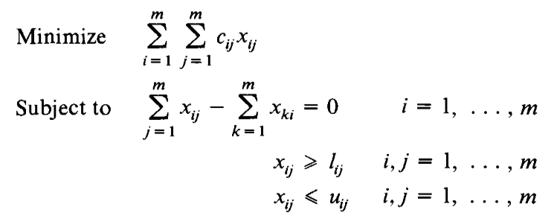
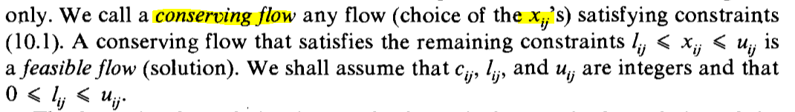
The Primal Phase

Slide 11
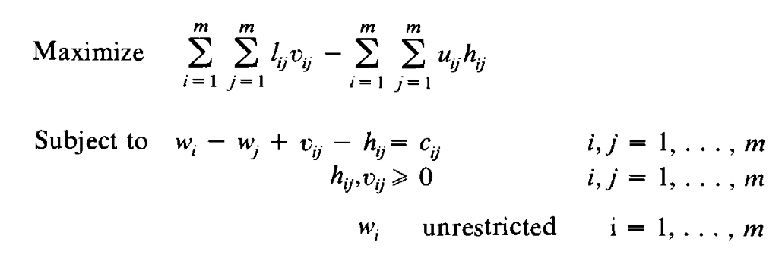
The Dual Phase

Slide 12
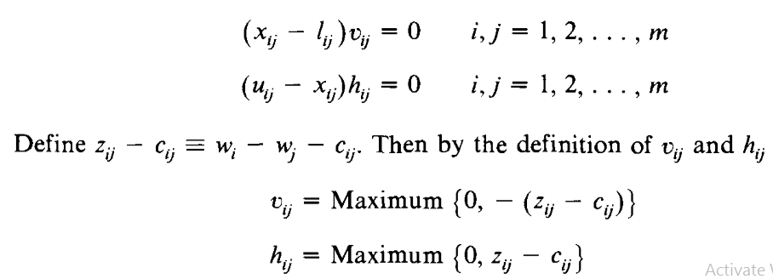

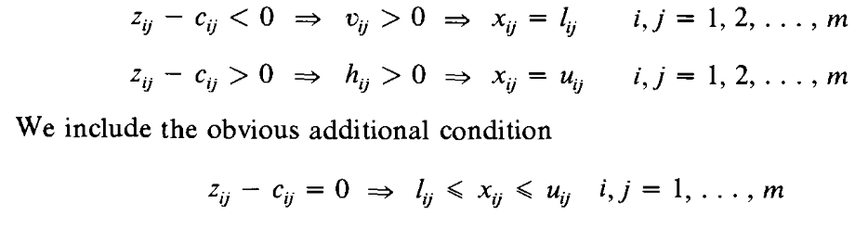
The complementary Slackness Condition

Slide 13
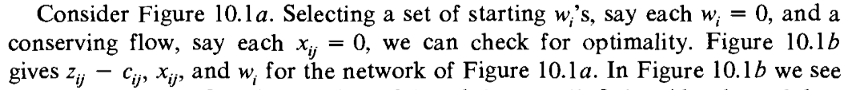
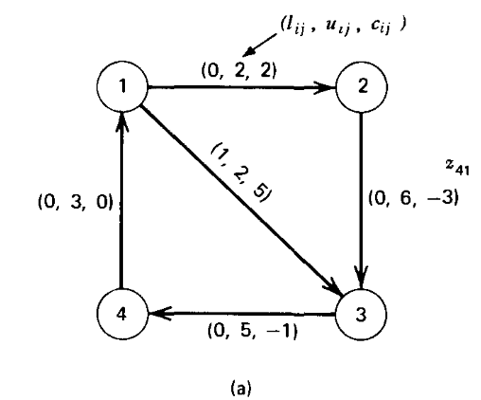
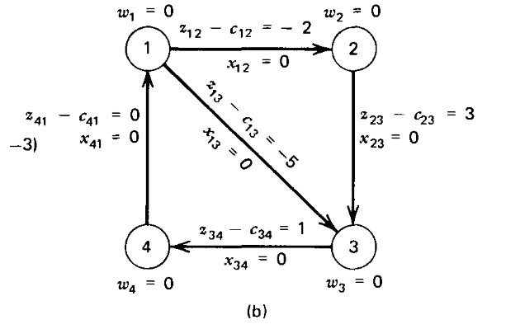
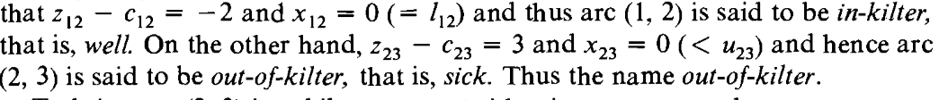

Slide 14
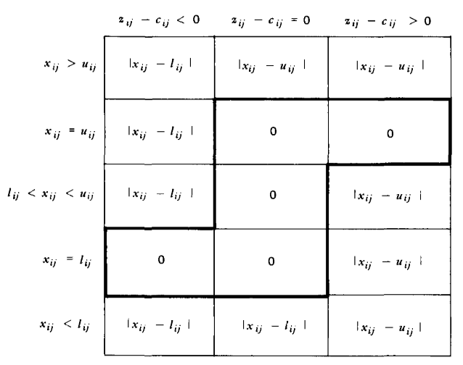
The Kilter States and Kilter Numbers
A kilter number can be thought of as the change required to bring a flow into feasibility and eventually optimality.
So we can add up all the kilter numbers to find how far from optimality we are at any given time.
An in kilter edge has a kilter number of zero.

Slide 15
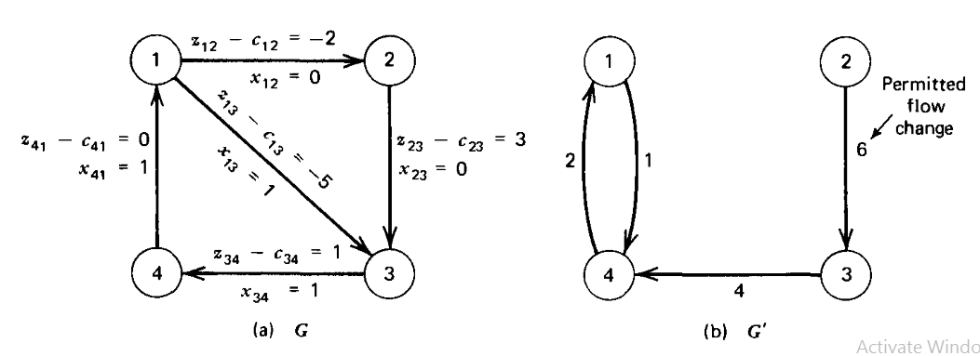
The Dual Phase and Variable Changes

Slide 16
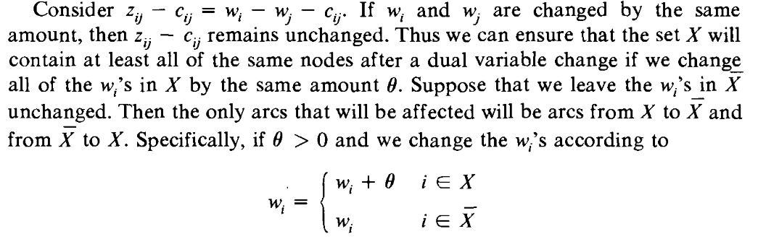
The Amount of Change

Slide 17
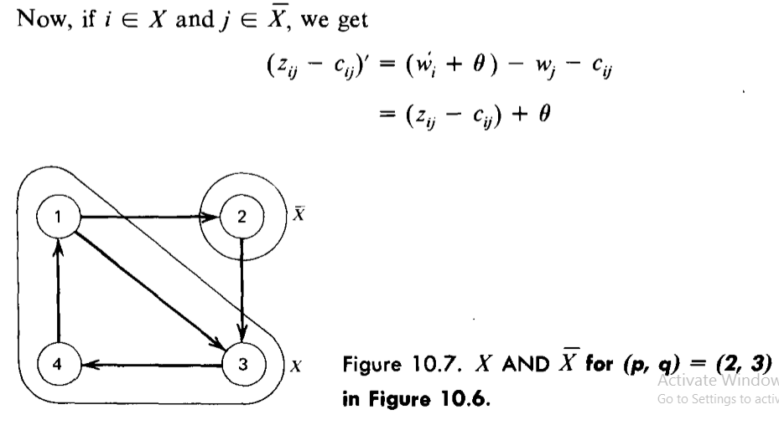

Slide 18
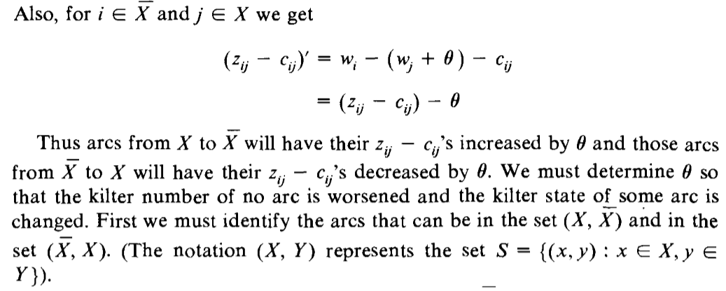

Slide 19
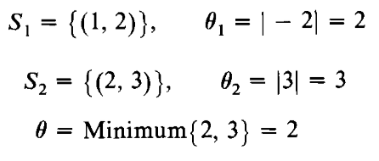
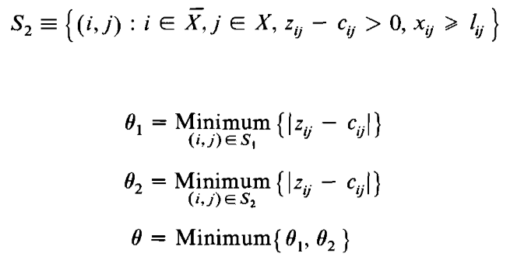
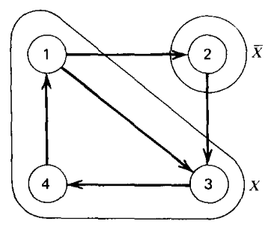
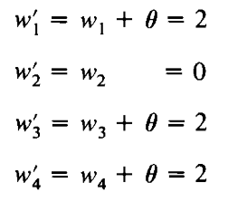

Slide 20
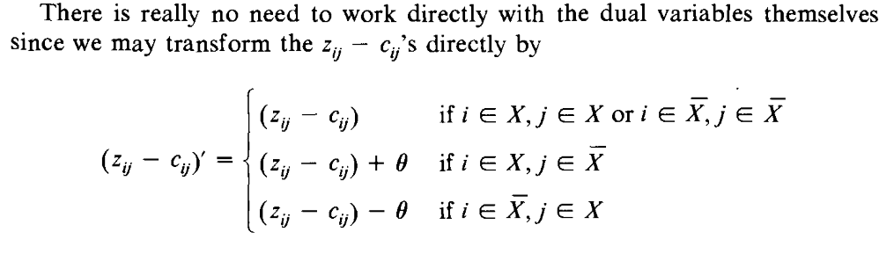

Slide 21
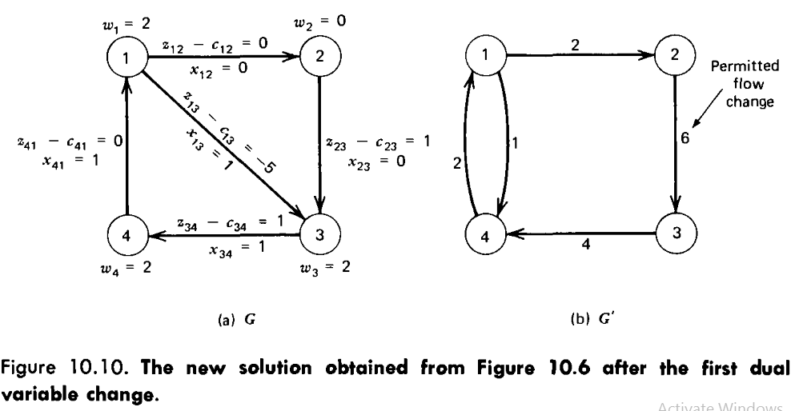

Slide 22
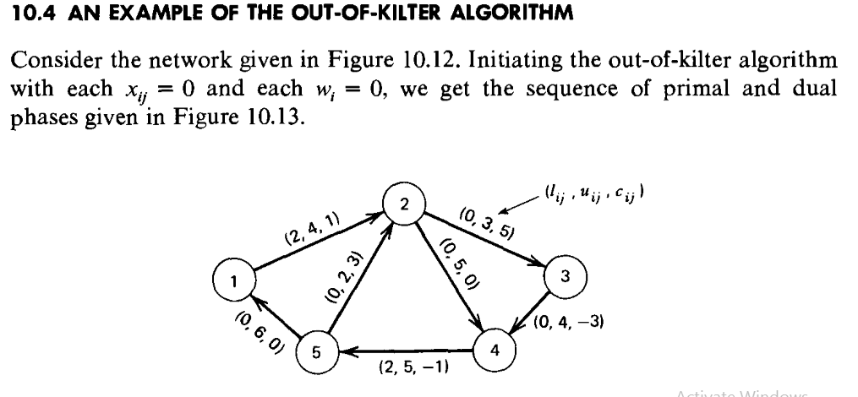

Slide 23
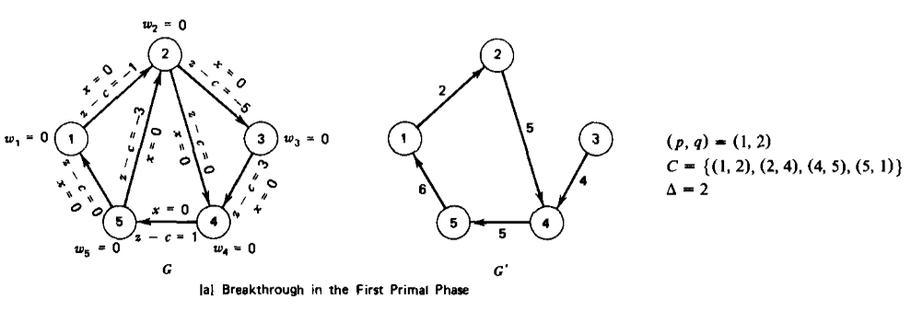
The Primal Phase

Slide 24
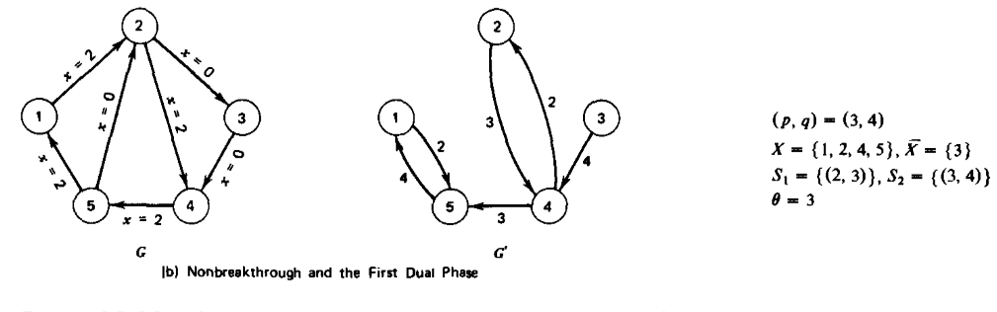
The First Dual Solution

Slide 25
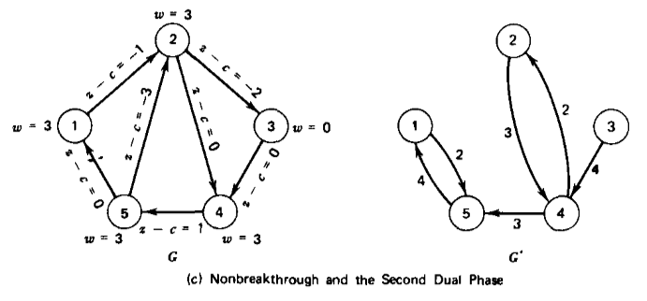
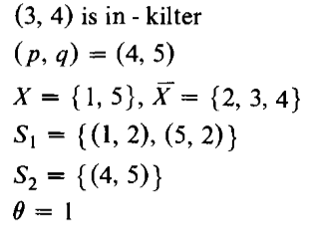
The Second Dual Phase

Slide 26
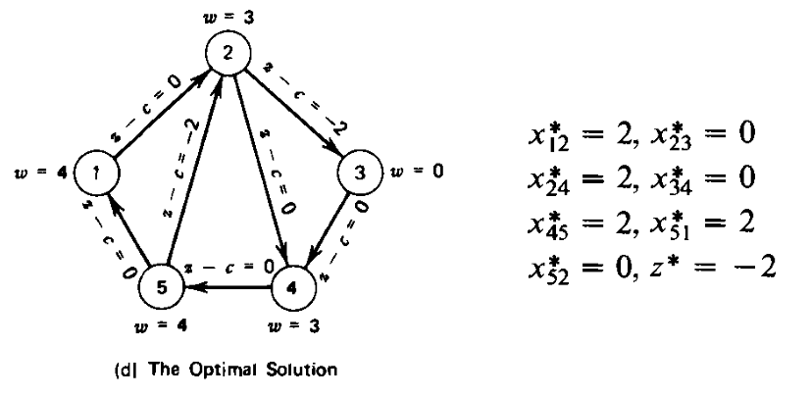
The Optimal Solution

