Slide 1
Review on Modelling Process Quality
Advanced Quality Engineering
IENG584

Slide 2
The Box Plot
The box plot is a graphical display that simultaneously displays several important features of the data, such as location or central tendency, spread or variability, departure from symmetry, and identification of observations that lie unusually far from the bulk of the data (these observations are often called “outliers”).
A box plot displays the three quartiles, the minimum, and the maximum of the data on a rectangular box, aligned either horizontally or vertically. The box encloses the interquartile range with the left (or lower) line at the first quartile Q1 and the right (or upper) line at the third quartile Q3. A line is drawn through the box at the second quartile Q2=$\overline{X}$(which is the fiftieth percentile or the median) A line at either end extends to the extreme values. These lines are usually called whiskers.

Slide 3
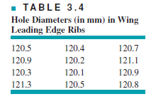
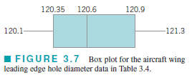
Example
Max
Min

Slide 4
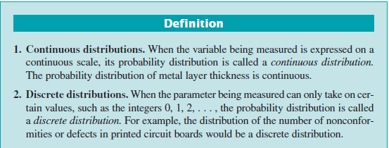
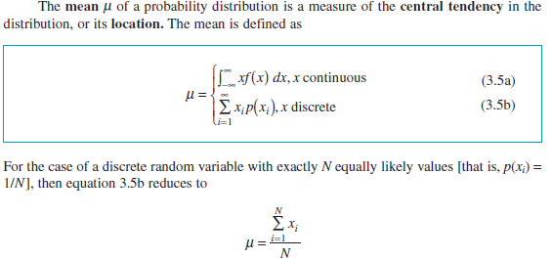

Slide 5
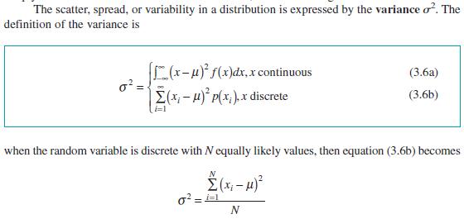
Importanat Discrete Distribution

Slide 6
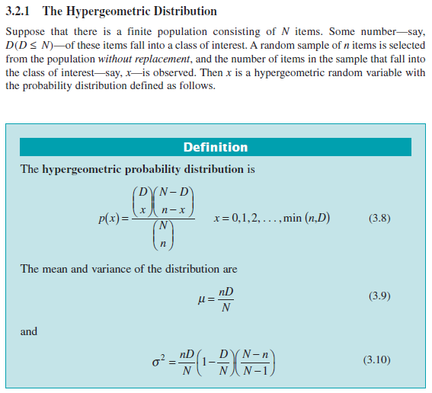

Slide 7
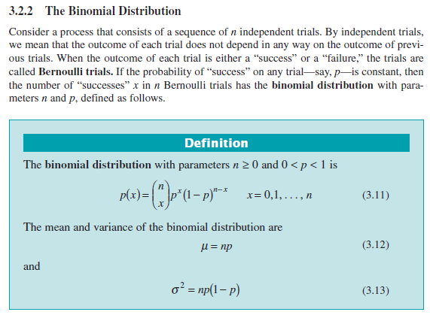

Slide 9
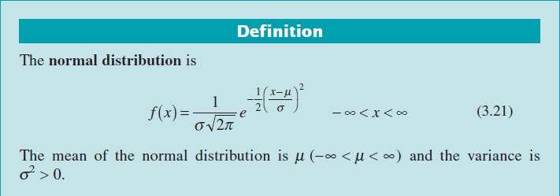
Importanat Continuous Distribution

Slide 10
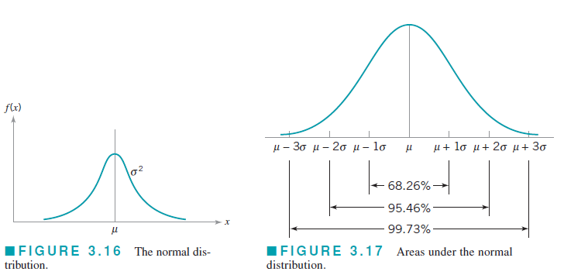

Slide 11
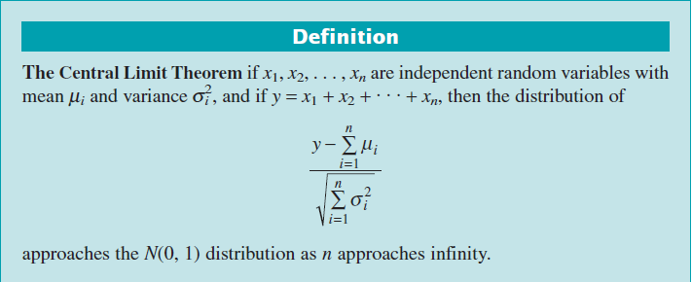
The normal distribution has many useful properties. One of these is relative to linear combinations of normally and independently distributed random variables. If x₁, x₂ . . . , x_{n} are normally and independently distributed random variables with means μ₁ , μ₂ ,…, μ_{n} and variances σ₁ , σ₂ ,…, σ_{n} respectively, then the distribution of
y= a₁x₁ + a₂x₂ +…+ a_{n}x_{n}
is normal with mean
μ_{y} = a₁μ₁ + a₂μ₂ +…+ a_{n}μ_{n}
and variance
σ _{y}² =a₁² σ ₁² + a₂² σ ₂² +…+ a_{n}² σ _{n}²
where a₁, a₂, . . . , a_{n} are constants.
The Central Limit Theorem. The normal distribution is often assumed as the
appropriate probability model for a random variable. Later on, we will discuss how to checkthe validity of this assumption; however, the central limit theorem is often a justification ofapproximate normality.

Slide 12
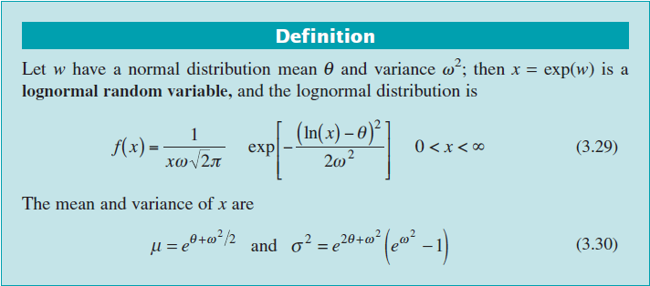
3.3.2 The Lognormal Distribution

Slide 17
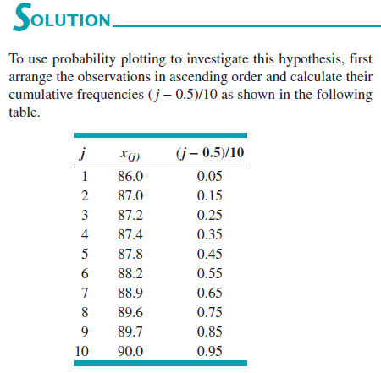
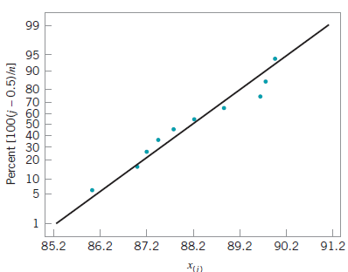

Slide 18
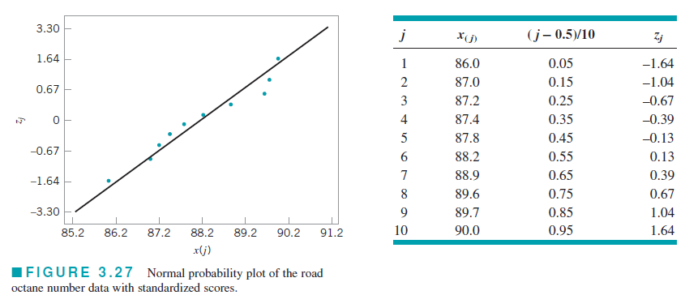

Slide 19
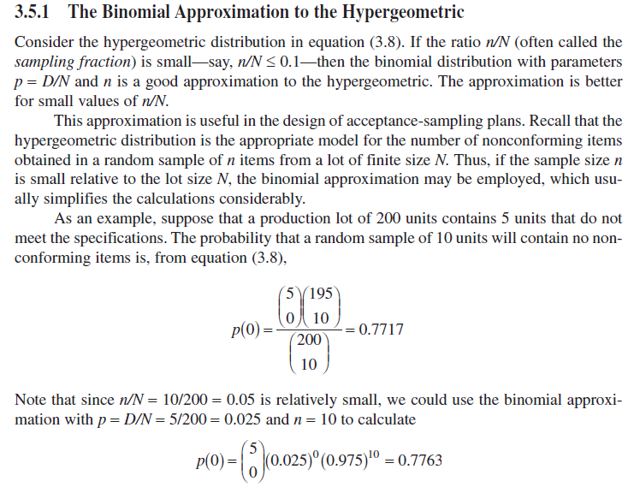

Slide 20
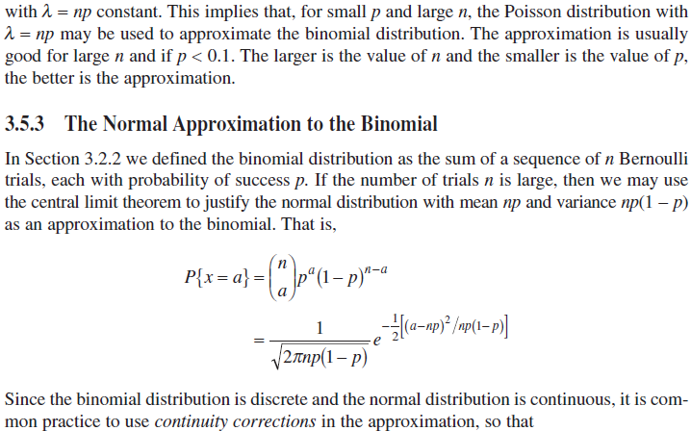

Slide 22
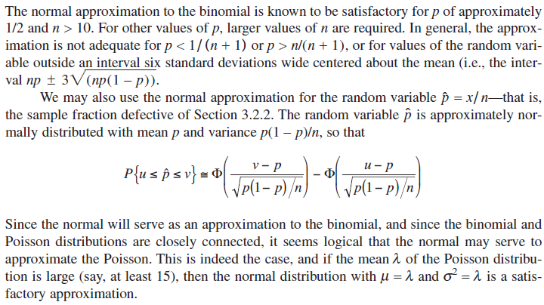

Slide 23
