Slide 1
Project Management for ITEC403
Alev Elçi
Eastern Mediterranean University
16 March 2012

Slide 2
Outline
Definitions for Project Management
Project Management Methodology
Project Management Process Groups
Team Building Game
Success Stories

Slide 3
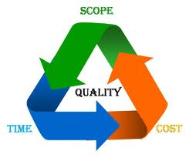
Project
“A planned undertaking of related activities to reach an objective that has a beginning and an end.”
Project Management Institute

Slide 4

Project Environment
One to many individuals involved
Time can range from days to years
Temporary
Prioritized and Selected Projects
Senior management support is needed
Project members often come and go
Project manager leads

Slide 5

Project Manager
Leader
Communicator
Negotiator
Problem solver
Influencer
Motivator

Slide 6
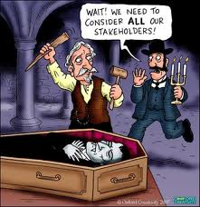
Project Stakeholders
Individuals who has interest in the success: Benefit, participate, or be impacted by proposed system
Project Manager
Customer
Organization
Team Members
Influencers
Project Management Office
Sponsors

Slide 7
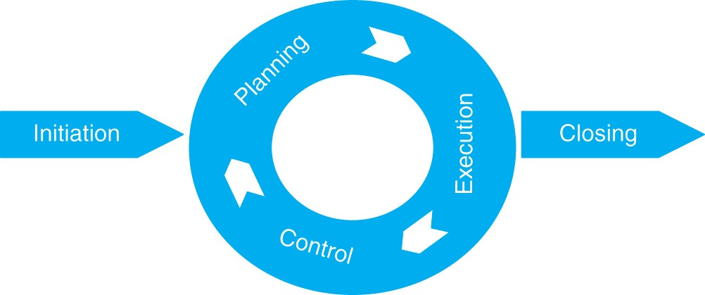
Methodology
Sets up Project Life Cycle steps so all project team uses the same project management process to deliver project

Slide 8



Slide 9
Project Team Development Stages
Form
  Become familiar with fellow team members
  Establish team goals
  Provide work assignments
Storm
  Set goals
  Establish power levels
  Identify leadership roles
Norm
  Develop common purpose
  Specify normal operating procedures
Perform
  Start project work
  Stage ends when the project is completed
Adjourn
  Complete project assignments
  Team members are released from the project and reassigned
  Different emotional reactions exhibited

Slide 10









Managing Project Communication
formal
informal

Slide 11
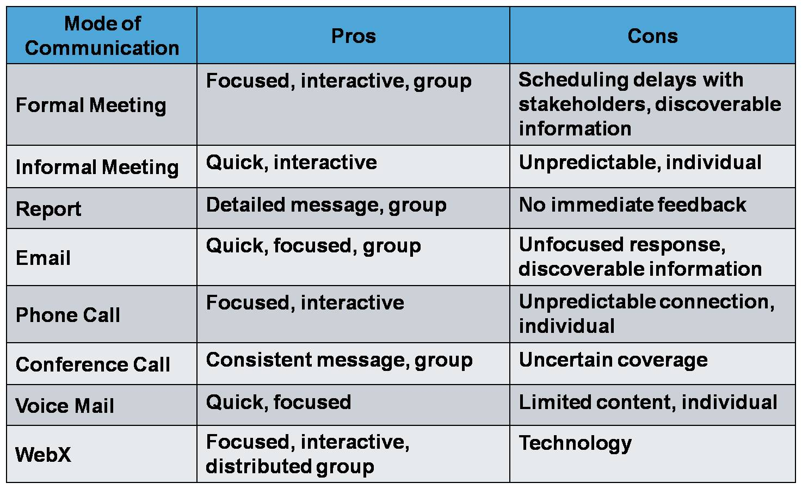
Managing Project Communication

Slide 12
Project Initiation & Planning
Scope
Scheduling
Resources
Quality
Risk
Procurement

Slide 13
Project Scope Statement
Document prepared for the customer that describes what the project will deliver and outlines generally at a high level all work required to complete the project
Addresses:
  What problem or opportunity does the project address?
  What are the quantifiable results to be achieved?
  What needs to be done?
  How will success be measured?
  How will the end of the project be identified?

Slide 14
Project Execution
Monitoring Progress
Managing Change

Slide 15
Project Control & Closure
Control
Closure

Slide 16
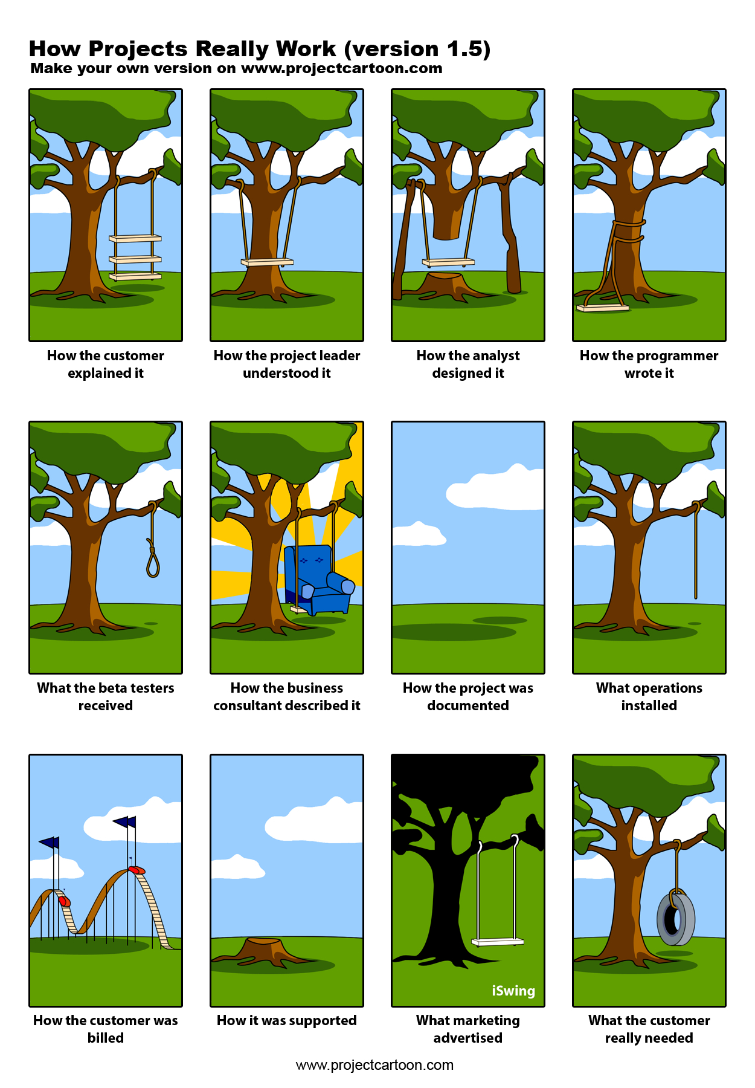

tough job

Slide 17
SUCCESS Stories
Steven Jobs & Steve Wozniak... Apple
http://www.youtube.com/watch?v=U3a8m51ERkA
http://www.youtube.com/watch?v=faVkaeTO7JE
Mark Zuckerberg, Eduardo Saverin, Dustin Moskovitz and Chris Hughes... Facebook
http://www.youtube.com/watch?v=--APdD6vejI&feature=related
http://www.youtube.com/watch?v=N-F3mCdP8t4&feature=related

Slide 18
SUCCESS Stories
Sergey Brin & Larry Page... Google
http://www.youtube.com/watch?v=_FbSu_2hucw&feature=related
http://www.youtube.com/watch?v=EjN5avRvApk

Slide 19


DREAM
LOVE what you do
have FUN enjoy
research
passION
Think DIFFERENT
get IDEAS
use emotions

Slide 20
Be ETHICAL give References !
The videos, pictures & cartoons used in this presentation are not my individual property
http://www.youtube.com/
http://www.google.com.tr/
Fuller M.A.,Valacich J.S., George J.F. (2008). Information Systems Project Management. Pearson Prentice Hall:NJ.

